Slide 1
Lecture 16: Optimization with Caches
CS 105 Spring 2021

Slide 2
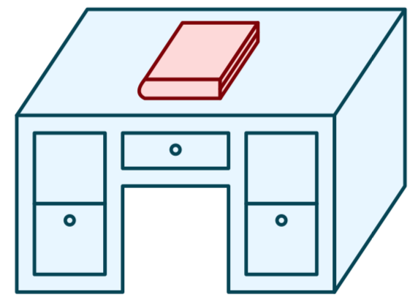
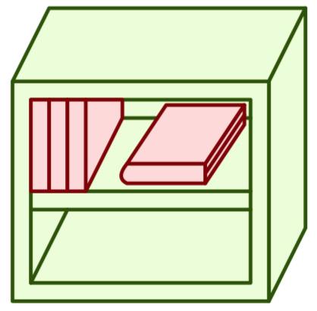
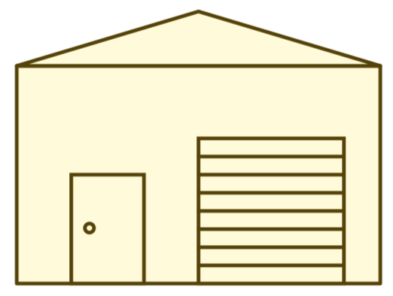
Review: Memory Hierarchy
L0:
Regs
CPU registers hold words retrieved from the L1 cache.
L1:
L1 cache
(SRAM)
L1 cache holds cache lines retrieved from the L2 cache.
Smaller,
faster,
and
costlier
(per byte)
storage
devices
L2:
L2 cache
(SRAM)
L2 cache holds cache lines
retrieved from L3 cache
L3:
L3 cache
(SRAM)
L3 cache holds cache lines
retrieved from main memory.
L4:
Main memory
(DRAM)
Main memory holds
disk blocks retrieved
from local disks.
Larger,
slower,
and
cheaper
(per byte)
storage
devices
Local secondary storage
(local disks)
Local disks hold files retrieved from disks
on remote servers
L5:
L6:
Remote secondary storage
(e.g., cloud, web servers)

Slide 3
Review: Principle of Locality
Programs tend to use data and instructions with addresses near or equal to those they have used recently
Temporal locality:
Recently referenced items are likely to be referenced again in the near future
Spatial locality:
Items with nearby addresses tend to be referenced close together in time

Slide 4
Review: An Example Cache
log(block size) bits
log(# sets) bits
the rest of the bits
E = 2: Two lines per set
Assume: cache block size 8 bytes
Address of data:
tag
index
offset
v
tag
0
1
2
3
4
5
6
7
v
tag
0
1
2
3
4
5
6
7
v
tag
0
1
2
3
4
5
6
7
v
tag
0
1
2
3
4
5
6
7
v
tag
0
1
2
3
4
5
6
7
v
tag
0
1
2
3
4
5
6
7
v
tag
0
1
2
3
4
5
6
7
v
tag
0
1
2
3
4
5
6
7

Slide 5
Typical Intel Core i7 Hierarchy
Processor package
Core 0
Core 3
L1 i-cache and d-cache:
32 KB, 8-way,
Access: 4 cycles
L2 unified cache:
256 KB, 8-way,
Access: 10 cycles
L3 unified cache:
8 MB, 16-way,
Access: 40-75 cycles
Block size: 64 bytes for all caches.
Regs
Regs
L1
d-cache
L1
i-cache
L1
d-cache
L1
i-cache
…
L2 unified cache
L2 unified cache
L3 unified cache
(shared by all cores)
Main memory

Slide 6
Cache Performance Metrics
Miss Rate
Fraction of memory references not found in cache (misses / accesses)
Typically 3-10% for L1
can be quite small (e.g., < 1%) for L2, depending on size, etc.
Hit Time
Time to deliver a line in the cache to the processor
includes time to determine whether the line is in the cache
Typically 4 clock cycles for L1, 10 clock cycles for L2
Miss Penalty
Additional time required because of a miss
typically 50-200 cycles for main memory (Trend: increasing!)

Slide 7
Memory Performance with Caching
Read throughput (aka read bandwidth): Number of bytes read from memory per second (MB/s)
Memory mountain: Measured read throughput as a function of spatial and temporal locality.
Compact way to characterize memory system performance.

Slide 8
Memory Mountain Test Function
long data[MAXELEMS]; /* Global array to traverse */
/* test - Iterate over first "elems" elements of
* array “data” with stride of "stride", using
* using 4x4 loop unrolling.
*/
int test(int elems, int stride) {
long i, sx2=stride*2, sx3=stride*3, sx4=stride*4;
long acc0 = 0, acc1 = 0, acc2 = 0, acc3 = 0;
long length = elems, limit = length - sx4;
/* Combine 4 elements at a time */
for (i = 0; i < limit; i += sx4) {
acc0 = acc0 + data[i];
acc1 = acc1 + data[i+stride];
acc2 = acc2 + data[i+sx2];
acc3 = acc3 + data[i+sx3];
}
/* Finish any remaining elements */
for (; i < length; i++) {
acc0 = acc0 + data[i];
}
return ((acc0 + acc1) + (acc2 + acc3));
}
Call test() with many combinations of elems
and stride.
For each elems and stride:
1. Call test() once to warm up the caches.
2. Call test() again and measure the read throughput(MB/s)

Slide 9
The Memory Mountain
Core i7 Haswell
2.1 GHz
32 KB L1 d-cache
256 KB L2 cache
8 MB L3 cache
64 B block size
Aggressive prefetching
L1
Ridges
of temporal locality
L2
L3
Slopes
of spatial locality
Mem

Slide 10
Exercise 1: Locality
Which of the following functions is better in terms of locality with respect to array src?
void copyij(int src[2048][2048],
int dst[2048][2048])
{
int i,j;
for (i = 0; i < 2048; i++)
for (j = 0; j < 2048; j++)
dst[i][j] = src[i][j];
}
void copyji(int src[2048][2048],
int dst[2048][2048])
{
int i,j;
for (j = 0; j < 2048; j++)
for (i = 0; i < 2048; i++)
dst[i][j] = src[i][j];
}

Slide 11
Exercise 1: Locality
Which of the following functions is better in terms of locality with respect to array src?
void copyij(int src[2048][2048],
int dst[2048][2048])
{
int i,j;
for (i = 0; i < 2048; i++)
for (j = 0; j < 2048; j++)
dst[i][j] = src[i][j];
}
void copyji(int src[2048][2048],
int dst[2048][2048])
{
int i,j;
for (j = 0; j < 2048; j++)
for (i = 0; i < 2048; i++)
dst[i][j] = src[i][j];
}
4.3ms
81.8ms
2.0 GHz Intel Core i7 Haswell

Slide 12
Another Locality Example
How would you permute the loops so that the function scans the 3-d array a with a stride-1 reference pattern (and thus has good spatial locality)?
int sum_array_3d(int a[M][N][N]){
int i, j, k, sum = 0;
for (i = 0; i < M; i++)
for (j = 0; j < N; j++)
for (k = 0; k < N; k++)
sum += a[i][j][k];
return sum;
}

Slide 13
Writing Cache-Friendly Code
Make the common case go fast
Focus on the inner loops of the core functions
Minimize the misses in the inner loops
Repeated references to variables are good (temporal locality)
Stride-1 reference patterns are good (spatial locality)

Slide 14
Example: Matrix Multiplication
Multiply N x N matrices
Matrix elements are doubles (8 bytes)
O(N³) total operations
N reads per source element
N values summed per destination
/* ijk */
for (i=0; i<n; i++) {
for (j=0; j<n; j++) {
sum = 0.0;
for (k=0; k<n; k++){
sum += a[i][k] * b[k][j];
}
c[i][j] = sum;
}
}

Slide 15
Miss Rate Analysis for Matrix Multiply
Assume:
Block size = 32B (big enough for four doubles)
Matrix dimension (N) is very large
Approximate 1/N as 0.0
Cache is not even big enough to hold multiple rows
Analysis Method:
Look at access pattern of inner loop
j
=
k
x
j
i
i
k
C
A
B

Slide 16
Layout of C Arrays in Memory (review)
C arrays allocated in row-major order
each row in contiguous memory locations
Stepping through columns in one row:
accesses successive elements
if data block size (B) > sizeof(a_{ij}) bytes, exploit spatial locality
miss rate = sizeof(a_{ij}) / B
Stepping through rows in one column:
accesses distant elements
no spatial locality!
miss rate = 1 (i.e. 100%)

Slide 17
Matrix Multiplication (ijk) (jik is similar)
/* ijk */
for (i=0; i<n; i++) {
for (j=0; j<n; j++) {
sum = 0.0;
for (k=0; k<n; k++)
sum += a[i][k] * b[k][j];
c[i][j] = sum;
}
}
Inner loop:
(*,j)
(i,j)
(i,*)
A
B
C
Row-wise
Column-
wise
Fixed
Misses per inner loop iteration:
A B C
0.25 1.0 0.0
2 loads, no stores
per inner loop iteration

Slide 18
Exercise 2: Matrix Multiplication
/* kij */
for (k=0; k<n; k++) {
for (i=0; i<n; i++) {
r = a[i][k];
for (j=0; j<n; j++)
c[i][j] += r * b[k][j];
}
}
/* jki */
for (j=0; j<n; j++) {
for (k=0; k<n; k++) {
r = b[k][j];
for (i=0; i<n; i++)
c[i][j] += a[i][k] * r;
}
}
Inner loop:
Inner loop:
(*,k)
(*,j)
(i,k)
(k,*)
(k,j)
(i,*)
A
B
C
A
B
C

Slide 19
Exercise 2: Matrix Multiplication
/* kij */
for (k=0; k<n; k++) {
for (i=0; i<n; i++) {
r = a[i][k];
for (j=0; j<n; j++)
c[i][j] += r * b[k][j];
}
}
/* jki */
for (j=0; j<n; j++) {
for (k=0; k<n; k++) {
r = b[k][j];
for (i=0; i<n; i++)
c[i][j] += a[i][k] * r;
}
}
Inner loop:
Inner loop:
(*,k)
(*,j)
(i,k)
(k,*)
(k,j)
(i,*)
A
B
C
A
B
C
2 loads, 1 store per inner loop iteration
2 loads, 1 store per inner loop iteration
Misses per inner loop iteration:
A B C
0.0 0.25 0.25
Misses per inner loop iteration:
A B C
1.0 0.0 1.0

Slide 20
Summary of Matrix Multiplication
for (i=0; i<n; i++) {
for (j=0; j<n; j++) {
sum = 0.0;
for (k=0; k<n; k++)
sum += a[i][k] * b[k][j];
c[i][j] = sum;
}
}
ijk (& jik):
2 loads, 0 stores
misses/iter = 1.25
for (k=0; k<n; k++) {
for (i=0; i<n; i++) {
r = a[i][k];
for (j=0; j<n; j++)
c[i][j] += r * b[k][j];
}
}
kij (& ikj):
2 loads, 1 store
misses/iter = 0.5
for (j=0; j<n; j++) {
for (k=0; k<n; k++) {
r = b[k][j];
for (i=0; i<n; i++)
c[i][j] += a[i][k] * r;
}
}
jki (& kji):
2 loads, 1 store
misses/iter = 2.0

Slide 21
Core i7 Matrix Multiply Performance
jki / kji
ijk / jik
kij / ikj

Slide 22
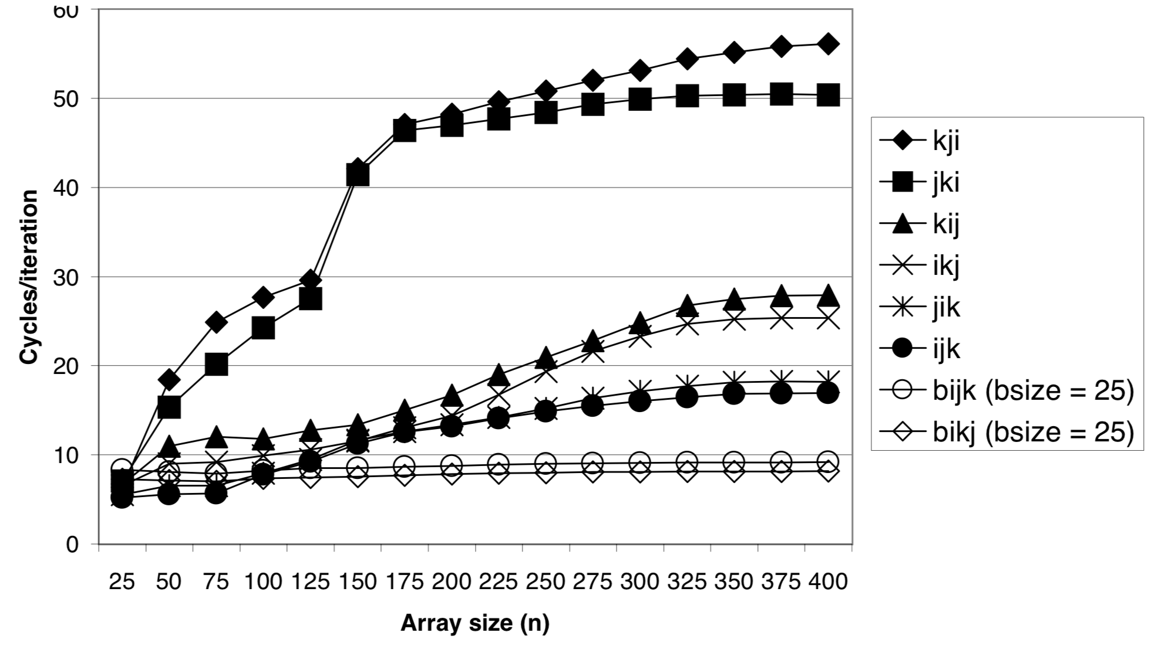
Matrix Multiply Performance
Core i7
Pentium III Xeon

Slide 23
Can we do better?
c = (double *) calloc(sizeof(double), n*n);
/* Multiply n x n matrices a and b */
void mmm(double *a, double *b, double *c, int n) {
int i, j, k;
for (i = 0; i < n; i++)
for (j = 0; j < n; j++)
for (k = 0; k < n; k++)
c[i*n + j] += a[i*n + k] * b[k*n + j];
}
j
c
a
b
+=
*
i

Slide 24
Cache Miss Analysis
Assume:
Matrix elements are doubles
Cache block = 4 doubles
Cache size C << n (much smaller than n)
First iteration:
n/4 + n = 5n/4 misses
Afterwards in cache: (schematic)
n
+=
*
+=
*
4 wide

Slide 25
Cache Miss Analysis
Assume:
Matrix elements are doubles
Cache block = 4 doubles
Cache size C << n (much smaller than n)
Second iteration:
n/4 + n = 5n/4 misses
Total misses:
5n/4 * n² = (5/4) * n³
n
+=
*
4 wide

Slide 26
Blocked Matrix Multiplication
c = (double *) calloc(sizeof(double), n*n);
/* Multiply n x n matrices a and b */
void mmm(double *a, double *b, double *c, int n) {
int i, j, k;
for (i = 0; i < n; i+=B)
for (j = 0; j < n; j+=B)
for (k = 0; k < n; k+=B)
/* B x B mini matrix multiplications */
for (i1 = i; i1 < i+B; i++)
for (j1 = j; j1 < j+B; j++)
for (k1 = k; k1 < k+B; k++)
c[i1*n+j1] += a[i1*n + k1]*b[k1*n + j1];
}
j1
c
a
b
c
=
*
+
i1
Block size B x B

Slide 27
Cache Miss Analysis
Assume:
Cache block = 4 doubles
Cache size C << n (much smaller than n)
Three blocks fit into cache: 3B² < C
First (block) iteration:
B²/4 misses for each block
2n/B * B²/4 = nB/2 (omitting matrix c)
Afterwards in cache (schematic)
n/B blocks
=
*
Block size B x B
=
*

Slide 28
Cache Miss Analysis
Assume:
Cache block = 4 doubles
Cache size C << n (much smaller than n)
Three blocks fit into cache: 3B² < C
Second (block) iteration:
Same as first iteration
2n/B * B²/4 = nB/2
Total misses:
nB/2 * (n/B)² = n³/(2B)
n/B blocks
+=
*
Block size B x B

Slide 29
Blocking Summary
No blocking: (5/4) * n³
Blocking: n³ / (2B)
Suggest largest possible block size B, but limit 3B² < C!
Reason for dramatic difference:
Matrix multiplication has inherent temporal locality:
Input data: 3n², computation 2n³
Every array elements used O(n) times!
But program has to be written properly

Slide 30
A reality check
This analysis only holds on some machines!
Intel Core i7 does aggressive pre-fetching for one-stride programs, so blocking doesn't actually improve performance
But on a Pentium III Xeon:

Slide 31
Exercise
Consider a procedure to copy and transpose the elements of an NxN matrix of type int. One possible implementation is given to the right.
How might you optimize this code to minimize the number of cache misses for 32x32 matrices? for 64x64 matrices?
Assume a direct-mapped cache with 32 cache lines and 32 byte data blocks.
void transpose(int *dst,
int *src, int n){
int i,j;
for(i = 0; i < n; i++){
for(j = 0; j < n; j++){
dst[j*dim+i]=src[i*dim+j];
}
}
}

Slide 32
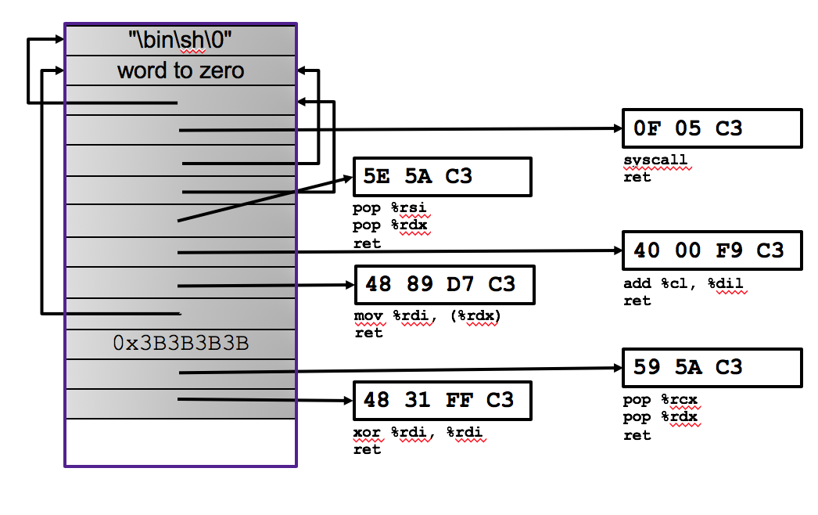
And that's the end of Part 1

Slide 33
Exercise 3: Feedback
Rate how well you think this recorded lecture worked
Better than an in-person class
About as well as an in-person class
Less well than an in-person class, but you still learned something
Total waste of time, you didn't learn anything
How much time did you spend on this video lecture (including time spent on exercises)?
Do you have any questions that you would like me to address in this week's problem session?
Do you have any other comments or feedback?

