Slide 1
Lecture 15: Caches (cont'd)
CS 105 Spring 2021

Slide 2
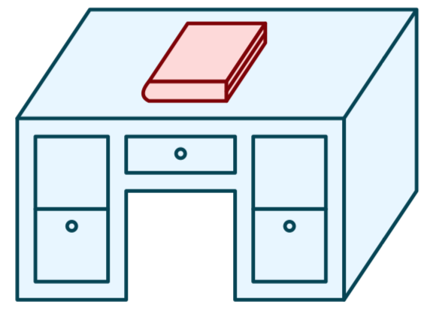
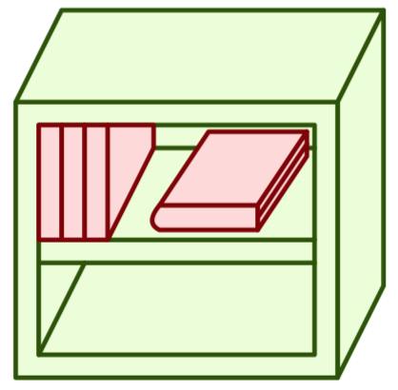
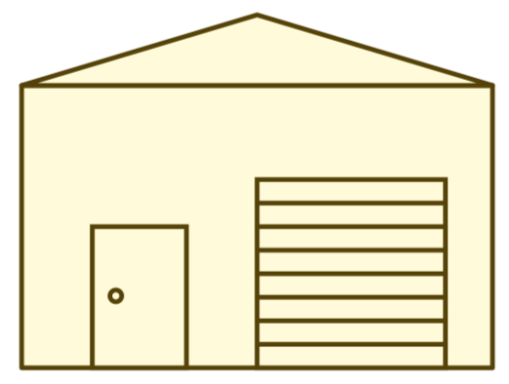
Review: Memory Hierarchy
L0:
Regs
CPU registers hold words retrieved from the L1 cache.
L1:
L1 cache
(SRAM)
L1 cache holds cache lines retrieved from the L2 cache.
Smaller,
faster,
and
costlier
(per byte)
storage
devices
L2:
L2 cache
(SRAM)
L2 cache holds cache lines
retrieved from L3 cache
L3:
L3 cache
(SRAM)
L3 cache holds cache lines
retrieved from main memory.
L4:
Main memory
(DRAM)
Main memory holds
disk blocks retrieved
from local disks.
Larger,
slower,
and
cheaper
(per byte)
storage
devices
Local secondary storage
(local disks)
Local disks hold files retrieved from disks
on remote servers
L5:
L6:
Remote secondary storage
(e.g., cloud, web servers)

Slide 3
Review: Principle of Locality
Programs tend to use data and instructions with addresses near or equal to those they have used recently
Temporal locality:
Recently referenced items are likely to be referenced again in the near future
Spatial locality:
Items with nearby addresses tend to be referenced close together in time

Slide 4
Review: Direct-mapped Cache
log(block size) bits
log(# lines) bits
the rest of the bits
valid bit
tag
data block
Address of data:
tag
index
offset
find line
v
tag
0
1
2
3
4
5
6
7
identifies byte in line
v
tag
0
1
2
3
4
5
6
7
cache lines
v
tag
0
1
2
3
4
5
6
7
v
tag
0
1
2
3
4
5
6
7
How well does this take advantage of spacial locality?
How well does this take advantage of temporal locality?

Slide 5
2-way Set Associative Cache
log(block size) bits
log(# sets) bits
the rest of the bits
E = 2: Two lines per set
Assume: cache block size 8 bytes
Address of data:
tag
index
offset
v
tag
0
1
2
3
4
5
6
7
v
tag
0
1
2
3
4
5
6
7
v
tag
0
1
2
3
4
5
6
7
v
tag
0
1
2
3
4
5
6
7
v
tag
0
1
2
3
4
5
6
7
v
tag
0
1
2
3
4
5
6
7
v
tag
0
1
2
3
4
5
6
7
v
tag
0
1
2
3
4
5
6
7

Slide 6
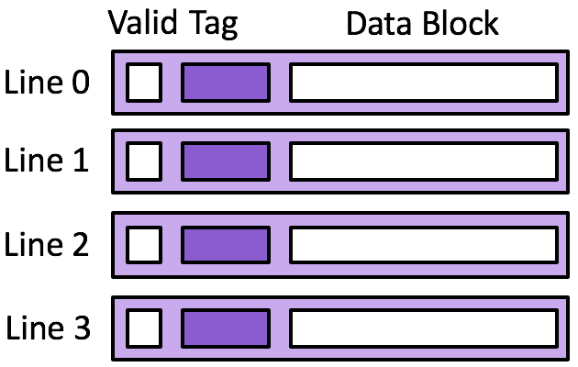
Exercise 1: 2-way Set Associative Cache
Memory
0x14
0x10
0x0c
0x08
0x04
0x00
Cache
Set 0
Set 1
18
17
16
15
14
Assume 8 byte data blocks
13
Set 0 | Set 1
Line 0 |  |  | Line 1 |  |  | Line 0 |  |  | Line 1
0 | 0 | 47 48 | 0 | 1 | 47 48 | 0 | 0 | 47 48 | 0 | 1 | 47 48
Access | tag | idx | off | h/m
rd 0x00
rd 0x04
rd 0x14
rd 0x00
rd 0x04
rd 0x14

Slide 7
Exercise 1: 2-way Set Associative Cache
Memory
0x14
0x10
0x0c
0x08
0x04
0x00
Cache
Set 0
Set 1
18
17
16
15
14
Assume 8 byte data blocks
13
Set 0 | Set 1
Line 0 |  |  | Line 1 |  |  | Line 0 |  |  | Line 1
0 | 0 | 47 48 | 0 | 1 | 47 48 | 0 | 0 | 47 48 | 0 | 1 | 47 48
Access | tag | idx | off | h/m
rd 0x00
rd 0x04
rd 0x14
rd 0x00
rd 0x04
rd 0x14
0000
0
000
m
1
0
13 14
0000
0
100
h
0001
0
100
m
1
1
17 18
0000
0
000
h
0000
0
100
h
0001
0
100
h
m
rd 0x20
0010
0
000

Slide 8
Eviction from the Cache
On a cache miss, a new block is loaded into the cache
Direct-mapped cache: A valid block at the same location must be evicted—no choice
Associative cache: If all blocks in the set are valid, one must be evicted
Random policy
FIFO
LIFO
Least-recently used; requires extra data in each set
Most-recently used; requires extra data in each set
Most-frequently used; requires extra data in each set

Slide 9
Exercise 2: Cache Eviction
Memory
0x14
0x10
0x0c
0x08
0x04
0x00
Cache
Set 0
Set 1
18
17
16
15
14
Assume 8 byte data blocks, LRU eviction
13
Set 0 | Set 1
Line 0 |  |  | Line 1 |  |  | Line 0 |  |  | Line 1
0 | 0 | 47 48 | 0 | 1 | 47 48 | 0 | 0 | 47 48 | 0 | 1 | 47 48
Access | tag | idx | off | h/m
rd 0x00
rd 0x04
rd 0x14
rd 0x00
rd 0x04
rd 0x14
0000
0
000
m
1
0
13 14
0000
0
100
h
0001
0
100
m
1
1
17 18
0000
0
000
h
0000
0
100
h
0001
0
100
h
m
rd 0x20
0010
0
000

Slide 10
Exercise 2: Cache Eviction
Memory
0x14
0x10
0x0c
0x08
0x04
0x00
Cache
Set 0
Set 1
18
17
16
15
14
Assume 8 byte data blocks, LRU eviction
13
Set 0 | Set 1
Line 0 |  |  | Line 1 |  |  | Line 0 |  |  | Line 1
0 | 0 | 47 48 | 0 | 1 | 47 48 | 0 | 0 | 47 48 | 0 | 1 | 47 48
Access | tag | idx | off | h/m
rd 0x00
rd 0x04
rd 0x14
rd 0x00
rd 0x04
rd 0x14
0000
0
000
m
1
0
13 14
0000
0
100
h
0001
0
100
m
1
1
17 18
0000
0
000
h
0000
0
100
h
0001
0
100
h
m
rd 0x20
0010
0
000
1
2
21 22

Slide 11
Caching Organization Summarized
A cache consists of lines
A line contains
A block of bytes, the data values from memory
A tag, indicating where in memory the values are from
A valid bit, indicating if the data are valid
Lines are organized into sets
Direct-mapped cache: one line per set
k-way associative cache: k lines per set
Fully associative cache: all lines in one set

Slide 12
Caching Vocabulary
Size: the total number of bytes that can be stored in the cache
Cache Hit: the desired value is in the cache and returned quickly
Cache Miss: the desired value is not in the cache and must be fetched from a more distant cache (or ultimately from main memory)
Miss rate: the fraction of accesses that are misses
Hit time: the time to process a hit
Miss penalty: the additional time to process a miss
Average access time: hit-time + miss-rate * miss-penalty

Slide 13
Categorizing Misses
Compulsory: first-reference to a block
Capacity: cache is too small to hold all of the data
Conflict: collisions in a specific set
Average access time: hit-time + miss-rate * miss-penalty
Notes:
Larger block size will reduce compulsory misses
Larger associativity will reduce conflict misses
Larger cache will reduce capacity misses
But: larger block size yields larger miss penalty (more data to copy from memory)
larger cache (and larger associativity): increased hit time
Classifying misses with a particular cache configuration:
Would this miss occur in a cache with infinite capacity? If the answer is yes, then this is a compulsory miss and we are done. If the answer is no, then consider question 2.
Would this miss occur in a fully associative cache with the desired capacity? If the answer is yes, then this is a capacity miss and we are done. If the answer is no, then consider question 3.
Would this miss occur in a cache with the desired capacity and associativity? If the answer is yes, then this is a conflict miss and we are done. If the answer is no, then this is not a miss – it is a hit!

Slide 14
Exercise 3: Categorizing Misses
For each of the cache misses in Exercise 1, categorize that miss as (1) compulsory, (2) capacity, or (3) conflict
Based on your categorizations, would you recommend (1) increasing the block size, (2) increasing the associativity, or (3) increasing the total cache size
Notes:
Both are compulsory misses, so it would make the most sense to increase the data block size

Slide 15
Typical Intel Core i7 Hierarchy
Processor package
Core 0
Core 3
L1 d-cache and i-cache:
32 KB, 8-way,
Access: 4 cycles
L2 unified cache:
256 KB, 8-way,
Access: 10 cycles
L3 unified cache:
8 MB, 16-way,
Access: 40-75 cycles
Block size: 64 bytes for all caches.
Regs
Regs
L1
d-cache
L1
i-cache
L1
d-cache
L1
i-cache
…
L2 unified cache
L2 unified cache
L3 unified cache
(shared by all cores)
Main memory

Slide 16
Caching and Writes
What to do on a write-hit?
Write-through: write immediately to memory
Write-back: defer write to memory until replacement of line
Need a dirty bit (line different from memory or not)
What to do on a write-miss?
Write-allocate: load into cache, update line in cache
Good if more writes to the location follow
No-write-allocate: writes straight to memory, does not load into cache
Typical
Write-through + No-write-allocate
Write-back + Write-allocate

Slide 17
Exercise 4: Write-through + No-write-allocate
Memory
0x24
0x20
0x1c
0x18
0x14
0x10
Cache
22
21
20
19
18
17
Assume 4 byte data blocks
Line 0 |  |  | Line 1 |  |  | Line 2 |  |  | Line 3 |  |  | W
0 | 0 | 47 | 0 | 1 | 47 | 0 | 2 | 47 | 0 | 3 | 47
Access | tag | idx | off | h/m
rd 0x10
wr 8,0x10
wr 9,0x24
rd 0x24
rd 0x20

Slide 18
Exercise 4: Write-through + No-write-allocate
Memory
0x24
0x20
0x1c
0x18
0x14
0x10
Cache
22
9
21
20
19
18
17
8
Assume 4 byte data blocks
Line 0 |  |  | Line 1 |  |  | Line 2 |  |  | Line 3 |  |  | W
0 | 0 | 47 | 0 | 1 | 47 | 0 | 2 | 47 | 0 | 3 | 47
Access | tag | idx | off | h/m
rd 0x10
wr 8,0x10
wr 9,0x24
rd 0x24
rd 0x20
0001
00
00
m
1
1
17
N
0001
00
00
h
1
1
8
Y
0010
01
00
m
Y
0010
01
00
m
1
2
9
N
0010
00
00
m
1
2
21
N

Slide 19
Exercise 5: Write-back + Write-allocate
Memory
0x24
0x20
0x1c
0x18
0x14
0x10
Cache
22
21
20
19
18
17
Assume 4 byte data blocks
Line 0 |  |  | Line 1 |  |  | Line 2 |  |  | Line 3 |  |  | W
0 | 0 | 47 | 0 | 1 | 47 | 0 | 2 | 47 | 0 | 3 | 47
Access | tag | idx | off | h/m
rd 0x10
wr 8,0x10
wr 9,0x24
rd 0x24
rd 0x20

Slide 20
Exercise 5: Write-back + Write-allocate
Memory
0x24
0x20
0x1c
0x18
0x14
0x10
Cache
22
21
20
19
18
17
8
Assume 4 byte data blocks
Line 0 |  |  | Line 1 |  |  | Line 2 |  |  | Line 3 |  |  | W
0 | 0 | 47 | 0 | 1 | 47 | 0 | 2 | 47 | 0 | 3 | 47
Access | tag | idx | off | h/m
rd 0x10
wr 8,0x10
wr 9,0x24
rd 0x24
rd 0x20
0001
00
00
m
1
1
17
N
0001
00
00
h
1
1
8
N
0010
01
00
m
1
2
9
N
0010
01
00
h
N
0010
00
00
m
1
2
21
Y

Slide 21
Exercise 6: Feedback
Rate how well you think this recorded lecture worked
Better than an in-person class
About as well as an in-person class
Less well than an in-person class, but you still learned something
Total waste of time, you didn't learn anything
How much time did you spend on this video lecture (including time spent on exercises)?
Do you have any questions that you would like me to address in this week's problem session?
Do you have any other comments or feedback?

