Slide 1
Lecture 14: Caches
CS 105 Spring 2021

Slide 2
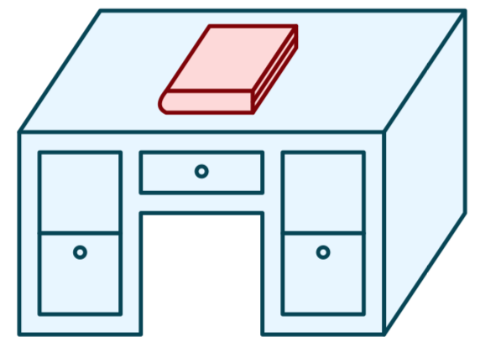
Life without caches
You decide that you want to learn more about computer systems than is covered in this course
The library contains all the books you could possibly want, but you don't like to study in libraries, you prefer to study at home.
You have the following constraints:
Desk
(can hold one book)
Library
(can hold many books)

Slide 3
Life without caches
Average latency to access a book: 40mins
Average throughput (incl. reading time): 1.2 books/hr

Slide 4
A Computer System
Register file
ALU
PC
System bus
Memory bus
Main
memory
Bus interface
I/O
bridge
CPU
I/O bus
Expansion slots for
other devices such
as network adapters
USB
controller
Graphics
adapter
Disk
controller
Mouse
Keyboard
Display
Disk
hello executable
stored on disk

Slide 5
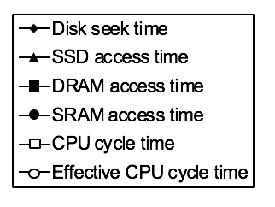
The CPU-Memory Gap
Disk
SSD
DRAM
SRAM
CPU
Notes:
SRAM: Faster (only 10 or so times slower than the CPU)
Expensive (1000x relative to DRAM)

Slide 6
Caching—The Very Idea
Keep some memory values nearby in fast memory
Modern systems have 3 or even 4 levels of caches
Cache idea is widely used:
Disk controllers
Web
(Virtual memory: main memory is a “cache” for the disk)

Slide 7
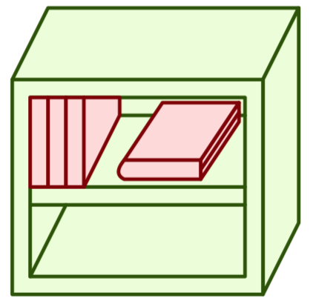
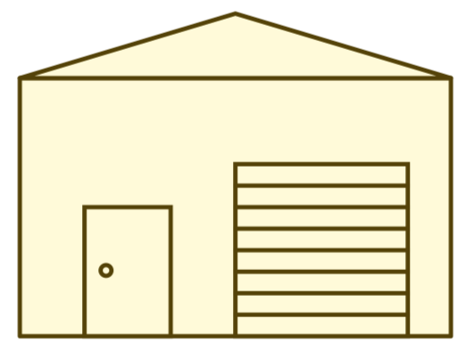
Memory Hierarchy
L0:
Regs
CPU registers hold words retrieved from the L1 cache.
L1:
L1 cache
(SRAM)
L1 cache holds cache lines retrieved from the L2 cache.
Smaller,
faster,
and
costlier
(per byte)
storage
devices
L2:
L2 cache
(SRAM)
L2 cache holds cache lines
retrieved from L3 cache
L3:
L3 cache
(SRAM)
L3 cache holds cache lines
retrieved from main memory.
L4:
Main memory
(DRAM)
Main memory holds
disk blocks retrieved
from local disks.
Larger,
slower,
and
cheaper
(per byte)
storage
devices
Local secondary storage
(local disks)
Local disks hold files retrieved from disks
on remote servers
L5:
L6:
Remote secondary storage
(e.g., cloud, web servers)

Slide 8
Latency numbers every programmer should know (2020)
L1 cache reference | 1 ns
Branch mispredict | 3 ns
L2 cache reference | 4 ns
Main memory reference | 100 ns
memory 1MB sequential read | 3,000 ns | 3 $μ$s
SSD random read | 16,000 ns | 16 $μ$s
SSD 1MB sequential read | 49,000 ns | 49 $μ$s
Magnetic Disk seek | 2,000,000 ns | 2 ms
Magnetic Disk 1MB sequential read | 825,000 ns | 825 $μ$s
Round trip in Datacenter | 500,000 ns | 500 $μ$s
Round trip CA<->Europe | 150,000,000 ns | 150 ms
Notes:
https://people.eecs.berkeley.edu/~rcs/research/interactive_latency.html
register access ~.2-.4ns (2.6 GHz cycle => register ~.38ns )

Slide 9
Life with caching
Average latency to access a book: <20mins
Average throughput (incl. reading time): ~2 books/hr

Slide 10
Caching—The Vocabulary
Size: the total number of bytes that can be stored in the cache
Cache Hit: the desired value is in the cache and returned quickly
Cache Miss: the desired value is not in the cache and must be fetched from a more distant cache (or ultimately from main memory)

Slide 11
Caching—The Vocabulary
Size: the total number of bytes that can be stored in the cache
Cache Hit: the desired value is in the cache and returned quickly
Cache Miss: the desired value is not in the cache and must be fetched from a more distant cache (or ultimately from main memory)
Miss rate: the fraction of accesses that are misses
Hit time: the time to process a hit
Miss penalty: the additional time to process a miss
Average access time: hit-time + miss-rate * miss-penalty

Slide 12
Exercise 1: Caching Strategies
How should we decide which books to keep in the bookshelf?

Slide 13
Example Access Patterns
int sum = 0;
for (int i = 0; i < n; i++){
sum += a[i];
}
return sum;
Data references
Reference array elements in succession.
Reference variable sum each iteration.
Instruction references
Reference instructions in sequence.
Cycle through loop repeatedly.

Slide 14
Example Access Patterns

Slide 15
Principle of Locality
Programs tend to use data and instructions with addresses near or equal to those they have used recently
Temporal locality:
Recently referenced items are likely to be referenced again in the near future
Spatial locality:
Items with nearby addresses tend to be referenced close together in time

Slide 16
Cache Organization

Slide 17
Cache Lines
valid bit
tag
data block
v
tag
0
1
2
3
4
5
6
7
data block: cached data (i.e., copy of bytes from memory)
tag: uniquely identifies which data is stored in the cache line
valid bit: indicates whether or not the line contains meaningful information

Slide 18
Direct-mapped Cache
log(block size) bits
log(# lines) bits
the rest of the bits
Address of data:
tag
index
offset
find line
v
tag
0
1
2
3
4
5
6
7
identifies byte in line
v
tag
0
1
2
3
4
5
6
7
v
tag
0
1
2
3
4
5
6
7
v
tag
0
1
2
3
4
5
6
7
Notes:
Note: low-order bits are always zero if we assume 4-byte words (since we'll always be looking up the address of a word), but we'll just think about those bits as part of the offset

Slide 19
Example: Direct-mapped Cache
Assume: cache block size 8 bytes
Assume: assume 8-bit machine
Address of data:
0xB4
Line 0
1
110
0F
12
AB
34
FF
FF
EA
68
1011 0100
Line 1
1
001
00
00
00
00
00
40
06
1D
101
10
100
Line 2
1
101
0D
00
00
00
2F
00
00
00
3 bit tag
2 bit index
3 bit offset
Line 3
0
001
00
11
22
33
44
55
66
77

Slide 20
Exercise 2: Interpreting Addresses
Consider the hex address 0xA59. What would be the tag, index, and offset for this address with each of the following cache configurations?
A direct-mapped cache with 8 cache lines and 8-byte data blocks
A direct-mapped cache with 16 cache lines and 4-byte data blocks
A direct-mapped cache with 16 cache lines and 8-byte data blocks

Slide 21
Exercise 2: Interpreting Addresses
Consider the hex address 0xA59. What would be the tag, index, and offset for this address with each of the following cache configurations?
A direct-mapped cache with 8 cache lines and 8-byte data blocks
A direct-mapped cache with 16 cache lines and 4-byte data blocks
A direct-mapped cache with 16 cache lines and 8-byte data blocks
1010 0101 1001
101001
011
001
tag
idx
off
101001
0110
01
tag
idx
off
10100
1011
001
tag
idx
off

Slide 22
Exercise 3: Cache Indices
Assume you have an array of 6 integers a that begins at address 0x601940. Assume you are running on a machine that has a direct-mapped cache with 8 cache lines and 8-byte data blocks. Which cache line would each of the 6 integers be stored in when it is in cache?
0x601940

Slide 23
Exercise 3: Cache Indices
Assume you have an array of 6 integers a that begins at address 0x601940. Assume you are running on a machine that has a direct-mapped cache with 8 cache lines and 8-byte data blocks. Which cache line would each of the 6 integers be stored in when it is in cache?
0x601940
Element | Address | Binary Address | Index | Offset
a[0]
a[1]
a[2]
a[2]
a[4]
a[5]
0x601940
… 0100 0000
000
000
0x601944
… 0100 0100
000
100
0x601948
… 0100 1000
001
000
0x60194c
… 0100 1100
001
100
0x601950
… 0101 0000
010
000
0x601954
… 0101 0100
010
100

Slide 24
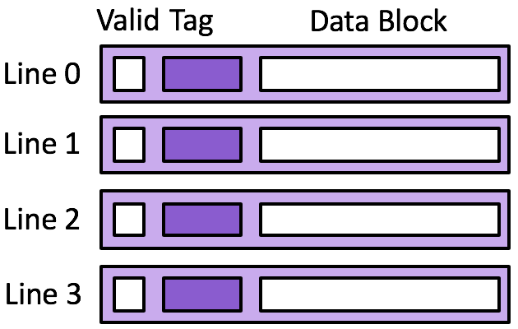
Exercise 3: Direct-mapped Cache
Memory
0x14
0x10
0x0c
0x08
0x04
0x00
Cache
18
17
16
15
14
13
Assume 4 byte data blocks
Line 0 |  |  | Line 1 |  |  | Line 2 |  |  | Line 3
0 |  | 47 | 0 |  | 47 | 0 |  | 47 | 0 |  | 47
Access | tag | idx | off | h/m
rd 0x00
rd 0x04
rd 0x14
rd 0x00
rd 0x04
rd 0x14
0000
0000
0000
0000
0000
00
00
m
1
0000
13
Notes:
1. Assume 4 byte data blocks, 4 cache lines
2. Assume 8 byte data blocks, 2 cache lines

Slide 25
Exercise 3: Direct-mapped Cache
Memory
0x14
0x10
0x0c
0x08
0x04
0x00
Cache
18
17
16
15
14
13
Assume 4 byte data blocks
Line 0 |  |  | Line 1 |  |  | Line 2 |  |  | Line 3
0 |  | 47 | 0 |  | 47 | 0 |  | 47 | 0 |  | 47
Access | tag | idx | off | h/m
rd 0x00
rd 0x04
rd 0x14
rd 0x00
rd 0x04
rd 0x14
0000
0000
0000
0000
0000
00
00
m
1
0000
13
0000
01
00
m
1
0000
14
0001
01
00
m
1
0001
18
0000
00
00
h
0000
01
00
m
1
0000
14
0001
01
00
m
1
0001
18
How well does this take advantage of spacial locality?
How well does this take advantage of temporal locality?
Notes:
1. Assume 4 byte data blocks, 4 cache lines
2. Assume 8 byte data blocks, 2 cache lines

Slide 26
Exercise 4: Direct-mapped Cache
Memory
0x14
0x10
0x0c
0x08
0x04
0x00
Cache
18
17
16
15
14
13
Assume 8 byte data blocks
Line 0 |  |  | Line 1
0 |  | 47 48 | 0 |  | 47 48
Access | tag | idx | off | h/m
rd 0x00
rd 0x04
rd 0x14
rd 0x00
rd 0x04
rd 0x14
0000
0000
Notes:
1. Assume 4 byte data blocks, 4 cache lines
2. Assume 8 byte data blocks, 2 cache lines

Slide 27
Exercise 4: Direct-mapped Cache
Memory
0x14
0x10
0x0c
0x08
0x04
0x00
Cache
18
17
16
15
14
13
Assume 8 byte data blocks
Line 0 |  |  | Line 1
0 |  | 47 48 | 0 |  | 47 48
Access | tag | idx | off | h/m
rd 0x00
rd 0x04
rd 0x14
rd 0x00
rd 0x04
rd 0x14
0000
0000
0000
0
000
m
1
0000
13 14
0000
0
100
h
0001
0
100
m
1
0001
17 18
0000
0
000
m
1
0000
13 14
0000
0
100
h
0001
0
100
m
1
0001
17 18
How well does this take advantage of spacial locality?
How well does this take advantage of temporal locality?
Notes:
1. Assume 4 byte data blocks, 4 cache lines
2. Assume 8 byte data blocks, 2 cache lines

Slide 28
Exercise 5: Feedback
Rate how well you think this recorded lecture worked
Better than an in-person class
About as well as an in-person class
Less well than an in-person class, but you still learned something
Total waste of time, you didn't learn anything
How much time did you spend on this video lecture (including time spent on exercises)?
Do you have any questions that you would like me to address in this week's problem session?
Do you have any other comments or feedback?

