Slide 1
Lecture 10: Buffer Overflows (cont'd)
CS 105 Fall 2020

Slide 2
Review: Buffer Overflow Attack
Idea: overwrite return address with address of instruction you want to execute next
If a string: use padding to fill up space between array and saved rip
Stack smashing: use padding to write program and jump there
Stack Frame
for call_echo
/* Echo Line */ void echo() { char buf[4]; gets(buf); puts(buf); }
00
00
00
00
saved
%rip
Return Address
(8 bytes)
Return Address
(8 bytes)
00
40
06
09
00
40
06
f6
19
18
17
16
20 bytes unused
Stack Frame
for echo
15
14
13
12
echo:
subq $0x18, %rsp
movq %rsp, %rdi
call gets
call puts
addq $0x18, %rsp
ret
11
0f
0e
0d
0c
0b
0a
09
08
07
06
05
04
03
02
01
%rsp
[3]
[2]
[1]
[0]
buf
Notes:
Note: works on linux
Demo: crash, jump

Slide 3
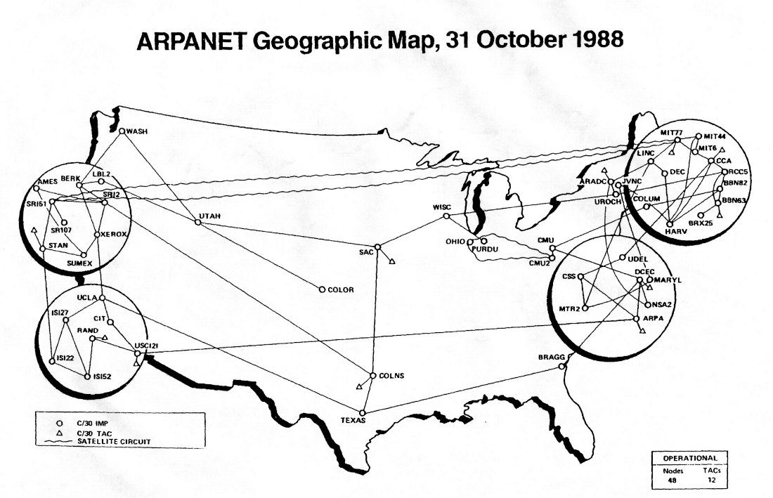
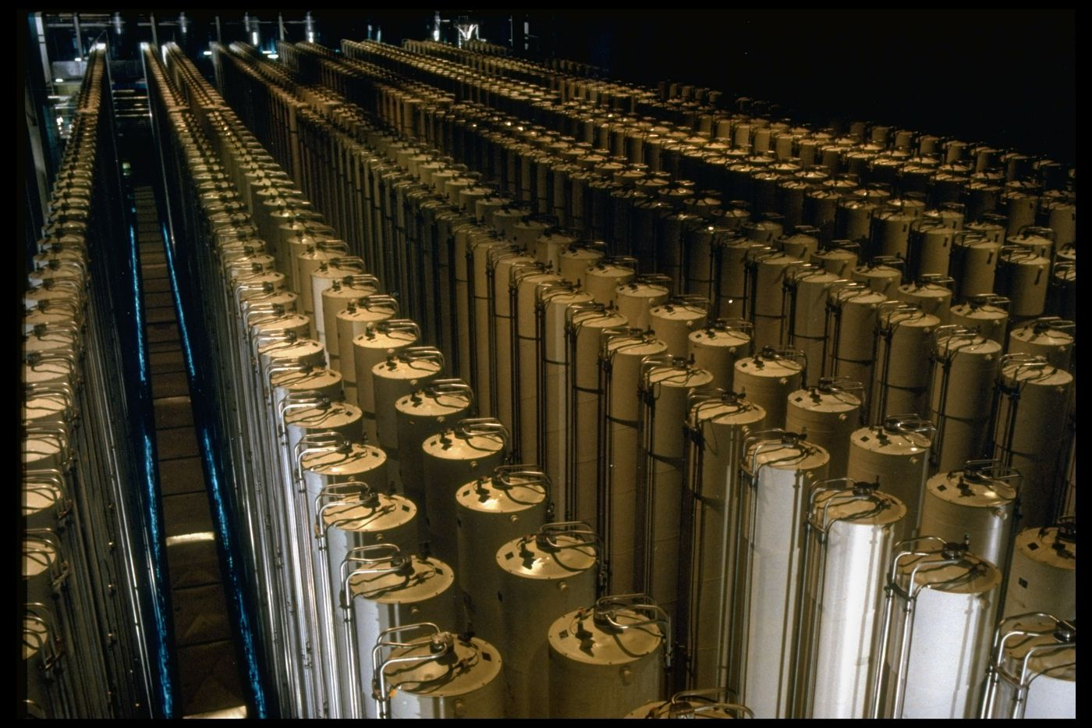
Review: Buffer Overflow Examples
Notes:
Morris Worm (November 2, 1988), $100,000-$10mil, bugs in finger and sendmail
Stuxnet (discovered 2010): bug in functions that process files to display icons when USB connected to PC
Heartbleed (2014): bug in openssl library hearbeat
WhatsApp (2019)

Slide 4
Defense #1: Avoid Overflow Vulnerabilities
/* Echo Line */ void echo() { char buf[4]; /* Way too small! */ fgets(buf, 4, stdin); puts(buf); }
For example, use library routines that limit string lengths
fgets instead of gets
strncpy instead of strcpy
Don’t use scanf with %s conversion specification (use fgets to read the string or use %ns where n is a suitable integer)
Or use a high-level language

Slide 5
Buffer Overflow Vulnerabilities
Notes:
https://www.cvedetails.com/vulnerabilities-by-types.php

Slide 6
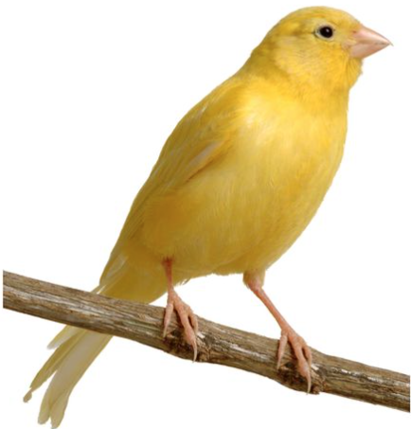
Defense #2: Compiler checks
Idea
Place special value (“canary”) on stack just beyond buffer
Check for corruption before exiting function
GCC Implementation
-fstack-protector
Now the default (disabled earlier)
0x7FFFFFFF
Stack
Stack Frame P
return address
Stack Frame Q
0x00000000

Slide 7
Stack Canaries
authenticate:
pushq %rbx
subq $16, %rsp
movq %rdi, %rbx
movq %fs:40, %rax
movq %rax, 8(%rsp)
xorl %eax, %eax
movq %rsp, %rdi
call gets
movq %rsp, %rsi
movq %rbx, %rdi
call strcmp
testl %eax, %eax
sete %al
movq 8(%rsp), %rdx
xorq %fs:40, %rdx
je .L2
call __stack_chk_fail
.L2:
movzbl %al, %eax
addq $16, %rsp
popq %rbx
ret
Stack Frame
for call_echo
00
00
00
00
Return Address
(8 bytes)
saved
%rip
Return Address
(8 bytes)
00
40
06
f6
Stack Frame
for echo
canary
34
33
32
31
30
20 bytes unused
Stack Frame
for echo
39
38
37
36
35
34
33
32
31
30
39
38
37
36
35
34
33
32
31
30
buf
%rsp
[3]
[2]
[1]
[0]

Slide 8
Exercise 1: Stack Canaries
Which of the following would make a good stack canary?
A secret, constant value
A fixed sequence of common terminators (\0, EOF, etc.)
A random number chosen each time the program is run

Slide 9
Review: Stack Smashing
Idea: fill the buffer with bytes that will be interpreted as code
Overwrite the return address with address of the beginning of the buffer
Stack Frame
for call_echo
/* Echo Line */ void echo() { char buf[4]; gets(buf); puts(buf); }
7f
ff
ff
ff
00
00
00
00
Return Address
(8 bytes)
saved
%rip
Return Address
(8 bytes)
ff
ff
ea
40
00
40
06
f6
33
32
31
30
20 bytes unused
Stack Frame
for echo
39
38
37
36
echo:
subq $18, %rsp
movq %rsp, %rdi
call gets
call puts
addq $18, %rsp
ret
35
34
33
32
31
30
39
38
37
36
35
34
33
32
31
30
%rsp
[3]
[2]
[1]
[0]
buf
Notes:
Note: works on linux
Demo: crash, jump

Slide 10
Defense #3: Memory Tagging
Memory
0x7FFF
Stack
NX
W $⊕$ X
Heap
NX
NX
Data
Nw
Code
0x0000

Slide 11
Code Reuse Attacks
Key idea: execute instructions that already exist
Defeats memory tagging defenses
Examples:
return to a function or line in the current program
return to a library function (e.g., return-into-libc)
return to some other instruction (return-oriented programming)

Slide 12
Handling Arguments
what function expects
when it is called…
overflow with argument
0x7FFFFFFF
0x7FFFFFFF
Stack
Stack
arg1
rdi
?
rdi
caller
stack frame
arg1
caller stack frame
pc0+4
pc0
&fun
&fun
rip
&(c3)
rip
&(5f c3)
&fun
arg1
return address
return address
callee stack frame
misc filler
buffer
heap
heap
data
data
code
code
5f c3

Slide 13
Return-into-libc

Slide 14
ASCII Armoring
Make sure all system library addresses contain a null byte (0x00).
Can be done by placing this code in the first 0x01010101 bytes of memory
Notes:
With ASCII armoring, all the system libraries (e.g. libc) addresses contain a NULL byte(0x00). This is commonly done by placing them in the first 0x01010101 bytes of memory (a few pages more than 16 MB, dubbed the "ASCII armor region"), as every address up to (but not including) this value contains at least one NULL byte. This makes it impossible to emplace code containing those addresses using string manipulation functions such as strcpy(). However, this technique does not work if the attacker has a way to overflow NULL bytes into the stack. If the program is too large to fit in the first 16 MiB, protection may be incomplete.[

Slide 15
Properties of x86 Assembly
lots of instructions
variable length instructions
not word aligned
dense instruction set

Slide 16
Gadgets
void setval(unsigned *p) {
*p = 3347663060u;
}
<setval>: 4004d9: c7 07 d4 48 89 c7 movl $0xc78948d4,(%rdi)
4004df: c3 ret
gadget address: 0x4004dc
encodes: movq %rax, %rdi
ret
executes: %rdi <- %rax
Notes:
https://defuse.ca/online-x86-assembler.htm

Slide 17
Example Gadgets
Load Constant
Load from memory
48 89 C0 C3
movq (%rax), %rax
ret
0xbad01010
return addr
5a c3
Return addr
popq %rdx
ret
58 c3
popq %rax
ret
0xbad00002

Slide 18
Return-oriented Programming
Notes:
Image By: Dino Dai Zovi

Slide 19
Return-oriented Programming
gadget_N_code c3
…
gadget_2_code c3
gadget_1_code c3
Final ret in each gadget sets pc (%rip) to
beginning of next gadget code

Slide 20
Return-Oriented Shellcode
%rip | %rdi | %rsi | %rax | %rdx
%rip | %rdi | %rsi | %rax | %rdx
4004b9 | 3b3b3b | ea70 | 3b | 0
%rip | %rdi | %rsi | %rax | %rdx
400666 | 3b3b3b | ea78 | 0 | 0
%rip | %rdi | %rsi | %rax | %rdx
400663 | 3b3b3b | ea78 | 0
%rip | %rdi | %rsi | %rax | %rdx
400660 | 3b3b3b | ea78 | 0
%rip | %rdi | %rsi | %rax | %rdx
40090b
%rip | %rdi | %rsi | %rax | %rdx
4004b8 | 3b3b3b | ea78 | 3b | 0
%rip | %rdi | %rsi | %rax | %rdx
400420 |  |  | 0
%rip | %rdi | %rsi | %rax | %rdx
40090e |  |  | 0
%rip | %rdi | %rsi | %rax | %rdx
4002a6 | 3b3b3b | ea78 | 3b | 0
%rip | %rdi | %rsi | %rax | %rdx
4002a3 | 3b3b3b | ea78 | 0 | 0
%rip | %rdi | %rsi | %rax | %rdx
400421 | 3b3b3b |  | 0
%rip | %rdi | %rsi | %rax | %rdx
400421 | 3b3b3b | ea78 | 0
%rip | %rdi | %rsi | %rax | %rdx
4004b9 | ea80 | ea70 | 3b | 0
"\bin\sh\0"
%rip | %rdi | %rsi | %rax | %rdx
40042a | ea80 | ea70 | 3b | 0
7fffffffea80
0
7fffffffea78
0x1122334455667788
7fffffffea70
0x7fffffffea80
7fffffffea68
0x40042a
0F 05 C3
7fffffffea60
0x7fffffffea80
5E 5F C3
syscall
ret
7fffffffea58
0x7fffffffea70
0x4004b8
pop %rsi
pop %rdi
ret
7fffffffea50
0x4002a3
40 00 F8 C3
7fffffffea48
7fffffffea40
0x400660
48 89 06 48 89 c2 C3
add %dil, %al
ret
7fffffffea38
0x7fffffffea78
mov %rax, (%rsi)
mov %rax, %rdx
ret
7fffffffea30
0x3b3b3b3b3b3b3b3b
7fffffffea28
0x400420
5F 5E C3
0x40090b
48 31 C0 C3
pop %rdi
pop %rsi
ret
7fffffffea20
xor %rax, %rax
ret
Notes:
Note: syscall: number of syscall actually passed in register %rax.
System call index: http://blog.rchapman.org/posts/Linux_System_Call_Table_for_x86_64/

Slide 21
Exercise 2: ROP
What are the values in the registers when the function at address 0x401a82 gets called?
%rip | %rdi | %rsi | %rax | %rdx
7fffffffea58
0x59b997d0
7fffffffea50
0x401a82
48 89 C7 C3
7fffffffea48
0x4002a3
mov %rax, %rdi
ret
7fffffffea40
0x401bb0
48 2B 02 C3
7fffffffea38
0x7fffffffea50
sub (%rdx), %rax
ret
7fffffffea30
0x401a5b
5A C3
7fffffffea28
0x59b997ff
pop %rdx
ret
7fffffffea20
0x4019e5
58 C3
pop %rax
ret

Slide 22
Exercise 2: ROP
What are the values in the registers when the function at address 0x401a82 gets called?
%rip | %rdi | %rsi | %rax | %rdx
401a5c |  |  | ..97ff | ..ea58
%rip | %rdi | %rsi | %rax | %rdx
401bb0 |  |  | ..97ff | ..ea58
%rip | %rdi | %rsi | %rax | %rdx
401a5b |  |  | ..97ff
%rip | %rdi | %rsi | %rax | %rdx
4002a3 |  |  | 2f | ..ea58
%rip | %rdi | %rsi | %rax | %rdx
4019e6 |  |  | ..97ff
%rip | %rdi | %rsi | %rax | %rdx
4019e5
%rip | %rdi | %rsi | %rax | %rdx
401a82 | 2f |  | 2f | ..ea58
%rip | %rdi | %rsi | %rax | %rdx
401bb3 |  |  | 2f | ..ea58
%rip | %rdi | %rsi | %rax | %rdx
4002a3 | 2f |  | 2f | ..ea58
%rip | %rdi | %rsi | %rax | %rdx
7fffffffea58
0x59b997d0
7fffffffea50
0x401a82
48 89 C7 C3
7fffffffea48
0x4002a3
mov %rax, %rdi
ret
7fffffffea40
0x401bb0
48 2B 02 C3
7fffffffea38
0x7fffffffea50
sub (%rdx), %rax
ret
7fffffffea30
0x401a5b
5A C3
7fffffffea28
0x59b997ff
pop %rdx
ret
7fffffffea20
0x4019e5
58 C3
pop %rax
ret

Slide 23
Address Space Layout Randomization
Notes:
information leakage attacks
format string vulnerabilities, side-channel attacks
Entropy reduction
NOP slides, heap spraying

Slide 24
Other defenses
Gadget Elimination
Control Flow Integrity
Code
Code
Notes:
compile time

Slide 25
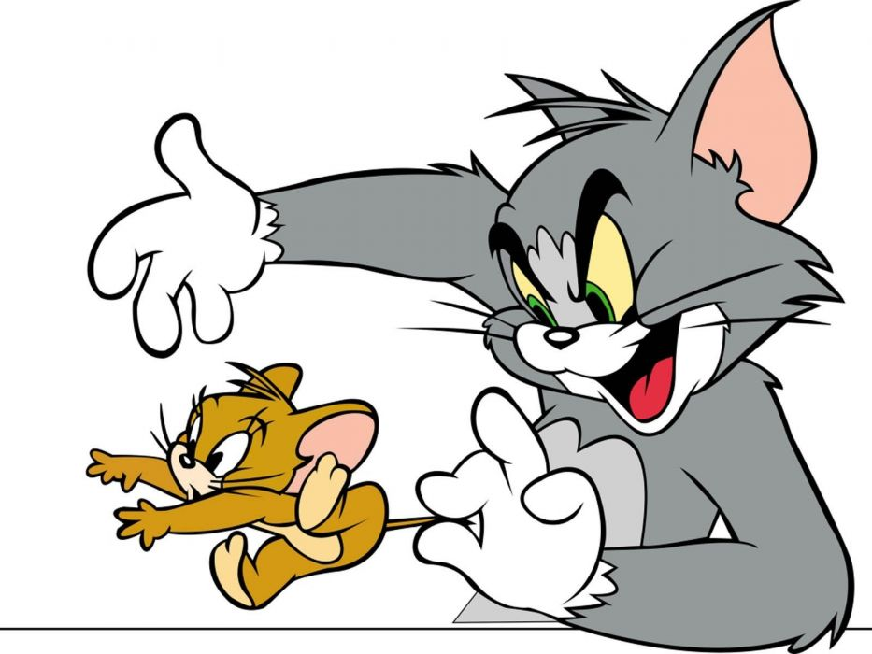
The state of the world
Defenses:
high-level languages
Stack Canaries
Memory tagging
ASLR
continuing research and development…
But all they aren't perfect!

Slide 26
Exercise 3: Feedback
Rate how well you think this recorded lecture worked
Better than an in-person class
About as well as an in-person class
Less well than an in-person class, but you still learned something
Total waste of time, you didn't learn anything
How much time did you spend on this video lecture (including time spent on exercises)?
Do you have any questions that you would like me to address in this week's problem session?
Do you have any other comments or feedback?

