Slide 1
Lecture 9: Buffer Overflows
CS 105 Fall 2020

Slide 2
From Last time…
Basic Principle
T A[L];
Array of data type T and length L
Identifier A can be used as a pointer to array element 0: Type T*
Reference Type Value
val[4] int 3
val int * x
val+1 int * x + 4
&val[2] int * x + 8
val[5] int ??
*(val+1) int 5
val + i int * x + 4 i
int val[5];
1
5
2
1
3
x
x + 4
x + 8
x + 12
x + 16
x + 20

Slide 3
Memory Referencing Bug Example
void f1(){
double a2[2] = {1.0,2.0};
int a1[4] = {1,2,3,4};
a1[4] = 1413754136;
a1[5] = 1074340347;
}
0x40068b
%rsp
f1:
sub $0x38,%rsp
movsd 0x216(%rip),%xmm0
movsd %xmm0,0x20(%rsp)
movsd 0x210(%rip),%xmm0
movsd %xmm0,0x28(%rsp)
movl $0x1,0x10(%rsp)
movl $0x2,0x14(%rsp)
movl $0x3,0x18(%rsp)
movl $0x4,0x1c(%rsp)
movl $0x54442d18,0x20(%rsp)
movl $0x400921fb,0x24(%rsp)
add $0x38,%rsp
retq
2.0
a2
0x54442d18
1.0
0x400921fb
4
3
a1
2
1
Notes:
Note: works on linux
Demo: crash, jump

Slide 4
Memory Referencing Bug Example
void f1(){
double a2[2] = {1.0,2.0};
int a1[4] = {1,2,3,4};
a1[10] = 47;
}
0x2f
0x40068b
%rsp
f1:
sub $0x38,%rsp
movsd 0x216(%rip),%xmm0
movsd %xmm0,0x20(%rsp)
movsd 0x210(%rip),%xmm0
movsd %xmm0,0x28(%rsp)
movl $0x1,0x10(%rsp)
movl $0x2,0x14(%rsp)
movl $0x3,0x18(%rsp)
movl $0x4,0x1c(%rsp)
movl $0x2f,0x18(%rsp)
add $0x38,%rsp
retq
2.0
a2
1.0
4
3
a1
2
1
Notes:
Note: works on linux
Demo: crash, jump

Slide 5
Exercise 1: Memory Bugs
What is the state of the stack immediately before the program returns from f2?
What will happen immediately after f2 returns?
int f2(){
int a1[4] = {1,2,3,4};
a1[6] = 47;
}
0x2f
0x40068b
%rsp
4
f2:
sub $0x18,%rsp
movl $0x1,(%rsp)
movl $0x2,0x4(%rsp)
movl $0x3,0x8(%rsp)
movl $0x4,0xc(%rsp)
movl $0x2f,0x18(%rsp)
add $0x18,%rsp
retq
3
a1
2
1
Notes:
Note: works on linux
Demo: crash, jump

Slide 6
Buffer Overflows
Most common form of memory reference bug
Unchecked lengths on string inputs
Particularly for bounded character arrays on the stack
sometimes referred to as stack smashing
Stack Frame
for call_echo
/* Echo Line */ void echo() { char buf[4]; gets(buf); puts(buf); }
00
00
00
00
Return Address
(8 bytes)
saved
%rip
Return Address
(8 bytes)
00
40
06
f6
34
00
32
31
30
20 bytes unused
Stack Frame
for echo
39
38
37
36
echo:
subq $0x18, %rsp
movq %rsp, %rdi
call gets
call puts
addq $0x18, %rsp
ret
35
34
33
32
31
30
39
38
37
36
35
34
33
32
31
30
%rsp
[3]
[2]
[1]
[0]
buf
Notes:
Note: works on linux
Demo: crash, jump

Slide 7
Exercise 2: Buffer Overflow
authenticate:
0x4005f6 <+0>: sub $0x28,%rsp
0x4005fa <+4>: mov %rdi,0x8(%rsp)
0x4005ff <+9>: lea 0x10(%rsp),%rax
0x400604 <+14>: mov %rax,%rdi
0x400607 <+17>: mov $0x0,%eax
0x40060c <+22>: callq 0x4004e0 <gets@plt>
0x400611 <+27>: lea 0x10(%rsp),%rdx
0x400616 <+32>: mov 0x8(%rsp),%rax
0x40061b <+37>: mov %rdx,%rsi
0x40061e <+40>: mov %rax,%rdi
0x400621 <+43>: callq 0x4004d0 <strcmp@plt>
0x400626 <+48>: test %eax,%eax
0x400628 <+50>: sete %al
0x40062b <+53>: movzbl %al,%eax
0x400636 <+64>: add $0x28,%rsp
0x40063a <+68>: retq
main:
0x40063b <+0>: sub $0x28,%rsp
0x40063f <+4>: mov %edi,0xc(%rsp)
0x400643 <+8>: mov %rsi,(%rsp)
0x400647 <+12>: movq $0x400728,0x18(%rsp)
0x400650 <+21>: mov $0x40072f,%edi
0x400655 <+26>: mov $0x0,%eax
0x40065a <+31>: callq 0x4004b0 <printf@plt>
0x40065f <+36>: jmp 0x400670 <main+53>
0x400661 <+38>: mov $0x400748,%edi
0x400666 <+43>: mov $0x0,%eax
0x40066b <+48>: callq 0x4004b0 <printf@plt>
0x400670 <+53>: mov 0x18(%rsp),%rax
0x400675 <+58>: mov %rax,%rdi
0x400678 <+61>: callq 0x4005f6 <authenticate>
0x40067d <+66>: test %eax,%eax
0x40067f <+68>: je 0x400661 <main+38>
0x400681 <+70>: mov $0x400768,%edi
0x400686 <+75>: callq 0x4004a0 <puts@plt>
0x040068b <+80>: mov $0x0,%eax
0x400690 <+85>: add $0x28,%rsp
0x400694 <+89>: retq
Construct an exploit string that will successfully cause the program to print "You are now logged in" without knowing the correct password
How many bytes of padding are in this exploit string?
What value will you overwrite the return address with?
int authenticate(char *password){
char buf[4];
gets(buf);
int correct = !strcmp(password, buf);
return correct;
}
int main(int argc, char ** argv){
char * pw = "123456";
printf("Enter your password: ");
while(!authenticate(pw)){
printf("Incorrect. Try again: ");
}
printf("You are now logged in\n");
return 0;
}

Slide 8
Exercise 2: Buffer Overflow
authenticate:
0x4005f6 <+0>: sub $0x28,%rsp
0x4005fa <+4>: mov %rdi,0x8(%rsp)
0x4005ff <+9>: lea 0x10(%rsp),%rax
0x400604 <+14>: mov %rax,%rdi
0x400607 <+17>: mov $0x0,%eax
0x40060c <+22>: callq 0x4004e0 <gets@plt>
0x400611 <+27>: lea 0x10(%rsp),%rdx
0x400616 <+32>: mov 0x8(%rsp),%rax
0x40061b <+37>: mov %rdx,%rsi
0x40061e <+40>: mov %rax,%rdi
0x400621 <+43>: callq 0x4004d0 <strcmp@plt>
0x400626 <+48>: test %eax,%eax
0x400628 <+50>: sete %al
0x40062b <+53>: movzbl %al,%eax
0x400636 <+64>: add $0x28,%rsp
0x40063a <+68>: retq
main:
0x40063b <+0>: sub $0x28,%rsp
0x40063f <+4>: mov %edi,0xc(%rsp)
0x400643 <+8>: mov %rsi,(%rsp)
0x400647 <+12>: movq $0x400728,0x18(%rsp)
0x400650 <+21>: mov $0x40072f,%edi
0x400655 <+26>: mov $0x0,%eax
0x40065a <+31>: callq 0x4004b0 <printf@plt>
0x40065f <+36>: jmp 0x400670 <main+53>
0x400661 <+38>: mov $0x400748,%edi
0x400666 <+43>: mov $0x0,%eax
0x40066b <+48>: callq 0x4004b0 <printf@plt>
0x400670 <+53>: mov 0x18(%rsp),%rax
0x400675 <+58>: mov %rax,%rdi
0x400678 <+61>: callq 0x4005f6 <authenticate>
0x40067d <+66>: test %eax,%eax
0x40067f <+68>: je 0x400661 <main+38>
0x400681 <+70>: mov $0x400768,%edi
0x400686 <+75>: callq 0x4004a0 <puts@plt>
0x040068b <+80>: mov $0x0,%eax
0x400690 <+85>: add $0x28,%rsp
0x400694 <+89>: retq
0x400681
0x40067d
%rsp
24 bytes padding
buf
pw

Slide 9
Stack Smashing
Idea: fill the buffer with bytes that will be interpreted as code
Overwrite the return address with address of the beginning of the buffer
Stack Frame
for call_echo
/* Echo Line */ void echo() { char buf[4]; gets(buf); puts(buf); }
7f
ff
ff
ff
00
00
00
00
Return Address
(8 bytes)
saved
%rip
Return Address
(8 bytes)
ff
ff
ea
40
00
40
06
f6
33
32
31
30
20 bytes unused
Stack Frame
for echo
39
38
37
36
echo:
subq $18, %rsp
movq %rsp, %rdi
call gets
call puts
addq $18, %rsp
ret
35
34
33
32
31
30
39
38
37
36
35
34
33
32
31
30
%rsp
[3]
[2]
[1]
[0]
buf
Notes:
Note: works on linux
Demo: crash, jump

Slide 10
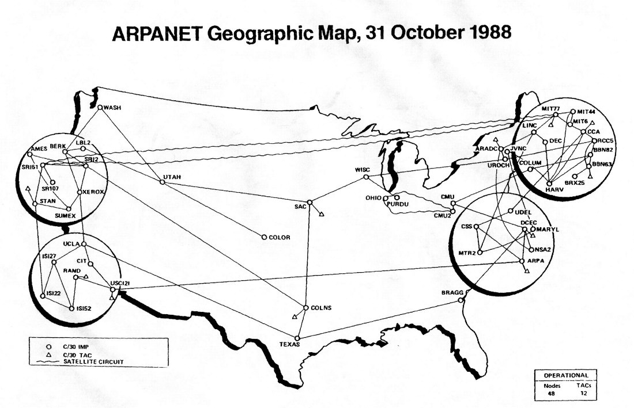
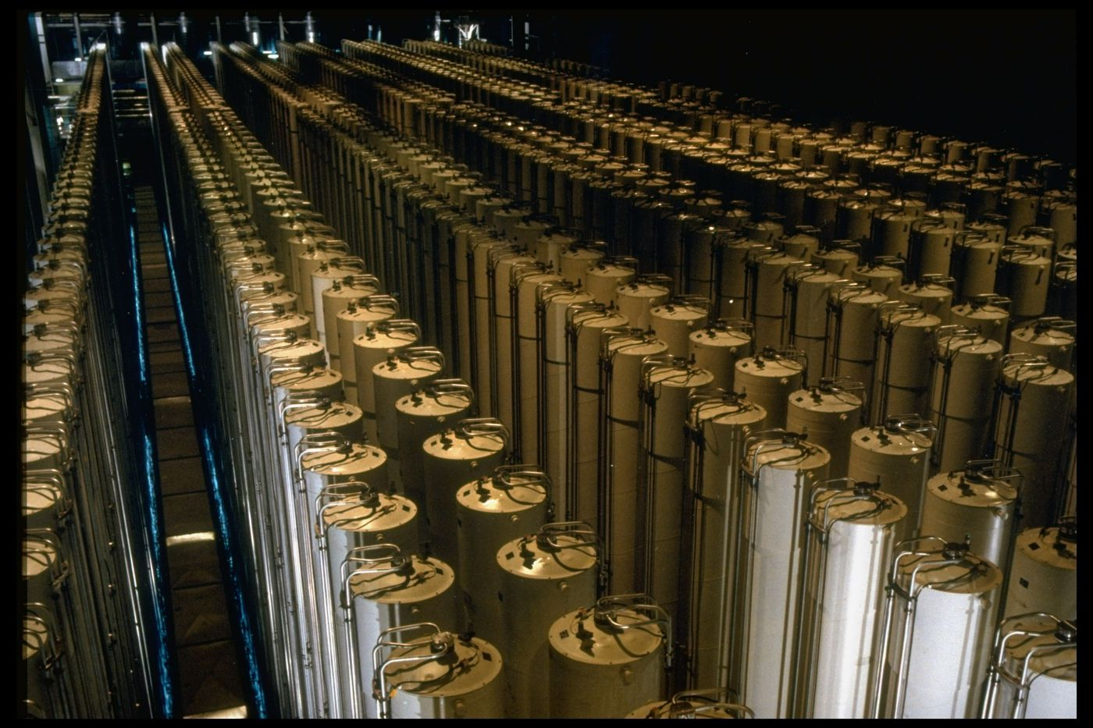
Buffer Overflow Examples
Notes:
Morris Worm (November 2, 1988), $100,000-$10mil, bugs in finger and sendmail
Stuxnet (discovered 2010): bug in functions that process files to display icons when USB connected to PC
Heartbleed (2014): bug in openssl library hearbeat
WhatsApp (2019)

Slide 11
Exercise 4: Feedback
Rate how well you think this recorded lecture worked
Better than an in-person class
About as well as an in-person class
Less well than an in-person class, but you still learned something
Total waste of time, you didn't learn anything
How much time did you spend on this video lecture (including time spent on exercises)?
Do you have any questions that you would like me to address in this week's problem session?
Do you have any other comments or feedback?

