Slide 1
Lecture 7: Procedure Calls in Assembly
CS 105 Fall 2020

Slide 2
Assembly/Machine Code View
Memory
0x7FFF
CPU
Stack
Registers
Data
PC
Condition
Codes
Heap
Data
Addresses
Code
Instructions
0x0000
Programmer-Visible State
PC: Program counter
16 Registers
Condition codes
Memory
Byte addressable array
Code and user data
Stack to support procedures

Slide 3
Assembly Characteristics: Operations
Transfer data between memory and register
Load data from memory into register
Store register data into memory
Perform arithmetic function on register or memory data
Transfer control
Conditional branches
Jumps to/from procedures

Slide 4
Procedures
Procedures provide an abstraction that implements some functionality with designated arguments and (optional) return value
e.g., functions, methods, subroutines, handlers
To support procedures at the machine level, we need mechanisms for:
Passing Control: When procedure P calls procedure Q, program counter must be set to address of Q, when Q returns, program counter must be reset to instruction in P following procedure call
Passing Data: Must handle parameters and return values
Allocating memory: Q must be able to allocate (and deallocate) space for local variables

Slide 5
The Stack
0x7FFFFFFF
the stack is a region of memory (traditionally the "top" of memory)
grows "down"
provides storage for functions (i.e., space for allocating local variables)
%rsp holds address of top element of stack
Stack
%rsp
Heap
Text
%rip
Code
0x00000000

Slide 6
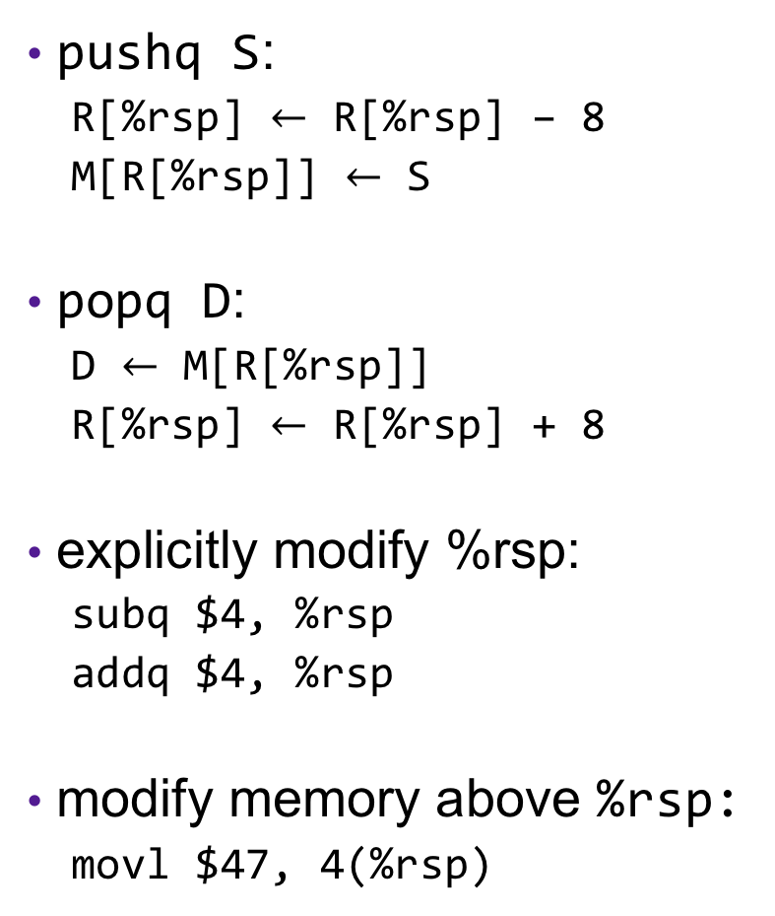
Modifying the Stack
0x7FFFFFFF
pushq S:
R[%rsp] $←$ R[%rsp] – 8
M[R[%rsp]] $←$ S
popq D:
D $←$ M[R[%rsp]]
R[%rsp] $←$ R[%rsp] + 8
explicitly modify %rsp:
subq $4, %rsp
addq $4, %rsp
modify memory above %rsp:
movl $47, 4(%rsp)
Stack
%rsp
S
Heap
Text
%rip
Code
0x00000000

Slide 7
Modifying the Stack
0x7FFFFFFF
call f:
pushq %rip
movq &f, %rip
ret:
popq %rip
Stack
%rsp
Heap
Text
%rip
Code
0x00000000

Slide 8
Procedure Call Example: Stack Frame
int proc(int *p);
int example1(int x) {
int a[4];
a[3] = 10;
return proc(a);
}
example1:
subq $16, %rsp
movl $10, 12(%rsp)
movq %rsp, %rdi
call 0x400546 <proc>
addq $16, %rsp
ret
Notes:
Walk through on board, then demo
Demo 1 - Procedure calls (note: run on linux server):
make example1
gdb example1
(gdb) b example1 # set breakpoint at beginning of function example1
(gdb) disassem example1 # show assembly code and walk through
(gdb) r
(gdb) info reg # observe values in %rsp and %rip
(gdb) stepi
(gdb) info reg # observe new values of %rsp and %rip
(gdb) x/4wd $rsp # see initial values in a as ints
(gdb) step i
(gdb) x/44wd $rsp # observe new array values (a[3] now 10)
(gdb) x/3gx $rsp # observe return address value
(gdb) disassem main # observe ret addr is next instr in main

Slide 9
enter and leave Instructions
Complex instructions designed to speed up common operations
enterq size,0
pushq %rbp
movq %rsp, %rbp
subq size, %rsp
leaveq
movq %rbp, %rsp
popq %rbp
Rarely used
The second argument is the
nesting level--unimportant in C
Occasionally used,
usually before ret

Slide 10
Exercise 1: Modifying the Stack
0x400557 <fun>:
400557: mov $13, 16(%rsp)
40055a: ret
0x40055b <main>:
40055b: sub $8, %rsp
40055f: push $47
400560: callq 400557 <fun>
400565: popq %rax
400566: addq (%rsp), %rax
40056a: addq $8, %rsp
40056e: ret
%rsp
%rip
%rax
What is the value in %rax immediately before main returns?
What is the value in %rsp immediately before main returns?

Slide 11
Exercise 1: Modifying the Stack
0x400557 <fun>:
400557: mov $13, 16(%rsp)
40055a: ret
0x40055b <main>:
40055b: sub $8, %rsp
40055f: push $47
400560: callq 400557 <fun>
400565: popq %rax
400566: addq (%rsp), %rax
40056a: addq $8, %rsp
40056e: ret
%rsp
13
47
%rip
0x400565
%rax
47
60
What is the value in %rax immediately before main returns?
What is the value in %rsp immediately before main returns?

Slide 12
X86-64 Register Usage Conventions
%rax
%r8
(function result)
(fifth argument)
%rbx
%r9
(sixth argument)
%rcx
%r10
(fourth argument)
%rdx
%r11
(third argument)
%rsi
%r12
(second argument)
%rdi
%r13
(first argument)
%rsp
%r14
(stack pointer)
%rbp
%r15
Callee-saved registers are shaded

Slide 13
Procedure Calls, Division of Labor
Caller
Callee
Before
Save registers, if necessary
Put arguments in place
Make call
After
Restore registers, if necessary
Use result
Preamble
Save registers, if necessary
Allocate space on stack
Exit code
Put return value in place
Restore registers, if necessary
Deallocate space on stack
Return

Slide 14
Stack Frames
0x7FFFFFFF
Each function called gets a stack frame
Passing data:
calling procedure P uses registers (and stack) to provide parameters to Q.
Q uses register %rax for return value
Passing control:
call <proc>
Pushes return address (current %rip) onto stack
Sets %rip to first instruction of proc
ret
Pops return address from stack and places it in %rip
Local storage:
allocate space on the stack by decrementing stack pointer, deallocate by incrementing
…
Stack
local variables
Arguments 7..n
%rsp
return address
saved registers
local variables
Heap
Text
%rip
Code
0x00000000

Slide 15
Procedure Call Example: Arguments
int func1(int x1, int x2, int x3,
int x4, int x5, int x6,
int x7, int x8){
int l1 = x1+x2;
int l2 = x3+x4;
int l3 = x5+x6;
int l4 = x7+x8;
int l5 = 4;
int l6 = 13;
int l7 = 47;
int l8 = l1 + l2 + l3 + l4 + l5
+ l6 + l7;
return l8;
}
int main(int argc, char *argv[]){
int x = func1(1,2,3,4,5,6,7,8);
return x;
}
func1:
addl %edi, %esi
addl %ecx, %edx
addl %r9d, %r8d
movl 16(%rsp), %eax
addl 8(%rsp), %eax
addl %esi, %edx
addl %r8d, %edx
leal 64(%rax,%rdx), %eax
ret
main:
movl $1, %edi
movl $2, %esi
movl $3, %edx
movl $4, %ecx
movl $5, %r8d
movl $6, %r9d
pushq $8
pushq $7
callq _function1
addq $16, %rsp
retq
Notes:
note: clang actually assembly adds pushq rax to beginning and popq rcx to end to align to 16 bytes (seen in demo)

Slide 16
Exercise 2: Value Passing
0x400540 <last>:
400540: mov %rdi, %rax
400543: imul %rsi, %rax
400547: ret
0x400548 <first>:
400548: lea 0x1(%rdi),%rsi
40054c: sub $0x1, %rdi
400550: callq 400540 <last>
400555: rep; ret
0x400556 <main>:
400560: mov $4, %rdi
400563: callq 400548 <first>
400568: addq $0x13, %rax
40056c: ret
%rsp
%rdi
%rsi
%rax
%rip
What value gets returned by main?
0x400560

Slide 17
Exercise 2: Value Passing
0x400540 <last>:
400540: mov %rdi, %rax
400543: imul %rsi, %rax
400547: ret
0x400548 <first>:
400548: lea 0x1(%rdi),%rsi
40054c: sub $0x1, %rdi
400550: callq 400540 <last>
400555: rep; ret
0x400556 <main>:
400560: mov $4, %rdi
400563: callq 400548 <first>
400568: addq $0x13, %rax
40056c: ret
%rsp
0x400568
0x400555
%rdi
%rsi
%rax
%rip
What value gets returned by main?
5
3
15
3
34
0x40054c
0x400550
0x400543
0x400560
0x400563
0x400540
0x400548
0x400547
0x400555
0x400568
4
0x40056c

Slide 18
Recursion
Handled Without Special Consideration
Stack frames mean that each function call has private storage
Saved registers & local variables
Saved return pointer
Register saving conventions prevent one function call from corrupting another’s data
Unless the C code explicitly does so (more later!)
Stack discipline follows call / return pattern
If P calls Q, then Q returns before P
Last-In, First-Out
Also works for mutual recursion
P calls Q; Q calls P

Slide 19
Recursive Function
bitcount_r:
testq %rdi, %rdi
je .L3
pushq %rbx
movq %rdi, %rbx
andl $1, %ebx
shrq %rdi
call bitcount_r
addq %rbx, %rax
popq %rbx
ret
.L3: # Base Case
movl $0, %eax
ret
/* Recursive bitcount */
long bitcount_r(unsigned long x) {
if (x == 0)
return 0;
else
return (x & 1)
+ bitcount_r(x >> 1);
}
What is in the stack frame?

Slide 20
Exercise 3: Feedback
Rate how well you think this recorded lecture worked
Better than an in-person class
About as well as an in-person class
Less well than an in-person class, but you still learned something
Total waste of time, you didn't learn anything
How much time did you spend on this video lecture (including time spent on exercises)?
Do you have any questions that you would like me to address in this week's problem session?
Do you have any other comments or feedback?

