Slide 1
Lecture 5: Introduction to Assembly
CS 105 Spring 2021

Slide 2
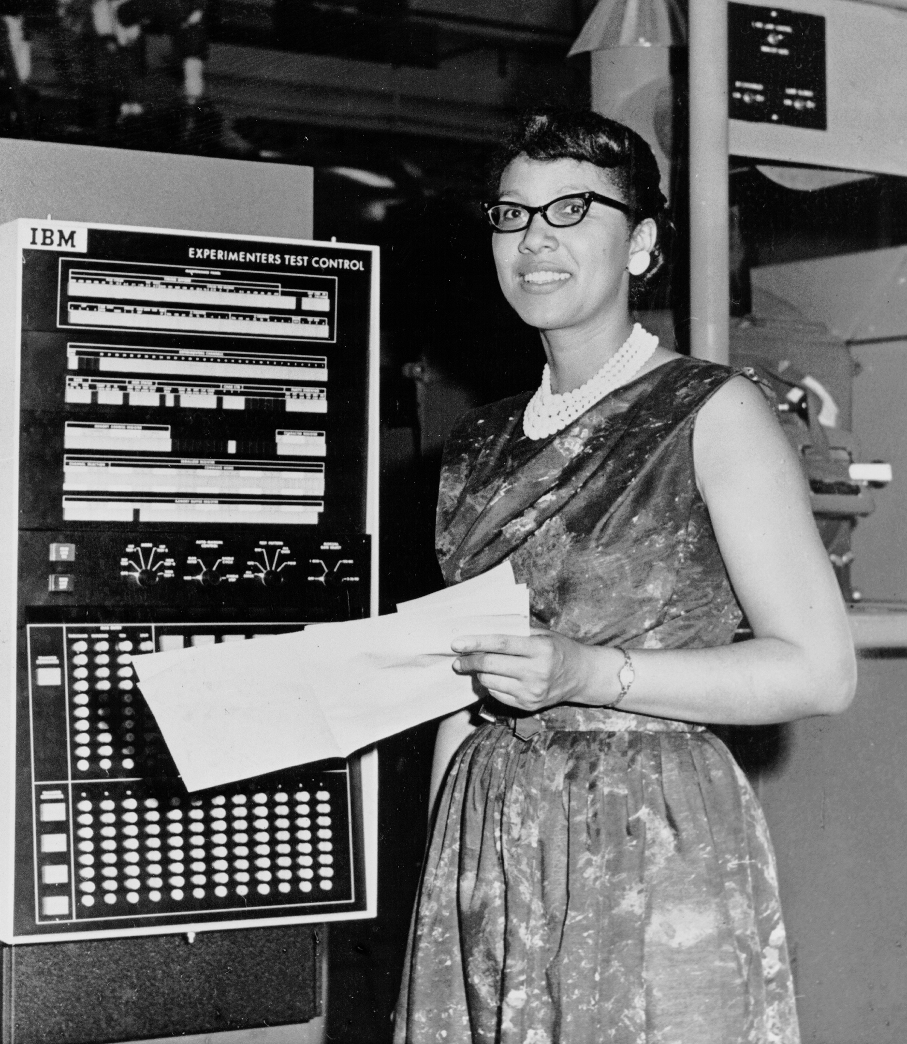
Programs
#include<stdio.h>
int main(int argc,
char ** argv){
printf("Hello
world!\n");
return 0;
}
55
48 89 e5
48 83 ec 20
48 8d 05 25 00 00 00
c7 45 fc 00 00 00 00
89 7d f8
48 89 75 f0
48 89 c7
b0 00
e8 00 00 00 00
31 c9
89 45 ec
89 c8
48 83 c4 20
5d
c3
Notes:
A program is a sequence of instructions that specifies how to perform a computation, in a language that a computer can execute
photo: Dorothy Vaughan, computer at Nasa

Slide 3
Compilation
printf.o
Pre-
processor
(cpp)
Compiler
(cc1)
Assembler
(as)
Linker
(ld)
hello.c
hello.i
hello.s
hello.o
hello
Source
program
(text)
Modified
source
program
(text)
Assembly
program
(text)
Relocatable
object
programs
(binary)
Executable
object
program
(binary)
#include<stdio.h>
int main(int argc,
char ** argv){
printf("Hello
world!\n");
return 0;
}
…
int printf(const char *
restrict,
...) __attribute__((__format__ (__printf__, 1, 2)));
…
int main(int argc,
char ** argv){
printf("Hello
world!\n");
return 0;
}
pushq %rbp
movq %rsp, %rbp
subq $32, %rsp
leaq L_.str(%rip), %rax
movl $0, -4(%rbp)
movl %edi, -8(%rbp)
movq %rsi, -16(%rbp)
movq %rax, %rdi
movb $0, %al
callq _printf
xorl %ecx, %ecx
movl %eax, -20(%rbp)
movl %ecx, %eax
addq $32, %rsp
popq %rbp
retq
55
48 89 e5
48 83 ec 20
48 8d 05 25 00 00 00
c7 45 fc 00 00 00 00
89 7d f8
48 89 75 f0
48 89 c7
b0 00
e8 00 00 00 00
31 c9
89 45 ec
89 c8
48 83 c4 20
5d
c3

Slide 4
gcc Option Summary
Output options
  Default is a.out
  -o <filename>, output goes to the named file
  -c, compile but do not link; output goes to program.o
  -S, assemble only; output goes to program.s
  -E, pre-process only; output goes to program.i
Optimization options (uppercase “Oh,” not zero!)
  -O, –O1, –O2, –O3, -Og, -Os
Debugging option: -g, include symbolic debugging information
Warning option example: -Wall
Library option example: -lm, link with the math library

Slide 5
x86-64 Assembly Language
Evolutionary design, going back to 8086 in 1978
  Basis for original IBM Personal Computer, 16-bits
Intel Pentium 4E (2004): 64 bit instruction set
High-level languages are translated into x86 instructions and then executed on the CPU
  Actual instructions are sequences of bytes
  We give them mnemonic names

Slide 6
Assembly/Machine Code View
Memory
0x7FFF
Central Processing Unit (CPU)
Stack
PC
Registers
Float registers
Heap
Condition
Codes
Addresses
Data
Code
Instructions
0x0000
Programmer-Visible State
  PC: Program counter (%rip)
  Register file: 16 Registers
  Float registers
  Condition codes
    Memory
    Byte addressable array
    Code and user data
    Stack to support procedures

Slide 7
Program Counter
Stores the address of the next instruction to execute
Repeat forever:
  Fetch instruction at address in PC
  Execute the instruction
  Update PC

Slide 8
Assembly Characteristics: Instructions
Transfer data between memory and register
  Load data from memory into register
  Store register data into memory
Perform arithmetic operations on register or memory data
Transfer control
  Conditional branches
  Unconditional jumps to/from procedures

Slide 9
Data Transfer in Assembly

Slide 10
X86-64 Integer Registers
%rax
%r8
(function result)
(fifth argument)
%rbx
%r9
(sixth argument)
%rcx
%r10
(fourth argument)
%rdx
%r11
(third argument)
%rsi
%r12
(second argument)
%rdi
%r13
(first argument)
%rsp
%r14
(stack pointer)
%rbp
%r15

Slide 11
Data Movement Instructions
MOV source, dest Moves data source->dest
dest = source

Slide 12
Operand Forms
Immediate:
  Syntax: $Imm Value: Imm Example: $47
Register:
  Syntax: r Value: R[r] Example: %rbp
Memory (Absolute):
  Syntax: Imm Value: M[Imm] Example: 0x4050
Memory (Indirect):
  Syntax: (r) Value: M[R[r]] Example: (%rbp)
Memory (Base+displacement):
  Syntax: Imm(r) Value: M[Imm+R[r]] Example: -12(%rbp)
Memory (Scaled indexed):
  Syntax: Imm(r1, r2, s) Value: M[Imm+R[r1]+R[r2]*s] Example: 7(%rdx, %rdx, 4)
Notes:
Note: done on board

Slide 13
Exercise 1: Operands
Register | Value
%rax | 0x100
%rcx | 0x01
%rdx | 0x03
Memory Address | Value
0x100 | 0xFF
0x104 | 0xAB
0x108 | 0x13
What are the values of the following operands (assuming register and memory state shown above)?
  %rax
  0x104
  $0x108
  (%rax)
  4(%rax)

Slide 14
Exercise 1: Operands
Register | Value
%rax | 0x100
%rcx | 0x01
%rdx | 0x03
Memory Address | Value
0x100 | 0xFF
0x104 | 0xAB
0x108 | 0x13
What are the values of the following operands (assuming register and memory state shown above)?
  %rax
  0x104
  $0x108
  (%rax)
  4(%rax)
0x100
0xAB
0x108
0xFF
0xAB

Slide 15
mov Operand Combinations
Source
Dest
Src,Dest
C Analog
Reg
mov $0x4,%rax
temp = 4;
Imm
Mem
mov $-147,(%rax)
*p = -147;
Reg
mov %rax,%rdx
temp2 = temp1;
mov
Reg
Mem
mov %rax,(%rdx)
*p = temp;
Mem
Reg
mov (%rax),%rdx
temp = *p;
Cannot do memory-memory transfer with a single instruction

Slide 16
Exercise 2: Moving Data
For each of the following move instructions, write an equivalent C assignment
  mov $0x40604a, %rbx
  mov %rbx, %rax
  mov $47, (%rax)

Slide 17
Exercise 2: Moving Data
For each of the following move instructions, write an equivalent C assignment
  mov $0x40604a, %rbx
  mov %rbx, %rax
  mov $47, (%rax)
x = 0x40604a
y = x
*y = 47

Slide 18
Sizes of C Data Types in x86-64
C declaration | Size (bytes) | Intel data type | Assembly suffix
char | 1 | Byte | b
short | 2 | Word | w
int | 4 | Double word | l
long | 8 | Quad word | q
char * | 8 | Quad word | q
float | 4 | Single precision | s
double | 8 | Double precision | l

Slide 19
Data Movement Instructions
MOV source, dest Move data source->dest
  movb Move 1 byte
  movw Move 2 bytes
  movl Move 4 bytes
  movq Move 8 bytes

Slide 20
X86-64 Integer Registers
%rax
%r8
%ax
%eax
%al
%r8d
%rbx
%r9
%ebx
%r9d
%bx
%bl
%rcx
%r10
%ecx
%r10d
%cx
%cl
%rdx
%r11
%dx
%edx
%dl
%r11d
%rsi
%r12
%esi
%r12d
%si
%sil
%rdi
%r13
%edi
%r13d
%di
%dil
%rsp
%r14
%esp
%r14d
%sp
%bsl
%rbp
%r15
%ebp
%bp
%bpl
%r15d

Slide 21
Exercise 3: Translating Assembly
Write a C function void decode1(long *xp, long *yp) that will do the same thing as the following assembly code:
decode:
movq (%rdi), %rax
movq (%rsi), %rcx
movq %rax, (%rsi)
movq %rcx, (%rdi)
ret
void decode(long *xp, long *yp){
}
Register | Use(s)
%rdi | Argument xp
%rsi | Argument yp

Slide 22
Exercise 3: Translating Assembly
Write a C function void decode1(long *xp, long *yp) that will do the same thing as the following assembly code:
decode:
movq (%rdi), %rax
movq (%rsi), %rcx
movq %rax, (%rsi)
movq %rcx, (%rdi)
ret
void decode(long *xp, long *yp){
long temp1 = *xp;
long temp2 = *yp;
*yp = temp1;
*xp = temp2;
}
Register | Use(s)
%rdi | Argument xp
%rsi | Argument yp

Slide 23
C is close to Machine Language
*dest = t;
C Code
  Store value t where designated by dest
Assembly
  Move 8-byte value to memory
    Quad words in x86-64 parlance
  Operands:
    t: Register %rax
    dest: Register %rbx
    *dest: Memory M[%rbx]
Object Code
  3-byte instruction
  at address 0x40059e
movq %rax, (%rbx)
0x40059e: 48 89 03

Slide 24
Arithmetic in Assembly

Slide 25
Some Arithmetic Operations
Two Operand Instructions:
  Format Computation
    andq Src,Dest Dest = Dest & Src
    orq Src,Dest Dest = Dest | Src
    xorq Src,Dest Dest = Dest ^ Src
    shlq Src,Dest Dest = Dest << Src Also called salq
    shrq Src,Dest Dest = Dest >> Src Logical
    sarq Src,Dest Dest = Dest >> Src Arithmetic
    addq Src,Dest Dest = Dest + Src
    subq Src,Dest Dest = Dest − Src
    imulq Src,Dest Dest = Dest * Src
Suffixes
char | b | 1
short | w | 2
int | l | 4
long | q | 8
pointer | q | 8
Notes:
different signed and unsigned multiply b/c need to set condition bits differently (e.g., overflow for -1*-1 vs 0xFFFF*0xFFFF

Slide 26
Some Arithmetic Operations
One Operand Instructions
    notq Dest Dest = ~Dest
    incq Dest Dest = Dest + 1
    decq Dest Dest = Dest − 1
    negq Dest Dest = − Dest
Suffixes
char | b | 1
short | w | 2
int | l | 4
long | q | 8
pointer | q | 8

Slide 27
Exercise 4: Assembly Operations
Register | Value
%rax | 0x100
%rbx | 0x108
%rdi | 0x01
Address | Value
0x100 | 0x012
0x108 | 0x89a
0x110 | 0x909
addq $0x47, %rax
addq %rbx, %rax
addq (%rbx), %rax
addq %rbx, (%rax)
addq 8(%rax,%rdi,8), %rax
Sum | Location
Notes:
D(rb,ri,S) = D + rb + ri*S

Slide 28
Exercise 4: Assembly Operations
Register | Value
%rax | 0x100
%rbx | 0x108
%rdi | 0x01
Address | Value
0x100 | 0x012
0x108 | 0x89a
0x110 | 0x909
addq $0x47, %rax
addq %rbx, %rax
addq (%rbx), %rax
addq %rbx, (%rax)
addq 8(%rax,%rdi,8), %rax
Sum | Location
0x147 %rax
0x208 %rax
0x99a %rax
0x11a 0x100
0xa09 %rax
Notes:
D(rb,ri,S) = D + rb + ri*S

Slide 29
Example: Translating Assembly
arith:
orq %rsi, %rdi
sarq $3, %rdi
notq %rdi
movq %rdx, %rax
subq %rdi, %rax
ret
long arith(long x, long y, long z){
x = x | y;
x = x >> 3;
x = ~x;
long ret = z - x;
return ret
}
Interesting Instructions
  sarq: arithmetic right shift
Register | Use(s)
%rdi | Argument x
%rsi | Argument y
%rdx | Argument z
%rax | return value

Slide 30
Address Computation Instruction
leaq Source, Dest
  Source is address mode expression
  Set Dest to address denoted by expression
Example: leaq (%rdi,%rdi,2), %rax
Uses
  Computing pointer arithmetic without a memory reference
    E.g., translation of p = &(x[i]);
  Computing arithmetic expressions of the form x + k*y
    k = 1, 2, 4, or 8
Example
p = x+i;
long m12(long x)
{
return x*12;
}
Converted to ASM by compiler:
leaq (%rdi,%rdi,2), %rax # t <- x+x*2
salq $2, %rax # return t<<2
Notes:
Note: need to motivate this move on board before start on this

Slide 31
Exercise 5: Translating Assembly
arith:
leaq (%rdi,%rsi), %rax
addq %rdx, %rax
leaq (%rsi,%rsi,2), %rdx
salq $4, %rdx
leaq 4(%rdi,%rdx), %rcx
imulq %rcx, %rax
ret
long arith(long x, long y,
long z){
}
Interesting Instructions
  leaq: address computation
  salq: shift
  imulq: multiplication
    But, only used once
Register | Use(s)
%rdi | Argument x
%rsi | Argument y
%rdx | Argument z
%rax | return value

Slide 32
Arithmetic Exercise
arith:
leaq (%rdi,%rsi), %rax
addq %rdx, %rax
leaq (%rsi,%rsi,2), %rdx
salq $4, %rdx
leaq 4(%rdi,%rdx), %rcx
imulq %rcx, %rax
ret
long arith(long x, long y,
long z){
long ret = x+y;
ret = ret+z;
z = y * 48;
long temp = x + z + 4;
ret = ret * temp;
return ret;
}
Interesting Instructions
  leaq: address computation
  salq: shift
  imulq: multiplication
    But, only used once
Register | Use(s)
%rdi | Argument x
%rsi | Argument y
%rdx | Argument z
%rax | return value

Slide 33
Exercise 6: Feedback
Rate how well you think this recorded lecture worked
  Better than an in-person class
  About as well as an in-person class
  Less well than an in-person class, but you still learned something
  Total waste of time, you didn't learn anything
How much time did you spend on this video lecture (including time spent on exercises)?
Do you have any comments or feedback?

