Slide 1
Lecture 1: Introduction to Computer Systems
CS 105

Slide 2
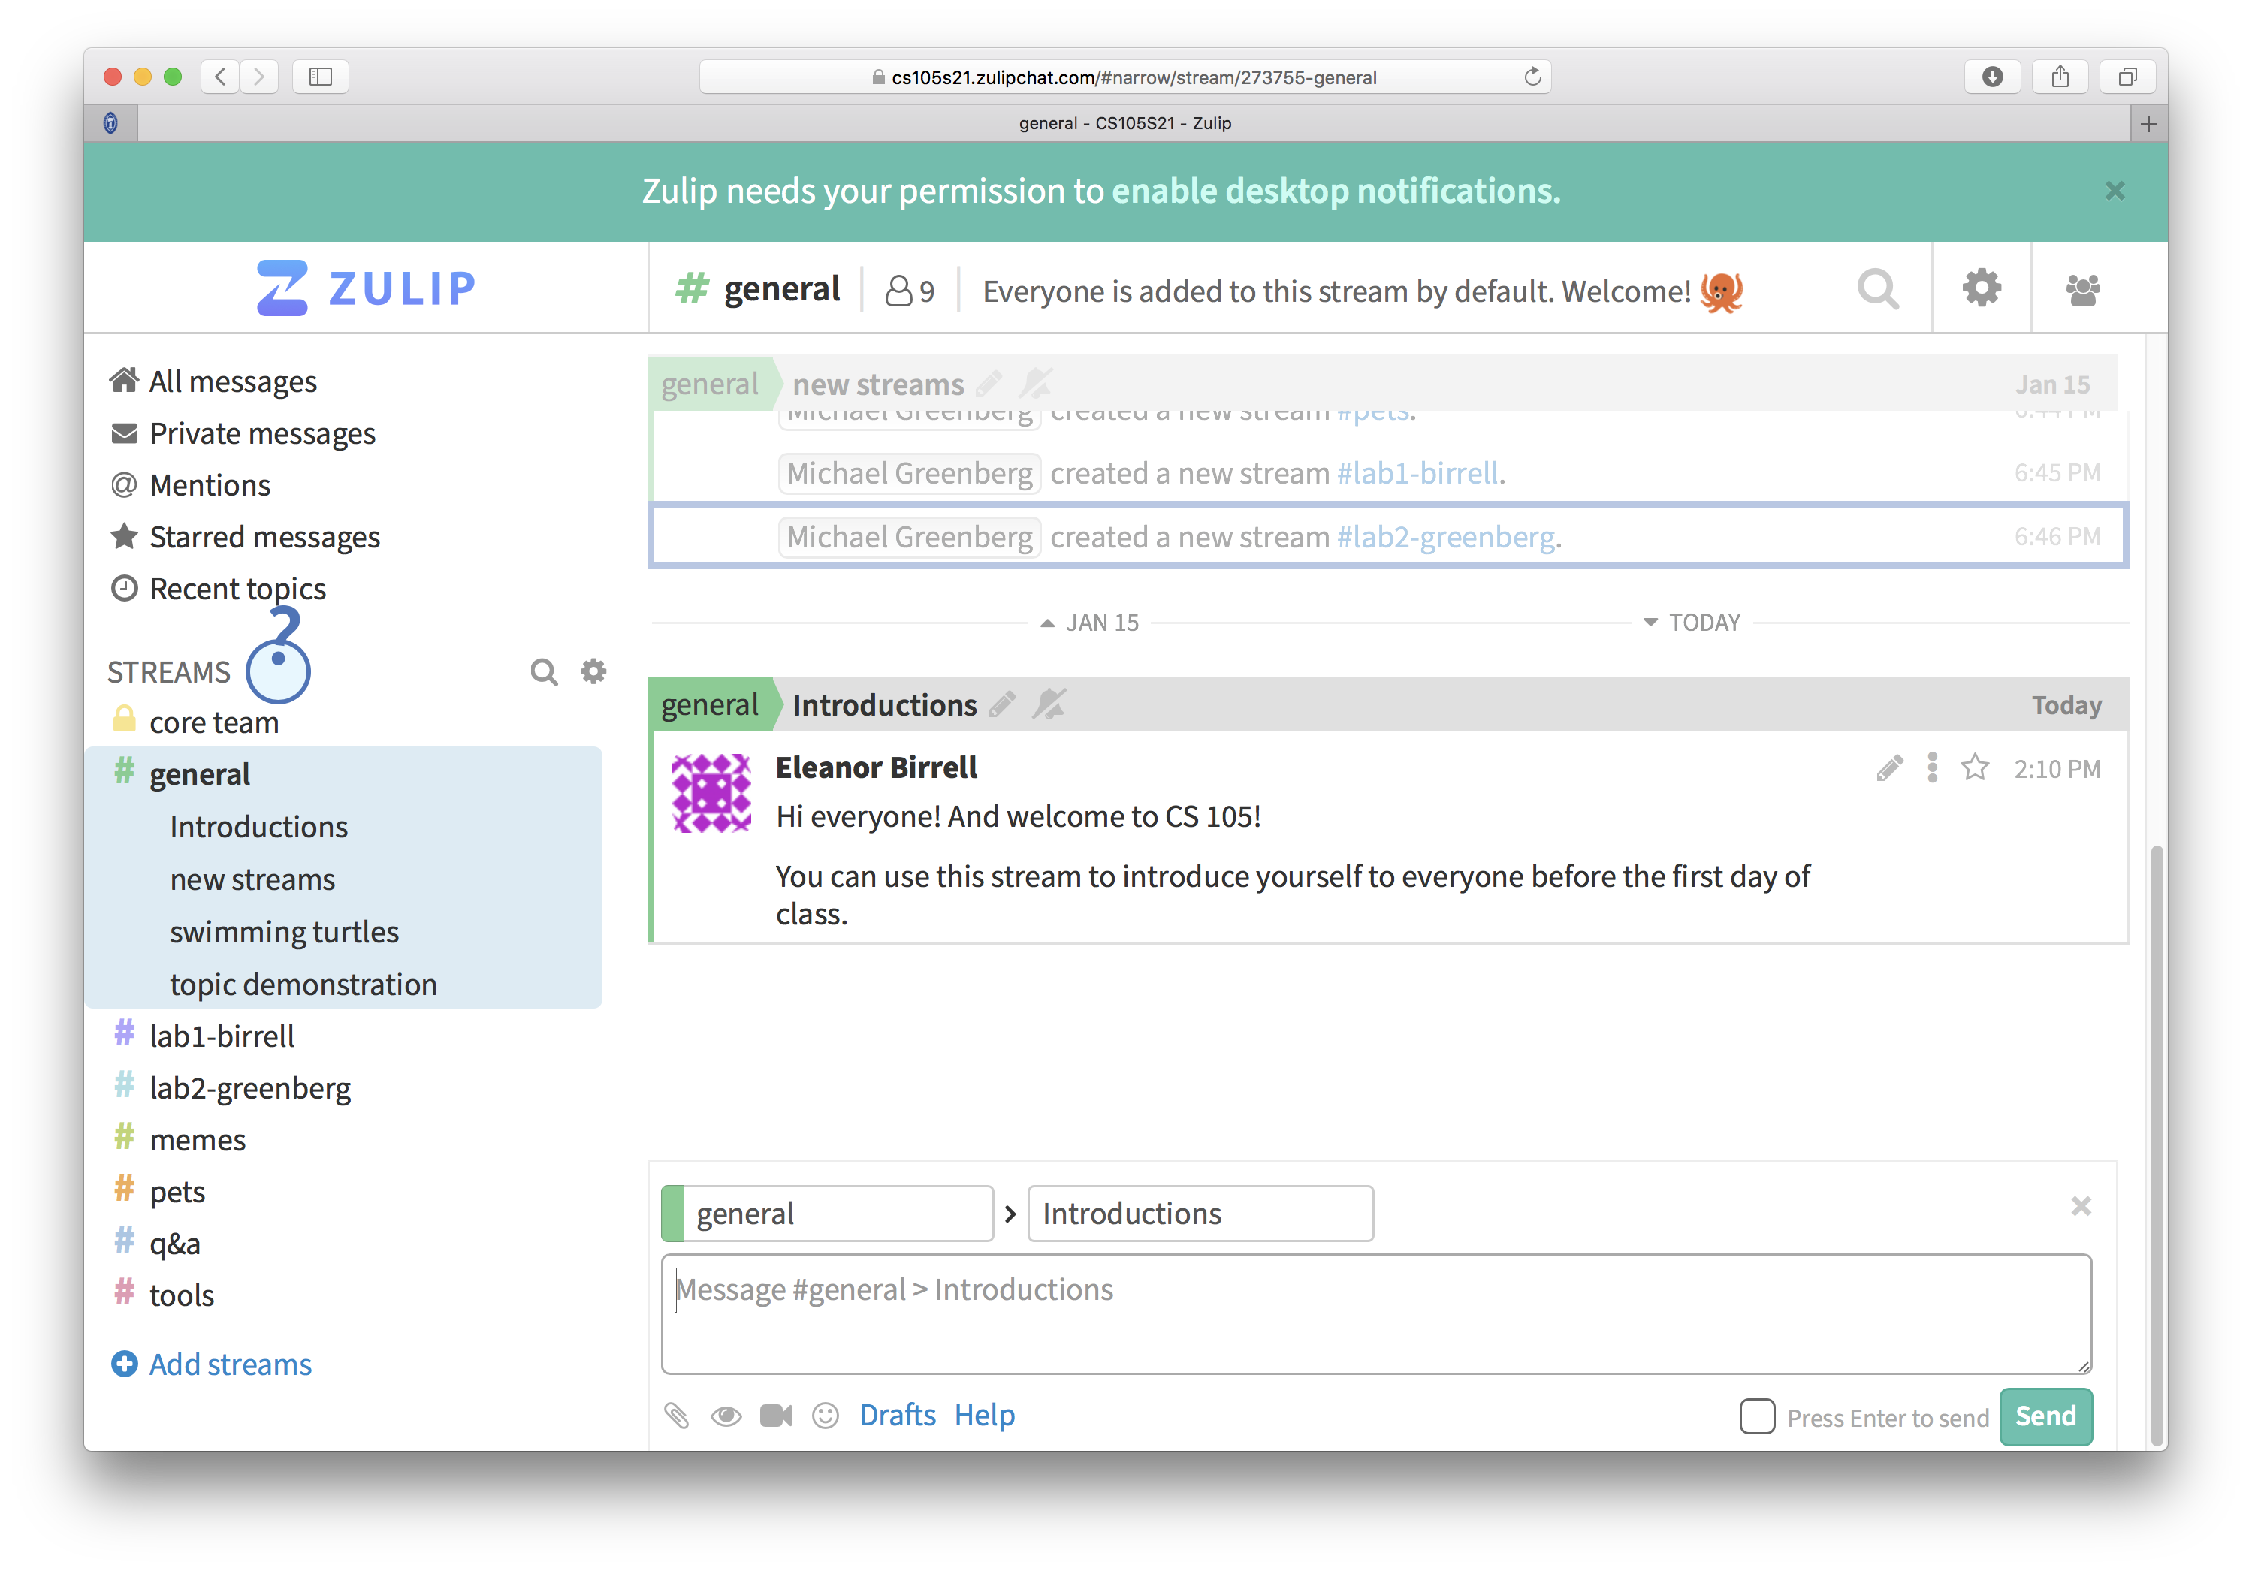
Exercise 0: Introductions
Go onto the CS 105 Zulip (https://cs105s21.zulipchat.com) and introduce yourself
Notice that there is a channel called #q&a. If you have questions while watching the lecture videos, post them there!

Slide 3
Abstraction

Slide 4
Correctness
Example 1: Is x² ≥ 0?
Floats: Yes!
Ints:
40000 * 40000 ➙ 1600000000
50000 * 50000 ➙ ??
Example 2: Is (x + y) + z = x + (y + z)?
Ints: Yes!
Floats:
(2^30 + -2^30) + 3.14 ➙ 3.14
2^30 + (-2^30 + 3.14) ➙ ??
Notes:
Source: xkcd.com/571

Slide 5
Computer Arithmetic
Does not generate random values
Arithmetic operations have important mathematical properties
Cannot assume all “usual” mathematical properties
Due to finiteness of representations
Integer operations satisfy “ring” properties
Commutativity, associativity, distributivity
Floating point operations satisfy “ordering” properties
Monotonicity, values of signs
Observation
Need to understand which abstractions apply in which contexts
Important issues for compiler writers and serious application programmers

Slide 6
Performance
void copyij(int src[2048][2048],
int dst[2048][2048]){
int i,j;
for (i = 0; i < 2048; i++){
for (j = 0; j < 2048; j++){
dst[i][j] = src[i][j];
}
}
}
void copyji(int src[2048][2048],
int dst[2048][2048]){
int i,j;
for (j = 0; j < 2048; j++){
for (i = 0; i < 2048; i++){
dst[i][j] = src[i][j];
}
}
}
4.3ms
81.8ms
Hierarchical memory organization
Performance depends on access patterns
Including how step through multi-dimensional array
Notes:
2.0 GHz Intel Core i7 Haswell

Slide 7
Real-World Performance
Constant factors matter too!
And even exact op count does not predict performance
Easily see 10:1 performance range depending on how code written
Must optimize at multiple levels: algorithm, data representations, procedures, and loops
Must understand system to optimize performance
How programs compiled and executed
How to measure program performance and identify bottlenecks
How to improve performance without destroying code modularity and generality

Slide 8
Security
void admin_stuff(int authenticated){
if(authenticated){
// do admin stuff
}
}
int dontTryThisAtHome(char * user_input, int size) {
char data[size];
int ret = memcpy(*user_input, data);
return ret;
}

Slide 9
Bits
a bit is a binary digit that can have two possible values
can be physically represented with a two state device

Slide 10
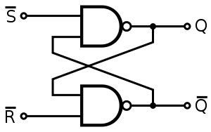
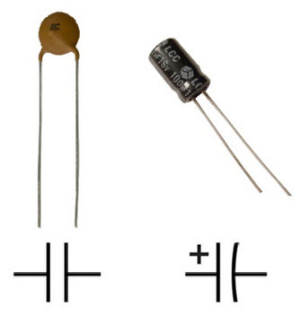
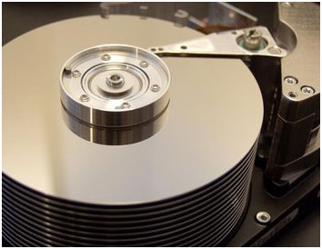
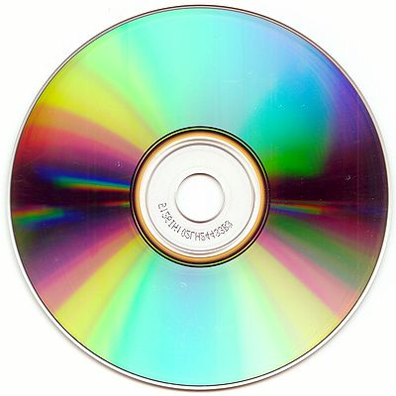
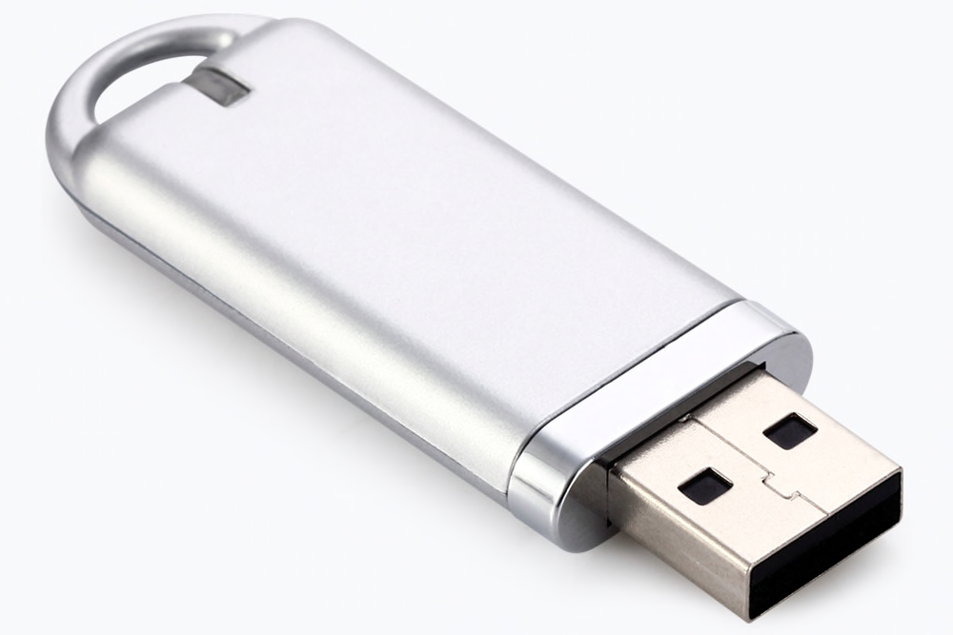
Storing bits
Static random access memory (SRAM): stores each bit of data in a flip-flop, a circuit with two stable states
Dynamic Memory (DRAM): stores each bit of data in a capacitor, which stores energy in an electric field (or not)
Magnetic Disk: regions of the platter are magnetized with either N-S polarity or S-N polarity
Optical Disk: stores bits as tiny indentations (pits) or not (lands) that reflect light differently
Flash Disk: electrons are stored in one of two gates separated by oxide layers

Slide 11
Boolean Algebra
Developed by George Boole in 19th Century
Algebraic representation of logic---encode “True” as 1 and “False” as 0
And
Or
Not
Exclusive-Or (Xor)

Slide 12
Exercise 1: Boolean Operations
Evaluate each of the following expressions
1 | (~1)
~( 1 | 1)
(~1) & 1
~( 1 ^ 1)

Slide 13
Exercise 1: Boolean Operations
Evaluate each of the following expressions
1 | (~1)
~( 1 | 1)
(~1) & 1
~( 1 ^ 1)
= 1 | 0 = 1
= ~1 = 0
= 0 & 1 = 0
= ~0 = 1

Slide 14
Bytes and Memory
bytes
Memory is an array of bits
A byte is a unit of eight bits
An index into the array is an address, location, or pointer
Often expressed in hexadecimal
We speak of the value in memory at an address
The value may be a single byte …
… or a multi-byte quantity starting at that address
00110111
1
1
1
0
1
1
0
3
0
11010001
1
0
0
0
1
0
1
2
1
01010011
1
1
0
0
1
0
1
1
0
01101100
0
0
1
1
0
1
0
1
0

Slide 15
General Boolean algebras
Bitwise operations on bytes
How does this map to set operations?
01101001
& 01010101
01000001
01101001
| 01010101
01111101
01101001
^ 01010101
00111100
~ 01010101
10101010
01000001
01111101
00111100
10101010

Slide 16
Exercise 2 : Bitwise Operations
Assume: a = 01101100, b = 10101010
What are the results of evaluating the following Boolean operations?
~a
~b
a & b
a | b
a ^ b

Slide 17
Exercise 2 : Bitwise Operations
Assume: a = 01101100, b = 10101010
What are the results of evaluating the following Boolean operations?
~a
~b
a & b
a | b
a ^ b
= ~01101100 = 10010011
= ~10101010 = 01010101
= 01101100 & 10101010 = 00101000
= 01101100 | 10101010 = 11101110
= 01101100 ^ 10101010 = 11000110

Slide 18
Bitwise vs Logical Operations in C
Bitwise Operators &, |, ~, ^
View arguments as bit vectors
operations applied bit-wise in parallel
Logical Operators &&, ||, !
View 0 as “False”
View anything nonzero as “True”
Always return 0 or 1
Early termination

Slide 19
Exercise 3: Bitwise vs Logical Operations
~01000001
~00000000
~~01000001
!01000001
!00000000
!!01000001
01101001 & 01010101
01101001 | 01010101
01101001 && 01010101
01101001 || 01010101
Notes:
0xBE, 0xFF, 0x41
0x41, 0x7D
0x00, 0x01, 0x01
0x01, 0x01

Slide 20
Exercise 3: Bitwise vs Logical Operations
~01000001
~00000000
~~01000001
!01000001
!00000000
!!01000001
01101001 & 01010101
01101001 | 01010101
01101001 && 01010101
01101001 || 01010101
10111110
11111111
01000001
00000000
00000001
00000001
01000001
01111101
00000001
00000001
Notes:
0xBE, 0xFF, 0x41
0x41, 0x7D
0x00, 0x01, 0x01
0x01, 0x01

Slide 21
Bit Shifting
Left Shift: x << y
Shift bit-vector x left y positions
Throw away extra bits on left
Fill with 0’s on right
Right Shift: x >> y
Shift bit-vector x right y positions
Throw away extra bits on right
Logical shift: Fill with 0’s on left
Arithmetic shift: Replicate most significant bit on left
Undefined Behavior if you shift amount < 0 or ≥ word size
Choice between logical and arithmetic depends on the type of data

Slide 22
Example: Bit Shifting
01101001 << 4
01101001 >>_{l} 2
01101001 >>_{a} 4
10010000
00011010
00000110
Notes:
Note: Shift demo

Slide 23
Exercise 4: Bit Shifting
10101010 << 4
10101010 >>_{l} 4
10101010 >>_{a} 4
10100000
00001010
11111010
Notes:
Note: Shift demo

Slide 24
Bits and Bytes Require Interpretation
00000000 00110101 00110000 00110001
might be interpreted as
The integer 3,485,745₁₀
A floating point number close to 4.884569 x 10⁻³⁹
The string “105”
A portion of an image or video
An address in memory

Slide 25
Information is Bits + Context

Slide 26
Exercise 5: Feedback
Rate how well you think this recorded lecture worked
Better than an in-person class
About as well as an in-person class
Less well than an in-person class, but you still learned something
Total waste of time, you didn't learn anything
How much time did you spend on this video lecture (including time spent on exercises)?
Are there any particular questions that you would like me to address in this week’s problem session?
Do you have any other comments or feedback?

