Slide 1
Introduction to Machine Learning
David Kauchak CS 51A – Spring 2019

Slide 2
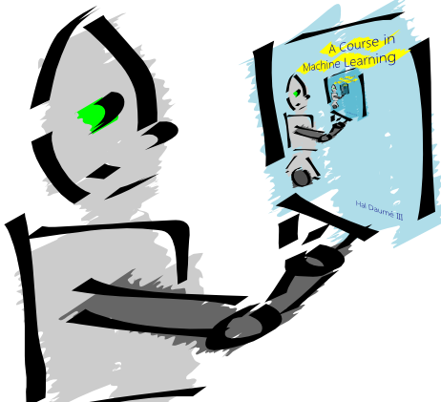
Machine Learning is…
Machine learning is about predicting the future based on the past.
-- Hal Daume III

Slide 3
Machine Learning is…
Machine learning is about predicting the future based on the past.
-- Hal Daume III
past
future
predict
learn
Training
Data
model/
predictor
Testing
Data
model/
predictor

Slide 4
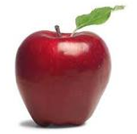
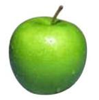
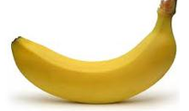
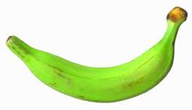
Data
examples
Data

Slide 5
Data
examples
Data

Slide 6
Data
examples
Data

Slide 7
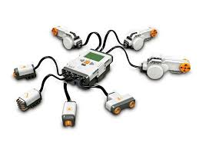
Data
examples
Data

Slide 8
Supervised learning
examples
label
label₁
label₃
labeled examples
label₄
label₅
Supervised learning: given labeled examples

Slide 9
Supervised learning
label
label₁
model/
predictor
label₃
label₄
label₅
Supervised learning: given labeled examples

Slide 10
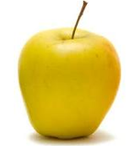
Supervised learning
model/
predictor
predicted label
Supervised learning: learn to predict new example

Slide 11
Supervised learning: classification
label
apple
Classification: a finite set of labels
apple
banana
banana
Supervised learning: given labeled examples

Slide 12
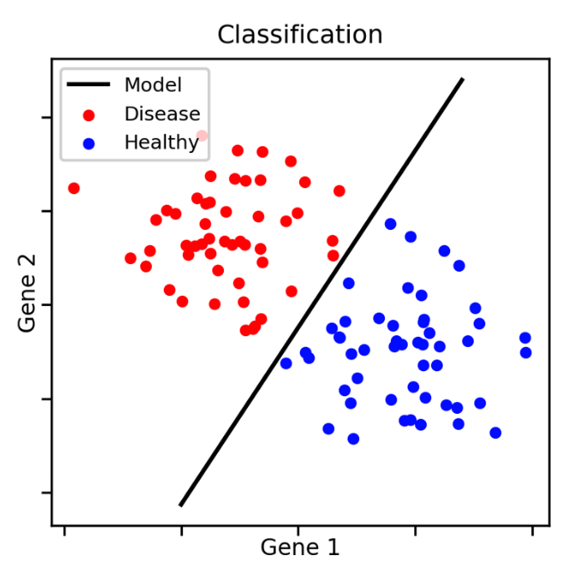
Classification Example

Slide 13
Classification Applications
Face recognition
Character recognition
Spam detection
Medical diagnosis: From symptoms to illnesses
Biometrics: Recognition/authentication using physical and/or behavioral characteristics: Face, iris, signature, etc
...

Slide 14
Supervised learning: regression
label
-4.5
Regression: label is real-valued
10.1
3.2
4.3
Supervised learning: given labeled examples

Slide 15
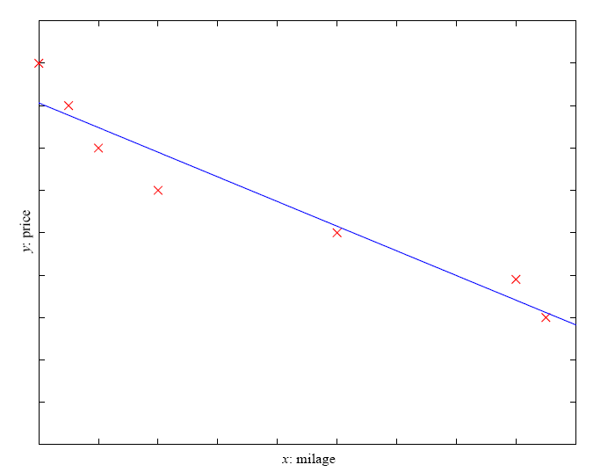
Regression Example
Price of a used car
x : car attributes (e.g. mileage)
y : price

Slide 16
Regression Applications
Economics/Finance: predict the value of a stock
Epidemiology
Car/plane navigation: angle of the steering wheel, acceleration, …
Temporal trends: weather over time
…

Slide 17
Supervised learning: ranking
label
1
Ranking: label is a ranking
4
2
3
Supervised learning: given labeled examples

Slide 18
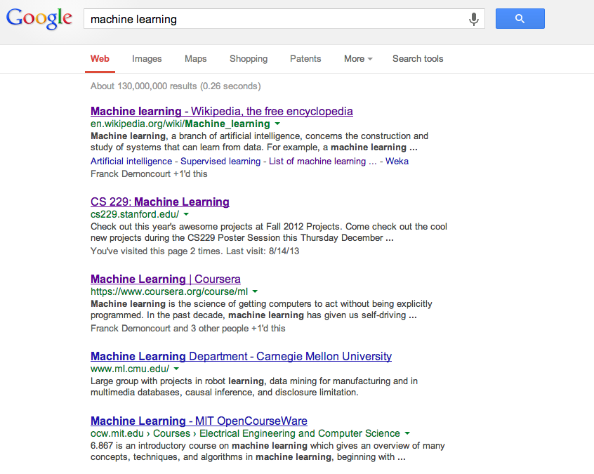
Ranking example
Given a query and
a set of web pages,
rank them according
to relevance

Slide 19
Ranking Applications
User preference, e.g. Netflix “My List” -- movie queue ranking
iTunes
flight search (search in general)
reranking N-best output lists
…

Slide 20
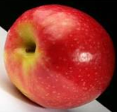
Unsupervised learning
Unupervised learning: given data, i.e. examples, but no labels

Slide 21
Unsupervised learning applications
learn clusters/groups without any label
customer segmentation (i.e. grouping)
image compression
bioinformatics: learn motifs
…

Slide 22
Reinforcement learning
left, right, straight, left, left, left, straight
GOOD
left, straight, straight, left, right, straight, straight
BAD
left, right, straight, left, left, left, straight
18.5
left, straight, straight, left, right, straight, straight
-3
Given a sequence of examples/states and a reward after completing that sequence, learn to predict the action to take in for an individual example/state

Slide 23
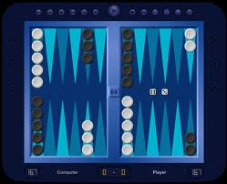
Reinforcement learning example
Backgammon
…
WIN!
…
LOSE!
Given sequences of moves and whether or not the player won at the end, learn to make good moves

Slide 24
Other learning variations
What data is available:
Supervised, unsupervised, reinforcement learning
semi-supervised, active learning, …
How are we getting the data:
online vs. offline learning
Type of model:
generative vs. discriminative
parametric vs. non-parametric

Slide 25
Representing examples
examples
What is an example?
How is it represented?

Slide 26
Features
examples
features
How our algorithms actually “view” the data
Features are the questions we can ask about the examples
f₁, f₂, f₃, …, f_{n}
f₁, f₂, f₃, …, f_{n}
f₁, f₂, f₃, …, f_{n}
f₁, f₂, f₃, …, f_{n}

Slide 27
Features
examples
features
How our algorithms actually “view” the data
Features are the questions we can ask about the examples
red, round, leaf, 3oz, …
green, round, no leaf, 4oz, …
yellow, curved, no leaf, 8oz, …
green, curved, no leaf, 7oz, …

Slide 28
Classification revisited
examples
label
red, round, leaf, 3oz, …
apple
learn
green, round, no leaf, 4oz, …
apple
model/
classifier
yellow, curved, no leaf, 8oz, …
banana
green, curved, no leaf, 7oz, …
banana
During learning/training/induction, learn a model of what distinguishes apples and bananas based on the features
Notes:
This is the problem we’ll focus on for this class

Slide 29
Classification revisited
predict
Apple or banana?
model/
classifier
red, round, no leaf, 4oz, …
The model can then classify a new example based on the features

Slide 30
Classification revisited
predict
model/
classifier
Apple
red, round, no leaf, 4oz, …
Why?
The model can then classify a new example based on the features

Slide 31
Classification revisited
Training data
Test set
examples
label
red, round, leaf, 3oz, …
apple
?
green, round, no leaf, 4oz, …
apple
red, round, no leaf, 4oz, …
yellow, curved, no leaf, 4oz, …
banana
green, curved, no leaf, 5oz, …
banana

Slide 32
Classification revisited
Training data
Test set
examples
label
red, round, leaf, 3oz, …
apple
?
green, round, no leaf, 4oz, …
apple
red, round, no leaf, 4oz, …
yellow, curved, no leaf, 4oz, …
banana
Learning is about generalizing from the training data
green, curved, no leaf, 5oz, …
banana

Slide 33
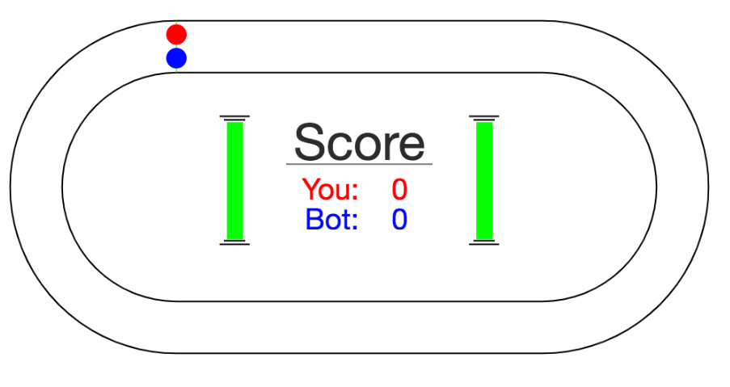
A simple machine learning example
http://www.mindreaderpro.appspot.com/

Slide 34
models
model/
classifier
We have many, many different options for the model
They have different characteristics and perform differently (accuracy, speed, etc.)

Slide 35
Probabilistic modeling
train
probabilistic model:
p(example)
Model the data with a probabilistic model which tells us how likely a given data example is
training data

Slide 36
Probabilistic models
Example to label
probabilistic model:
p(example)
apple
or
banana
yellow, curved, no leaf, 6oz
features

Slide 37
Probabilistic models
For each label, ask for the probability
yellow, curved, no leaf, 6oz, banana
probabilistic model:
p(example)
yellow, curved, no leaf, 6oz, apple
features
label

Slide 38
Probabilistic models
Pick the label with the highest probability
yellow, curved, no leaf, 6oz, banana
probabilistic model:
p(example)
0.004
0.00002
yellow, curved, no leaf, 6oz, apple
features
label

Slide 39
Probability basics
A probability distribution gives the probabilities of all possible values of an event
For example, say we flip a coin three times. We can define the probability of the number of time the coin came up heads.
P(num heads)
P(3) = ?
P(2) = ?
P(1) = ?
P(0) = ?

Slide 40
Probability distributions
What are the possible outcomes of three flips (hint, there are eight of them)?
T T T
T T H
T H T
T H H
H T T
H T H
H H T
H H H

Slide 41
Probability distributions
Assuming the coin is fair, what are our probabilities?
number of times it happens
probability =
total number of cases
T T T
T T H
T H T
T H H
H T T
H T H
H H T
H H H
P(num heads)
P(3) = ?
P(2) = ?
P(1) = ?
P(0) = ?

Slide 42
Probability distributions
Assuming the coin is fair, what are our probabilities?
number of times it happens
probability =
total number of cases
T T T
T T H
T H T
T H H
H T T
H T H
H H T
H H H
P(num heads)
P(3) = ?
P(2) = ?
P(1) = ?
P(0) = ?

Slide 43
Probability distributions
Assuming the coin is fair, what are our probabilities?
number of times it happens
probability =
total number of cases
T T T
T T H
T H T
T H H
H T T
H T H
H H T
H H H
P(num heads)
P(3) = 1/8
P(2) = ?
P(1) = ?
P(0) = ?

Slide 44
Probability distributions
Assuming the coin is fair, what are our probabilities?
number of times it happens
probability =
total number of cases
T T T
T T H
T H T
T H H
H T T
H T H
H H T
H H H
P(num heads)
P(3) = 1/8
P(2) = ?
P(1) = ?
P(0) = ?

Slide 45
Probability distributions
Assuming the coin is fair, what are our probabilities?
number of times it happens
probability =
total number of cases
T T T
T T H
T H T
T H H
H T T
H T H
H H T
H H H
P(num heads)
P(3) = 1/8
P(2) = 3/8
P(1) = ?
P(0) = ?

Slide 46
Probability distributions
Assuming the coin is fair, what are our probabilities?
number of times it happens
probability =
total number of cases
T T T
T T H
T H T
T H H
H T T
H T H
H H T
H H H
P(num heads)
P(3) = 1/8
P(2) = 3/8
P(1) = 3/8
P(0) = 1/8

Slide 47
Probability distribution
A probability distribution assigns probability values to all possible values
Probabilities are between 0 and 1, inclusive
The sum of all probabilities in a distribution must be 1
P(num heads)
P(3) = 1/8
P(2) = 3/8
P(1) = 3/8
P(0) = 1/8

Slide 48
Probability distribution
A probability distribution assigns probability values to all possible values
Probabilities are between 0 and 1, inclusive
The sum of all probabilities in a distribution must be 1
P
P(3) = 1/2
P(2) = 1/2
P(1) = 1/2
P(0) = 1/2
P
P(3) = -1
P(2) = 2
P(1) = 0
P(0) = 0

Slide 49
Some example probability distributions
probability of heads
(distribution options: heads, tails)
probability of passing class
(distribution options: pass, fail)
probability of rain today
(distribution options: rain or no rain)
probability of getting an ‘A’
(distribution options: A, B, C, D, F)

Slide 50
Conditional probability distributions
Sometimes we may know extra information about the world that may change our probability distribution
P(X|Y) captures this (read “probability of X given Y”)
Given some information (Y) what does our probability distribution look like
Note that this is still just a normal probability distribution

Slide 51
Conditional probability example
P(pass 51a)
P(pass) = 0.9
P(not pass) = 0.1
Unconditional probability distribution

Slide 52
Conditional probability example
P(pass 51a | don’t study)
P(pass) = 0.5
P(not pass) = 0.5
Still probability distributions over passing 51A
P(pass 51a)
P(pass) = 0.9
P(not pass) = 0.1
P(pass 51a | do study)
P(pass) = 0.95
P(not pass) = 0.05
Conditional probability distributions

Slide 53
Conditional probability example
P(rain in LA)
P(rain) = 0.05
P(no rain) = 0.95
Unconditional probability distribution

Slide 54
Conditional probability example
P(rain in LA| January )
P(rain) = 0.2
P(no rain) = 0.8
Still probability distributions over passing rain in LA
P(rain in LA)
P(rain) = 0.05
P(no rain) = 0.95
P(rain in LA| not January )
P(pass) = 0.03
P(not pass) = 0.97
Conditional probability distributions

Slide 55
Joint distribution
Probability over two events: P(X,Y)
Has probabilities for all possible combinations over the two events
51Pass, EngPass | P(51Pass, EngPass)
true, true | .88
true, false | .01
false, true | .04
false, false | .07

Slide 56
Joint distribution
Still a probability distribution
All questions/probabilities that we might want to ask about these two things can be calculated from the joing distribution
51Pass, EngPass | P(51Pass, EngPass)
true, true | .88
true, false | .01
false, true | .04
false, false | .07
What is P(51pass = true)?

Slide 57
Joint distribution
51Pass, EngPass | P(51Pass, EngPass)
true, true | .88
true, false | .01
false, true | .04
false, false | .07
There are two ways that a person can pass 51:
they can do it while passing or not passing English
P(51Pass=true) = P(true, true) + P(true, false) = 0.89

Slide 58
Relationship between distributions
$$P\left(X,Y\right)=P\left(Y\right)∗P(X|Y)$$
joint distribution
conditional distribution
unconditional distribution
Can think of it as describing the two events happening in two steps:
The likelihood of X and Y happening:
How likely it is that Y happened?
Given that Y happened, how likely is it that X happened?
Notes:
Called the chain rule

Slide 59
Relationship between distributions
$$P\left(51Pass, EngPass\right)=P\left(EngPass\right)∗P(51Pass|EngPass)$$
The probability of passing CS51 and English is:
Probability of passing English *
Probability of passing CS51 given that you passed English
Notes:
Called the chain rule

Slide 60
Relationship between distributions
$$P\left(51Pass, EngPass\right)=P\left(51Pass\right)∗P(EngPass|51Pass)$$
The probability of passing CS51 and English is:
Probability of passing CS51 *
Probability of passing English given that you passed CS51
Can also view it with the other event happening first
Notes:
Called the chain rule

