Slide 1
mastermind Implemented
David Kauchak
CS52 – Spring 2017

Slide 2
Admin
Assignment 7
CS lunch today in Frank Blue Room

Slide 3
Miscellaneous SML

Slide 4
Assignment 3 revisited
new type equivalence: code -> code -> int

Slide 5
Assignment 3 revisited
new type equivalence: code -> int list

Slide 6
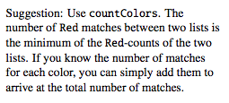
Assignment 3 revisited
new type equivalence: code -> code -> int

Slide 7
Assignment 3 revisited
new type equivalence: code -> code -> int

Slide 8
Assignment 3 revisited
new type equivalence: code -> code -> response

Slide 9
Assignment 3 revisited
new type equivalence: code -> response -> code -> bool

Slide 10
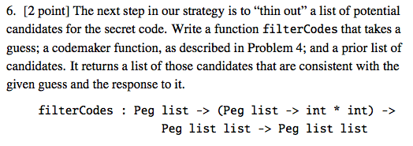
Assignment 3 revisited
new type equivalence: code -> codemaker -> code list -> code list

