Slide 1
Circuits
David Kauchak CS 52 – Spring 2017

Slide 2
Admin
Assignment 5
Assignment 6 out soon!
Survey

Slide 3
Examples
The Logisim circuit examples can be found at:
http://www.cs.pomona.edu/~dkauchak/classes/cs52/examples/logisim/

Slide 4
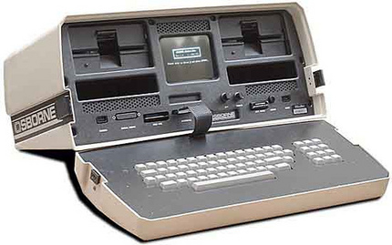
Diving into your computer

Slide 5
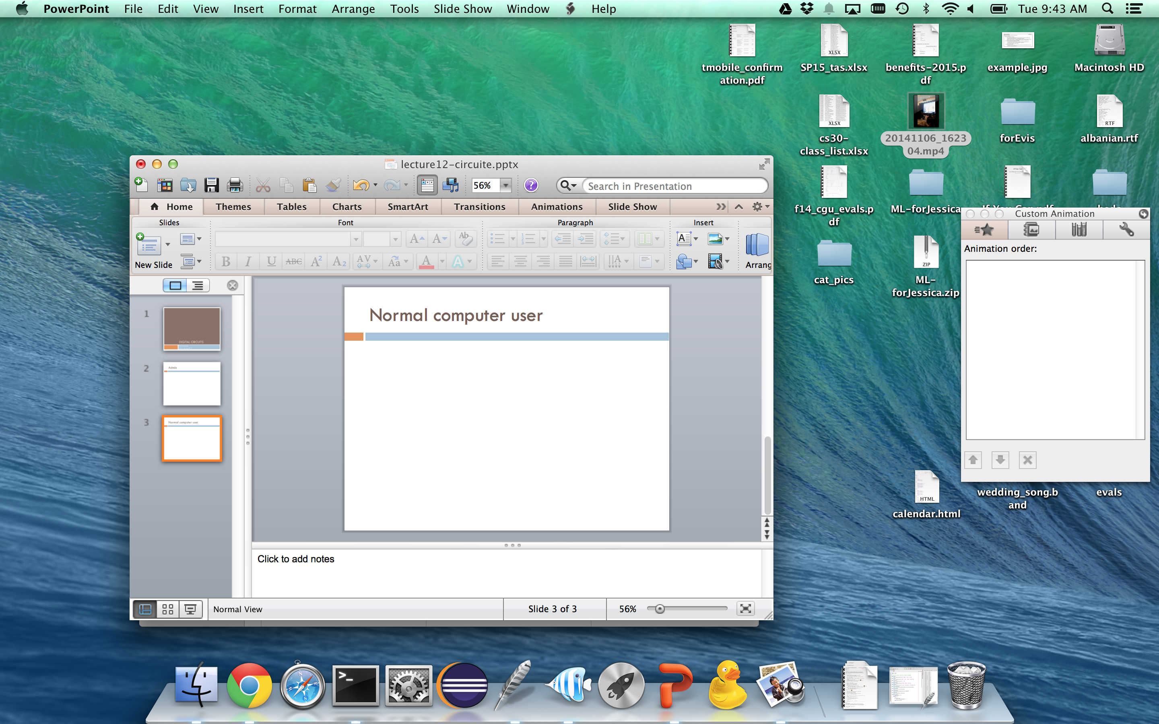
Normal computer user

Slide 6
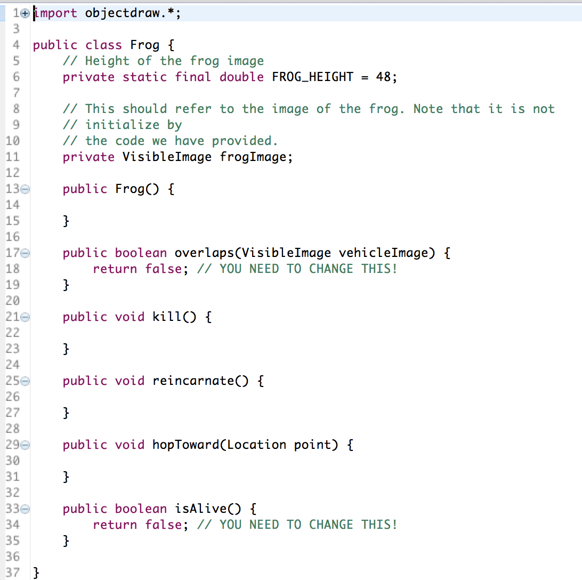
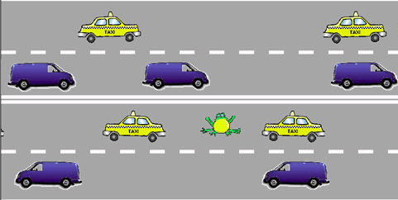
After intro CS

Slide 7
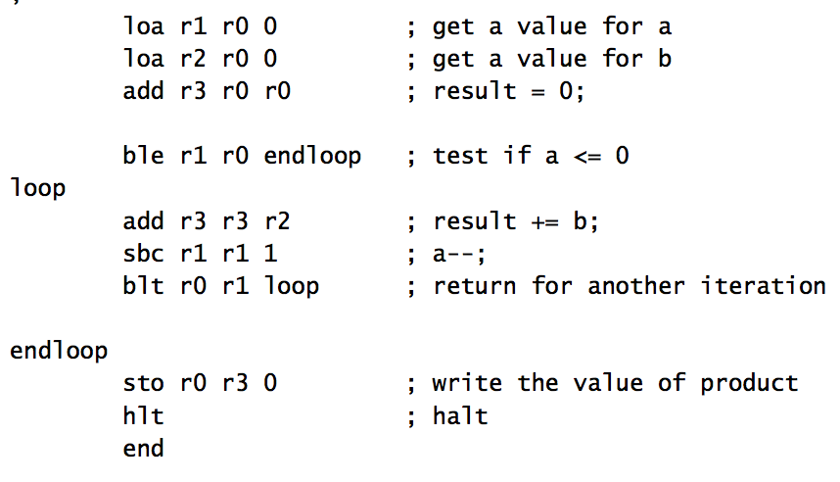
After 5 weeks of cs52

Slide 8
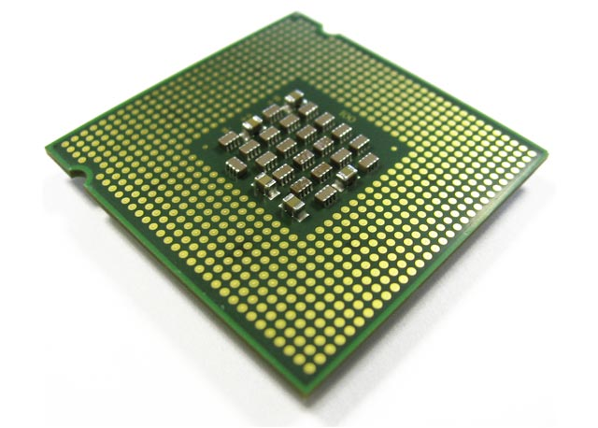
What now?

Slide 9
Quick recap
01010
01111
+

Slide 10
Quick recap
1
1
1
0
01010
01111
+
11001

Slide 11
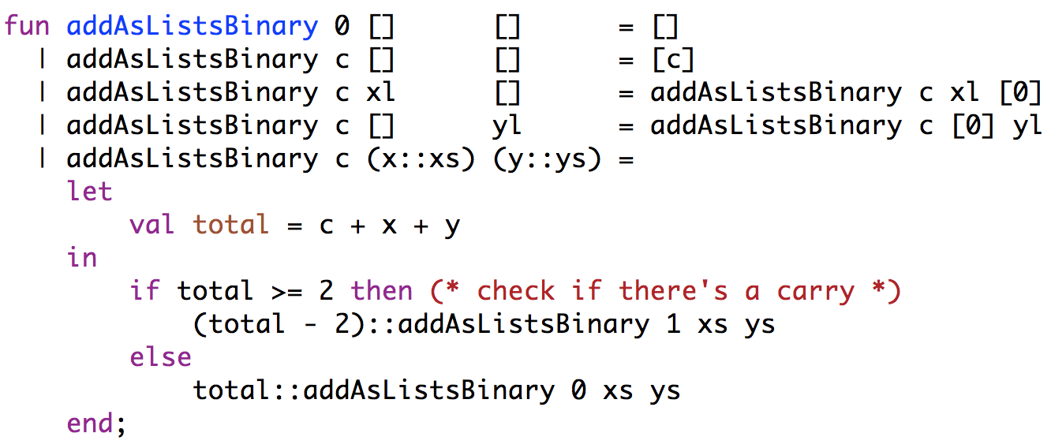
SML: Binary addition

Slide 12
SML: Binary addition
1
1
1
0
01010
01111
+
11001
handle a digit at a time

Slide 13
SML: Binary addition
1
1
1
0
01010
01111
+
11001
generate two pieces of information
output bit
carry bit

Slide 14
A recursive component
1
1
1
0
01010
01111
+
11001
in1
in2
carry-in
carry-out
out

Slide 15
Adding with components
01010
01111
+
1
1
0
1
1
1
0
1
in1
in2
carry-in
in1
in2
carry-in
in1
in2
carry-in
in1
in2
carry-out
carry-out
carry-out
carry-out
out
out
out
out

Slide 16
Adding with components
01010
01111
+
1
1
0
1
1
1
0
1
in1
in2
carry-in
in1
in2
carry-in
in1
in2
carry-in
in1
in2
?
carry-out
carry-out
carry-out
carry-out
out
out
out
out
?

Slide 17
Adding with components
0
01010
01111
+
1
1
1
0
1
1
1
0
0
1
in1
in2
carry-in
in1
in2
carry-in
in1
in2
carry-in
in1
in2
?
carry-out
carry-out
carry-out
carry-out
out
out
out
out
?
1

Slide 18
Adding with components
1
0
01010
01111
+
0
1
1
1
0
1
1
1
1
0
0
1
in1
in2
carry-in
in1
in2
carry-in
in1
in2
carry-in
in1
in2
?
carry-out
carry-out
carry-out
carry-out
out
out
out
out
0
1
?

Slide 19
Adding with components
1
1
0
01010
01111
+
0
0
1
1
1
1
0
1
1
1
1
0
0
1
?
in1
in2
carry-in
in1
in2
carry-in
in1
in2
carry-in
in1
in2
carry-out
carry-out
carry-out
carry-out
out
out
out
out
?
0
0
1

Slide 20
Adding with components
1
1
1
0
01010
01111
+
1
1
0
0
1
1
1
1
0
1
1
1
1
0
0
1
1
in1
in2
carry-in
in1
in2
carry-in
in1
in2
carry-in
in1
in2
carry-out
carry-out
carry-out
carry-out
out
out
out
out
1
0
0
1

Slide 21
Implementing the component
in1
in2
carry-in
carry-out
out
What goes on inside the component?

Slide 22
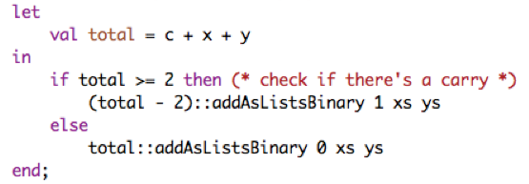
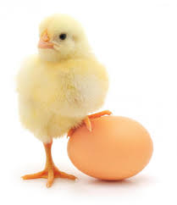
Implementing the component
in1
in2
carry-in
carry-out
out
Current implementation uses addition!

Slide 23
Implementing the component
in1 | in2 | carry-in | out | carry-out
0 | 0 | 0
0 | 0 | 1
0 | 1 | 0
0 | 1 | 1
1 | 0 | 0
1 | 0 | 1
1 | 1 | 0
1 | 1 | 1
in1
in2
carry-in
carry-out
out
What are the outputs?

Slide 24
Implementing the component
in1 | in2 | carry-in | out | carry-out
0 | 0 | 0 | 0 | 0
0 | 0 | 1 | 1 | 0
0 | 1 | 0 | 1 | 0
0 | 1 | 1 | 0 | 1
1 | 0 | 0 | 1 | 0
1 | 0 | 1 | 0 | 1
1 | 1 | 0 | 0 | 1
1 | 1 | 1 | 1 | 1
in1
in2
carry-in
carry-out
out

Slide 25
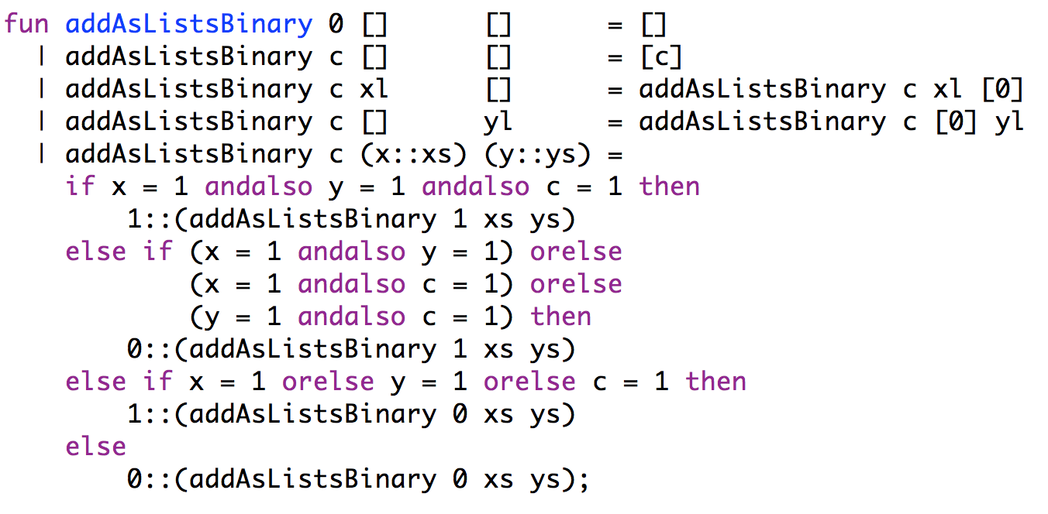
Another implementation
Don’t use addition anymore
Translated the problem into a boolean logic problem

Slide 26
What are some boolean operators?
A | B | A and B | A or B | not A
0 | 0 | 0 | 0 | 1
0 | 1 | 0 | 1 | 1
1 | 0 | 0 | 1 | 0
1 | 1 | 1 | 1 | 0

Slide 27
What are some boolean operators?
A | B | A and B | A or B | not A | A nand B | A nor B | A xor B
0 | 0 | 0 | 0 | 1 | 1 | 1 | 0
0 | 1 | 0 | 1 | 1 | 1 | 0 | 1
1 | 0 | 0 | 1 | 0 | 1 | 0 | 1
1 | 1 | 1 | 1 | 0 | 0 | 0 | 0

Slide 28
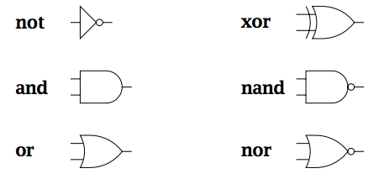
Gates
Gates have inputs and outputs
values are 0 or 1
They are hardware components!

Slide 29
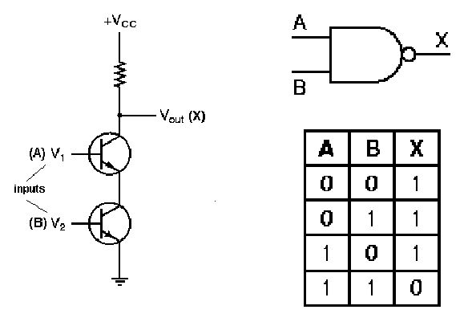
Gates as hardware

Slide 30
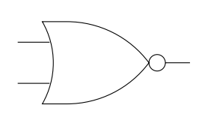
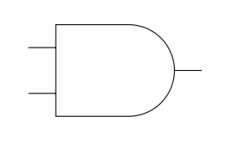
Utilizing gates
A | B | A and B | A or B | not A | A nand B | A nor B | A xor B
0 | 0 | 0 | 0 | 1 | 1 | 1 | 0
0 | 1 | 0 | 1 | 1 | 1 | 0 | 1
1 | 0 | 0 | 1 | 0 | 1 | 0 | 1
1 | 1 | 1 | 1 | 0 | 0 | 0 | 0
1
0
?
0

Slide 31
Utilizing gates
A | B | A and B | A or B | not A | A nand B | A nor B | A xor B
0 | 0 | 0 | 0 | 1 | 1 | 1 | 0
0 | 1 | 0 | 1 | 1 | 1 | 0 | 1
1 | 0 | 0 | 1 | 0 | 1 | 0 | 1
1 | 1 | 1 | 1 | 0 | 0 | 0 | 0
0
1
0
0
0

Slide 32
Utilizing gates
A | B | A and B | A or B | not A | A nand B | A nor B | A xor B
0 | 0 | 0 | 0 | 1 | 1 | 1 | 0
0 | 1 | 0 | 1 | 1 | 1 | 0 | 1
1 | 0 | 0 | 1 | 0 | 1 | 0 | 1
1 | 1 | 1 | 1 | 0 | 0 | 0 | 0
1
1
?
1

Slide 33
Utilizing gates
A | B | A and B | A or B | not A | A nand B | A nor B | A xor B
0 | 0 | 0 | 0 | 1 | 1 | 1 | 0
0 | 1 | 0 | 1 | 1 | 1 | 0 | 1
1 | 0 | 0 | 1 | 0 | 1 | 0 | 1
1 | 1 | 1 | 1 | 0 | 0 | 0 | 0
0
1
1
0
1
When is this circuit 1?

Slide 34
Utilizing gates
in1 | in2 | in3 | OUT
0 | 0 | 0 | 0
0 | 0 | 1 | 1
0 | 1 | 0 | 0
0 | 1 | 1 | 0
1 | 0 | 0 | 0
1 | 0 | 1 | 0
1 | 1 | 0 | 0
1 | 1 | 1 | 0
1
1
1
Notes:
nor is only true with inputs 0, 0
and gate will therefore only be true when in1 and in2 are both 0 and in3 is 1

Slide 35
Designing more interesting circuits
A | B | A and B | A or B | not A | A nand B | A nor B | A xor B
0 | 0 | 0 | 0 | 1 | 1 | 1 | 0
0 | 1 | 0 | 1 | 1 | 1 | 0 | 1
1 | 0 | 0 | 1 | 0 | 1 | 0 | 1
1 | 1 | 1 | 1 | 0 | 0 | 0 | 0
in1 | in2 | in3 | OUT
0 | 0 | 0 | 0
0 | 0 | 1 | 1
0 | 1 | 0 | 1
0 | 1 | 1 | 1
1 | 0 | 0 | 1
1 | 0 | 1 | 1
1 | 1 | 0 | 1
1 | 1 | 1 | 1
Design a circuit for this

Slide 36
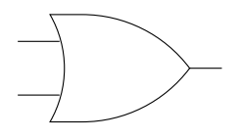
Designing more interesting circuits
in1 | in2 | in3 | OUT
0 | 0 | 0 | 0
0 | 0 | 1 | 1
0 | 1 | 0 | 1
0 | 1 | 1 | 1
1 | 0 | 0 | 1
1 | 0 | 1 | 1
1 | 1 | 0 | 1
1 | 1 | 1 | 1

Slide 37
Designing more interesting circuits
A | B | A and B | A or B | not A | A nand B | A nor B | A xor B
0 | 0 | 0 | 0 | 1 | 1 | 1 | 0
0 | 1 | 0 | 1 | 1 | 1 | 0 | 1
1 | 0 | 0 | 1 | 0 | 1 | 0 | 1
1 | 1 | 1 | 1 | 0 | 0 | 0 | 0
in1 | in2 | in3 | OUT
0 | 0 | 0 | 1
0 | 0 | 1 | 0
0 | 1 | 0 | 0
0 | 1 | 1 | 0
1 | 0 | 0 | 1
1 | 0 | 1 | 0
1 | 1 | 0 | 1
1 | 1 | 1 | 0
Design a circuit for this

Slide 38
Minterm expansion
A failsafe way to design a circuit…
in1 | in2 | in3 | OUT
0 | 0 | 0 | 1
0 | 0 | 1 | 0
0 | 1 | 0 | 0
0 | 1 | 1 | 0
1 | 0 | 0 | 1
1 | 0 | 1 | 0
1 | 1 | 0 | 1
1 | 1 | 1 | 0

Slide 39
Minterm expansion
A failsafe way to design a circuit…
in1 | in2 | in3 | OUT
0 | 0 | 0 | 1
0 | 0 | 1 | 0
0 | 1 | 0 | 0
0 | 1 | 1 | 0
1 | 0 | 0 | 1
1 | 0 | 1 | 0
1 | 1 | 0 | 1
1 | 1 | 1 | 0
All these should be 1 and everything else 0

Slide 40
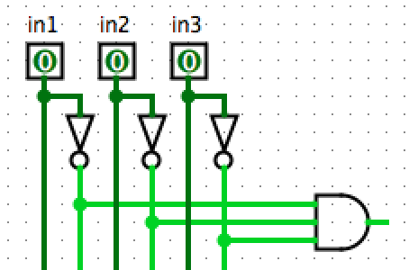
Minterm expansion
When will this and-gate be 1?

Slide 41
Minterm expansion
Only when in1=0, in2=0, in3=0

Slide 42
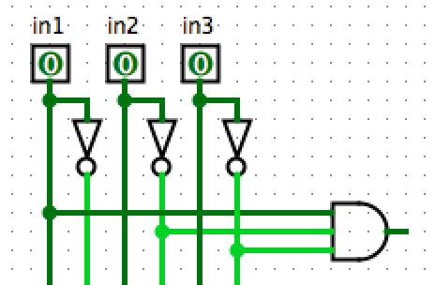
Minterm expansion
When will this and-gate be 1?

Slide 43
Minterm expansion
Only when in1=1, in2=0, in3=0

Slide 44
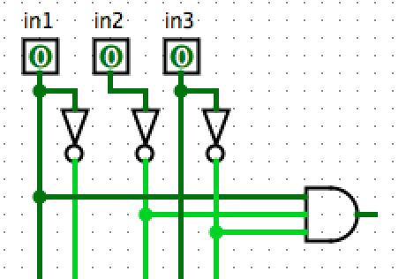
Minterm expansion
Does this help us?

Slide 45
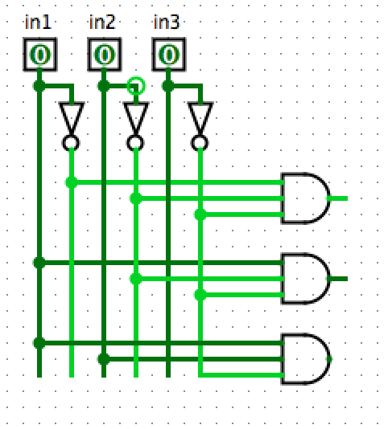
Minterm expansion
in1 | in2 | in3 | OUT
0 | 0 | 0 | 1
0 | 0 | 1 | 0
0 | 1 | 0 | 0
0 | 1 | 1 | 0
1 | 0 | 0 | 1
1 | 0 | 1 | 0
1 | 1 | 0 | 1
1 | 1 | 1 | 0
Only these three inputs can be true!

Slide 46
Minterm expansion
in1 | in2 | in3 | OUT
0 | 0 | 0 | 1
0 | 0 | 1 | 0
0 | 1 | 0 | 0
0 | 1 | 1 | 0
1 | 0 | 0 | 1
1 | 0 | 1 | 0
1 | 1 | 0 | 1
1 | 1 | 1 | 0
How do we combine these?

Slide 47
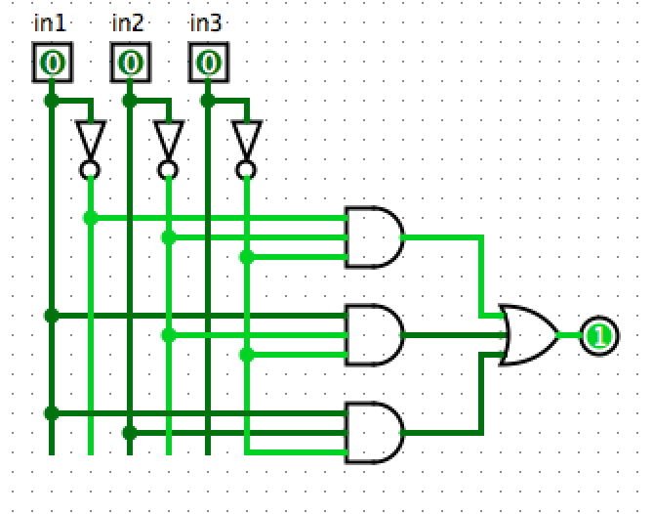
Minterm expansion
in1 | in2 | in3 | OUT
0 | 0 | 0 | 1
0 | 0 | 1 | 0
0 | 1 | 0 | 0
0 | 1 | 1 | 0
1 | 0 | 0 | 1
1 | 0 | 1 | 0
1 | 1 | 0 | 1
1 | 1 | 1 | 0
Or-gate!

Slide 48
Back to addition…
in1 | in2 | carry-in | carry-out | sum
0 | 0 | 0 | 0 | 0
0 | 0 | 1 | 0 | 1
0 | 1 | 0 | 0 | 1
0 | 1 | 1 | 1 | 0
1 | 0 | 0 | 0 | 1
1 | 0 | 1 | 1 | 0
1 | 1 | 0 | 1 | 0
1 | 1 | 1 | 1 | 1
in1
in2
carry-in
carry-out
out

Slide 49
A half-adder: no carry-in
A | B | carry | sum
0 | 0 | 0 | 0
0 | 1 | 0 | 1
1 | 0 | 0 | 1
1 | 1 | 1 | 0

Slide 50
A half-adder: no carry-in
A | B | A and B | A or B | not A | A nand B | A nor B | A xor B
0 | 0 | 0 | 0 | 1 | 1 | 1 | 0
0 | 1 | 0 | 1 | 1 | 1 | 0 | 1
1 | 0 | 0 | 1 | 0 | 1 | 0 | 1
1 | 1 | 1 | 1 | 0 | 0 | 0 | 0
A | B | carry | sum
0 | 0 | 0 | 0
0 | 1 | 0 | 1
1 | 0 | 0 | 1
1 | 1 | 1 | 0
Hint: solve each output bit independently
Design a circuit for this

Slide 51
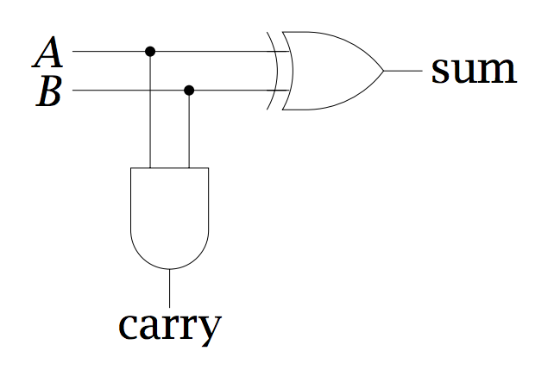
A half-adder: no carry-in
low order bit of A+B
A | B | carry | sum
0 | 0 | 0 | 0
0 | 1 | 0 | 1
1 | 0 | 0 | 1
1 | 1 | 1 | 0
higher order bit of A+B

Slide 52
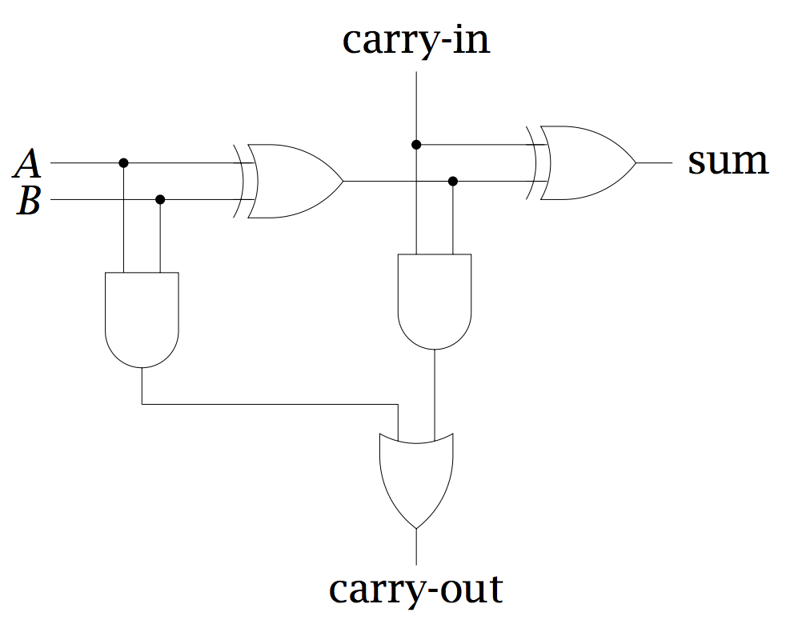
Implementing a full adder
half-adder
half-adder

Slide 53
Implementing a full adder
low order bit of A+B
low order bit of A+B+C
high order bit of A+B
Can we ever get a carry from both half adders?
A | B | carry | sum
0 | 0 | 0 | 0
0 | 1 | 0 | 1
1 | 0 | 0 | 1
1 | 1 | 1 | 0
high order bit of A+B+C

Slide 54
Implementing the component
in1
in2
carry-in
carry-out
out
What goes on inside the component?

Slide 55
Implementing the component
A
B
carry-in
carry-out
sum

Slide 56
Ripple carry adder
To implement an n-bit adder, we chain together n full- adders, each adder handles one bit position
A = A₃ A₂ A₁ A₀
Adder for adding 4-bit numbers
B = B₃ B₂ B₁ B₀
?
A₃
B₃
carry-in
A₂
B₂
carry-in
A₁
B₁
carry-in
A₀
B₀
carry-in
carry-out
carry-out
carry-out
carry-out
out
out
out
out

Slide 57
Ripple carry adder
To implement an n-bit adder, we chain together n full- adders, each adder handles one bit position
A = A₃ A₂ A₁ A₀
Adder for adding 4-bit numbers
B = B₃ B₂ B₁ B₀
0
A₃
B₃
carry-in
A₂
B₂
carry-in
A₁
B₁
carry-in
A₀
B₀
carry-in
carry-out
carry-out
carry-out
carry-out
out
out
out
out

Slide 58
Look at ripple carry adder example
Many circuits
half-adder
full-adder (using half-adders)
ripple-carry adder (using full-adders)

Slide 59
Simulator basics

Slide 60
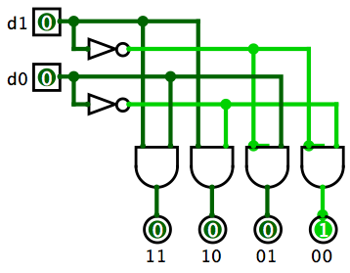
Mystery circuit
d₁ | d₀ | out₀ | out₁ | out₃ | out₃
0 | 0
0 | 1
1 | 0
1 | 1
out₃
out₂
out₁
out₀
What does this circuit do?

Slide 61
2-bit decoder
d₁ | d₀ | out₀ | out₁ | out₃ | out₃
0 | 0 | 1 | 0 | 0 | 0
0 | 1 | 0 | 1 | 0 | 0
1 | 0 | 0 | 0 | 1 | 0
1 | 1 | 0 | 0 | 0 | 1
Sends ‘1’ along one of the output lines

Slide 62
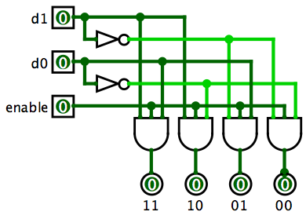
2-bit decoder*
What does the extra input do?

Slide 63
2-bit decoder*
When 0, doesn’t select any lines, when 1, functions normally

Slide 64
3-bit decoder
3 inputs
How many output lines?

Slide 65
3-bit decoder
3 inputs
8 output lines
Could make from scratch
Better idea: reuse 2-bit decoders

Slide 66
3-bit decoder
Could we use two 2-bit decoders?

Slide 67
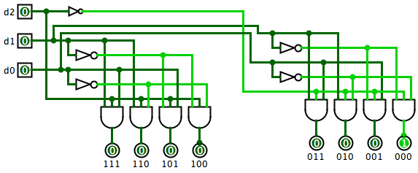
3-bit decoder
d2 gets sent to the enable of the two 2-bit decoders. One as normal and one negated.

Slide 68
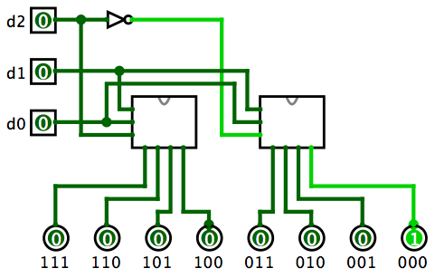
3-bit decoder using 2-bit decoders
2-bit decoder
2-bit decoder

Slide 69
Look at decoders in simulator

Slide 70
Barrel shifters

Slide 71
Examples
The Logisim circuit examples can be found at:
http://www.cs.pomona.edu/~dkauchak/classes/cs52/examples/logisim/

