Slide 1
Linked list visualized
[1, 8, 4, 7]
data: 1
data: 8
data: 4
data: 7
head
next:
next:
next:
next: null
Look at code

Slide 2
Iterating through a linked list
data: 1
data: 8
data: 4
data: 7
head
next:
next:
next:
next: null
How can we iterate through a linked list?

Slide 3
Iterating through a linked list
data: 1
data: 8
data: 4
data: 7
head
next:
next:
next:
next: null
finger
Use a variable starting at the head and move it down the list

Slide 4
Iterating through a linked list
data: 1
data: 8
data: 4
data: 7
head
next:
next:
next:
next: null
finger
Use a variable starting at the head and move it down the list
How will we know when we’re at the end?

Slide 5
Iterating through a linked list: printing it
data: 1
data: 8
data: 4
data: 7
head
next:
next:
next:
next: null

Slide 6
Iterating through a linked list: printing it
data: 1
data: 8
data: 4
data: 7
head
next:
next:
next:
next: null
finger

Slide 7
Iterating through a linked list: printing it
data: 1
data: 8
data: 4
data: 7
head
next:
next:
next:
next: null
finger

Slide 8
Iterating through a linked list: printing it
data: 1
data: 8
data: 4
data: 7
head
next:
next:
next:
next: null
finger
1

Slide 9
Iterating through a linked list: printing it
data: 1
data: 8
data: 4
data: 7
head
next:
next:
next:
next: null
finger
1

Slide 10
Iterating through a linked list: printing it
data: 1
data: 8
data: 4
data: 7
head
next:
next:
next:
next: null
finger
1
8

Slide 11
Iterating through a linked list: printing it
data: 1
data: 8
data: 4
data: 7
head
next:
next:
next:
next: null
finger
1
8

Slide 12
Iterating through a linked list: printing it
data: 1
data: 8
data: 4
data: 7
head
next:
next:
next:
next: null
finger
1
8
4

Slide 13
Iterating through a linked list: printing it
data: 1
data: 8
data: 4
data: 7
head
next:
next:
next:
next: null
finger
1
8
4

Slide 14
Iterating through a linked list: printing it
data: 1
data: 8
data: 4
data: 7
head
next:
next:
next:
next: null
finger
1
8
4

Slide 15
Iterating through a linked list: printing it
data: 1
data: 8
data: 4
data: 7
head
next:
next:
next:
next: null
finger
1
8
4
7

Slide 16
Iterating through a linked list: printing it
data: 1
data: 8
data: 4
data: 7
head
next:
next:
next:
next: null
finger:null
1
8
4
7

Slide 17
Iterating through a linked list: printing it
data: 1
data: 8
data: 4
data: 7
head
next:
next:
next:
next: null
finger:null
1
8
4
7

Slide 18
Checking if a value is in the list
data: 1
data: 8
data: 4
data: 7
head
next:
next:
next:
next: null
Write a method contains that takes a value as input and returns a boolean indicating whether or not the linked list contains that value:

Slide 19
Adding to the end
[1, 8, 4, 7]
data: 1
data: 8
data: 4
data: 7
head
next:
next:
next:
next: null
How can we add a value to the end of the list?

Slide 20
Adding to the end: add 9 to the end
[1, 8, 4, 7]
data: 1
data: 8
data: 4
data: 7
head
next:
next:
next:
next: null
find the end of the list
finger
How do we know we’re at the end?

Slide 21
Adding to the end: add 9 to the end
[1, 8, 4, 7]
data: 1
data: 8
data: 4
data: 7
head
next:
next:
next:
next: null
find the end of the list
finger
finger.next() == null

Slide 22
Adding to the end: add 9 to the end
[1, 8, 4, 7]
data: 1
data: 8
data: 4
data: 7
data: 9
head
next:
next:
next:
next: null
next: null
finger
create a new node and add it to the end

Slide 23
Adding to the end: add 9 to the end
[1, 8, 4, 7]
data: 1
data: 8
data: 4
data: 7
data: 9
head
next:
next:
next:
next:
next: null
finger
create a new node and add it to the end

Slide 24
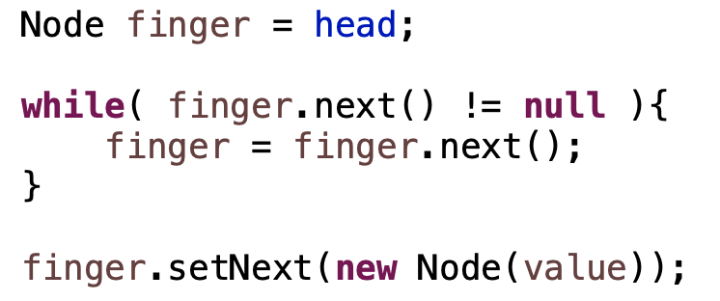
Adding to the end: add 9 to the end
[1, 8, 4, 7]
data: 1
data: 8
data: 4
data: 7
data: 9
head
next:
next:
next:
next:
next: null
finger

Slide 25
Adding to the end
[1, 8, 4, 7]
data: 1
data: 8
data: 4
data: 7
head
next:
next:
next:
next: null
Any special cases we need to handle?

Slide 26
Adding to the end
[1, 8, 4, 7]
What would happen here?
head: null
Notes:
null pointer exception!

Slide 27
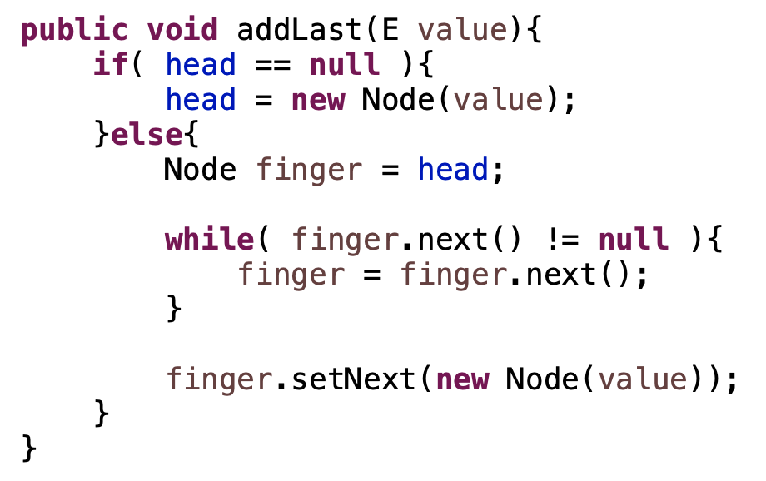
Adding to the end
[1, 8, 4, 7]
head: null

Slide 28
Removing a value
[1, 8, 4, 7]
data: 1
data: 8
data: 4
data: 7
head
next:
next:
next:
next: null
How can we we remove a value from the list?

Slide 29
Removing a value: remove 4
[1, 8, 4, 7]
data: 1
data: 8
data: 4
data: 7
head
next:
next:
next:
next: null
finger
Find it

Slide 30
Removing a value: remove 4
[1, 8, 4, 7]
data: 1
data: 8
data: 4
data: 7
head
next:
next:
next:
next: null
prev
finger
Need the node before it too!

Slide 31
Removing a value: remove 4
[1, 8, 4, 7]
data: 1
data: 8
data: 4
data: 7
head
next:
next:
next:
next: null
prev
finger
splice it out

Slide 32
Removing a value: remove 4
[1, 8, 4, 7]
data: 1
data: 8
data: 4
data: 7
head
next:
next:
next:
next: null
prev
finger
splice it out

Slide 33
Removing a value: remove 4
[1, 8, 4, 7]
data: 1
data: 8
data: 7
head
next:
next:
next: null
prev
splice it out

Slide 34
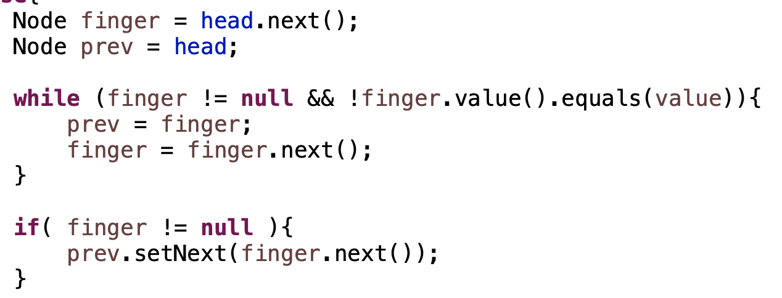
Removing a value
data: 1
data: 8
data: 4
data: 7
head
next:
next:
next:
next: null

Slide 35
Removing a value
data: 1
data: 8
data: 4
data: 7
head
next:
next:
next:
next: null
prev
finger

Slide 36
Removing a value
data: 1
data: 8
data: 4
data: 7
head
next:
next:
next:
next: null
prev
finger

Slide 37
Removing a value
data: 1
data: 8
data: 4
data: 7
head
next:
next:
next:
next: null
prev
finger

Slide 38
Removing a value
data: 1
data: 8
data: 4
data: 7
head
next:
next:
next:
next: null
prev
finger

Slide 39
Removing a value
data: 1
data: 8
data: 4
data: 7
head
next:
next:
next:
next: null
prev
finger

Slide 40
Removing a value
data: 1
data: 8
data: 4
data: 7
head
next:
next:
next:
next: null
prev
finger
When would finger be null?

Slide 41
Removing a value
data: 1
data: 8
data: 4
data: 7
head
next:
next:
next:
next: null
prev
finger

Slide 42
Removing a value
data: 1
data: 8
data: 4
data: 7
head
next:
next:
next:
next: null
Any special cases we need to handle?

Slide 43
Removing a value
head: null
What would happen here?

Slide 44
Removing a value
data: 1
data: 8
data: 4
data: 7
head
next:
next:
next:
next: null
Any other special cases we need to handle?

Slide 45
Removing a value
data: 1
data: 8
data: 4
data: 7
head
next:
next:
next:
next: null
Delete 1. Does it work?

Slide 46
Removing a value
data: 1
data: 8
data: 4
data: 7
head
next:
next:
next:
next: null
prev
finger
Delete 1. Does it work?

Slide 47
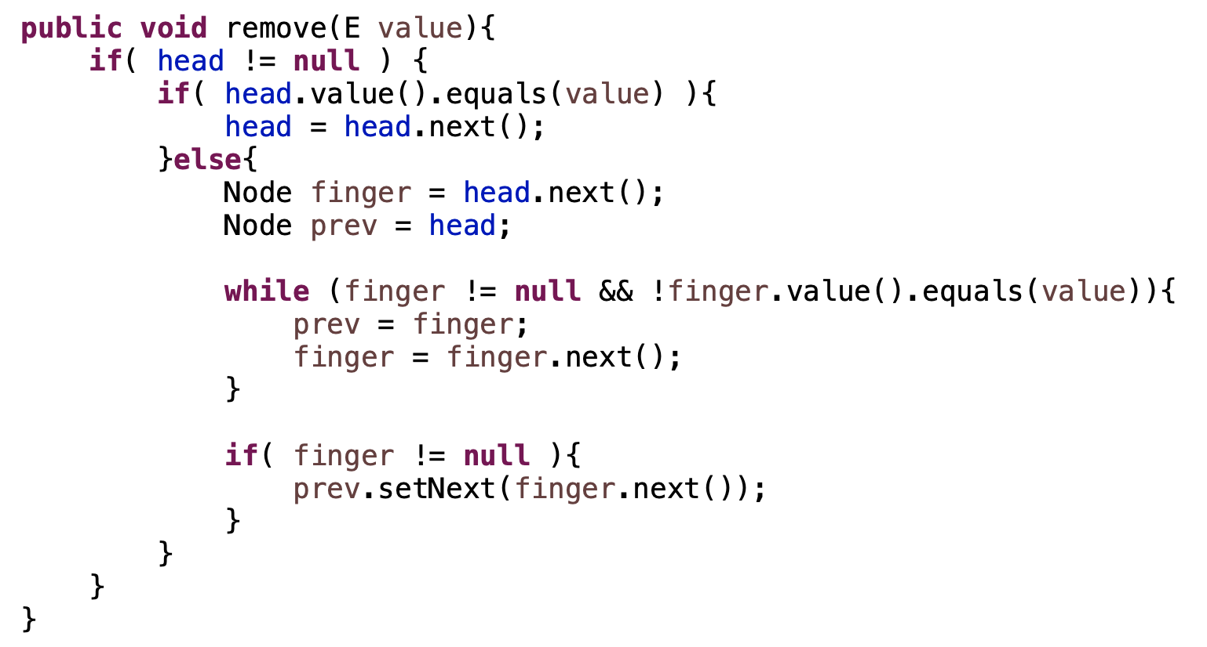
Removing a value

Slide 48
Removing a value
handle empty list
removing first element
all other elements

Slide 49
Linked lists: fast or slow?
add to the end
add to the front
contains
get
insert at an index
remove an element
set the value of an existing element
size

Slide 50
Linked lists: fast or slow?
add to the end slow
add to the front: fast
contains slow
get slow
insert at an index slow
remove an element slow
remove from the front fast
set the value of an existing element slow
size fast

Slide 51
Linked lists: fast or slow?
add to the end slow
add to the front: fast
contains slow
get slow
insert at an index slow
remove an element slow
remove from the front fast
set the value of an existing element slow
size fast
Can we make any of these faster?

Slide 52
Linked list visualized
[1, 8, 4, 7]
data: 1
data: 8
data: 4
data: 7
head
next:
next:
next:
next: null
How does this help us?
tail

Slide 53
Linked list visualized
data: 1
data: 8
data: 4
data: 7
head
next:
next:
next:
next: null
We don’t have to search for the end of the list!
tail

Slide 54
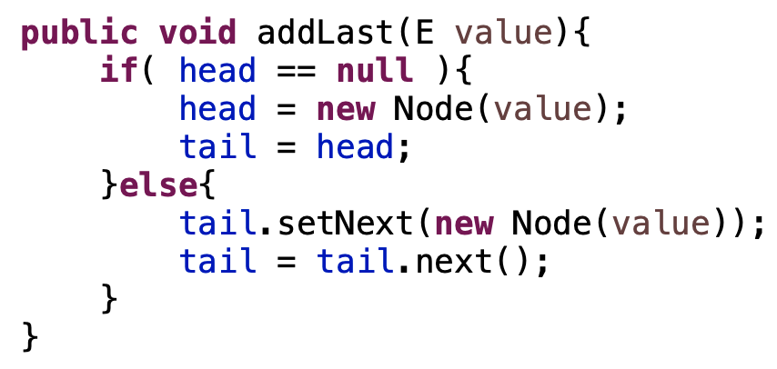
Linked list visualized
data: 1
data: 8
data: 4
data: 7
head
next:
next:
next:
next: null
tail

Slide 55
Linked list visualized
[1, 8, 4, 7]
data: 1
data: 8
data: 4
data: 7
head
next:
next:
next:
next: null
tail
Any downsides?

Slide 56
Circularly linked list visualized
[1, 8, 4, 7]
data: 1
data: 8
data: 4
data: 7
next:
next:
next:
next:
tail
Where is head?

Slide 57
Circularly linked list visualized
[1, 8, 4, 7]
data: 1
data: 8
data: 4
data: 7
next:
next:
next:
next:
tail
tail.next()

Slide 58
Linked lists: fast or slow?
add to the end fast
add to the front: fast
contains slow
get slow
insert at an index slow
remove an element slow
remove from the front fast
set the value of an existing element slow
size fast

Slide 59
Linked list visualized
[1, 8, 4, 7]
data: 1
data: 8
data: 4
data: 7
head
next:
next:
next:
next: null
tail
Is removing from the end fast?

Slide 60
Linked list visualized
[1, 8, 4, 7]
data: 1
data: 8
data: 4
data: 7
head
next:
next:
next:
next: null
tail
No! Need access to previous

Slide 61
Doubly linked list visualized
Keep track of both the next and previous node in the list
data: 1
data: 8
data: 4
data: 7
head
next:
next:
next:
next:
prev: null
prev:
prev:
prev:
tail

Slide 62
Doubly linked list visualized
data: 1
data: 8
data: 4
data: 7
head
next:
next:
next:
next:
prev: null
prev:
prev:
prev:
tail
Is removing from the end fast?

Slide 63
Doubly linked list visualized
data: 1
data: 8
data: 4
data: 7
head
next:
next:
next:
next:
prev: null
prev:
prev:
prev:
tail

Slide 64
Doubly linked list visualized
data: 1
data: 8
data: 4
data: 7
head
next:
next:
next:
next:
prev: null
prev:
prev:
prev:
tail

Slide 65
Doubly linked list visualized
data: 1
data: 8
data: 4
data: 7
head
next:
next:
next: null
next:
prev: null
prev:
prev:
prev:
tail

Slide 66
Doubly linked list visualized
finger
data: 1
data: 8
data: 4
data: 7
head
next:
next:
next:
next:
prev: null
prev:
prev:
prev:
tail
Could I remove a node if I had a reference to it?

Slide 67
Doubly linked list visualized
finger
data: 1
data: 8
data: 4
data: 7
head
next:
next:
next:
next:
prev: null
prev:
prev:
prev:
tail
Could I remove a node if I had a reference to it?

Slide 68
Doubly linked list visualized
finger
data: 1
data: 8
data: 4
data: 7
head
next:
next:
next:
next:
prev: null
prev:
prev:
prev:
tail

Slide 69
Doubly linked list visualized
finger
data: 1
data: 8
data: 4
data: 7
head
next:
next:
next:
next:
prev: null
prev:
prev:
prev:
tail

Slide 70
Doubly linked list visualized
finger
data: 1
data: 8
data: 4
data: 7
head
next:
next:
next:
next:
prev: null
prev:
prev:
prev:
tail

Slide 71
Doubly linked list visualized
finger
data: 1
data: 8
data: 4
data: 7
head
next:
next:
next:
next:
prev: null
prev:
prev:
prev:
tail

Slide 72
Doubly linked list visualized
finger
data: 1
data: 8
data: 4
data: 7
head
next:
next:
next:
next:
prev: null
prev:
prev:
prev:
tail
How does this help us? Still have to find the node?

Slide 73
Doubly linked list visualized
finger
data: 1
data: 8
data: 4
data: 7
head
next:
next:
next:
next:
prev: null
prev:
prev:
prev:
tail
If we’re iterating over the data already
Other scenarios (see upcoming assignment ☺)

Slide 74
List performance
 | ArrayList | Singly linked list | Singly linked list (tail) | Doubly linked list
add to end | fast (amortized) | slow | fast | fast
add to front | slow | fast | fast | fast
insert at index | slow | slow | slow | slow
contains | slow | slow | slow | slow
get | fast | slow | slow | slow
set | fast | slow | slow | slow
remove | slow | slow | slow | slow
remove from end | fast | slow | slow | fast
remove from front | slow | fast | fast | fast
size | fast | fast | fast | fast

