Slide 1
Linked list visualized
[1, 8, 4, 7]
data: 1
data: 8
data: 4
data: 7
head
next:
next:
next:
next: null

Slide 2
Adding to the front
[1, 8, 4, 7]
data: 1
data: 8
data: 4
data: 7
head
next:
next:
next:
next: null
How can we add a value to the front of the list?

Slide 3
Adding to the front: add 9 to front
[1, 8, 4, 7]
data: 1
data: 8
data: 4
data: 7
head
next:
next:
next:
next: null
data: 9
create a new Node
next: null

Slide 4
Adding to the front: add 9 to front
[1, 8, 4, 7]
data: 1
data: 8
data: 4
data: 7
head
next:
next:
next:
next: null
data: 9
set the next value of that node to be head
next:

Slide 5
Adding to the front: add 9 to front
[1, 8, 4, 7]
data: 1
data: 8
data: 4
data: 7
head
next:
next:
next:
next: null
data: 9
set head to this new node
next:

Slide 6
Adding to the front: add 9 to front
[1, 8, 4, 7]
data: 9
data: 1
data: 8
data: 4
data: 7
head
next:
next:
next:
next:
next: null

Slide 7
Adding to the front: add 9 to front
[1, 8, 4, 7]
data: 9
data: 1
data: 8
data: 4
data: 7
head
next:
next:
next:
next:
next: null

Slide 8
Adding to the front: add 9 to front
[1, 8, 4, 7]
data: 1
data: 8
data: 4
data: 7
head
next:
next:
next:
next: null
data: 9
newNode
next: null

Slide 9
Adding to the front: add 9 to front
[1, 8, 4, 7]
data: 1
data: 8
data: 4
data: 7
head
next:
next:
next:
next: null
data: 9
newNode
next:

Slide 10
Adding to the front: add 9 to front
[9, 1, 8, 4, 7]
data: 1
data: 8
data: 4
data: 7
head
next:
next:
next:
next: null
data: 9
newNode
next:

Slide 11
Adding to the front
Does this work if the linked list is empty?
head: null

Slide 12
Adding to the front
Does this work if the linked list is empty?
head: null
data: 9
newNode
next: null

Slide 13
Adding to the front
Does this work if the linked list is empty?
head: null
data: 9
newNode
next: null

Slide 14
Adding to the front
Does this work if the linked list is empty?
head:
data: 9
newNode
next: null

Slide 15
Removing from the front
[1, 8, 4, 7]
data: 1
data: 8
data: 4
data: 7
head
next:
next:
next:
next: null
How can we delete a value to the front of the list?
(assuming the list isn’t empty)

Slide 16
Removing from the front
[1, 8, 4, 7]
data: 1
data: 8
data: 4
data: 7
head
next:
next:
next:
next: null
Simply move head down the list!

Slide 17
Removing from the front
[1, 8, 4, 7]
data: 1
data: 8
data: 4
data: 7
head
next:
next:
next:
next: null
Simply move head down the list!

Slide 18
Removing from the front
[1, 8, 4, 7]
data: 1
data: 8
data: 4
data: 7
head
next:
next:
next:
next: null
How can do this in code?

Slide 19
Removing from the front
[1, 8, 4, 7]
data: 1
data: 8
data: 4
data: 7
head
next:
next:
next:
next: null
How can do this in code?

Slide 20
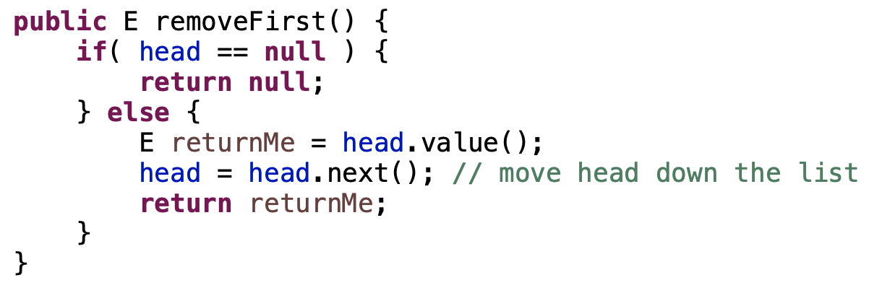
Removing from the front
[1, 8, 4, 7]
data: 1
data: 8
data: 4
data: 7
head
next:
next:
next:
next: null

Slide 21
Iterating through a linked list
data: 1
data: 8
data: 4
data: 7
head
next:
next:
next:
next: null

Slide 22
Iterating through a linked list
data: 1
data: 8
data: 4
data: 7
head
next:
next:
next:
next: null
How can we iterate through a linked list?

Slide 23
Iterating through a linked list
data: 1
data: 8
data: 4
data: 7
head
next:
next:
next:
next: null
finger
Use a variable starting at the head and move it down the list

Slide 24
Iterating through a linked list
data: 1
data: 8
data: 4
data: 7
head
next:
next:
next:
next: null
finger
Use a variable starting at the head and move it down the list
How will we know when we’re at the end?

Slide 25
Iterating through a linked list: printing it
data: 1
data: 8
data: 4
data: 7
head
next:
next:
next:
next: null

Slide 26
Iterating through a linked list: printing it
data: 1
data: 8
data: 4
data: 7
head
next:
next:
next:
next: null
finger

Slide 27
Iterating through a linked list: printing it
data: 1
data: 8
data: 4
data: 7
head
next:
next:
next:
next: null
finger

Slide 28
Iterating through a linked list: printing it
data: 1
data: 8
data: 4
data: 7
head
next:
next:
next:
next: null
finger
1

Slide 29
Iterating through a linked list: printing it
data: 1
data: 8
data: 4
data: 7
head
next:
next:
next:
next: null
finger
1

Slide 30
Iterating through a linked list: printing it
data: 1
data: 8
data: 4
data: 7
head
next:
next:
next:
next: null
finger
1
8

Slide 31
Iterating through a linked list: printing it
data: 1
data: 8
data: 4
data: 7
head
next:
next:
next:
next: null
finger
1
8

Slide 32
Iterating through a linked list: printing it
data: 1
data: 8
data: 4
data: 7
head
next:
next:
next:
next: null
finger
1
8
4

Slide 33
Iterating through a linked list: printing it
data: 1
data: 8
data: 4
data: 7
head
next:
next:
next:
next: null
finger
1
8
4

Slide 34
Iterating through a linked list: printing it
data: 1
data: 8
data: 4
data: 7
head
next:
next:
next:
next: null
finger
1
8
4

Slide 35
Iterating through a linked list: printing it
data: 1
data: 8
data: 4
data: 7
head
next:
next:
next:
next: null
finger
1
8
4
7

Slide 36
Iterating through a linked list: printing it
data: 1
data: 8
data: 4
data: 7
head
next:
next:
next:
next: null
finger:null
1
8
4
7

Slide 37
Iterating through a linked list: printing it
data: 1
data: 8
data: 4
data: 7
head
next:
next:
next:
next: null
finger:null
1
8
4
7

