Slide 1
balanced search trees
David Kauchak CS 62 – Spring 2021

Slide 2
Admin
Last day for “normal” mentor hours, Friday (5/7)
More on mentor hours next week

Slide 3
Binary Search Trees
BST – A binary tree where each each node has a key, and every node’s key is:
Larger than all keys in its left subtree. (everything left is smaller)
Smaller than all keys in its right subtree. (everything right is larger)
12
8
14
5
9
20

Slide 4
Operations
Search – Does the key exist in the tree
Insert – Insert the key into tree
Delete – Delete the key from the tree

Slide 5
Height of the tree
Most of the operations take time O(height)
We said trees built from random data have height O(log n), which is asymptotically tight
Two problems:
We can’t always insure random data
What happens when we delete nodes and insert others after building a tree?
Worst case height for binary search trees is O(n) ☹

Slide 6
Balanced trees
Make sure that the trees remain balanced!
Red-black trees
AVL trees
2-3 trees
2-3-4 trees
B-trees
…
Height is guaranteed to be O(log n)

Slide 7
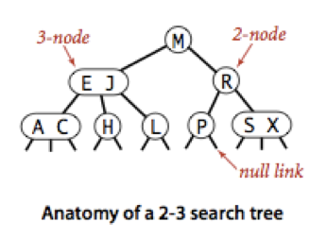
2-3 trees
2-node: one key and two children (left and right)
everything in left is smaller than key
everything right is greater than (or equal to) key
3-node: two keys (k₁, k₂) and three children, left, middle and right
k₁ < k₂
everything in left is less than k₁
everything in middle is between k₁ and k₂ (greater than or equal to k₁ and less than k₂)
everything in right is greater than (or equal to) k₂

Slide 8
Search
How do we search for a key?

Slide 9
Search
Almost identical to BST search
Only difference: sometimes we have two keys

Slide 10
Search
Search(H)
M
Which child?

Slide 11
Search
Search(H)
M
E J
Which child?

Slide 12
Search
Search(H)
M
E J
H

Slide 13
Search
Search(B)
M
Which child?

Slide 14
Search
Search(B)
M
E J
Which child?

Slide 15
Search
Search(B)
M
E J
A C
Which child?

Slide 16
Search
Search(B)
M
E J
A C
Not found!

Slide 17
Search
M
E J
R
A C
H
L
P
S X

Slide 18
Insertion
Like BST, insert always happens at a leaf
If the leaf is a 2-node, just insert it directly

Slide 19
Insertion
If the leaf is a 2-node, just insert it directly
Insert(F)
M
E J
R
A C
H
L
P
S X
Where should it go?

Slide 20
Insertion
If the leaf is a 2-node, just insert it directly
Insert(F)
M
E J
R
A C
H
L
P
S X

Slide 21
Insertion
If the leaf is a 2-node, just insert it directly
Insert(F)
M
E J
R
A C
H
L
P
S X

Slide 22
Insertion
If the leaf is a 2-node, just insert it directly
Insert(F)
M
E J
R
A C
H
L
P
S X

Slide 23
Insertion
If the leaf is a 2-node, just insert it directly
Insert(F)
M
E J
R
A C
F H
L
P
S X

Slide 24
Insertion
Like BST, insert always happens at a leaf
If the leaf is a 2-node, just insert it directly
If the leaf is a 3-node:
We now have three values at this leaf
Send the middle value up a node
Make new 2-nodes out of the smallest and largest

Slide 25
Insertion
If the leaf is a 3-node:
We now have three values at this leaf
Send the middle value up a node
Make new 2-nodes out of the smallest and largest
Insert(T)
M
Where should it go?
E J
R
A C
F H
L
P
S X

Slide 26
Insertion
If the leaf is a 3-node:
We now have three values at this leaf
Send the middle value up a node
Make new 2-nodes out of the smallest and largest
Insert(T)
M
E J
R
A C
F H
L
P
S X

Slide 27
Insertion
If the leaf is a 3-node:
We now have three values at this leaf
Send the middle value up a node
Make new 2-nodes out of the smallest and largest
Insert(T)
M
E J
R
A C
F H
L
P
S T X

Slide 28
Insertion
If the leaf is a 3-node:
We now have three values at this leaf
Send the middle value up a node
Make new 2-nodes out of the smallest and largest
R
Insert(T)
M
S T X
E J
R T
A C
F H
L
P
S
X

Slide 29
Insertion
If the leaf is a 3-node:
We now have three values at this leaf
Send the middle value up a node
Make new 2-nodes out of the smallest and largest
Insert(I)
M
Where should it go?
E J
R T
A C
F H
L
P
S
X

Slide 30
Insertion
If the leaf is a 3-node:
We now have three values at this leaf
Send the middle value up a node
Make new 2-nodes out of the smallest and largest
Insert(I)
M
E J
R T
A C
F H
L
P
S
X

Slide 31
Insertion
If the leaf is a 3-node:
We now have three values at this leaf
Send the middle value up a node
Make new 2-nodes out of the smallest and largest
Insert(I)
M
E J
R T
A C
F H I
L
P
S
X

Slide 32
Insertion
If the leaf is a 3-node:
We now have three values at this leaf
Send the middle value up a node
Make new 2-nodes out of the smallest and largest
Insert(I)
M
E H J
R T
A C
F
I
L
P
S
X

Slide 33
Insertion
If the leaf is a 3-node:
We now have three values at this leaf
Send the middle value up a node
Make new 2-nodes out of the smallest and largest
Insert(I)
M
What now?
E H J
R T
A C
F
I
L
P
S
X

Slide 34
Insertion
If the leaf is a 3-node:
We now have three values at this leaf
Send the middle value up a node
Make new 2-nodes out of the smallest and largest
Insert(I)
M
Repeat!
E H J
R T
A C
F
I
L
P
S
X

Slide 35
Insertion
If the leaf is a 3-node:
We now have three values at this leaf
Send the middle value up a node
Make new 2-nodes out of the smallest and largest
Insert(I)
M
E H J
R T
A C
F
I
L
P
S
X

Slide 36
Insertion
If the leaf is a 3-node:
We now have three values at this leaf
Send the middle value up a node
Make new 2-nodes out of the smallest and largest
Insert(I)
H M
E J
R T
A C
F
I
L
P
S
X

Slide 37
Insertion
If the leaf is a 3-node:
We now have three values at this leaf
Send the middle value up a node
Make new 2-nodes out of the smallest and largest
Insert(I)
H M
E
J
R T
A C
F
I
L
P
S
X

Slide 38
Insertion
If the leaf is a 2-node, just insert it directly
If the leaf is a 3-node:
We now have three values at this leaf
Send the middle value up a node
Make new 2-nodes out of the smallest and largest
When will the height of the tree change?

Slide 39
Insertion
If the leaf is a 2-node, just insert it directly
If the leaf is a 3-node:
We now have three values at this leaf
Send the middle value up a node
Make new 2-nodes out of the smallest and largest
Only when the root is a 3-node and we insert into a path that is all 3-nodes!
Effect: The tree can hold quite a few values before having to increase the height

Slide 40
Practice
Draw the 2-3 tree that results when you insert the keys:
E A S Y Q U T I O N in that order in an initially empty tree.

Slide 41
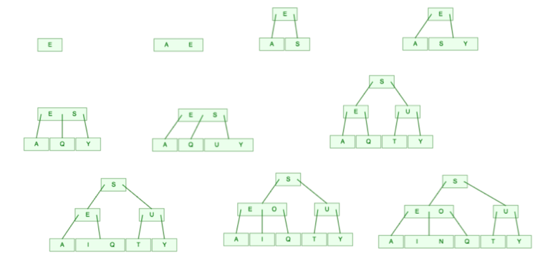
Practice
Draw the 2-3 tree that results when you insert the keys:
E A S Y Q U T I O N in that order in an initially empty tree.

Slide 42
Running time
Worst case height: O(log n)
What does that mean?

Slide 43
Running time
Worst case height: O(log n)
Insert, search and delete are all O(log n)

Slide 44
2-3 search trees in practice
A pain to implement
Overhead can often make slower than standard BST
Other balanced trees exist that provide the same worst case guarantee, but are faster (e.g, red-black trees)

Slide 45
Red-black tree high-level
https://www.cs.usfca.edu/~galles/visualization/RedBlack.html

