Slide 1
graphs: shortest paths
David Kauchak CS 62 – Spring 2021

Slide 2
Admin
Last quiz!
Last assignment due next Friday (5/7)
Next week:
Tuesday: balanced trees
Wednesday: course feedback forms, ethics discussion, work session
Thursday: recap/review

Slide 3
Shortest paths
What is the shortest path from a to d?
B
D
A
C
E

Slide 4
Shortest paths
How can we find this?
B
D
A
C
E

Slide 5
Shortest paths
BFS visits vertices in increasing distance!
B
D
A
C
E

Slide 6
BFS with distances
Look at ShortestPaths.bfsDistances in GraphExamples
https://github.com/pomonacs622021sp/LectureCode/tree/master/GraphExamples

Slide 7
Shortest paths
What is the shortest path from a to d?
2
B
D
3
3
A
1
2
1
C
E
4

Slide 8
Shortest paths
We can still use BFS
2
B
D
3
3
A
1
2
1
C
E
4

Slide 9
Shortest paths
We can still use BFS
2
B
D
B
D
3
3
A
1
2
A
1
C
E
C
E
4

Slide 10
Shortest paths
We can still use BFS
B
D
A
C
E

Slide 11
Shortest paths
What is the problem?
B
D
A
C
E

Slide 12
Shortest paths
Running time is dependent on the weights!
B
B
2
100
1
A
50
A
4
C
200
C

Slide 13
Shortest paths
B
B
100
A
50
A
200
C
C

Slide 14
Shortest paths
B
A
C

Slide 15
Shortest paths
B
A
C

Slide 16
Shortest paths
Nothing will change as we expand the frontier until we’ve gone out 100 levels
B
A
C

Slide 17
Key idea
Explore the vertices in order of increasing distance from the starting vertex
Keep track of the distances to each vertex
If we find a better path, update that distance

Slide 18
Dijkstra’s high-level
Explore the vertices in order of increasing distance from the starting vertex
Use a priority queue to keep track of the shortest path found so far to a vertex
Initialize: distance to start = 0 and all others infinity
repeat
get vertex v with shortest distance
for each vertex, adj, adjacent to v (edge exists v → adj)
if path v → adj is shortest then best path for adj so far
update the distance for adj
update the priority queue

Slide 19
Initialize: distance to start = 0 and all others infinity
repeat
get vertex v with shortest distance
for each vertex, adj, adjacent to v (edge exists v → adj)
if path v → adj is shortest then best path for adj so far
update the distance for adj
update the priority queue
3
B
D
3
1
A
1
2
1
C
E
4

Slide 20
Initialize: distance to start = 0 and all others infinity
repeat
get vertex v with shortest distance
for each vertex, adj, adjacent to v (edge exists v → adj)
if path v → adj is shortest then best path for adj so far
update the distance for adj
update the priority queue
∞
∞
3
B
D
3
∞
1
A
1
2
∞
1
C
E
∞
4

Slide 21
Initialize: distance to start = 0 and all others infinity
repeat
get vertex v with shortest distance
for each vertex, adj, adjacent to v (edge exists v → adj)
if path v → adj is shortest then best path for adj so far
update the distance for adj
update the priority queue
PQ
A 0 B ∞ C ∞ D ∞ E ∞
∞
∞
3
B
D
3
0
1
A
1
2
∞
1
C
E
∞
4

Slide 22
Initialize: distance to start = 0 and all others infinity
repeat
get vertex v with shortest distance
for each vertex, adj, adjacent to v (edge exists v → adj)
if path v → adj is shortest then best path for adj so far
update the distance for adj
update the priority queue
PQ
B ∞ C ∞ D ∞ E ∞
∞
∞
3
B
D
3
0
1
A
1
2
∞
1
C
E
∞
4

Slide 23
Initialize: distance to start = 0 and all others infinity
repeat
get vertex v with shortest distance
for each vertex, adj, adjacent to v (edge exists v → adj)
if path v → adj is shortest then best path for adj so far
update the distance for adj
update the priority queue
PQ
B ∞ C ∞ D ∞ E ∞
∞
∞
3
B
D
3
0
1
A
1
2
∞
1
C
E
∞
4

Slide 24
Initialize: distance to start = 0 and all others infinity
repeat
get vertex v with shortest distance
for each vertex, adj, adjacent to v (edge exists v → adj)
if path v → adj is shortest then best path for adj so far
update the distance for adj
update the priority queue
PQ
C 1 B ∞ D ∞ E ∞
∞
∞
3
B
D
3
0
1
A
1
2
1
1
C
E
∞
4

Slide 25
Initialize: distance to start = 0 and all others infinity
repeat
get vertex v with shortest distance
for each vertex, adj, adjacent to v (edge exists v → adj)
if path v → adj is shortest then best path for adj so far
update the distance for adj
update the priority queue
PQ
C 1 B ∞ D ∞ E ∞
∞
∞
3
B
D
3
0
1
A
1
2
1
1
C
E
∞
4

Slide 26
Initialize: distance to start = 0 and all others infinity
repeat
get vertex v with shortest distance
for each vertex, adj, adjacent to v (edge exists v → adj)
if path v → adj is shortest then best path for adj so far
update the distance for adj
update the priority queue
PQ
C 1 B 3 D ∞ E ∞
3
∞
3
B
D
3
0
1
A
1
2
1
1
C
E
∞
4

Slide 27
Initialize: distance to start = 0 and all others infinity
repeat
get vertex v with shortest distance
for each vertex, adj, adjacent to v (edge exists v → adj)
if path v → adj is shortest then best path for adj so far
update the distance for adj
update the priority queue
PQ
C 1 B 3 D ∞ E ∞
3
∞
3
B
D
3
0
1
A
1
2
1
1
C
E
∞
4

Slide 28
Initialize: distance to start = 0 and all others infinity
repeat
get vertex v with shortest distance
for each vertex, adj, adjacent to v (edge exists v → adj)
if path v → adj is shortest then best path for adj so far
update the distance for adj
update the priority queue
PQ
B 3 D ∞ E ∞
3
∞
3
B
D
3
0
1
A
1
2
1
1
C
E
∞
4

Slide 29
Initialize: distance to start = 0 and all others infinity
repeat
get vertex v with shortest distance
for each vertex, adj, adjacent to v (edge exists v → adj)
if path v → adj is shortest then best path for adj so far
update the distance for adj
update the priority queue
PQ
B 3 D ∞ E ∞
3
∞
3
B
D
3
0
1
A
1
2
1
1
C
E
∞
4

Slide 30
Initialize: distance to start = 0 and all others infinity
repeat
get vertex v with shortest distance
for each vertex, adj, adjacent to v (edge exists v → adj)
if path v → adj is shortest then best path for adj so far
update the distance for adj
update the priority queue
PQ
B 3 D ∞ E ∞
3
∞
3
B
D
3
0
1
A
1
2
1
1
C
E
∞
4

Slide 31
Initialize: distance to start = 0 and all others infinity
repeat
get vertex v with shortest distance
for each vertex, adj, adjacent to v (edge exists v → adj)
if path v → adj is shortest then best path for adj so far
update the distance for adj
update the priority queue
PQ
B 2 D ∞ E ∞
2
∞
3
B
D
3
0
1
A
1
2
1
1
C
E
∞
4

Slide 32
Initialize: distance to start = 0 and all others infinity
repeat
get vertex v with shortest distance
for each vertex, adj, adjacent to v (edge exists v → adj)
if path v → adj is shortest then best path for adj so far
update the distance for adj
update the priority queue
PQ
B 2 D ∞ E ∞
2
∞
3
B
D
3
0
1
A
1
2
1
1
C
E
∞
4

Slide 33
Initialize: distance to start = 0 and all others infinity
repeat
get vertex v with shortest distance
for each vertex, adj, adjacent to v (edge exists v → adj)
if path v → adj is shortest then best path for adj so far
update the distance for adj
update the priority queue
PQ
B 2 E 5 D ∞
2
∞
3
B
D
3
0
1
A
1
2
1
1
C
E
5
4

Slide 34
Initialize: distance to start = 0 and all others infinity
repeat
get vertex v with shortest distance
for each vertex, adj, adjacent to v (edge exists v → adj)
if path v → adj is shortest then best path for adj so far
update the distance for adj
update the priority queue
PQ
B 2 E 5 D ∞
2
∞
3
B
D
3
0
1
A
1
2
Frontier?
1
1
C
E
5
4

Slide 35
Initialize: distance to start = 0 and all others infinity
repeat
get vertex v with shortest distance
for each vertex, adj, adjacent to v (edge exists v → adj)
if path v → adj is shortest then best path for adj so far
update the distance for adj
update the priority queue
PQ
B 2 E 5 D ∞
2
∞
3
B
D
3
0
All nodes reachable from starting node within a given distance
1
A
1
2
1
1
C
E
5
4

Slide 36
Initialize: distance to start = 0 and all others infinity
repeat
get vertex v with shortest distance
for each vertex, adj, adjacent to v (edge exists v → adj)
if path v → adj is shortest then best path for adj so far
update the distance for adj
update the priority queue
PQ
E 3 D 5
2
5
3
B
D
3
0
1
A
1
2
1
1
C
E
3
4

Slide 37
Initialize: distance to start = 0 and all others infinity
repeat
get vertex v with shortest distance
for each vertex, adj, adjacent to v (edge exists v → adj)
if path v → adj is shortest then best path for adj so far
update the distance for adj
update the priority queue
PQ
D 5
2
5
3
B
D
3
0
1
A
1
2
1
1
C
E
3
4

Slide 38
Initialize: distance to start = 0 and all others infinity
repeat
get vertex v with shortest distance
for each vertex, adj, adjacent to v (edge exists v → adj)
if path v → adj is shortest then best path for adj so far
update the distance for adj
update the priority queue
PQ
2
5
3
B
D
3
0
1
A
1
2
1
1
C
E
3
4

Slide 39
Initialize: distance to start = 0 and all others infinity
repeat
get vertex v with shortest distance
for each vertex, adj, adjacent to v (edge exists v → adj)
if path v → adj is shortest then best path for adj so far
update the distance for adj
update the priority queue
PQ
2
5
3
B
D
0
1
A
1
1
1
C
E
3

Slide 40
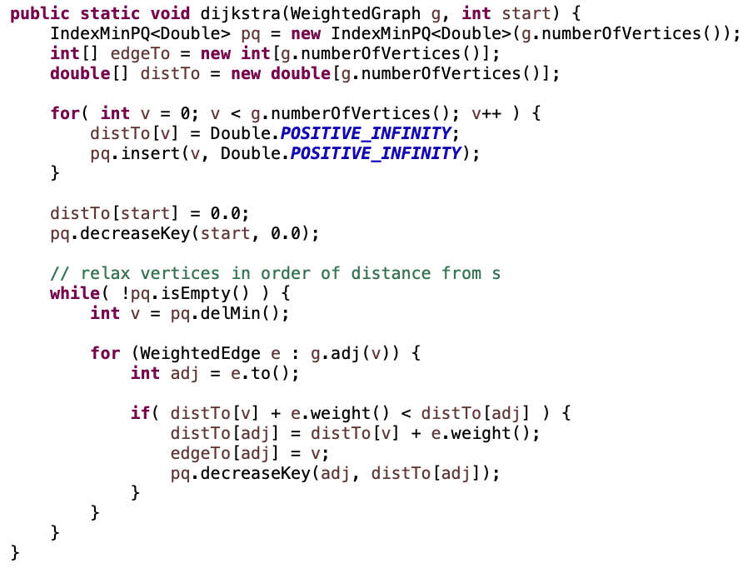
Dijkstra’s algorithm

Slide 41
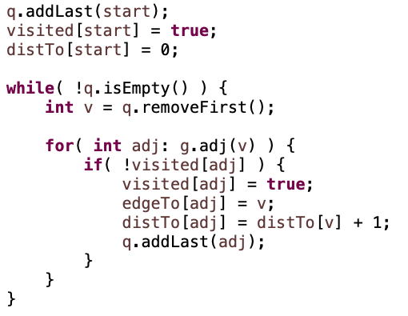
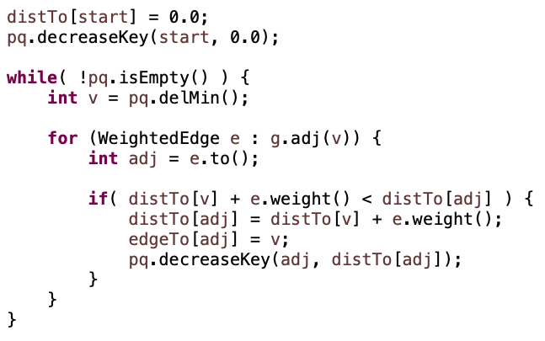
Dijkstra’s algorithm
Dijkstra’s
BFS

Slide 42
Dijkstra example
Look at ShortestPaths.dijkstra in GraphExamples
https://github.com/pomonacs622021sp/LectureCode/tree/master/GraphExamples

Slide 43
Why does it work?
When a vertex is removed from the priority queue, distTo[v] is the actual shortest distance from s to v
The only time a vertex gets removed is when the distance from s to that vertex is smaller than the distance to any remaining vertex
Therefore, there cannot be any other path that hasn’t been visited already that would result in a shorter path

Slide 44
Why does it work?
When a vertex is removed from the priority queue, distTo[v] is the actual shortest distance from s to v
The only time a vertex gets removed is when the distance from s to that vertex is smaller than the distance to any remaining vertex
Therefore, there cannot be any other path that hasn’t been visited already that would result in a shorter path
Does this make any assumptions?

Slide 45
What about this graph?
What’s the shortest path from A to C?
What would Dijkstra’s do?
3
B
D
3
1
A
-3
2
1
C
E
4

Slide 46
What about this graph?
Dijkstra’s only works on graphs with positive edge weights
3
B
D
3
1
A
-3
2
1
C
E
4

Slide 47
Why does it work?
When a vertex is removed from the priority queue, distTo[v] is the actual shortest distance from s to v
The only time a vertex gets removed is when the distance from s to that vertex is smaller than the distance to any remaining vertex
Therefore, there cannot be any other path that hasn’t been visited already that would result in a shorter path
Assuming no negative edge weights!

Slide 48
Relaxing an edge
This update is called “relaxing” an edge
We can apply this to an edge as many times as we want
This idea is used in other shortest paths algorithms (e.g., Bellman-Ford)

Slide 49
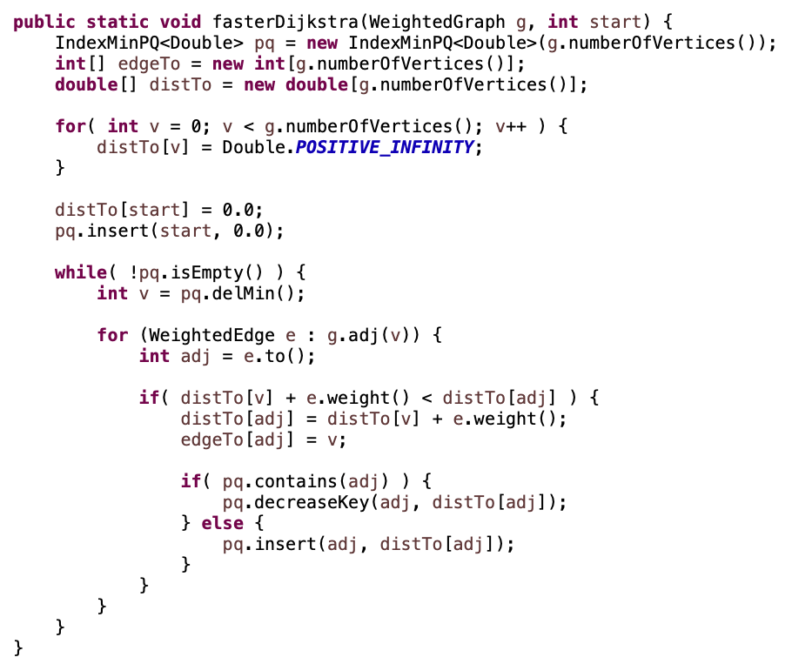
Dijkstra in practice
don’t insert everything into pq
only insert starting vertex
insert when we discover a vertex

Slide 50
Run-time
V calls
E calls

Slide 51
Running time?
Depends on the heap implementation
V * delMin
E * decreaseKey
Total
Array
O(|V|²)
O(|E|)
O(|V|²)
Bin heap
O(|V| log |V|)
O(|E| log |V|)
O((|V|+|E|) log |V|)
O(|E| log |V|)

Slide 52
Running time?
Depends on the heap implementation
V * delMin
E * decreaseKey
Total
Array
O(|V|²)
O(|E|)
O(|V|²)
Bin heap
O(|V| log |V|)
O(|E| log |V|)
O((|V|+|E|) log |V|)
O(|E| log |V|)
Fib heap
O(|V| log |V|)
O(|E|)
O(|V| log |V| + |E|)

Slide 53
Shortest paths
Dijkstra’s: single source shortest paths for positive edge weight graphs
What is single source?

Slide 54
Shortest paths
Dijkstra’s: single source shortest paths for positive edge weight graphs
Many other variants:
graphs with negative edges
all pairs shortest paths
…

