Slide 1
binary search trees
David Kauchak CS 62 – Spring 2021

Slide 2
Administrative
Autocomplete
Lab tomorrow: Q&A + work session (make some progress on assignment!)
Midterm 2 next week
Pre-pre enrollment

Slide 3
Binary Search Trees
BST – A binary tree where each each node has a value, and every node’s value is:
Greater than all values in its left subtree. (everything left is smaller)
Less than or equal to all values in its right subtree. (everything right is larger)
12
8
14
5
9
20

Slide 4
Operations
Search – Does the key exist in the tree
Insert – Insert the key into tree
Delete – Delete the key from the tree

Slide 5
Finding an element
Search(9)
12
8
14
5
9
20
How do we find an element?

Slide 6
Finding an element
Search(9)
12
8
14
5
9
20

Slide 7
Finding an element
Search(9)
12
8
14
5
9
20

Slide 8
Finding an element
Search(9)
12
8
14
5
9
20

Slide 9
Finding an element
Search(9)
12
8
14
5
9
20

Slide 10
Finding an element
Search(13)
12
8
14
5
9
20

Slide 11
Finding an element
Search(13)
12
8
14
5
9
20

Slide 12
Finding an element
Search(13)
12
8
14
5
9
20

Slide 13
Finding an element
Search(13)
12
8
14
5
9
?
20

Slide 14
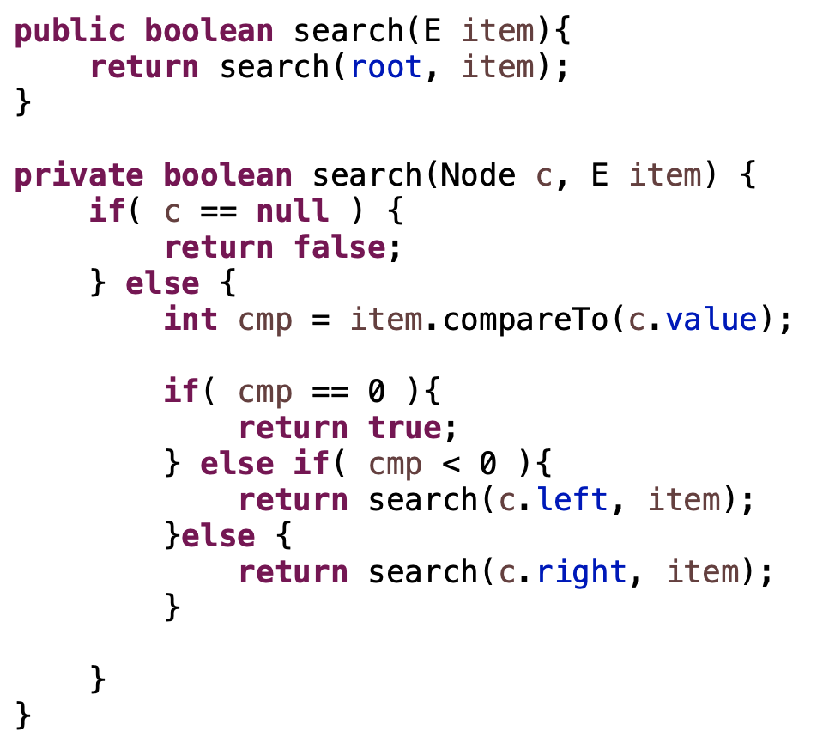
Finding an element

Slide 15
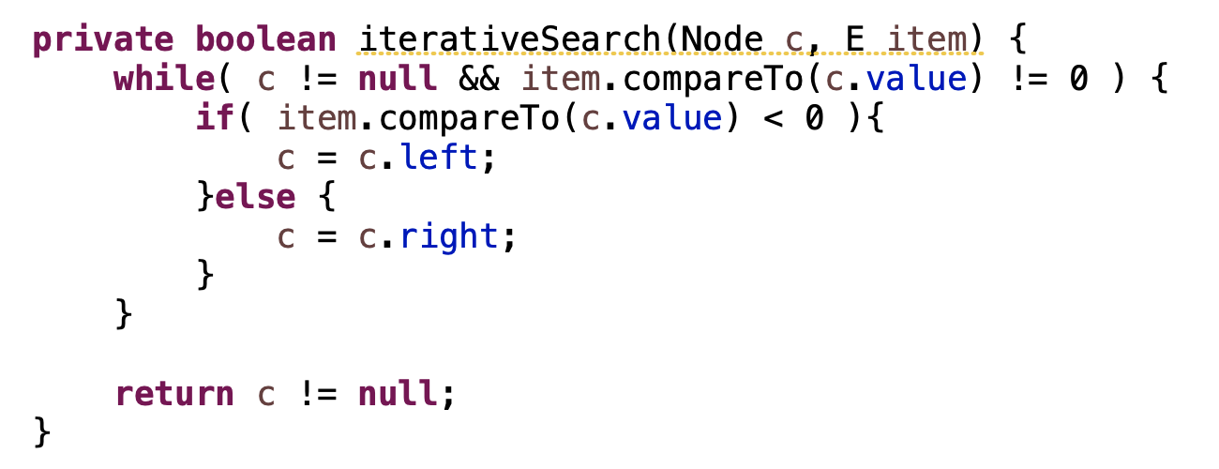
Finding an element

Slide 16
Finding an element
Search(9)
12
8
14
5
9
20
What is the worst case running time of search?

Slide 17
Finding an element
Search(9)
12
8
14
5
9
20
Worst case, have to search to the lowest leaf
O(height)

Slide 18
Inserting
Insert(17)
12
8
14
5
9
20
How do we insert an element?

Slide 19
Inserting
Insert(17)
12
8
14
5
9
20

Slide 20
Inserting
Insert(17)
12
8
14
5
9
20

Slide 21
Inserting
Insert(17)
12
8
14
5
9
20
17

Slide 22
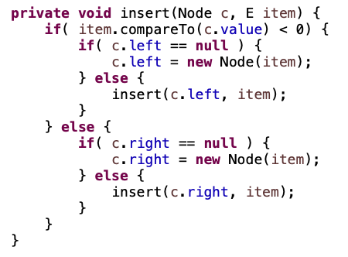
Inserting

Slide 23
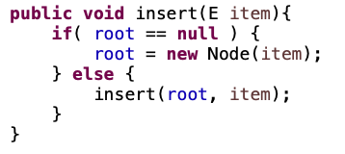
Inserting

Slide 24
Inserting
Insert(17)
12
8
14
5
9
20
17
What is the worst case running time of insert?

Slide 25
Inserting
Insert(17)
12
8
14
5
9
20
17
Worst case, have to search to the lowest leaf
O(height)

Slide 26
Inserting duplicate
Insert(14)
12
8
14
5
9
20

Slide 27
Visiting all nodes
In sorted order
12
8
14
5
9
20

Slide 28
Visiting all nodes
5
In sorted order
12
8
14
5
9
20

Slide 29
Visiting all nodes
5, 8
12
8
14
5
9
20

Slide 30
Visiting all nodes
5, 8, 9
12
8
14
5
9
20

Slide 31
Visiting all nodes
5, 8, 9, 12
12
8
14
5
9
20

Slide 32
Visiting all nodes
5, 8, 9, 12
What’s happening?
12
8
14
5
9
20

Slide 33
Visiting all nodes
5, 8, 9, 12, 14
12
8
14
5
9
20

Slide 34
Visiting all nodes
5, 8, 9, 12, 14, 20
12
8
14
5
9
20

Slide 35
Min/Max?
12
8
14
5
9
20

Slide 36
Successor and predecessor
Predecessor(12)?
9
12
8
14
5
9
13
20

Slide 37
Successor and predecessor
Predecessor in general?
largest node of all those smaller than this node
rightmost element of the left subtree
12
8
14
5
9
13
20

Slide 38
Successor
Successor(12)?
13
12
8
14
5
9
13
20

Slide 39
Successor
Successor in general?
smallest node of all those larger than this node
leftmost element of the right subtree
12
8
14
5
9
13
20

Slide 40
Successor
What if the node doesn’t have a right subtree?
smallest node of all those larger than this node
leftmost element of the right subtree
12
8
14
5
9
13
20

Slide 41
Successor
What if the node doesn’t have a right subtree?
node is the largest
the successor is the node that has x as a predecessor
12
8
14
5
9
13
20

Slide 42
Successor
successor is the node that has x as a predecessor
12
8
14
5
9
13
20

Slide 43
Successor
successor is the node that has x as a predecessor
12
8
14
5
9
13
20

Slide 44
Successor
successor is the node that has x as a predecessor
12
8
14
5
9
13
20

Slide 45
Successor
keep going up until we’re no longer a right child
successor is the node that has x as a predecessor
12
8
14
5
9
13
20

Slide 46
Deletion
12
8
14
5
9
13
20
Three cases!

Slide 47
Deletion: case 1
No children
Just delete the node
12
8
14
5
9
13
20
17

Slide 48
Deletion: case 1
No children
Just delete the node
12
8
14
5
13
20
17

Slide 49
Deletion: case 2
One child
Splice out the node
12
8
14
5
13
20
17

Slide 50
Deletion: case 2
One child
Splice out the node
12
5
14
13
20
17

Slide 51
Deletion: case 3
Two children Replace x with the smallest value of the right subtree
12
How does this maintain the search tree property?
5
14
13
20
17

Slide 52
Deletion: case 3
Two children Replace x with the smallest value of the right subtree
12
Larger than everything to the left
Smaller than everything to the right
5
14
13
20
17

Slide 53
Deletion: case 3
Two children Replace x with the smallest value of the right subtree
12
12
5
14
5
17
13
20
13
20
17

Slide 54
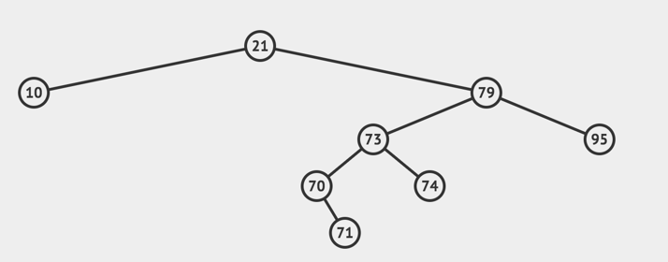
Deletion
Delete 21

Slide 55
Deletion
Min of the right subtree

Slide 56
Deletion
Replace the value: involves a case 2 deletion

Slide 57
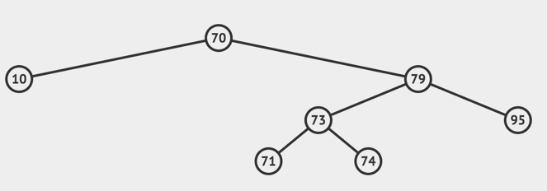
Deletion
Replace the value: involves a case 2 deletion

Slide 58
Deletion: case 3
The min of the right subtree will always be either a case 1 deletion or a case 2 deletion
Why?

Slide 59
Deletion: case 3
The min of the right subtree will always be either a case 1 deletion or a case 2 deletion
Why?
12
min
The minimum cannot have a left child

Slide 60
Deletion: case 3
The min of the right subtree will always be either a case 1 deletion or a case 2 deletion
Why?
12
min
The minimum cannot have a left child

Slide 61
Deletion: case 3
The min of the right subtree will always be either a case 1 deletion or a case 2 deletion
12
min
What is the worst case running time of delete?

Slide 62
Deletion: case 3
The min of the right subtree will always be either a case 1 deletion or a case 2 deletion
12
min
Case 1 and Case 2: O(1)
Case 3: Find min and do a case 1 or case 2 delete
O(height)

Slide 63
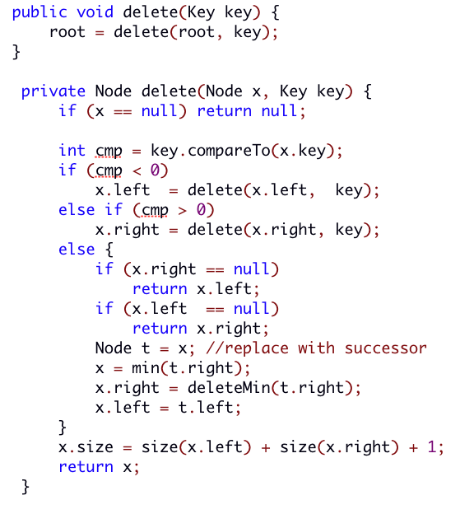
Delete implemented

Slide 64
Delete implemented
Search: find the key

Slide 65
Delete implemented
Case 1 and Case 2

Slide 66
Delete implemented
Case 3

Slide 67
Height of the tree
Most of the operations take time O(height)
Trees built from random data have height O(log n)
Two problems:
We can’t always insure random data
What happens when we delete nodes and insert others after building a tree?
Worst case height for binary search trees is O(n) ☹

Slide 68
Why BSTs?
Hashtables are fast at search/insert/delete, O(1)
Why BSTs?

Slide 69
Why BSTs?
Hashtables are fast at search/insert/delete, O(1)
Min/Max
Successor/predecessor
Inorder traversal
order statistics (5th largest element, etc.)
Notes:
,

Slide 70
Operations
Search – Does the key exist in the tree
Insert – Insert the key into tree
Delete – Delete the key from the tree

