Slide 1
priority queues
David Kauchak CS 62 – Spring 2021

Slide 2
Admin
Pre-pre enrollment
thanks all of you that are not potential CS majors for your patience!
Autocomplete assignment

Slide 3
Binary heap
A binary tree where the value of a parent is greater than or equal to the value of its children
Additional restriction: the tree must be complete!
Max heap vs. min heap

Slide 4
Binary heap - references
all nodes in a heap are themselves heaps
16
parent ≥ child
14
10
complete tree
8
7
9
3
2
4
1

Slide 5
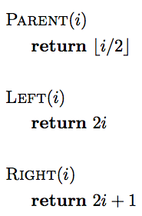
Binary heap - array

Slide 6
Binary heap - array
- 16 14 10 8 7 9 3 2 4 1
0 1 2 3 4 5 6 7 8 9 10
16
14
10
8
7
9
3
2
4
1

Slide 7
What are heaps good for?
16
14
10
8
7
9
3
2
4
1

Slide 8
ExtractMax
Return and remove the largest element in the set. The rest of the data should stay as a heap
16
14
10
8
7
9
3
2
4
1

Slide 9
ExtractMax
Remove the root
?
14
10
8
7
9
3
2
4
1

Slide 10
ExtractMax
Remove the last node (rightmost leaf on the last level) and put it at the root
1
14
10
8
7
9
3
2
4

Slide 11
Sink
Fix a heap where the left/right are heaps, but the parent/child ordering might be violated at the parent node
1
14
10
8
7
9
3
2
4

Slide 12
Sink
Fix a heap where the left/right are heaps, but the parent/child ordering might be violated at the parent node
14
Swap with largest child
1
10
8
7
9
3
2
4

Slide 13
Sink
Fix a heap where the left/right are heaps, but the parent/child ordering might be violated at the parent node
14
Swap with largest child
8
10
1
7
9
3
2
4

Slide 14
Sink
Fix a heap where the left/right are heaps, but the parent/child ordering might be violated at the parent node
14
8
10
Swap with largest child
4
7
9
3
2
1

Slide 15
Sink: when are we done?
Fix a heap where the left/right are heaps, but the parent/child ordering might be violated at the parent node
10
9
4
8
7
1
2
2
4
- At a leaf
- if the node is larger than the two children

Slide 16
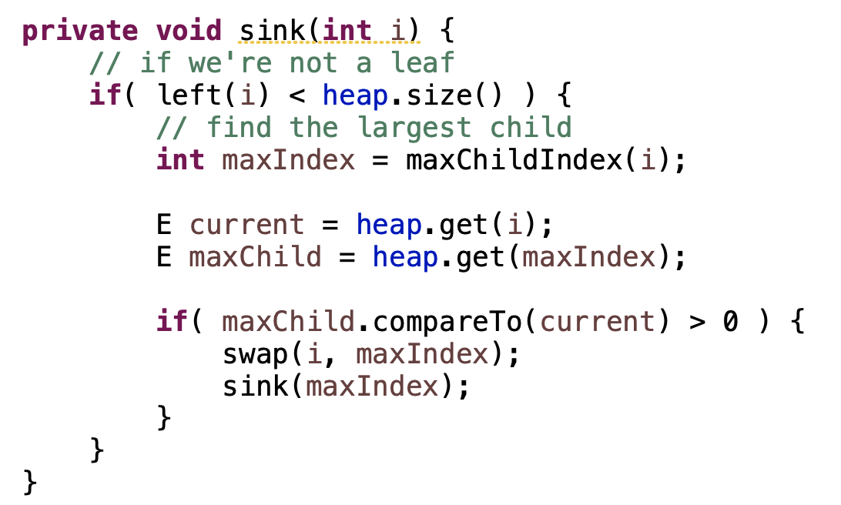
sink/heapify/demote

Slide 17
sink runtime
What is the worst case runtime?

Slide 18
sink runtime
What is the worst case runtime?
O(height of tree)

Slide 19
sink runtime
What is the worst case runtime?
O(log n)

Slide 20
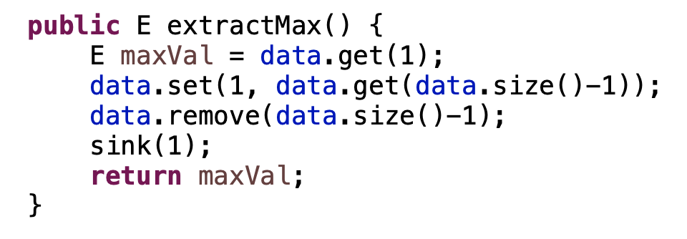
ExtractMax
largest value is at the root (index 1)
move the last value to the root
remove the last item
call sink on the root
return the largest value

Slide 21
ExtractMax
What is the worst case runtime?

Slide 22
ExtractMax
What is the worst case runtime?
O(log n)

Slide 23
Insert
How do we insert a value into a heap?
16
14
10
15
8
7
9
3
2
4
1

Slide 24
Insert
Insert the value at the end of the array (or as the rightmost leaf)
16
14
10
8
7
9
3
2
4
1
15

Slide 25
Insert
Swap the value up until it’s in the right place
16
14
10
8
7
9
3
swim value up
2
4
1
15

Slide 26
Insert
Swap the value up until it’s in the right place
16
14
10
8
15
9
3
swim value up
2
4
1
7

Slide 27
Insert
Swap the value up until it’s in the right place
16
14
10
swim value up
8
15
9
3
2
4
1
7

Slide 28
Insert
Swap the value up until it’s in the right place
16
15
10
swim value up
8
14
9
3
2
4
1
7

Slide 29
Insert
Swap the value up until it’s in the right place
16
swim value up
15
10
8
14
9
3
2
4
1
7

Slide 30
Insert
Swap the value up until it’s in the right place
16
When do we stop?
swim value up
15
10
8
14
9
3
2
4
1
7

Slide 31
Insert
Swap the value up until it’s in the right place
16
When do we stop?
swim value up
Less than our parent
or we’re the root
15
10
8
14
9
3
2
4
1
7

Slide 32
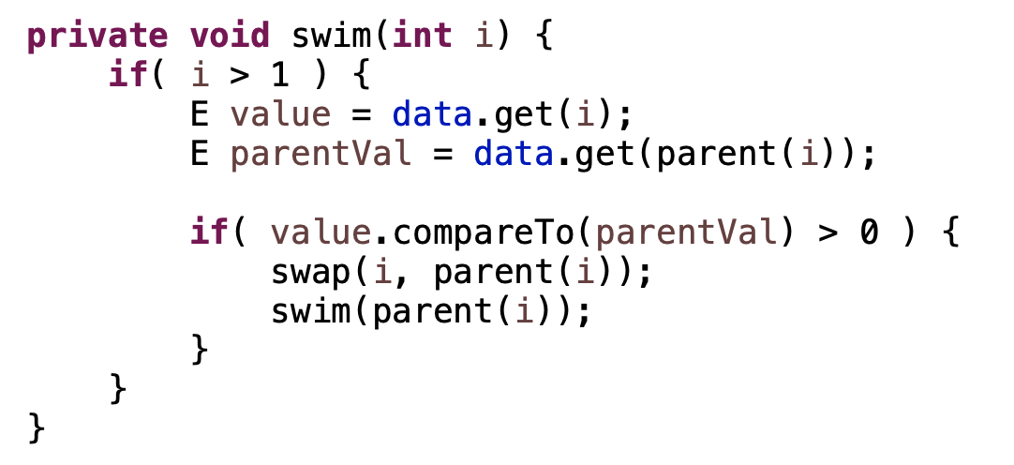
swim/percolate up

Slide 33
swim/percolate up
What’s the worst case runtime?

Slide 34
swim/percolate up
What’s the worst case runtime?
O(height of tree) = O(log n)

Slide 35
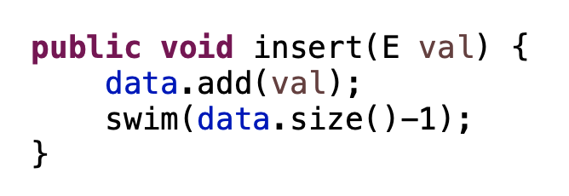
insert

Slide 36
insert
What’s the worst case runtime?

Slide 37
insert
What’s the worst case runtime?
O(log n)

Slide 38
Heaps summarized
Very good at extracting min/max (depending on heap ordering)
 | best | worst | average
max | O(1) | O(1) | O(1)
extractMax | O(1) | O(log n) | O(log n)
insert | O(1) | O(log n) | O(log n)
change node | O(1) | O(log n) | O(log n)

Slide 39
Heapsort
Could we sort data with a heap?
What would be the runtime (best, average, worst)?
 | best | worst | average
max | O(1) | O(1) | O(1)
extractMax | O(1) | O(log n) | O(log n)
insert | O(1) | O(log n) | O(log n)
change node | O(1) | O(log n) | O(log n)

Slide 40
Heapsort
Build a heap out of the data (e.g., insert n items into heap)
Call extractMin n times and add to answer

Slide 41
Heapsort runtime
Build a heap out of the data (e.g., insert n items into heap)
Call extractMin n times and add to answer
Best case?
Worst case?
Average case?

Slide 42
Heapsort runtime
Best case?
Worst case?
Average case?
O(n) – when all items have the same value
O(n log n)
O(n log n)
 | best | worst | average
max | O(1) | O(1) | O(1)
extractMax | O(1) | O(log n) | O(log n)
insert | O(1) | O(log n) | O(log n)
change node | O(1) | O(log n) | O(log n)

Slide 43
Heapsort
Build a heap out of the data (e.g., insert n items into heap)
Call extractMin n times and add to answer
Stable?
In-place?
No.
Not this implementation, but can be done without too much trouble

Slide 44
Sorting summarized
 | in-place? | stable? | Best | Average | Worst | Notes
Selection | X |  | O(n²) | O(n²) | O(n²) | n swaps
Insertion | X | X | O(n) | O(n²) | O(n²) | use for partially ordered
Merge |  | X | O(n log n) | O(n log n) | O(n log n) | guaranteed, stable
Quick | X |  | O(n log n) | O(n log n) | O(n²) | fastest in practice
Heap | X |  | O(n) | O(n log n) | O(n log n) | guaranteed, in-place

Slide 45
Priority Queues
Queues work well for keeping track of sequential ordering when everything is equivalent (e.g., waiting in line to get lunch!)
Some queues everything is not equivalent (e.g., ER waiting room)
Priority queues support add/remove orderd by a weight/priority

Slide 46
Priority Queues
Applications?

Slide 47
Priority Queues
Applications?
process scheduling (e.g., ‘top’ command)
network traffic scheduling
Many algorithms
Search algorithms (A*)
Shortest paths algorithms (Dijsktra’s)
Minimum spanning trees (Prim’s)
Huffman codes

Slide 48
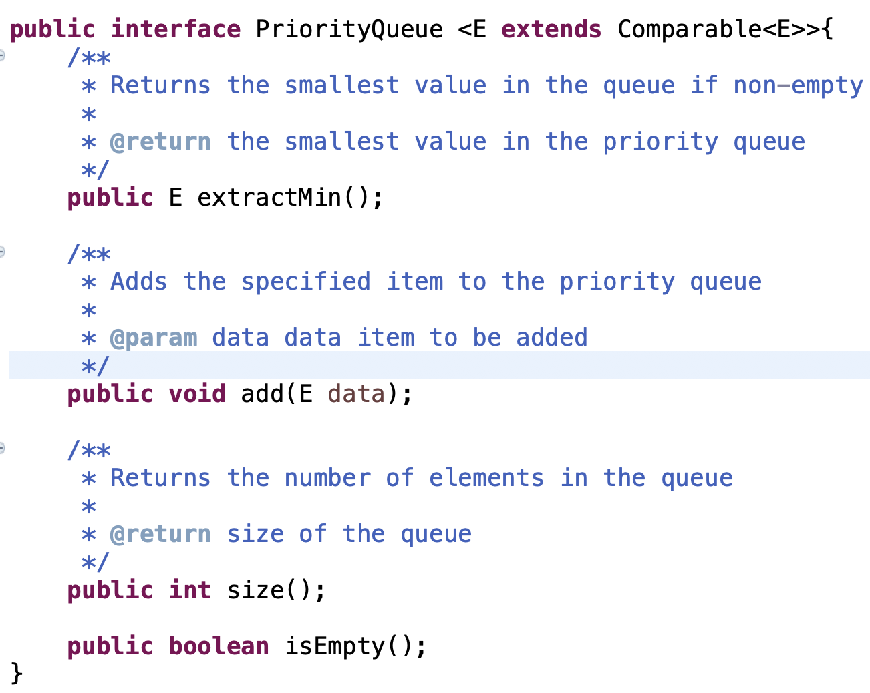
Priority queue interface

Slide 49
Priority queue
two key methods:
add
extractMin (highest priority)
How can we do this?
See how many options you can come up with that have *different* runtimes for operations!

Slide 50
Option 1: unordered ArrayList
add:
extractMin:

Slide 51
Option 1: unordered ArrayList
add: add to the end of the ArrayList
extractMin: search for the smallest, return and remove it
Worst case running times?

Slide 52
Option 1: unordered ArrayList
add: add to the end of the ArrayList
O(1) amortized
extractMin: search for the smallest, return and remove it
O(n)
Worst case running times?

Slide 53
Option 1b: unordered LinkedList
add: add to the end of the linked list
extractMin: search for the smallest, return and remove it
Worst case running times?

Slide 54
Option 1b: unordered LinkedList
add: add to the end of the linked list
O(1)
extractMin: search for the smallest, return and remove it
O(n)
Worst case running times?

Slide 55
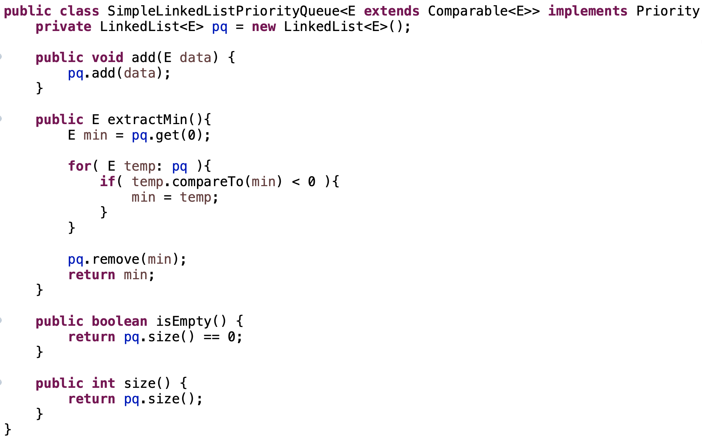
Option 1b: unordered LinkedList

Slide 56
Option 2: sorted order linked list
add:
extractMin:

Slide 57
Option 2: sorted order linked list
add: search for the correct location and insert
extractMin: remove and return the first thing from the list
Worst case running times?

Slide 58
Option 2: sorted order linked list
add: search for the correct location and insert O(n)
extractMin: remove and return the first thing from the list O(1)
Worst case running times?

Slide 59
Option 3: heap
add/insert
extractMin
Worst case running times?

Slide 60
Option 3: heap
add/insert
O(log n)
extractMin
O(log n)
Worst case running times?

Slide 61
Priority queues summarized
Different scenarios may benefit from different implementations
Priority queue ≠ heap
 | add | extractMin
unordered linked list | O(1) | O(n)
sorted linked list | O(n) | O(1)
heap | O(log n) | O(log n)

Slide 62
How do we build a heap?
You have n values you want to build a heap out of
How can we build it?

Slide 63
One option
n calls to Insert – O(n log n)
Can we do better?
…

Slide 64
Another option

Slide 65
Another option
Why does this work?!

Slide 66
4 1 3 2 16 9 10 14 8 7
1 2 3 4 5 6 7 8 9 10
4
1
3
2
16
9
10
14
8
7

Slide 67
swim
4 1 3 2 16 9 10 14 8 7
1 2 3 4 5 6 7 8 9 10
4
1
3
2
16
9
10
14
8
7

Slide 68
swim
4 1 3 2 16 9 10 14 8 7
1 2 3 4 5 6 7 8 9 10
4
1
3
2
16
9
10
14
8
7

Slide 69
swim
4 1 3 14 16 9 10 2 8 7
1 2 3 4 5 6 7 8 9 10
4
1
3
14
16
9
10
2
8
7

Slide 70
swim
4 1 3 14 16 9 10 2 8 7
1 2 3 4 5 6 7 8 9 10
4
1
3
14
16
9
10
2
8
7

Slide 71
swim
4 1 10 14 16 9 3 2 8 7
1 2 3 4 5 6 7 8 9 10
4
1
10
14
16
9
3
2
8
7

Slide 72
swim
4 1 10 14 16 9 3 2 8 7
1 2 3 4 5 6 7 8 9 10
4
1
10
14
16
9
3
2
8
7

Slide 73
swim
4 16 10 14 7 9 3 2 8 1
1 2 3 4 5 6 7 8 9 10
4
16
10
14
7
9
3
2
8
1

Slide 74
swim
4 16 10 14 7 9 3 2 8 1
1 2 3 4 5 6 7 8 9 10
4
16
10
14
7
9
3
2
8
1

Slide 75
swim
16 14 10 8 7 9 3 2 4 1
1 2 3 4 5 6 7 8 9 10
16
14
10
8
7
9
3
2
4
1

Slide 76
Sink revisited
What does sink assume about the children of i?

Slide 77
Sink revisited
What does sink assume about the children of i?
That they’re valid heaps

Slide 78
Building a heap
Start with n/2 “simple” heaps
call swim on element n/2-1, n/2-2, n/2-3 …
all children have smaller indices
building from the bottom up, makes sure that all the children are heaps

Slide 79
Building a heap
Worst case runtime?

Slide 80
Building a heap
Worst case runtime?
O(n)

