Slide 1
hEAPS
David Kauchak CS 62 – Spring 2021

Slide 2
Admin
Pre-pre enrollment
OnDiskSort
Lab tomorrow

Slide 3
Trees
A set of nodes based on a parent-child relationship
Each node has one parent
Root has no parent
2
14
10
3
1
9
7
2
4
8
16

Slide 4
Binary tree
2
14
10
Each parent has at most 2 children
3
1
9
7
2
8
16

Slide 5
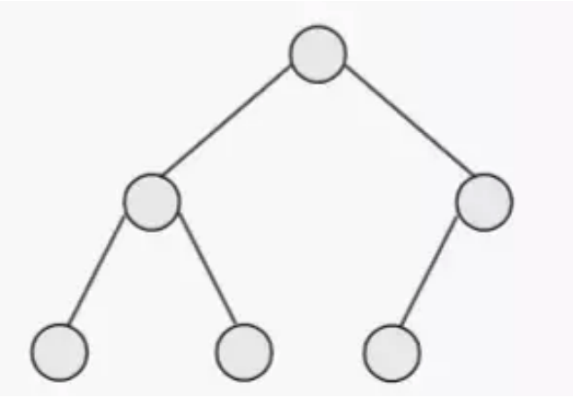
Full + Complete?
12
Full tree: a binary tree where every node has 0 or 2 children
Complete: All levels except the last are completely filled and all nodes on the last level are on the left

Slide 6
Full + Complete?
12
Complete
Full + Complete
Neither

Slide 7
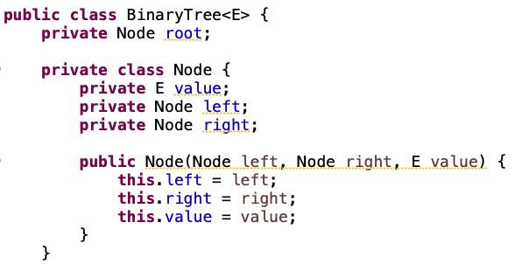
Implementing a binary tree

Slide 8
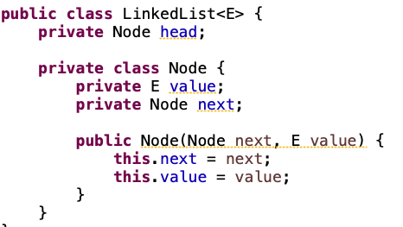
Recursive data structure!

Slide 9
Tree traversals
Inorder(node):
Inorder(left) visit node (e.g., print)
Inorder(right)
F
C
A
G
H
B
E
E
F
What would be printed out?

Slide 10
Tree traversals
Inorder(node):
Inorder(left) visit node (e.g., print)
Inorder(right)
F
C
A
G
H
B
E
E
F
E G F C H F B A E

Slide 11
Tree traversals
Postorder(node):
Postorder(left)
Postorder(right) visit node (e.g., print)
F
C
A
G
H
B
E
E
F
What would be printed out?

Slide 12
Tree traversals
Postorder(node):
Postorder(left)
Postorder(right) visit node (e.g., print)
F
C
A
G
H
B
E
E
F
E F G H C B E A F

Slide 13
Tree traversals
Preorder(node):
visit node (e.g., print)
Preorder(left)
Preorder(right)
F
C
A
G
H
B
E
E
F
What would be printed out?

Slide 14
Tree traversals
Preorder(node):
visit node (e.g., print)
Preorder(left)
Preorder(right)
F
C
A
G
H
B
E
E
F
F C G E F H A B E

Slide 15
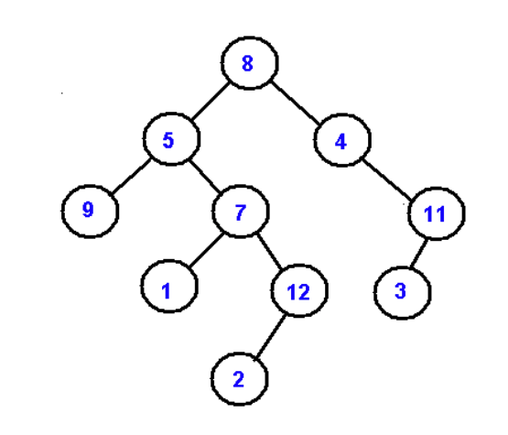
in-order, post-order, pre-order
Inorder(node):
Inorder(left) visit node (e.g., print)
Inorder(right)
Postorder(node):
Postorder(left)
Postorder(right) visit node (e.g., print)
Preorder(node):
visit node (e.g., print)
Preorder(left)
Preorder(right)

Slide 16
Binary heap
A binary tree where the value of a parent is greater than or equal to the value of its children
Additional restriction: the tree must be complete!
Max heap vs. min heap

Slide 17
Binary heap - references
all nodes in a heap are themselves heaps
16
parent ≥ child
14
10
complete tree
8
7
9
3
2
4
1
level does not indicate size

Slide 18
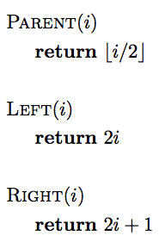
Binary heap - array

Slide 19
Binary heap - array
- 16 14 10 8 7 9 3 2 4 1
0 1 2 3 4 5 6 7 8 9 10
Note 0 is empty!

Slide 20
Binary heap - array
- 16 14 10 8 7 9 3 2 4 1
0 1 2 3 4 5 6 7 8 9 10
Left child of A[3]?

Slide 21
Binary heap - array
- 16 14 10 8 7 9 3 2 4 1
0 1 2 3 4 5 6 7 8 9 10
Left child of A[3]?
2*3 = 6

Slide 22
Binary heap - array
- 16 14 10 8 7 9 3 2 4 1
0 1 2 3 4 5 6 7 8 9 10
Parent of A[8]?

Slide 23
Binary heap - array
- 16 14 10 8 7 9 3 2 4 1
0 1 2 3 4 5 6 7 8 9 10
Parent of A[8]?

Slide 24
Binary heap - array
- 16 14 10 8 7 9 3 2 4 1
0 1 2 3 4 5 6 7 8 9 10
16
14
10
8
7
9
3
2
4
1

Slide 25
Identify the valid heaps
[-, 15, 12, 3, 11, 10, 2, 1, 7, 8]
16
10
15
9
3
8
[-, 20, 18, 10, 17, 16, 15, 9, 14, 13]

Slide 26
What are heaps good for?
16
14
10
8
7
9
3
2
4
1

Slide 27
What are heaps good for?
What’s the largest value in this heap?
16
14
10
8
7
9
3
2
4
1

Slide 28
What are heaps good for?
What’s the largest value in this heap?
16
14
10
Heaps are good at min/max operations (depending on min/max ordering)!
8
7
9
3
2
4
1

Slide 29
What are heaps good for?
What’s the 2nd largest value? The 3rd? The 4th?
16
14
10
8
7
9
3
2
4
1

Slide 30
ExtractMax
Return and remove the largest element in the set. The rest of the data should stay as a heap
16
14
10
8
7
9
3
2
4
1

Slide 31
ExtractMax
Return and remove the largest element in the set. The rest of the data should stay as a heap
?
14
10
8
7
9
3
2
4
1

Slide 32
ExtractMax
Return and remove the largest element in the set. The rest of the data should stay as a heap
14
?
10
8
7
9
3
2
4
1

Slide 33
ExtractMax
Return and remove the largest element in the set. The rest of the data should stay as a heap
14
8
10
4
7
9
3
?
2
1
Now what? Is this a heap?

Slide 34
ExtractMax
Return and remove the largest element in the set. The rest of the data should stay as a heap
?
14
10
8
7
9
3
2
4
1

Slide 35
ExtractMax
Return and remove the largest element in the set. The rest of the data should stay as a heap
1
14
10
8
7
9
3
2
4

Slide 36
ExtractMax
Return and remove the largest element in the set. The rest of the data should stay as a heap
1
14
10
8
7
9
3
2
4
Now what?

Slide 37
ExtractMax
Return and remove the largest element in the set. The rest of the data should stay as a heap
14
Swap with largest child
1
10
8
7
9
3
2
4

Slide 38
ExtractMax
Return and remove the largest element in the set. The rest of the data should stay as a heap
14
1
10
8
7
9
3
2
4
Now what?

Slide 39
ExtractMax
Return and remove the largest element in the set. The rest of the data should stay as a heap
14
Swap with largest child
8
10
1
7
9
3
2
4

Slide 40
ExtractMax
Return and remove the largest element in the set. The rest of the data should stay as a heap
14
8
10
Swap with largest child
1
7
9
3
2
4

Slide 41
ExtractMax
Return and remove the largest element in the set. The rest of the data should stay as a heap
14
8
10
Swap with largest child
4
7
9
3
2
1

Slide 42
ExtractMax
Return and remove the largest element in the set. The rest of the data should stay as a heap
14
8
10
4
7
9
3
When are we done?
2
1

Slide 43
ExtractMax
Return and remove the largest element in the set. The rest of the data should stay as a heap
14
8
10
4
7
9
3
When are we done?
2
1
We’re at a leaf

Slide 44
ExtractMax
Return and remove the largest element in the set. The rest of the data should stay as a heap
16
9
10
8
7
1
2
2
4
4
Will it always be a leaf?

Slide 45
ExtractMax
Return and remove the largest element in the set. The rest of the data should stay as a heap
4
Swap with largest child
9
10
8
7
1
2
2
4

Slide 46
ExtractMax
Return and remove the largest element in the set. The rest of the data should stay as a heap
10
Swap with largest child
9
4
8
7
1
2
2
4

Slide 47
ExtractMax
Return and remove the largest element in the set. The rest of the data should stay as a heap
10
9
4
8
7
1
2
What next?
2
4

Slide 48
ExtractMax
Return and remove the largest element in the set. The rest of the data should stay as a heap
10
9
4
8
7
1
2
What next?
2
4
We’re done!
Also stop if the node is larger than the two children

Slide 49
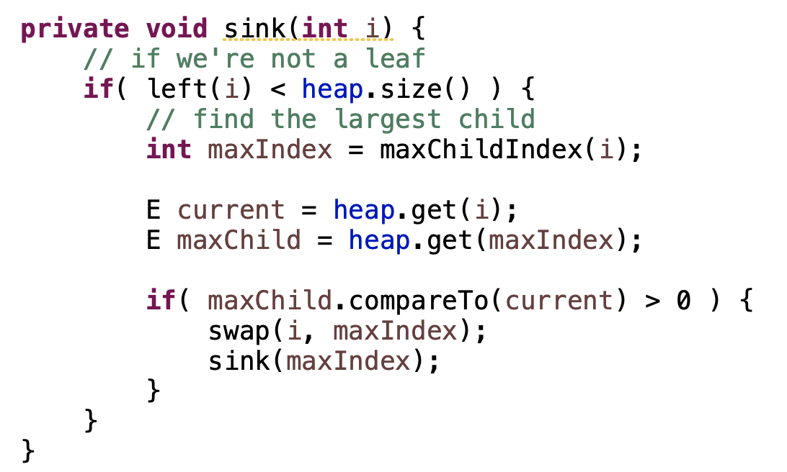
sink/heapify/demote

Slide 50
sink runtime
What is the worst case runtime?

Slide 51
sink runtime
What is the worst case runtime?
O(height of tree)

Slide 52
Nodes in a binary tree
F
What is the tallest you can make a complete tree, using the fewest nodes?
C
A
G
H
B
E

Slide 53
Nodes in a binary tree
F
What is the tallest you can make a complete tree, using the fewest nodes?
C
A
G
H
B
E
J
$$1+2+4+8+…+2^{h−1}+1=2^{h}$$

Slide 54
Nodes in a binary tree
F
What is the tallest you can make a complete tree, using the fewest nodes?
C
A
G
H
B
E
J
$$n=2^{h}$$
$$h=log⁡(n)$$

Slide 55
sink runtime
What is the worst case runtime?
O(log n)

Slide 56
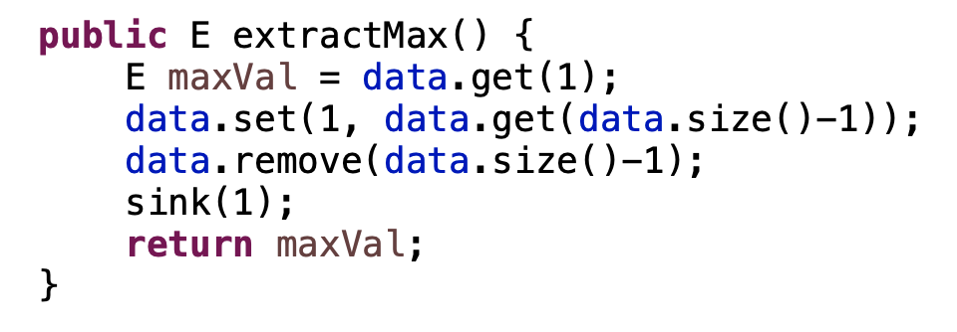
ExtractMax

Slide 57
ExtractMax
What is the worst case runtime?

Slide 58
ExtractMax
What is the worst case runtime?
O(log n)

