Slide 1
binary trees
David Kauchak CS 62 – Spring 2021

Slide 2
Admin
Learning community reorganization
https://docs.google.com/spreadsheets/d/1xvZL4y_FTq1h8nhYFmwCYBL_qv2neLM-n8KqkNRdadA/edit#gid=0
Advisor declaration + pre-pre enrollment
Town hall this afternoon (4:10pm)
Office hours today: 3:30-4pm

Slide 3
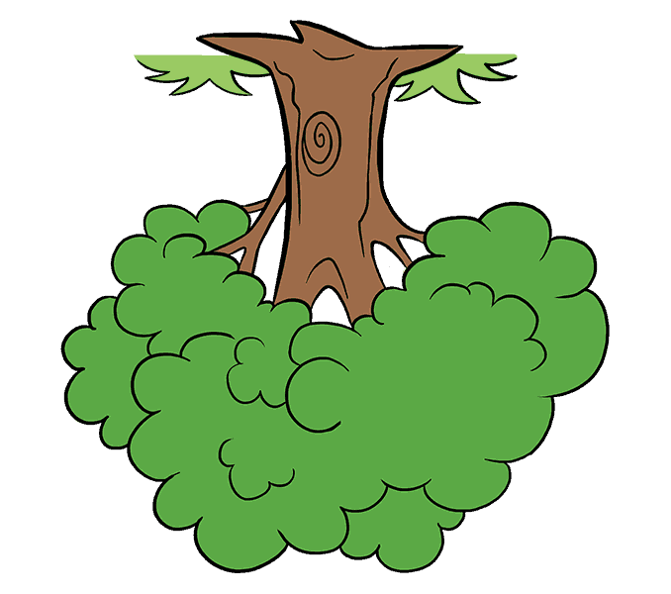
Trees
2
14
10
root
3
1
9
7
leaves
2
4
8
16

Slide 4
Trees
A set of nodes based on a parent-child relationship
Each node has one parent
Root has no parent
2
14
10
3
1
9
7
2
4
8
16

Slide 5
Another example
B
F
C
E
A
D

Slide 6
Another example: the lone wolf
12

Slide 7
Another example: the twig
D
B
A
F

Slide 8
Binary tree
2
14
10
Each parent has at most 2 children
3
1
9
7
2
8
16

Slide 9
Tree terminology
Edge:
one of the lines
Defined by a parent and child, (C,F)
F
C
A
G
H
B
E
E
F
E

Slide 10
Tree terminology
Sibling: two nodes that share the same parent
E and F are siblings
F
C
A
G
H
B
E
E
F
E

Slide 11
Tree terminology
Subtree: a node and all of the nodes below it
subtree rooted at C
F
C
A
G
H
B
E
E
F
E

Slide 12
Tree terminology
Leaf: node without any children
Internal node: non-leaf node
F
C
A
G
H
B
E
E
F
E

Slide 13
Tree terminology
Simple path: a series of distinct nodes with edges between successive nodes
F-C-H-E
F
C
A
G
H
B
E
E
F
E

Slide 14
Tree terminology
Simple path: a series of distinct nodes with edges between successive nodes
F-C-H-E
Path length: number of edges on path
F
C
A
G
H
B
E
E
F
E
How long is this path?

Slide 15
Tree terminology
Simple path: a series of distinct nodes with edges between successive nodes
F-C-H-E
Path length: number of edges on path
F
C
A
G
H
B
E
E
F
E
3, (F,C), (C,H), (H,E)

Slide 16
Tree terminology
Height of a node: length of longest path from the node to a leaf
F
C
A
G
H
B
E
What is the height of C?
E
F
E

Slide 17
Tree terminology
Height of a node: length of longest path from the node to a leaf
F
C
A
G
H
B
E
What is the height of C?
E
F
E
2

Slide 18
Tree terminology
Height of a node: length of longest path from the node to a leaf
F
C
A
G
H
B
E
What is the height of C?
E
F

Slide 19
Tree terminology
Height of a node: length of longest path from the node to a leaf
F
C
A
G
H
B
E
What is the height of C?
E
F
2

Slide 20
Tree terminology
Height of the tree: height of the root (longest path from root to a leaf)
F
C
A
G
H
B
E
What is the height of the tree?
E
F
E

Slide 21
Tree terminology
Height of the tree: height of the root (longest path from root to a leaf)
F
C
A
G
H
B
E
What is the height of the tree?
E
F
E
3

Slide 22
Tree terminology
What is the height of the tree?
D
B
A
F

Slide 23
Tree terminology
What is the height of the tree?
D
B
3
A
F

Slide 24
Tree terminology
Degree of node: number of children
Degree of tree (arity): max degree of any of the nodes
F
C
A
G
H
B
E
What is the degree of the tree?
E
F
E

Slide 25
Tree terminology
Degree of node: number of children
Degree of tree (arity): max degree of any of the nodes
F
C
A
G
H
B
E
What is the degree of the tree?
2
E
E
F

Slide 26
Tree terminology
Degree of node: number of children
Degree of tree (arity): max degree of any of the nodes
2
14
10
3
1
9
7
What is the degree of the tree?
2
4
8
16

Slide 27
Tree terminology
Degree of node: number of children
Degree of tree (arity): max degree of any of the nodes
2
14
10
3
1
9
7
What is the degree of the tree?
3
16
2
4
8

Slide 28
Tree terminology
Level/depth of node:
Root is 0
Level(child) = 1 + level(parent)
(also: length of path from root to node)
F
C
A
G
H
B
E
What is the depth of G?
E
F
E

Slide 29
Tree terminology
Level/depth of node:
Root is 0
Level(child) = 1 + level(parent)
(also: length of path from root to node)
F
C
A
G
H
B
E
What is the depth of G?
E
F
E
2

Slide 30
Tree terminology
Height of node:
Leaf is 0
h(node) = max height of children
F
C
A
G
H
B
E
What is the height of C?
E
F

Slide 31
Tree terminology
Height of node:
Leaf is 0
h(node) = max height of children
F
C
A
G
H
B
E
What is the height of C?
E
F
2

Slide 32
Tree terminology (almost there!)
Full tree: a binary tree where every node has 0 or 2 children
Complete: All levels except the last are completely filled and all nodes on the last level are on the left

Slide 33
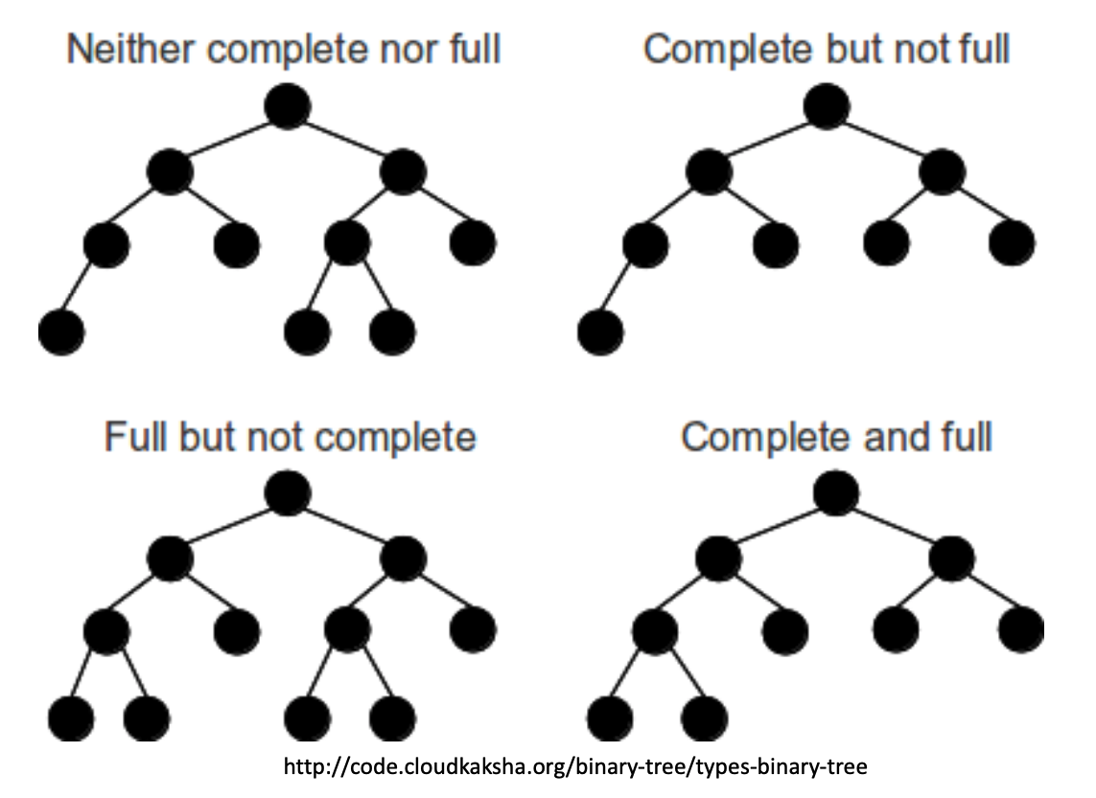
Full + Complete

Slide 34
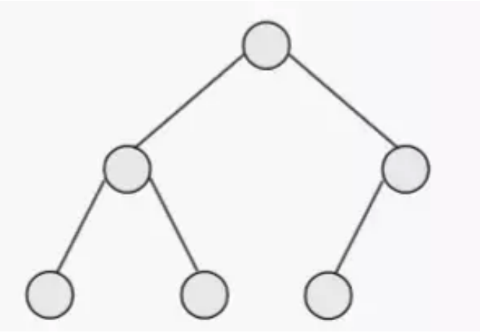
Full + Complete?
12
Full tree: a binary tree where every node has 0 or 2 children
Complete: All levels except the last are completely filled and all nodes on the last level are on the left

Slide 35
Full + Complete?
12
Complete
Full + Complete
Neither

Slide 36
Nodes in a binary tree
F
What is the most nodes we can have at a level k?
C
A
Level = 2
G
H
B
E
E
F

Slide 37
Nodes in a binary tree
F
What is the most nodes we can have at a level k?
C
A
Level = 2
G
H
B
E
At most 2^{k} nodes (when every node above it has two children)
E
F

Slide 38
Nodes in a binary tree
F
What is the most nodes we can have in a tree of height h?
C
A
G
H
B
E
E
F

Slide 39
Nodes in a binary tree
F
What is the most nodes we can have in a tree of height h?
C
A
G
H
B
E
$$1+2+4+8+…+2h=2^{h+1}−1$$
When the tree is full and complete!

Slide 40
Nodes in a binary tree
F
What is the smallest number of nodes we can have in a tree of height h?
C
A
G
H
B
E
E
F

Slide 41
Nodes in a binary tree
D
B
What is the smallest number of nodes we can have in a tree of height h?
A
h+1 (the twig!)
F

Slide 42
Nodes in a binary tree
$$n=2^{h+1}−1$$
F
$$n+1=2^{h+1}$$
C
A
$$2^{h+1}=n+1$$
$$h+1=log⁡(n+1)$$
G
H
B
E
$$h=\log\left(n+1\right)−1$$

Slide 43
Nodes in a binary tree
F
C
A
G
H
B
E
$$\log\left(n+1\right)−1≤h≤n−1$$
Height is somewhere between log(n) of nodes and n nodes

