Slide 1
Comparators + iterators
David Kauchak CS 62 – Spring 2021

Slide 2
Admin
Compression assignment

Slide 3
Partition

Slide 4
lessThanIndex
i
… 5 1 2 7 8 4 3 6 …
start
end
≤ pivot
> pivot
unprocessed

Slide 5
vals[end] is called the pivot
Partitions the elements nums[start…end-1] in to two sets, those ≤ pivot and those > pivot
Operates in place
Final result:
start
pivot
end
nums
≤ pivot
> pivot

Slide 6
Partition running time?
O(n)
Notes:
where n is end-start
just walks through each element in this range and does a constant amount of work

Slide 7
Quicksort

Slide 8
Quicksort
8 5 1 3 6 2 7 4

Slide 9
Quicksort
8 5 1 3 6 2 7 4

Slide 10
Quicksort
1 3 2 4 6 8 7 5

Slide 11
Quicksort
1 3 2 4 6 8 7 5

Slide 12
Quicksort
1 3 2 4 6 8 7 5

Slide 13
Quicksort
1 2 3 4 6 8 7 5

Slide 14
Quicksort
1 2 3 4 6 8 7 5

Slide 15
Quicksort
1 2 3 4 6 8 7 5

Slide 16
Quicksort
1 2 3 4 6 8 7 5

Slide 17
Quicksort
1 2 3 4 6 8 7 5

Slide 18
Quicksort
1 2 3 4 5 8 7 6
What happens here?

Slide 19
Quicksort
1 2 3 4 5 8 7 6

Slide 20
Quicksort
1 2 3 4 5 8 7 6

Slide 21
Quicksort
1 2 3 4 5 6 7 8

Slide 22
Quicksort
1 2 3 4 5 6 7 8

Slide 23
Running time of Quicksort?
Worst case?
Each call to Partition splits the array into an empty array and n-1 array

Slide 24
Quicksort: Worst case running time
n-1 + n-2 + n-3 + … + 1 =
O(n²)
When does this happen?
sorted
reverse sorted
near sorted/reverse sorted

Slide 25
Quicksort best case?
Each call to Partition splits the array into two equal parts
…
How much work is done at each “level”, i.e. running time of a level?
O(n)

Slide 26
Quicksort best case?
Each call to Partition splits the array into two equal parts
…
How many levels are there?
Similar to mergesort, each call to Partition will throw away half the data until we’re down to one element: log₂ n levels

Slide 27
Quicksort best case?
Each call to Partition splits the array into two equal parts
…
Overall runtime?
O(n log n)

Slide 28
Quicksort Average case?
Two intuitions
As long as the Partition procedure always splits the array into some constant ratio between the left and the right, say L-to-R, e.g. 9-to-1, then we maintain O(n log n)
As long as we only have a constant number of “bad” partitions intermixed with a “good partition” then we maintain O(n log n)

Slide 29
How can we avoid the worst case?
Inject randomness into the data
void randomizedPartition(E [] nums, int start, int end){
int i = randomInt(start, end);
swap(nums, i, end);
return partition = partition(nums, start, end);
}
Randomized quicksort is average case O(n log n)

Slide 30
What is the worst case running time of randomized Quicksort?
O(n²)
We could still get very unlucky and pick “bad” partitions at every step

Slide 31
Quicksort properties
Stable?
In-place?

Slide 32
Quicksort properties
Stable: possible, but not the way we’ve written it (and requires more storage!)
In-place: yes!

Slide 33
Sorting summarized
 | in-place? | stable? | Best | Average | Worst | Notes
Selection | X |  | O(n²) | O(n²) | O(n²) | n swaps
Insertion | X | X | O(n) | O(n²) | O(n²) | use for partially ordered
Merge |  | X | O(n log n) | O(n log n) | O(n log n) | guaranteed
Quick | X |  | O(n log n) | O(n log n) | O(n²) | fastest in practice

Slide 34
Comparable interface
https://docs.oracle.com/javase/8/docs/api/java/lang/Comparable.html
Interface Comparable<T>
int compareTo(T other)
-1: this object is less than other (technically, any negative number)
0: this object is equal to other
1: this object is greater than other (technically, any positive number)

Slide 35
Built-in sorting
Arrays: (https://docs.oracle.com/javase/8/docs/api/java/util/Arrays.html)
Collections:(https://docs.oracle.com/javase/8/docs/api/java/util/Collections.html)

Slide 36
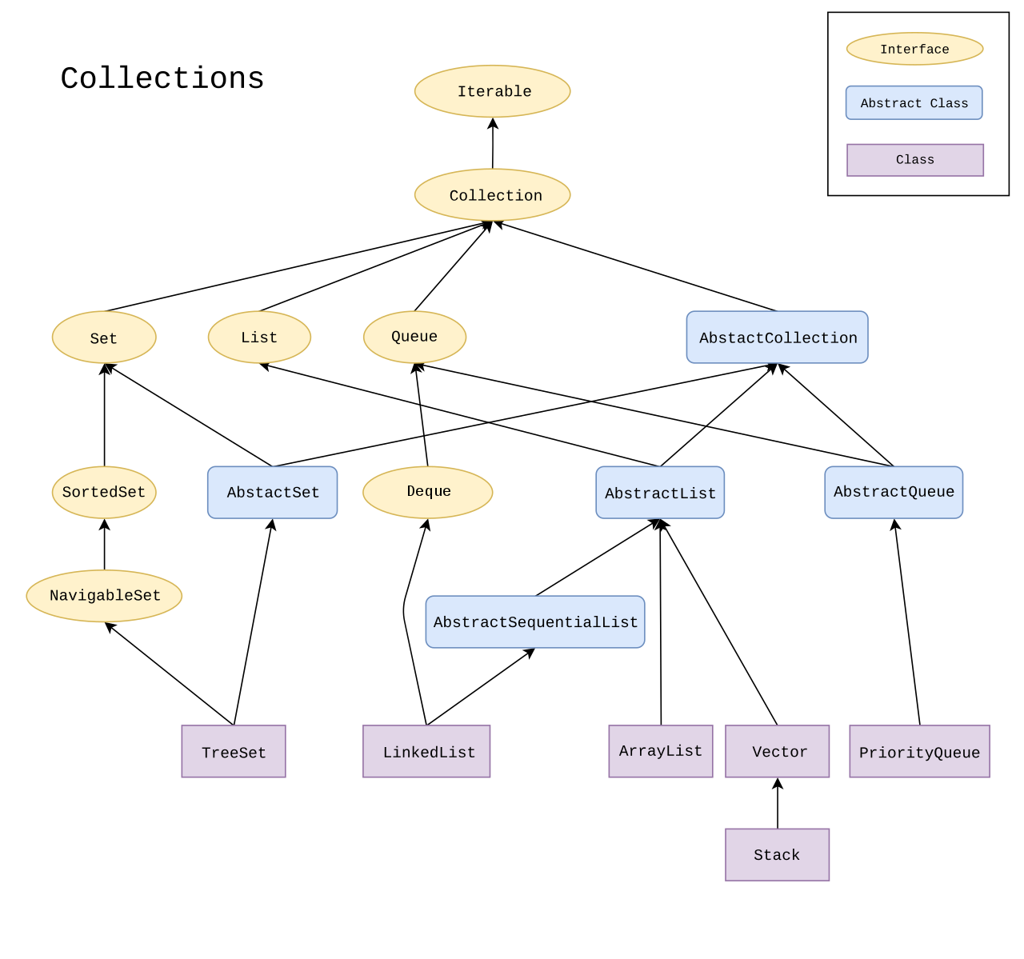
Collections

Slide 37
Naturally sorting cards
https://github.com/pomonacs622021sp/LectureCode/blob/master/SortingCards/SortableCard.java
SortableCard:
implements Comparable<SortableCard>
Utilizes String.compareTo and Integer.compare
Foreach loop!
naturalSort()

Slide 38
Comparator: unnatural sorting
https://docs.oracle.com/javase/8/docs/api/java/util/Comparator.html
Create a different ordering without having to modify the class!
Interface Comparator<T>
int compare(T o1, T o2)
-1: o1 is less than o2 (technically, any negative number)
0: o1 is equal to o2
1: o1 is greater than o2 (technically, any positive number)

Slide 39
Unnatural sorting
Arrays: (https://docs.oracle.com/javase/8/docs/api/java/util/Arrays.html)
Collections:(https://docs.oracle.com/javase/8/docs/api/java/util/Collections.html)

Slide 40
Unnaturally sorting cards
https://github.com/pomonacs622021sp/LectureCode/blob/master/SortingCards/BridgeCardSort.java
Add 20 to aces
Reverse the suit ordering
Reverse the number ordering
bridgeOrderingSort
Notes:
implements Comparable
utilize String.compareTo and Integer.compare
point out foreach loop

Slide 41
Iterator
https://docs.oracle.com/javase/8/docs/api/java/util/Iterator.html
A way to move through all of the data in a collection
Interface Iterator<E>:
boolean hasNext()
E next()
Have we seen this before? How can we iterate through the data?

Slide 42
Iterator

Slide 43
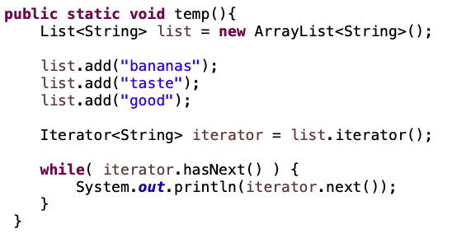
Iterator example
What would we see printed?

Slide 44
Iterator example
bananas
taste
good

Slide 45
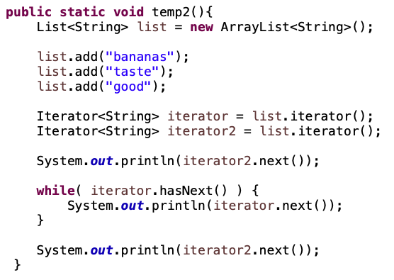
Iterator example
What would we see printed?

Slide 46
Iterator example
bananas
bananas
taste
good
taste
Each iterator has its own state!

Slide 47
Iterable
https://docs.oracle.com/javase/8/docs/api/java/lang/Iterable.html
interface Iterable<E>:
Iterator<E> iterator()
Just a single method that returns an Iterator.

Slide 48
Why Iterable??
Any class that implements the Iterable class can be used in a foreach loop!

Slide 49
How to make a class Iterable
Implement Iterable interface
Make a private inner class that implements the Iterator interface
Have the iterator method return an instance of the private inner class

Slide 50
An example
https://github.com/pomonacs622021sp/LectureCode/blob/master/Iterable/IterableArrayList.java
Each instance of the inner class will have its own count instance variable

Slide 51
Iterator vs. Iterable
Iterators are a useful mechanism for iterating over almost any type of data
Iterators are the thing that do most of the work (and require most of the coding!)
Iterable allows us to use it in a foreach loop and is often just creating an instance of an Iterator

