Slide 1
quicksort
David Kauchak CS 62 – Spring 2021

Slide 2
Admin
Compression assignment

Slide 3
MergeSort
Divide the data in half
Call MergeSort on each half (resulting in two sorted halves)
Merge the two halves

Slide 4
MergeSort
1 2 3 4 5 6 7 8
ms(7 1 4 2 6 5 3 8)
1 2 4 7
3 5 6 8
ms(7 1 4 2)
ms(6 5 3 8)
1 7
2 4
…
ms(7 1)
ms(4 2)
7
1
4
2
ms(7)
ms(1)
ms(4)
ms(2)
merge!

Slide 5
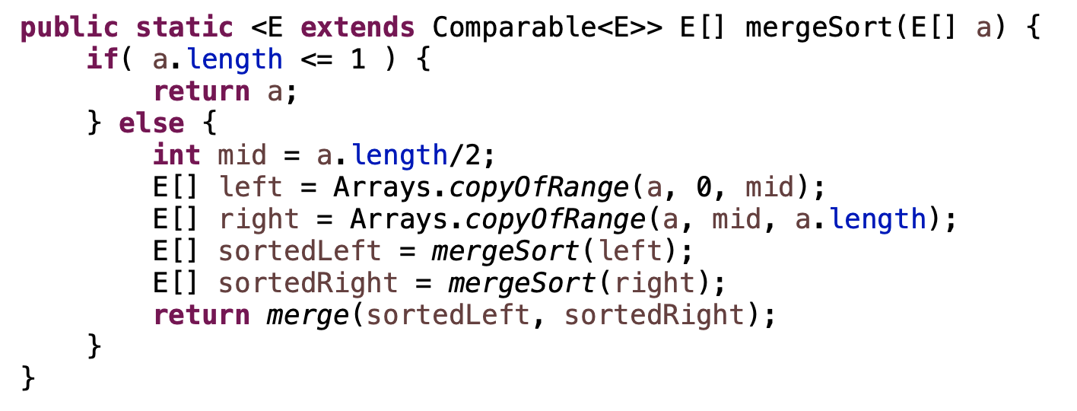
MergeSort: implementation 1

Slide 6
MergeSort: implementation 1
requires copying the data

Slide 7
MergeSort: implementation 2
mergeSortHelper(data, low, high)
if high-low > 1
midPoint = low + (high-low)/2
mergeSortHelper(data, low, mid)
mergeSortHelper(data, mid, high)
merge(data, low, mid, high)
How is this different?

Slide 8
MergeSort: implementation 2
mergeSortHelper(data, low, high)
if high-low > 1
midPoint = low + (high-low)/2
mergeSortHelper(data, low, mid)
mergeSortHelper(data, mid, high)
merge(data, low, mid, high)
doesn’t require the extra copy!
low/high specify the range we’re sorting
merge = mergeSortHelper(data, 0, data.length)

Slide 9
Merge:
merge(data, low, mid, high)
Assume:
data starting at low up to, but not including, mid is sorted
data starting at mid up to, but not including, high is sorted
Goal:
data from low up to, but not including, high is sorted
Note: merge still requires an extra helper array!

Slide 10
MergeSort runtime
Divide the data in half
Call MergeSort on each half (resulting in two sorted halves)
Merge the two halves
What is the runtime of mergesort??

Slide 11
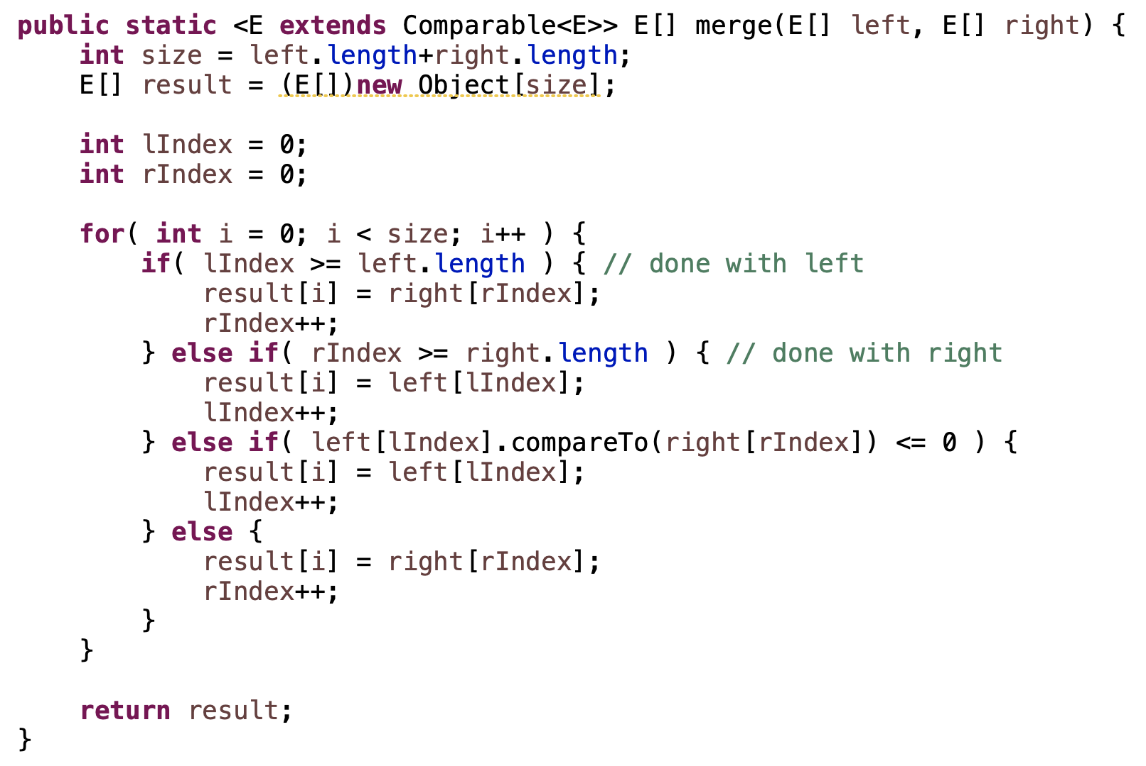
Merge runtime
What is the runtime of merge?

Slide 12
Merge runtime
O(left.length + right.length) = O(n)

Slide 13
MergeSort runtime
Divide the data in half
Call MergeSort on each half (resulting in two sorted halves)
Merge the two halves
Ignoring the cost of the recursive call, how much work is done per call of MergeSort?

Slide 14
MergeSort runtime
Divide the data in half
Call MergeSort on each half (resulting in two sorted halves)
Merge the two halves
Ignoring the cost of the recursive call, how much work is done per call of MergeSort?
O(n)

Slide 15
Mergesort runtime
work done
ms(length=n)
n

Slide 16
Mergesort runtime
work done
ms(length=n)
n
ms(n/2)
ms(n/2)

Slide 17
Mergesort runtime
work done
ms(length=n)
n
ms(n/2)
ms(n/2)
How much work is done for these calls?

Slide 18
Mergesort runtime
work done
ms(length=n)
n
ms(n/2)
ms(n/2)
n/2+n/2 = n
How much work is done for these calls?

Slide 19
Mergesort runtime
work done
ms(length=n)
n
ms(n/2)
ms(n/2)
n
ms(n/4)
ms(n/4)
ms(n/4)
ms(n/4)

Slide 20
Mergesort runtime
work done
ms(length=n)
n
ms(n/2)
ms(n/2)
n
ms(n/4)
ms(n/4)
ms(n/4)
ms(n/4)
How much work is done for these calls?

Slide 21
Mergesort runtime
work done
ms(length=n)
n
ms(n/2)
ms(n/2)
n
n
ms(n/4)
ms(n/4)
ms(n/4)
ms(n/4)
How much work is done for these calls?

Slide 22
Mergesort runtime
work done
ms(length=n)
n
ms(n/2)
ms(n/2)
n
n
ms(n/4)
ms(n/4)
ms(n/4)
ms(n/4)
…
…
How many levels are there?

Slide 23
Mergesort runtime
work done
ms(length=n)
n
ms(n/2)
ms(n/2)
n
n
ms(n/4)
ms(n/4)
ms(n/4)
ms(n/4)
…
…
How many levels are there?

Slide 24
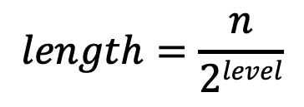
We’ve seen this before…
Each level down we decrease the size by 2:
$$length=\frac{n}{2level}$$

Slide 25
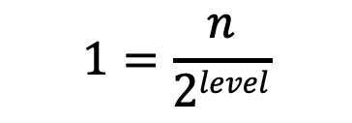
We’ve seen this before…
Each level down we decrease the size by 2:
$$length=\frac{n}{2level}$$
We stop when the length is 1:
$$1=\frac{n}{2level}$$
$$2level=n$$
$$level=log2n$$

Slide 26
MergeSort running time
O(n) work at each level
log n levels
Overall runtime: O(n log n) (best, worst, average)

Slide 27
MergeSort properties
Stable?
In-place?

Slide 28
MergeSort properties
Stable: yes!

Slide 29
MergeSort properties
Stable: yes
In-place: sort of
easy way to implement is not
very hard to do (but possible)
in practice, variants of merge sort that combine with insertion sort are in-place

Slide 30
Partition
what does this method do?

Slide 31
… 5 7 1 2 8 4 3 6 …
start
end

Slide 32
lessThanIndex
… 5 7 1 2 8 4 3 6 …
start
end

Slide 33
lessThanIndex
i
… 5 7 1 2 8 4 3 6 …
start
end

Slide 34
lessThanIndex
i
… 5 7 1 2 8 4 3 6 …
start
end

Slide 35
lessThanIndex
i
… 5 7 1 2 8 4 3 6 …
start
end

Slide 36
lessThanIndex
i
… 5 7 1 2 8 4 3 6 …
start
end

Slide 37
lessThanIndex
i
… 5 7 1 2 8 4 3 6 …
start
end

Slide 38
lessThanIndex
i
… 5 7 1 2 8 4 3 6 …
start
end

Slide 39
lessThanIndex
i
… 5 7 1 2 8 4 3 6 …
start
end

Slide 40
lessThanIndex
i
… 5 1 7 2 8 4 3 6 …
start
end

Slide 41
lessThanIndex
i
… 5 1 7 2 8 4 3 6 …
start
end

Slide 42
lessThanIndex
i
… 5 1 7 2 8 4 3 6 …
start
end

Slide 43
lessThanIndex
i
… 5 1 2 7 8 4 3 6 …
start
end

Slide 44
lessThanIndex
i
… 5 1 2 7 8 4 3 6 …
start
end

Slide 45
lessThanIndex
i
… 5 1 2 7 8 4 3 6 …
start
end
What’s happening?

Slide 46
lessThanIndex
i
… 5 1 2 7 8 4 3 6 …
start
end
≤ pivot
> pivot
unprocessed

Slide 47
lessThanIndex
i
… 5 1 2 7 8 4 3 6 …
start
end

Slide 48
lessThanIndex
i
… 5 1 2 4 8 7 3 6 …
start
end

Slide 49
lessThanIndex
i
… 5 1 2 4 3 7 8 6 …
start
end

Slide 50
lessThanIndex
i
… 5 1 2 4 3 6 8 7 …
start
end

Slide 51
vals[end] is called the pivot
Partitions the elements nums[start…end-1] in to two sets, those ≤ pivot and those > pivot
Operates in place
Final result:
start
pivot
end
nums
≤ pivot
> pivot

Slide 52
Partition running time?
Notes:
where n is end-start
just walks through each element in this range and does a constant amount of work

Slide 53
Partition running time?
O(n)
Notes:
where n is end-start
just walks through each element in this range and does a constant amount of work

Slide 54
Quicksort
How can we use this method to sort?

Slide 55
Quicksort

Slide 56
Quicksort
8 5 1 3 6 2 7 4

Slide 57
Quicksort
8 5 1 3 6 2 7 4

Slide 58
Quicksort
1 3 2 4 6 8 7 5

Slide 59
Quicksort
1 3 2 4 6 8 7 5

Slide 60
Quicksort
1 3 2 4 6 8 7 5

Slide 61
Quicksort
1 2 3 4 6 8 7 5

Slide 62
Quicksort
1 2 3 4 6 8 7 5

Slide 63
Quicksort
1 2 3 4 6 8 7 5

Slide 64
Quicksort
1 2 3 4 6 8 7 5

Slide 65
Quicksort
1 2 3 4 6 8 7 5

Slide 66
Quicksort
1 2 3 4 5 8 7 6
What happens here?

Slide 67
Quicksort
1 2 3 4 5 8 7 6

Slide 68
Quicksort
1 2 3 4 5 8 7 6

Slide 69
Quicksort
1 2 3 4 5 6 7 8

Slide 70
Quicksort
1 2 3 4 5 6 7 8

Slide 71
Running time of Quicksort?
Worst case?
Each call to Partition splits the array into an empty array and n-1 array

Slide 72
Quicksort: Worst case running time
n-1 + n-2 + n-3 + … + 1 =
O(n²)
When does this happen?
sorted
reverse sorted
near sorted/reverse sorted

Slide 73
Quicksort best case?
Each call to Partition splits the array into two equal parts
…
How much work is done at each “level”, i.e. running time of a level?
O(n)

Slide 74
Quicksort best case?
Each call to Partition splits the array into two equal parts
…
How many levels are there?
Similar to mergesort, each call to Partition will throw away half the data until we’re down to one element: log₂ n levels

Slide 75
Quicksort best case?
Each call to Partition splits the array into two equal parts
…
Overall runtime?
O(n log n)

Slide 76
Quicksort Average case?
Two intuitions
As long as the Partition procedure always splits the array into some constant ratio between the left and the right, say L-to-R, e.g. 9-to-1, then we maintain O(n log n)
As long as we only have a constant number of “bad” partitions intermixed with a “good partition” then we maintain O(n log n)

Slide 77
How can we avoid the worst case?
Inject randomness into the data
void randomizedPartition(E [] nums, int start, int end){
int i = randomInt(start, end);
swap(nums, i, end);
return partition = partition(nums, start, end);
}
Randomized quicksort is average case O(n log n)

Slide 78
What is the wost case running time of randomized Quicksort?
O(n²)
We could still get very unlucky and pick “bad” partitions at every step

Slide 79
Quicksort properties
Stable?
In-place?

Slide 80
Quicksort properties
Stable: possible, but not the way we’ve written it (and requires more storage!0
In-place: yes!

