Slide 1
Mergesort
David Kauchak CS 62 – Spring 2021

Slide 2
Admin
Compression assignment
Lab tomorrow

Slide 3
Sorting
Insertion sort
Selection sort
How do they work? Best, worst, average case runtime?

Slide 4
Selection sort
3 44 38 5 47 1 36 26
sorted
unsorted
Divide the array into two parts: a sorted part on the left and an unsorted part on the right
Repeat:
Find the smallest element in the unsorted part
Swap it with the leftmost element of the unsorted array
The sorted array is now one element larger

Slide 5
Selection sort
1 3 5 2647 4436 38
sorted
unsorted
Divide the array into two parts: a sorted part on the left and an unsorted part on the right
Repeat:
Find the smallest element in the unsorted part
Swap it with the leftmost element of the unsorted array
The sorted array is now one element larger

Slide 6
Selection sort: overall runtime
O(n²)
Best case = worst case = averages case =
Divide the array into two parts: a sorted part on the left and an unsorted part on the right
Repeat:
Find the smallest element in the unsorted part
Swap it with the leftmost element of the unsorted array
The sorted array is now one element larger

Slide 7
Insertion sort
3 44 38 5 47 1 36 26
Divide the array into two parts:
left part: left elements in sorted order
right part: right elements in unsorted order
Repeat:
Look at the next element in the unsorted part
Find the correct location in the sorted part (by sliding each item right one at a time)
The sorted array is now one element larger

Slide 8
Insertion sort
3 5 38 4447 1 36 26
sorted
unsorted
Divide the array into two parts:
left part: left elements in sorted order
right part: right elements in unsorted order
Repeat:
Look at the next element in the unsorted part
Find the correct location in the sorted part (by sliding each item right one at a time)
The sorted array is now one element larger

Slide 9
Insertion sort: overall runtime
Best case: O(n), the array is already sorted
Worst case: O(n²), the array is reverse sorted (same sum as before)
Average case: O(n²), n iterations and still have to move n/2 entries on average
Divide the array into two parts:
left part: left elements in sorted order
right part: right elements in unsorted order
Repeat:
Look at the next element in the unsorted part
Find the correct location in the sorted part (by sliding each item right one at a time)
The sorted array is now one element larger

Slide 10
Sorting algorithm properties
Stable sorting algorithms
If there are ties, the elements occur in their original order
Excel demo!

Slide 11
Selection sort
Divide the array into two parts: a sorted part on the left and an unsorted part on the right
Repeat:
Find the smallest element in the unsorted part
Swap it with the leftmost element of the unsorted array
The sorted array is now one element larger
Insertion sort
Are these stable?
Divide the array into two parts:
left part: left elements in sorted order
right part: right elements in unsorted order
Repeat:
Look at the next element in the unsorted part
Find the correct location in the sorted part (by sliding each item right one at a time)
The sorted array is now one element larger

Slide 12
Selection sort
Divide the array into two parts: a sorted part on the left and an unsorted part on the right
Repeat:
Find the smallest element in the unsorted part
Swap it with the leftmost element of the unsorted array
The sorted array is now one element larger
Insertion sort is stable
Divide the array into two parts:
left part: left elements in sorted order
right part: right elements in unsorted order
Repeat:
Look at the next element in the unsorted part
Find the correct location in the sorted part (by sliding each item right one at a time)
The sorted array is now one element larger

Slide 13
Sorting algorithm properties
In-place sorting
Can be done without additional memory, i.e., another array

Slide 14
Selection sort
Divide the array into two parts: a sorted part on the left and an unsorted part on the right
Repeat:
Find the smallest element in the unsorted part
Swap it with the leftmost element of the unsorted array
The sorted array is now one element larger
Insertion sort
Are these in-place?
Divide the array into two parts:
left part: left elements in sorted order
right part: right elements in unsorted order
Repeat:
Look at the next element in the unsorted part
Find the correct location in the sorted part (by sliding each item right one at a time)
The sorted array is now one element larger

Slide 15
Selection sort is in place
Divide the array into two parts: a sorted part on the left and an unsorted part on the right
Repeat:
Find the smallest element in the unsorted part
Swap it with the leftmost element of the unsorted array
The sorted array is now one element larger
Insertion sort is in-place
Divide the array into two parts:
left part: left elements in sorted order
right part: right elements in unsorted order
Repeat:
Look at the next element in the unsorted part
Find the correct location in the sorted part (by sliding each item right one at a time)
The sorted array is now one element larger

Slide 16
Selection sort
Divide the array into two parts: a sorted part on the left and an unsorted part on the right
Repeat:
Find the smallest element in the unsorted part
Swap it with the leftmost element of the unsorted array
The sorted array is now one element larger
Insertion sort
What questions do we ask about the data?
Divide the array into two parts:
left part: left elements in sorted order
right part: right elements in unsorted order
Repeat:
Look at the next element in the unsorted part
Find the correct location in the sorted part (by sliding each item right one at a time)
The sorted array is now one element larger

Slide 17
Selection sort
Divide the array into two parts: a sorted part on the left and an unsorted part on the right
Repeat:
Find the smallest element in the unsorted part
Swap it with the leftmost element of the unsorted array
The sorted array is now one element larger
Insertion sort
What questions do we ask about the data?
Divide the array into two parts:
left part: left elements in sorted order
right part: right elements in unsorted order
Repeat:
Look at the next element in the unsorted part
Find the correct location in the sorted part (by sliding each item right one at a time)
The sorted array is now one element larger
Compare to other elements

Slide 18
Comparable interface
https://docs.oracle.com/javase/8/docs/api/java/lang/Comparable.html
Interface Comparable<T>
int compareTo(T other)
-1: this object is less than other (technically, any negative number)
0: this object is equal to other
1: this object is greater than other (technically, any positive number)

Slide 19
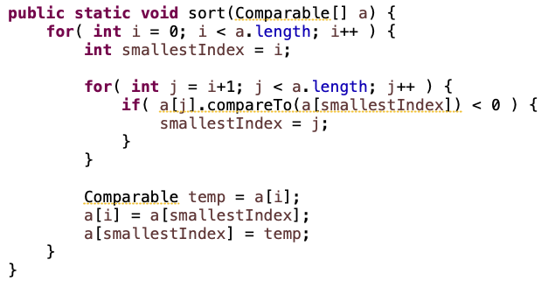
Which algorithm is this?

Slide 20
Which algorithm is this?
is a[j] < a[smallestIndex]

Slide 21
Which algorithm is this?
find the smallest value in the unsorted part (i+1… end)

Slide 22
Which algorithm is this?
swap i and the smallest value

Slide 23
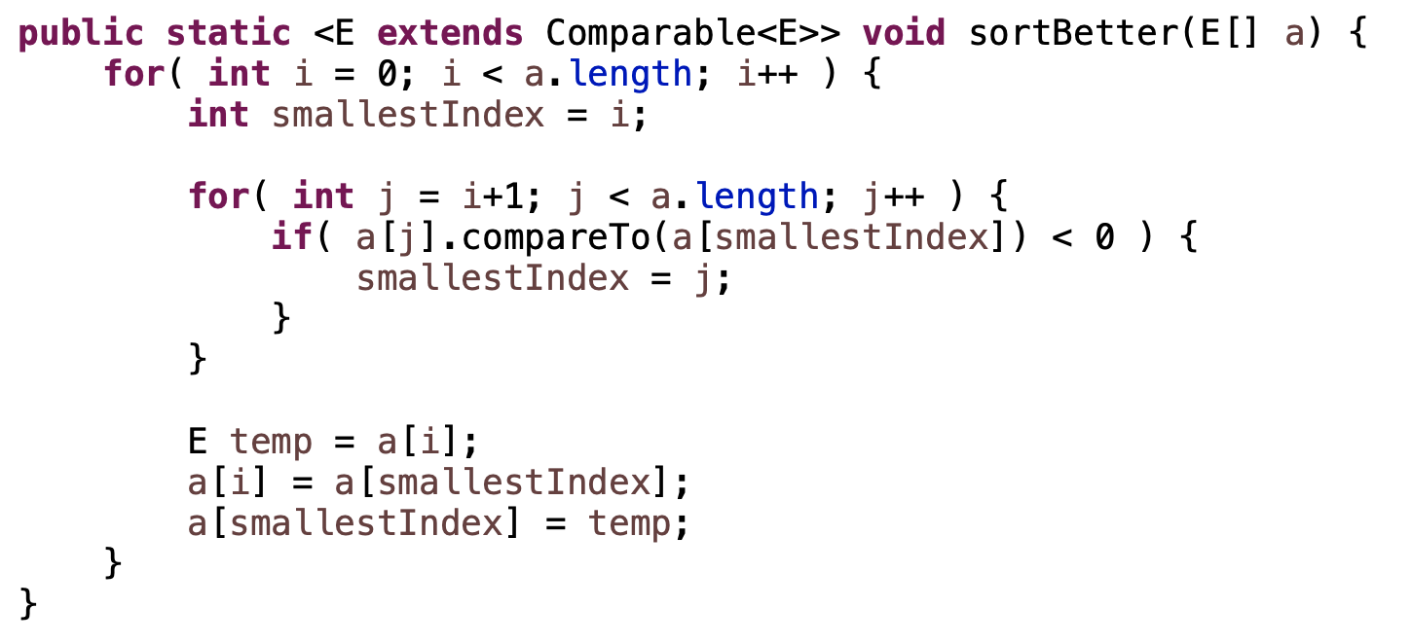
A better way
We can constrain the type variable to only allow for classes that implement Comparable<E>.

Slide 24
Merge
Assuming left (L) and right (R) are sorted already, merge the two to create a new, single sorted array
L: 1 3 5 8
R: 2 4 6 7
How can we do this?

Slide 25
Merge
L: 1 3 5 8
R: 2 4 6 7
Create a new array to hold the result that is the combined length
Notes:
Eventually, all of the things in L and R will make it down here

Slide 26
Merge
L: 1 3 5 8
R: 2 4 6 7
What item is first?
How did you know?

Slide 27
Merge
L: 1 3 5 8
R: 2 4 6 7
Compare the first two elements in the lists!

Slide 28
Merge
L: 1 3 5 8
R: 2 4 6 7
1
What item is second?
How did you know?

Slide 29
Merge
L: 1 3 5 8
R: 2 4 6 7
1
Compare the smallest element that hasn’t been used yet in each list
For L, this is next element in the list
For R, this is still the first element

Slide 30
Merge
L: 1 3 5 8
R: 2 4 6 7
1
General algorithm?

Slide 31
Merge
L: 1 3 5 8
R: 2 4 6 7
General algorithm:
Keep the index for where we are in each input array
Start them both at 0
Repeat until we’re done:
Compare current elements
Copy smaller one down and increment that index

Slide 32
Merge
L: 1 3 5 8
R: 2 4 6 7
1
General algorithm:
Keep the index for where we are in each input array
Start them both at 0
Repeat until we’re done:
Compare current elements
Copy smaller one down and increment that index

Slide 33
Merge
L: 1 3 5 8
R: 2 4 6 7
1
General algorithm:
Keep the index for where we are in each input array
Start them both at 0
Repeat until we’re done:
Compare current elements
Copy smaller one down and increment that index

Slide 34
Merge
L: 1 3 5 8
R: 2 4 6 7
1 2
General algorithm:
Keep the index for where we are in each input array
Start them both at 0
Repeat until we’re done:
Compare current elements
Copy smaller one down and increment that index

Slide 35
Merge
L: 1 3 5 8
R: 2 4 6 7
1 2
General algorithm:
Keep the index for where we are in each input array
Start them both at 0
Repeat until we’re done:
Compare current elements
Copy smaller one down and increment that index

Slide 36
Merge
L: 1 3 5 8
R: 2 4 6 7
1 2 3
General algorithm:
Keep the index for where we are in each input array
Start them both at 0
Repeat until we’re done:
Compare current elements
Copy smaller one down and increment that index

Slide 37
Merge
L: 1 3 5 8
R: 2 4 6 7
1 2 3
General algorithm:
Keep the index for where we are in each input array
Start them both at 0
Repeat until we’re done:
Compare current elements
Copy smaller one down and increment that index

Slide 38
Merge
L: 1 3 5 8
R: 2 4 6 7
1 2 3 4
General algorithm:
Keep the index for where we are in each input array
Start them both at 0
Repeat until we’re done:
Compare current elements
Copy smaller one down and increment that index

Slide 39
Merge
L: 1 3 5 8
R: 2 4 6 7
1 2 3 4
General algorithm:
Keep the index for where we are in each input array
Start them both at 0
Repeat until we’re done:
Compare current elements
Copy smaller one down and increment that index

Slide 40
Merge
L: 1 3 5 8
R: 2 4 6 7
1 2 3 4 5
General algorithm:
Keep the index for where we are in each input array
Start them both at 0
Repeat until we’re done:
Compare current elements
Copy smaller one down and increment that index

Slide 41
Merge
L: 1 3 5 8
R: 2 4 6 7
1 2 3 4 5
General algorithm:
Keep the index for where we are in each input array
Start them both at 0
Repeat until we’re done:
Compare current elements
Copy smaller one down and increment that index

Slide 42
Merge
L: 1 3 5 8
R: 2 4 6 7
1 2 3 4 5 6
General algorithm:
Keep the index for where we are in each input array
Start them both at 0
Repeat until we’re done:
Compare current elements
Copy smaller one down and increment that index

Slide 43
Merge
L: 1 3 5 8
R: 2 4 6 7
1 2 3 4 5 6
General algorithm:
Keep the index for where we are in each input array
Start them both at 0
Repeat until we’re done:
Compare current elements
Copy smaller one down and increment that index

Slide 44
Merge
L: 1 3 5 8
R: 2 4 6 7
1 2 3 4 5 6 7
What do we do now?

Slide 45
Merge
L: 1 3 5 8
R: 2 4 6 7
1 2 3 4 5 6 7 8
If we run off the end of either array, just copy the remaining from the other array

Slide 46
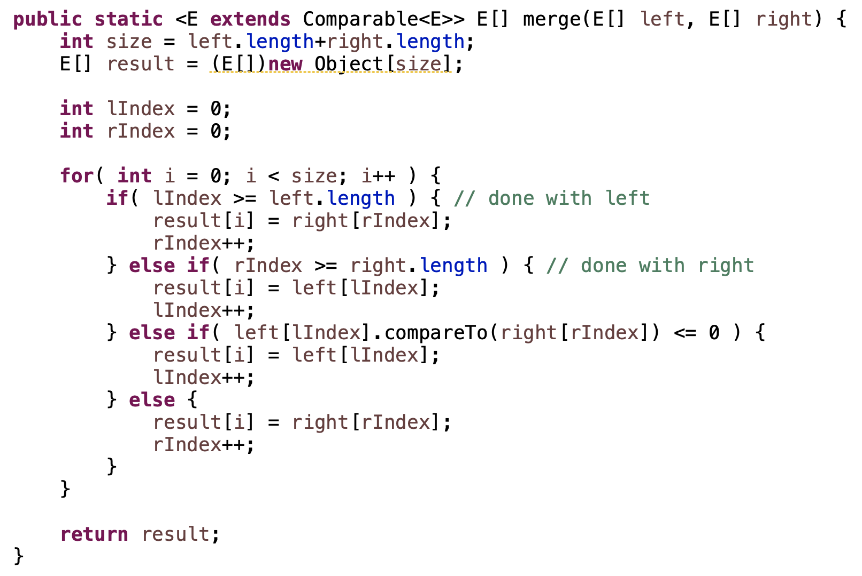
Merge in code

Slide 47
MergeSort
Divide the data in half
Call MergeSort on each half (resulting in two sorted halves)
Merge the two halves

Slide 48
MergeSort
Divide the data in half
Call MergeSort on each half (resulting in two sorted halves)
Merge the two halves
If the two halves are sorted, does MergeSort work?

Slide 49
MergeSort
Divide the data in half
Call MergeSort on each half (resulting in two sorted halves)
Merge the two halves
What are we missing? Why does this work?

Slide 50
MergeSort
Divide the data in half
Call MergeSort on each half (resulting in two sorted halves)
Merge the two halves
MergeSort is recursive. We’re missing a base case!

Slide 51
MergeSort: base case
7
Is this array sorted?

Slide 52
MergeSort: base case
7
If the array is of size 1 (or 0), it’s sorted

Slide 53
MergeSort
ms(7 1 4 2 6 5 3 8)

Slide 54
MergeSort
ms(7 1 4 2 6 5 3 8)
7 1 4 2
6 5 3 8
split in half

Slide 55
MergeSort
ms(7 1 4 2 6 5 3 8)
ms(7 1 4 2)
6 5 3 8
sort left side

Slide 56
MergeSort
ms(7 1 4 2 6 5 3 8)
ms(7 1 4 2)
6 5 3 8
7 1
4 2
split in half

Slide 57
MergeSort
ms(7 1 4 2 6 5 3 8)
ms(7 1 4 2)
6 5 3 8
ms(7 1)
4 2
sort left side

Slide 58
MergeSort
ms(7 1 4 2 6 5 3 8)
ms(7 1 4 2)
6 5 3 8
ms(7 1)
4 2
7
1
split in half

Slide 59
MergeSort
ms(7 1 4 2 6 5 3 8)
ms(7 1 4 2)
6 5 3 8
ms(7 1)
4 2
ms(7)
1
sort left side

Slide 60
MergeSort
ms(7 1 4 2 6 5 3 8)
ms(7 1 4 2)
6 5 3 8
ms(7 1)
4 2
ms(7)
1
what now?

Slide 61
MergeSort
ms(7 1 4 2 6 5 3 8)
ms(7 1 4 2)
6 5 3 8
ms(7 1)
4 2
7
ms(7)
1
Base case!

Slide 62
MergeSort
ms(7 1 4 2 6 5 3 8)
ms(7 1 4 2)
6 5 3 8
ms(7 1)
4 2
7
ms(7)
1
what now?

Slide 63
MergeSort
ms(7 1 4 2 6 5 3 8)
ms(7 1 4 2)
6 5 3 8
ms(7 1)
4 2
7
ms(7)
ms(1)
sort right side!

Slide 64
MergeSort
ms(7 1 4 2 6 5 3 8)
ms(7 1 4 2)
6 5 3 8
ms(7 1)
4 2
7
1
ms(7)
ms(1)
sort right side!

Slide 65
MergeSort
ms(7 1 4 2 6 5 3 8)
ms(7 1 4 2)
6 5 3 8
ms(7 1)
4 2
7
1
ms(7)
ms(1)
what now?

Slide 66
MergeSort
ms(7 1 4 2 6 5 3 8)
ms(7 1 4 2)
6 5 3 8
ms(7 1)
4 2
7
1
ms(7)
ms(1)
merge!

Slide 67
MergeSort
ms(7 1 4 2 6 5 3 8)
ms(7 1 4 2)
6 5 3 8
1 7
ms(7 1)
4 2
7
1
ms(7)
ms(1)
merge!

Slide 68
MergeSort
ms(7 1 4 2 6 5 3 8)
ms(7 1 4 2)
6 5 3 8
1 7
ms(7 1)
ms(4 2)
7
1
ms(7)
ms(1)
sort right

Slide 69
MergeSort
ms(7 1 4 2 6 5 3 8)
ms(7 1 4 2)
6 5 3 8
1 7
ms(7 1)
ms(4 2)
7
1
4
2
ms(7)
ms(1)
ms(4)
ms(2)
split in half
sort left
sort right

Slide 70
MergeSort
ms(7 1 4 2 6 5 3 8)
ms(7 1 4 2)
6 5 3 8
1 7
ms(7 1)
ms(4 2)
7
1
4
2
ms(7)
ms(1)
ms(4)
ms(2)
merge!

Slide 71
MergeSort
ms(7 1 4 2 6 5 3 8)
ms(7 1 4 2)
6 5 3 8
1 7
2 4
ms(7 1)
ms(4 2)
7
1
4
2
ms(7)
ms(1)
ms(4)
ms(2)
merge!

Slide 72
MergeSort
ms(7 1 4 2 6 5 3 8)
ms(7 1 4 2)
6 5 3 8
1 7
2 4
ms(7 1)
ms(4 2)
7
1
4
2
ms(7)
ms(1)
ms(4)
ms(2)
now what?

Slide 73
MergeSort
ms(7 1 4 2 6 5 3 8)
1 2 4 7
ms(7 1 4 2)
6 5 3 8
1 7
2 4
ms(7 1)
ms(4 2)
7
1
4
2
ms(7)
ms(1)
ms(4)
ms(2)
merge!

Slide 74
MergeSort
ms(7 1 4 2 6 5 3 8)
1 2 4 7
ms(7 1 4 2)
ms(6 5 3 8)
1 7
2 4
ms(7 1)
ms(4 2)
7
1
4
2
ms(7)
ms(1)
ms(4)
ms(2)
sort right side!

Slide 75
MergeSort
ms(7 1 4 2 6 5 3 8)
1 2 4 7
3 5 6 8
ms(7 1 4 2)
ms(6 5 3 8)
1 7
2 4
…
ms(7 1)
ms(4 2)
7
1
4
2
ms(7)
ms(1)
ms(4)
ms(2)
sort right side!

Slide 76
MergeSort
ms(7 1 4 2 6 5 3 8)
1 2 4 7
3 5 6 8
ms(7 1 4 2)
ms(6 5 3 8)
1 7
2 4
…
ms(7 1)
ms(4 2)
7
1
4
2
ms(7)
ms(1)
ms(4)
ms(2)
merge!

Slide 77
MergeSort
1 2 3 4 5 6 7 8
ms(7 1 4 2 6 5 3 8)
1 2 4 7
3 5 6 8
ms(7 1 4 2)
ms(6 5 3 8)
1 7
2 4
…
ms(7 1)
ms(4 2)
7
1
4
2
ms(7)
ms(1)
ms(4)
ms(2)
merge!

Slide 78
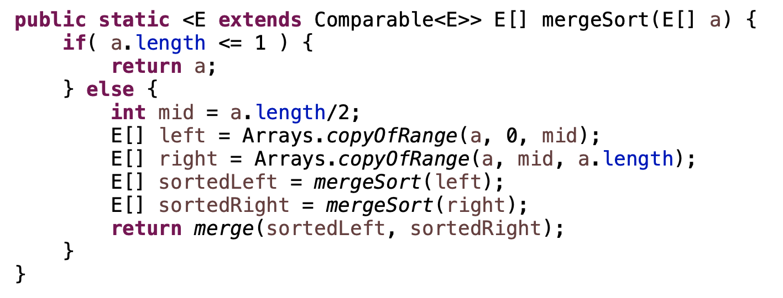
MergeSort: implementation 1

