Slide 1
sorting basics
David Kauchak CS 62 – Spring 2021

Slide 2
Admin
Erin’s office hours today 7-8pm (going forward)
My office hours today 3:30-4pm
Compression assignment hints/observations

Slide 3
Sorting
What sorting algorithms have you seen before?
If I gave you a deck of cards and asked you to sort it, how would you do it?

Slide 4
Sorting algorithms
Adaptive heapsort
Bitonic sorter
Block sort
Bubble sort
Bucket sort
Cascade mergsort
Cocktail sort
Comb sort
Flashsort
Gnome sort
Heapsort
Insertion sort
Library sort
Mergesort
Pancake sort
Quicksort
Radix sort
Selection sort
Shell sort
Spaghetti sort
Treesort

Slide 5
Selection sort
Divide the data into two parts: sorted and unsorted
Repeat:

Slide 6
Selection sort
Divide the array into two parts: a sorted part on the left and an unsorted part on the right
Repeat:
Find the smallest element in the unsorted part
Swap it with the leftmost element of the unsorted array
The sorted array is now one element larger

Slide 7
Selection sort
3 44 38 5 47 1 36 26
sorted
unsorted
Divide the array into two parts: a sorted part on the left and an unsorted part on the right
Repeat:
Find the smallest element in the unsorted part
Swap it with the leftmost element of the unsorted array
The sorted array is now one element larger

Slide 8
Selection sort
3 44 38 5 47 1 36 26
sorted
unsorted
Smallest?
Divide the array into two parts: a sorted part on the left and an unsorted part on the right
Repeat:
Find the smallest element in the unsorted part
Swap it with the leftmost element of the unsorted array
The sorted array is now one element larger

Slide 9
Selection sort
3 44 38 5 47 1 36 26
sorted
unsorted
Divide the array into two parts: a sorted part on the left and an unsorted part on the right
Repeat:
Find the smallest element in the unsorted part
Swap it with the leftmost element of the unsorted array
The sorted array is now one element larger

Slide 10
Selection sort
1 44 38 5 47 3 36 26
sorted
unsorted
Divide the array into two parts: a sorted part on the left and an unsorted part on the right
Repeat:
Find the smallest element in the unsorted part
Swap it with the leftmost element of the unsorted array
The sorted array is now one element larger

Slide 11
Selection sort
1 44 38 5 47 3 36 26
sorted
unsorted
Smallest?
Divide the array into two parts: a sorted part on the left and an unsorted part on the right
Repeat:
Find the smallest element in the unsorted part
Swap it with the leftmost element of the unsorted array
The sorted array is now one element larger

Slide 12
Selection sort
1 44 38 5 47 3 36 26
sorted
unsorted
Smallest?
Divide the array into two parts: a sorted part on the left and an unsorted part on the right
Repeat:
Find the smallest element in the unsorted part
Swap it with the leftmost element of the unsorted array
The sorted array is now one element larger

Slide 13
Selection sort
1 3 38 5 47 4436 26
sorted
unsorted
Divide the array into two parts: a sorted part on the left and an unsorted part on the right
Repeat:
Find the smallest element in the unsorted part
Swap it with the leftmost element of the unsorted array
The sorted array is now one element larger

Slide 14
Selection sort
1 3 5 3847 4436 26
sorted
unsorted
Divide the array into two parts: a sorted part on the left and an unsorted part on the right
Repeat:
Find the smallest element in the unsorted part
Swap it with the leftmost element of the unsorted array
The sorted array is now one element larger

Slide 15
Selection sort
1 3 5 2647 4436 38
sorted
unsorted
Divide the array into two parts: a sorted part on the left and an unsorted part on the right
Repeat:
Find the smallest element in the unsorted part
Swap it with the leftmost element of the unsorted array
The sorted array is now one element larger

Slide 16
Selection sort
1 3 5 2636 4447 38
sorted
unsorted
Divide the array into two parts: a sorted part on the left and an unsorted part on the right
Repeat:
Find the smallest element in the unsorted part
Swap it with the leftmost element of the unsorted array
The sorted array is now one element larger

Slide 17
Running time to find the smallest element
Best case?
Worst case?
Average case?
Divide the array into two parts: a sorted part on the left and an unsorted part on the right
Repeat:
Find the smallest element in the unsorted part
Swap it with the leftmost element of the unsorted array
The sorted array is now one element larger

Slide 18
Running time to find the smallest element
All cases: size_of_unsorted_array – we have to search through the entire unsorted array to find it
Divide the array into two parts: a sorted part on the left and an unsorted part on the right
Repeat:
Find the smallest element in the unsorted part
Swap it with the leftmost element of the unsorted array
The sorted array is now one element larger

Slide 19
Overall runtime
3 44 38 5 47 1 36 26
sorted
unsorted
size_of_unsorted_array
How big is this for the first iteration?

Slide 20
Overall runtime
3 44 38 5 47 1 36 26
sorted
unsorted
size_of_unsorted_array
How big is this for the first iteration?
n

Slide 21
Overall runtime
1 44 38 5 47 3 36 26
sorted
unsorted
size_of_unsorted_array
How big is this for the second iteration?

Slide 22
Overall runtime
1 44 38 5 47 3 36 26
sorted
unsorted
size_of_unsorted_array
How big is this for the second iteration?
n-1

Slide 23
Overall runtime
1 3 5 3847 4436 26
sorted
unsorted
size_of_unsorted_array
How big is this for the second iteration?

Slide 24
Overall runtime
1 3 5 3847 4436 26
sorted
unsorted
size_of_unsorted_array
How big is this for the second iteration?
n-2

Slide 25
Overall runtime
1 3 5 3847 4436 26
sorted
unsorted
size_of_unsorted_array
How big is this for the last iteration?

Slide 26
Overall runtime
1 3 5 2636 3844 47
sorted
unsorted
size_of_unsorted_array
How big is this for the last iteration?
1

Slide 27
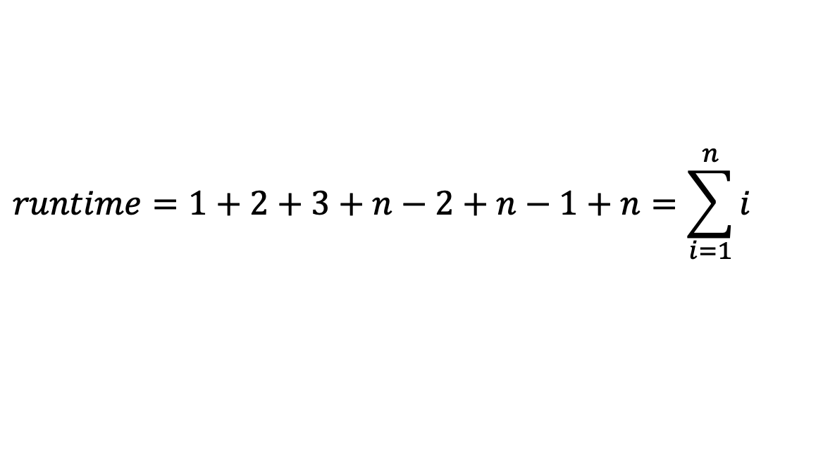
Overall runtime
$$runtime=1+2+3+n−2+n−1+n=\sum_{i=1}^{n}{i}$$
Divide the array into two parts: a sorted part on the left and an unsorted part on the right
Repeat:
Find the smallest element in the unsorted part
Swap it with the leftmost element of the unsorted array
The sorted array is now one element larger

Slide 28
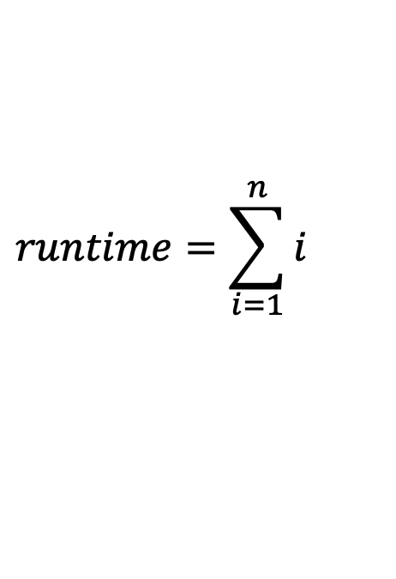
Overall runtime
$$runtime=\sum_{i=1}^{n}{i}$$
?
Divide the array into two parts: a sorted part on the left and an unsorted part on the right
Repeat:
Find the smallest element in the unsorted part
Swap it with the leftmost element of the unsorted array
The sorted array is now one element larger

Slide 29
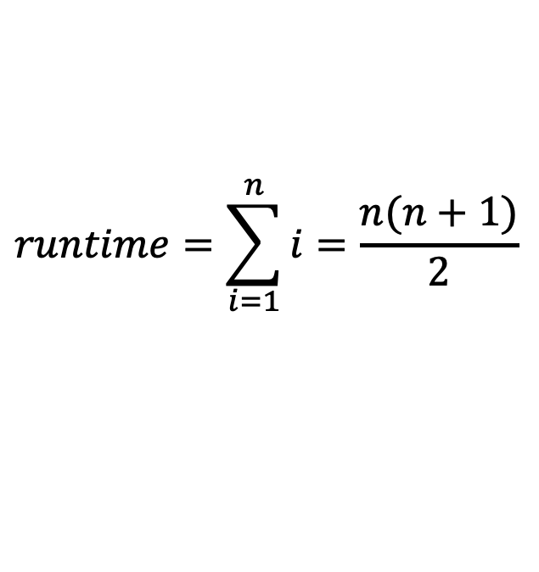
Overall runtime
$$runtime=\sum_{i=1}^{n}{i}=\frac{n(n+1)}{2}$$
Divide the array into two parts: a sorted part on the left and an unsorted part on the right
Repeat:
Find the smallest element in the unsorted part
Swap it with the leftmost element of the unsorted array
The sorted array is now one element larger

Slide 30
Overall runtime
$$runtime=\sum_{i=1}^{n}{i}=\frac{n(n+1)}{2}$$
O(?)
Divide the array into two parts: a sorted part on the left and an unsorted part on the right
Repeat:
Find the smallest element in the unsorted part
Swap it with the leftmost element of the unsorted array
The sorted array is now one element larger

Slide 31
Selection sort: overall runtime
$$runtime=\sum_{i=1}^{n}{i}=\frac{n(n+1)}{2}$$
O(n²)
Divide the array into two parts: a sorted part on the left and an unsorted part on the right
Repeat:
Find the smallest element in the unsorted part
Swap it with the leftmost element of the unsorted array
The sorted array is now one element larger

Slide 32
Insertion sort
3 44 38 5 47 1 36 26
Divide the array into two parts:
left part: left elements in sorted order
right part: right elements in unsorted order
Repeat:
Look at the next element in the unsorted part
Find the correct location in the sorted part (by sliding each item right one at a time)
The sorted array is now one element larger

Slide 33
Insertion sort
3 44 38 5 47 1 36 26
sorted
unsorted
Divide the array into two parts:
left part: left elements in sorted order
right part: right elements in unsorted order
Repeat:
Look at the next element in the unsorted part
Find the correct location in the sorted part (by sliding each item right one at a time)
The sorted array is now one element larger

Slide 34
Insertion sort
3 44 38 5 47 1 36 26
sorted
unsorted
Divide the array into two parts:
left part: left elements in sorted order
right part: right elements in unsorted order
Repeat:
Look at the next element in the unsorted part
Find the correct location in the sorted part (by sliding each item right one at a time)
The sorted array is now one element larger

Slide 35
Insertion sort
3 38 44 5 47 1 36 26
sorted
unsorted
Divide the array into two parts:
left part: left elements in sorted order
right part: right elements in unsorted order
Repeat:
Look at the next element in the unsorted part
Find the correct location in the sorted part (by sliding each item right one at a time)
The sorted array is now one element larger

Slide 36
Insertion sort
3 38 44 5 47 1 36 26
sorted
unsorted
Divide the array into two parts:
left part: left elements in sorted order
right part: right elements in unsorted order
Repeat:
Look at the next element in the unsorted part
Find the correct location in the sorted part (by sliding each item right one at a time)
The sorted array is now one element larger

Slide 37
Insertion sort
3 38 44 5 47 1 36 26
sorted
unsorted
Is 5 in the correct spot?
Divide the array into two parts:
left part: left elements in sorted order
right part: right elements in unsorted order
Repeat:
Look at the next element in the unsorted part
Find the correct location in the sorted part (by sliding each item right one at a time)
The sorted array is now one element larger

Slide 38
Insertion sort
3 38 5 44 47 1 36 26
sorted
unsorted
Divide the array into two parts:
left part: left elements in sorted order
right part: right elements in unsorted order
Repeat:
Look at the next element in the unsorted part
Find the correct location in the sorted part (by sliding each item right one at a time)
The sorted array is now one element larger

Slide 39
Insertion sort
3 38 5 44 47 1 36 26
sorted
unsorted
Is 5 in the correct spot?
Divide the array into two parts:
left part: left elements in sorted order
right part: right elements in unsorted order
Repeat:
Look at the next element in the unsorted part
Find the correct location in the sorted part (by sliding each item right one at a time)
The sorted array is now one element larger

Slide 40
Insertion sort
3 5 38 4447 1 36 26
sorted
unsorted
Divide the array into two parts:
left part: left elements in sorted order
right part: right elements in unsorted order
Repeat:
Look at the next element in the unsorted part
Find the correct location in the sorted part (by sliding each item right one at a time)
The sorted array is now one element larger

Slide 41
Insertion sort
3 5 38 4447 1 36 26
sorted
unsorted
Is 5 in the correct spot?
Divide the array into two parts:
left part: left elements in sorted order
right part: right elements in unsorted order
Repeat:
Look at the next element in the unsorted part
Find the correct location in the sorted part (by sliding each item right one at a time)
The sorted array is now one element larger

Slide 42
Insertion sort
3 5 38 4447 1 36 26
sorted
unsorted
Divide the array into two parts:
left part: left elements in sorted order
right part: right elements in unsorted order
Repeat:
Look at the next element in the unsorted part
Find the correct location in the sorted part (by sliding each item right one at a time)
The sorted array is now one element larger

Slide 43
Insertion sort
3 5 38 4447 1 36 26
sorted
unsorted
Divide the array into two parts:
left part: left elements in sorted order
right part: right elements in unsorted order
Repeat:
Look at the next element in the unsorted part
Find the correct location in the sorted part (by sliding each item right one at a time)
The sorted array is now one element larger

Slide 44
Insertion sort
3 5 38 4447 1 36 26
sorted
unsorted
Was that fast or slow?
Divide the array into two parts:
left part: left elements in sorted order
right part: right elements in unsorted order
Repeat:
Look at the next element in the unsorted part
Find the correct location in the sorted part (by sliding each item right one at a time)
The sorted array is now one element larger

Slide 45
Insertion sort
1 3 5 3844 4736 26
sorted
unsorted
Divide the array into two parts:
left part: left elements in sorted order
right part: right elements in unsorted order
Repeat:
Look at the next element in the unsorted part
Find the correct location in the sorted part (by sliding each item right one at a time)
The sorted array is now one element larger

Slide 46
Insertion sort
1 3 5 3844 4736 26
sorted
unsorted
Was that fast or slow?
Divide the array into two parts:
left part: left elements in sorted order
right part: right elements in unsorted order
Repeat:
Look at the next element in the unsorted part
Find the correct location in the sorted part (by sliding each item right one at a time)
The sorted array is now one element larger

Slide 47
Running time to find the correct spot
Best case?
Worst case?
Average case?
Divide the array into two parts:
left part: left elements in sorted order
right part: right elements in unsorted order
Repeat:
Look at the next element in the unsorted part
Find the correct location in the sorted part (by sliding each item right one at a time)
The sorted array is now one element larger

Slide 48
Running time to find the correct spot
Best case: O(1), it’s larger than any element to the left
Worst case: size_sorted_part, it’s smaller than any element to the left
Average case: size_sorted_part/2
Divide the array into two parts:
left part: left elements in sorted order
right part: right elements in unsorted order
Repeat:
Look at the next element in the unsorted part
Find the correct location in the sorted part (by sliding each item right one at a time)
The sorted array is now one element larger

Slide 49
Insertion sort: overall runtime
Best case? When does this happen?
Worst case? When does this happen?
Average case?
Divide the array into two parts:
left part: left elements in sorted order
right part: right elements in unsorted order
Repeat:
Look at the next element in the unsorted part
Find the correct location in the sorted part (by sliding each item right one at a time)
The sorted array is now one element larger

Slide 50
Overall runtime
Best case: O(n), the array is already sorted
Worst case: O(n²), the array is reverse sorted (same sum as before)
Average case: O(n²), n iterations and still have to move n/2 entries on average
Divide the array into two parts:
left part: left elements in sorted order
right part: right elements in unsorted order
Repeat:
Look at the next element in the unsorted part
Find the correct location in the sorted part (by sliding each item right one at a time)
The sorted array is now one element larger

