Slide 1
Hashtables 2
David Kauchak CS 62 – Spring 2021

Slide 2
Admin
Lab tomorrow
Midterm recap (save questions for then)
Course feedback discussion
Start next assignment (2 week assignment)
Quiz on Thursday

Slide 3
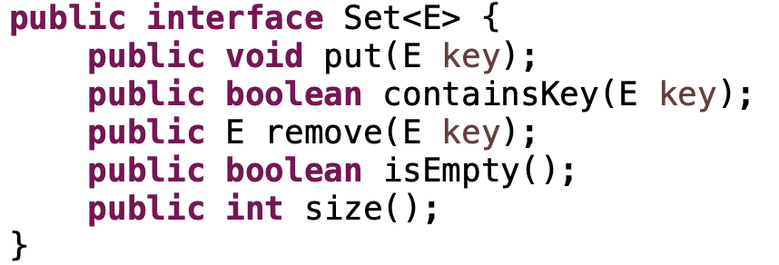
Sets
An unordered collection
Things can be added and removes
Check if things are in the set

Slide 4
Why not just arrays?
array must be as large as the universe of keys
universe of keys - U
Array

Slide 5
Why not just arrays?
array must be as large as the universe of keys
universe of keys - U
space of actual keys used is often much, much smaller than the universe of keys
actual keys, n
Array

Slide 6
Hashtables
Using an array is still a good idea
Key idea: need to translate from the key into an index in the array
Array
null
null
null
null
null
5
null
7
null
null
null
null
null
null
null
m

Slide 7
Hash function, h
A hash function is a function that maps the universe of keys to a restricted range (e.g., the size of an array)
universe of keys - U
hash function, h: U ➔m
m << |U|

Slide 8
Hash function, h
A hash function is a function that maps the universe of keys to a restricted range (e.g., the size of an array)
universe of keys - U
hash function, h: U ➔m
m << |U|

Slide 9
Hash function, h
A hash function is a function that maps the universe of keys to a restricted range (e.g., the size of an array)
universe of keys - U
hash function, h: U ➔m
m << |U|

Slide 10
Collisions
A collision occurs when h(x) = h(y), but x ≠ y
A good hash function will minimize the number of collisions
Because the number of hashtable (array) entries is less than the possible keys (i.e. m < |U|) collisions are inevitable!
We need to handle collisions!
Collision resolution techniques?

Slide 11
Collision resolution by chaining
Hashtable consists of an array of linked lists
When a collision occurs, the element is added to linked list at that location
If two entries x ≠ y have the same hash value h(x) = h(y), then table[h(x)] will contain a linked list with both values
null
null
null
null
null
null
null
null
null
null
null
null

Slide 12
Collision resolution by chaining
null
null
null
null
null
null
null
null
null
null
null
null
put?
containsKey?
remove

Slide 13
Collision resolution by chaining
null
null
null
null
null
null
null
null
null
null
null
null
put: addFirst h(key)
containsKey: contains h(key)
remove: remove h(key)

Slide 14
Running time?
put: addFirst h(key)
containsKey: contains h(key)
remove: remove h(key)
null
null
null
null
null
null
null
null
null
null
null
null

Slide 15
Running time?
put: O(1)
containsKey: O(length of linked list)
remove: O(length of linked list)
null
null
null
null
null
null
null
null
null
null
null
null

Slide 16
Length of the chain
Worst case?

Slide 17
Length of the chain
Worst case?
All elements hash to the same location
h(k) = 4
n
…

Slide 18
Length of the chain
Average case:
Depends on how well the hash function distributes the keys
What is the best we could hope for a hash function?
simple uniform hashing: an element is equally likely to end up in any of the m slots
Under simple uniform hashing what is the average length of a chain in the table?
n keys over m slots = n / m = α

Slide 19
The load of a table/hashtable
m = number of possible entries in the table
n = number of keys stored in the table
α = n/m is the load factor of the hashtable
The smaller α, the more wasteful the table
The load also helps us talk about run time

Slide 20
Average chain length
If you roll a fair m sided die n times, how many times are we likely to see a given value?
For example, 10 sided die:
1 time
1/10
100 times
100/10 = 10

Slide 21
containsKey average running time
Two cases:
Key is not in the table
must search all entries
O(1 + α)
Key is in the table
on average search half of the entries
O(1 + α)

Slide 22
Hash functions
Function that takes as input a key and return a value from 0 to m-1 (the size of the hashtable)
universe of keys - U
hash function, h: U ➔m

Slide 23
Hash functions
What makes a good hash function?
Approximates the assumption of simple uniform hashing
Deterministic – h(x) should always return the same value
Low cost – if it is expensive to calculate the hash value (e.g. log n) then we don’t gain anything by using a table
Challenge: we don’t generally know the distribution of the keys
Frequently data tend to be clustered (e.g. similar strings, run-times, SSNs). A good hash function should spread these out across the table

Slide 24
Division method
h(k) = k mod m
m k h(k)
11 25
11 1
11 17
13 133
13 7
13 25

Slide 25
Division method
h(k) = k mod m
m k h(k)
11 25
3
11 1
1
11 17
6
13 133
3
13 7
7
13 25
12

Slide 26
Division method
Don’t use a power of two. Why?
m k bin(k) h(k)
25 11001
8 1 00001
8 17 10001

Slide 27
Division method
Don’t use a power of two. Why?
if h(k) = k mod 2^{p}, the hash function is just the lower p bits of the value
m k bin(k) h(k)
25 11001 1
8 1 00001 1
8 17 10001 1

Slide 28
Division method
Good rule of thumb for m is a prime number not too close to a power of 2
Pros:
quick to calculate
easy to understand
Cons:
keys close to each other will end up close in the hashtable

Slide 29
Multiplication method
Multiply the key by a constant 0 < A < 1 and extract the fractional part of kA, then scale by m to get the index
extracts the fractional portion of kA

Slide 30
Multiplication method
Common choice is for m as a power of 2 and
Why a power of 2?
Book has other heuristics

Slide 31
Multiplication method
m k A
8 15 0.618
8 23 0.618
8 100 0.618
kA h(k)

Slide 32
Multiplication method
m k A
8 15 0.618
8 23 0.618
8 100 0.618
kA h(k)
9.27
floor(0.27*8) = 2
14.214
floor(0.214*8) = 1
61.8
floor(0.8*8) = 6

Slide 33
Other hash functions
http://en.wikipedia.org/wiki/List_of_hash_functions
cyclic redundancy checks (i.e. disks, cds, dvds)
Checksums (i.e. networking, file transfers)
Cryptographic (i.e. MD5, SHA)

Slide 34
Open addressing
Keeping around an array of linked lists can be inefficient and a hassle
Like to keep the hashtable as just an array of elements (no pointers)
How do we deal with collisions?
compute another slot in the hashtable to examine

Slide 35
Hash functions with open addressing
Hash function must define a probe sequence which is the list of slots to examine when a put or containsKey
The hash function takes an additional parameter i which is the number of collisions that have already occurred
The probe sequence must be a permutation of every hashtable entry. Why?
{ h(k,0), h(k,1), h(k,2), …, h(k, m-1) } is a permutation of { 0, 1, 2, 3, …, m-1 }
Notes:
If we didn’t do this, we wouldn’t visit all of the entries in the table!

Slide 36
Hash functions with open addressing
Hash function must define a probe sequence which is the list of slots to examine when doing a put or containsKey
The hash function takes an additional parameter i which is the number of collisions that have already occurred
The probe sequence must be a permutation of every hashtable entry. Why?
If not, we wouldn’t explore all the possible location in the table!
Notes:
If we didn’t do this, we wouldn’t visit all of the entries in the table!

Slide 37
Probe sequence
h(k, 0)

Slide 38
Probe sequence
h(k, 1)

Slide 39
Probe sequence
h(k, 2)

Slide 40
Probe sequence
h(k, 3)

Slide 41
Probe sequence
h(k, …)
must visit all locations
…

Slide 42
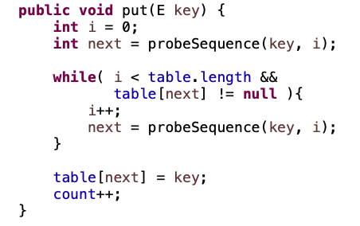
Open addressing: put
What does this code do?

Slide 43
Open addressing: put
get the first entry to check

Slide 44
Open addressing: put
as long as we haven’t check all entries and the entry isn’t empty

Slide 45
Open addressing: put
get the next entry to check

Slide 46
Open addressing: put
put the key into the table (assumes table wasn’t full)

Slide 47
Open addressing
containsKey?
remove?

Slide 48
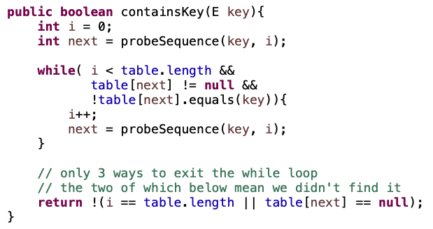
Open addressing: containsKey

Slide 49
Open addressing: containsKey
very similar to put!
also need to check if we’ve found the key

Slide 50
Open addressing: containsKey
return false if we searched the whole table or we got to a null entry

Slide 51
Open addressing: remove
Two options:
mark node as “deleted” (rather than null)
modify containsKey to continue looking if a “deleted” node is seen
modify put to fill in “deleted” entries
increases search times!
if a lot of deleting will happen, use chaining

Slide 52
Probing schemes
Linear probing – if a collision occurs, go to the next slot
h(k,i) = (h(k) + i) mod m
Does it meet our requirement that it visits every slot?
for example, m = 7 and h(k) = 4
h(k,0) = 4
h(k,1) = 5
h(k,2) = 6
h(k,3) = 0
h(k,3) = 1

Slide 53
Linear probing: put
h( , 0)

Slide 54
Linear probing: put
h( , 1)

Slide 55
Linear probing: put
h( , 2)

Slide 56
Linear probing: put
h( , 3)

Slide 57
Linear probing: put
h( , 3)

Slide 58
Linear probing
Problem:
primary clustering – long runs of occupied slots tend to build up and these tend to grow
any value here results in an increase in the cluster
become more and more probable for a value to end up in that range

Slide 59
Quadratic probing
h(k,i) = (h(k) + c₁i + c₂i²) mod m
Rather than a linear sequence, we probe based on a quadratic function
Problems:
must pick constants and m so that we have a proper probe sequence
if h(x) = h(y), then h(x,i) = h(y,i) for all i
secondary clustering

Slide 60
Double hashing
Probe sequence is determined by a second hash function
h(k,i) = (h₁(k) + i(h₂(k))) mod m
Problem:
h₂(k) must visit all possible positions in the table

Slide 61
Running time of put and containsKey for open addressing
Depends on the hash function/probe sequence
Worst case?
O(n) – probe sequence visits every full entry first before finding an empty

Slide 62
Running time of put and containsKey for open addressing
Average case?
We have to make at least one probe

Slide 63
Running time of put and containsKey for open addressing
Average case?
What is the probability that the first probe will not be successful (assume uniform hashing function)?
α

Slide 64
Running time of put and containsKey for open addressing
Average case?
What is the probability that the first two probed slots will not be successful?
~α²
why ‘~’?

Slide 65
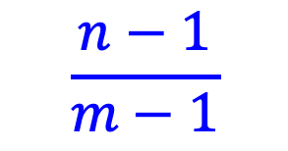
Running time of put and containsKey for open addressing
Average case?
What is the probability that the first two probed slots will not be successful?
~α²
$$\frac{n−1}{m−1}$$
Technically, second probe is:
Notes:
For largish, n and m, this is close to alpha

Slide 66
Running time of put and containsKey for open addressing
Average case?
What is the probability that the first three probed slots will not be successful?
~α³

Slide 67
Running time of insert and search for open addressing
Average case: expected number of probes
sum of the probability of making 1 probe, 2 probes, 3 probes, …

Slide 68
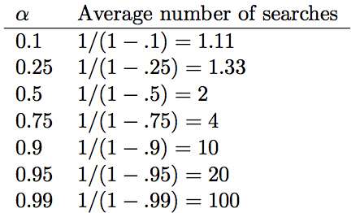
Average number of probes

Slide 69
How big should a hashtable be?
A good rule of thumb is the hashtable should be around half full
What happens when the hashtable gets full?
Copy: Create a new table and copy the values over
results in one expensive put
simple to implement
Amortized copy: When a certain ratio is hit, grow the table, but copy the entries over a few at a time with every insert
no single put is expensive and can guarantee per put performance
more complicated to implement

Slide 70
To the code…
abstract classes!
Making your classes hashable:
hashCode
equals
HashSet:
https://docs.oracle.com/javase/8/docs/api/java/util/HashSet.html
HashMap: https://docs.oracle.com/javase/8/docs/api/java/util/HashMap.html

