Slide 1
Hashtables
David Kauchak CS 62 – Spring 2021

Slide 2
Admin
No mentor hours: Friday (3/5) – Tuesday (3/16)
Mentors will reach out regarding learning community meetings.
Office hours today: 3:30-4pm
No office hours next week
No assignment over spring break!

Slide 3
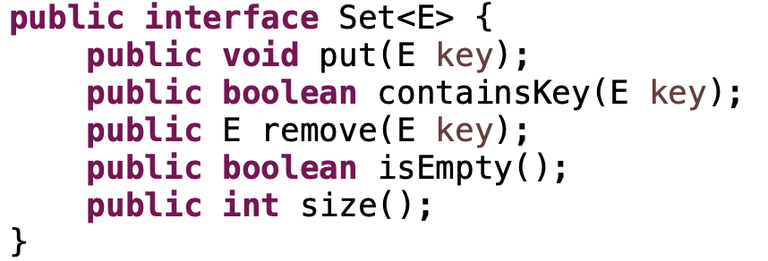
Sets
An unordered collection
Things can be added and removes
Check if things are in the set
Could we do this with any of our data structures so far?
Big-O runtime of methods?

Slide 4
Sets
An unordered collection
Things can be added and removes
Check if things are in the set
We’d like to make these operations fast: O(1)!

Slide 5
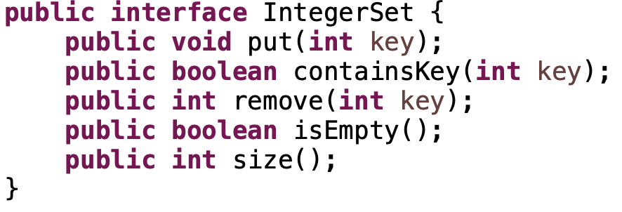
Integer sets
What if we assume that they’re integers.
Any ideas how to do this fast?

Slide 6
Integer sets
Array
null
null
null
null
null
null
null
null
null
null
null
null
null
null
null

Slide 7
Integer sets
put(5)
Where should we put it?
Array
null
null
null
null
null
null
null
null
null
null
null
null
null
null
null

Slide 8
Integer sets
put(5)
Array
null
null
null
null
null
5
null
null
null
null
null
null
null
null
null

Slide 9
Integer sets
put(7)
Where should we put it?
Array
null
null
null
null
null
5
null
null
null
null
null
null
null
null
null

Slide 10
Integer sets
put(7)
Where should we put it?
Array
null
null
null
null
null
5
null
7
null
null
null
null
null
null
null

Slide 11
Integer sets
containsKey(4)?
Array
null
null
null
null
null
5
null
7
null
null
null
null
null
null
null

Slide 12
Integer sets
containsKey(4)?
No!
Array
null
null
null
null
null
5
null
7
null
null
null
null
null
null
null

Slide 13
Integer sets
containsKey(7)?
Array
null
null
null
null
null
5
null
7
null
null
null
null
null
null
null

Slide 14
Integer sets
containsKey(7)?
Yes!
Array
null
null
null
null
null
5
null
7
null
null
null
null
null
null
null

Slide 15
Integer sets
remove(5)?
Array
null
null
null
null
null
5
null
7
null
null
null
null
null
null
null

Slide 16
Integer sets
remove(5)?
Array
null
null
null
null
null
null
null
7
null
null
null
null
null
null
null

Slide 17
Integer sets
What is the big-O runtime of the methods?
O(1)
Array
null
null
null
null
null
5
null
7
null
null
null
null
null
null
null

Slide 18
Integer sets
Any problems?
Array
null
null
null
null
null
5
null
7
null
null
null
null
null
null
null

Slide 19
Integer sets
Negative numbers (could fix this by adding a constant)
The array would have to be huge!
(ints range from -2³¹ to 2³¹-1,
2³¹= ~2 billion)
Any problems?
Array
null
null
null
null
null
5
null
7
null
null
null
null
null
null
null

Slide 20
Keys
universe of keys - U
For whatever key we’re using (e.g., integers), there is a universe of all possible keys

Slide 21
Why not just arrays?
array must be as large as the universe of keys
universe of keys - U
Array

Slide 22
Why not just arrays?
array must be as large as the universe of keys
universe of keys - U
space of actual keys used is often much, much smaller than the universe of keys
actual keys, n
Array

Slide 23
Why not arrays?
Think of indexing all last names < 10 characters
Census listing of all last names http://www.census.gov/genealogy/names/dist.all.last
88,799 last names
What is the size of our space of keys?
26¹⁰ = a big number
Not feasible!
Even if it were, not space efficient

Slide 24
Hashtables
Using an array is still a good idea
Key idea: need to translate from the key into an index in the array
Array
null
null
null
null
null
5
null
7
null
null
null
null
null
null
null
m

Slide 25
Hash function, h
A hash function is a function that maps the universe of keys to a restricted range (e.g., the size of an array)
universe of keys - U
hash function, h: U ➔m
m << |U|

Slide 26
Hash function, h
A hash function is a function that maps the universe of keys to a restricted range (e.g., the size of an array)
universe of keys - U
hash function, h: U ➔m
m << |U|

Slide 27
Hash function, h
A hash function is a function that maps the universe of keys to a restricted range (e.g., the size of an array)
universe of keys - U
hash function, h: U ➔m
m << |U|

Slide 28
Hash function, h
What can happen if m < |U|?
universe of keys - U
hash function, h: U ➔m
m << |U|

Slide 29
Collisions
If m < |U|, then two keys can map to the same position in the hashtable (pidgeonhole principle)
universe of keys - U
hash function, h
m << |U|

Slide 30
Collisions
A collision occurs when h(x) = h(y), but x ≠ y
A good hash function will minimize the number of collisions
Because the number of hashtable (array) entries is less than the possible keys (i.e. m < |U|) collisions are inevitable!
We need to handle collisions!
Collision resolution techniques?

Slide 31
Collision resolution by chaining
Hashtable consists of an array of linked lists
When a collision occurs, the element is added to linked list at that location
If two entries x ≠ y have the same hash value h(x) = h(y), then table[h(x)] will contain a linked list with both values
null
null
null
null
null
null
null
null
null
null
null
null

Slide 32
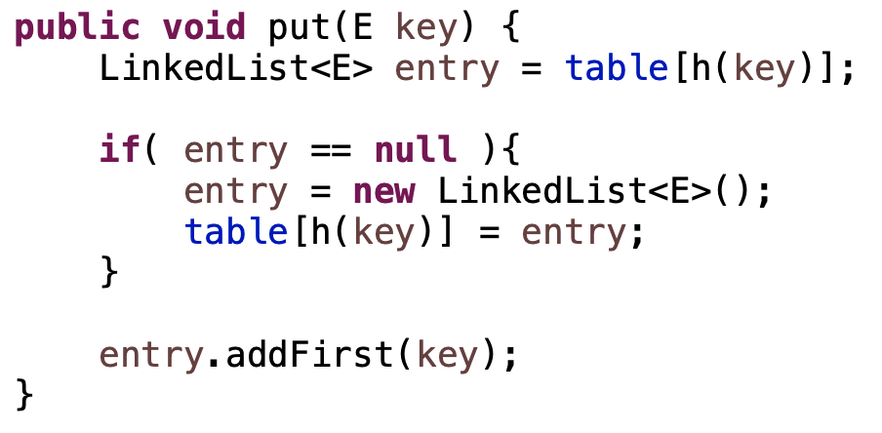
put
What does this code do?

Slide 33
put( )
null
null
null
null
null
null
null
null
null
null
null
null
null

Slide 34
put( )
h( )
hash function is a mapping from the key to some value < m
null
null
null
null
null
null
null
null
null
null
null
null
null

Slide 35
put( )
h( )
hash function is a mapping from the key to some value < m
null
null
null
null
null
null
null
null
null
null
null
null
null

Slide 36
put( )
h( )
hash function is a mapping from the key to some value < m
null
null
null
null
null
null
null
null
null
null
null
null
null

Slide 37
More methods
containsKey?
remove?
null
null
null
null
null
null
null
null
null
null
null
null

Slide 38
containsKey
null
null
null
null
null
null
null
null
null
null
null
null

Slide 39
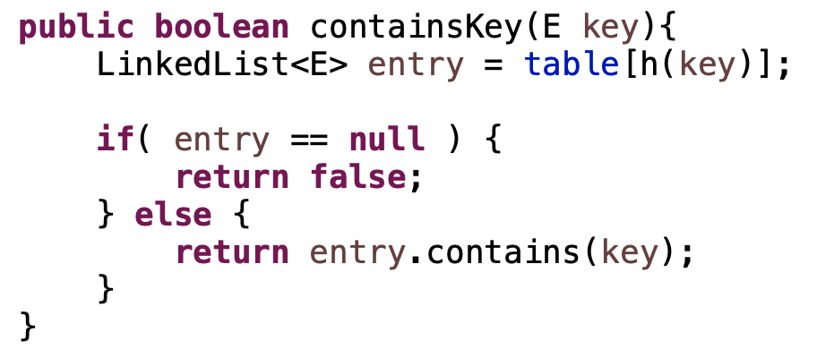
ternary operator

Slide 40
containsKey
containsKey( )
null
null
null
null
null
null
null
null
null
null
null
null

Slide 41
containsKey
containsKey( )
h( )
null
null
null
null
null
null
null
null
null
null
null
null

Slide 42
containsKey
containsKey( )
h( )
null
null
null
null
null
null
null
null
null
null
null
null

Slide 43
containsKey
containsKey( )
h( )
null
null
null
null
null
null
null
null
null
null
null
null

Slide 44
containsKey
containsKey( )
h( )
null
null
null
null
null
null
null
null
null
null
null
null

Slide 45
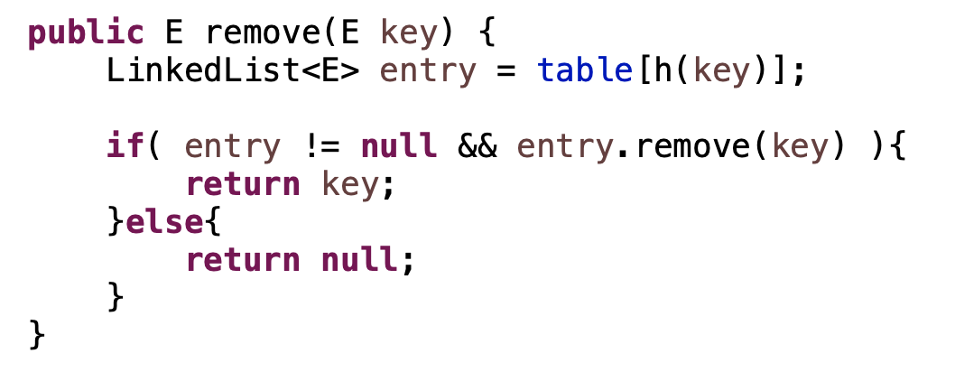
remove
null
null
null
null
null
null
null
null
null
null
null
null

Slide 46
remove
containsKey( )
null
null
null
null
null
null
null
null
null
null
null
null

Slide 47
remove
containsKey( )
h( )
null
null
null
null
null
null
null
null
null
null
null
null

Slide 48
remove
containsKey( )
h( )
null
null
null
null
null
null
null
null
null
null
null
null

Slide 49
remove
containsKey( )
h( )
null
null
null
null
null
null
null
null
null
null
null
null

Slide 50
remove
containsKey( )
h( )
null
null
null
null
null
null
null
null
null
null
null
null

Slide 51
Running time?
put
containsKey
remove
null
null
null
null
null
null
null
null
null
null
null
null

Slide 52
Running time?
put: O(1)
containsKey: O(length of linked list)
remove: O(length of linked list)
null
null
null
null
null
null
null
null
null
null
null
null

Slide 53
Length of the chain
Worst case?

Slide 54
Length of the chain
Worst case?
All elements hash to the same location
h(k) = 4
n
…

