Slide 1
Linked list visualized
[1, 8, 4, 7]
data: 1
data: 8
data: 4
data: 7
head
next:
next:
next:
next: null
Look at code

Slide 2
Adding to the end
[1, 8, 4, 7]
data: 1
data: 8
data: 4
data: 7
head
next:
next:
next:
next: null
How can we add a value to the end of the list?

Slide 3
Adding to the end: add 9 to the end
[1, 8, 4, 7]
data: 1
data: 8
data: 4
data: 7
head
next:
next:
next:
next: null
find the end of the list
finger
How do we know we’re at the end?

Slide 4
Adding to the end: add 9 to the end
[1, 8, 4, 7]
data: 1
data: 8
data: 4
data: 7
head
next:
next:
next:
next: null
find the end of the list
finger
finger.next() == null

Slide 5
Adding to the end: add 9 to the end
[1, 8, 4, 7]
data: 1
data: 8
data: 4
data: 7
data: 9
head
next:
next:
next:
next: null
next: null
finger
create a new node and add it to the end

Slide 6
Adding to the end: add 9 to the end
[1, 8, 4, 7]
data: 1
data: 8
data: 4
data: 7
data: 9
head
next:
next:
next:
next:
next: null
finger
create a new node and add it to the end

Slide 7
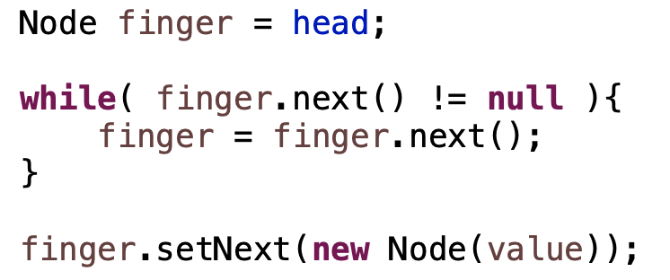
Adding to the end: add 9 to the end
[1, 8, 4, 7]
data: 1
data: 8
data: 4
data: 7
data: 9
head
next:
next:
next:
next:
next: null
finger

Slide 8
Adding to the end
[1, 8, 4, 7]
data: 1
data: 8
data: 4
data: 7
head
next:
next:
next:
next: null
Any special cases we need to handle?

Slide 9
Adding to the end
[1, 8, 4, 7]
What would happen here?
head: null
Notes:
null pointer exception!

Slide 10
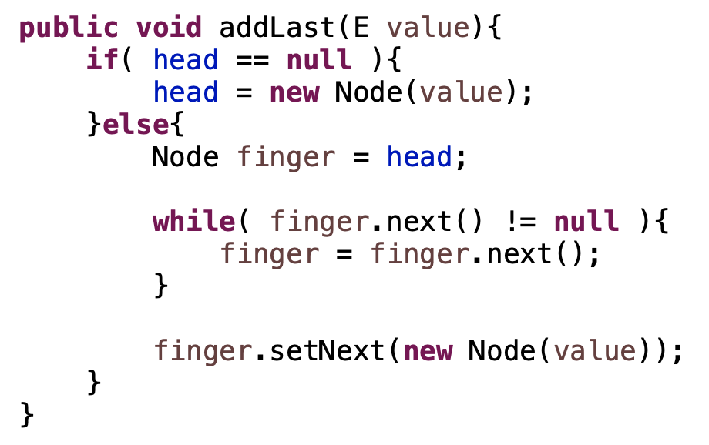
Adding to the end
[1, 8, 4, 7]
head: null

Slide 11
Removing a value
[1, 8, 4, 7]
data: 1
data: 8
data: 4
data: 7
head
next:
next:
next:
next: null
How can we we remove a value from the list?

Slide 12
Removing a value: remove 4
[1, 8, 4, 7]
data: 1
data: 8
data: 4
data: 7
head
next:
next:
next:
next: null
finger
Find it

Slide 13
Removing a value: remove 4
[1, 8, 4, 7]
data: 1
data: 8
data: 4
data: 7
head
next:
next:
next:
next: null
prev
finger
Need the node before it too!

Slide 14
Removing a value: remove 4
[1, 8, 4, 7]
data: 1
data: 8
data: 4
data: 7
head
next:
next:
next:
next: null
prev
finger
splice it out

Slide 15
Removing a value: remove 4
[1, 8, 4, 7]
data: 1
data: 8
data: 4
data: 7
head
next:
next:
next:
next: null
prev
finger
splice it out

Slide 16
Removing a value: remove 4
[1, 8, 4, 7]
data: 1
data: 8
data: 7
head
next:
next:
next: null
prev
splice it out

Slide 17
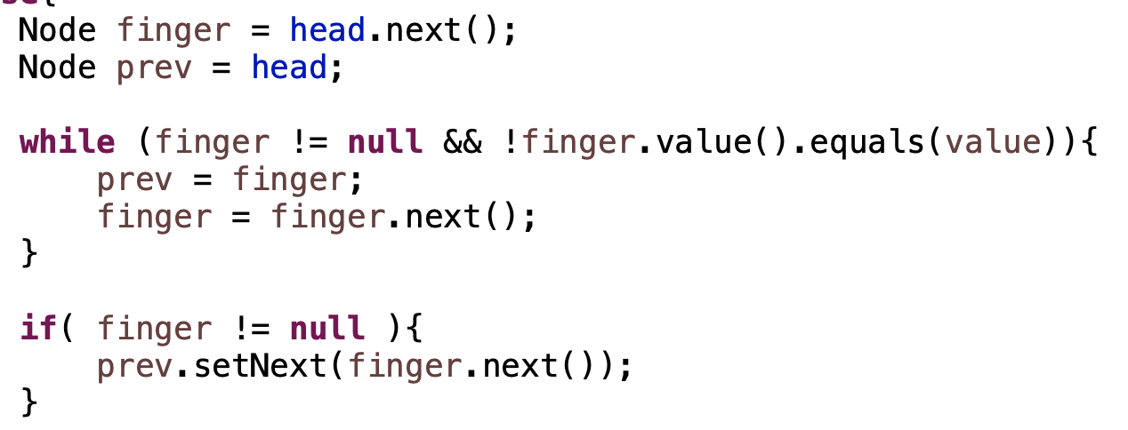
Removing a value
data: 1
data: 8
data: 4
data: 7
head
next:
next:
next:
next: null

Slide 18
Removing a value
data: 1
data: 8
data: 4
data: 7
head
next:
next:
next:
next: null
prev
finger

Slide 19
Removing a value
data: 1
data: 8
data: 4
data: 7
head
next:
next:
next:
next: null
prev
finger

Slide 20
Removing a value
data: 1
data: 8
data: 4
data: 7
head
next:
next:
next:
next: null
prev
finger

Slide 21
Removing a value
data: 1
data: 8
data: 4
data: 7
head
next:
next:
next:
next: null
prev
finger

Slide 22
Removing a value
data: 1
data: 8
data: 4
data: 7
head
next:
next:
next:
next: null
prev
finger

Slide 23
Removing a value
data: 1
data: 8
data: 4
data: 7
head
next:
next:
next:
next: null
prev
finger
When would finger be null?

Slide 24
Removing a value
data: 1
data: 8
data: 4
data: 7
head
next:
next:
next:
next: null
prev
finger

Slide 25
Removing a value
data: 1
data: 8
data: 4
data: 7
head
next:
next:
next:
next: null
Any special cases we need to handle?

Slide 26
Removing a value
head: null
What would happen here?

Slide 27
Removing a value
data: 1
data: 8
data: 4
data: 7
head
next:
next:
next:
next: null
Any other special cases we need to handle?

Slide 28
Removing a value
data: 1
data: 8
data: 4
data: 7
head
next:
next:
next:
next: null
Delete 1. Does it work?

Slide 29
Removing a value
data: 1
data: 8
data: 4
data: 7
head
next:
next:
next:
next: null
prev
finger
Delete 1. Does it work?

Slide 30
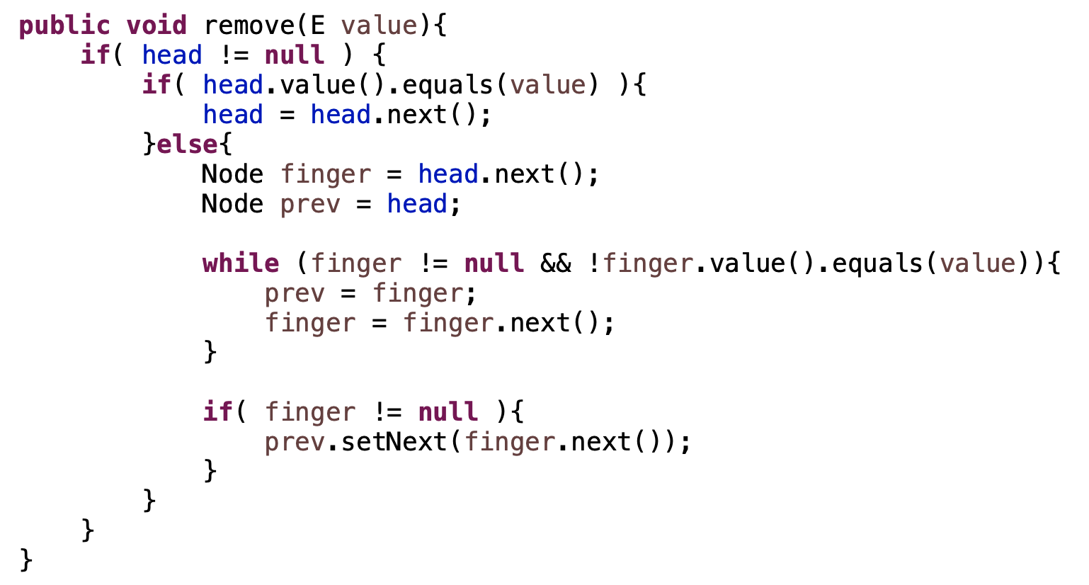
Removing a value

Slide 31
Removing a value
handle empty list
removing first element
all other elements

Slide 32
Linked lists: fast or slow?
add to the end
add to the front
contains
get
insert at an index
remove an element
set the value of an existing element
size

Slide 33
Linked lists: fast or slow?
add to the end slow
add to the front: fast
contains slow
get slow
insert at an index slow
remove an element slow
remove from the front fast
set the value of an existing element slow
size fast

Slide 34
Linked lists: fast or slow?
add to the end slow
add to the front: fast
contains slow
get slow
insert at an index slow
remove an element slow
remove from the front fast
set the value of an existing element slow
size fast
Can we make any of these faster?

Slide 35
Linked list visualized
[1, 8, 4, 7]
data: 1
data: 8
data: 4
data: 7
head
next:
next:
next:
next: null
How does this help us?
tail

Slide 36
Linked list visualized
data: 1
data: 8
data: 4
data: 7
head
next:
next:
next:
next: null
We don’t have to search for the end of the list!
tail

Slide 37
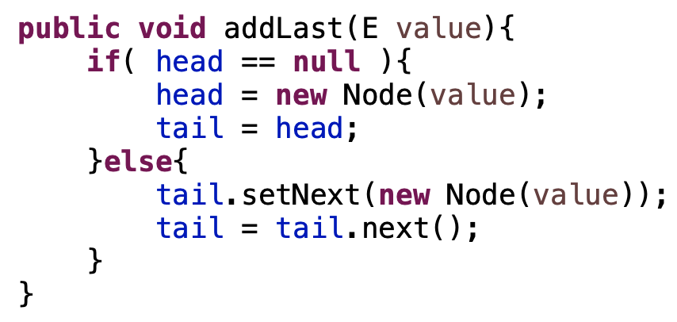
Linked list visualized
data: 1
data: 8
data: 4
data: 7
head
next:
next:
next:
next: null
tail

Slide 38
Linked list visualized
[1, 8, 4, 7]
data: 1
data: 8
data: 4
data: 7
head
next:
next:
next:
next: null
tail
Any downsides?

Slide 39
Circularly linked list visualized
[1, 8, 4, 7]
data: 1
data: 8
data: 4
data: 7
next:
next:
next:
next:
tail
Where is head?

Slide 40
Circularly linked list visualized
[1, 8, 4, 7]
data: 1
data: 8
data: 4
data: 7
next:
next:
next:
next:
tail
tail.next()

Slide 41
Linked lists: fast or slow?
add to the end fast
add to the front: fast
contains slow
get slow
insert at an index slow
remove an element slow
remove from the front fast
set the value of an existing element slow
size fast

Slide 42
Linked list visualized
[1, 8, 4, 7]
data: 1
data: 8
data: 4
data: 7
head
next:
next:
next:
next: null
tail
Is removing from the end fast?

Slide 43
Linked list visualized
[1, 8, 4, 7]
data: 1
data: 8
data: 4
data: 7
head
next:
next:
next:
next: null
tail
No! Need access to previous

Slide 44
Doubly linked list visualized
Keep track of both the next and previous node in the list
data: 1
data: 8
data: 4
data: 7
head
next:
next:
next:
next:
prev: null
prev:
prev:
prev:
tail

Slide 45
Doubly linked list visualized
data: 1
data: 8
data: 4
data: 7
head
next:
next:
next:
next:
prev: null
prev:
prev:
prev:
tail
Is removing from the end fast?

Slide 46
Doubly linked list visualized
data: 1
data: 8
data: 4
data: 7
head
next:
next:
next:
next:
prev: null
prev:
prev:
prev:
tail

Slide 47
Doubly linked list visualized
data: 1
data: 8
data: 4
data: 7
head
next:
next:
next:
next:
prev: null
prev:
prev:
prev:
tail

Slide 48
Doubly linked list visualized
data: 1
data: 8
data: 4
data: 7
head
next:
next:
next: null
next:
prev: null
prev:
prev:
prev:
tail

Slide 49
Doubly linked list visualized
finger
data: 1
data: 8
data: 4
data: 7
head
next:
next:
next:
next:
prev: null
prev:
prev:
prev:
tail
Could I remove a node if I had a reference to it?

Slide 50
Doubly linked list visualized
finger
data: 1
data: 8
data: 4
data: 7
head
next:
next:
next:
next:
prev: null
prev:
prev:
prev:
tail
Could I remove a node if I had a reference to it?

Slide 51
Doubly linked list visualized
finger
data: 1
data: 8
data: 4
data: 7
head
next:
next:
next:
next:
prev: null
prev:
prev:
prev:
tail

Slide 52
Doubly linked list visualized
finger
data: 1
data: 8
data: 4
data: 7
head
next:
next:
next:
next:
prev: null
prev:
prev:
prev:
tail

Slide 53
Doubly linked list visualized
finger
data: 1
data: 8
data: 4
data: 7
head
next:
next:
next:
next:
prev: null
prev:
prev:
prev:
tail

Slide 54
Doubly linked list visualized
finger
data: 1
data: 8
data: 4
data: 7
head
next:
next:
next:
next:
prev: null
prev:
prev:
prev:
tail

Slide 55
Doubly linked list visualized
finger
data: 1
data: 8
data: 4
data: 7
head
next:
next:
next:
next:
prev: null
prev:
prev:
prev:
tail
How does this help us? Still have to find the node?

Slide 56
Doubly linked list visualized
finger
data: 1
data: 8
data: 4
data: 7
head
next:
next:
next:
next:
prev: null
prev:
prev:
prev:
tail
If we’re iterating over the data already
Other scenarios (see upcoming assignment ☺)

Slide 57
List performance
 | ArrayList | Singly linked list | Singly linked list (tail) | Doubly linked list
add to end | fast (amortized) | slow | fast | fast
add to front | slow | fast | fast | fast
insert at index | slow | slow | slow | slow
contains | slow | slow | slow | slow
get | fast | slow | slow | slow
set | fast | slow | slow | slow
remove | slow | slow | slow | slow
remove from end | fast | slow | slow | fast
remove from front | slow | fast | fast | fast
size | fast | fast | fast | fast

