Slide 1
minimum spanning trees + course recap
David Kauchak CS62– Fall 2020

Slide 2
Admin
Quiz 10 graded
Assignment 10 due Today
Last mentor hours tonight
Will update office hours/mentor hours for next week
Final exam 12/4, 2-5pm (PST)
4 pages of notes (2 double-sided)
sakai
Will post zoom link
If you can’t take it then, let me know and you can take it any time that day

Slide 3
Minimum spanning trees (MST)
The lowest weight set of edges that connects all vertices of an undirected graph with positive weights
1
1
A
C
E
A
C
E
3
4
4
4
4
2
5
4
2
5
B
D
F
B
D
F
4
6

Slide 4
MSTs
Can an MST have a cycle?
1
A
C
E
4
4
2
5
B
D
F
4

Slide 5
MSTs
Can an MST have a cycle?
1
A
C
E
4
4
2
5
B
D
F

Slide 6
Kruskal’s algorithm
Given a partition S, let edge e be the minimum cost edge that crosses the partition. Every minimum spanning tree contains edge e.
Kruskals:
Sort edges by increasing weight
for each edge (by increasing weight):
check if adding edge to MST creates a cycle
if not, add edge to MST
Notes:
an MST will never have a cycle since one edge in the cycle would be redundant

Slide 7
Why does Kruskal’s work?
Never adds an edge that creates a cycle
Therefore, always adds lowest cost edge to connect two connected components. By min cut property, that edge must be part of the MST
Kruskals:
Sort edges by increasing weight
for each edge (by increasing weight):
check if adding edge to MST creates a cycle
if not, add edge to MST
Run-time: O(VE+E²) do this E times

Slide 8
Kruskal’s details
We can do better!
Uses a data structure called “disjoint set” to efficiently check whether adding an edge creates a cycle
Run-time: O(E log E) (bounded by the sort)

Slide 9
Prim’s algorithm
Greedily grow the MST starting at a vertex:
Start with a random vertex and count that vertex as connected by the MST
Add the edge with the smallest weight that connects a vertex not connected by the MST
Repeat until we’ve added V-1 edges

Slide 10
Prim’s
Add the edge with the smallest weight that connects a vertex not connected by the MST
1
A
C
E
3
4
5
MST
4
4
2
B
D
F
4
6
A
C
E
B
D
F

Slide 11
Prim’s
Add the edge with the smallest weight that connects a vertex not connected by the MST
1
A
C
E
3
4
5
MST
4
4
2
B
D
F
4
6
A
C
E
B
D
F

Slide 12
Prim’s
Add the edge with the smallest weight that connects a vertex not connected by the MST
1
A
C
E
3
4
5
MST
4
4
2
4
5
B
D
F
4
6
A
C
E
B
D
F
6

Slide 13
Prim’s
Add the edge with the smallest weight that connects a vertex not connected by the MST
1
A
C
E
3
4
5
MST
4
4
2
5
B
D
F
4
6
A
C
E
B
D
F
6

Slide 14
Prim’s
Add the edge with the smallest weight that connects a vertex not connected by the MST
1
A
C
E
3
4
5
MST
4
4
2
1
5
B
D
F
4
6
A
C
E
B
D
F
4
2

Slide 15
Prim’s
Add the edge with the smallest weight that connects a vertex not connected by the MST
1
A
C
E
3
4
5
MST
4
4
2
5
B
D
F
4
6
A
C
E
B
D
F
4
2

Slide 16
Prim’s
Add the edge with the smallest weight that connects a vertex not connected by the MST
1
A
C
E
3
4
5
MST
4
4
2
5
B
D
F
4
6
A
C
E
B
D
F
4
2

Slide 17
Prim’s
Add the edge with the smallest weight that connects a vertex not connected by the MST
1
A
C
E
3
4
5
MST
4
4
2
5
B
D
F
4
6
A
C
E
B
D
F
4

Slide 18
Prim’s
Add the edge with the smallest weight that connects a vertex not connected by the MST
1
A
C
E
3
4
5
MST
4
4
2
5
B
D
F
4
6
A
C
E
B
D
F
4

Slide 19
Prim’s
Add the edge with the smallest weight that connects a vertex not connected by the MST
1
A
C
E
3
4
5
MST
4
4
2
5
B
D
F
4
6
A
C
E
B
D
F

Slide 20
Prim’s
Add the edge with the smallest weight that connects a vertex not connected by the MST
1
A
C
E
3
4
5
MST
4
4
2
5
B
D
F
4
6
A
C
E
B
D
F

Slide 21
Prim’s
Add the edge with the smallest weight that connects a vertex not connected by the MST
1
A
C
E
3
4
5
MST
4
4
2
B
D
F
4
6
A
C
E
B
D
F

Slide 22
Practice: start at vertex 0

Slide 23
Solution
Sum = 8 + 8 + 9 + 9 + 11 + 11 + 12 + 14 = 82

Slide 24
Why does Prim’s work?
Given a partition S, let edge e be the minimum cost edge that crosses the partition. Every minimum spanning tree contains edge e.
Let S be the set of vertices visited so far
The only time we add a new edge is if it’s the lowest weight edge from S to V-S

Slide 25
Prim’s
Add the edge with the smallest weight that connects a vertex not connected by the MST
How do we find the smallest weight edge? Or, how could we keep track of it?
MST
1
5
1
A
C
E
A
C
E
3
4
5
4
4
2
B
D
F
B
D
F
4
6
4
2

Slide 26
Prim’s
Add the edge with the smallest weight that connects a vertex not connected by the MST
Very similar implementation to Dijksra’s!
Use a priority queue
MST
1
5
1
A
C
E
A
C
E
3
4
5
4
4
2
B
D
F
B
D
F
4
6
4
2

Slide 27
Running time of Prim’s
Varies depending on the priority queue implementation
Practical version: O(E log V)

Slide 28
Sample question 1: True or False
A binary tree with n nodes has at most height O(log₂ n)
Heapsort is always O(n log₂ n)
A complete graph is connected.
The following code will print out 1: String[] strings = new String[10]; strings[0] = "banana"; System.out.println(strings.length);

Slide 29
Sample question 2
Write a method for that takes a BinaryTree, a value, and an ArrayList and populates the ArrayList with all data items in the tree that are less than the value passed in. Assume that the data item stored in the tree is a string and that the strings are unique.
public static <E implements comparable<E>> void findLessThan (BinaryTree<E> t, E value, ArrayList<E> list)

Slide 30
Sample question 3
What is a hashtable collision? Why do they happen? What are two ways of dealing with them?

Slide 31
Sample question 4
Explain the difference between weak and strong connectivity in a directed graph.

Slide 32
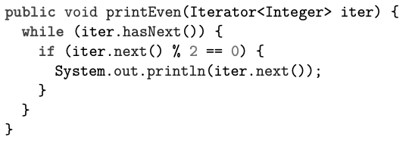
Sample question 5
Explain the problem with the following code and suggest how to fix it:

Slide 33
Sample question 6
In a graph where the shortest path from A to B is 3 edges, while the shortest path from A to C is 7 edges, will breadth-first search starting at A explore B or C first, or does it depend on the structure of the graph? Justify your answer.

Slide 34
Sample question 7
a. Draw a diagram of a doubly-linked list with both head and tail pointers that contains the elements 17, 23, and 31. Use arrows to indicate pointers, including the head and tail pointers, and the next and previous pointers of each node. For null pointers, draw an arrow pointing to the word “NULL.”
b. Assuming we wanted to insert the value 47 between the 23 and 31 in our list, write a list of which pointers would have to be changed. Include pointers that are part of the new node.

Slide 35
Sample question 8
Draw a directed, acyclic graph with 5 nodes which is not a tree, but which has at least one spanning tree. Label your nodes with the letters A through E.

Slide 36
Sample question 9
Assuming that BinaryTree t is a full binary search tree and that it is not a leaf, what does the method below do?
public static String mystery(BinaryTree t){
BinaryTree temp = t.right();
while( !temp.left().isEmpty() ){
temp = temp.left();
}
return temp.data();
}

Slide 37
Sample question 1 solution
False. At most O(n)
True.
True. It has edges between every pair of vertices.
False. Even though it only has one entry in it, strings will always have length 10 since it is an arrays length never changes.

Slide 38
Sample question 3: solution
Collisions happen when you have two different objects (i.e., objects that are not equals) that have the same hashCode
They happen because hash codes are mapping from a larger space of possibilities (e.g., all strings) down to a finite set of hash codes (e.g., 64-bit integers)
Collision resolution by chaining or open addressing

Slide 39
Sample question 4: solution
A strongly-connected directed graph is one in which for any pair of nodes A and B, there is both a path from A to B and a path from B to A. In a weakly-connected graph, this would be true if edges could be traversed either direction, but it isn’t necessarily true with the edges as-is. A weakly-connected graph is simply any graph which cannot be cut into two pieces without cutting through at least one edge.

Slide 40
Sample question 5: solution
This code calls next once in the condition of the while loop, and then again in the body, getting two different values each time. It needs to call next only once, and store the result.

Slide 41
Sample question 6: solution
It will explore B first, because breadth-first search always explores closer nodes (in terms of path length) before farther ones.

Slide 42
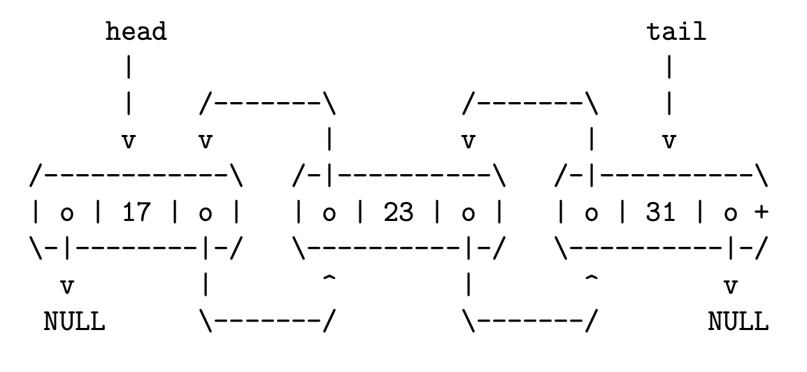
Sample question 7: solution
a.
b.
23.next
31.previous
47.previous
47.next

Slide 43
Sample question 8: solution
A
B
C
D
E

Slide 44
Sample question 9: solution
Finds the value that comes immediately after the root in sorted order

