Slide 1
CS52 machine
David Kauchak CS 54 – Fall 2022

Slide 2
Admin
Midterm 1
Practice problems posted
Very light coverage of numbers with different bases (I wouldn’t put Q7 on the midterm)
Assignment 2 grading
Assignment 3
Assignment 4

Slide 3
Admin
Extra mentor hours:
Monday, 8-10pm (Gabriel)
Tuesday, 8:15-9:30 (Will)
My Wednesday office hours:
9:30-10:30am (No hours 10:30am-12)

Slide 4
Examples from this lecture
https://cs.pomona.edu/classes/cs54/examples/cs52machine

Slide 5
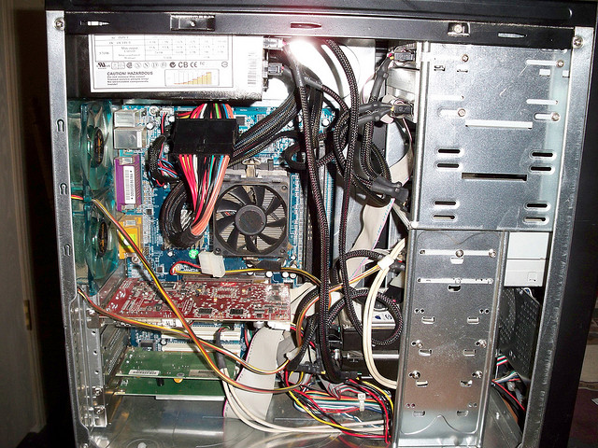
Computer internals

Slide 6
Computer internals simplified
CPU
RAM
What does it stand for?
What does it do?
What does it stand for?
What does it do?

Slide 7
Computer internals simplified
CPU
RAM
(Central Processing Unit,
aka “the processor”)
(Random Access Memory,
aka “memory” or “main memory”)
Does all the work!
Temporary storage

Slide 8
Computer internals simplified
“the computer”
hard drive
CPU
RAM
Why do we need a hard drive?

Slide 9
Computer internals simplified
“the computer”
hard drive
CPU
RAM
Persistent memory
RAM only stores data while it has power

Slide 10
Computer simplified
“the computer”
hard drive
CPU
RAM
network
media drive
input devices
display

Slide 11
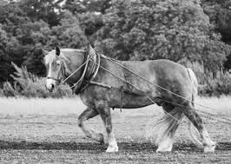
Inside the CPU
CPU
processor
processor: does the work
registers: local, fast memory slots
…
registers
Why all these levels of memory?

Slide 12
Memory speed
operation | access time | times slower than register access | for comparison…
register | 0.3 ns | 1 | 1 s
RAM | 120 ns | 400 | 6 min
Hard disk | 1ms | ~million | 1 month
box, onedrive, … | 0.4s | ~billion | 30 years

Slide 13
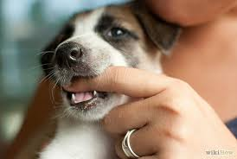
Memory
RAM
010101111000101000010010 …
What is a byte?
?

Slide 14
Memory
RAM
01010111 10001010 00010010 …
byte = 8 bits
byte is abbreviated as B
My laptop has 32GB (gigabytes) of memory. How many bits is that?

Slide 15
Memory sizes
 | bits
byte | 8
kilobyte (KB) | 2^10 bytes = ~8,000
megabyte (MB) | 2^20 =~ 8 million
gigabyte (GB) | 2^30 = ~8 billion
My laptop has 32GB (gigabytes) of memory. How many bits is that?

Slide 16
Memory sizes
 | bits
byte | 8
kilobyte (KB) | 2^10 bytes = ~8,000
megabyte (MB) | 2^20 =~ 8 million
gigabyte (GB) | 2^30 = ~8 billion
~256 billion bits!

Slide 17
Memory
address
0
1
2
3
…
01010111
10001010
00010010
01011010
…
RAM
Memory is byte addressable

Slide 18
Memory
address
0
1
2
3
…
01010111
10001010
00010010
01011010
…
RAM
Memory is organized into “words”, which is the most common functional unit

Slide 19
Memory
address
32-bit words
0
4
8
...
10101011 10001010 00010010 01011010
11001011 00001110 01010010 01010110
10111011 10010010 00000000 01110100
…
RAM
Most modern computers use 32-bit (4 byte) or 64-bit (8 byte) words

Slide 20
Memory in the CS52 Machine
address
16-bit words
0
2
4
...
10101011 10001010
00010010 01011010
11001011 00001110
…
RAM
We’ll use 16-bit words for our model (the CS52 machine)

Slide 21
CS52 machine
CPU
instruction counter
(location in memory of the next
instruction in memory)
processor
ic
r0
holds the value 0 (read only)
r1
general purpose
read/write
r2
registers
r3

Slide 22
instruction counter
(location in memory of the next
instruction in memory)
ic
r0
holds the value 0 (read only)
r1
general purpose
read/write
r2
r3

Slide 23
CS52 machine instructions
CPU
processor
What types of operations might we want to do (think really basic)?
registers

Slide 24
CS52 machine code
Four main types of instructions
math
branch/conditionals
memory
control the machine (e.g. stop it)

Slide 25
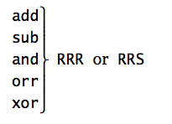
instruction name
arguments

Slide 26
instruction name
arguments
instruction/operation name
(always three characters)

Slide 27
instruction name
arguments
operation arguments
R = register (e.g. r0)
S = signed number (byte)

Slide 28
instruction name
arguments
1st R: register where the answer will go
2nd R: register of first operand
3rd S/R: register/value of second operand

Slide 29
add r1 r2 r3
What does this do?
1st R: register where the answer will go
2nd R: register of first operand
3rd S/R: register/value of second operand

Slide 30
add r1 r2 r3
r1 = r2 + r3
Add contents of registers r2 and r3 and store the result in r1
1st R: register where the answer will go
2nd R: register of first operand
3rd S/R: register/value of second operand

Slide 31
add r2 r1 10
What does this do?
1st R: register where the answer will go
2nd R: register of first operand
3rd S/R: register/value of second operand

Slide 32
add r2 r1 10
r2 = r1 + 10
Add 10 to the contents of register r1 and store in r2
1st R: register where the answer will go
2nd R: register of first operand
3rd S/R: register/value of second operand

Slide 33
add r1 r0 8
neg r2 r1
sub r2 r1 r2
What number is in r2?
1st R: register where the answer will go
2nd R: register of first operand
3rd S/R: register/value of second operand

Slide 34
add r1 r0 8
neg r2 r1
sub r2 r1 r2
r1 = 8
r2 = -8, r1 = 8
r2 = 16
1st R: register where the answer will go
2nd R: register of first operand
3rd S/R: register/value of second operand

Slide 35
Accessing memory
sto = save data in register TO memory
loa = put data FROM memory into a register
sto r1 r2 ; store the contents of r1 to mem[r2]
loa r1 r2 ; get data from mem[r2] and put into r1

Slide 36
Accessing memory
sto = save data in register TO memory
loa = put data FROM memory into a register
Special cases:
saving TO (sto) address 0 prints
reading from (loa) address 0 gets input from user

Slide 37
Basic structure of CS52 program
; great comments at the top!
;
instruction1 ; comment
instruction2 ; comment
...
hlt
whitespace before operations/instructions

Slide 38
Running the CS52 machine
Look at subtract.a52
load two numbers from the user
subtract
print the result

Slide 39
CS52 simulator
Different windows
Memory (left)
Instruction execution (right)
Registers
I/O and running program

Slide 40
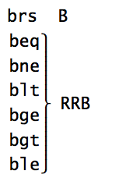
1st R: first register for comparison
2nd R: second register in comparison
3rd B: label

Slide 41
beq r3 r0 done
What does this do?
1st R: first register for comparison
2nd R: second register in comparison
3rd B: label

Slide 42
beq r3 r0 done
If r3 = 0, branch to the label “done”
if not (else) ic is incremented as normal to the next instruction
1st R: first register for comparison
2nd R: second register in comparison
3rd B: label

Slide 43
ble r2 r3 done
What does this do?
1st R: first register for comparison
2nd R: second register in comparison
3rd B: label

Slide 44
ble r2 r3 done
If r2 <= r3, branch to the label done
1st R: first register for comparison
2nd R: second register in comparison
3rd B: label

Slide 45
Conditionals
Loops
Change the order that instructions are executed

Slide 46
CS52 machine execution

Slide 47
Basic structure of CS52 program
; great comments at the top!
;
instruction1 ; comment
instruction2 ; comment
...
label1
instruction ; comment
instruction ; comment
label2
...
hlt
end
- whitespace before operations/instructions
- labels go here

Slide 48
More CS52 examples
Look at max_simple.a52
Get two values from the user
Compare them
Use a branch to distinguish between the two cases
Goal is to get largest value in r3
print largest value

