Slide 1
Introduction to Machine Learning
David Kauchak
CS 51A – Spring 2025

Slide 2

Machine Learning is…
Machine learning is about predicting the future based on the past.
-- Hal Daume III

Slide 3
Machine Learning is…
Machine learning is about predicting the future based on the past.
-- Hal Daume III
past
future
predict
learn
Training
Data
model/
predictor
Testing
Data
model/
predictor

Slide 4
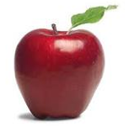
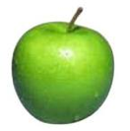
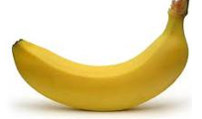
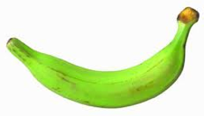
Data
examples
Data

Slide 5
Supervised learning
examples
label
label₁
label₃
labeled examples
label₄
label₅
Supervised learning: given labeled examples

Slide 6
Supervised learning
label
label₁
model/
predictor
label₃
label₄
label₅
Supervised learning: given labeled examples

Slide 7
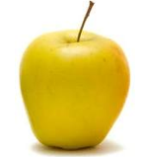
Supervised learning
model/
predictor
predicted label
Supervised learning: learn to predict new example

Slide 8
Supervised learning: classification
label
apple
Classification: a finite set of labels
apple
banana
banana
Supervised learning: given labeled examples

Slide 9
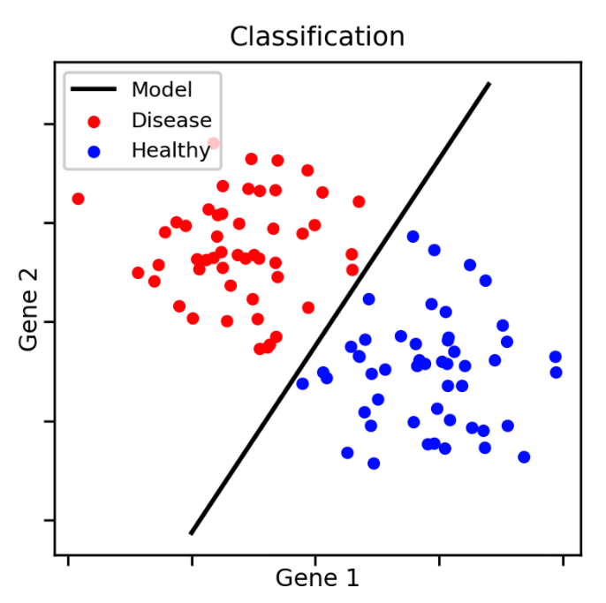
Classification Example

Slide 10
Classification Applications
Face recognition
Character recognition
Spam detection
Medical diagnosis: From symptoms to illnesses
Biometrics: Recognition/authentication using physical and/or behavioral characteristics: Face, iris, signature, etc
...

Slide 11
Supervised learning: regression
label
-4.5
Regression: label is real-valued
10.1
3.2
4.3
Supervised learning: given labeled examples

Slide 12
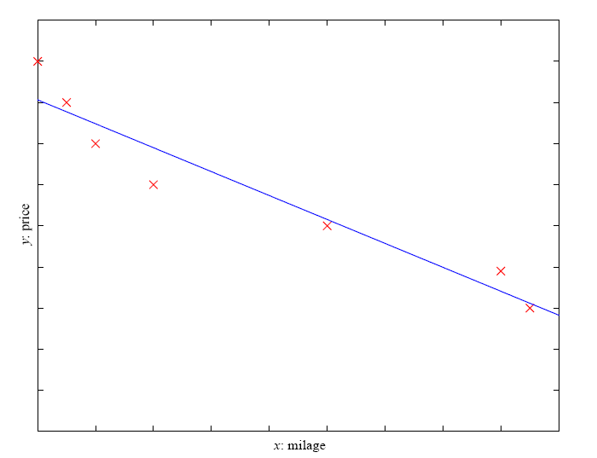
Regression Example
Price of a used car
x : car attributes
(e.g. mileage)
y : price

Slide 13
Regression Applications
Economics/Finance: predict the value of a stock
Epidemiology
Car/plane navigation: angle of the steering wheel, acceleration, …
Temporal trends: weather over time
…

Slide 14
Supervised learning: ranking
label
1
Ranking: label is a ranking
4
2
3
Supervised learning: given labeled examples

Slide 15
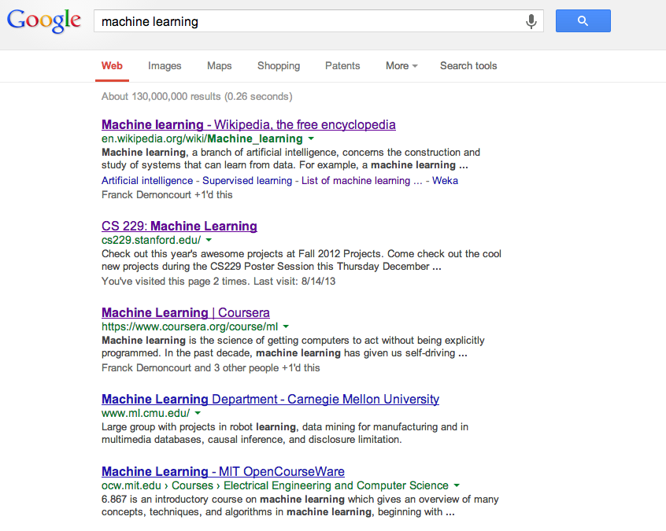
Ranking example
Given a query and
a set of web pages,
rank them according
to relevance

Slide 16
Ranking Applications
User preference, e.g. Netflix “My List” -- movie queue ranking
iTunes
flight search (search in general)
reranking N-best output lists
…

Slide 17
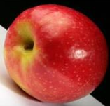
Unsupervised learning
Unupervised learning: given data, i.e. examples, but no labels

Slide 18
Unsupervised learning applications
  learn clusters/groups without any label
customer segmentation (i.e. grouping)
image compression
bioinformatics: learn motifs
…

Slide 19
Reinforcement learning
left, right, straight, left, left, left, straight
GOOD
left, straight, straight, left, right, straight, straight
BAD
left, right, straight, left, left, left, straight
18.5
left, straight, straight, left, right, straight, straight
-3
Given a sequence of examples/states and a reward after completing that sequence, learn to predict the action to take in for an individual example/state

Slide 20
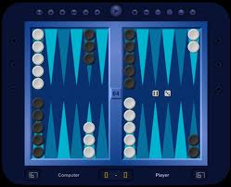
Reinforcement learning example
Backgammon
…
WIN!
…
LOSE!
Given sequences of moves and whether or not the player won at the end, learn to make good moves

Slide 21
Other learning variations
What data is available:
    Supervised, unsupervised, reinforcement learning
    semi-supervised, active learning, …
How are we getting the data:
    online vs. offline learning
Type of model:
    generative vs. discriminative
    parametric vs. non-parametric

Slide 22
Representing examples
examples
What is an example?
How is it represented?

Slide 23
Features
examples
features
How our algorithms actually “view” the data
Features are the questions we can ask about the examples
f₁, f₂, f₃, …, f_{n}
f₁, f₂, f₃, …, f_{n}
f₁, f₂, f₃, …, f_{n}
f₁, f₂, f₃, …, f_{n}

Slide 24
Features
examples
features
How our algorithms actually “view” the data
Features are the questions we can ask about the examples
red, round, leaf, 3oz, …
green, round, no leaf, 4oz, …
yellow, curved, no leaf, 8oz, …
green, curved, no leaf, 7oz, …

Slide 25
Classification revisited
examples
label
red, round, leaf, 3oz, …
apple
learn
green, round, no leaf, 4oz, …
apple
model/
classifier
yellow, curved, no leaf, 8oz, …
banana
green, curved, no leaf, 7oz, …
banana
During learning/training/induction, learn a model of what distinguishes apples and bananas based on the features
Notes:
This is the problem we’ll focus on for this class

Slide 26
Classification revisited
predict
Apple or banana?
model/
classifier
red, round, no leaf, 4oz, …
The model can then classify a new example based on the features

Slide 27
Classification revisited
predict
model/
classifier
Apple
red, round, no leaf, 4oz, …
Why?
The model can then classify a new example based on the features

Slide 28
Classification revisited
Training data
Test set
examples
label
red, round, leaf, 3oz, …
apple
?
green, round, no leaf, 4oz, …
apple
red, round, no leaf, 4oz, …
yellow, curved, no leaf, 4oz, …
banana
green, curved, no leaf, 5oz, …
banana

Slide 29
Classification revisited
Training data
Test set
examples
label
red, round, leaf, 3oz, …
apple
?
green, round, no leaf, 4oz, …
apple
red, round, no leaf, 4oz, …
yellow, curved, no leaf, 4oz, …
banana
Learning is about generalizing from the training data
green, curved, no leaf, 5oz, …
banana

Slide 30
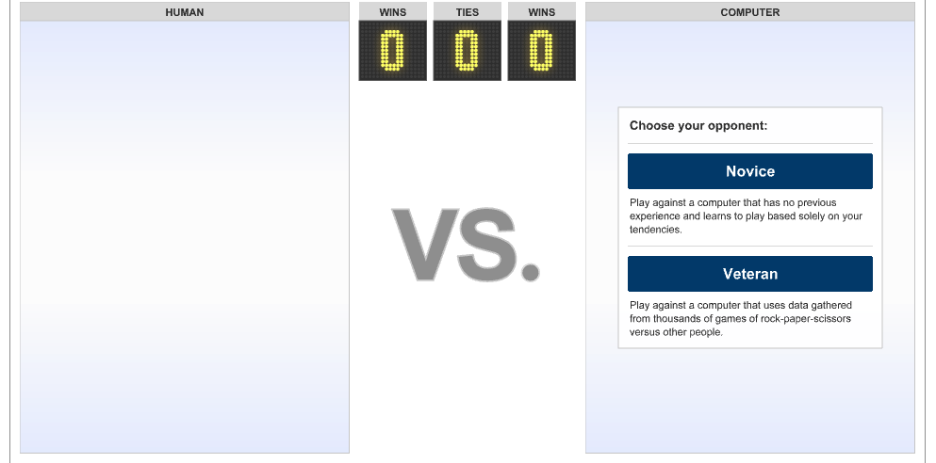
Rock, paper, scissors
https://archive.nytimes.com/www.nytimes.com/interactive/science/rock-paper-scissors.html

Slide 31
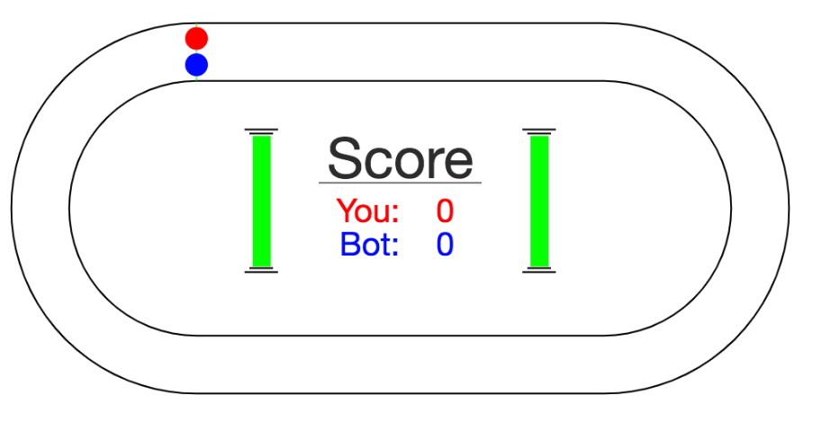
A simple machine learning example
http://www.mindreaderpro.appspot.com/

Slide 32
models
model/
classifier
We have many, many different options for the model
They have different characteristics and perform differently (accuracy, speed, etc.)

Slide 33
Probabilistic modeling
train
probabilistic model:
p(example)
Model the data with a probabilistic model which tells us how likely a given data example is
training data

Slide 34
Probabilistic models
Example to label
probabilistic model:
p(example)
apple
or
banana
yellow, curved, no leaf, 6oz
features

Slide 35
Probabilistic models
For each label, ask for the probability
yellow, curved, no leaf, 6oz, banana
probabilistic model:
p(example)
yellow, curved, no leaf, 6oz, apple
features
label

Slide 36
Probabilistic models
Pick the label with the highest probability
yellow, curved, no leaf, 6oz, banana
probabilistic model:
p(example)
0.004
0.00002
yellow, curved, no leaf, 6oz, apple
features
label

Slide 37
Probability basics
A probability distribution gives the probabilities of all possible values of an event
For example, say we flip a coin three times. We can define the probability of the number of time the coin came up heads.
P(num heads)
P(3) = ?
P(2) = ?
P(1) = ?
P(0) = ?

Slide 38
Probability distributions
What are the possible outcomes of three flips (hint, there are eight of them)?
T T T
T T H
T H T
T H H
H T T
H T H
H H T
H H H

Slide 39
Probability distributions
Assuming the coin is fair, what are our probabilities?
number of times it happens
probability =
total number of cases
T T T
T T H
T H T
T H H
H T T
H T H
H H T
H H H
P(num heads)
P(3) = ?
P(2) = ?
P(1) = ?
P(0) = ?

Slide 40
Probability distributions
Assuming the coin is fair, what are our probabilities?
number of times it happens
probability =
total number of cases
T T T
T T H
T H T
T H H
H T T
H T H
H H T
H H H
P(num heads)
P(3) = ?
P(2) = ?
P(1) = ?
P(0) = ?

Slide 41
Probability distributions
Assuming the coin is fair, what are our probabilities?
number of times it happens
probability =
total number of cases
T T T
T T H
T H T
T H H
H T T
H T H
H H T
H H H
P(num heads)
P(3) = 1/8
P(2) = ?
P(1) = ?
P(0) = ?

Slide 42
Probability distributions
Assuming the coin is fair, what are our probabilities?
number of times it happens
probability =
total number of cases
T T T
T T H
T H T
T H H
H T T
H T H
H H T
H H H
P(num heads)
P(3) = 1/8
P(2) = ?
P(1) = ?
P(0) = ?

Slide 43
Probability distributions
Assuming the coin is fair, what are our probabilities?
number of times it happens
probability =
total number of cases
T T T
T T H
T H T
T H H
H T T
H T H
H H T
H H H
P(num heads)
P(3) = 1/8
P(2) = 3/8
P(1) = ?
P(0) = ?

Slide 44
Probability distributions
Assuming the coin is fair, what are our probabilities?
number of times it happens
probability =
total number of cases
T T T
T T H
T H T
T H H
H T T
H T H
H H T
H H H
P(num heads)
P(3) = 1/8
P(2) = 3/8
P(1) = 3/8
P(0) = 1/8

Slide 45
Probability distribution
A probability distribution assigns probability values to all possible values
Probabilities are between 0 and 1, inclusive
The sum of all probabilities in a distribution must be 1
P(num heads)
P(3) = 1/8
P(2) = 3/8
P(1) = 3/8
P(0) = 1/8

Slide 46
Probability distribution
A probability distribution assigns probability values to all possible values
Probabilities are between 0 and 1, inclusive
The sum of all probabilities in a distribution must be 1
P
P(3) = 1/2
P(2) = 1/2
P(1) = 1/2
P(0) = 1/2
P
P(3) = -1
P(2) = 2
P(1) = 0
P(0) = 0

Slide 47
Some example probability distributions
probability of heads
  (distribution options: heads, tails)
probability of passing class
  (distribution options: pass, fail)
probability of rain today
  (distribution options: rain or no rain)
probability of getting an ‘A’
  (distribution options: A, B, C, D, F)

Slide 48
Conditional probability distributions
Sometimes we may know extra information about the world that may change our probability distribution
P(X|Y) captures this (read “probability of X given Y”)
  Given some information (Y) what does our probability distribution look like
  Note that this is still just a normal probability distribution

Slide 49
Conditional probability example
P(pass 51a)
P(pass) = 0.9
P(not pass) = 0.1
Unconditional probability distribution

Slide 50
Conditional probability example
P(pass 51a | don’t study)
P(pass) = 0.5
P(not pass) = 0.5
Still probability distributions over passing 51A
P(pass 51a)
P(pass) = 0.9
P(not pass) = 0.1
P(pass 51a | do study)
P(pass) = 0.95
P(not pass) = 0.05
Conditional probability distributions

Slide 51
Conditional probability example
P(rain in LA)
P(rain) = 0.05
P(no rain) = 0.95
Unconditional probability distribution

Slide 52
Conditional probability example
P(rain in LA| March )
P(rain) = 0.2
P(no rain) = 0.8
Still probability distributions over passing rain in LA
P(rain in LA)
P(rain) = 0.05
P(no rain) = 0.95
P(rain in LA| not March )
P(pass) = 0.03
P(not pass) = 0.97
Conditional probability distributions

Slide 53
Joint distribution
Probability over two events: P(X,Y)
Has probabilities for all possible combinations over the two events
51Pass, EngPass | P(51Pass, EngPass)
true, true | .88
true, false | .01
false, true | .04
false, false | .07

Slide 54
Joint distribution
Still a probability distribution
All questions/probabilities that we might want to ask about these two things can be calculated from the joing distribution
51Pass, EngPass | P(51Pass, EngPass)
true, true | .88
true, false | .01
false, true | .04
false, false | .07
What is P(51pass = true)?

Slide 55
Joint distribution
51Pass, EngPass | P(51Pass, EngPass)
true, true | .88
true, false | .01
false, true | .04
false, false | .07
There are two ways that a person can pass 51:
they can do it while passing or not passing English
P(51Pass=true) = P(true, true) + P(true, false) = 0.89

Slide 56

Relationship between distributions
$$P\left(X,Y\right)=P\left(Y\right)∗P(X|Y)$$
joint distribution
conditional distribution
unconditional distribution
Can think of it as describing the two events happening in two steps:
The likelihood of X and Y happening:
How likely it is that Y happened?
Given that Y happened, how likely is it that X happened?
Notes:
Called the chain rule

Slide 57
Relationship between distributions
$$P\left(51Pass, EngPass\right)=P\left(EngPass\right)∗P(51Pass|EngPass)$$
The probability of passing CS51 and English is:
Probability of passing English *
Probability of passing CS51 given that you passed English
Notes:
Called the chain rule

Slide 58
Relationship between distributions
$$P\left(51Pass, EngPass\right)=P\left(51Pass\right)∗P(EngPass|51Pass)$$
The probability of passing CS51 and English is:
Probability of passing CS51 *
Probability of passing English given that you passed CS51
Can also view it with the other event happening first
Notes:
Called the chain rule

Slide 59
Back to probabilistic modeling
train
probabilistic model:
p(label|data)
Build a model of the conditional distribution:
P(label | data)
How likely is a label given the data
training data

Slide 60
Back to probabilistic models
For each label, calculate the probability of the label given the data
yellow, curved, no leaf, 6oz, banana
probabilistic model:
p(label|data)
yellow, curved, no leaf, 6oz, apple
features
label

Slide 61
Back to probabilistic models
Pick the label with the highest probability
yellow, curved, no leaf, 6oz, banana
probabilistic model:
p(label|data)
0.004
0.00002
yellow, curved, no leaf, 6oz, apple
MAX
features
label

Slide 62
Naïve Bayes model
Two parallel ways of breaking down the joint distribution
$$P\left(data, label\right)=P\left(label\right)∗P(data|label)$$
$$P\left(data, label\right)=P\left(data\right)∗P(label|data)$$
$$P\left(label\right)∗P(data|label) =P\left(data\right)∗P(label|data)$$
What is P(label|data)?

Slide 63
Naïve Bayes
$$P\left(label\right)∗P(data|label) =P\left(data\right)∗P(label|data)$$
$$P\left(label | data\right)=\frac{P\left(label\right)∗P\left(data | label\right)}{P\left(data\right)}$$
(This is called Bayes’ rule!)

Slide 64

Naïve Bayes
$$P\left(label | data\right)=\frac{P\left(label\right)∗P\left(data | label\right)}{P\left(data\right)}$$
$$\frac{P\left(positive\right)∗P\left(data | positive\right)}{P\left(data\right)}$$
probabilistic model:
p(label|data)
MAX
$$\frac{P\left(negative\right)∗P\left(data | negative\right)}{P\left(data\right)}$$

Slide 65

One observation
$$\frac{P\left(positive\right)∗P\left(data | positive\right)}{P\left(data\right)}$$
MAX
$$\frac{P\left(negative\right)∗P\left(data | negative\right)}{P\left(data\right)}$$
For picking the largest P(data) doesn’t matter!

Slide 66
One observation
$$P\left(positive\right)∗P\left(data | positive\right)$$
MAX
$$P\left(negative\right)∗P\left(data | negative\right)$$
For picking the largest P(data) doesn’t matter!

Slide 67
A simplifying assumption (for this class)
$$P\left(positive\right)∗P\left(data | positive\right)$$
MAX
$$P\left(negative\right)∗P\left(data | negative\right)$$
If we assume P(positive) = P(negative) then:
$$P\left(data | positive\right)$$
MAX
$$P\left(data | negative\right)$$
Notes:
This is generally not true, but will make our life simpler for this class.

Slide 68

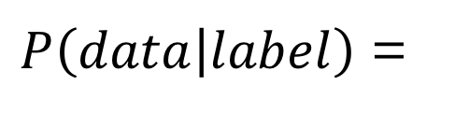
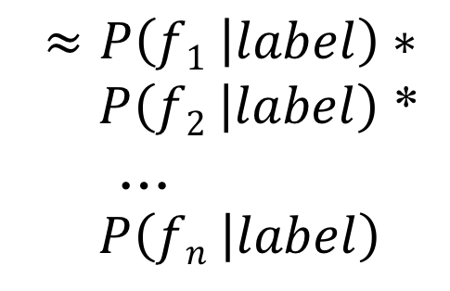
Naïve Bayes Assumption
$P\left(data | label\right)$ =
$P\left(f1,f2, …,fn | label\right)$
$$≈P\left(f1 | label\right)∗$$
$P\left(f2 | label\right)$ *
…
$P\left(fn | label\right)$
This is generally not true!
However…, it makes our life easier.
This is why the model is called Naïve Bayes

Slide 69
Naïve Bayes
$P\left(f1 | positive\right)∗P\left(f2 | positive\right)$ *…* $P\left(fn | positive\right)$
MAX
$P\left(f1 | negative\right)$ * $P\left(f2 | negative\right)$ *…* $P\left(fn | negative\right)$
Where do these come from?

Slide 70
Training Naïve Bayes
train
probabilistic model:
p(label|data)
training data

Slide 71
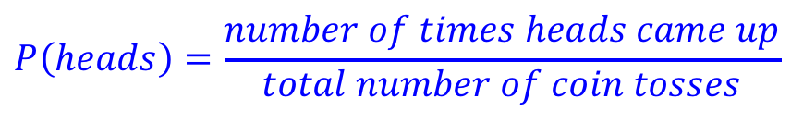
An aside: P(heads)
What is the P(heads) on a fair coin?
  0.5
What if you didn’t know that, but had a coin to experiment with?
  Flip it a bunch of times and count how many times it comes up heads
$$P\left(heads\right)=\frac{number of times heads came up}{total number of coin tosses}$$

Slide 72
Try it out…

Slide 73
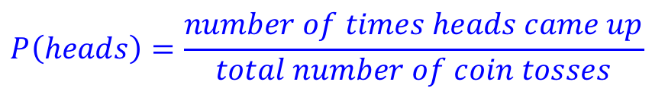

P(feature|label)
$$P\left(heads\right)=\frac{number of times heads came up}{total number of coin tosses}$$
Can we do the same thing here? What is the probability of a feature given positive, i.e. the probability of a feature occurring in in the positive label?
$$P\left(feature | positive\right)= ?$$

Slide 74
P(feature|label)
$$P\left(heads\right)=\frac{number of times heads came up}{total number of coin tosses}$$
Can we do the same thing here? What is the probability of a feature given positive, i.e. the probability of a feature occurring in in the positive label?
$$P\left(feature | positive\right)=\frac{number of positive examples with that feature}{total number of positive examples}$$

Slide 75
Training Naïve Bayes
train
Count how many examples have each label
For all examples with a particular label, count how many times each feature occurs
Calculate the conditional probabilities of each feature for all labels:
probabilistic model:
p(label|data)
training data
$$P\left(feature | label\right)= \frac{number of ``label^{′′}examples with that feature}{total number of examples with that label}$$

Slide 76
Classifying with Naïve Bayes
For each label, calculate the product of p(feature|label) for each label
P(yellow|banana)*…*P(6oz|banana)
yellow, curved, no leaf, 6oz
MAX
P(yellow|apple)*…*P(6oz|apple)

Slide 77
Naïve Bayes Text Classification
Positive
Negative
I loved it
I loved that movie
I hated that I loved it
I hated it
I hated that movie
I loved that I hated it
Given examples of text in different categories, learn to predict the category of new examples
Sentiment classification: given positive/negative examples of text (sentences), learn to predict whether new text is positive/negative

Slide 78
Text classification training
Positive
Negative
I loved it
I loved that movie
I hated that I loved it
I hated it
I hated that movie
I loved that I hated it
We’ll assume words just occur once in any given sentence

Slide 79
Text classification training
Positive
Negative
I loved it
I loved that movie
I hated that loved it
I hated it
I hated that movie
I loved that hated it
We’ll assume words just occur once in any given sentence

Slide 80
Training the model
Positive
Negative
I loved it
I loved that movie
I hated that loved it
I hated it
I hated that movie
I loved that hated it
For each word and each label, learn:
p(word | label)

Slide 81
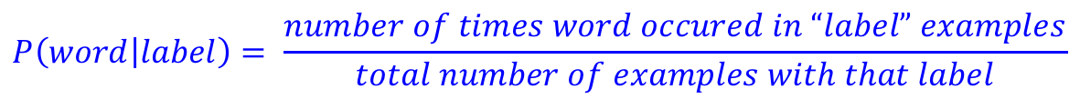
Training the model
Positive
Negative
I loved it
I loved that movie
I hated that loved it
I hated it
I hated that movie
I loved that hated it
P(I | positive) = ?
$$P\left(word | label\right)= \frac{number of times word occured in “label” examples}{total number of examples with that label}$$

Slide 82
Training the model
Positive
Negative
I loved it
I loved that movie
I hated that loved it
I hated it
I hated that movie
I loved that hated it
P(I | positive) = 3/3 = 1.0
$$P\left(word | label\right)= \frac{number of times word occured in “label” examples}{total number of examples with that label}$$

Slide 83
Training the model
Positive
Negative
I loved it
I loved that movie
I hated that loved it
I hated it
I hated that movie
I loved that hated it
P(I | positive) = 1.0
P(loved | positive) = ?
$$P\left(word | label\right)= \frac{number of times word occured in “label” examples}{total number of examples with that label}$$

Slide 84
Training the model
Positive
Negative
I loved it
I loved that movie
I hated that loved it
I hated it
I hated that movie
I loved that hated it
P(I | positive) = 1.0
P(loved | positive) = 3/3
$$P\left(word | label\right)= \frac{number of times word occured in “label” examples}{total number of examples with that label}$$

Slide 85
Training the model
Positive
Negative
I loved it
I loved that movie
I hated that loved it
I hated it
I hated that movie
I loved that hated it
P(I | positive) = 1.0
P(loved | positive) = 3/3
P(hated | positive) = ?
$$P\left(word | label\right)= \frac{number of times word occured in “label” examples}{total number of examples with that label}$$

Slide 86
Training the model
Positive
Negative
I loved it
I loved that movie
I hated that loved it
I hated it
I hated that movie
I loved that hated it
P(I | positive) = 1.0
P(loved | positive) = 2/3
P(hated | positive) = 1/3
…
P(I | negative) = ?
$$P\left(word | label\right)= \frac{number of times word occured in “label” examples}{total number of examples with that label}$$

Slide 87
Training the model
Positive
Negative
I loved it
I loved that movie
I hated that loved it
I hated it
I hated that movie
I loved that hated it
P(I | positive) = 1.0
P(loved | positive) = 2/3
P(hated | positive) = 1/3
…
P(I | negative) = 1.0
$$P\left(word | label\right)= \frac{number of times word occured in “label” examples}{total number of examples with that label}$$

Slide 88
Training the model
Positive
Negative
I loved it
I loved that movie
I hated that loved it
I hated it
I hated that movie
I loved that hated it
P(I | positive) = 1.0
P(loved | positive) = 2/3
P(hated | positive) = 1/3
…
P(I | negative) = 1.0
P(movie | negative) = ?
$$P\left(word | label\right)= \frac{number of times word occured in “label” examples}{total number of examples with that label}$$

Slide 89
Training the model
Positive
Negative
I loved it
I loved that movie
I hated that loved it
I hated it
I hated that movie
I loved that hated it
P(I | positive) = 1.0
P(loved | positive) = 2/3
P(hated | positive) = 1/3
…
P(I | negative) = 1.0
P(movie | negative) = 1/3
…
$$P\left(word | label\right)= \frac{number of times word occured in “label” examples}{total number of examples with that label}$$

Slide 90
Classifying
P(I | positive) = 1.0
P(loved | positive) = 1.0
p(it | positive) = 2/3
p(that | positive) = 2/3
p(movie|positive) = 1/3
P(hated | positive) = 1/3
P(I | negative) = 1.0
p(hated | negative) = 1.0
p(that | negative) = 2/3
P(movie | negative) = 1/3
p(it | negative) = 2/3
p(loved | negative) = 1/3
Notice that each label has its own probability distribution
P(loved| positive)
P(loved | positive) = 2/3
P(no loved|positive) = 1/3

Slide 91
Trained model
P(I | positive) = 1.0
P(loved | positive) = 2/3
p(it | positive) = 2/3
p(that | positive) = 2/3
p(movie|positive) = 1/3
P(hated | positive) = 1/3
P(I | negative) = 1.0
p(hated | negative) = 1.0
p(that | negative) = 2/3
P(movie | negative) = 1/3
p(it | negative) = 2/3
p(loved | negative) = 1/3
How would we classify: “I hated movie”?

Slide 92
Trained model
P(I | positive) = 1.0
P(loved | positive) = 2/3
p(it | positive) = 2/3
p(that | positive) = 2/3
p(movie|positive) = 1/3
P(hated | positive) = 1/3
P(I | negative) = 1.0
p(hated | negative) = 1.0
p(that | negative) = 2/3
P(movie | negative) = 1/3
p(it | negative) = 2/3
p(loved | negative) = 1/3
P(I | positive) * P(hated | positive) * P(movie | positive) = 1.0 * 1/3 * 1/3 = 1/9
P(I | negative) * P(hated | negative) * P(movie | negative) = 1.0 * 1.0 * 1/3 = 1/3

Slide 93
Trained model
P(I | positive) = 1.0
P(loved | positive) = 2/3
p(it | positive) = 2/3
p(that | positive) = 2/3
p(movie|positive) = 1/3
P(hated | positive) = 1/3
P(I | negative) = 1.0
p(hated | negative) = 1.0
p(that | negative) = 2/3
P(movie | negative) = 1/3
p(it | negative) = 2/3
p(loved | negative) = 1/3
How would we classify: “I hated the movie”?

Slide 94
Trained model
P(I | positive) = 1.0
P(loved | positive) = 2/3
p(it | positive) = 2/3
p(that | positive) = 2/3
p(movie|positive) = 1/3
P(hated | positive) = 1/3
P(I | negative) = 1.0
p(hated | negative) = 1.0
p(that | negative) = 2/3
P(movie | negative) = 1/3
p(it | negative) = 2/3
p(loved | negative) = 1/3
P(I | positive) * P(hated | positive) * P(the | positive) * P(movie | positive) =
P(I | negative) * P(hated | negative) * P(the | negative) * P(movie | negative) =

Slide 95
Trained model
P(I | positive) = 1.0
P(loved | positive) = 2/3
p(it | positive) = 2/3
p(that | positive) = 2/3
p(movie|positive) = 1/3
P(hated | positive) = 1/3
P(I | negative) = 1.0
p(hated | negative) = 1.0
p(that | negative) = 2/3
P(movie | negative) = 1/3
p(it | negative) = 2/3
p(loved | negative) = 1/3
P(I | positive) * P(hated | positive) * P(the | positive) * P(movie | positive) =
P(I | negative) * P(hated | negative) * P(the | negative) * P(movie | negative) =
What are these?

Slide 96
Trained model
P(I | positive) = 1.0
P(loved | positive) = 2/3
p(it | positive) = 2/3
p(that | positive) = 2/3
p(movie|positive) = 1/3
P(hated | positive) = 1/3
P(I | negative) = 1.0
p(hated | negative) = 1.0
p(that | negative) = 2/3
P(movie | negative) = 1/3
p(it | negative) = 2/3
p(loved | negative) = 1/3
P(I | positive) * P(hated | positive) * P(the | positive) * P(movie | positive) =
P(I | negative) * P(hated | negative) * P(the | negative) * P(movie | negative) =
0. Is this a problem?

Slide 97
Trained model
P(I | positive) = 1.0
P(loved | positive) = 2/3
p(it | positive) = 2/3
p(that | positive) = 2/3
p(movie|positive) = 1/3
P(hated | positive) = 1/3
P(I | negative) = 1.0
p(hated | negative) = 1.0
p(that | negative) = 2/3
P(movie | negative) = 1/3
p(it | negative) = 2/3
p(loved | negative) = 1/3
P(I | positive) * P(hated | positive) * P(the | positive) * P(movie | positive) =
P(I | negative) * P(hated | negative) * P(the | negative) * P(movie | negative) =
Yes. They make the entire product go to 0 !

Slide 98
Trained model
P(I | positive) = 1.0
P(loved | positive) = 2/3
p(it | positive) = 2/3
p(that | positive) = 2/3
p(movie|positive) = 1/3
P(hated | positive) = 1/3
P(I | negative) = 1.0
p(hated | negative) = 1.0
p(that | negative) = 2/3
P(movie | negative) = 1/3
p(it | negative) = 2/3
p(loved | negative) = 1/3
P(I | positive) * P(hated | positive) * P(the | positive) * P(movie | positive) =
P(I | negative) * P(hated | negative) * P(the | negative) * P(movie | negative) =
Our solution: assume any unseen word has a small, fixed probability, e.g. in this example 1/10

Slide 99
Trained model
P(I | positive) = 1.0
P(loved | positive) = 2/3
p(it | positive) = 2/3
p(that | positive) = 2/3
p(movie|positive) = 1/3
P(hated | positive) = 1/3
P(I | negative) = 1.0
p(hated | negative) = 1.0
p(that | negative) = 2/3
P(movie | negative) = 1/3
p(it | negative) = 2/3
p(loved | negative) = 1/3
P(I | positive) * P(hated | positive) * P(the | positive) * P(movie | positive) = 1/90
P(I | negative) * P(hated | negative) * P(the | negative) * P(movie | negative) = 1/30
Our solution: assume any unseen word has a small, fixed probability, e.g. in this example 1/10

Slide 100
Full disclaimer
I’ve fudged a few things on the Naïve Bayes model for simplicity
Our approach is very close, but it takes a few liberties that aren’t technically correct, but it will work just fine ☺
If you’re curious, I’d be happy to talk to you offline

