Slide 1
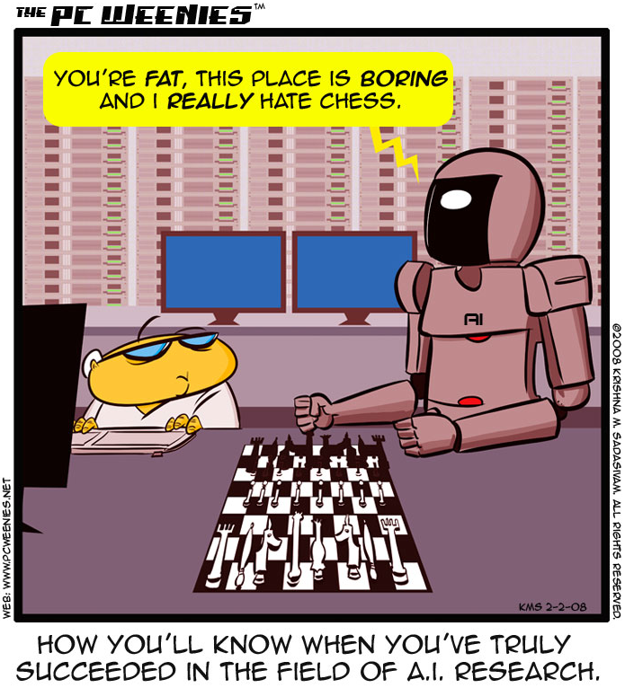
http://www.bbspot.com/comics/PC-Weenies/2008/02/3248.php

Slide 2
Intro to AI
CS51A
David Kauchak
Spring 2025
Adapted from notes from:
Sara Owsley Sood

Slide 3

Admin
Assignment 6 due Friday
Lab this week
Extra mentor hours on Friday (TBA)
Ethics presentations:

Slide 4
AI is a huge field
What is AI (artificial intelligence)…

Slide 5
AI is a huge field
What is AI…
One definition:
“Building programs that enable computers to do what humans can do.”
For example:
read, walk around, drive, play games, solve problems, learn, have conversations…

Slide 6
A broader definition
“Building programs that enable computers to do do intelligent things”
human vs. rational
Think like a human Cognitive Modeling | Think rationally Logic-based Systems
Act like a human Turing Test | Act rationally Rational Agents
thinking
vs.
acting

Slide 7
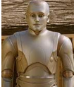

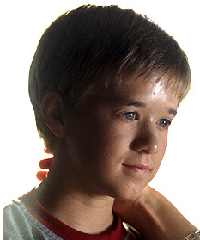
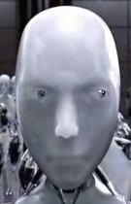

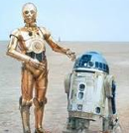

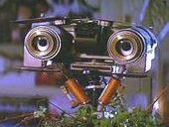
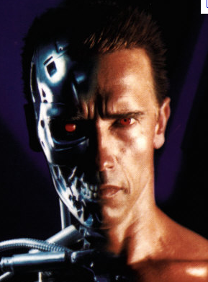
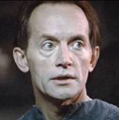

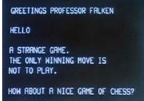
How is AI viewed in popular media?

Slide 8

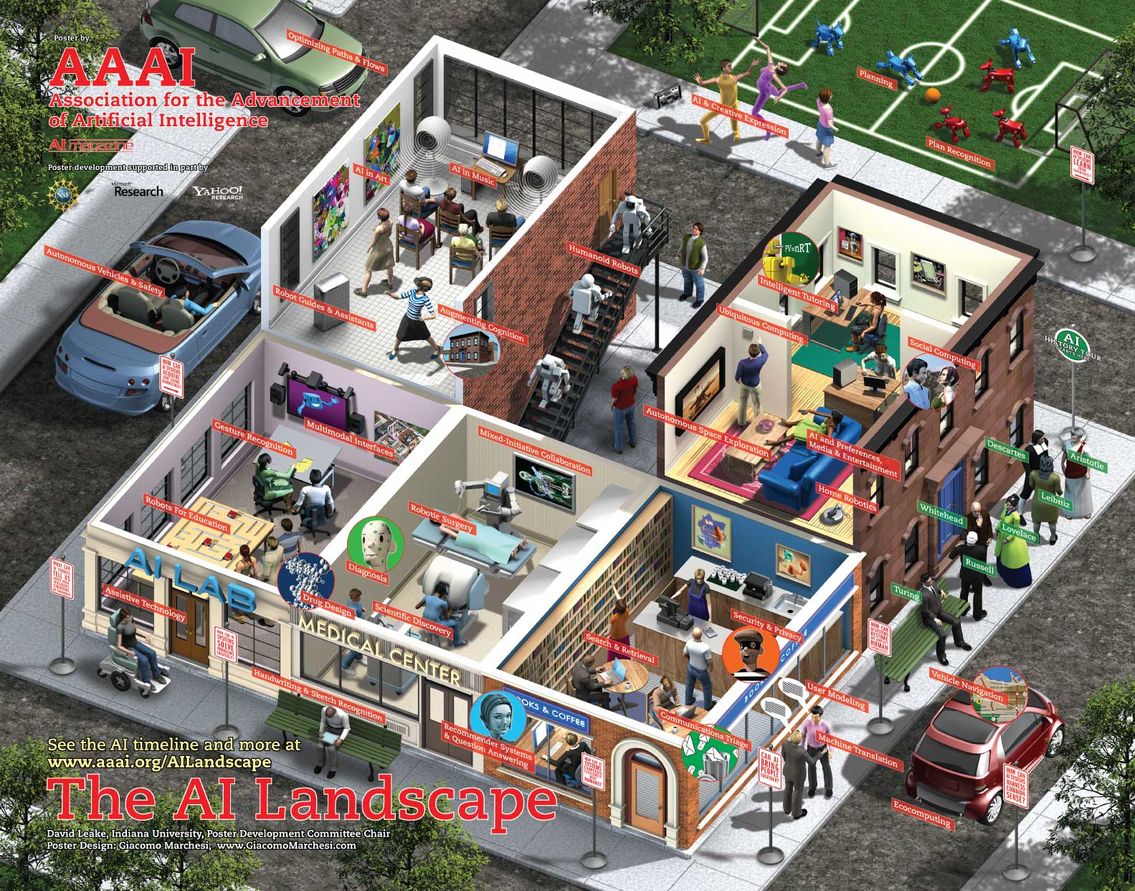
What challenges are there?

Slide 9
What challenges are there?
Perception
  perceive the environment via sensors
Computer vision (perception via images/video)
  process visual information
  object identification, face recognition, motion tracking
Natural language processing and generation
  speech recognition, language understanding
  language translation, speech generation, summarization

Slide 10
What challenges are there?
Knowledge representation
  encode known information
  water is wet, the sun is hot, Dave is a person, …
Learning
  learn from environment
  What type of feedback? (supervised vs. unsupervised vs. reinforcement vs …)
Reasoning/problem solving
  achieve goals, solve problems
  planning
  How do you make an omelet? I’m carrying an umbrella and it’s raining… will I get wet?
Robotics
  How can computers interact with the physical world?

Slide 11
What can we currently do?

Slide 12
What can we currently do?
Understand spoken language?
speech recognition is really good, if:
  restricted vocabulary
  specific speaker with training
Gotten quite good in the last few years and shows up in lots of places:
  Mobile: Siri, Ok Google, etc.
  Home assistants: Alexa, Google Home
What does the spoken language actually mean (language understanding)?
  much harder problem!
  LLMs are getting better at this, though they don’t explicit represent the “meaning”

Slide 13
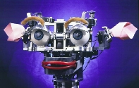
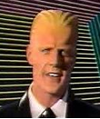
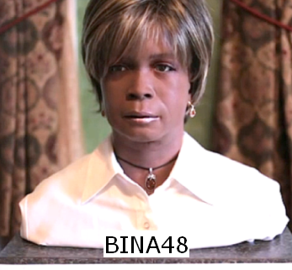
What can we currently do?
Speak?
  Understandable, but you wouldn’t confuse it for a person
  Can do accents, intonations, etc.
  Better with restricted vocabulary
  Loquendo
    https://www.nuance.com/omni-channel-customer-engagement/voice-and-ivr/text-to-speech.html
    Dealing with facial expression is challenging
Kismet (MIT)

Slide 14
What can we currently do?
Drive a car?

Slide 15
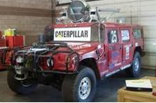
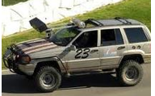
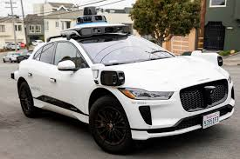
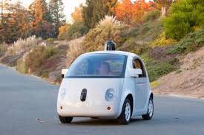
What can we currently do?
Drive a car?
  Freeway driving is relatively straightforward
  Off-road a bit harder
    see DARPA grand challenges (2004, 2005)
  And urban driving is even trickier
  Waymo
  Tesla
  Uber

Slide 16
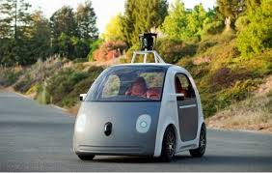
What can we currently do?
Drive a car?
https://www.google.com/selfdrivingcar/
https://www.tesla.com/autopilot
Uber
…

Slide 17
What can we currently do?
Drive a car?
Many driver assist technologies:
Automatic breaking
Automatic pedestrian detection
Lane drift avoidance
”smart” cruise control
Blind spot warning
…

Slide 18
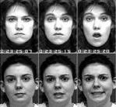
What can we currently do?
Identify emotion?
This is hard!
Some success in text
  movie reviews (assignment 7!)
  blogs
  twitter
  dealing with sarcasm is hard
Some success with faces
  strongly biased by training data
  works best when exaggerated

Slide 19
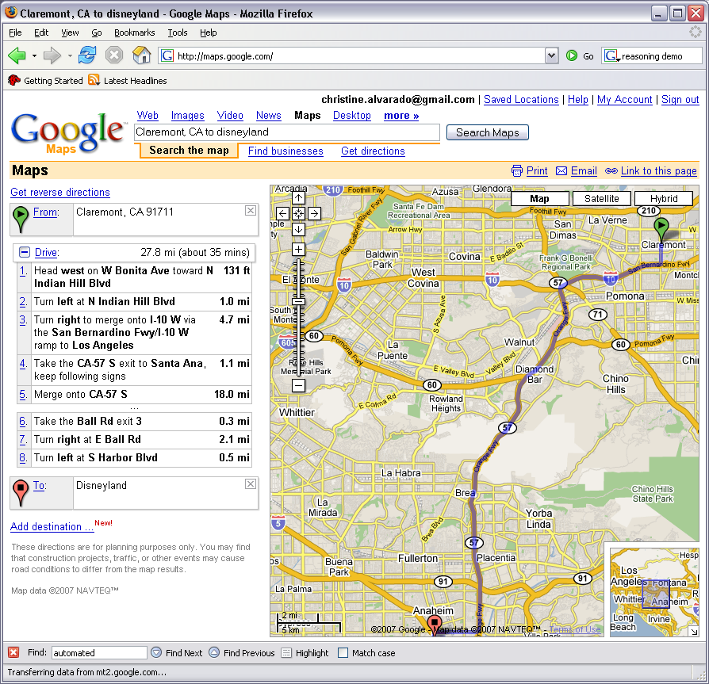
What can we currently do?
Reasoning?
  Success on small sub-problems
  General purpose reasoning is harder
    Wolfram Alpha
    OpenCyc

Slide 20
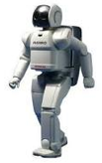
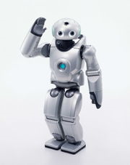
What can we currently do?
Walk?
  Robots have had a variety of locomotion methods
  Walking with legs, is challenging
    Differing terrains, stairs, running, ramps, etc.
  Getting better every year
    https://www.youtube.com/watch?v=8dFTc4W8wm0

Slide 21
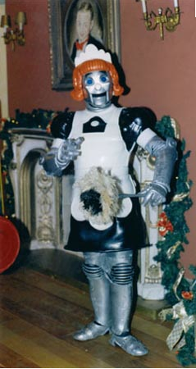
When will I have my robot helper?
What can we currently do?

Slide 22
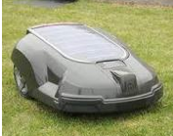
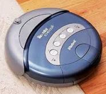
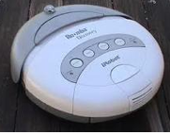
What can we currently do?

Slide 23
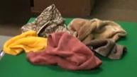
What can we currently do?
Fold a pile of towels?
UC Berkeley towel folding robot:
http://www.youtube.com/watch?v=gy5g33S0Gzo

Slide 24
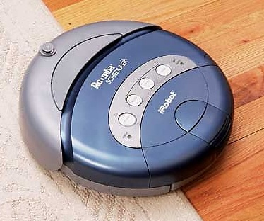
How do we make computers ”intelligent?"
Computer,
clean the house!
Um… OK…??
This one's got no chance…
Notes:
Assume that we want this vacuum to clean this house
To us - if someone told us to use a vacuum to clean a house, the sequence of events that should follow are pretty clear
We’d walk into the house, figure out what rooms needed to be vacuumed and start vacuuming
We’d methodically go through the room, not vacuuming over places we’ve already been, until we cover the whole room, then move to the next room

Slide 25
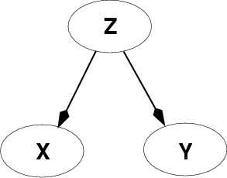
Fundamental problem of AI
Reasoning with knowledge
and uncertainty
Search
Many different ways of making an agent intelligent
Learning
Reasoning with
Utility

Slide 26
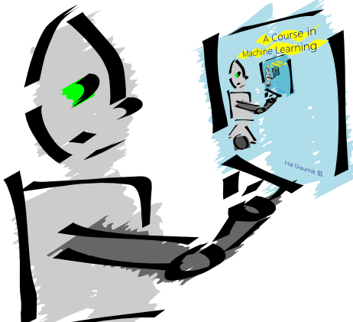
Machine Learning is…
Machine learning is about predicting the future based on the past.
-- Hal Daume III

Slide 27
Machine Learning is…
Machine learning is about predicting the future based on the past.
-- Hal Daume III
past
future
predict
learn
Training
Data
model/
predictor
Testing
Data
model/
predictor

Slide 28

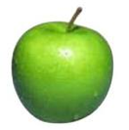

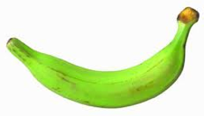
Data
examples
Data

Slide 29

Data
examples
Data

Slide 30

Data
examples
Data

Slide 31


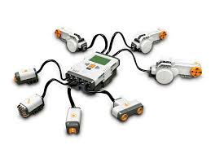
Data
examples
Data

Slide 32
Supervised learning
examples
label
label₁
label₃
labeled examples
label₄
label₅
Supervised learning: given labeled examples

Slide 33
Supervised learning
label
label₁
model/
predictor
label₃
label₄
label₅
Supervised learning: learn a model

Slide 34

Supervised learning
model/
predictor
predicted label
Supervised learning: learn to predict new example

Slide 35
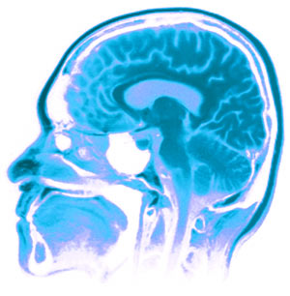
Neural Networks
Neural Networks try to mimic the structure and function of our nervous system
People like biologically motivated approaches

Slide 36
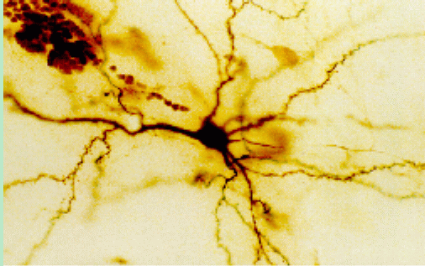
Our Nervous System
Neuron
What do you know?

Slide 37
Our nervous system: the computer science view
the human brain is a large collection of interconnected neurons
a NEURON is a brain cell
  they collect, process, and disseminate electrical signals
  they are connected via synapses
  they FIRE depending on the conditions of the neighboring neurons

Slide 38
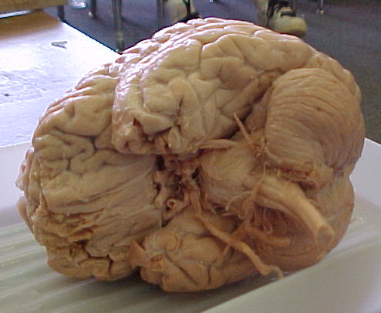
Our nervous system
The human brain
  contains ~10¹¹ (100 billion) neurons
  each neuron is connected to ~10⁴ (10,000) other neurons
  Neurons can fire as fast as 10⁻³ seconds
How does this compare to a computer?

Slide 39
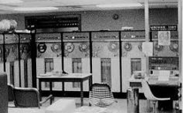
Humans vs. Machines
10¹¹ neurons
10¹¹ neurons
10¹⁴ synapses
10⁻³ “cycle” time
10¹⁰ transistors
10¹¹ bits of ram/memory
10¹³ bits on disk
10⁻⁹ cycle time

Slide 40

Brains are still pretty fast
Who is this?

Slide 41
Brains are still pretty fast
If you were me, you’d be able to identify this person in 10⁻¹ (1/10) s!
Given a neuron firing time of 10⁻³ s, how many neurons in sequence could fire in this time?
  A few hundred
What are possible explanations?
  either neurons are performing some very complicated computations
  brain is taking advantage of the massive parallelization (remember, neurons are connected ~10,000 other neurons)

Slide 42
Artificial Neural Networks
Node (Neuron)
Edge (synapses)
our approximation

Slide 43
Neural networks
Node A
Weight w
Node B
(neuron)
(neuron)
W is the strength of signal sent between A and B.
If A fires and w is positive, then A stimulates B.
If A fires and w is negative, then A inhibits B.

Slide 44
Neural networks
…
A given neuron has many, many connecting, input neurons
If a neuron is stimulated enough, then it also fires
How much stimulation is required is determined by its threshold

Slide 45
A Single Neuron/Perceptron
Input x₁
Each input contributes:
x_{i} * w_{i}
Weight w₁
Weight w₂
Input x₂
Output y
threshold function
Input x₃
Weight w₃
Weight w₄
Input x₄

Slide 46
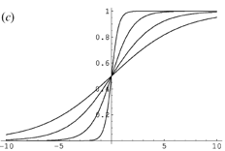
Possible threshold functions
hard threshold
sigmoid

Slide 47
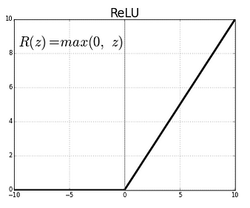
Many other activation functions
Rectified Linear Unit
Softmax (for probabilities)

Slide 48
A Single Neuron/Perceptron
1
1
1
-1
?
0
1
Threshold of 1
0.5
1

Slide 49
A Single Neuron/Perceptron
1
1
1
-1
?
0
1
Threshold of 1
0.5
1
1*1 + 1*-1 + 0*1 + 1*0.5 = 0.5

Slide 50
A Single Neuron/Perceptron
1
1
1
-1
0
Weighted sum is 0.5, which is not larger than the threshold
0
1
Threshold of 1
0.5
1

Slide 51
A Single Neuron/Perceptron
1
1
0
-1
?
0
1
Threshold of 1
0.5
1
1*1 + 0*-1 + 0*1 + 1*0.5 = 1.5

Slide 52
A Single Neuron/Perceptron
1
1
0
-1
1
Weighted sum is 1.5, which is larger than the threshold
0
1
Threshold of 1
0.5
1

Slide 53
Neural network
inputs
Individual perceptrons/neurons
Notes:
- often we view a slice of them

Slide 54
Neural network
some inputs are provided/entered
inputs
Notes:
- often we view a slice of them

Slide 55
Neural network
inputs
each perceptron computes and calculates an answer
Notes:
- often we view a slice of them

Slide 56
Neural network
inputs
those answers become inputs for the next level
Notes:
- often we view a slice of them

Slide 57
Neural network
inputs
finally get the answer after all levels compute
Notes:
- often we view a slice of them

Slide 58
Neural network
Different kinds/characteristics of networks
inputs
inputs
inputs
How are these different?

Slide 59
Neural network
inputs
inputs
hidden units/layer
Feed forward networks

Slide 60
Neural network
inputs
Recurrent network
Output is fed back to input
Can support memory!
How?

Slide 61
History of Neural Networks
McCulloch and Pitts (1943) – introduced model of artificial neurons and suggested they could learn
Hebb (1949) – Simple updating rule for learning
Rosenblatt (1962) - the perceptron model
Minsky and Papert (1969) – wrote Perceptrons
Bryson and Ho (1969, but largely ignored until 1980s--Rosenblatt) – invented back-propagation learning for multilayer networks

Slide 62
Training the perceptron
First wave in neural networks in the 1960’s
Single neuron
Trainable: its threshold and input weights can be modified
If the neuron doesn’t give the desired output, then it has made a mistake
Input weights and threshold can be changed according to a learning algorithm

Slide 63
Examples - boolean operators
AND – if all inputs are 1, return 1, otherwise return 0
OR – if at least one input is 1, return 1, otherwise return 0
NOT – return the opposite of the input
XOR – if exactly one input is 1, then return 1, otherwise return 0

Slide 64
AND
x₁ | x₂ | x₁ and x₂
0 | 0 | 0
0 | 1 | 0
1 | 0 | 0
1 | 1 | 1
Notes:
We have the truth table for AND

Slide 65
AND
x₁ | x₂ | x₁ and x₂
0 | 0 | 0
0 | 1 | 0
1 | 0 | 0
1 | 1 | 1
Input x₁
W₁ = ?
T = ?
Output y
Input x₂
W₂ = ?
Notes:
And here we have the node for AND
Assume that all inputs are either 1 or 0, “on” or “off”
When they are activated, they become “on”
So what weights do we need to assign to these two links and what threshold do we need to put in this unit in order to represent an AND gate?

Slide 66
AND
x₁ | x₂ | x₁ and x₂
0 | 0 | 0
0 | 1 | 0
1 | 0 | 0
1 | 1 | 1
Input x₁
W₁ = 1
T = 2
Output y
Output is 1 only if
all inputs are 1
Input x₂
W₂ = 1
Inputs are either 0 or 1

Slide 67
AND
Input x₁
W₁ = ?
W₂ = ?
Input x₂
T = ?
Output y
Input x₃
W₃ = ?
W₄ = ?
Input x₄
Notes:
We can extend this to take more inputs
What are the new weights and thresholds?

Slide 68
AND
Input x₁
W₁ = 1
W₂ = 1
Input x₂
T = 4
Output y
Output is 1 only if
all inputs are 1
Input x₃
W₃ = 1
W₄ = 1
Input x₄
Inputs are either 0 or 1

Slide 69
OR
x₁ | x₂ | x₁ or x₂
0 | 0 | 0
0 | 1 | 1
1 | 0 | 1
1 | 1 | 1

Slide 70
OR
x₁ | x₂ | x₁ or x₂
0 | 0 | 0
0 | 1 | 1
1 | 0 | 1
1 | 1 | 1
Input x₁
W₁ = ?
T = ?
Output y
Input x₂
W₂ = ?
Notes:
What about for an OR gate?
What weights and thresholds would serve to create an OR gate?

Slide 71
OR
x₁ | x₂ | x₁ or x₂
0 | 0 | 0
0 | 1 | 1
1 | 0 | 1
1 | 1 | 1
Input x₁
W₁ = 1
T = 1
Output y
Output is 1 if at
least 1 input is 1
Input x₂
W₂ = 1
Inputs are either 0 or 1

Slide 72
OR
Input x₁
W₁ = ?
W₂ = ?
Input x₂
T = ?
Output y
Input x₃
W₃ = ?
W₄ = ?
Input x₄
Notes:
Similarly, we can expand it to take more inputs

Slide 73
OR
Input x₁
W₁ = 1
W₂ = 1
Input x₂
T = 1
Output y
Output is 1 if at
least 1 input is 1
Input x₃
W₃ = 1
W₄ = 1
Input x₄
Inputs are either 0 or 1

Slide 74
NOT
x₁ | not x₁
0 | 1
1 | 0

Slide 75
NOT
x₁ | not x₁
0 | 1
1 | 0
W₁ = ?
Input x₁
T = ?
Output y
Notes:
Now it gets a little bit trickier, what weight and threshold might work to create a NOT gate?

Slide 76
NOT
W₁ = -1
Input x₁
T = 0
Output y
Input is either 0 or 1
If input is 1, output is 0.
If input is 0, output is 1.

Slide 77
How about…
x₁ | x₂ | x₃ | x₁ and x₂
0 | 0 | 0 | 1
0 | 1 | 0 | 0
1 | 0 | 0 | 1
1 | 1 | 0 | 0
0 | 0 | 1 | 1
0 | 1 | 1 | 1
1 | 0 | 1 | 1
1 | 1 | 1 | 0
Input x₁
w₁ = ?
w₂ = ?
Input x₂
Output y
T = ?
Input x₃
w₃ = ?

Slide 78
Training neural networks
Learn individual node parameters (e.g. threshold)
Learn the individual weights between nodes

Slide 79
Positive or negative?
NEGATIVE

Slide 80
Positive or negative?
NEGATIVE

Slide 81
Positive or negative?
POSITIVE

Slide 82
Positive or negative?
NEGATIVE

Slide 83
Positive or negative?
POSITIVE

Slide 84
Positive or negative?
POSITIVE

Slide 85
Positive or negative?
NEGATIVE

Slide 86
Positive or negative?
POSITIVE

Slide 87
A method to the madness
blue = positive
yellow triangles = positive
all others negative
How did you figure this out (or some of it)?

Slide 88
Perceptron learning
A few missing details, but not much more than this
Keeps adjusting weights as long as it makes mistakes
If the training data is linearly separable the perceptron learning algorithm is guaranteed to converge to the “correct” solution (where it gets all examples right)

Slide 89
Training neural networks
x₁ | x₂ | x₃ | x₁ and x₂
0 | 0 | 0 | 1
0 | 1 | 0 | 0
1 | 0 | 0 | 1
1 | 1 | 0 | 0
0 | 0 | 1 | 1
0 | 1 | 1 | 1
1 | 0 | 1 | 1
1 | 1 | 1 | 0
Input x₁
w₁ = ?
w₂ = ?
Input x₂
Output y
T = ?
Input x₃
w₃ = ?
start with some initial weights and thresholds
show examples repeatedly to NN
update weights/thresholds by comparing NN output to actual output

Slide 90
Perceptron learning algorithm
repeat until you get all examples right:
for each “training” example:
  calculate current prediction on example
  if wrong:
    update weights and threshold towards getting this example correct

Slide 91
Perceptron learning
1
1
predicted
1
-1
?
0
actual
1
Threshold of 1
1
0.5
1

Slide 92
Perceptron learning
Weighted sum is 0.5, which is not equal or larger than the threshold
1
1
predicted
1
-1
0
0
actual
1
Threshold of 1
1
0.5
1
What could we adjust to make it right?

Slide 93
Perceptron learning
1
1
predicted
1
-1
0
0
actual
1
Threshold of 1
1
0.5
1
This weight doesn’t matter, so don’t change

Slide 94
Perceptron learning
1
1
predicted
1
-1
0
0
actual
1
Threshold of 1
1
0.5
1
Could increase any of these weights

Slide 95
Perceptron learning
1
1
predicted
1
-1
0
0
actual
1
Threshold of 1
1
0.5
1
Could decrease the threshold

