Slide 1
Adversarial Search
CS51A David Kauchak Spring 2022
Some material borrowed from :
Sara Owsley Sood and others

Slide 2
Admin
Assignment 10
Midterm 2 on Monday
From dictionaries (2/21) through informed search (4/11)
Practice problems available
2 page “cheat” sheet
Will try and have an additional mentor session for midterm questions over the weekend

Slide 3
Tic Tac Toe as search
Given a state (i.e. board configuration), what move should we make!

Slide 4
Tic Tac Toe as search
X

Slide 5
Tic Tac Toe as search
X
X
O
O
O
X
O
X
X
X
O
X
O
O
X
O
X

Slide 6
Tic Tac Toe as search
How can we pose this as a search problem?

Slide 7
Tic Tac Toe as search
X
X
…
X

Slide 8
Tic Tac Toe as search
X
Now what?

Slide 9
Tic Tac Toe as search
X
O’s turn!
X
O
X
O
X
…
O
…

Slide 10
Tic Tac Toe as search
Eventually, we’ll get to a state without any options
X
X
O
X
X
O
X
X
O
X
O
O
X
O
…
O
O
X
O
X
O
X
O
X
X
X
O
WIN
TIE
LOSE
Try and make moves that move us towards a win, i.e. where there are leaves with a WIN.

Slide 11
Tic Tac Toe
X’s turn
x
x
…
x
O’s turn
x
o
x
o
x
…
X’s turn
o
…
…
…
Problem: we don’t know what O will do

Slide 12
I’m X, what will ‘O’ do?
X
X
O
O
X
O
X
O’s turn
X
X
O
X
X
O
O
X
O
O
X
O
X
O
X
O

Slide 13
Minimizing risk
The computer doesn’t know what move O (the opponent) will make
It can assume that it will try and make the best move possible
Even if O actually makes a different move, we’re no worse off. Why?
X
X
O
O
X
O
X
X
X
O
X
X
O
O
X
O
O
X
O
X
O
X
O

Slide 14
Optimal Strategy
An Optimal Strategy is one that is at least as good as any other, no matter what the opponent does
If there's a way to force the win, it will
Will only lose if there's no other option

Slide 15
Defining a scoring function
X
X
O
X
X
O
X
X
O
X
O
O
X
O
…
O
O
X
O
X
O
X
O
X
X
X
O
WIN
TIE
LOSE
+1
0
-1
Idea:
define a function that gives us a “score” for how good each state is
higher scores mean better

Slide 16
Defining a scoring function
X
X
O
Our (X) turn
O
O
X
O
X
What should be the score of this state?
+1: we can get to a win

Slide 17
Defining a scoring function
X
X
O
Opponent’s (O) turn
O
X
O
X
What should be the score of this state?
-1: opponent can get to a win

Slide 18
Defining a scoring function
X
X
O
O
X
O
-1
Opponent’s (O) turn
X
X
X
O
X
X
O
O
X
O
O
X
O
X
O
X
O
+1
-1

Slide 19
Defining a scoring function
X
O
Our (X) turn
O
X
What should be the score of this state?

Slide 20
Defining a scoring function
X
O
Our (X) turn
O
X
X
O
O turn
O
What’s the score of this state?
X
X
X
O
O
X
O
X
O
X
O
X turn
+1
O
+1
O
O
+1
O
+1
O
O
X
O
X
X
X
X
X
X
X
X
O
O
X
O
X
O
X
O
O
O
O
X
O
X
O
O
+1
+1
+1
+1
X
X
O
X
X
X
X
X
X
X
X

Slide 21
Defining a scoring function
X
O
Our (X) turn
+1
O
What’s the score of this state?
X
X
O
O turn
+1
O
X
X
X
O
O
X
O
X
O
X
O
X turn
+1
O
+1
O
O
+1
O
+1
O
O
X
O
X
X
X
X
X
X
X
X
O
O
X
O
X
O
X
O
O
O
O
X
O
X
O
O
+1
+1
+1
+1
X
X
O
X
X
X
X
X
X
X
X

Slide 22
Defining a scoring function
X
Our (X) turn
O
What should be the score of this state?
0: If we play perfectly and so does O, the best we can do is a tie (could do better if O makes a mistake)

Slide 23
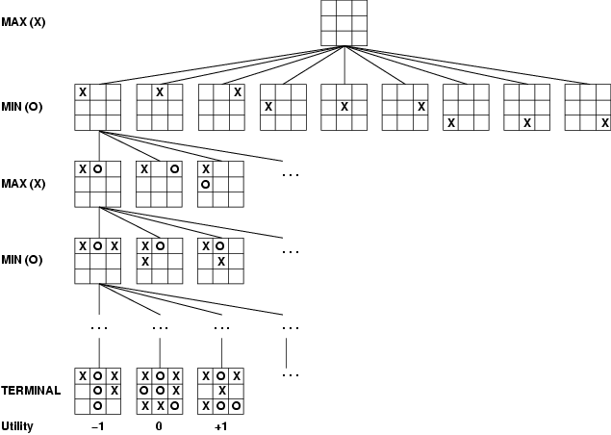
How can X play optimally?

Slide 24
How can X play optimally?
When it’s my turn, pick the highest scoring state
When it’s the opponent’s turn, assume the lowest scoring state (from my perspective)
If we can reach the end games, we can percolate these answers all the way back up

Slide 25
How can X play optimally?
Start from the bottom and propagate the score up:
if X’s turn, pick the move that maximizes the utility
if O’s turn, pick the move that minimizes the utility
Is this optimal?

Slide 26
Minimax Algorithm: An Optimal Strategy
minimax(state) =
if state is a terminal state
score(state)
else if MY turn
over all next states, s: return the maximum of minimax(s)
else if OPPONENTS turn
over all next states, s: return the minimum of minimax(s)
Uses recursion to compute the “value” of each state
Searches down to the leaves, then the values are “backed up” through the tree as the recursion finishes
What type of search is this?
What does this assume about how MIN will play? What if this isn’t true?
Note: We can't always search all the way down to the bottom of the tree…

Slide 27
Baby Nim
MAX
MIN
Take 1 or 2 at each turn
Goal: take the last match
MAX
What move should I take?
MIN
MAX

Slide 28
Baby Nim
MAX
5
MAX
1
2
MIN
4
3
MIN
2
1
2
1
Take 1 or 2 at each turn
Goal: take the last match
MAX
3
2
2
1
MAX
MAX wins
1
2
1
2
1
2
1
MIN
MIN
2
1
1
W
1
W
W
W
= 1.0
1
2
1
1
1
MAX
1
W
W
W
W
W
= -1.0
MAX
1
MIN wins/
MAX loses
W

Slide 29
Baby Nim
MAX
5
MAX
1
2
MIN
4
3
MIN
2
1
2
1
Take 1 or 2 at each turn
Goal: take the last match
MAX
3
2
2
1
MAX
MAX wins
1
2
1
2
1
2
1
MIN
MIN
2
1
1
W
1
W
W
W
= 1.0
1.0
1.0
1.0
1
1
1
2
1
?
MAX
1
W
W
W
W
W
= -1.0
MAX
-1.0
-1.0
-1.0
-1.0
1
MIN wins/
MAX loses
W
1.0

Slide 30
Baby Nim
MAX
5
MAX
1
2
MIN
4
3
MIN
2
1
2
1
Take 1 or 2 at each turn
Goal: take the last match
MAX
3
2
2
1
MAX
MAX wins
1
2
1
2
1
2
1
?
MIN
MIN
2
1
1
W
1
W
W
W
= 1.0
1.0
1.0
1.0
1
1
1
2
1
MAX
1
W
W
W
W
W
= -1.0
MAX
1.0
-1.0
-1.0
-1.0
-1.0
1
MIN wins/
MAX loses
W
1.0

Slide 31
Baby Nim
MAX
5
MAX
1
2
MIN
4
3
MIN
2
1
2
1
Take 1 or 2 at each turn
Goal: take the last match
MAX
3
2
2
1
MAX
MAX wins
1
2
1
2
1
2
1
?
MIN
MIN
2
1
1
W
1
W
W
W
= 1.0
-1.0
1.0
1.0
1.0
1
1
1
2
1
MAX
1
W
W
W
W
W
= -1.0
MAX
1.0
-1.0
-1.0
-1.0
-1.0
1
MIN wins/
MAX loses
W
1.0

Slide 32
Baby Nim
MAX
5
MAX
1
2
MIN
4
3
MIN
2
1
2
1
Take 1 or 2 at each turn
Goal: take the last match
?
2
1
MAX
3
2
MAX
MAX wins
1
2
1
2
1
2
1
MIN
MIN
2
1
1
W
1
W
W
W
= 1.0
-1.0
-1.0
1.0
1.0
1.0
1
1
1
2
1
MAX
1
W
W
W
W
W
= -1.0
MAX
1.0
-1.0
-1.0
-1.0
-1.0
1
MIN wins/
MAX loses
W
1.0

Slide 33
Baby Nim
MAX
5
MAX
1
2
MIN
4
3
MIN
2
1
2
1
Take 1 or 2 at each turn
Goal: take the last match
MAX
3
2
2
1
MAX
-1.0
MAX wins
1
2
1
2
1
2
1
?
MIN
MIN
2
1
1
W
1
W
W
W
= 1.0
-1.0
-1.0
1.0
1.0
1.0
1
1
1
2
1
MAX
1
W
W
W
W
W
= -1.0
MAX
1.0
-1.0
-1.0
-1.0
-1.0
1
MIN wins/
MAX loses
W
1.0

Slide 34
Baby Nim
MAX
5
MAX
1
2
MIN
4
3
MIN
2
1
2
1
Take 1 or 2 at each turn
Goal: take the last match
?
2
1
MAX
3
2
MAX
-1.0
MAX wins
1
2
1
2
1
2
1
MIN
MIN
2
1
1
W
1
W
W
-1.0
-1.0
-1.0
1.0
1.0
W
= 1.0
1
1.0
2
1
1
1
MAX
1
W
W
W
W
W
= -1.0
MAX
1.0
-1.0
-1.0
-1.0
-1.0
1
MIN wins/
MAX loses
W
1.0

Slide 35
Baby Nim
MAX
5
MAX
1
2
?
MIN
4
3
MIN
2
1
2
1
Take 1 or 2 at each turn
Goal: take the last match
MAX
3
2
2
1
MAX
-1.0
1.0
MAX wins
1
2
1
2
1
2
1
MIN
MIN
2
1
1
W
1
W
W
-1.0
-1.0
-1.0
1.0
1.0
W
= 1.0
1
1.0
2
1
1
1
MAX
1
W
W
W
W
W
= -1.0
MAX
1.0
-1.0
-1.0
-1.0
-1.0
1
MIN wins/
MAX loses
W
1.0

Slide 36
Baby Nim
MAX
5
MAX
1
2
MIN
4
3
MIN
-1.0
2
1
2
1
Take 1 or 2 at each turn
Goal: take the last match
MAX
3
2
2
1
MAX
1.0
-1.0
MAX wins
1
2
1
2
1
2
1
?
MIN
MIN
2
1
1
W
1
W
W
-1.0
-1.0
-1.0
1.0
1.0
W
= 1.0
1
1.0
2
1
1
1
MAX
1
W
W
W
W
W
= -1.0
MAX
1.0
-1.0
-1.0
-1.0
-1.0
1
MIN wins/
MAX loses
W
1.0

Slide 37
Baby Nim
MAX
5
MAX
1
2
MIN
4
3
MIN
-1.0
2
1
2
1
Take 1 or 2 at each turn
Goal: take the last match
?
MAX
3
2
2
1
MAX
1.0
-1.0
MAX wins
1
2
1
2
1
2
1
?
MIN
MIN
2
1
1
W
1
W
W
-1.0
-1.0
-1.0
-1.0
1.0
1.0
W
= 1.0
1
1.0
2
1
1
1
MAX
1
W
W
W
W
W
= -1.0
MAX
1.0
-1.0
-1.0
-1.0
-1.0
1
MIN wins/
MAX loses
W
1.0

Slide 38
Baby Nim
MAX
5
MAX
1
2
MIN
4
3
MIN
-1.0
2
1
2
1
Take 1 or 2 at each turn
Goal: take the last match
?
MAX
3
2
2
1
MAX
1.0
1.0
-1.0
MAX wins
1
2
1
2
1
2
1
MIN
MIN
2
1
1
W
1
W
W
-1.0
-1.0
-1.0
-1.0
1.0
1.0
W
= 1.0
1
1.0
2
1
1
1
MAX
1
W
W
W
W
W
= -1.0
MAX
1.0
-1.0
-1.0
-1.0
-1.0
1
MIN wins/
MAX loses
W
1.0

Slide 39
Baby Nim
MAX
5
MAX
1
2
?
MIN
4
3
MIN
-1.0
2
1
2
1
Take 1 or 2 at each turn
Goal: take the last match
MAX
3
2
2
1
MAX
1.0
1.0
1.0
-1.0
MAX wins
1
2
1
2
1
2
1
MIN
MIN
2
1
1
W
1
W
W
-1.0
-1.0
-1.0
-1.0
1.0
1.0
W
= 1.0
1
1.0
2
1
1
1
MAX
1
W
W
W
W
W
= -1.0
MAX
1.0
-1.0
-1.0
-1.0
-1.0
1
MIN wins/
MAX loses
W
1.0

Slide 40
Baby Nim
5
Which move?
MAX
MAX
1
2
MIN
4
3
MIN
-1.0
2
1
1.0
2
1
Take 1 or 2 at each turn
Goal: take the last match
MAX
3
2
2
1
MAX
1.0
1.0
1.0
-1.0
MAX wins
1
2
1
2
1
2
1
MIN
MIN
2
1
1
W
1
W
W
-1.0
-1.0
-1.0
-1.0
1.0
1.0
W
= 1.0
1
1.0
2
1
1
1
MAX
1
W
W
W
W
W
= -1.0
MAX
1.0
-1.0
-1.0
-1.0
-1.0
1
MIN wins/
MAX loses
W
1.0

Slide 41
Baby Nim
could still win, but not optimal!!!
MAX
5
MAX
1
2
MIN
4
3
MIN
-1.0
2
1
1.0
2
1
Take 1 or 2 at each turn
Goal: take the last match
MAX
3
2
2
1
MAX
1.0
1.0
1.0
-1.0
MAX wins
1
2
1
2
1
2
1
MIN
MIN
2
1
1
W
1
W
W
-1.0
-1.0
-1.0
-1.0
1.0
1.0
W
= 1.0
1
1.0
2
1
1
1
MAX
1
W
W
W
W
W
= -1.0
MAX
1.0
-1.0
-1.0
-1.0
-1.0
1
MIN wins/
MAX loses
W
1.0

Slide 42
Minimax example 2
MAX
A1
A2
A3
MIN
A11
A12
A13
A21
A22
A23
A31
A32
A33
3
12
8
2
4
6
14
5
2
Which move should be made: A₁, A₂ or A₃?

Slide 43
Minimax example 2
MAX
A1
A2
A3
MIN
3
2
2
A11
A12
A13
A21
A22
A23
A31
A32
A33
3
12
8
2
4
6
2
5
14

Slide 44
Properties of minimax
Minimax is optimal!
Are we done?
Yes (if tree is finite)
Yes (against an optimal opponent)
O(bm)
O(bm) (depth-first exploration)

Slide 45
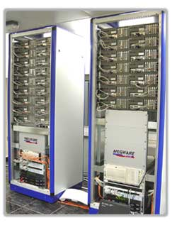
Games State Space Sizes
On average, there are ~35 possible moves that a chess player can make from any board configuration…
0 Ply
1 Ply
18 Ply!!
2 Ply
17005
Branching Factor Estimates
for different two-player games
Tic-tac-toe 4
Connect Four 7
Checkers 10
Othello 30
Chess 35
Go 300
Hydra at home in the United Arab Emirates…

Slide 46
Games State Space Sizes
On average, there are ~35 possible moves that a chess player can make from any board configuration…
0 Ply
1 Ply
2 Ply
Branching Factor Estimates
for different two-player games
Tic-tac-toe 4
Connect Four 7
Checkers 10
Othello 30
Chess 35
Go 300
Boundaries for qualitatively different games…

Slide 47
Games State Space Sizes
On average, there are ~35 possible moves that a chess player can make from any board configuration…
0 Ply
1 Ply
2 Ply
Branching Factor Estimates
for different two-player games
Can search entire space
Tic-tac-toe 4
Connect Four 7
Checkers 10
Othello 30
Chess 35
Go 300
“solved” games
CHINOOK (2007)
computer-dominated
Can’t ☹
human-dominated
Is this true?

Slide 48
Games State Space Sizes
AlphaGo (created by Google), in April 2016 beat one of the best Go players:
http://www.nytimes.com/2016/04/05/science/google-alphago-artificial-intelligence.html
0 Ply
1 Ply
2 Ply
Branching Factor Estimates
for different two-player games
Can search entire space
Tic-tac-toe 4
Connect Four 7
Checkers 10
Othello 30
Chess 35
Go 300
“solved” games
CHINOOK (2007)
computer-dominated
Can’t ☹
What do we do?

Slide 49
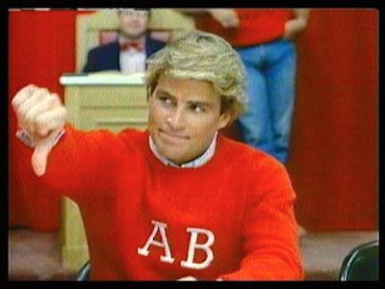
Alpha-Beta pruning
An optimal pruning strategy
only prunes paths that are suboptimal (i.e. wouldn’t be chosen by an optimal playing player)
returns the same result as minimax, but faster
Name the movie ☺

Slide 50
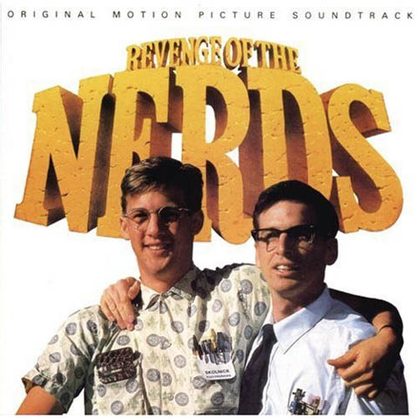
Alpha-Beta pruning

Slide 51
Games State Space Sizes
Pruning helps get a bit deeper
For many games, still can’t search the entire tree
Now what?
0 Ply
1 Ply
2 Ply
Branching Factor Estimates
for different two-player games
Tic-tac-toe 4
Connect Four 7
Checkers 10
Othello 30
Chess 35
Go 300
computer-dominated

Slide 52
Games State Space Sizes
Pruning helps get a bit deeper
For many games, still can’t search the entire tree
Go as deep as you can:
estimate the score/quality of the state (called an evaluation function)
use that instead of the real score
0 Ply
1 Ply
2 Ply
Branching Factor Estimates
for different two-player games
Tic-tac-toe 4
Connect Four 7
Checkers 10
Othello 30
Chess 35
Go 300
computer-dominated

Slide 53
Tic Tac Toe evaluation functions
O
X
X
O
Ideas?

Slide 54
Example Tic Tac Toe EVAL
Tic Tac Toe
Assume MAX is using “X”
EVAL(state) =
if state is win for MAX:
+ ∞
if state is win for MIN:
- ∞
else:
(number of rows, columns and diagonals available to MAX) -
(number of rows, columns and diagonals available to MIN)
X
O
= 6 - 4 = 2
O
X
X
O
= 4 - 3 = 1

Slide 55
Chess evaluation functions
Ideas?

Slide 56
Chess EVAL
Assume each piece has the following values
pawn = 1;
knight = 3;
bishop = 3;
rook = 5;
queen = 9;
EVAL(state) =
sum of the value of white pieces –
sum of the value of black pieces
= 31 - 36 = -5

Slide 57
Chess EVAL
Assume each piece has the following values
pawn = 1;
knight = 3;
bishop = 3;
rook = 5;
queen = 9;
EVAL(state) =
sum of the value of white pieces –
sum of the value of black pieces
Any problems with this?

Slide 58
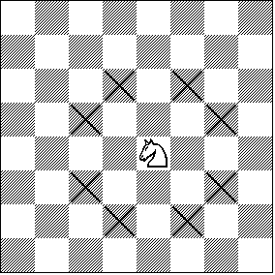
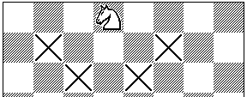
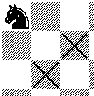
Chess EVAL
Ignores actual positions!
Actual heuristic functions are often a weighted combination of features

Slide 59
Chess EVAL
number of pawns
number of attacked knights
1 if king has knighted, 0 otherwise
A feature can be any numerical information about the board
as general as the number of pawns
to specific board configurations
Deep Blue: 8000 features!

Slide 60
history/end-game tables
History
keep track of the quality of moves from previous games
use these instead of search
end-game tables
do a reverse search of certain game configurations, for example all board configurations with king, rook and king
tells you what to do in any configuration meeting this criterion
if you ever see one of these during search, you lookup exactly what to do

Slide 61
end-game tables
Devastatingly good
Allows much deeper branching
for example, if the end-game table encodes a 20-move finish and we can search up to 14
can search up to depth 34
Stiller (1996) explored all end-games with 5 pieces
one case check-mate required 262 moves!
Knoval (2006) explored all end-games with 6 pieces
one case check-mate required 517 moves!
Traditional rules of chess require a capture or pawn move within 50 or it’s a stalemate

Slide 62
Opening moves
At the very beginning, we’re the farthest possible from any goal state
People are good with opening moves
Tons of books, etc. on opening moves
Most chess programs use a database of opening moves rather than search

Slide 63
Nim
K piles of coins
On your turn you must take one or more coins from one pile
Player that takes the last coin wins
Example: https://www.goobix.com/games/nim/

