Slide 1
informed Search
David Kauchak
CS51A – Spring 2022

Slide 2
Admin
Assignment 9

Slide 3
Foxes and Chickens
Three foxes and three chickens wish to cross the river. They have a small boat that will carry up to two animals. Everyone can navigate the boat. If at any time the foxes outnumber the chickens on either bank of the river, they will eat the chickens. Find the smallest number of crossings that will allow everyone to cross the river safely.
What is the “state” of this problem (it should capture all possible valid configurations)?

Slide 4
Foxes and Chickens
Three foxes and three chickens wish to cross the river. They have a small boat that will carry up to two animals. Everyone can navigate the boat. If at any time the foxes outnumber the chickens on either bank of the river, they will eat the chickens. Find the smallest number of crossings that will allow everyone to cross the river safely.

Slide 5
Foxes and Chickens
Three foxes and three chickens wish to cross the river. They have a small boat that will carry up to two animals. Everyone can navigate the boat. If at any time the foxes outnumber the chickens on either bank of the river, they will eat the chickens. Find the smallest number of crossings that will allow everyone to cross the river safely.
FFFCCC B
FFCC B FC
FC B FFCC
…

Slide 6
Searching for a solution
FFFCCC B ~~
What states can we get to from here?

Slide 7
Searching for a solution
FFFCCC B ~~
FCCC ~~ B FF
FFCCC ~~ B F
FFCC ~~ B FC
Next states?

Slide 8
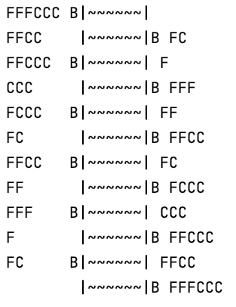
Fox and Chickens Solution
How is this solution different than the n-queens problem?

Slide 9
Fox and Chickens Solution
Solution is not a state, but a sequence of actions (or a sequence of states)

Slide 10
Code!
https://cs.pomona.edu/classes/cs51a/examples/chickens.txt

Slide 11
One other problem
FFFCCC B ~~
FCCC ~~ B FF
FFCCC ~~ B F
FFCC ~~ B FC
FFFCCC B~~
FFCCC B~~ F
FFFCCC B~~
What would happen if we ran DFS here?

Slide 12
One other problem
FFFCCC B ~~
FCCC ~~ B FF
FFCCC ~~ B F
FFCC ~~ B FC
FFFCCC B~~
FFCCC B~~ F
FFFCCC B~~
If we always go left first, will continue forever!

Slide 13
One other problem
FFFCCC B ~~
FCCC ~~ B FF
FFCCC ~~ B F
FFCC ~~ B FC
FFFCCC B~~
FFCCC B~~ F
FFFCCC B~~
Does BFS have this problem?

Slide 14
One other problem
FFFCCC B ~~
FCCC ~~ B FF
FFCCC ~~ B F
FFCC ~~ B FC
FFFCCC B~~
FFCCC B~~ F
FFFCCC B~~
Does BFS have this problem?
No!

Slide 15
DFS vs. BFS
Why do we use DFS then, and not BFS?

Slide 16
DFS vs. BFS
1
Consider a search problem where each state has two states you can reach
Assume the goal state involves 20 actions, i.e. moving between ~20 states
2
3
4
5
6
7
…
How big can the queue get for BFS?

Slide 17
DFS vs. BFS
1
Consider a search problem where each state has two states you can reach
Assume the goal state involves 20 actions, i.e. moving between ~20 states
2
3
4
5
6
7
…
At any point, need to remember roughly a “row”

Slide 18
DFS vs. BFS
1
Consider a search problem where each state has two states you can reach
Assume the goal state involves 20 actions, i.e. moving between ~20 states
2
3
4
5
6
7
…
How big does this get?

Slide 19
DFS vs. BFS
1
Consider a search problem where each state has two states you can reach
Assume the goal state involves 20 actions, i.e. moving between ~20 states
2
3
4
5
6
7
…
Doubles every level we have to go deeper.
For 20 actions that is 2²⁰ = ~1 million states!

Slide 20
DFS vs. BFS
1
Consider a search problem where each state has two states you can reach
Assume the goal state involves 20 actions, i.e. moving between ~20 states
2
3
4
5
6
7
…
How many states would DFS keep on the stack?

Slide 21
DFS vs. BFS
1
Consider a search problem where each state has two states you can reach
Assume the goal state involves 20 actions, i.e. moving between ~20 states
2
3
4
5
6
7
…
Only one path through the tree, roughly 20 states

Slide 22
One other problem
FFFCCC B ~~
FCCC ~~ B FF
FFCCC ~~ B F
FFCC ~~ B FC
FFFCCC B~~
FFCCC B~~ F
FFFCCC B~~
If we always go left first, will continue forever!
Solution?

Slide 23
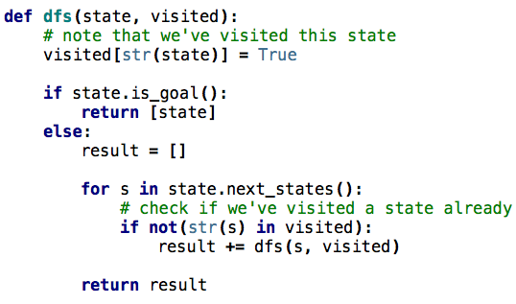
DFS avoiding repeats
Notes:
visited is a dictionary of states we’ve visited

Slide 24
Other search problems
What problems have you seen that could be posed as search problems?
What is the state?
Start state
Goal state
State-space/transition between states

Slide 25
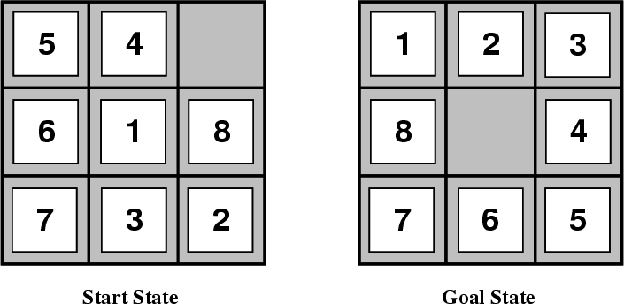
8-puzzle

Slide 26
8-puzzle
goal
state representation?
start state?
state-space/transitions?

Slide 27
8-puzzle
state:
all 3 x 3 configurations of the tiles on the board
transitions between states:
Move Blank Square Left, Right, Up or Down.
This is a more efficient encoding than moving each of the 8 distinct tiles

Slide 28
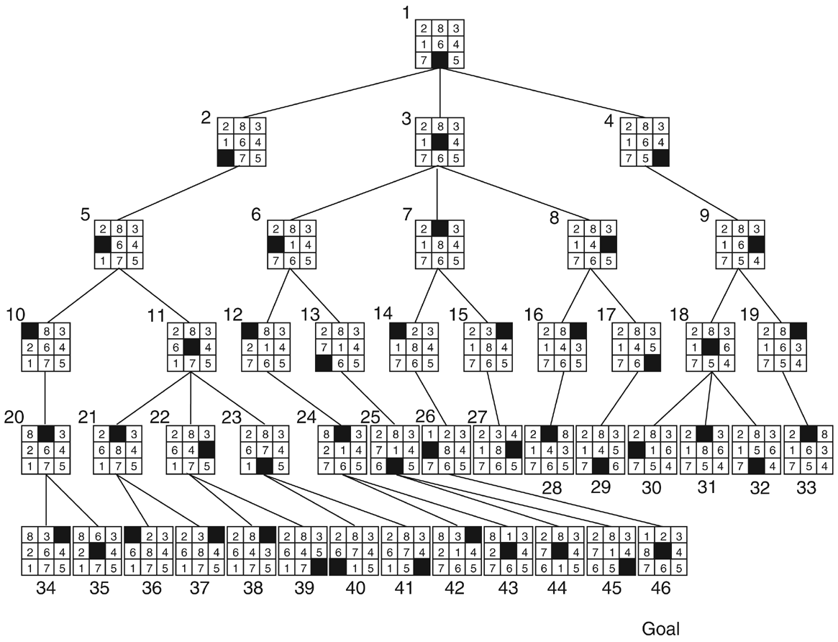

Slide 29
Cryptarithmetic
Find an assignment of digits (0, ..., 9) to letters so that a given arithmetic expression is true. examples: SEND + MORE = MONEY
FORTY Solution: 29786
+ TEN 850
+ TEN 850
----- -----
SIXTY 31486
F=2, O=9, R=7, etc.

Slide 30
Remove 5 Sticks
Given the following configuration of sticks, remove exactly 5 sticks in such a way that the remaining configuration forms exactly 3 squares.

Slide 31
Water Jug Problem
Given a full 5-gallon jug and a full 2-gallon jug, fill the 2-gallon jug with exactly one gallon of water.
5
2

Slide 32
Water Jug Problem
State = (x,y), where x is the number of gallons of water in the 5-gallon jug and y is # of gallons in the 2-gallon jug
Initial State = (5,2)
Goal State = (*,1), where * means any amount
Operator table
5
Name | Cond. | Transition | Effect
Empty5 | – | (x,y)→(0,y) | Empty 5-gal. jug
Empty2 | – | (x,y)→(x,0) | Empty 2-gal. jug
2to5 | x ≤ 3 | (x,2)→(x+2,0) | Pour 2-gal. into 5-gal.
5to2 | x ≥ 2 | (x,0)→(x-2,2) | Pour 5-gal. into 2-gal.
5to2part | y < 2 | (1,y)→(0,y+1) | Pour partial 5-gal. into 2-gal.
2

Slide 33
8-puzzle revisited
How hard is this problem?
1
3
8
4
7
6
5
2

Slide 34
8-puzzle revisited
The average depth of a solution for an 8-puzzle is 22 moves
An exhaustive search requires searching ~3²² = 3.1 x 10¹⁰ states
BFS: 10 terabytes of memory
DFS: 8 hours (assuming one million nodes/second)
Can we do better?
Is DFS and BFS intelligent?
1
3
8
4
7
6
5
2

Slide 35
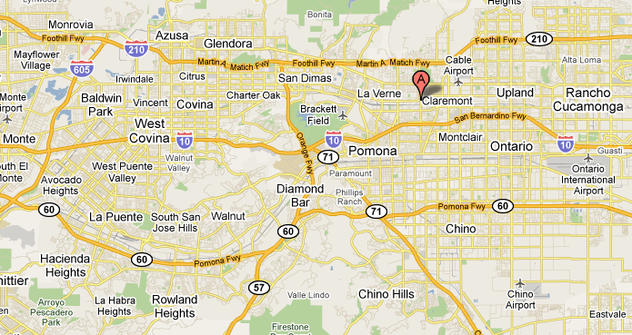
from: Claremont to:Rowland Heights
How do you think google maps does it?

Slide 36
from: Claremont to:Rowland Heights
What would the search algorithms do?

Slide 37
from: Claremont to:Rowland Heights
DFS

Slide 38
from: Claremont to:Rowland Heights
BFS

Slide 39
from: Claremont to: Rowland Heights
Ideas?

Slide 40
from: Claremont to: Rowland Heights
We’d like to bias search towards the actual solution

Slide 41
Informed search
Order to_visit based on some knowledge of the world that estimates how “good” a state is
h(n) is called an evaluation function
Best-first search
rank to_visit based on h(n)
take the most desirable state in to_visit first
different approaches depending on how we define h(n)

Slide 42
Heuristic
Merriam-Webster's Online Dictionary
Heuristic (pron. \hyu-’ris-tik\): adj. [from Greek heuriskein to discover.] involving or serving as an aid to learning, discovery, or problem-solving by experimental and especially trial-and-error methods
The Free On-line Dictionary of Computing (2/19/13)
heuristic 1. Of or relating to a usually speculative formulation serving as a guide in the investigation or solution of a problem: "The historian discovers the past by the judicious use of such a heuristic device as the 'ideal type'" (Karl J. Weintraub).

Slide 43
Heuristic function: h(n)
An estimate of how close the node is to a goal
Uses domain-specific knowledge!
Examples
Map path finding?
straight-line distance from the node to the goal (“as the crow flies”)
8-puzzle?
how many tiles are out of place
sum of the “distances” of the out of place tiles
Foxes and Chickens?
number of people on the starting bank

