Slide 1
Search
David Kauchak
CS51A – Spring 2022

Slide 2
Admin
Assignment 9

Slide 3
Search algorithm
Keep track of a list of states that we could visit, we’ll call it “to_visit”
General idea:
take a state off the to_visit list
if it’s the goal state
we’re done!
if it’s not the goal state
Add all of the next states to the to_visit list
repeat

Slide 4
Search algorithms
add the start state to to_visit
Repeat
take a state off the to_visit list
if it’s the goal state
we’re done!
if it’s not the goal state
Add all of the next states to the to_visit list
Two variants: breadth first search (BFS) and depth first search (DFS) depending on whether we use a stack or a queue for to_visit. Which is which?

Slide 5
Search algorithms
add the start state to to_visit
Repeat
take a state off the to_visit list
if it’s the goal state
we’re done!
if it’s not the goal state
Add all of the next states to the to_visit list
Depth first search (DFS): to_visit is a stack
Breadth first search (BFS): to_visit is a queue

Slide 6
Implementing the state space
What the “world” (in this case a maze) looks like
We’ll define the world as a collection of discrete states
States are connected if we can get from one state to another by taking a particular action
This is called the “state space”

Slide 7
Implementing state space
What the “world” (in this case a maze) looks like
We’ll define the world as a collection of discrete states
States are connected if we can get from one state to another by taking a particular action
This is called the “state space”
State:
Is this the goal state? (is_goal)
What states are connected to this state? (next_states)

Slide 8
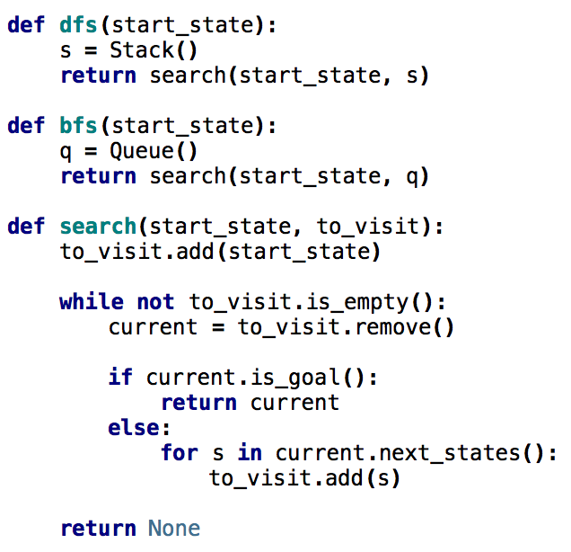
Search variants implemented
add the start state to to_visit
Repeat
take a state off the to_visit list
if it’s the goal state
we’re done!
if it’s not the goal state
Add all of the successive states to the to_visit list

Slide 9
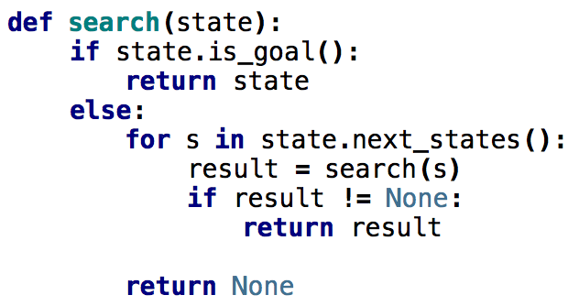
What order would this variant visit the states?
1
2
3
4
5
6
7
8
1, 2, 5
9

Slide 10
What order would this variant visit the states?
1
2
3
4
5
6
7
8
1, 2, 5, 3, 6, 9, 7, 8
9
What search algorithm is this?

Slide 11
What order would this variant visit the states?
1
2
3
4
5
6
7
8
1, 2, 5, 3, 6, 9, 7, 8
9
DFS!

Slide 12
DFS with a stack
add the start state to to_visit
Repeat
take a state off the to_visit list
if it’s the goal state
we’re done!
if it’s not the goal state
Add all of the successive states to the to_visit list
1
2
3
4
5
6
7
8
9
Depth first search (DFS): to_visit is a stack
Breadth first search (BFS): to_visit is a queue

Slide 13
DFS with a stack
DFS:
1, 4, 3, 8, 7, 6, 9, 2, 5
1
2
3
4
5
6
7
8
9
Depth first search (DFS): to_visit is a stack
Breadth first search (BFS): to_visit is a queue

Slide 14
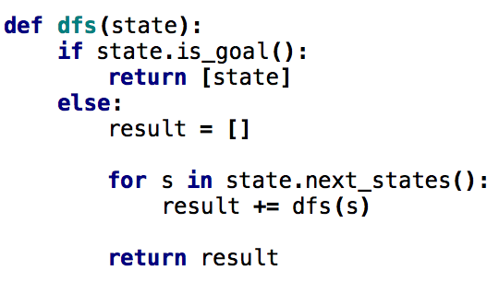
One last DFS variant
How is this different?

Slide 15
One last DFS variant
Returns ALL solutions found, not just one

Slide 16
Matrices!

Slide 17
N-queens problem
Place N queens on an N by N chess board such that none of the N queens are attacking any other queen.
Solution(s)?

Slide 18
N-queens problem
Place N queens on an N by N chess board such that none of the N queens are attacking any other queen.

Slide 19
N-queens problem
Place N queens on an N by N chess board such that none of the N queens are attacking any other queen.
Solution(s)?

Slide 20
N-queens problem
Place N queens on an N by N chess board such that none of the N queens are attacking any other queen.
How do we solve this with search:
What is a state?
What is the start state?
What is the goal?
How do we transition from one state to the next?

Slide 21
Search algorithm
add the start state to to_visit
Repeat
take a state off the to_visit list
if it’s the goal state
we’re done!
if it’s not the goal state
Add all of the next states to the to_visit list
Is this a goal state?
What states can I get to from the current state?
Any problem that we can define these three things can be plugged into the search algorithm!

Slide 22
N queens problem
http://en.wikipedia.org/wiki/Eight_queens_puzzle

