Slide 1
Search
David Kauchak
CS51A – Fall 2019

Slide 2
Admin
Assignment 8

Slide 3
What is AI?
Think like a human Cognitive Modeling | Think rationally Logic-based Systems
Act like a human Turing Test | Act rationally Rational Agents
"knowledge"
“reasoning”
“emotions”
perception
“learning”
language
motor skills
Next couple of weeks

Slide 4
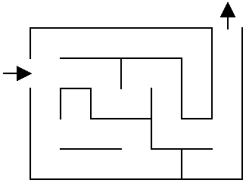
Solve the maze!

Slide 5
Solve the maze!

Slide 6
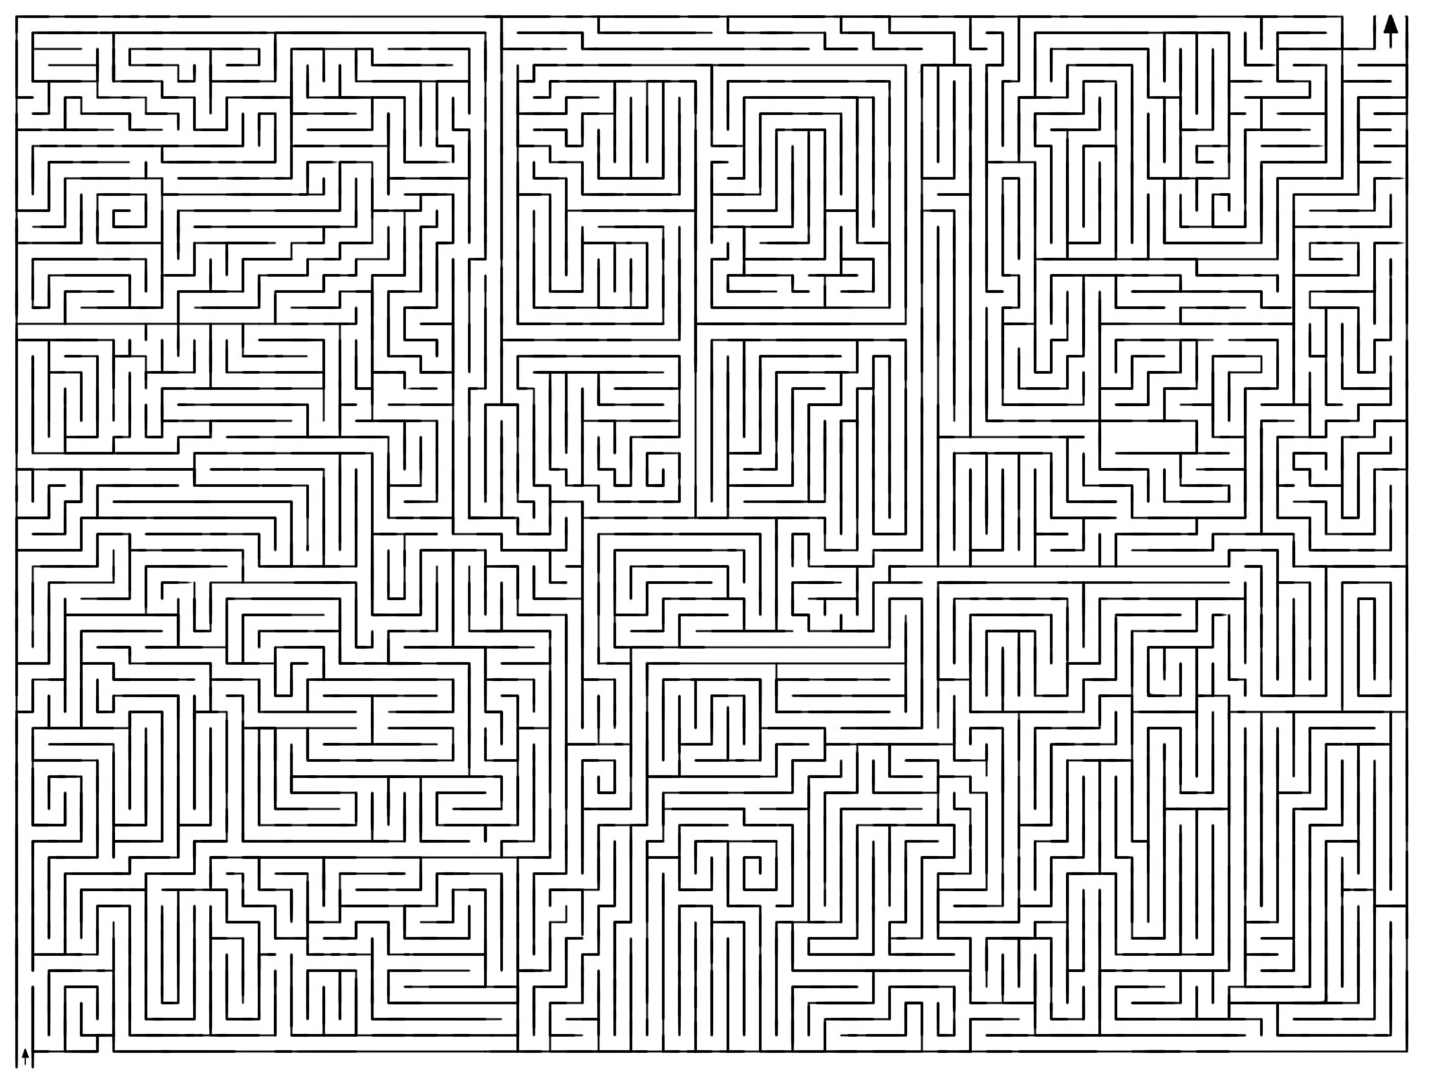
Solve the maze!

Slide 7
Solve the maze!
How did you figure it out?

Slide 8
One approach
What now?

Slide 9
One approach
Three choices

Slide 10
One approach
Pick one!
What now?

Slide 11
One approach
Still three options!
Which would you explore/pick?

Slide 12
One approach
Most people go down a single path until they realize that it’s wrong

Slide 13
One approach
Keep exploring

Slide 14
One approach
Keep exploring

Slide 15
One approach
What now?

Slide 16
One approach
Are we stuck?
No. Red positions are just possible options we haven’t explored

Slide 17
One approach
How do we know not to go left?

Slide 18
One approach
Have to be careful and keep track of where we’ve been if we can loop

Slide 19
One approach
Now what?

Slide 20
One approach
Now what?

Slide 21
One approach

Slide 22
Search problems
What information do we need to figure out a solution?

Slide 23
Search problems
Where to start
Where to finish (goal)
What the “world” (in this case a maze) looks like
We’ll define the world as a collection of discrete states
States are connected if we can get from one state to another by taking a particular action
This is called the “state space”

Slide 24
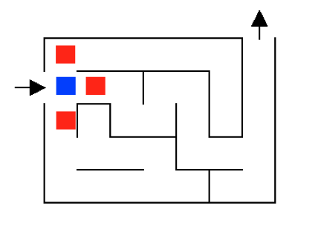
State space example

Slide 25
State space example
…
…
…

Slide 26
State space example
For a given problem, still could have different state-spaces
How many more states are there?

Slide 27
State space example

Slide 28
State space example

Slide 29
State space example
Now what?

Slide 30
State space example

Slide 31
State space example
Now what?

Slide 32
State space example

Slide 33
State space example
Could we have found the exit any other way?

Slide 34
Search algorithm
Keep track of a list of states that we could visit, we’ll call it “to_visit”
General idea:
take a state off the to_visit list
if it’s the goal state
we’re done!
if it’s not the goal state
Add all of the next states to the to_visit list
repeat

Slide 35
1
4
2
3
8
7
5
6
11
12
9
10
14
to_visit
13
- take a state off the to_visit list
- if it’s the goal state
we’re done!
- if it’s not the goal state
Add all of the next states to the to_visit list
- repeat
How do we start?

Slide 36
1
4
2
3
8
7
5
6
11
12
9
10
14
to_visit
13
- take a state off the to_visit list
- if it’s the goal state
we’re done!
- if it’s not the goal state
Add all of the next states to the to_visit list
- repeat
1
Add start to to_visit

Slide 37
1
4
2
3
8
7
5
6
11
12
9
10
14
to_visit
13
- take a state off the to_visit list
- if it’s the goal state
we’re done!
- if it’s not the goal state
Add all of the next states to the to_visit list
- repeat
Is it a goal state?

Slide 38
1
4
2
3
8
7
5
6
11
12
9
10
14
to_visit
13
- take a state off the to_visit list
- if it’s the goal state
we’re done!
- if it’s not the goal state
Add all of the next states to the to_visit list
- repeat
2
3
4

Slide 39
1
4
2
3
8
7
5
6
11
12
9
10
14
to_visit
13
- take a state off the to_visit list
- if it’s the goal state
we’re done!
- if it’s not the goal state
Add all of the next states to the to_visit list
- repeat
3
4
Is it a goal state?

Slide 40
1
4
2
3
8
7
5
6
11
12
9
10
14
to_visit
13
- take a state off the to_visit list
- if it’s the goal state
we’re done!
- if it’s not the goal state
Add all of the next states to the to_visit list
- repeat
3
4

Slide 41
1
4
2
3
8
7
5
6
11
12
9
10
14
to_visit
13
- take a state off the to_visit list
- if it’s the goal state
we’re done!
- if it’s not the goal state
Add all of the next states to the to_visit list
- repeat
3
4
Dead-end. What do we do now?

Slide 42
1
4
2
3
8
7
5
6
11
12
9
10
14
to_visit
13
- take a state off the to_visit list
- if it’s the goal state
we’re done!
- if it’s not the goal state
Add all of the next states to the to_visit list
- repeat
3
4
list keeps track of where to go next, i.e. the states we know about but haven’t explored

Slide 43
1
4
2
3
8
7
5
6
11
12
9
10
14
to_visit
13
- take a state off the to_visit list
- if it’s the goal state
we’re done!
- if it’s not the goal state
Add all of the next states to the to_visit list
- repeat
4
Is it a goal state?

Slide 44
1
4
2
3
8
7
5
6
11
12
9
10
14
to_visit
13
- take a state off the to_visit list
- if it’s the goal state
we’re done!
- if it’s not the goal state
Add all of the next states to the to_visit list
- repeat
5
6
4

Slide 45
1
4
2
3
8
7
5
6
11
12
9
10
14
to_visit
13
- take a state off the to_visit list
- if it’s the goal state
we’re done!
- if it’s not the goal state
Add all of the next states to the to_visit list
- repeat
6
4
Is it a goal state?

Slide 46
1
4
2
3
8
7
5
6
11
12
9
10
14
to_visit
13
- take a state off the to_visit list
- if it’s the goal state
we’re done!
- if it’s not the goal state
Add all of the next states to the to_visit list
- repeat
6
4

Slide 47
1
4
2
3
8
7
5
6
11
12
9
10
14
to_visit
13
- take a state off the to_visit list
- if it’s the goal state
we’re done!
- if it’s not the goal state
Add all of the next states to the to_visit list
- repeat
4
Is it a goal state?

Slide 48
1
4
2
3
8
7
5
6
11
12
9
10
14
to_visit
13
- take a state off the to_visit list
- if it’s the goal state
we’re done!
- if it’s not the goal state
Add all of the next states to the to_visit list
- repeat
4

Slide 49
1
4
2
3
8
7
5
6
11
12
9
10
14
to_visit
13
- take a state off the to_visit list
- if it’s the goal state
we’re done!
- if it’s not the goal state
Add all of the next states to the to_visit list
- repeat
4
How was the to_visit list organized in this example, i.e., what order?
It’s a stack!!! (LIFO)

Slide 50
1
4
2
3
8
7
5
6
11
12
9
10
14
to_visit
13
- take a state off the to_visit list
- if it’s the goal state
we’re done!
- if it’s not the goal state
Add all of the next states to the to_visit list
- repeat
4
What would happen if we used a queue?

Slide 51
Search algorithms
add the start state to to_visit
Repeat
take a state off the to_visit list
if it’s the goal state
we’re done!
if it’s not the goal state
Add all of the next states to the to_visit list

Slide 52
Search algorithms
add the start state to to_visit
Repeat
take a state off the to_visit list
if it’s the goal state
we’re done!
if it’s not the goal state
Add all of the next states to the to_visit list
Depth first search (DFS): to_visit is a stack
Breadth first search (BFS): to_visit is a queue

Slide 53
What order will BFS and DFS visit the states assuming states are added to to_visit left to right?
add the start state to to_visit
Repeat
take a state off the to_visit list
if it’s the goal state
we’re done!
if it’s not the goal state
Add all of the successive states to the to_visit list
1
2
3
4
5
6
7
8
9
Depth first search (DFS): to_visit is a stack
Breadth first search (BFS): to_visit is a queue

Slide 54
What order will BFS and DFS visit the states?
DFS:
1, 4, 3, 8, 7, 6, 9, 2, 5
1
2
3
4
Why not 1, 2, 5?
5
6
7
8
9
Depth first search (DFS): to_visit is a stack
Breadth first search (BFS): to_visit is a queue

Slide 55
What order will BFS and DFS visit the states?
DFS:
1, 4, 3, 8, 7, 6, 9, 2, 5
1
2
3
4
5
6
7
8
1
STACK
9
Depth first search (DFS): to_visit is a stack
Breadth first search (BFS): to_visit is a queue

Slide 56
What order will BFS and DFS visit the states?
DFS:
1, 4, 3, 8, 7, 6, 9, 2, 5
1
2
3
4
4
3
5
6
7
8
2
STACK
9
Depth first search (DFS): to_visit is a stack
Breadth first search (BFS): to_visit is a queue

Slide 57
What order will BFS and DFS visit the states?
DFS:
1, 4, 3, 8, 7, 6, 9, 2, 5
1
2
3
4
3
5
6
7
8
2
STACK
9
Depth first search (DFS): to_visit is a stack
Breadth first search (BFS): to_visit is a queue

Slide 58
What order will BFS and DFS visit the states?
DFS:
1, 4, 3, 8, 7, 6, 9, 2, 5
1
BFS:
1, 2, 3, 4, 5
2
3
4
5
6
7
8
9
Depth first search (DFS): to_visit is a stack
Breadth first search (BFS): to_visit is a queue

Slide 59
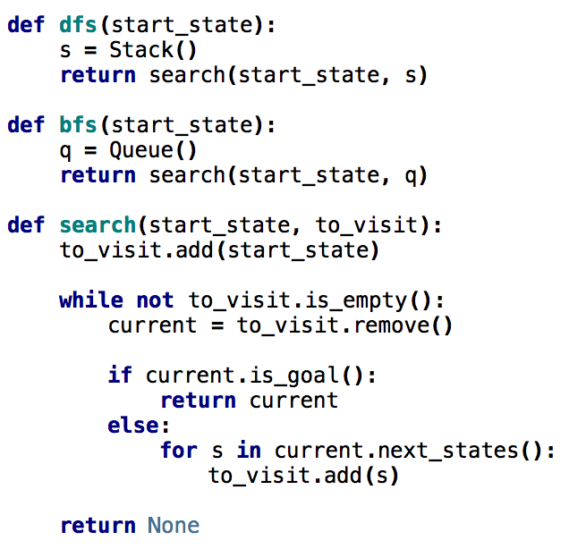
Search variants implemented
add the start state to to_visit
Repeat
take a state off the to_visit list
if it’s the goal state
we’re done!
if it’s not the goal state
Add all of the successive states to the to_visit list

Slide 60
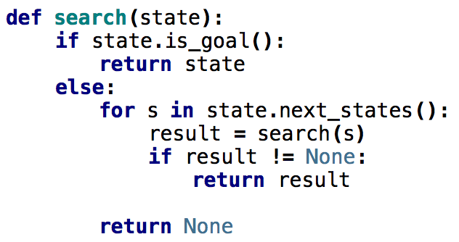
What order would this variant visit the states?
1
2
3
4
5
6
7
8
1, 2, 5
9

Slide 61
What order would this variant visit the states?
1
2
3
4
5
6
7
8
1, 2, 5, 3, 6, 9, 7, 8
9
What search algorithm is this?

Slide 62
What order would this variant visit the states?
1
2
3
4
5
6
7
8
1, 2, 5, 3, 6, 9, 7, 8
9
DFS!

