Slide 1
Midterm 1 review
CS51 – Spring 2026

Slide 2
Midterm logistics
1 double-side page of notes, hand-written

Slide 3
Topics
History of CS
Ethics
Boolean algebra
  Operators: AND, OR, NOT, XOR
  Evaluating expressions
  Laws: distributive law, De Morgan’s
  DNF – minterm expansion
  CNF – maxterm expansion
  K-Maps

Slide 4
Topics continued
Number representation
  Converting between bases
  Binary: unsigned, sign/magnitude, twos complement, fixed vs. variable length
  Addition in other bases
  Shifting: left vs. right, arithmetic vs. logical
  Overflow

Slide 5
Topics continued
Bitwise operators
  &, |, ^, ~
  masking
  bitwise operations in Python
    bit_length()
Representing other information in binary

Slide 6
Topics continue
Circuits
  Gates: AND, OR, NOT, XOR, NAND, XNOR
  Circuits from truth tables
  Half-adder/adder, ripple-carry adder
  Decoder
  Multiplexer
  Barrel shifter

Slide 7
Topics continued
Memory
  Different types: registers, RAM, hard-drive
  Units of memory: bit, nibble, byte…
  Memory implementation
  SR-latch

Slide 8
Topics continued
CS51 machine
  “Hardware” setup, i.e., registers
  Assembly
    arithmetic operations
    branch operations
    loa/sto (particularly for I/O)
Will not be asked to write any assembly code
Only material from 2/17 on this checkpoint (i.e., no functions)

Slide 9
Practice Problem 1
Assuming unsigned numbers, fill in the rest of the missing entries in the table for representations in other bases.
Binary | Decimal | Hex
100101
 | 910
 |  | 1AB

Slide 10
Answer Problem 1
Binary | Decimal | Hex
100101 | 37 | 25
1110001110 | 910 | 38E
000110101011 | 427 | 1AB

Slide 11
Practice Problem 2
i) Given this 4-variable Boolean function, calculate is DNF and build the circuit that corresponds to this minterm expansion. ii) use a K-map to simplify it and build the corresponding circuit.
A | B | C | D | Output
0 | 0 | 0 | 0 | 0
0 | 0 | 0 | 1 | 1
0 | 0 | 1 | 0 | 0
0 | 0 | 1 | 1 | 1
0 | 1 | 0 | 0 | 1
0 | 1 | 0 | 1 | 0
0 | 1 | 1 | 0 | 1
0 | 1 | 1 | 1 | 0
1 | 0 | 0 | 0 | 1
1 | 0 | 0 | 1 | 1
1 | 0 | 1 | 0 | 0
1 | 0 | 1 | 1 | 0
1 | 1 | 0 | 0 | 1
1 | 1 | 0 | 1 | 1
1 | 1 | 1 | 0 | 0
1 | 1 | 1 | 1 | 0

Slide 12
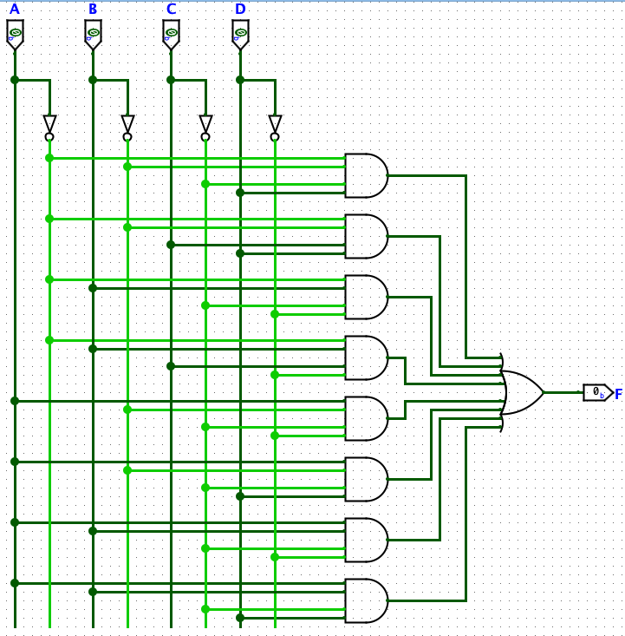
Answer 2
i) Given this 4-variable Boolean function, calculate is DNF and build the circuit that corresponds to this minterm expansion DNF:
m1 ∨ m3 ∨ m4 ∨ m6 ∨ m8 ∨ m9 ∨ m12 ∨ m13

Slide 13
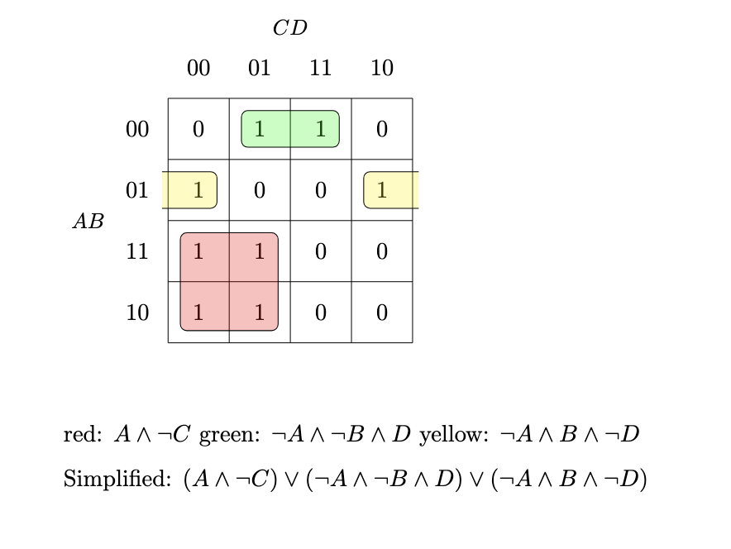
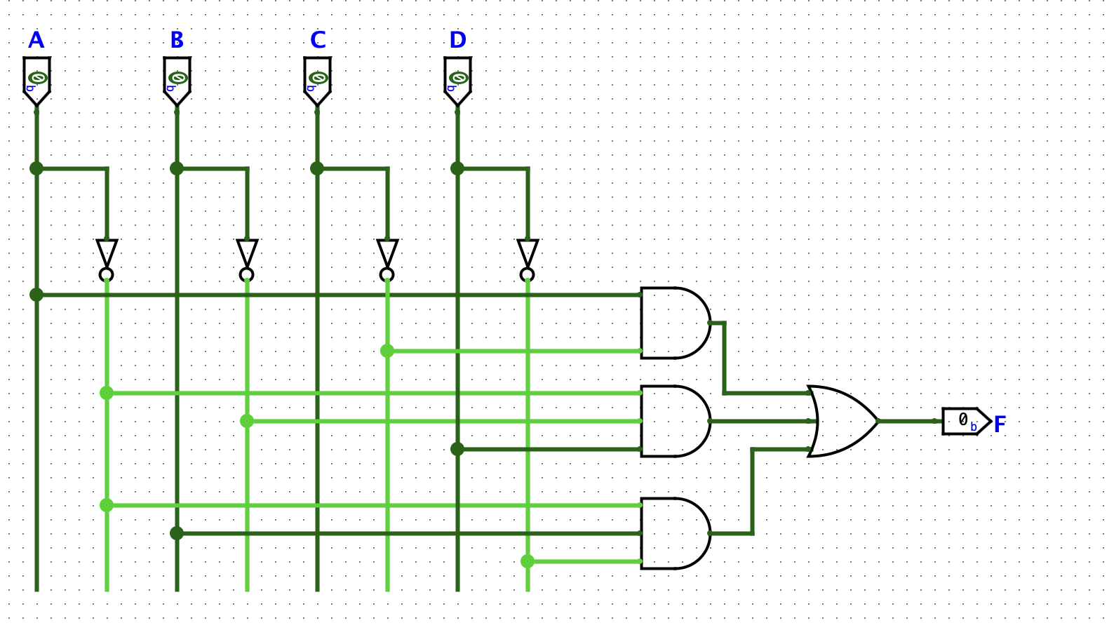
Answer 2
ii) use a K-map to simplify it and build the corresponding circuit.

Slide 14
Practice Problem 3
What would the results of the following bitwise masks be in decimal?
~8
9&3
-2|3
7^9

Slide 15
Answer 3
What would the results of the following bitwise masks be in decimal?
~8 = -9. Remember, ~x=-(x+1)
9&3 = 1
  01001 & 00011 = 0001
-2|3 =-1
  110|001=111
7^9=14
  00111^01001= 01110

Slide 16
Practice Problem 4
Assuming x is a positive number, what would the following function do?
def mystery(x):
return x & (x - 1)

Slide 17
Practice Problem 4
It resets (sets to 0) the least significant set bit (the right most bit that is 1) in x.

