Slide 1
Binary Arithmetic in Python & Representing Information
Computer Systems
+
>>
CS51 – Fall 2026
à
🥳
Notes:
Today we will continue with binary arithmetic, seeing some tricks we can do in Python. We will also see how to use them to represent information that goes past integers (e.g., characters, emojis, even colors!)

Slide 2
Bitwise operations
Notes:
The first thing we will see is how we can apply apply bitwise operations on binary numbers

Slide 3
Bitwise operations
If we are given two numbers, we can apply the operators NOT, AND, OR, and XOR bitwise.
Treat numbers as two's complement.
Perform Boolean operation per bit.
Convert result to decimal.
AND (&)
X | Y | X ∧ Y
0 | 0 | 0
0 | 1 | 0
1 | 0 | 0
1 | 1 | 1
NOT (~)
X | ¬ X
0 | 1
1 | 0
OR (|)
XOR (^)
X | Y | X ∨ Y
0 | 0 | 0
0 | 1 | 1
1 | 0 | 1
1 | 1 | 1
X | Y | X ⊕ Y
0 | 0 | 0
0 | 1 | 1
1 | 0 | 1
1 | 1 | 0
Notes:
We have seen that in Boolean Algebra that we have the logical operators NOT, AND, OR, and XOR. Given two numbers, we can apply each of these operators bitwise. We treat the numbers as two's complement representations in their binary form and then apply the Boolean operation for each bit of the two numbers. Note that we have slightly different notation to denote bitwise operations. AND is known as &, OR as |, XOR as ^. The only unary operator is NOT and is denoted as ^. Be careful because ^ in Boolean Algebra is AND but in bitwise operations is XOR.

Slide 4
AND (&)
Bitwise operation AND (&)
X | Y | X ∧ Y
0 | 0 | 0
0 | 1 | 0
1 | 0 | 0
1 | 1 | 1
6 & 5 = ?
Treat numbers as two's complement.
Perform Boolean operation per bit.
Convert result to decimal.
Notes:
Given this recipe, what do you think the result of bitwise AND would be if we applied it on 6 and 5, that is what is 6 & 5 equal to?

Slide 5
AND (&)
Bitwise operation AND (&)
X | Y | X ∧ Y
0 | 0 | 0
0 | 1 | 0
1 | 0 | 0
1 | 1 | 1
6 & 5 = ?
Treat numbers as two's complement.
Perform Boolean operation per bit.
Convert result to decimal.
6₁₀ = ?₂
5₁₀ = ?₂
Notes:
First, we convert 6 and 5 to their binary form in two's complement. What are they equal to?

Slide 6
AND (&)
Bitwise operation AND (&)
X | Y | X ∧ Y
0 | 0 | 0
0 | 1 | 0
1 | 0 | 0
1 | 1 | 1
6 & 5 = ?
Treat numbers as two's complement.
Perform Boolean operation per bit.
Convert result to decimal.
6₁₀ = 0 1 1 0₂
5₁₀ = 0 1 0 1₂
Notes:
Let's assume 4-bits here (if we didn't have the fourth bit, 110 would be seen as a negative number!). We get 0110 and 0101, respectively.

Slide 7
AND (&)
Bitwise operation AND (&)
X | Y | X ∧ Y
0 | 0 | 0
0 | 1 | 0
1 | 0 | 0
1 | 1 | 1
6 & 5 = ?
Treat numbers as two's complement.
Perform Boolean operation per bit.
Convert result to decimal.
6₁₀ = 0 1 1 0₂
&
5₁₀ = 0 1 0 1₂
Notes:
Next, can you apply the operation of AND on each pair of bits starting from right and going left?

Slide 8
AND (&)
Bitwise operation AND (&)
X | Y | X ∧ Y
0 | 0 | 0
0 | 1 | 0
1 | 0 | 0
1 | 1 | 1
6 & 5 = ?
Treat numbers as two's complement.
Perform Boolean operation per bit.
Convert result to decimal.
6₁₀ = 0 1 1 0₂
&
5₁₀ = 0 1 0 1₂
0 1 0 0₂
Notes:
Did you get 0100?

Slide 9
AND (&)
Bitwise operation AND (&)
X | Y | X ∧ Y
0 | 0 | 0
0 | 1 | 0
1 | 0 | 0
1 | 1 | 1
6 & 5 = ?
Treat numbers as two's complement.
Perform Boolean operation per bit.
Convert result to decimal.
6₁₀ = 0 1 1 0₂
&
5₁₀ = 0 1 0 1₂
?₁₀ = 0 1 0 0₂
Notes:
Assuming that 0100 is in the two's complement form of a decimal number, which one is it?

Slide 10
AND (&)
Bitwise operation AND (&)
X | Y | X ∧ Y
0 | 0 | 0
0 | 1 | 0
1 | 0 | 0
1 | 1 | 1
6 & 5 = 4
Treat numbers as two's complement.
Perform Boolean operation per bit.
Convert result to decimal.
6₁₀ = 0 1 1 0₂
&
5₁₀ = 0 1 0 1₂
4₁₀ = 0 1 0 0₂
Notes:
That's right, it's 4! So putting it together 6&5=4

Slide 11
OR (|)
Bitwise operation OR (|)
X | Y | X ∧ Y
0 | 0 | 0
0 | 1 | 1
1 | 0 | 1
1 | 1 | 1
11 | -9 = ?
Treat numbers as two's complement.
Perform Boolean operation per bit.
Convert result to decimal.
Notes:
Let's do the same now with bitwise OR applied on 11 and -9.

Slide 12
OR (|)
Bitwise operation OR (|)
X | Y | X ∧ Y
0 | 0 | 0
0 | 1 | 1
1 | 0 | 1
1 | 1 | 1
11 | -9 = ?
Treat numbers as two's complement.
Perform Boolean operation per bit.
Convert result to decimal.
11₁₀ = ?₂
-9₁₀ = ?₂
Notes:
What are the two's complement binary representations of 11 and -9?

Slide 13
OR (|)
Bitwise operation OR (|)
X | Y | X ∧ Y
0 | 0 | 0
0 | 1 | 1
1 | 0 | 1
1 | 1 | 1
11 | -9 = ?
Treat numbers as two's complement.
Perform Boolean operation per bit.
Convert result to decimal.
11₁₀ = 0 1 0 1 1₂
-9₁₀ = 1 0 1 1 1₂
Notes:
Did you get 01011 and 10111?

Slide 14
OR (|)
Bitwise operation OR (|)
X | Y | X ∧ Y
0 | 0 | 0
0 | 1 | 1
1 | 0 | 1
1 | 1 | 1
11 | -9 = ?
Treat numbers as two's complement.
Perform Boolean operation per bit.
Convert result to decimal.
11₁₀ = 0 1 0 1 1₂
|
-9₁₀ = 1 0 1 1 1₂
Notes:
Next, apply OR on each pair of bits starting from right and going to left.

Slide 15
OR (|)
Bitwise operation OR (|)
X | Y | X ∧ Y
0 | 0 | 0
0 | 1 | 1
1 | 0 | 1
1 | 1 | 1
11 | -9 = ?
Treat numbers as two's complement.
Perform Boolean operation per bit.
Convert result to decimal.
11₁₀ = 0 1 0 1 1₂
|
-9₁₀ = 1 0 1 1 1₂
1 1 1 1 1₂
Notes:
You should gave found it to be equal to 11111.

Slide 16
OR (|)
Bitwise operation OR (|)
X | Y | X ∧ Y
0 | 0 | 0
0 | 1 | 1
1 | 0 | 1
1 | 1 | 1
11 | -9 = ?
Treat numbers as two's complement.
Perform Boolean operation per bit.
Convert result to decimal.
11₁₀ = 0 1 0 1 1₂
|
-9₁₀ = 1 0 1 1 1₂
?₁₀ = 1 1 1 1 1₂
Notes:
Which decimal number is this equal to?

Slide 17
OR (|)
Bitwise operation OR (|)
X | Y | X ∧ Y
0 | 0 | 0
0 | 1 | 1
1 | 0 | 1
1 | 1 | 1
11 | -9 = -1
Treat numbers as two's complement.
Perform Boolean operation per bit.
Convert result to decimal.
11₁₀ = 0 1 0 1 1₂
|
-9₁₀ = 1 0 1 1 1₂
-1₁₀ = 1 1 1 1 1₂
Notes:
-1 (remember, it's always -1 if it’s all 1s). So 11 | -9 = -1

Slide 18
NOT (~)
X | ¬ X
0 | 1
1 | 0
Bitwise operation NOT (~)
~9 = ?
Treat numbers as two's complement.
Perform Boolean operation per bit.
Convert result to decimal.
Notes:
Let's see how bitwise NOT play out by applying it on 9.

Slide 19
NOT (~)
X | ¬ X
0 | 1
1 | 0
Bitwise operation NOT (~)
~9 = ?
Treat numbers as two's complement.
Perform Boolean operation per bit.
Convert result to decimal.
9₁₀ = ?₂
Notes:
You know the drill. Start by converting 9 to its two's complement representation.

Slide 20
NOT (~)
X | ¬ X
0 | 1
1 | 0
Bitwise operation NOT (~)
~9 = ?
Treat numbers as two's complement.
Perform Boolean operation per bit.
Convert result to decimal.
9₁₀ = 0 1 0 0 1₂
Notes:
It should be 01001. Don't forget we need to pad with a zero at the beginning otherwise 1001 would be seen as a negative number since we're working with signed numbers.

Slide 21
NOT (~)
X | ¬ X
0 | 1
1 | 0
Bitwise operation NOT (~)
~9 = ?
Treat numbers as two's complement.
Perform Boolean operation per bit.
Convert result to decimal.
~ 9₁₀ = 0 1 0 0 1₂
Notes:
Proceed with applying NOT to each bit.

Slide 22
NOT (~)
X | ¬ X
0 | 1
1 | 0
Bitwise operation NOT (~)
~9 = ?
Treat numbers as two's complement.
Perform Boolean operation per bit.
Convert result to decimal.
~ 9₁₀ = 0 1 0 0 1₂
1 0 1 1 0₂
Notes:
You shuld get 10110

Slide 23
NOT (~)
X | ¬ X
0 | 1
1 | 0
Bitwise operation NOT (~)
~9 = ?
Treat numbers as two's complement.
Perform Boolean operation per bit.
Convert result to decimal.
~ 9₁₀ = 0 1 0 0 1₂
?₁₀ = 1 0 1 1 0₂
Notes:
What is 10110 in decimal?

Slide 24
NOT (~)
X | ¬ X
0 | 1
1 | 0
Bitwise operation NOT (~)
~9 = -10
Treat numbers as two's complement.
Perform Boolean operation per bit.
Convert result to decimal.
~ 9₁₀ = 0 1 0 0 1₂
-10₁₀ = 1 0 1 1 0₂
Notes:
It's -10. So ~9=-10.

Slide 25
XOR (^)
X | Y | X ⊕ Y
0 | 0 | 0
0 | 1 | 1
1 | 0 | 1
1 | 1 | 0
Bitwise operation XOR (^)
10^1 = ?
Treat numbers as two's complement.
Perform Boolean operation per bit.
Convert result to decimal.
Notes:
And finally, let's see what bitwise XOR would look like when applied to 10 and 1.

Slide 26
XOR (^)
X | Y | X ⊕ Y
0 | 0 | 0
0 | 1 | 1
1 | 0 | 1
1 | 1 | 0
Bitwise operation XOR (^)
10^1 = ?
Treat numbers as two's complement.
Perform Boolean operation per bit.
Convert result to decimal.
10₁₀ = ?₂
1₁₀ = ?₂
Notes:
Start by converting 10 and 1 to their binary two's complement form.

Slide 27
XOR (^)
X | Y | X ⊕ Y
0 | 0 | 0
0 | 1 | 1
1 | 0 | 1
1 | 1 | 0
Bitwise operation XOR (^)
10^1 = ?
Treat numbers as two's complement.
Perform Boolean operation per bit.
Convert result to decimal.
10₁₀ = 0 1 0 1 0₂
1₁₀ = 0 1₂
Notes:
10 is 01010 (again don't forget to pad with the 0 at the beginning so that it's positive) and 1 is. Notice anything weird?

Slide 28
XOR (^)
X | Y | X ⊕ Y
0 | 0 | 0
0 | 1 | 1
1 | 0 | 1
1 | 1 | 0
Bitwise operation XOR (^)
10^1 = ?
Treat numbers as two's complement.
Perform Boolean operation per bit.
Convert result to decimal.
10₁₀ = 0 1 0 1 0₂
1₁₀ = 0 0 0 0 1₂
Notes:
Exactly, they are unequal lengths. So how we will resolve this is with sign extension so that the smaller number has the same number of bits with the larger one.

Slide 29
XOR (^)
X | Y | X ⊕ Y
0 | 0 | 0
0 | 1 | 1
1 | 0 | 1
1 | 1 | 0
Bitwise operation XOR (^)
10^1 = ?
Treat numbers as two's complement.
Perform Boolean operation per bit.
Convert result to decimal.
10₁₀ = 0 1 0 1 0₂
^
1₁₀ = 0 0 0 0 1₂
Notes:
Now proceed as usual by applying XOR on each pair of bits

Slide 30
XOR (^)
X | Y | X ⊕ Y
0 | 0 | 0
0 | 1 | 1
1 | 0 | 1
1 | 1 | 0
Bitwise operation XOR (^)
10^1 = ?
Treat numbers as two's complement.
Perform Boolean operation per bit.
Convert result to decimal.
10₁₀ = 0 1 0 1 0₂
^
1₁₀ = 0 0 0 0 1₂
0 1 0 1 1₂
Notes:
Now proceed as usual by applying XOR on each pair of bits

Slide 31
XOR (^)
X | Y | X ⊕ Y
0 | 0 | 0
0 | 1 | 1
1 | 0 | 1
1 | 1 | 0
Bitwise operation XOR (^)
10^1 = ?
Treat numbers as two's complement.
Perform Boolean operation per bit.
Convert result to decimal.
10₁₀ = 0 1 0 1 0₂
^
1₁₀ = 0 0 0 0 1₂
?₁₀ = 0 1 0 1 1₂
Notes:
Which decimal number is this?

Slide 32
XOR (^)
X | Y | X ⊕ Y
0 | 0 | 0
0 | 1 | 1
1 | 0 | 1
1 | 1 | 0
Bitwise operation XOR (^)
10^1 = 11
Treat numbers as two's complement.
Perform Boolean operation per bit.
Convert result to decimal.
10₁₀ = 0 1 0 1 0₂
^
1₁₀ = 0 0 0 0 1₂
11₁₀ = 0 1 0 1 1₂
Notes:
It's 11, so 10^1=11

Slide 33
XOR (^)
X | Y | X ⊕ Y
0 | 0 | 0
0 | 1 | 1
1 | 0 | 1
1 | 1 | 0
Bitwise operation XOR (^)
10^-1 = ?
Treat numbers as two's complement.
Perform Boolean operation per bit.
Convert result to decimal.
Notes:
What if instead of 10^1 we applied 10^-1?

Slide 34
XOR (^)
X | Y | X ⊕ Y
0 | 0 | 0
0 | 1 | 1
1 | 0 | 1
1 | 1 | 0
Bitwise operation XOR (^)
10^-1 = ?
Treat numbers as two's complement.
Perform Boolean operation per bit.
Convert result to decimal.
10₁₀ = ?₂
-1₁₀ = ?₂
Notes:
Start by converting 10 and -1 to their binary two's complement form.

Slide 35
XOR (^)
X | Y | X ⊕ Y
0 | 0 | 0
0 | 1 | 1
1 | 0 | 1
1 | 1 | 0
Bitwise operation XOR (^)
10^-1 = ?
Treat numbers as two's complement.
Perform Boolean operation per bit.
Convert result to decimal.
10₁₀ = 0 1 0 1 0₂
-1₁₀ = 1₂
Notes:
10 is 01010 (again don't forget to pad with the 0 at the beginning so that it's positive) and 1 is 1. Notice anything weird?

Slide 36
XOR (^)
X | Y | X ⊕ Y
0 | 0 | 0
0 | 1 | 1
1 | 0 | 1
1 | 1 | 0
Bitwise operation XOR (^)
10^-1 = ?
Treat numbers as two's complement.
Perform Boolean operation per bit.
Convert result to decimal.
10₁₀ = 0 1 0 1 0₂
-1₁₀ = 1 1 1 1 1₂
Notes:
Again, they are unequal lengths. So again, how we will resolve this is with sign extension so that the smaller number has the same number of bits with the larger one.

Slide 37
XOR (^)
X | Y | X ⊕ Y
0 | 0 | 0
0 | 1 | 1
1 | 0 | 1
1 | 1 | 0
Bitwise operation XOR (^)
10^-1 = ?
Treat numbers as two's complement.
Perform Boolean operation per bit.
Convert result to decimal.
10₁₀ = 0 1 0 1 0₂
^
-1₁₀ = 1 1 1 1 1₂
Notes:
Now proceed as usual by applying XOR on each pair of bits

Slide 38
XOR (^)
X | Y | X ⊕ Y
0 | 0 | 0
0 | 1 | 1
1 | 0 | 1
1 | 1 | 0
Bitwise operation XOR (^)
10^-1 = ?
Treat numbers as two's complement.
Perform Boolean operation per bit.
Convert result to decimal.
10₁₀ = 0 1 0 1 0₂
^
-1₁₀ = 1 1 1 1 1₂
1 0 1 0 1₂
Notes:
Now proceed as usual by applying XOR on each pair of bits

Slide 39
XOR (^)
X | Y | X ⊕ Y
0 | 0 | 0
0 | 1 | 1
1 | 0 | 1
1 | 1 | 0
Bitwise operation XOR (^)
10^-1 = ?
Treat numbers as two's complement.
Perform Boolean operation per bit.
Convert result to decimal.
10₁₀ = 0 1 0 1 0₂
^
-1₁₀ = 1 1 1 1 1₂
?₁₀ = 1 0 1 0 1₂
Notes:
Which decimal number is this?

Slide 40
XOR (^)
X | Y | X ⊕ Y
0 | 0 | 0
0 | 1 | 1
1 | 0 | 1
1 | 1 | 0
Bitwise operation XOR (^)
10^-1 = -11
Treat numbers as two's complement.
Perform Boolean operation per bit.
Convert result to decimal.
10₁₀ = 0 1 0 1 0₂
^
1₁₀ = 1 1 1 1 1₂
-11₁₀ = 1 0 1 0 1₂
Notes:
It's -11, so 10^-1=-11

Slide 41
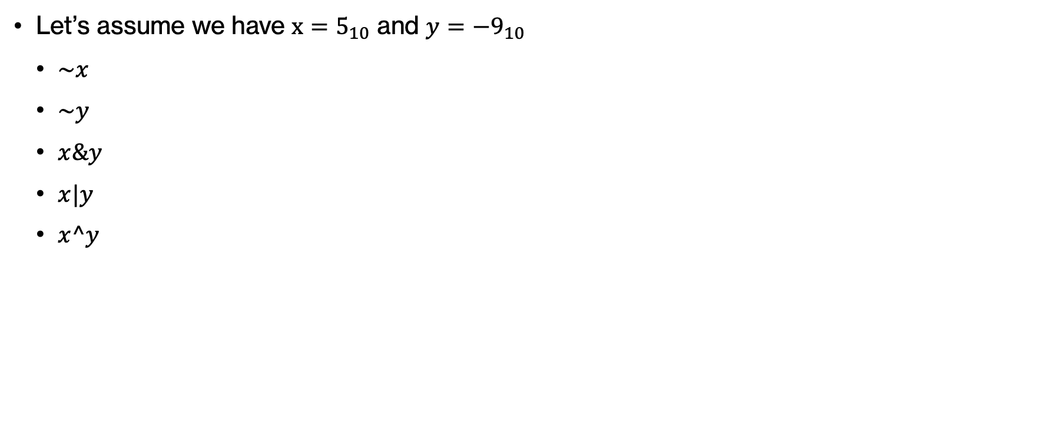
PRACTICE TIME – Bitwise operations
AND (&)
NOT (~)
X | Y | X ∧ Y
0 | 0 | 0
0 | 1 | 0
1 | 0 | 0
1 | 1 | 1
Let’s assume we have $x=5_{10}$ and ${y=−9_{10}}_{ }$
  $\sim x$
  $\sim y$
  $x\&y$
  $x|y$
  $x^y$
X | ¬ X
0 | 1
1 | 0
OR (|)
XOR (^)
X | Y | X ∨ Y
0 | 0 | 0
0 | 1 | 1
1 | 0 | 1
1 | 1 | 1
X | Y | X ⊕ Y
0 | 0 | 0
0 | 1 | 1
1 | 0 | 1
1 | 1 | 0
Notes:
Let's check our understanding with these two numbers.

Slide 42
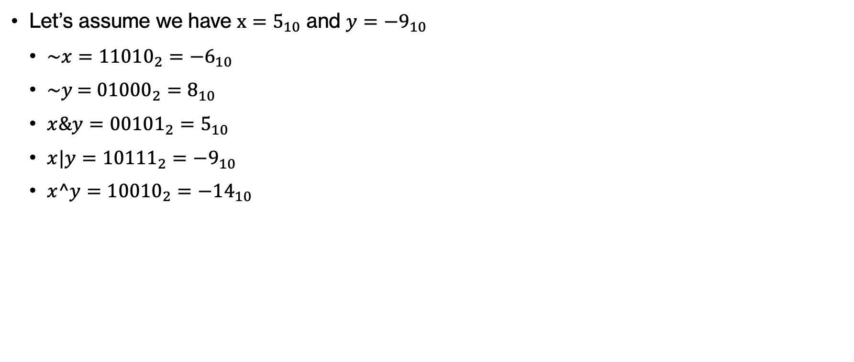
ANSWER – Bitwise operations
AND (&)
NOT (~)
X | Y | X ∧ Y
0 | 0 | 0
0 | 1 | 0
1 | 0 | 0
1 | 1 | 1
Let’s assume we have $x=5_{10}$ and ${y=−9_{10}}_{ }$
  $\sim x={11010}_{2}=−6_{10}$
  $\sim y$ = ${01000}_{2}=8_{10}$
  $x\&y={00101}_{2}=5_{10}$
  $x|y={10111}_{2}={−9}_{10}$
  $x^y={10010}_{2}=−{14}_{10}$
X | ¬ X
0 | 1
1 | 0
OR (|)
XOR (^)
X | Y | X ∨ Y
0 | 0 | 0
0 | 1 | 1
1 | 0 | 1
1 | 1 | 1
X | Y | X ⊕ Y
0 | 0 | 0
0 | 1 | 1
1 | 0 | 1
1 | 1 | 0
42
Notes:
Did you get these results?

Slide 43
Masking
We can use bitwise operations to mask a certain number of bits in a number.
By masking, we can reset, set, or invert certain bits in a number.
Bitwise AND will reset a subset of the bits to 0
Bitwise OR will set a subset of the bits to 1
Bitwise XOR will invert a subset of the bits
Notes:
Bitwise operations often go hand in hand with masking. When we apply a mask on an input, we isolate certain bits and reset them to 0 (logical AND), set them to 1 (logical OR) or invert them (XOR). We will see each one with examples and an opportunity to practice.

Slide 44
Bitwise AND – Resetting bits to 0
We want to reset the three least significant bits to 0
Bit | 6th | 5th | 4th | 3rd | 2nd | 1st | 0th
Data | 0/1 | 0/1 | 0/1 | 0/1 | 0/1 | 0/1 | 0/1
Mask
Result
&
What number should we bitwise-AND (&) to do this?
Notes:
Say we have a 7-bit number and want to reset the three least significant (right-most) bits to 0. What number should we bitwise-AND to do this?

Slide 45
Bitwise AND – Resetting bits to 0
We want to reset the three least significant bits to 0
Bit | 6th | 5th | 4th | 3rd | 2nd | 1st | 0th
Data | 0/1 | 0/1 | 0/1 | 0/1 | 0/1 | 0/1 | 0/1
Mask | 1 | 1 | 1 | 1 | 0 | 0 | 0
Result
&
What number should we bitwise-AND (&) to do this?
Notes:
We'd need 1111 in the first 4 bits, and 000 in the three bits, resulting to the number 1111000

Slide 46
Bitwise AND – Resetting bits to 0
We want to reset the three least significant bits to 0
Bit | 6th | 5th | 4th | 3rd | 2nd | 1st | 0th
Data | 0/1 | 0/1 | 0/1 | 0/1 | 0/1 | 0/1 | 0/1
Mask | 1 | 1 | 1 | 1 | 0 | 0 | 0
Result
&
What number is this in decimal?
Notes:
What number is this in decimal?

Slide 47
Bitwise AND – Resetting bits to 0
We want to reset the three least significant bits to 0
Bit | 6th | 5th | 4th | 3rd | 2nd | 1st | 0th
Data | 0/1 | 0/1 | 0/1 | 0/1 | 0/1 | 0/1 | 0/1
Mask | 1 | 1 | 1 | 1 | 0 | 0 | 0
Result
&
-8₁₀
What number is this in decimal?
Notes:
It's -10. Here's a trick, you can ignore all but the rightmost 1 for the sign and then that's -8+0+0+0=-8.

Slide 48
Bitwise AND – Resetting bits to 0
Say we have 47 & -8. What's the result?
Bit | 6th | 5th | 4th | 3rd | 2nd | 1st | 0th
Data | 0 | 1 | 0 | 1 | 1 | 1 | 1
Mask | 1 | 1 | 1 | 1 | 0 | 0 | 0
Result | 0 | 1 | 0 | 1 | 0 | 0 | 0
47₁₀
&
-8₁₀
Notes:
Say we now try to apply a mask to reset the last three bits of the number 47, that is we apply 47&-8. What's the result?

Slide 49
Bitwise AND – Resetting bits to 0
Say we have 47 & -8. What's the result?
Bit | 6th | 5th | 4th | 3rd | 2nd | 1st | 0th
Data | 0 | 1 | 0 | 1 | 1 | 1 | 1
Mask | 1 | 1 | 1 | 1 | 0 | 0 | 0
Result | 0 | 1 | 0 | 1 | 0 | 0 | 0
47₁₀
&
-8₁₀
40₁₀
Notes:
It should be 0101000 or 40 in decimal.

Slide 50
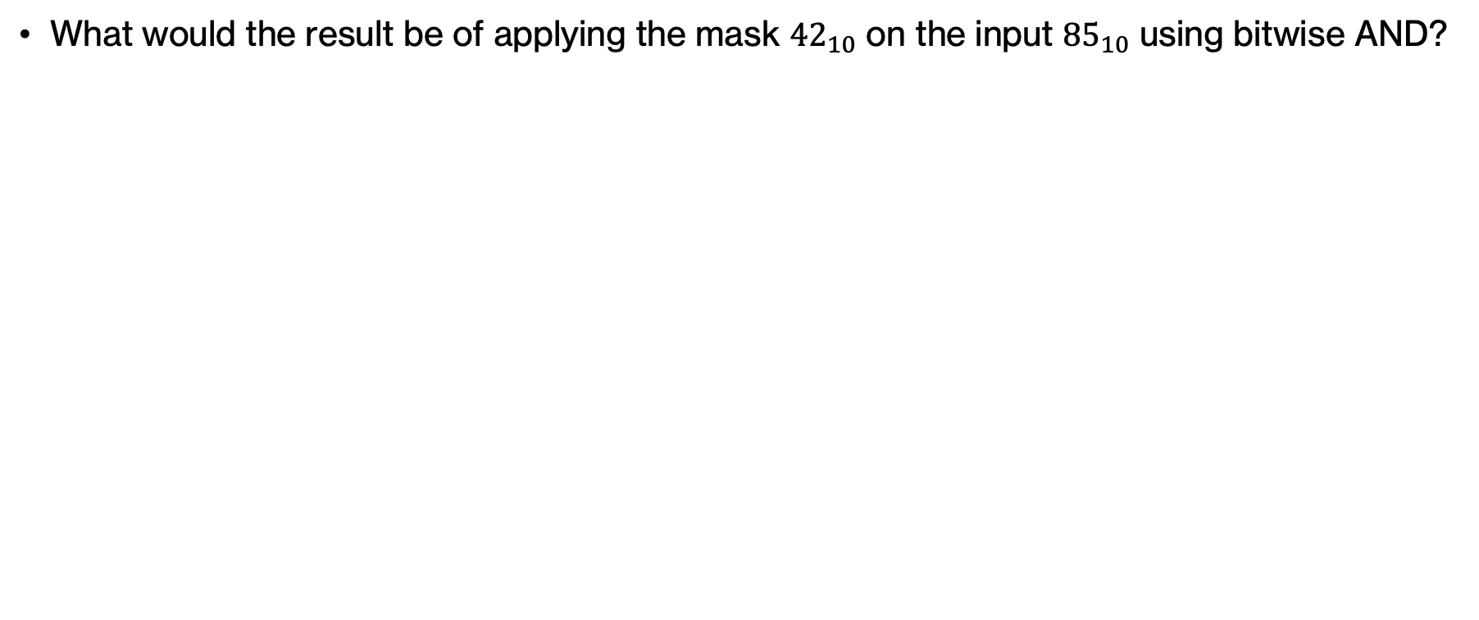
PRACTICE TIME - Bitwise AND
What would the result be of applying the mask ${42}_{10}$ on the input ${85}_{10}$ using bitwise AND?
Notes:
Your turn. Start by converting 42 and 85 to binary before you apply bitwise AND. What was its effects on the bits? What will the result be in decimal?

Slide 51
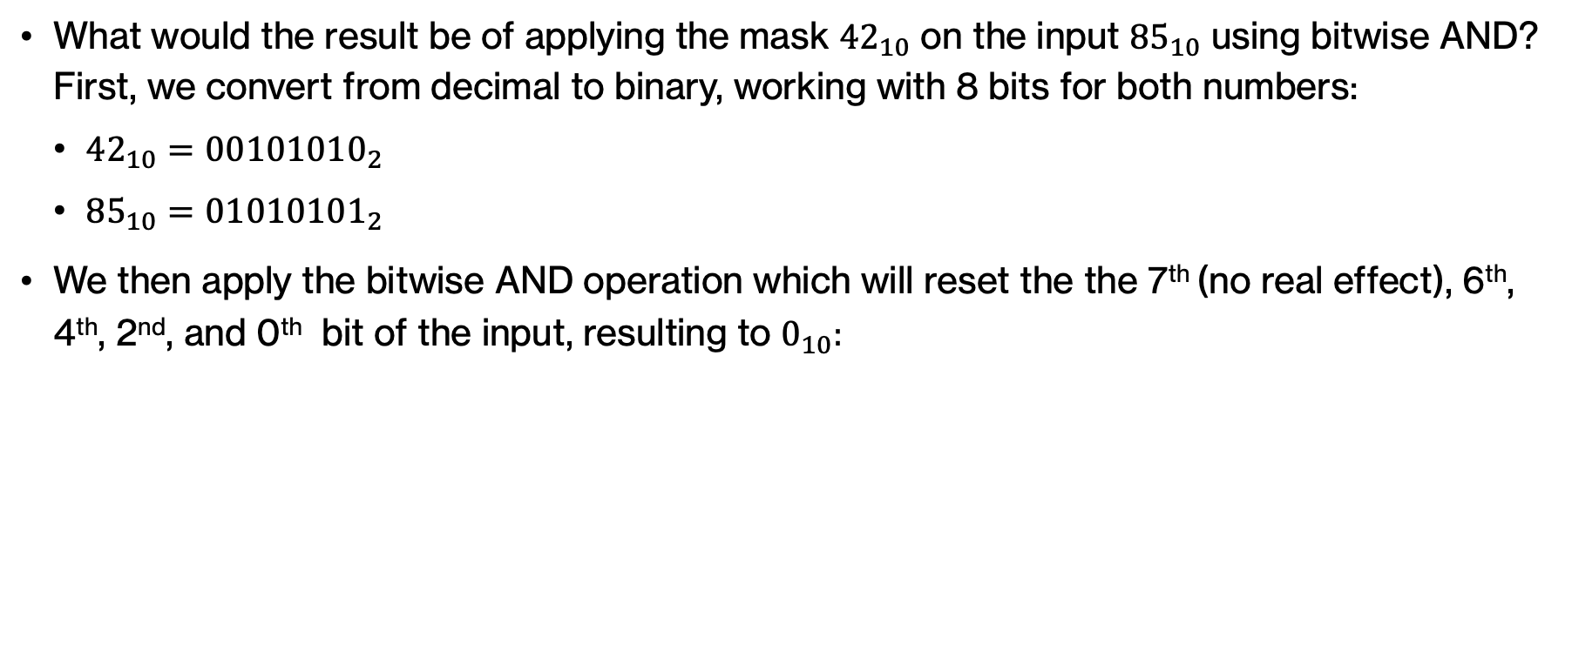
ANSWER - Bitwise AND
What would the result be of applying the mask ${42}_{10}$ on the input ${85}_{10}$ using bitwise AND? First, we convert from decimal to binary, working with 8 bits for both numbers:
  ${42}_{10}={00101010}_{2}$
  ${85}_{10}={01010101}_{2}$
We then apply the bitwise AND operation which will reset the the 7th (no real effect), 6th, 4th, 2nd, and 0th bit of the input, resulting to $0_{10}:$
Bit | 7th | 6th | 5th | 4th | 3rd | 2nd | 1st | 0th
Data | 0 | 1 | 0 | 1 | 0 | 1 | 0 | 1
Mask | 0 | 0 | 1 | 0 | 1 | 0 | 1 | 0
Result | 0 | 0 | 0 | 0 | 0 | 0 | 0 | 0
85₁₀
&
42₁₀
0₁₀
Notes:
Don't forget that since we are working with positive numbers we'd need 8 bits for 85. And since 42 can be described with 7 bits, we'd need to extend the sign by adding an extra 0.

Slide 52
Bitwise OR – Setting bits to 1
We want to set the two most significant bits to 1
Bit | 6th | 5th | 4th | 3rd | 2nd | 1st | 0th
Data | 0/1 | 0/1 | 0/1 | 0/1 | 0/1 | 0/1 | 0/1
Mask
Result
I
What number should we bitwise-OR (|) to do this?
Notes:
Say we have a 7-bit number and want to set the two most significant (left-most) bits to 1. What number should we bitwise-OR to do this?

Slide 53
Bitwise OR – Setting bits to 1
We want to set the two most significant bits to 1
Bit | 6th | 5th | 4th | 3rd | 2nd | 1st | 0th
Data | 0/1 | 0/1 | 0/1 | 0/1 | 0/1 | 0/1 | 0/1
Mask | 1 | 1 | 0 | 0 | 0 | 0 | 0
Result
|
What number should we bitwise-OR (|) to do this?
Notes:
We'd need 11 in the first 2 bits, and 00000 in the next five bits, resulting to the number 1100000

Slide 54
Bitwise OR – Setting bits to 1
We want to set the two most significant bits to 1
Bit | 6th | 5th | 4th | 3rd | 2nd | 1st | 0th
Data | 0/1 | 0/1 | 0/1 | 0/1 | 0/1 | 0/1 | 0/1
Mask | 1 | 1 | 0 | 0 | 0 | 0 | 0
Result
|
What number is this in decimal?
Notes:
What number is this in decimal?

Slide 55
Bitwise OR – Setting bits to 1
We want to set the two most significant bits to 1
Bit | 6th | 5th | 4th | 3rd | 2nd | 1st | 0th
Data | 0/1 | 0/1 | 0/1 | 0/1 | 0/1 | 0/1 | 0/1
Mask | 1 | 1 | 0 | 0 | 0 | 0 | 0
Result
-32₁₀
|
What number is this in decimal?
Notes:
It's -32. Here's a trick, you can ignore all but the rightmost 1 for the sign and then that's -32

Slide 56
Bitwise OR – Setting bits to 1
Say we have 47 | - 32. What's the result?
Bit | 6th | 5th | 4th | 3rd | 2nd | 1st | 0th
Data | 0 | 1 | 0 | 1 | 1 | 1 | 1
Mask | 1 | 1 | 0 | 0 | 0 | 0 | 0
Result | 1 | 1 | 0 | 1 | 1 | 1 | 1
47₁₀
|
-32₁₀
Notes:
Say we have 47 | -32. What's the result?

Slide 57
Bitwise OR – Setting bits to 1
Say we have 47 | -32. What's the result?
Bit | 6th | 5th | 4th | 3rd | 2nd | 1st | 0th
Data | 0 | 1 | 0 | 1 | 1 | 1 | 1
Mask | 1 | 1 | 0 | 0 | 0 | 0 | 0
Result | 1 | 1 | 0 | 1 | 1 | 1 | 1
47₁₀
-32₁₀
|
-17₁₀
Notes:
It should be 1101111 or -17 in decimal.

Slide 58
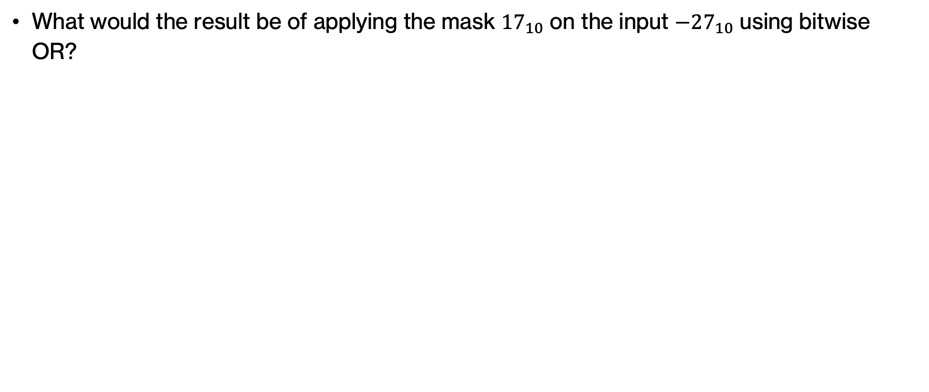
PRACTICE TIME - Bitwise OR
What would the result be of applying the mask ${17}_{10}$ on the input ${−27}_{10}$ using bitwise OR?
Notes:
Your turn! As before, convert 17 and -27 to binary (using signed extension for two's complement) .

Slide 59
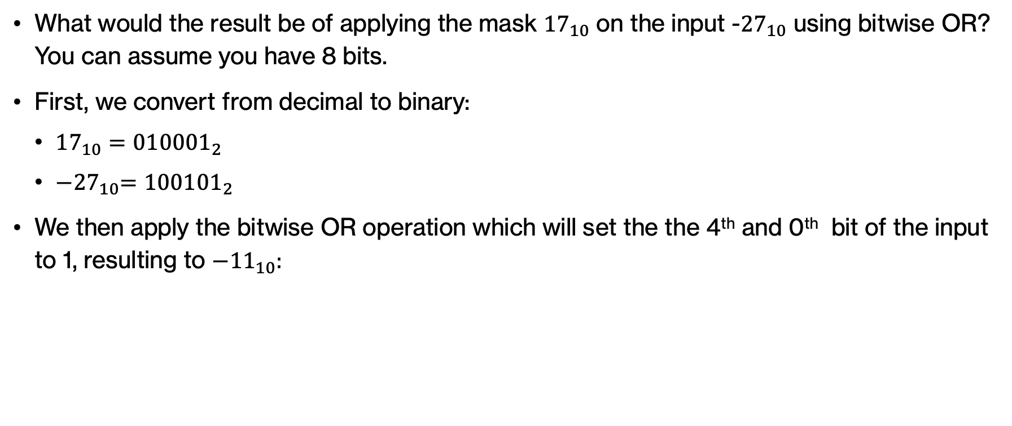
ANSWER - Bitwise OR
What would the result be of applying the mask ${17}_{10}$ on the input -${27}_{10}$ using bitwise OR? You can assume you have 8 bits.
First, we convert from decimal to binary:
  ${17}_{10}={010001}_{2}$
  ${−27}_{10}={100101}_{2}$
We then apply the bitwise OR operation which will set the the 4th and 0th bit of the input to 1, resulting to ${−11}_{10}:$
Bit | 5th | 4th | 3rd | 2nd | 1st | 0th
Data | 1 | 0 | 0 | 1 | 0 | 1
Mask | 0 | 1 | 0 | 0 | 0 | 1
Result | 1 | 1 | 0 | 1 | 0 | 1
-27₁₀
17₁₀
|
-11₁₀
Notes:
This will result in the 4th and 0th bit being set to 1.

Slide 60
Bitwise XOR – Inverting bits
We want to invert the two most and two least significant bits.
Bit | 7th | 6th | 5th | 4th | 3rd | 2nd | 1st | 0th
Data | 0/1 | 0/1 | 0/1 | 0/1 | 0/1 | 0/1 | 0/1 | 0/1
Mask
Result
^
What number should we bitwise-XOR (^) to do this?
Notes:
Say we have a 7-bit number and want to invert the two most significant (left-most) and two least significant (right-most) bits. What number should we bitwise-XOR to do this?

Slide 61
Bitwise XOR – Inverting bits
We want to invert the two most and two least significant bits.
Bit | 7th | 6th | 5th | 4th | 3rd | 2nd | 1st | 0th
Data | 0/1 | 0/1 | 0/1 | 0/1 | 0/1 | 0/1 | 0/1 | 0/1
Mask | 1 | 1 | 0 | 0 | 0 | 0 | 1 | 1
Result
^
What number should we bitwise-XOR (^) to do this?
Notes:
We'd need 11 in the first and last 2 bits, that is 11000011

Slide 62
Bitwise XOR – Inverting bits
We want to invert the two most and two least significant bits.
Bit | 7th | 6th | 5th | 4th | 3rd | 2nd | 1st | 0th
Data | 0/1 | 0/1 | 0/1 | 0/1 | 0/1 | 0/1 | 0/1 | 0/1
Mask | 1 | 1 | 0 | 0 | 0 | 0 | 1 | 1
Result
^
What number is this in decimal?
Notes:
What number is this in decimal?

Slide 63
Bitwise XOR – Inverting bits
We want to invert the two most and two least significant bits.
Bit | 7th | 6th | 5th | 4th | 3rd | 2nd | 1st | 0th
Data | 0/1 | 0/1 | 0/1 | 0/1 | 0/1 | 0/1 | 0/1 | 0/1
Mask | 1 | 1 | 0 | 0 | 0 | 0 | 1 | 1
Result
-61₁₀
^
What number is this in decimal?
Notes:
It's -61. Here's a trick, you can ignore all but the rightmost 1 for the sign and then that's -64+2+1=-61

Slide 64
Bitwise XOR – Inverting bits
Say we have 117 ^ -61. What's the result?
117₁₀
Bit | 7th | 6th | 5th | 4th | 3rd | 2nd | 1st | 0th
Data | 0 | 1 | 1 | 1 | 0 | 1 | 0 | 1
Mask | 1 | 1 | 0 | 0 | 0 | 0 | 1 | 1
Result
-61₁₀
^
Notes:
Say we have 117 ^ -61. What's the result?

Slide 65
Bitwise XOR – Inverting
Say we have 117 ^ -61. What's the result?
117₁₀
Bit | 7th | 6th | 5th | 4th | 3rd | 2nd | 1st | 0th
Data | 0 | 1 | 1 | 1 | 0 | 1 | 0 | 1
Mask | 1 | 1 | 0 | 0 | 0 | 0 | 1 | 1
Result | 1 | 0 | 1 | 1 | 0 | 1 | 1 | 0
-61₁₀
^
-74₁₀
Notes:
It should be 10110110 or -128+32+16+4+2=-74 in decimal.

Slide 66
Digital logic mysteries
Bitwise operations can be quite useful in digital logic and can make code both more concise and faster.
  We can represent many Boolean values with a single integer (e.g., in memory constrained environments)
  Are fast, so can speed up computation (if you can pose your problem as a bitwise operation)
  Interacting with low-level hardware
Next assignment will give you more practice with bitwise operations.
In the meantime, let’s work on some mystery functions.
Notes:
Bitwise operations can be quite useful in digital logic and can make code both more concise and faster.
This week's assignment will give you more practice with bitwise operations.
In the meantime, let’s work on some mystery functions. You want to try different numbers to come up with theories of what they do.

Slide 67
PRACTICE TIME - Mystery 1
What does the following Python function do?
def mystery1(a, b):
return (a ^ b) == 0
Notes:
Think, what type will this function return? If you assume a and b are integers, what are good inputs to test? When would the result of applying a bitwise xor result to the decimal number 0?

Slide 68
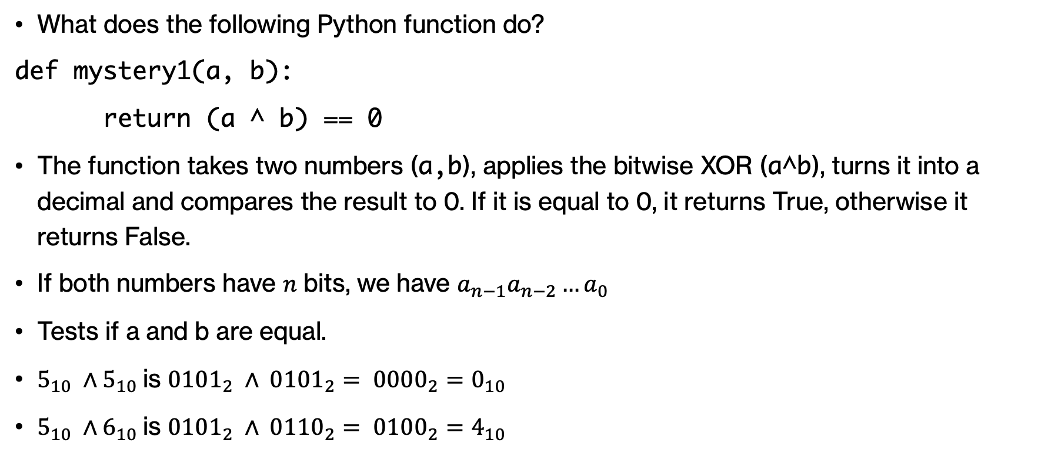
ANSWER - Mystery 1
What does the following Python function do?
def mystery1(a, b):
return (a ^ b) == 0
The function takes two numbers (a,b), applies the bitwise XOR (a^b), turns it into a decimal and compares the result to 0. If it is equal to 0, it returns True, otherwise it returns False.
If both numbers have $n$ bits, we have $a_{n−1}a_{n−2}…a_{0}$
Tests if a and b are equal.
$5_{10} ∧5_{10}$is ${0101}_{2} ∧ {0101}_{2}= {0000}_{2}=0_{10}$
$5_{10} ∧6_{10}$is ${0101}_{2} ∧ {0110}_{2}= {0100}_{2}=4_{10}$
Notes:
The function returns a bool. It seems like it's converting the result of the XOR bitwise operation on a and b to a decimal number and comparing it against 0. 0 in decimal is 0000…0 in binary. For the result of a bitwise XOR operation to always be 0, we would need every single bit we compare between the two numbers to be equal.

Slide 69
PRACTICE TIME - Mystery 2
What does the following Python function do? You can assume we are working with 4 bits
def mystery2(a):
return (a & (1<<3)) != 0
Notes:
Again, what is the return type? Try a few different inputs for a.

Slide 70
ANSWER - Mystery 2
What does the following Python function do? You can assume we are working with 4 bits
def mystery2(a):
return (a & (1<<3)) != 0
Checks whether a is negative by isolating the MSB.
Notes:
Don't forget that if you have an n-bit number, the MSB would be at the n-1 bit (starting 0 to the right and advancing to the left)

Slide 71
PRACTICE TIME - Mystery 3
What does the following Python function do?
def mystery3(a,b):
return (a & (1<<b)) != 0
Notes:
This should feel very familiar. The only thing we changed is 3 to b.

Slide 72
ANSWER - Mystery 3
What does the following Python function do?
def mystery3(a,b):
return (a & (1<<b)) != 0
Tests if the b-th bit in a is 1.
Notes:
So now we test the b-th bit, not necessarily the MSB. Ideally, we should have checked that b is within the n bits that a has but that's a bit complicated in languages like Python.

Slide 73
PRACTICE TIME - Mystery 4
What does the following Python function do?
def mystery4(a):
return a | 1
Notes:
Last head scratcher. What does this super concise function do? Let's start by realizing that it does not return a bool but a decimal number

Slide 74
ANSWER - Mystery 4
What does the following Python function do?
def mystery4(a):
return a | 1
If a is even, it returns a+1, if a is odd, it leaves it unchanged.
Notes:
Cool, huh?

Slide 75
Beyond numbers

Slide 76
Representing information
So far, we have seen that computers store information in bits and we have interpreted these bits as integers.
But what about non-integer numbers, such as floating-point numbers, or any other type of information, such as letters, emojis, colors, sound etc?
There are different international standards that determine how binary is encoded into other representations.
Notes:
So far, we have seen that computers store information in bits and we have interpreted these bits as integers.
But what about non-integer numbers, such as floating-point numbers, or any other type of information, such as letters, emojis, colors, sound etc?
There are different international standards that determine how binary is encoded into other representations.

Slide 77
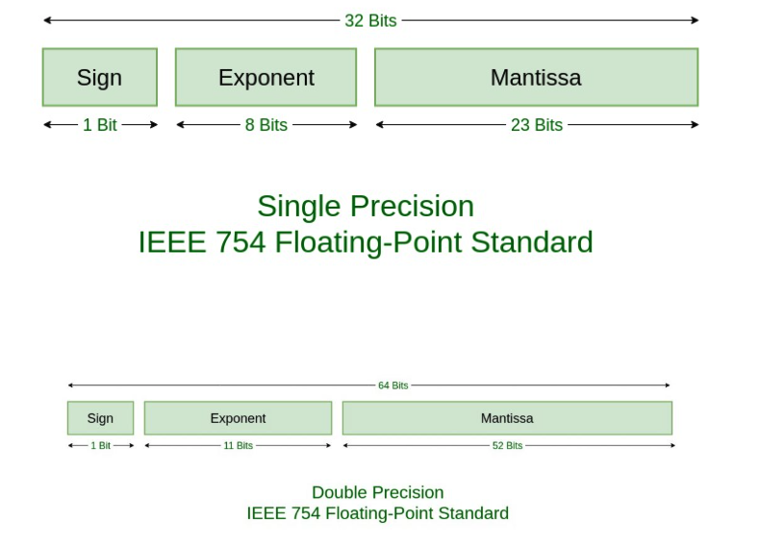
Floating point numbers
Notes:
For example, the most used standard to encode real numbers is the IEEE 754 standard.
But under the hood, it’s all bits!

Slide 78
Encoding text - ASCII
ASCII (American Standard Code for Information Interchange) which was established in the ‘60s and used 7 bits to represent 128 characters: These included the capital and lowercase letters of the English alphabet, digits 0-9, punctuation and special symbols like @.
  For example, 01000011 01010011 00110101 00110001 00100001 represents the text “CS51!”
ASCII was adopted by different computer manufacturers ensuring interoperability.
Soon an 8th bit was used to expand the available set to 255 characters.
In the US, this was used for accented characters and mathematical symbols and many other languages used these extra characters to encode their own alphabets.
But that meant that text written in different languages encoded to gibberish when read in a different context.
Notes:
ASCII (American Standard Code for Information Interchange) which was established in the ‘60s and used 7 bits to represent 128 characters: These included the capital and lowercase letters of the English alphabet, digits 0-9, punctuation and special symbols like @.
For example, 01000011 01010011 00110101 00110001 00100001 represents the text “CS51!”
ASCII was adopted by different computer manufacturers ensuring interoperability.
Soon an 8th bit was used to expand the available set to 255 characters.
In the US, this was used for accented characters and mathematical symbols and many other languages used these extra characters to encode their own alphabets.
But that meant that text written in different languages encoded to gibberish when read in a different context.

Slide 79
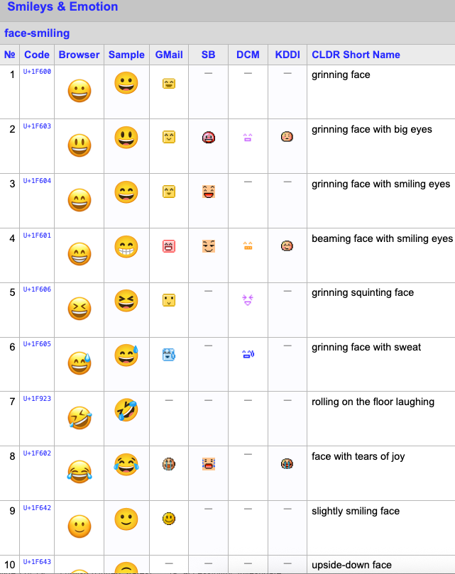
Encoding text - Unicode
In 1990s, Unicode expanded encoding to thousands of characters to account for all different schemes individual languages used and even includes emojis!
The most common implementations of Unicode are UTF-8 , which was designed for backward compatibility with ASCII, and UTF-16.
Notes:
In 1990s, Unicode expanded encoding to thousands of characters to account for all different schemes individual languages used and even includes emojis!
The most common implementations of Unicode are UTF-8 ,which was designed for backward compatibility with ASCII, and UTF-16.

Slide 80

How is an image represented?
Notes:
Say we have a picture of Homer. How are images represented?

Slide 81
How is an image represented?
images are made up of pixels
for a color image, each pixel corresponds to an RGB value (i.e. three numbers)
Notes:
Images are made up of pixels so we can think of them as a grid of pixels where each cell corresponds to an RGB value.

Slide 82
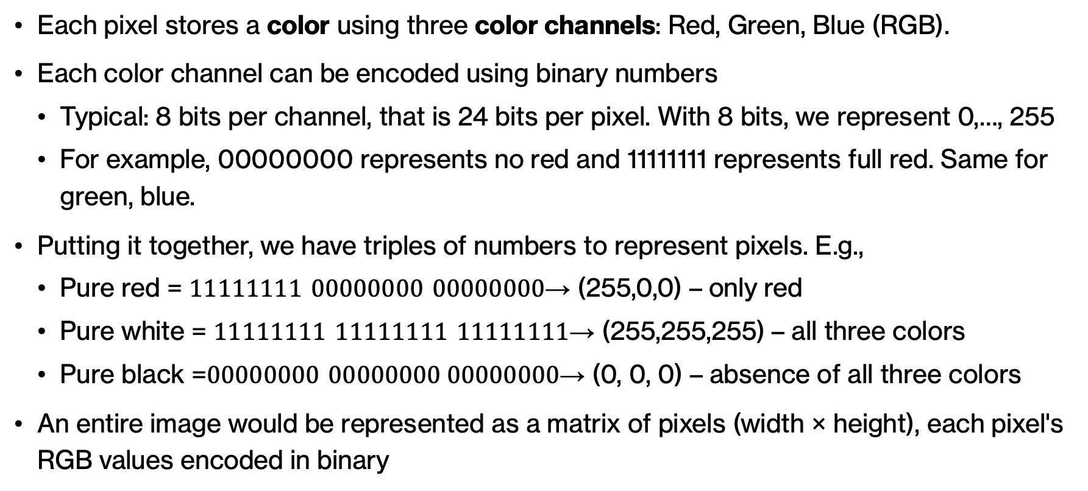
Encoding images
Each pixel stores a color using three color channels: Red, Green, Blue (RGB).
Each color channel can be encoded using binary numbers
  Typical: 8 bits per channel, that is 24 bits per pixel. With 8 bits, we represent 0,…, 255
  For example, 00000000 represents no red and 11111111 represents full red. Same for green, blue.
Putting it together, we have triples of numbers to represent pixels. E.g.,
  Pure red = $11111111 00000000 00000000$→ (255,0,0) – only red
  Pure white = $11111111 11111111 11111111$→ (255,255,255) – all three colors
  Pure black =$00000000 00000000 00000000$→ (0, 0, 0) – absence of all three colors
An entire image would be represented as a matrix of pixels (width × height), each pixel's RGB values encoded in binary
Notes:
Images consist of pixels, the smallest image unit.
Each pixel stores a color using three color channels: Red, Green, Blue (RGB).
Each color channel can be encoded using binary numbers
Typical: 8 bits per channel, that is 24 bits per pixel. With 8 bits, we can represent 0,…, 255
For example, 00000000 represents no red and 11111111 represents full red. Same for green, blue.
Putting it together, we have triples of numbers to represent pixels. E.g.,
Pure red = $11111111 00000000 00000000$→ (255,0,0) – only red
Pure white = $11111111 11111111 11111111$→ (255,255,255) – all three colors
Pure black =$00000000 00000000 00000000$→ (0, 0, 0) – absence of all three colors
An entire image would be represented as a matrix of pixels (width × height), each pixel's RGB values encoded in binary

Slide 83
PRACTICE TIME - Encoding images
If we have 8 bits for each of the three color channels, how many colors can we support in a 24-bit RGB system?
Notes:
Let's think for a moment, if we have 8 bits for each of the three color channels, how many colors can we support in a 24-bit RGB system?

Slide 84
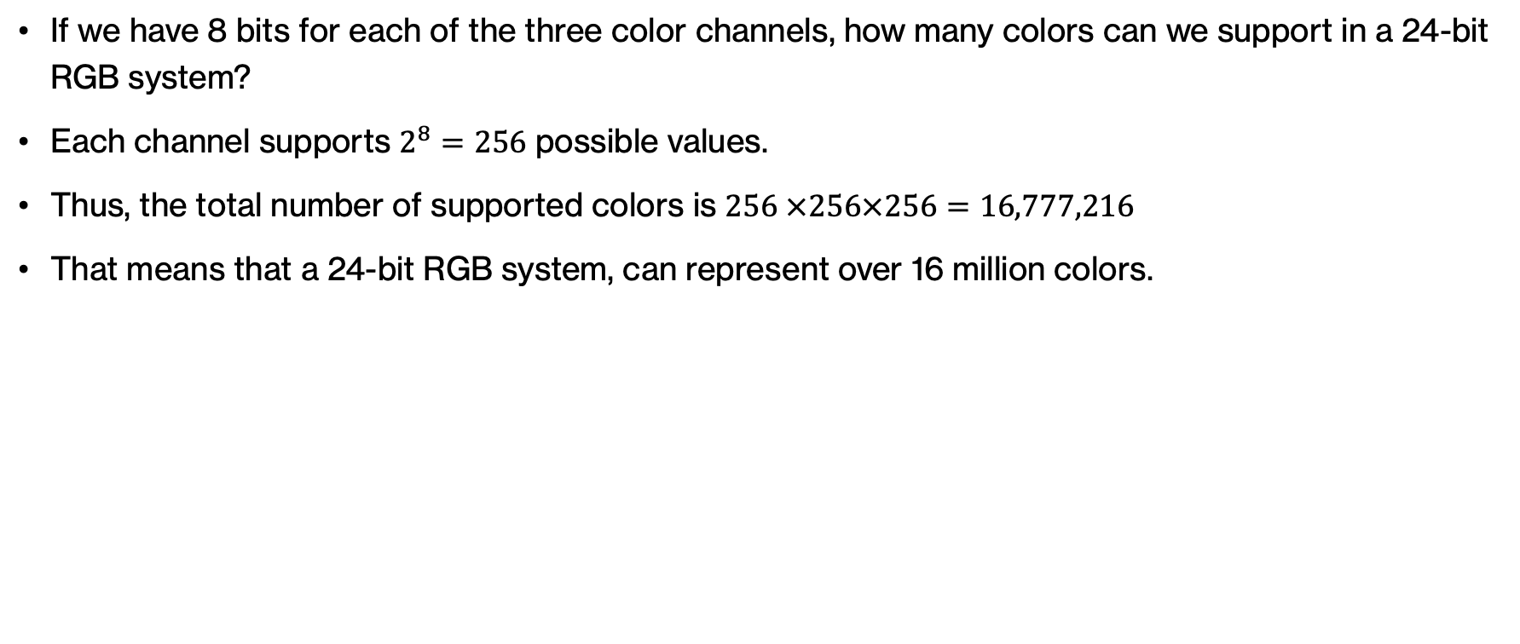
ANSWER - Encoding images
If we have 8 bits for each of the three color channels, how many colors can we support in a 24-bit RGB system?
Each channel supports $2^{8}=256$ possible values.
Thus, the total number of supported colors is $256 ×256×256=16,777,216$
That means that a 24-bit RGB system, can represent over 16 million colors.
Notes:
Each channel supports $2^{8}=256$ possible values.
Thus, the total number of supported colors is $256 ×256×256=16,777,216$
That means that a 24-bit RGB system can represent over 16 million colors.

Slide 85
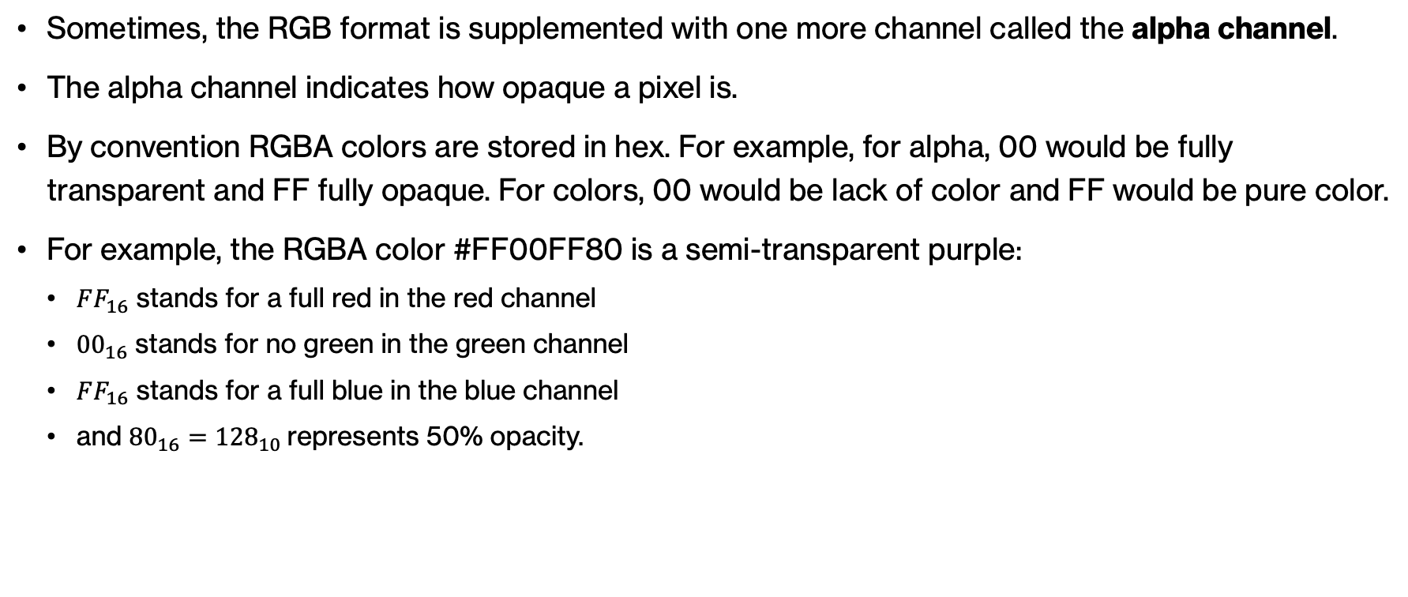
RGBA format
Sometimes, the RGB format is supplemented with one more channel called the alpha channel.
The alpha channel indicates how opaque a pixel is.
By convention RGBA colors are stored in hex. For example, for alpha, 00 would be fully transparent and FF fully opaque. For colors, 00 would be lack of color and FF would be pure color.
For example, the RGBA color #FF00FF80 is a semi-transparent purple:
  $FF_{16}$ stands for a full red in the red channel
  ${00}_{16}$ stands for no green in the green channel
  $FF_{16}$ stands for a full blue in the blue channel
  and ${80}_{16}={128}_{10}$represents 50% opacity.
Notes:
Beyond rbg, we often encode one more piece of information about pixels, their alpha value which stands for how opaque a pixel is. We typically work with hex numbers, that is 00 would be fully transparent for alpha or lack of color for rgb, and ff would be fully opaque for alpha and full on color for rgb. You can now see why #FF00FF80 is a semi transparent purple.

Slide 86
Practice Problems

Slide 87
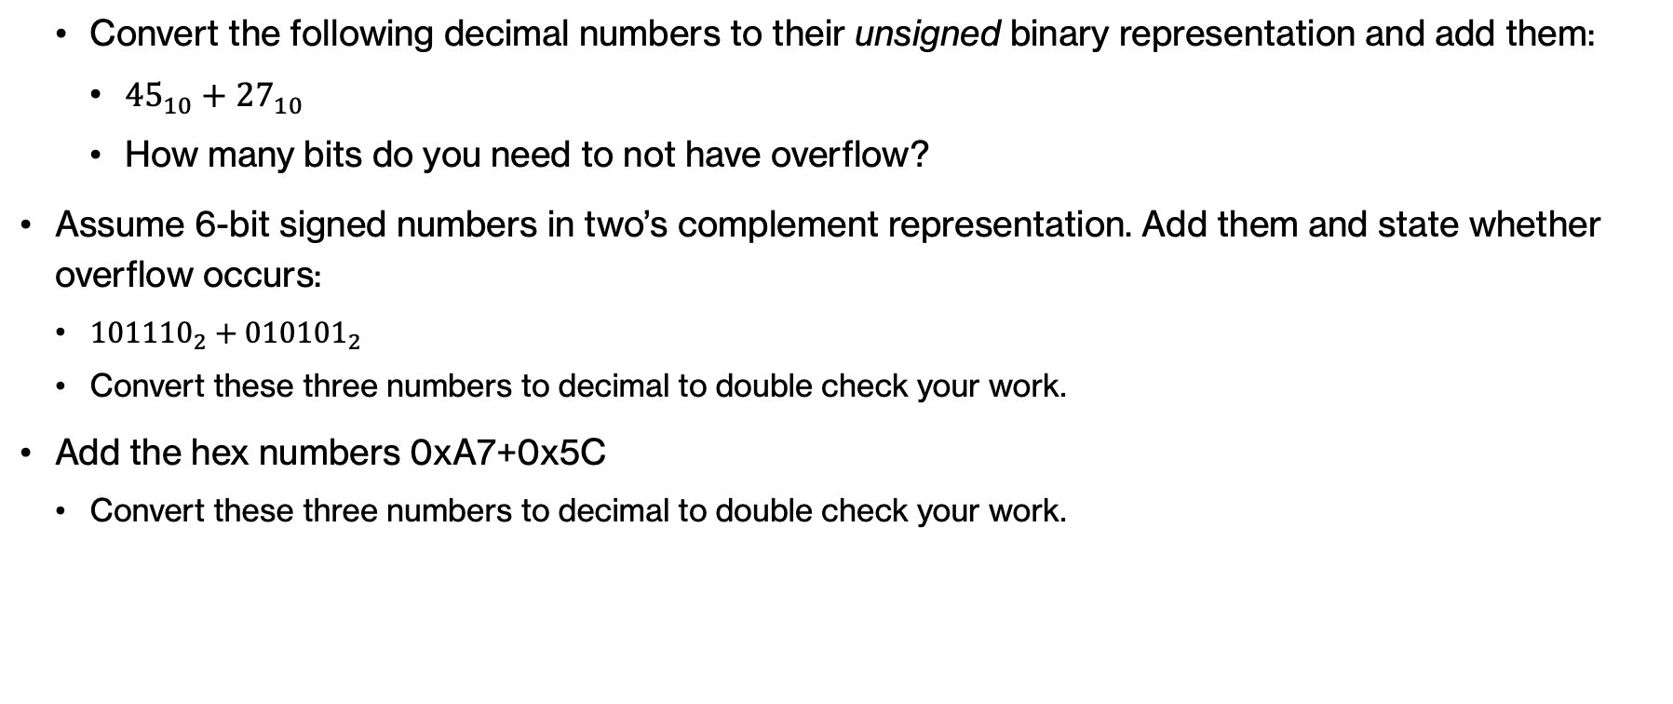
Practice Problems – Problem 1
  Convert the following decimal numbers to their unsigned binary representation and add them:
    ${45}_{10}+{27}_{10}$
    How many bits do you need to not have overflow?
Assume 6-bit signed numbers in two’s complement representation. Add them and state whether overflow occurs:
  ${101110}_{2}​+{010101}_{2}​$
  Convert these three numbers to decimal to double check your work.
Add the hex numbers 0xA7+0x5C
  Convert these three numbers to decimal to double check your work.

Slide 88
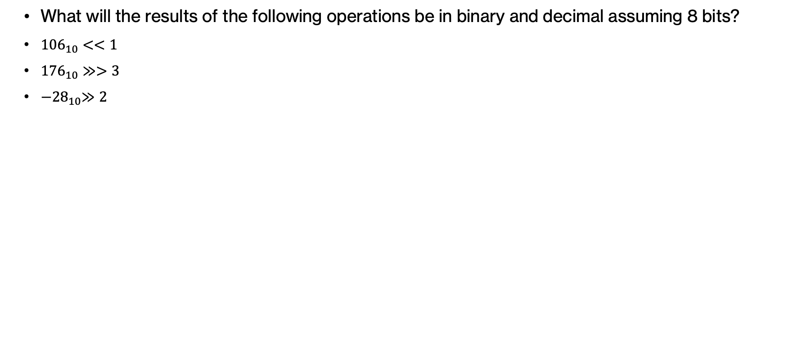
Practice Problems – Problem 2
  What will the results of the following operations be in binary and decimal assuming 8 bits?
  ${−28}_{10}≫2$

Slide 89
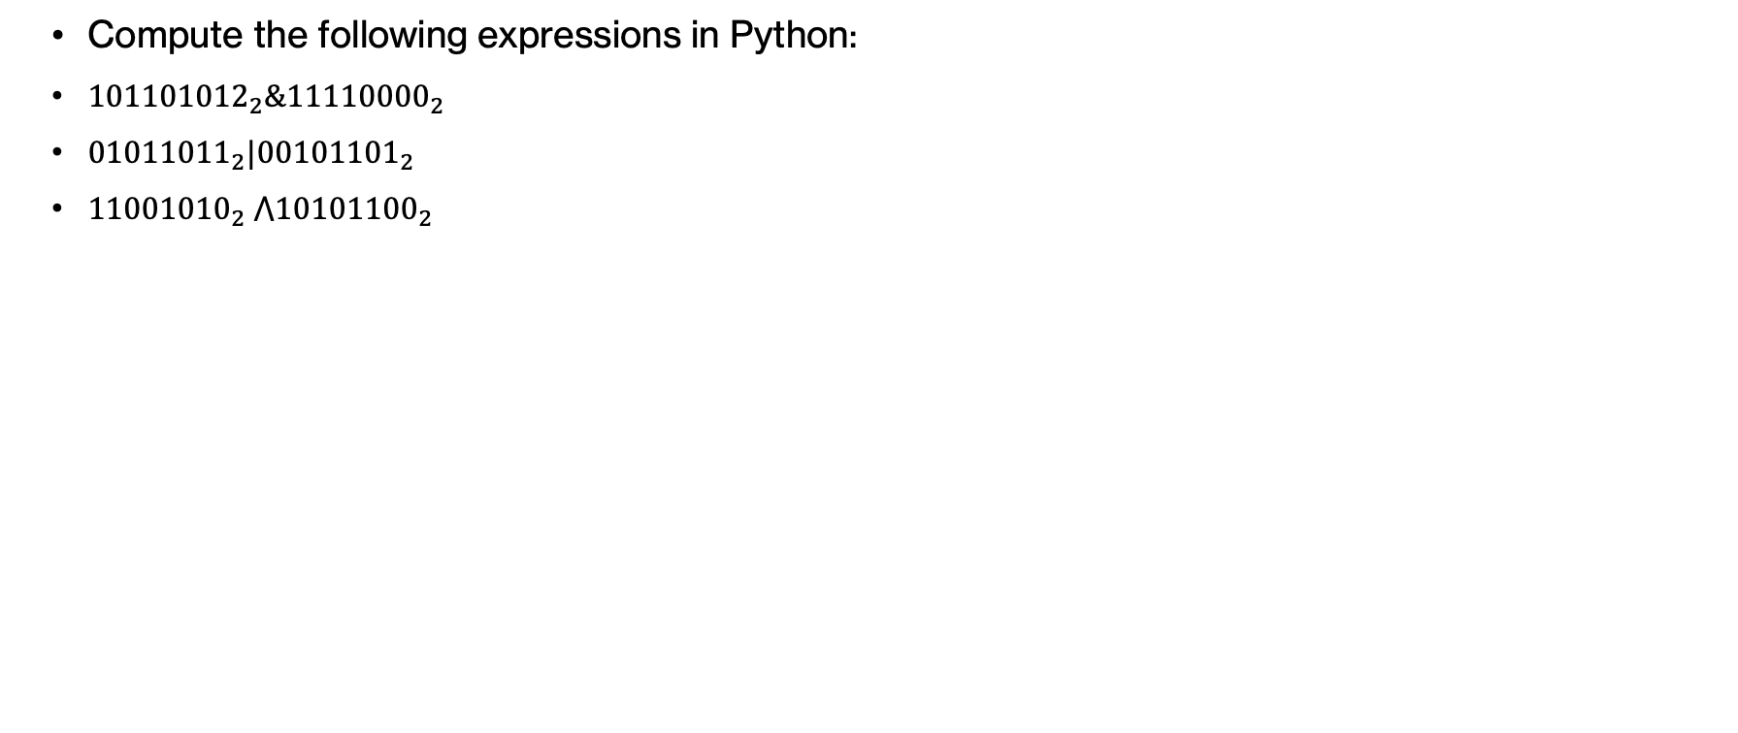
Practice Problems – Problem 3
  Compute the following expressions in Python:
  ${101101012}_{2}​\&{11110000}_{2}$
  ${01011011}_{2}|{00101101}_{2}$
  ${11001010}_{2} ⋀1{0101100}_{2}​$

Slide 90
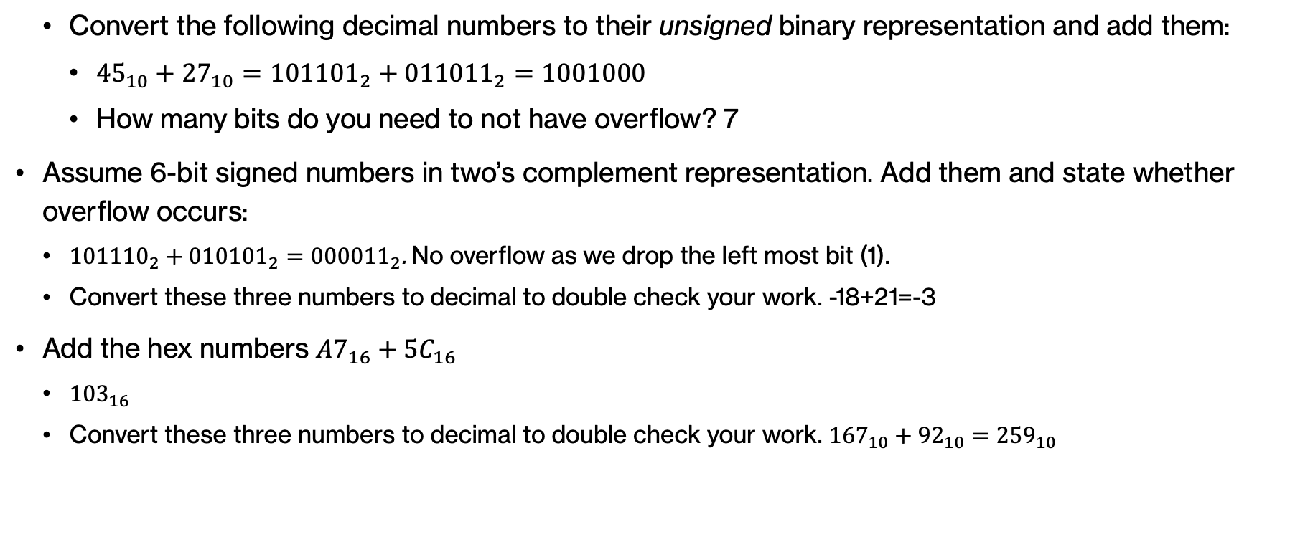
Practice Problems – Answer 1
  Convert the following decimal numbers to their unsigned binary representation and add them:
    ${45}_{10}+{27}_{10}={101101}_{2}+{011011}_{2}=1001000$
    How many bits do you need to not have overflow? 7
Assume 6-bit signed numbers in two’s complement representation. Add them and state whether overflow occurs:
  ${101110}_{2}​+{010101}_{2}​={000011}_{2}$. No overflow as we drop the left most bit (1).
  Convert these three numbers to decimal to double check your work. -18+21=-3
Add the hex numbers $A7_{16}+5C_{16}$
  ${103}_{16}$
  Convert these three numbers to decimal to double check your work. ${167}_{10}+{92}_{10}={259}_{10}$

Slide 91
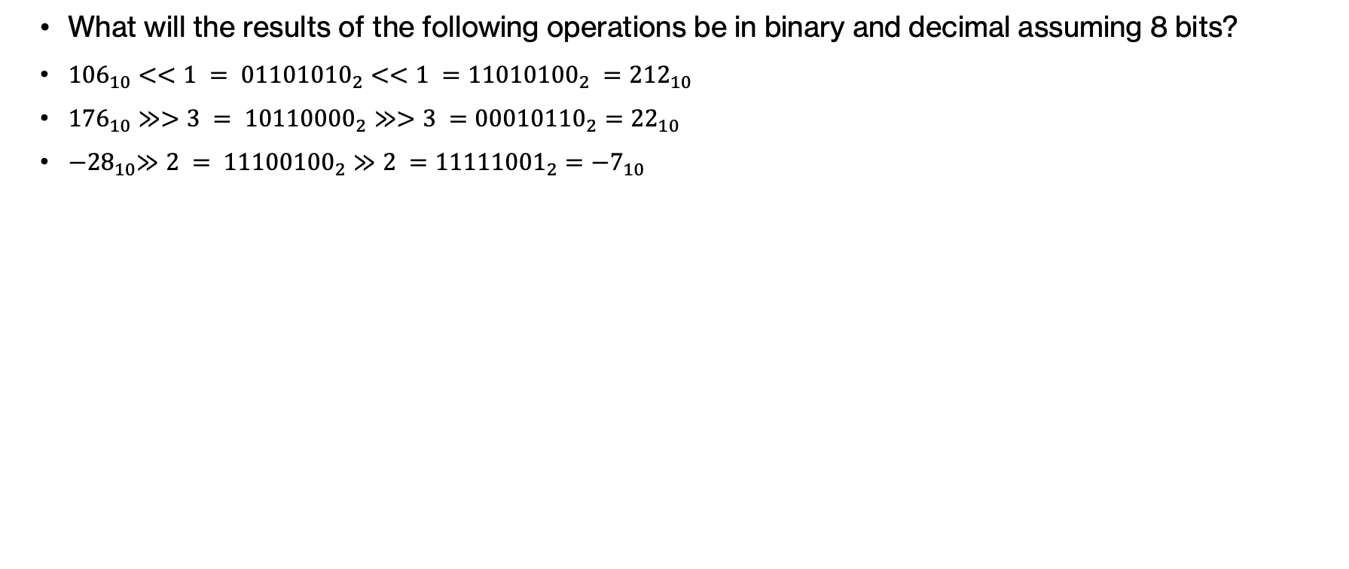
Practice Problems – Answer 2
  What will the results of the following operations be in binary and decimal assuming 8 bits?
  ${−28}_{10}≫2 = {11100100}_{2}≫2 ={11111001}_{2}={−7}_{10}$

Slide 92
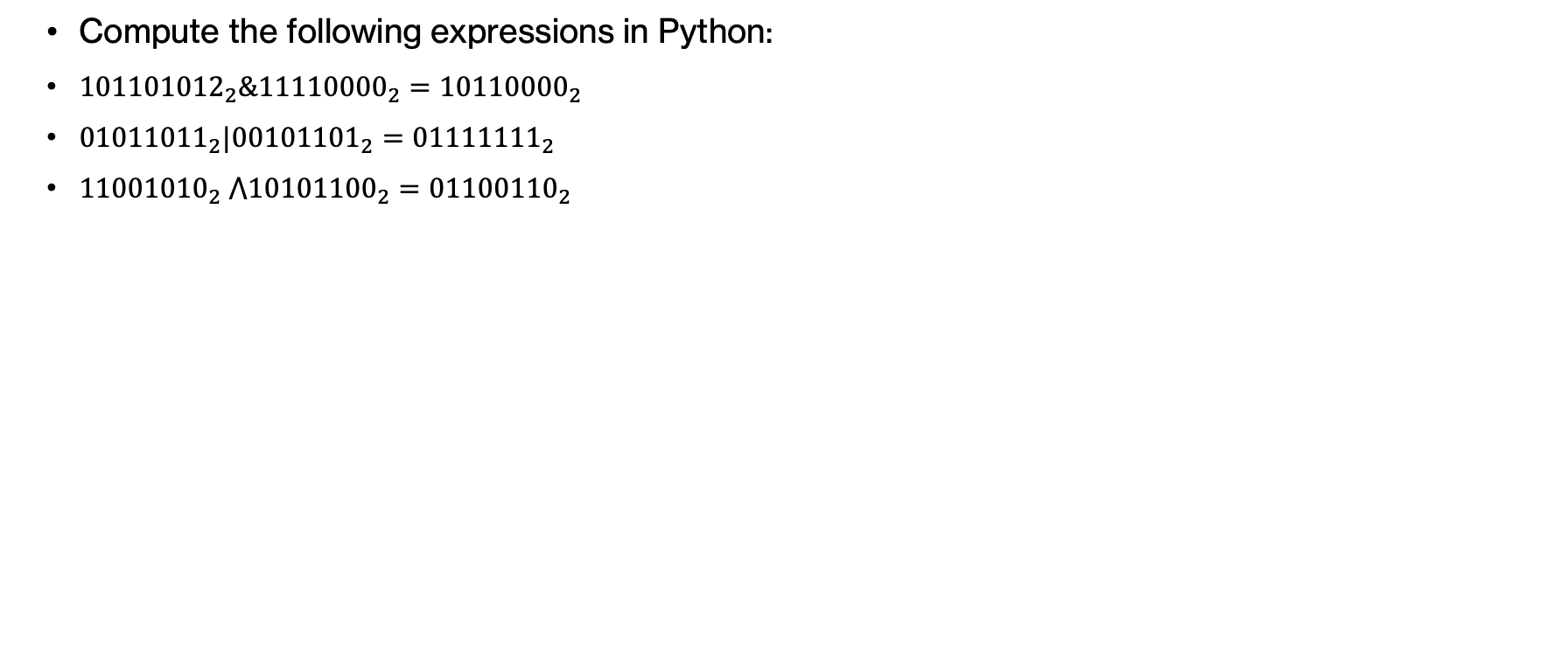
Practice Problems – Answer 3
  Compute the following expressions in Python:
  ${101101012}_{2}​\&{11110000}_{2}={10110000}_{2}$
  ${01011011}_{2}|{00101101}_{2}={01111111}_{2}$
  ${11001010}_{2} ⋀1{0101100}_{2}​={01100110}_{2}$

