Slide 1
Binary Arithmetic
Computer Systems
+
>>
CS51 – Fall 2026
-
01
Notes:
Last time, we saw that there are different numeral systems. We examined binary, decimal, and hexadecimal and learned how to convert a number from one representation to another. Today, we will focus on binary numbers alone and learn how to perform basic arithmetic with them

Slide 2
Addition
Notes:
How do we perform addition in decimal?

Slide 3
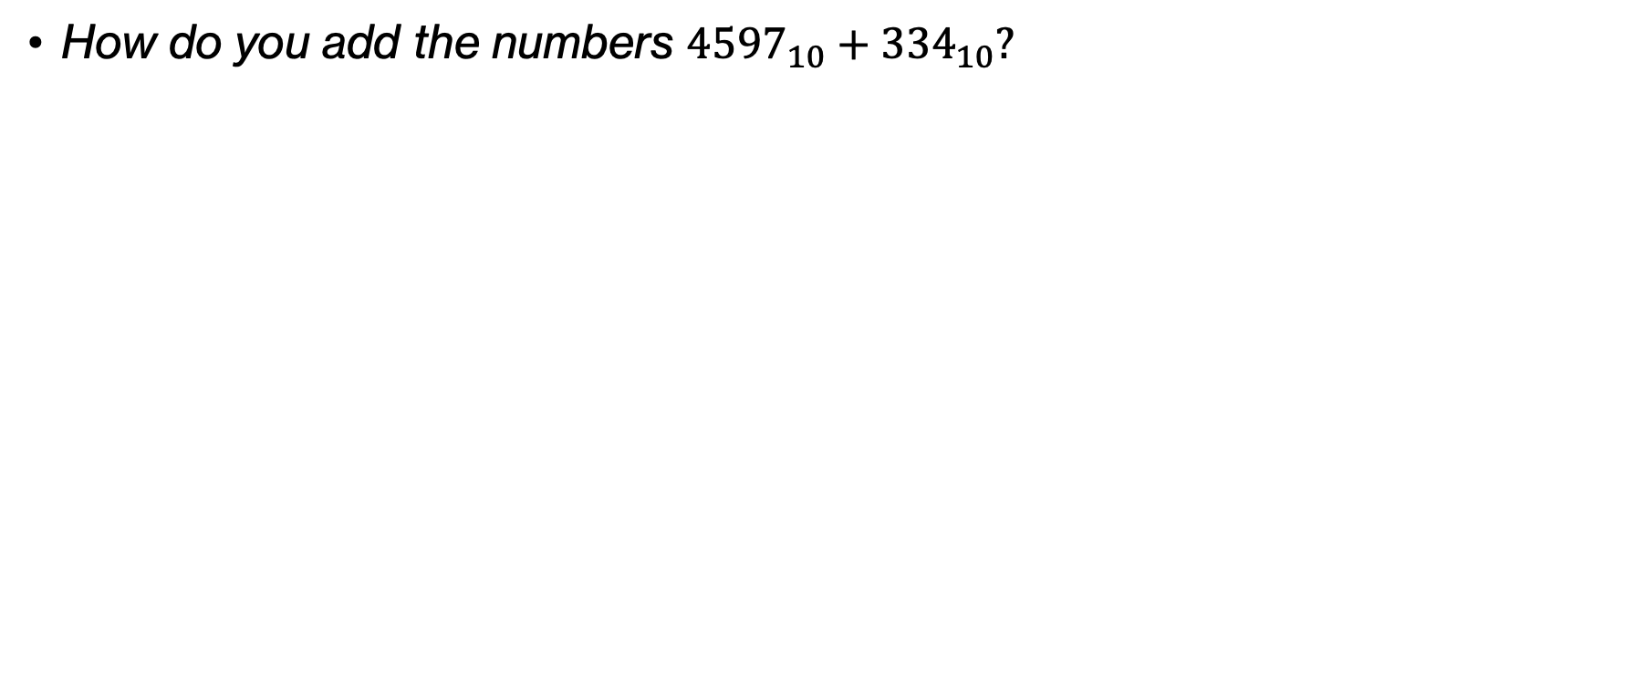
Think
How do you add the numbers ${4597}_{10}+{334}_{10}?$
Notes:
Let's go back to primary education. How would you add the two decimal numbers 4597 and 334?

Slide 4
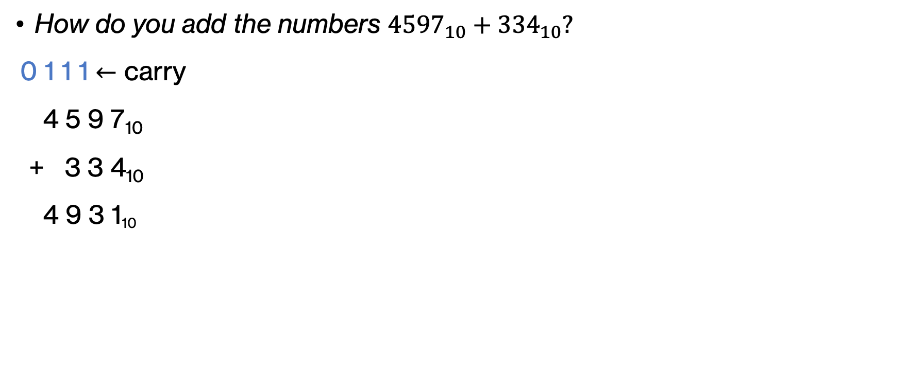
Think
How do you add the numbers ${4597}_{10}+{334}_{10}?$
0 1 1 1 $←$ carry
4 5 9 7₁₀
+ 3 3 4₁₀
4 9 3 1₁₀
Notes:
Presumably, you started with adding the rightmost digits (the least significant digits). If the sum is greater or equal to 10, then carry a 1 and write down the sum%10. Repeat with the next digits to the left, but this time include the carry in the addition.

Slide 5
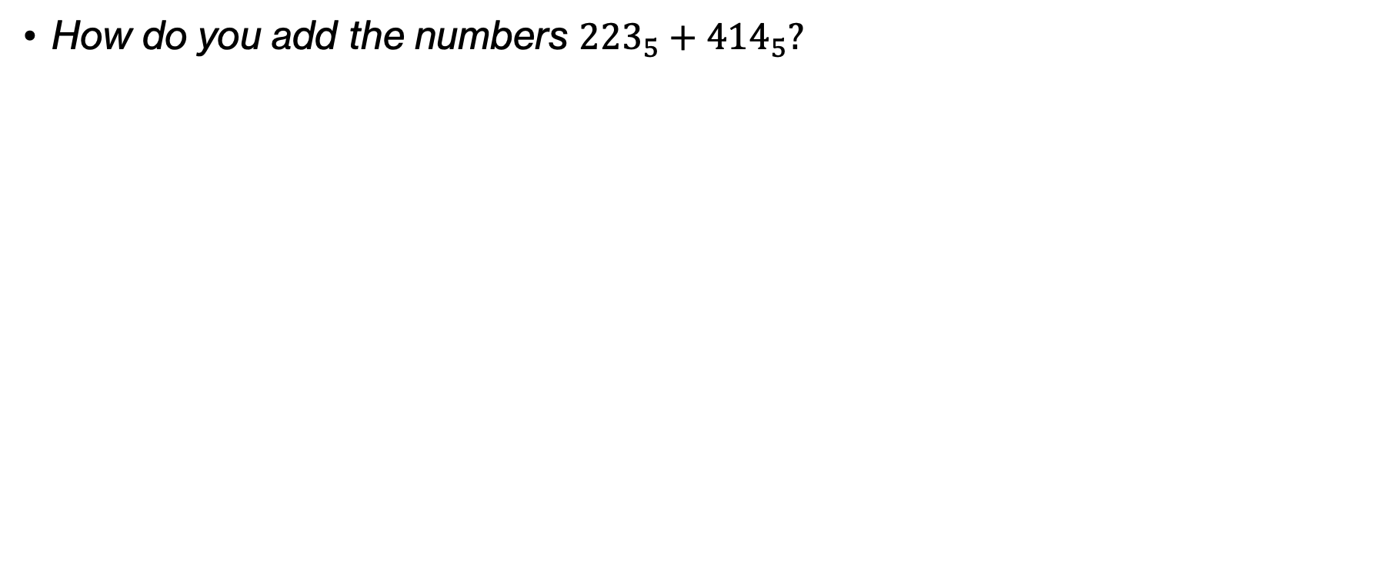
Think
How do you add the numbers ${223}_{5}+{414}_{5}?$
Notes:
OK you (thankfully!) remember decimal addition. How would we go about adding together these two base 5 numbers?

Slide 6
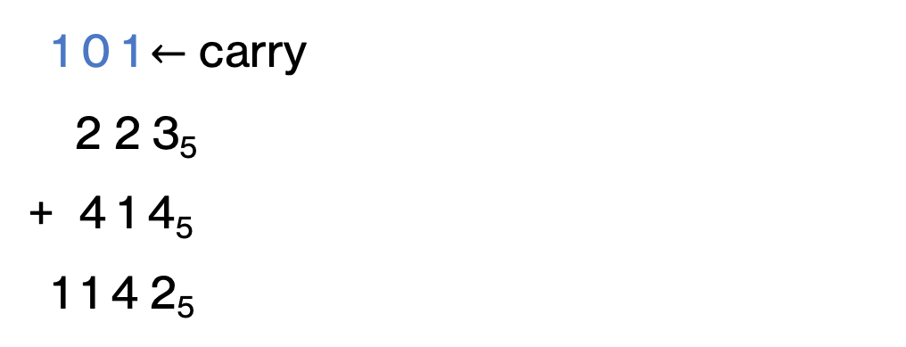
Think
How do you add the numbers ${223}_{5}+{414}_{5}?$
1 0 1$←$ carry
2 2 3₅
+ 4 1 4₅
1 1 4 2₅
Notes:
Again, we'd start with the least significant digits and add them up. If the sum exceeds our base (i.e.5), we have a carry of 1.

Slide 7
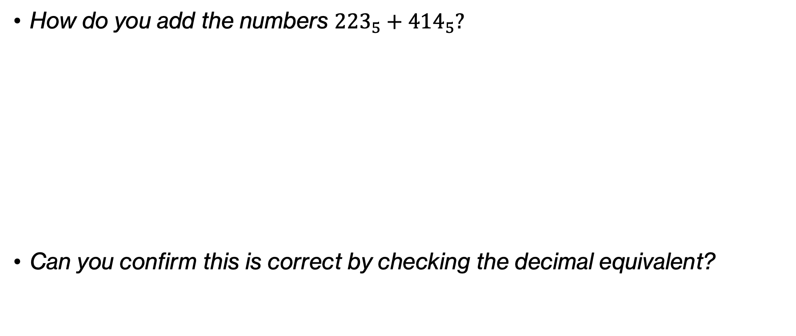
Think
How do you add the numbers ${223}_{5}+{414}_{5}?$
Can you confirm this is correct by checking the decimal equivalent?
1 0 1$←$ carry
2 2 3₅
+ 4 1 4₅
1 1 4 2₅
Notes:
Let's further convince ourselves that this is correct by checking the decimal equivalent

Slide 8
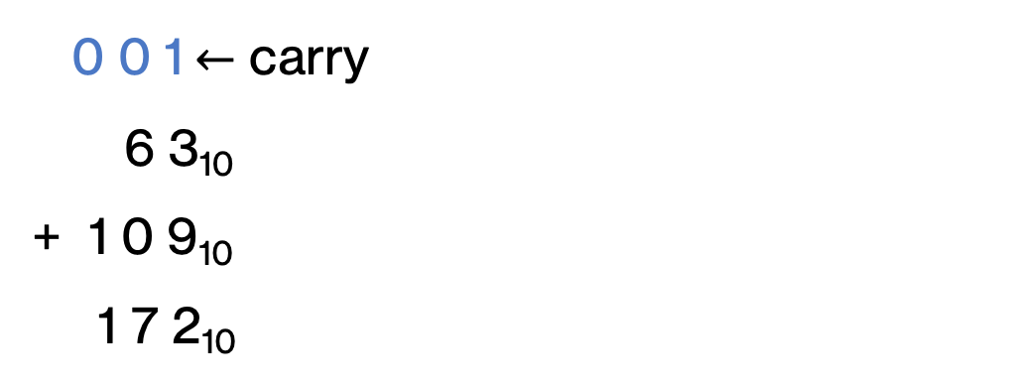
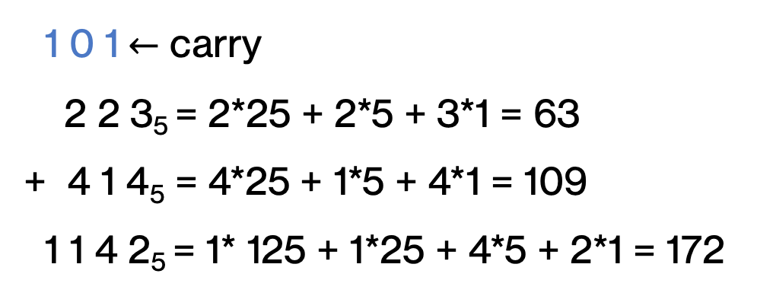
Think
How do you add the numbers ${223}_{5}+{414}_{5}?$
1 0 1$←$ carry
2 2 3₅ = 2*25 + 2*5 + 3*1 = 63
+ 4 1 4₅ = 4*25 + 1*5 + 4*1 = 109
1 1 4 2₅ = 1* 125 + 1*25 + 4*5 + 2*1 = 172
0 0 1$←$ carry
6 3₁₀
+ 1 0 9₁₀
1 7 2₁₀
Notes:
Remember all the work we did from last class meeting? Looks like we got it right

Slide 9
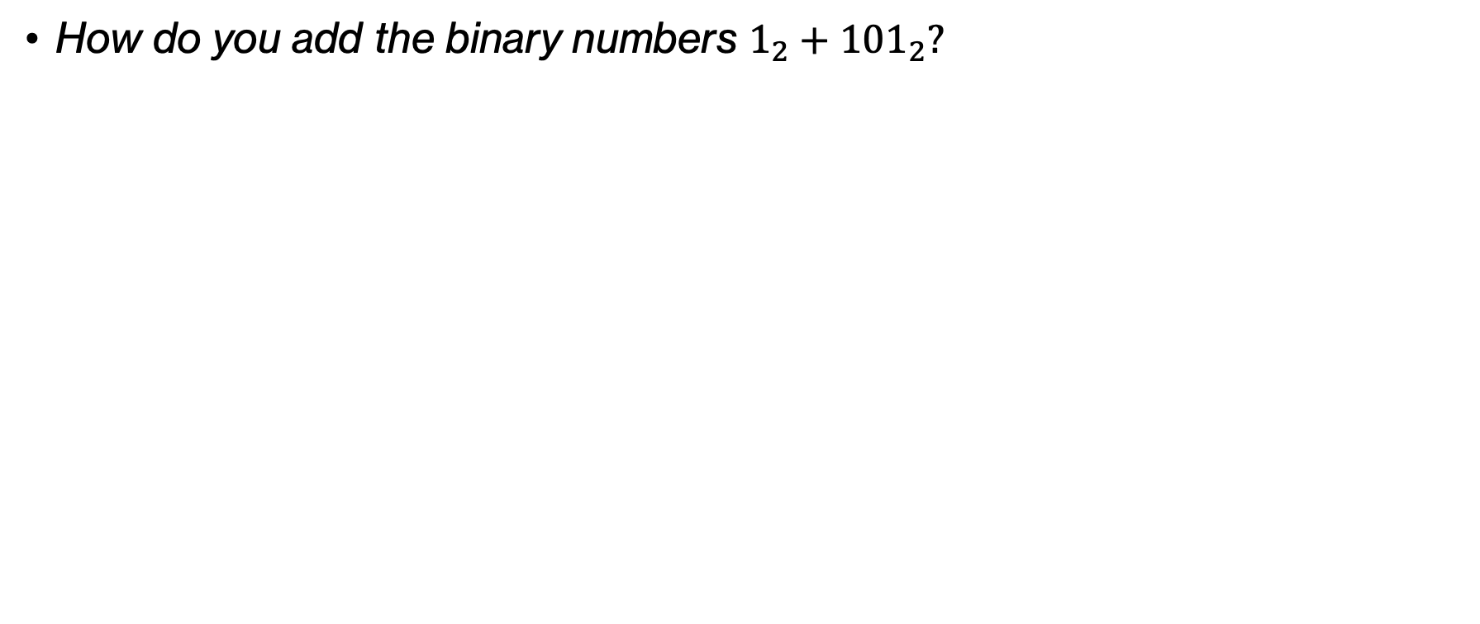
Think
How do you add the binary numbers $1_{2}+{101}_{2}?$
Notes:
What if we wanted to add the two binary numbers 1 and 0101?

Slide 10
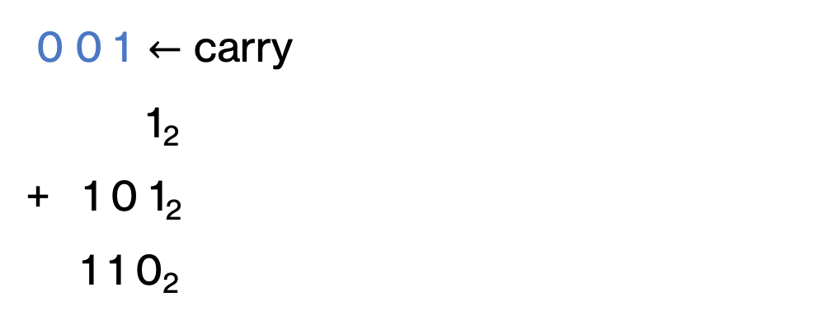
Think
How do you add the binary numbers $1_{2}+{101}_{2}?$
0 0 1$←$ carry
1₂
+ 1 0 1₂
1 1 0₂
Notes:
we'd follow the same process from right to left. if we add two bits equal to 1, then we get back 0 and have a carry of 1.

Slide 11
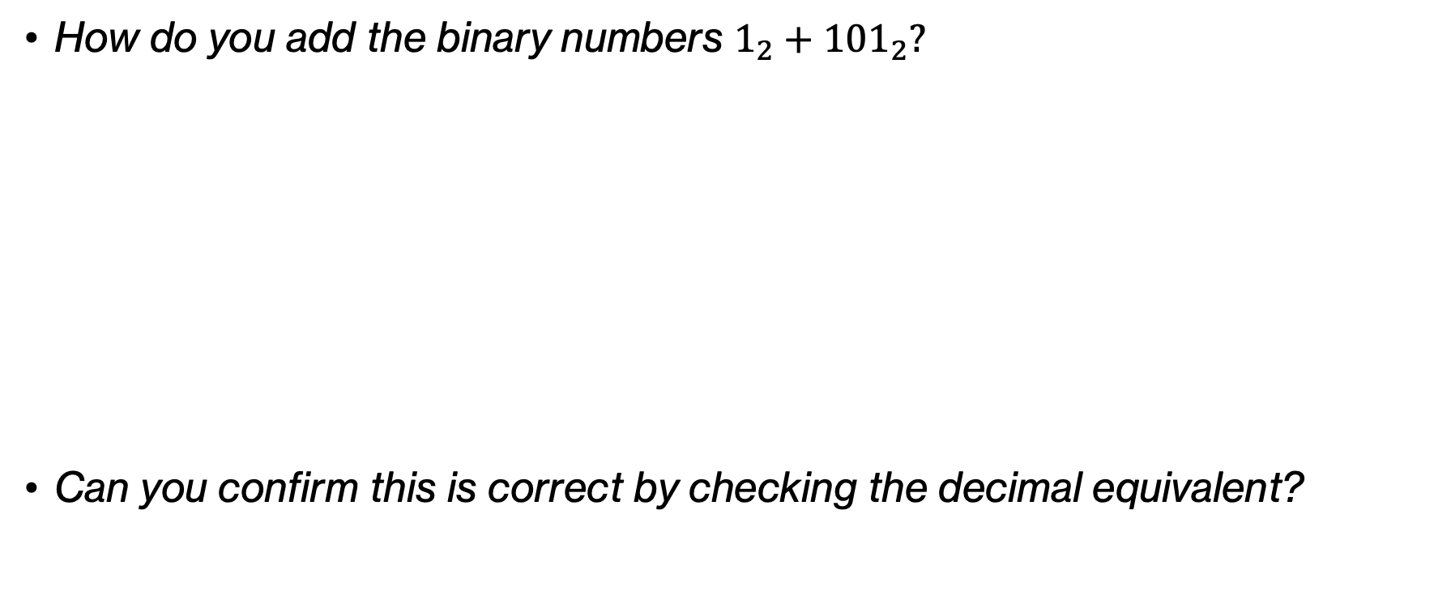
Think
How do you add the binary numbers $1_{2}+{101}_{2}?$
Can you confirm this is correct by checking the decimal equivalent?
0 0 1$←$ carry
1₂
+ 1 0 1₂
1 1 0₂
Notes:
Again, can we confirm that what we did is correct by converting it to its decimal representation we are more comfortable with

Slide 12
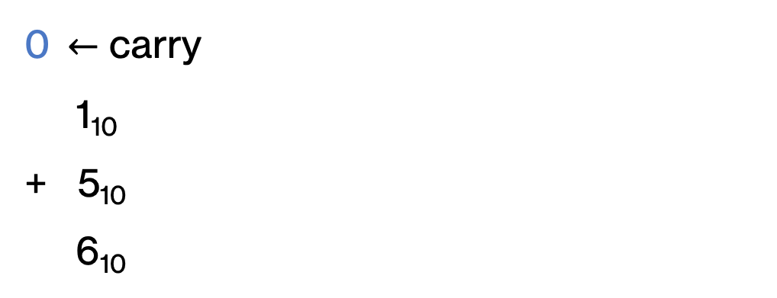
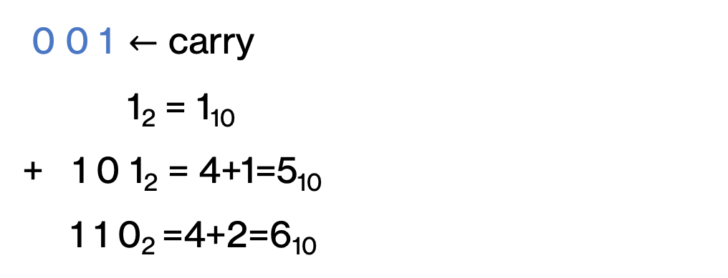
Think
How do you add the binary numbers $1_{2}+{101}_{2}?$
Can you confirm this is correct by checking the decimal equivalent?
0 0 1$←$ carry
1₂ = 1₁₀
+ 1 0 1₂ = 4+1=5₁₀
1 1 0₂ =4+2=6₁₀
0$←$ carry
1₁₀
+ 5₁₀
6₁₀
Notes:
Indeed, it's 1+5=6.

Slide 13
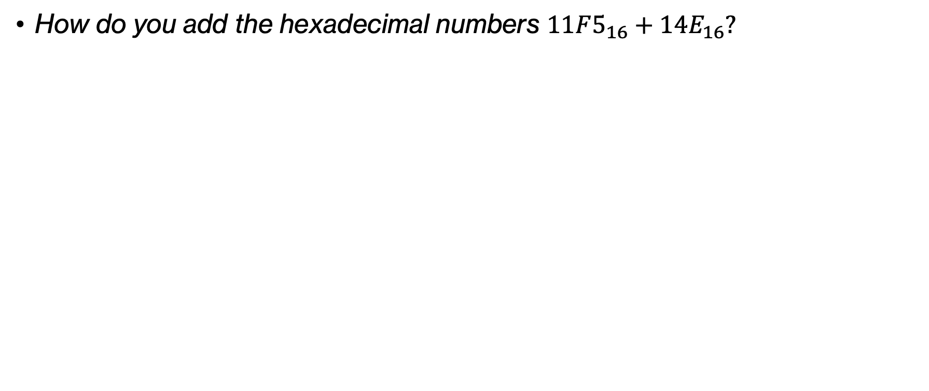
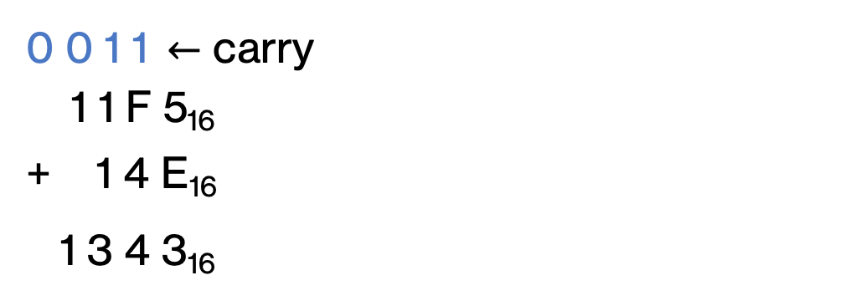
Think
How do you add the hexadecimal numbers $11F5_{16}+{14E}_{16}?$
0 0 1 1$←$ carry
1 1 F 5₁₆
+ 1 4 E₁₆
1 3 4 3₁₆
Notes:
Indeed, it's 1+5=6.

Slide 14
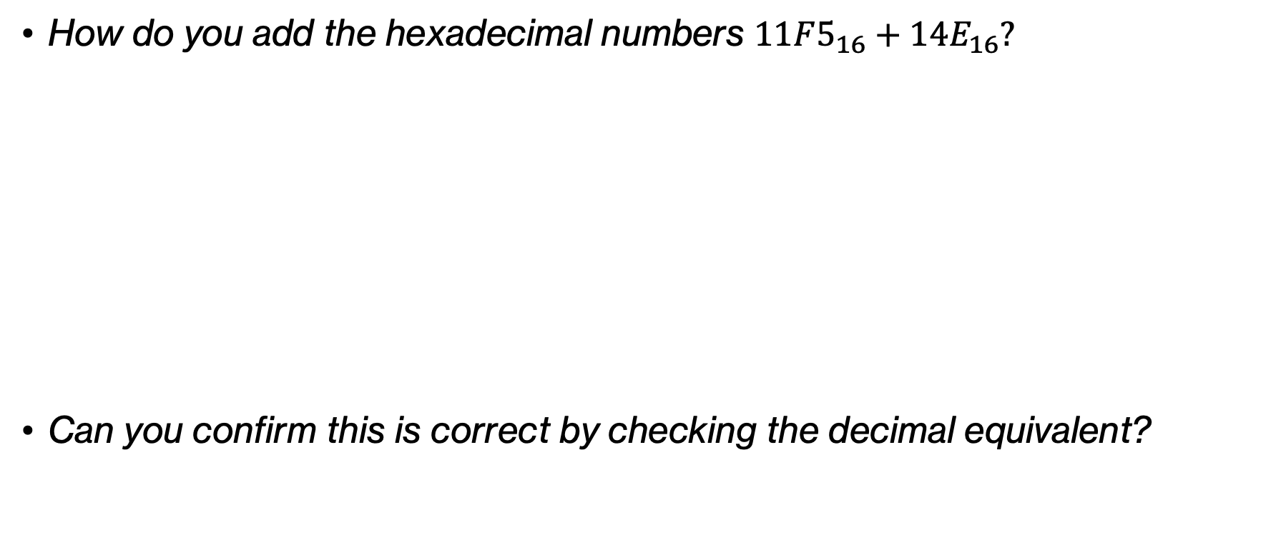
Think
How do you add the hexadecimal numbers $11F5_{16}+{14E}_{16}?$
Can you confirm this is correct by checking the decimal equivalent?
0 0 1 1$←$ carry
1 1 F 5₁₆
+ 1 4 E₁₆
1 3 4 3₁₆
Notes:
Can you confirm it is correct by calculating the decimal equivalent representations

Slide 15
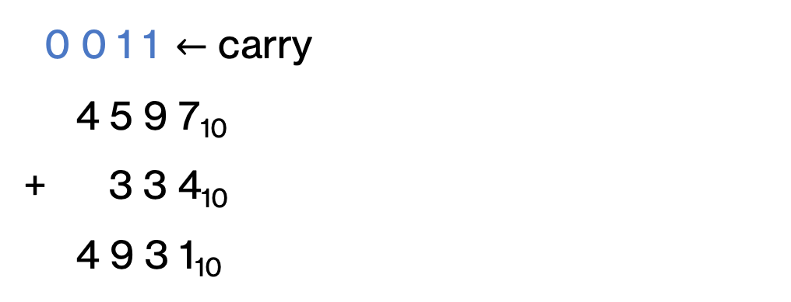
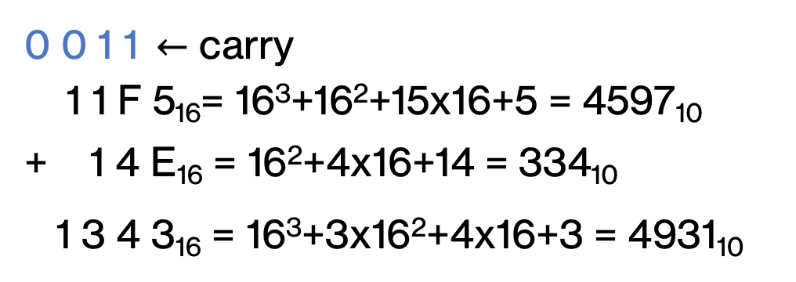
Think
How do you add the hexadecimal numbers $11F5_{16}+{14E}_{16}?$
Can you confirm this is correct by checking the decimal equivalent?
0 0 1 1$←$ carry
1 1 F 5₁₆= 16³+16²+15x16+5 = 4597₁₀
+ 1 4 E₁₆ = 16²+4x16+14 = 334₁₀
1 3 4 3₁₆ = 16³+3x16²+4x16+3 = 4931₁₀
0 0 1 1$←$ carry
4 5 9 7₁₀
+ 3 3 4₁₀
4 9 3 1₁₀
Notes:
Indeed they add up to 4931.

Slide 16
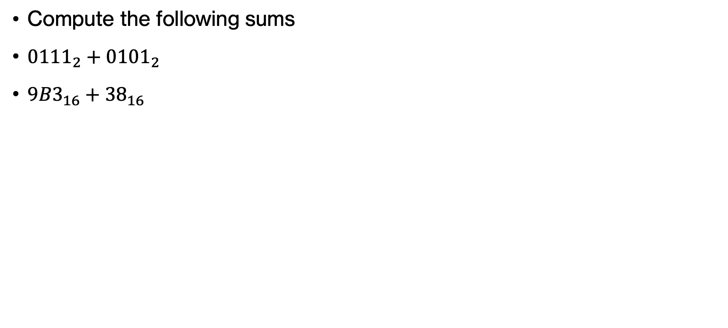
PRACTICE TIME - Addition
Compute the following sums
${0111}_{2}+{0101}_{2}$
${9B3}_{16}+{38}_{16}$
Notes:
OK Let's see whether we can do addition in binary and hex.

Slide 17
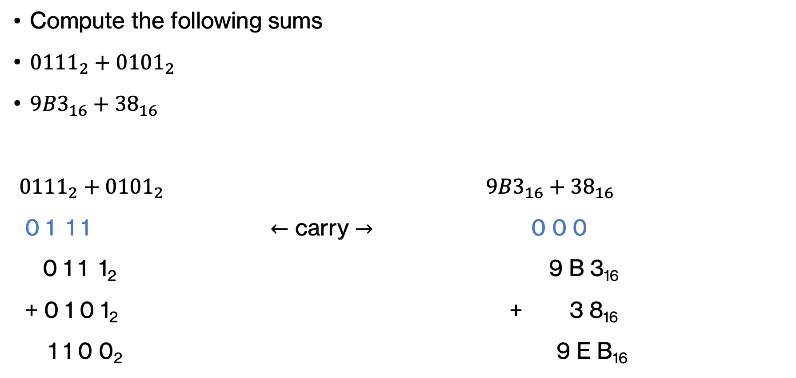
ANSWER - Addition
Compute the following sums
${0111}_{2}+{0101}_{2}$
${9B3}_{16}+{38}_{16}$
${0111}_{2}+{0101}_{2}$ ${9B3}_{16}+{38}_{16}$
0 1 1 1 $←$ carry $→$ 0 0 0
0 1 1 1₂ 9 B 3₁₆
+ 0 1 0 1₂ + 3 8₁₆
1 1 0 0₂ 9 E B₁₆
Notes:
Dod you get these results?

Slide 18
Overflow

Slide 19
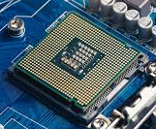

Simplified view of a computer
“the computer”
CPU
hard drive
RAM
Both RAM and the hard drive store a sequence of bits.
010010010011010010010111100010001010
Notes:
Remember we said a computer at its basis is the CPU communicating with the RAM, that is the memory, where temporary data are stored as long as we have power. More permanent data are stored in the hard drive. Both types of memory store information in sequences of bits.

Slide 20
Word length
“the computer”
CPU
hard drive
RAM
To simplify hardware, these bits are grouped into fixed length chunks called “words”, e.g., in groups of 4.
0100 1001 0011 0100 1001 0111 1000 1000 1010
Notes:
To simplify hardware, we group bits into fixed length chunks called words.

Slide 21
Computers today
“the computer”
CPU
hard drive
RAM
Most computers today work with 64-bit words.
Notes:
Most computers today read words in 64 bits. When I grew up, most had 32-bit words but as our computational needs go up, computer architecture has to adapt.

Slide 22
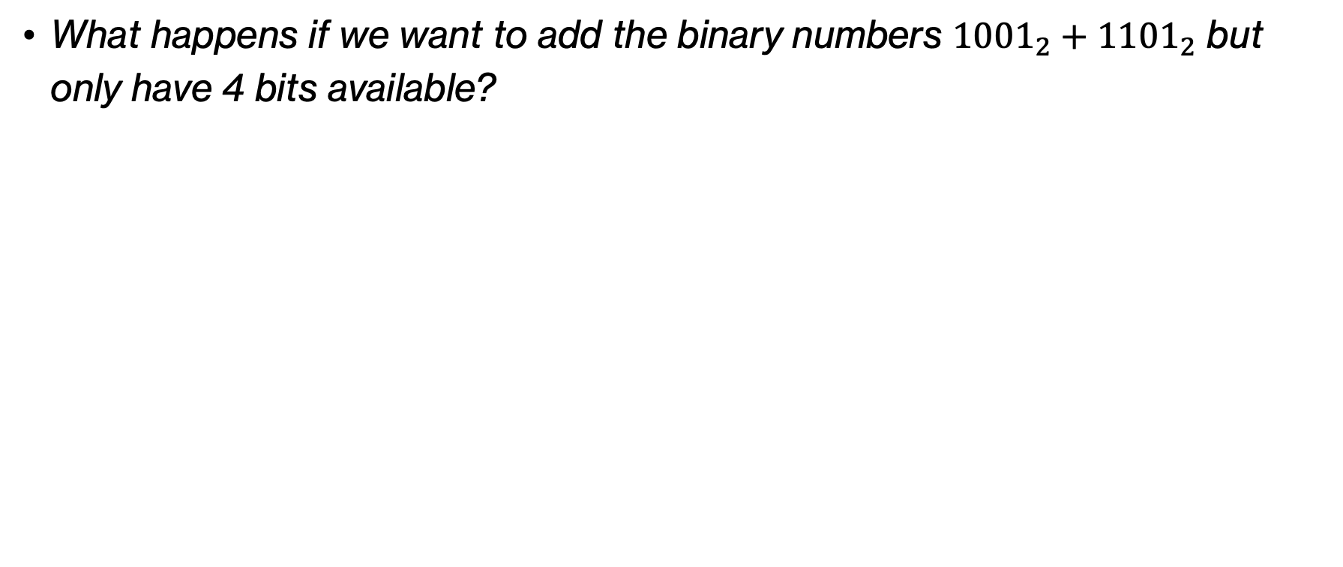
Think
What happens if we want to add the binary numbers ${1001}_{2}+{1101}_{2}$ but only have 4 bits available?
Notes:
What if we want to add two binary numbers and we know that the result has to fit in a fixed number of bits, e.g., can you try to add the two binary numbers 1001 and 1101?

Slide 23
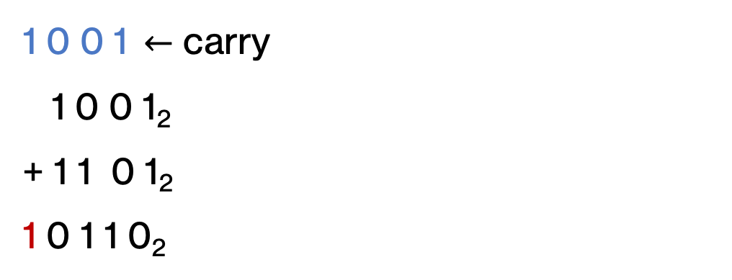
Think
What happens if we want to add the binary numbers ${1001}_{2}+{1101}_{2}$ but only have 4 bits available?
1 0 0 1$←$ carry
1 0 0 1₂
+ 1 1 0 1₂
1 0 1 1 0₂
Notes:
You see that we would need an extra bit!

Slide 24
Overflow
If we operate on a fixed number of bits, addition can overflow if the result is too big to fit in the available space.
1 0 0 1$←$ carry
1 0 0 1₂
+ 1 1 0 1₂
1 0 1 1 0₂
Notes:
This can be a problem and the problem is known as overflow.

Slide 25
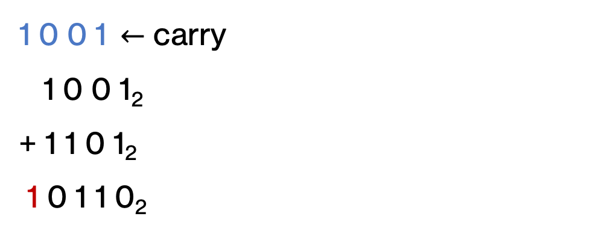
Think
If we operate on a fixed number of bits, addition can overflow if the result is too big to fit in the available space.
How can we detect overflow?
1 0 0 1$←$ carry
1 0 0 1₂
+ 1 1 0 1₂
1 0 1 1 0₂
Notes:
How do you think we can detect overflow?

Slide 26
Think
If we operate on a fixed number of bits, addition can overflow if the result is too big to fit in the available space.
How can we detect overflow?
  If the carry bit for the MSB is 1, then we have overflow
1 0 0 1$←$ carry
1 0 0 1₂
+ 1 1 0 1₂
1 0 1 1 0₂
Notes:
We just need to check the carry bit for the most significant (remember, left most) bit. If it's 1, then we know we are in trouble.

Slide 27
Signed numbers
Notes:
Everything we have seen so far has assume we are working with positive numbers only, including 0. Now we will move into signed numbers, that is numbers that can tell us whether they are positive or negative.

Slide 28
Binary numbers revisited
What is -6₁₀ in binary?
Notes:
Here's a question for you. Say we have the -6 decimal number. How do we represent it in binary?

Slide 29
One option: sign/magnitude
sign
0 = positive
1 = negative
magnitude
fixed bit length (e.g., 4 bits)
Notes:
Our first option is to work with a representation called sign or magnitude. If we have a fixed number of bits, say 4, we reserve the left most bit for the sign. The convention is that if it's a 0, then the number is positive. If it's 1, it's negative. The remaining 3 bits are known as the magnitude.

Slide 30
One option: sign/magnitude
What is -6₁₀ in sign/magnitude?
sign
0 = positive
1 = negative
magnitude
fixed bit length (e.g., 4 bits)
Notes:
So if we go back to -6 from decimal and want to represent it in binary using the sign/magnitude representation, what would that look like?

Slide 31
One option: sign/magnitude
1
1
1
0
What are the range of values we can support with 4 bits in sign/magnitude representation?
sign
0 = positive
1 = negative
magnitude
fixed bit length (e.g., 4 bits)
Notes:
If we had 4 bits available and we use the sign/magnitude representation, what is the range of decimal values we can support?

Slide 32
One option: sign/magnitude
1
1
1
0
What are the range of values we can support with 4 bits in sign/magnitude representation?
1111 = -7 to 0111 = 7
sign
0 = positive
1 = negative
magnitude
fixed bit length (e.g., 4 bits)
Notes:
The largest magnitude is 111 with 3 bits, that is 7. So we can go from -7 to 7

Slide 33
Think
1
1
1
0
Any problems?
sign
0 = positive
1 = negative
magnitude
fixed bit length (e.g., 4 bits)
Notes:
Do you foresee any problems with this representation?

Slide 34
Think
1
1
1
0
Any problems?
We have two zeros, 0000 and 1000
sign
0 = positive
1 = negative
magnitude
fixed bit length (e.g., 4 bits)
Notes:
We end up with two zeros, one for the positive and one for the negative sign.

Slide 35
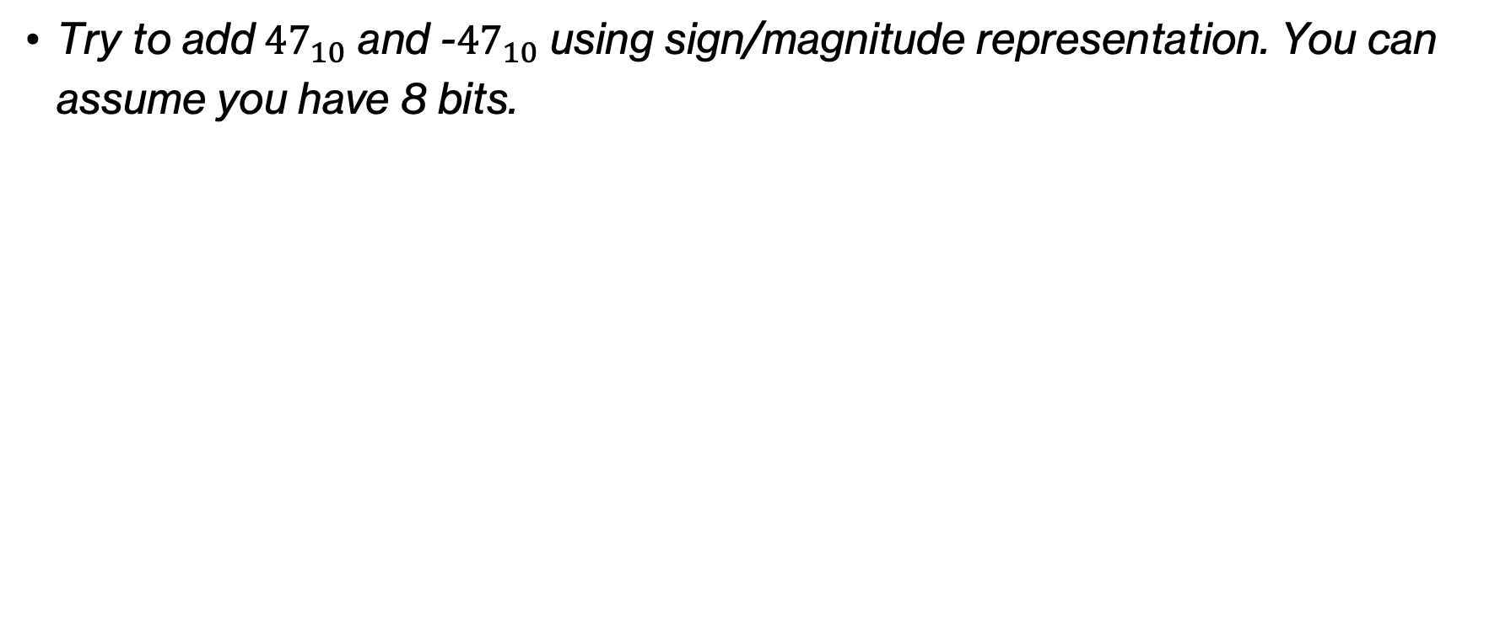
Think
Try to add${47}_{10}$ and -${47}_{10}$ using sign/magnitude representation. You can assume you have 8 bits.
Notes:
There's also one more problem. Try to add 47 and -47 in binary using sign/magnitude representation.

Slide 36
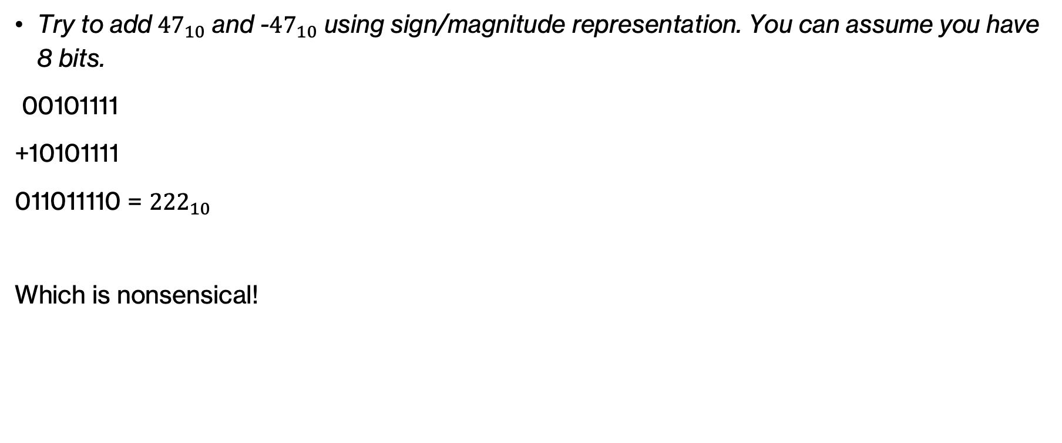
Think
Try to add${47}_{10}$ and -${47}_{10}$ using sign/magnitude representation. You can assume you have 8 bits.
00101111
+10101111
011011110 = ${222}_{10}$
Which is nonsensical!
Notes:
Instead of 0, we got the nonsensical 222?!

Slide 37
A better option: two's complement representation
For a number with $n$ bits, the MSB represents $−2^{n−1}$
unsigned
2³
2²
2¹
2⁰
signed
(two's complement)
-2³
2²
2¹
2⁰
Notes:
We will see another representation that addresses both of these problems. This representation is known as two's complement and the basic idea behind it is that the MSB (meaning the left most bit represents the number -2^(n-1). Every other bit works as usual.

Slide 38
Think
What numbers do we get?
1
0
0
1
unsigned
2³
2²
2¹
2⁰
1
0
0
1
signed
(two's complement)
-2³
2²
2¹
2⁰
Notes:
With that in mind, what numbers do we get if we have the bits 1001 in unsigned and signed (in two's complement) representation?

Slide 39
Think
What numbers do we get?
1
0
0
1
unsigned
9
2³
2²
2¹
2⁰
1
0
0
1
signed
(two's complement)
-7
-2³
2²
2¹
2⁰
Notes:
In the case of unsigned, we have 1x2^3+1x2^0=9. But in two's complement that is -2^3+2^0 = -8+1=-7.

Slide 40
Think
What numbers do we get now?
1
1
1
1
unsigned
2³
2²
2¹
2⁰
1
1
1
1
signed
(two's complement)
-2³
2²
2¹
2⁰
Notes:
What if we read the 4-bit number 1111 in each of the two representations?

Slide 41
Think
What numbers do we get now?
1
1
1
1
unsigned
15
2³
2²
2¹
2⁰
1
1
1
1
signed
(two's complement)
-1
-2³
2²
2¹
2⁰
Notes:
In the case of unsigned, we have 1x2^3+1x2^2+1x2^1+1x2^0=1. But in two's complement that is -2^3+2^2+2^1+2^0 = -8+4+2+1=-1

Slide 42
Think
What numbers do we get now?
1
1
0
0
unsigned
2³
2²
2¹
2⁰
1
1
0
0
signed
(two's complement)
-2³
2²
2¹
2⁰
Notes:
OK what about now?

Slide 43
Think
What numbers do we get now?
1
1
0
0
unsigned
12
2³
2²
2¹
2⁰
1
1
0
0
signed
(two's complement)
-4
-2³
2²
2¹
2⁰
Notes:
Did you get 12 and -4?

Slide 44
Think
How many numbers can we represent with each representation if we have 4 bits?
unsigned
2³
2²
2¹
2⁰
signed
(two's complement)
-2³
2²
2¹
2⁰
Notes:
If we have 4 bits, how many numbers can we represent in unsigned and how many in signed (with two's complement)

Slide 45
Think
How many numbers can we represent with each representation if we have 4 bits?
  16 numbers: 0000, 0001, …, 1111, regardless of representation
unsigned
2³
2²
2¹
2⁰
signed
(two's complement)
-2³
2²
2¹
2⁰
Notes:
It's 16 (2^4), regardless of the representation

Slide 46
Think
What is the range of numbers we can represent for each approach with 4 bits?
unsigned
2³
2²
2¹
2⁰
signed
(two's complement)
-2³
2²
2¹
2⁰
Notes:
What is the range of numbers that each approach can support with 4 bits?

Slide 47
Think
What is the range of numbers we can represent for each approach with 4 bits?
  unsigned: 0, 1, … 15
  signed: -8, -7, …, 7
unsigned
2³
2²
2¹
2⁰
signed
(two's complement)
-2³
2²
2¹
2⁰
Notes:
For unsigned, since they are all positive it goes 0 to 15. But for signed it's -8 to 7

Slide 48
binary representation | unsigned
0000 | 0
0001 | 1
0010 | ?
0011
0100
0101
0110
0111
1000
1001
1010
1011
1100
1101
1110
1111
Notes:
If 0000 corresponds to 0 in unsigned and 0001 to 1, what does 0010 correspond to?

Slide 49
binary representation | unsigned
0000 | 0
0001 | 1
0010 | 2
0011
0100
0101
0110
0111
1000
1001
1010
1011
1100
1101
1110
1111
Notes:
2, right? What about the rest of the column

Slide 50
binary representation | unsigned | two's complement
0000 | 0 | ?
0001 | 1
0010 | 2
0011 | 3
0100 | 4
0101 | 5
0110 | 6
0111 | 7
1000 | 8
1001 | 9
1010 | 10
1011 | 11
1100 | 12
1101 | 13
1110 | 14
1111 | 15
Notes:
Well we just said, it would be 0,…, 15. How about two's complement representation of 0000?

Slide 51
binary representation | unsigned | two's complement
0000 | 0 | 0
0001 | 1 | 1
0010 | 2 | 2
0011 | 3 | 3
0100 | 4 | 4
0101 | 5 | 5
0110 | 6 | 6
0111 | 7 | 7
1000 | 8 | ?
1001 | 9
1010 | 10
1011 | 11
1100 | 12
1101 | 13
1110 | 14
1111 | 15
Notes:
It's of course 0. And the same applies all the way to 0111. How about 1000?

Slide 52
binary representation | unsigned | two's complement
0000 | 0 | 0
0001 | 1 | 1
0010 | 2 | 2
0011 | 3 | 3
0100 | 4 | 4
0101 | 5 | 5
0110 | 6 | 6
0111 | 7 | 7
1000 | 8 | -8
1001 | 9 | ?
1010 | 10
1011 | 11
1100 | 12
1101 | 13
1110 | 14
1111 | 15
Notes:
Did you get -8? How about the rest of the column?

Slide 53
binary representation | unsigned | two's complement
0000 | 0 | 0
0001 | 1 | 1
0010 | 2 | 2
0011 | 3 | 3
0100 | 4 | 4
0101 | 5 | 5
0110 | 6 | 6
0111 | 7 | 7
1000 | 8 | -8
1001 | 9 | -7
1010 | 10 | -6
1011 | 11 | -5
1100 | 12 | -4
1101 | 13 | -3
1110 | 14 | -2
1111 | 15 | -1
Notes:
Did you get this? Do you notice that 1xxxx is always the smallest number we can represent with the number of bits we have available and then the negative numbers keep increasing?

Slide 54
binary representation | unsigned | two's complement
0000 | 0 | 0
0001 | 1 | 1
0010 | 2 | 2
0011 | 3 | 3
0100 | 4 | 4
0101 | 5 | 5
0110 | 6 | 6
0111 | 7 | 7
1000 | 8 | -8
1001 | 9 | -7
1010 | 10 | -6
1011 | 11 | -5
1100 | 12 | -4
1101 | 13 | -3
1110 | 14 | -2
1111 | 15 | -1
How can you tell if a number is negative?
Notes:
Assuming two's complement representation, how can you tell if a number is negative?

Slide 55
binary representation | unsigned | two's complement
0000 | 0 | 0
0001 | 1 | 1
0010 | 2 | 2
0011 | 3 | 3
0100 | 4 | 4
0101 | 5 | 5
0110 | 6 | 6
0111 | 7 | 7
1000 | 8 | -8
1001 | 9 | -7
1010 | 10 | -6
1011 | 11 | -5
1100 | 12 | -4
1101 | 13 | -3
1110 | 14 | -2
1111 | 15 | -1
How can you tell if a number is negative?
Look at the MSB
Notes:
You just look at the most significant bit.

Slide 56
binary representation | unsigned | two's complement
0000 | 0 | 0
0001 | 1 | 1
0010 | 2 | 2
0011 | 3 | 3
0100 | 4 | 4
0101 | 5 | 5
0110 | 6 | 6
0111 | 7 | 7
1000 | 8 | -8
1001 | 9 | -7
1010 | 10 | -6
1011 | 11 | -5
1100 | 12 | -4
1101 | 13 | -3
1110 | 14 | -2
1111 | 15 | -1
The smallest number is 1 followed by 0s for the rest of the bits
Notes:
Here's another cool fact. If you have n bits, the smallest number you can represent will be 1000.000 where 1 is the MSB and 0s go to the rest of n-1 bits!

Slide 57
binary representation | unsigned | two's complement
0000 | 0 | 0
0001 | 1 | 1
0010 | 2 | 2
0011 | 3 | 3
0100 | 4 | 4
0101 | 5 | 5
0110 | 6 | 6
0111 | 7 | 7
1000 | 8 | -8
1001 | 9 | -7
1010 | 10 | -6
1011 | 11 | -5
1100 | 12 | -4
1101 | 13 | -3
1110 | 14 | -2
1111 | 15 | -1
-1 is always all 1s
Notes:
And one more: -1 is going to be all 1s

Slide 58
A two’s complement trick
You can also calculate the value of a negative number represented as two's complement as follows:
  Flip all of the bits (0 → 1 and 1→ 0)
  Add 1
  The resulting number is the magnitude of the original negative number
flip the bits
add 1
1101
0010
0011
-3
Notes:
There is a cool trick you can use to calculate the value of a negative number in two's complement. You flip the bits (so 0s turn to 1s and 1s to 0s). You add a 1 the usual way. And the resulting number is the magnitude of the negative number.

Slide 59
Think
You can also calculate the value of a negative number represented as two's complement as follows:
  Flip all of the bits (0 → 1 and 1→ 0)
  Add 1
  The resulting number is the magnitude of the original negative number
Which number is 1110?
1110
Notes:
Your turn. Which negative number is 1110?

Slide 60
Think
You can also calculate the value of a negative number represented as two's complement as follows:
  Flip all of the bits (0 → 1 and 1→ 0)
  Add 1
  The resulting number is the magnitude of the original negative number
flip the bits
add 1
1110
0001
0010
-2
Notes:
You know that 1110 is going to be negative so follow the trick of flipping its bits, adding 1. You get 0010 which is 2. So then your original number was -2

Slide 61
Addition with 4-bit two's complement numbers
0001₂
01 01₂
+
?
Notes:
OK, say we have these two 4-bit two's complement numbers, what's the result of this addition?

Slide 62
Addition with 4-bit two's complement numbers
0
0
1
0001₂
01 01₂
+
01 10₂
Notes:
We add up as before, using the carry bit when needed

Slide 63
Addition with 4-bit two's complement numbers
0110
0101
+
?
Notes:
What about now? Assume that from now on all is binary numbers

Slide 64
Addition with 4-bit two's complement numbers
1
0
0
0110
0101
+
1011?
Notes:
So I got 1011. Is this right? Remember, I added two positive numbers (how do I know this? they have 0 at the MSB) and ended up with a negative?

Slide 65
Addition with 4-bit two's complement numbers
1
0
0
0110
0101
6
+
5
1011?
-5? (11 unsigned)
Overflow! We cannot represent this number (it’s too large)
Notes:
We have overflow as we cannot represent this number. 6+5=11 which is out of the range of -8,..,7 we can represent with 4 bits.

Slide 66
Addition with 4-bit two's complement numbers
0110
1101
+
?
Notes:
What about adding these two two's complement binary numbers?

Slide 67
Addition with 4-bit two's complement numbers
1
1
0
0
0110
1 101
+
0011
Notes:
We get 0011 but also have a carry of 1 floating

Slide 68
Addition with 4-bit two's complement numbers
1
1
0
0
0110
1101
6
ignore the last carry
+
-3
0011
3
Notes:
If we ignore the last carry, we actually see that what we got is correct!

Slide 69
Think
How do you know that overflow has occurred with two's complement numbers?
Notes:
So how do we know that overflow has occurred when adding two two's complement numbers?

Slide 70
Overflow in two's complement
How do you know that overflow has occurred with two's complement numbers?
  Can only happen when adding two numbers of the same sign
  Add the numbers and discard the last carry bit
  Check the sign of the resulting number: if the resulting differs than the sign of the two numbers added, there is overflow
Notes:
Overflow can now only happen if we add two numbers with the same sign (i.e., two positive or two negative numbers). So we will add the numbers as usual and discard the carry bit for the MSB. Since overflow can happen only if two numbers have the same sign, we check the sign of the resulting number (i.e. the MSB) and if it's different than the two numbers we added, then we have overflow. That is, if you have two positive numbers (MSB is 0) and you get a result with MSB 1, you know you are in trouble. Similarly, adding two negative numbers (MSB 1) and getting MSB 0 in the result means overflow.

Slide 71
Subtraction
Notes:
Any idea about how we can perform subtraction in binary?

Slide 72
Subtraction
Negate the 2nd number (flip the bits and add 1)
Add them!
Notes:
The work is actually quite simple. We just have to negate the 2nd number, that is flip its bits from 0 to 1 and 1 to 0 and then 1, and add the first and negated number.

Slide 73
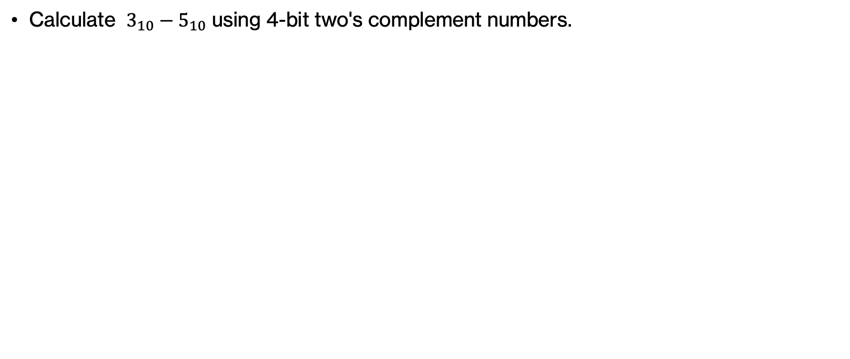
PRACTICE TIME – Subtracting two’s complements
Calculate $3_{10}−5_{10}$ using 4-bit two's complement numbers.
Notes:
Let's practice by calculating 3-5 in two's complement assuming 4 bits,

Slide 74
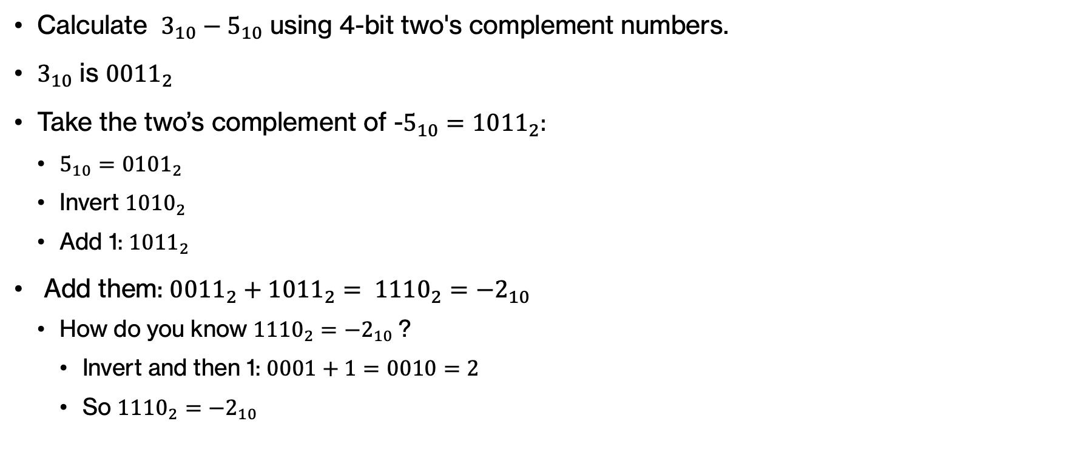
ANSWER – Subtracting two’s complements
Calculate $3_{10}−5_{10}$ using 4-bit two's complement numbers.
$3_{10}$ is ${0011}_{2}$
Take the two’s complement of -$5_{10}={1011}_{2}:$
  ${5_{10}=0101}_{2}$
  Invert ${1010}_{2}$
  Add 1: ${1011}_{2}$
Add them: ${{0011}_{2}+{1011}_{2}= 1110}_{2}={−2}_{10}$
  How do you know ${1110}_{2}={−2}_{10}$?
    Invert and then 1: $0001+1=0010=2$
    So ${1110}_{2}=−2_{10}$
Notes:
Did you get this?

Slide 75
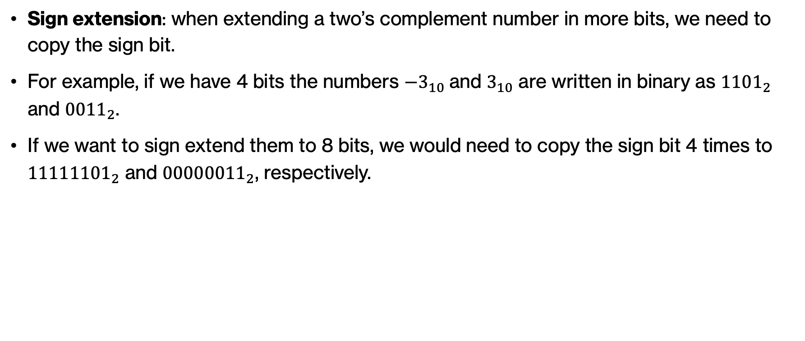
Sign extension in two’s complements
Sign extension: when extending a two’s complement number in more bits, we need to copy the sign bit.
For example, if we have 4 bits the numbers $−3_{10}$and $3_{10}$ are written in binary as ${1101}_{2}$ and ${0011}_{2}$.
If we want to sign extend them to 8 bits, we would need to copy the sign bit 4 times to ${11111101}_{2}$ and ${00000011}_{2}$, respectively.
Notes:
When we want to extend a two's complement number to more bits, we are going to copy the sign bit (0 for positive, 1 for negative). E.g., if we have 4 bits and the binary representations for -3 and 3 (1101 and 0011, respectively), we would pad them with 1s and 0s, respectively.

Slide 76
Why number representation errors matter
1. Ariane 5 Rocket Explosion (1996)
  Flight software converted a 64-bit floating point value into a 16-bit signed integer.
  The value was too large which caused an overflow which led to system failure.
  The rocket self-destructed 40 seconds after launch leading to a loss of $370 million.
2. Classic Video Games
  Many classic video games stored scores/lives in 8-bit signed integers (−128, … ,127)
  If score exceeded 127 it wrapped to negative values.
  Players suddenly saw “negative lives” or game crashes.
Notes:
Why do representations of numbers matter? Here are two examples when things can go wrong. Ariane 5 rocket launched in 1996 and the flight software converted a 64-bit floating point number into a 16-bit integer. The value was too large, causing an overflow and system failure. The rocket self-destructed less than a minute pass its launch, taking with it more than $370 million. A less catastrophic example would be to look at classic video games, e.g., some used 8 bits to store scores or lives. If a score exceeded the max number, ie. 127, it wrapped to negative values and played suddenly saw negative lives or game crashes.

Slide 77
Shifting
Notes:
We will move next to shifting, a type of operation we can do on numbers.

Slide 78
Shifting: variable length numbers
Shifting shifts the binary representation of the number right or left
37 >> 2
?
number to be shifted
number of positions to shift
right shift
Notes:
The next topic we will cover is that of shifting. Shifting shifts the binary representation of a number either right or left. For example, here I am saying I want to shift 37 2 positions to the right (note the direction of ?>>)

Slide 79
Shifting: variable length numbers
Shifting shifts the binary representation of the number right or left
37 >> 2
37
100101
100101
9
shift right two positions
(discard bits shifting off)
number in binary
decimal form
Notes:
So how do we shift 37 2 positions to the right? We convert it to its binary representation (assume unsigned numbers). Shift right two positions by discarding the 2 lowest bits. Convert 1001 to decimal and you get 9. So 37>>2=9!

Slide 80
Think
Shifting shifts the binary representation of the number right or left
37 >> 3
?
Notes:
What if I asked you to shift 37 3 positions to the right?

Slide 81
Think
Shifting shifts the binary representation of the number right or left
37 >> 3
37
100101
100101
4
shift right three positions
(discard bits shifting off)
number in binary
decimal form
Notes:
You would repeat the same process discarding the last 3 bits and end up with 100 which is equal to 4.

Slide 82
Shifting 8-bit numbers
Shifting shifts the binary representation of the number right or left
37 >> 2
What is 37 as an 8-bit binary number?
37
00100101
pad with 0s
number in binary
Notes:
What if instead of a variable number of bits, we have a fixed one, say 8. We will use sign extension to pad with 0s the front of the binary number.

Slide 83
Shifting 8-bit numbers
Shifting shifts the binary representation of the number right or left
37 >> 2
37
00100101
0000100101
9
shift right two positions
(discard away bits shifting off and pad)
decimal form
number in binary
Notes:
As we shift two bits to the right, we will continue padding the front with 0s since we have a fixed length representation.

Slide 84
Think
Shifting shifts the binary representation of the number right or left
15 << 2
?
Notes:
What do you think happens if we wanted to shift 2 positions to the left?

Slide 85
Think
Shifting shifts the binary representation of the number right or left
15 << 2
15
?
number in binary
Notes:
Assuming an 8-bit representation, what is 15 in binary?

Slide 86
Shifting 8-bit numbers
Shifting shifts the binary representation of the number right or left
15 << 2
15
00001111
number in binary
Notes:
00001111 (we need the four 0s as padding in the front)

Slide 87
Think
Shifting shifts the binary representation of the number right or left
15 << 2
15
00001111
?
shift left two positions
(discard bits shifting off)
number in binary
Notes:
If we were to shift left two positions and discard bits we shift off, what would we get?

Slide 88
Shifting 8-bit numbers
Shifting shifts the binary representation of the number right or left
15 << 2
15
00001111
00001111??
shift left two positions
(discard bits shifting off)
number in binary
Notes:
We discard the first two bits but what happens at the end so that we end up with 8 bits?

Slide 89
Shifting 8-bit numbers
Shifting shifts the binary representation of the number right or left
15 << 2
15
00001111
0000111100
shift left two positions
(discard bits shifting off)
number in binary
Notes:
Just pad it with 0s! We always do so independently of sign

Slide 90
Shifting 8-bit numbers
Shifting shifts the binary representation of the number right or left
15 << 2
15
00001111
0000111100
60
shift left two positions
(discard bits shifting off)
number in binary
decimal form
Notes:
And then as usual, convert to its decimal form which gives you 60.

Slide 91
Think
What does left shifting by one position do mathematically?
0
A
B
C
2³
2²
2¹
2⁰
Notes:
Let's think, what does left shifting by 1 position do mathematically?

Slide 92
Shifting mathematically: unsigned
What does left shifting by one position do mathematically?
0
A
B
C
2³
2²
2¹
2⁰
A
B
C
0
2³
2²
2¹
2⁰
Notes:
We had four bits (assume 0 at the MSB) and shifting discarded that 0 and padded 0 at the end. Try to calculate the decimal result

Slide 93
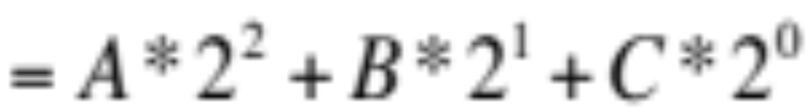
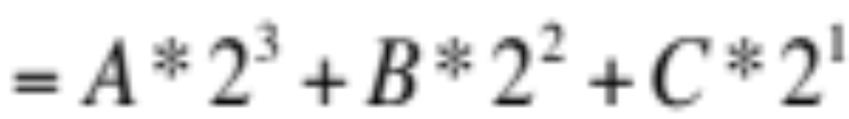
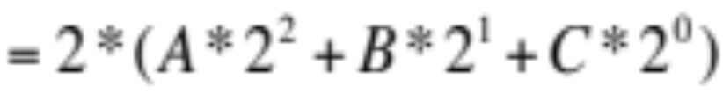
Shifting mathematically: unsigned
What does left shifting by one position do mathematically?
0
A
B
C
2³
2²
2¹
2⁰
A
B
C
0
2³
2²
2¹
2⁰
Notes:
Is this what you got?

Slide 94
Shifting mathematically: unsigned
What does left shifting by one position do mathematically?
0
A
B
C
2³
2²
2¹
2⁰
Doubles the number!
A
B
C
0
2³
2²
2¹
2⁰
Notes:
Do you see that the bottom is twice as big as the top?

Slide 95
Think
What does left shifting by n positions do mathematically?
Notes:
So if we have left shifting by n positions, what do we end up with?

Slide 96
Think
What does left shifting by n positions do mathematically?
Multiply by 2^{n} (doubles it n times)
Notes:
We double n times, or multiply by 2^n

Slide 97
Shifting mathematically: unsigned
What does right shifting by one position do mathematically?
0
A
B
C
2³
2²
2¹
2⁰
Notes:
Lets' apply the same idea to right shifting

Slide 98
Shifting mathematically: unsigned
What does right shifting by one position do mathematically?
0
A
B
C
2³
2²
2¹
2⁰
0
0
A
B
2³
2²
2¹
2⁰
Notes:
If we had four bits (assuming 0 for MSB), right shifting by 1 position would discard C and pad 0 in the front.

Slide 99
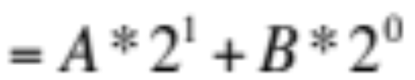
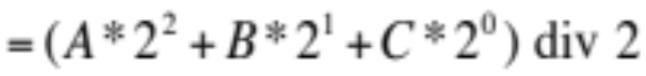
Shifting mathematically: unsigned
What does right shifting by one position do mathematically?
0
A
B
C
2³
2²
2¹
2⁰
0
0
A
B
2³
2²
2¹
2⁰
Notes:
Try to convert this to decimal

Slide 100
Shifting mathematically: unsigned
What does right shifting by one position do mathematically?
0
A
B
C
2³
2²
2¹
2⁰
Integer divide by 2
(// in Python)
0
0
A
B
2³
2²
2¹
2⁰
Notes:
That's like doing integer division by 2 which by rounding down to infinity. Remember, integer division is // in Python

Slide 101
Think
What does right shifting by n positions do mathematically?
Notes:
So what does right shifting an unsigned number by n positions do?

Slide 102
Think
What does right shifting by n positions do mathematically?
Integer division by 2^{n} (halves it n times)
Notes:
It halves it n times or it performs integer division by 2^n

Slide 103
Think
Shifting shifts the binary representation of the number right or left
-4 >> 1
What is -4 as a 4-bit binary number?
Notes:
Now what if we don't have only unsigned number. Say we work with 4-bit numbers and we want to shift -4 one position to the right.

Slide 104
Shifting 4-bit numbers
Shifting shifts the binary representation of the number right or left
-4 >> 1
-4
1100
number in binary
Notes:
It's 1100 (assuming two's complement)

Slide 105
Think
Shifting shifts the binary representation of the number right or left
-4 >> 1
How do we fill in the leftmost bit?
-4
1100
?1100
shift right one position
(discard bits shifting off)
number in binary
Notes:
If we are to shift one position to the right, how do we fill in the leftmost bit to end up with 4 bits?

Slide 106
Shifting 4-bit numbers
Two types of right shifts:
  logical shift: always shift in 0s
  arithmetic shift: shift in the same as the high-order bit
-4
1100
?1100
shift right one position
(discard bits shifting off)
number in binary
Notes:
We have two options. One is called logical shift and it always adds 0s. In arithmetic shift, in contrast, we pad with the same bit as the MSB or high-order bit.

Slide 107
Think
Two types of right shifts:
  logical shift: always shift in 0s
  arithmetic shift: shift in the same as the high-order bit
-4
1100
?1100
shift right one position
(discard bits shifting off)
number in binary
Notes:
What if we followed arithmetic shift next?

Slide 108
Think
Two types of right shifts:
  logical shift: always shift in 0s
  arithmetic shift: shift in the same as the high-order bit
-4
1100
11100
shift right one position
(discard bits shifting off)
number in binary
Notes:
We would pad it with 1 as this was the MSB.

Slide 109
Shifting 4-bit numbers
Two types of right shifts:
  logical shift: always shift in 0s
  arithmetic shift: shift in the same as the high-order bit
-4 >> 1
-4
1100
11100
?
shift right one position
(discard bits shifting off)
number in binary
decimal form
Notes:
What is the decimal form?

Slide 110
Shifting 4-bit numbers
Two types of right shifts:
  logical shift: always shift in 0s
  arithmetic shift: shift in the same as the high-order bit
-4 >> 1
-4
1100
11100
-2
shift right one position
(discard bits shifting off)
number in binary
decimal form
Notes:
It's -2

Slide 111
Think
Shifting shifts the binary representation of the number right or left
-4 >> 2
?
Notes:
What if we wan to shift -4 2 positions to the right and we have a 4-bit representation?

Slide 112
Think
Two types of right shifts:
  logical shift: always shift in 0s
  arithmetic shift: shift in the same as the high-order bit
-4 >> 2
-4
1100
111100
-1
shift right two positions
(discard bits shifting off)
number in binary
decimal form
Notes:
Assuming again arithmetic shift, we would discard the last two 0s and add two 1s in the front which results in the number -1.

Slide 113
Think
What does right arithmetic shifting by n positions do mathematically for signed numbers?
Notes:
So what does right arithmetic shifting by n positions do mathematically when we are working with signed numbers?

Slide 114
Arithmetic shifting mathematically
What does right arithmetic shifting by n positions do mathematically for signed numbers?
Integer division by 2^{n} (halve n times)
Same thing!!
Notes:
Same thing with unsigned number, it divides them by 2^n.

Slide 115
Think
Two types of right shifts:
  logical shift: always shift in 0s
  arithmetic shift: shift in the same as the high-order bit
-4
1100
?1100
shift right one position
(discard bits shifting off)
number in binary
Notes:
OK what if we did logical shifting?

Slide 116
Shifting 4-bit numbers
Two types of right shifts:
  logical shift: always shift in 0s
  arithmetic shift: shift in the same as the high-order bit
-4
1100
01100
shift right one position
(discard bits shifting off)
number in binary
Notes:
We'd just pad with 0

Slide 117
Think
Two types of right shifts:
  logical shift: always shift in 0s
  arithmetic shift: shift in the same as the high-order bit
-4 >>> 1
-4
1100
01100
?
shift right one position
(discard bits shifting off)
number in binary
decimal form
Notes:
Which would result to?

Slide 118
Shifting 4-bit numbers
Two types of right shifts:
  logical shift: always shift in 0s
  arithmetic shift: shift in the same as the high-order bit
-4 >>> 1
-4
1100
0110
6
shift right one position
(discard bits shifting off)
number in binary
decimal form
Notes:
6! So with logical shifts it doesn't seem like we are halving.

Slide 119
Think
Are there two types of left shifts?
  logical shift: always shift in 0s
  arithmetic shift: ?
arithmetic
-3 << 1
?
logical
-3 <<< 1
?
Notes:
So if we have logical and arithmetic right shift, do we have the same for left?

Slide 120
Left shifts
Are there two types of left shifts?
  logical shift: always shift in 0s
  arithmetic shift: ?
arithmetic
-3 << 1
1101
1101?
(double the number)
logical
-3 <<< 1
1101
11010
Notes:
How can we double the number if we do an arithmetic left shift?

Slide 121
Left shifts
Are there two types of left shifts?
  logical shift: always shift in 0s
  arithmetic shift: ?
arithmetic
-3 << 1
1101
11010
(double the number)
logical
-3 <<< 1
1101
11010
Only one type of left shift
Notes:
We would need to add a 0. Which means that we only have one type of left shift

Slide 122
Shifting summarized
Arithmetic shift:
  Right shift n
    shift n bits to the right
    discard right n bits
    left n bits match high-order bits of original number
    Effect: Integer division by 2^{n} (halve n times)
  Left shift
    shift n bits to the left
    discard left n bits
    right n bits are 0s
    Effect: multiply by 2^{n} (double n times)
Logical shift right:
  left n bits are 0s (no mathematical guarantees for negative numbers)
Notes:
So if we were to summarize shifting, arithmetic shifting is truly what happens both for left and right but logical shifting can only happen for right.

Slide 123
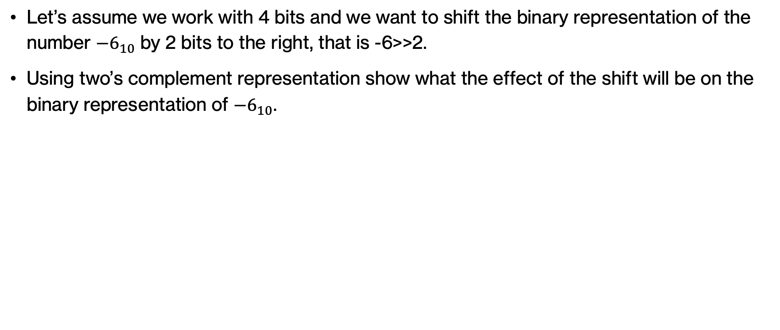
PRACTICE TIME - Arithmetic right shift
Let’s assume we work with 4 bits and we want to shift the binary representation of the number ${−6}_{10}$ by 2 bits to the right, that is -6>>2.
Using two’s complement representation show what the effect of the shift will be on the binary representation of ${−6}_{10}$.
Notes:
Your turn to apply arithmetic right shift by 2 bits to the binary -6 using two's complement and assuming 4 bits.

Slide 124
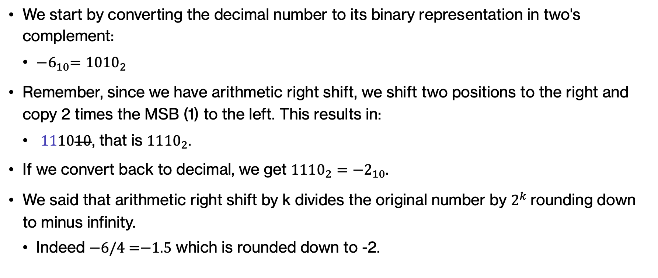
ANSWER - Arithmetic right shift
We start by converting the decimal number to its binary representation in two's complement:
  ${−6}_{10}={1010}_{2}$
Remember, since we have arithmetic right shift, we shift two positions to the right and copy 2 times the MSB (1) to the left. This results in:
  $111010$, that is ${1110}_{2}$.
If we convert back to decimal, we get ${1110}_{2}={−2}_{10}.$
We said that arithmetic right shift by k divides the original number by $2^{k}$rounding down to minus infinity.
  Indeed $\text{−}\text{6/4 }\text{=}\text{−1.5}$which is rounded down to -2.
Notes:
We will start by converting the decimal number to its binary representation in two's complement, i.e. 1010. We shift two to the right, i.e. 10 and pad it with two MSB signs, i.e. 1110. That would be the number -2. Let's check that the division by 4 holds. Yes, $\text{−}\text{6/4 }\text{=}\text{−1.5}$which is rounded down to -2.

Slide 125
PRACTICE TIME – Left shift
What happens when we shift -10<<3 assuming we have 8 bits?
Notes:
Your turn, assume you have 8 bits, and you try to shift -10 by 3 bits to the left.

Slide 126
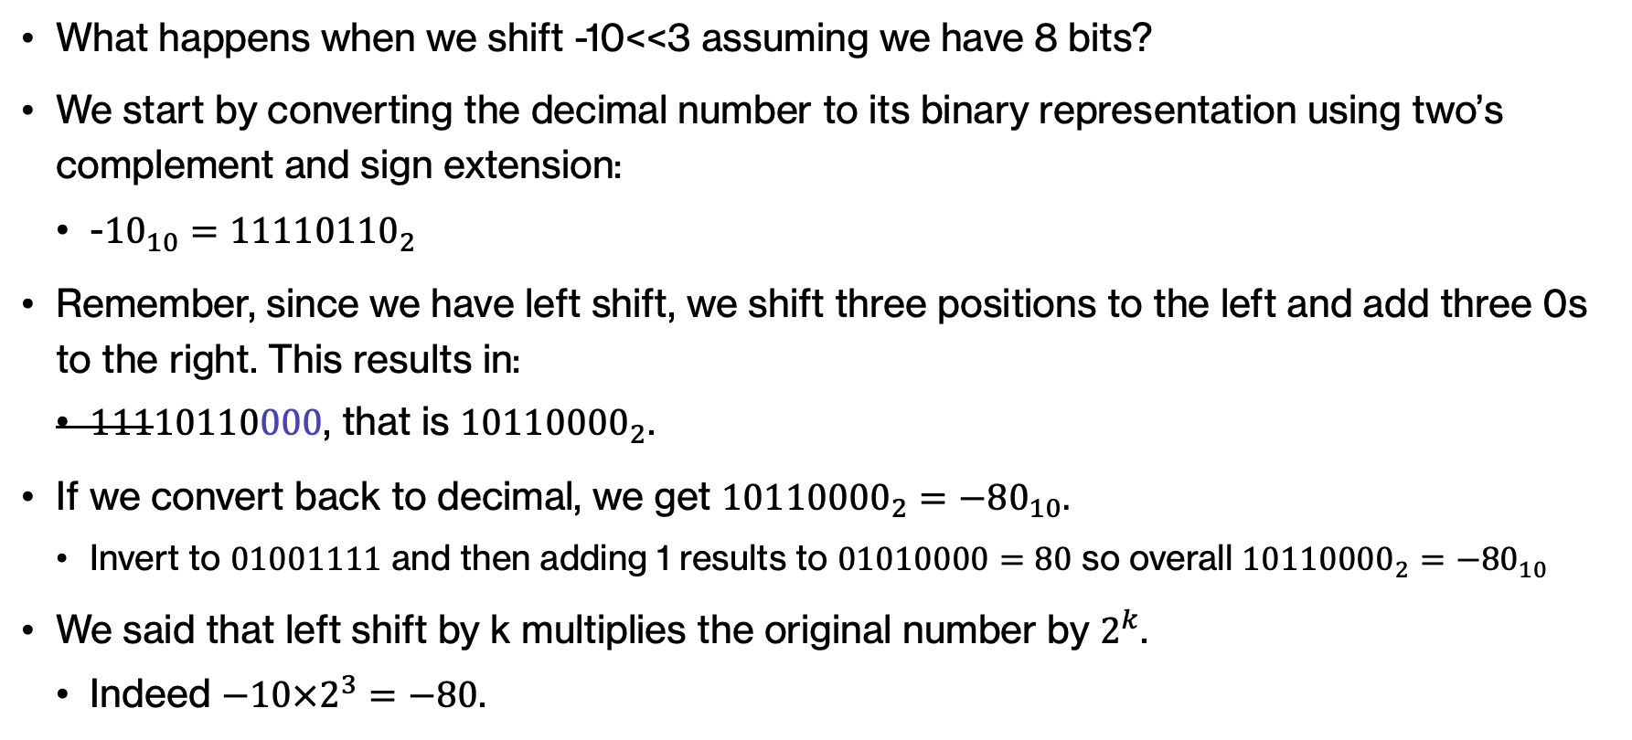
ANSWER – Left shift
What happens when we shift -10<<3 assuming we have 8 bits?
We start by converting the decimal number to its binary representation using two’s complement and sign extension:
  -${10}_{10}={11110110}_{2}$
Remember, since we have left shift, we shift three positions to the left and add three 0s to the right. This results in:
  $11110110000$, that is ${10110000}_{2}$.
If we convert back to decimal, we get ${10110000}_{2}={−80}_{10}.$
  Invert to $01001111$ and then adding 1 results to $01010000=80$ so overall ${10110000}_{2}={−80}_{10}$
We said that left shift by k multiplies the original number by $2^{k}$.
  Indeed $−10×2^{3}=−80$.
Notes:
Start by converting to the two's complement representation in binary I,e, 10110. Pad it with 1s to reach 8 bits. 11110110.
Shift three to the left and add three 0s to the right. $10110000$ which is equal to -80 and it checks out in terms of multiplying -10 by 2^3!

Slide 127
Shifting in Python
Python supports left and arithmetic right shifting. It denotes them as << and >>, respectively.
Other programming languages, like Java, support both arithmetic and logical right shift and use the >> and >>> operators to distinguish them.
Notes:
Python supports left shifting and right arithmetic shifting using the << and >> operators. Other languages, like Java, also support logical right shifting making a distinction by using >>>.

Slide 128
Practice Problems
Notes:
Time to practice at home

Slide 129
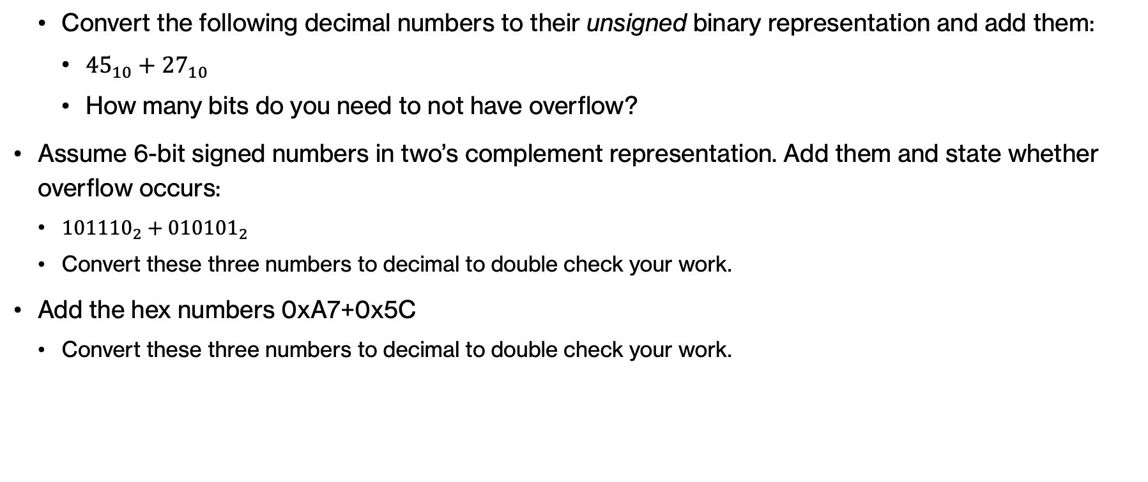
Practice Problems – Problem 1
  Convert the following decimal numbers to their unsigned binary representation and add them:
    ${45}_{10}+{27}_{10}$
    How many bits do you need to not have overflow?
Assume 6-bit signed numbers in two’s complement representation. Add them and state whether overflow occurs:
  ${101110}_{2}​+{010101}_{2}​$
  Convert these three numbers to decimal to double check your work.
Add the hex numbers 0xA7+0x5C
  Convert these three numbers to decimal to double check your work.

Slide 130
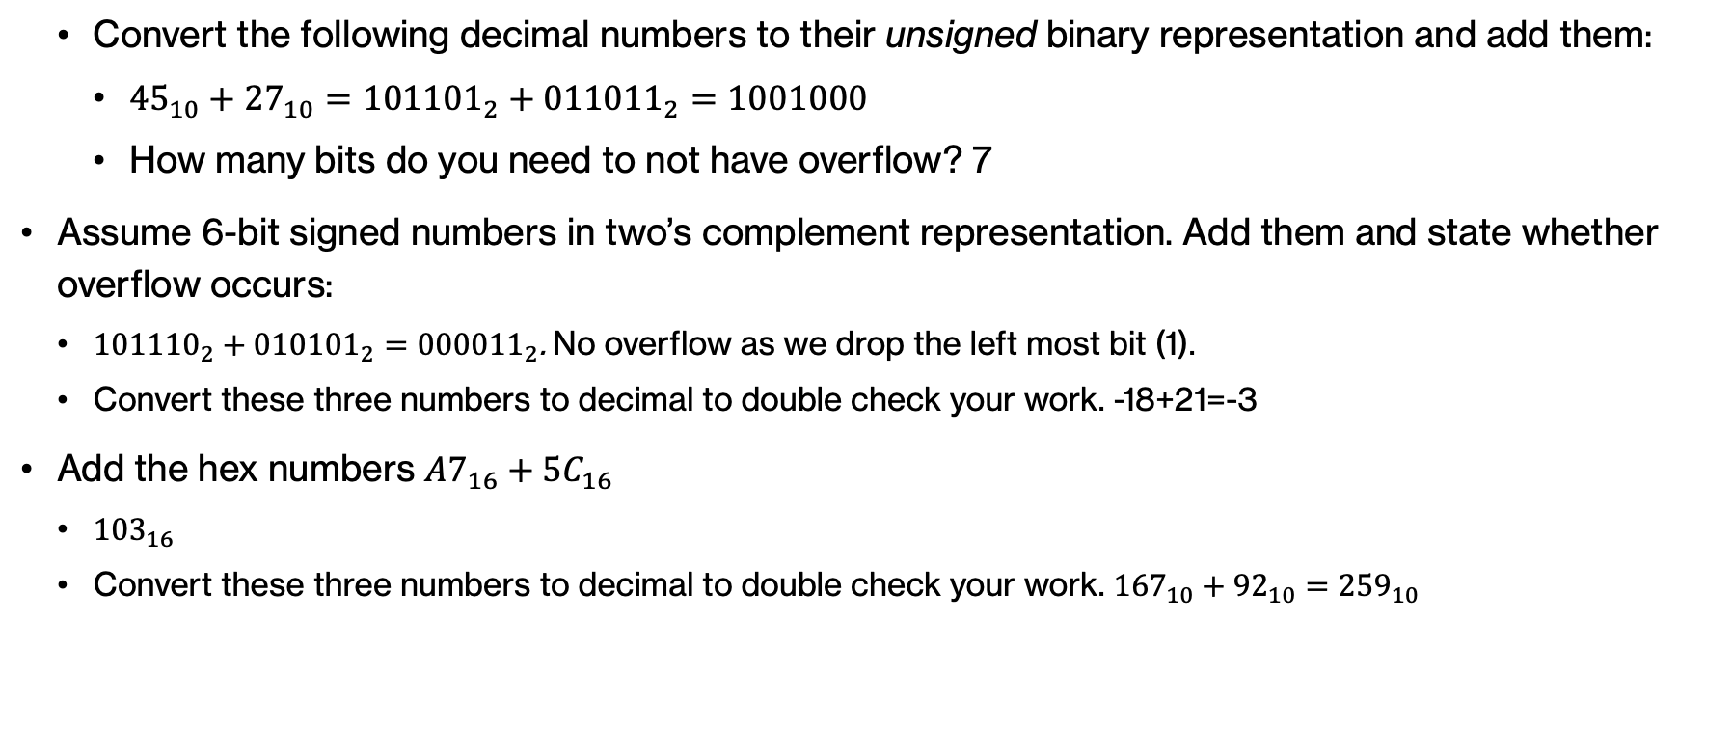
Practice Problems – Answer 1
  Convert the following decimal numbers to their unsigned binary representation and add them:
    ${45}_{10}+{27}_{10}={101101}_{2}+{011011}_{2}=1001000$
    How many bits do you need to not have overflow? 7
Assume 6-bit signed numbers in two’s complement representation. Add them and state whether overflow occurs:
  ${101110}_{2}​+{010101}_{2}​={000011}_{2}$. No overflow as we drop the left most bit (1).
  Convert these three numbers to decimal to double check your work. -18+21=-3
Add the hex numbers $A7_{16}+5C_{16}$
  ${103}_{16}$
  Convert these three numbers to decimal to double check your work. ${167}_{10}+{92}_{10}={259}_{10}$

Slide 131
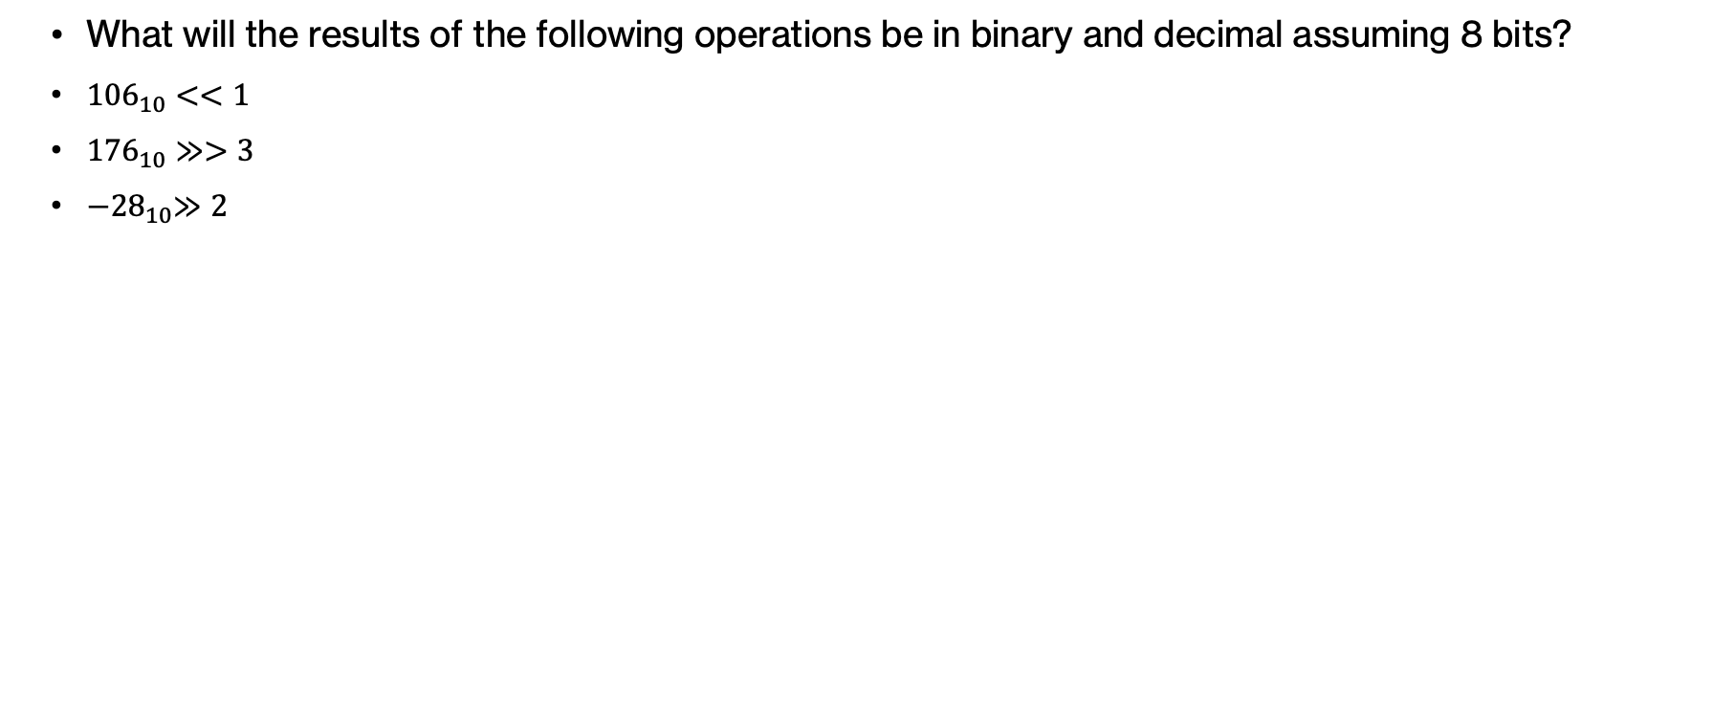
Practice Problems – Problem 2
  What will the results of the following operations be in binary and decimal assuming 8 bits?
  ${−28}_{10}≫2$

Slide 132
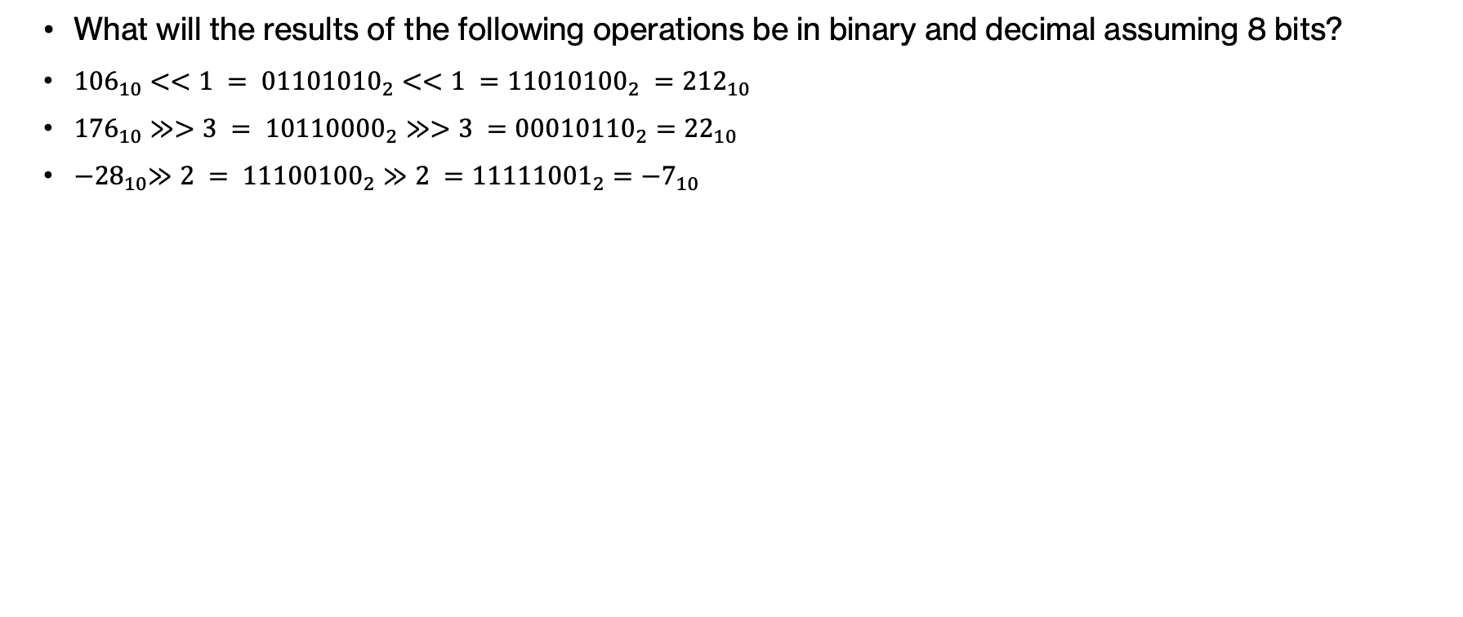
Practice Problems – Answer 2
  What will the results of the following operations be in binary and decimal assuming 8 bits?
  ${−28}_{10}≫2 = {11100100}_{2}≫2 ={11111001}_{2}={−7}_{10}$

