Slide 1
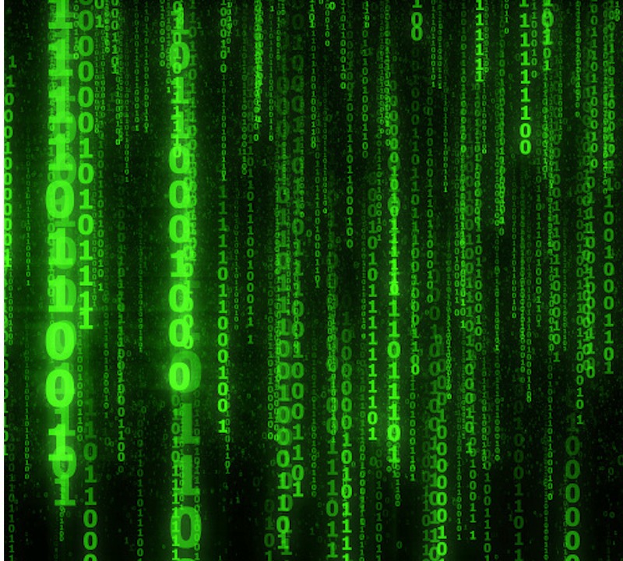
Numeral Systems
Computer Systems
CS51 – Fall 2026
Notes:
Last time we talked about how physical components like transistors allow us to represent data in computers in one of two binary states, 0 or 1, False or True etc. Working with binary data is just one example of a numeral system which we will tackle today. But first, I want us to see how to work with Boolean variables in Python.

Slide 2
Boolean Algebra
in Python

Slide 3
Boolean variables in Python
In Python, Boolean variables are represented through the bool data type. A bool variable can either be True or False. These values can also be seen as equal to 1 and 0, respectively.
For example, raining = False declares a variable called raining and assigns to it the value False.
The comparison operators ==, !=, >, <, >=, <= return bools. For example,
  10 < 0 evaluates to False
  11 >= 11 evaluates to True
  11 > 11.0 evaluates to False
  10 == 10.0 evaluates to True
  10 != 10.0 evaluates to False
Notes:
So far, we have been talking about 0s and 1s either as Boolean variables and have learned we can combine them with logical operators (e.g., AND, OR, XOR, NOT) in Boolean Algebra. We also saw that there is an equivalent representation in circuits, which we will explore in more depth in subsequent class meetings.. In Python, you may have already worked with Boolean variables through the bool data type. A bool variable can be True or False, equivalently to 1 and 0. If you have worked with comparison operators, you have also evaluated Boolean expressions.

Slide 4
Boolean Algebra in Python
We can combine bools and logical operators in Boolean expressions, for example, to evaluate them in conditionals (if statements) and loops (for and while).
Python supports three logical operators:
  not for negation (i.e., ¬)
  and for conjunction (i.e., ∧)
  or for disjunction (i.e., ∨)
Notes:
We can combine bool variables and logical operators in Boolean expressions, for example to evaluate them in conditionals (if statements) and loops, such as the for and while loops. Python also supports not, and, and or.

Slide 5
Short-circuit evaluation in Python
Python supports short-circuiting, a technique that evaluates a logical expression from left to right and stops evaluation once the truth can be determined.
For example, if x=3 and we have the expression:
  x>3 and x<24
  Once Python evaluates x>3 being False and sees that and follows, then it can immediately evaluate the whole expression to False, without needing to evaluate whether x<24.
Notes:
Interestingly, Python supports short-circuiting, a technique that evaluates a logical expression from left to right and stops once the truth can be determined without wasting unnecessarily time by evaluating the rest of the expression. What do you think are the benefits of such approach? that's right, we can optimize our code and not waste unnecessarily time. Here is an example of how short-circuiting works when and is included in the expression. Say we have a variable x set to 3. If we have the expression x>3 and x<24, Python will stop evaluating right once it sees that the False expression x>3 is followed by and because anything that has at least one False, evaluates to False.

Slide 6
Think
Assume x=3 again.
Can you come up with an expression that includes an or operator and which would lead to short-circuiting?
Notes:
Your turn now to create an expression that this time includes an or statement and which would short-circuit.

Slide 7
Think
Assume x=3 again.
Can you come up with an expression that includes an or operator and which would lead to short-circuiting?
  x==3 or x>24
Notes:
For example x==3 would result to True. Once Python sees that True is followed by an or, it doesn't need to evaluate x>24. It can immediately declare that True or ANYTHING will evaluate to True.

Slide 8
Short-circuit evaluation and optimization
Because of short-circuit evaluation, we can avoid deeply nested if statements to handle exceptional cases. For example,
  if x == 0 or (x-1)/x > 0.5: …
  When x is equal to 0, evaluating the second operand of the or statement would cause a divide-by-zero error. But the second disjunct isn’t evaluated when x is equal to 0 because the first operand was True!
Notes:
Because of short-circuit evaluation, we can avoid deeply nested if statements to handle exceptional cases. For example, when x is equal to 0, evaluating the second operand of the or statement would cause a divide-by-zero error. But the second disjunct isn’t evaluated when x is equal to 0 because the first operand was True!

Slide 9
Short-circuit evaluation and optimization
We can take advantage of short-circuit evaluation to make our code a bit faster. For example, when writing an if statement that contains the logical operator and, you should first write what is simpler to calculate or often false before something that is complex to calculate or often true:
  if (simpleOrOftenFalse() and complexOrOftenTrue()):…
Notes:
Short-circuiting allows us to write more condensed if statements or even make our code faster.

Slide 10
PRACTICE TIME – Boolean expressions
Assume the variable x currently stores the value 47. What will the following expressions evaluate to?
  True and not False
  not True or not False
  True and not 0
  False or not 1
  2 < x and x < 50
  x > 2 and < 20
  (2 > x) or (x == 47)
  not (x == x)
  not (x != 3)
  x < 0 and (y/x) == 3
  x > 0 or (y/x) == 3
Notes:
Let’s see whether you can evaluate the following Boolean expressions

Slide 11
ANSWER – Boolean expressions
Assume the variable x currently stores the value 47. What will the following expressions evaluate to?
  True and not False - True
  not True or not False - True
  True and not 0 – True
  False or not 1 - False
  2 < x and x < 50 - True
  x > 2 and < 20 – Invalid syntax
  (2 > x) or (x == 47) - True
  not (x == x) - False
  not (x != 3) – False
  x < 0 and (y/x) == 3 – False
  x > 0 or (y/x) == 3 - True
Notes:
0 corresponds to False and 1 to True! For the last two, because of shortcircuiting, Python will never find out that y was not declared. It will see x<0 evaluate it to False and since then that is connected with AND it knows that the entire statement has to be False. Similarly, x>0 is True and since it's connected with an OR, it doesn't matter, the whole thing will be evaluated to True.

Slide 12
Numeral Systems

Slide 13
Decimal numbers
We are used to numbers that use ten digits: 0, 1, 2, 3, 4, 5, 6, 7, 8, 9.
This arithmetic is called base 10 (denoted as a subscript) and such numbers are called decimal.
To avoid confusion, we use subscripts to indicate a base of a number.
  For example, instead 9247 we will write the number 9247₁₀.
Notes:
Although computer scientists love binary data, we are not used to them in everyday life. Instead, we are accustomed to talking about numbers that use ten digits, 0,…9, which we combine to form longer numbers. This type of arithmetic is called base 10 or decimal (deci means one tenth). To avoid confusion, we will use subscripts to indicate the base of a number, e.g., 9247_{10}

Slide 14
Think
What number is 9247₁₀?
Notes:
But if you think about it, what number is 9247?

Slide 15
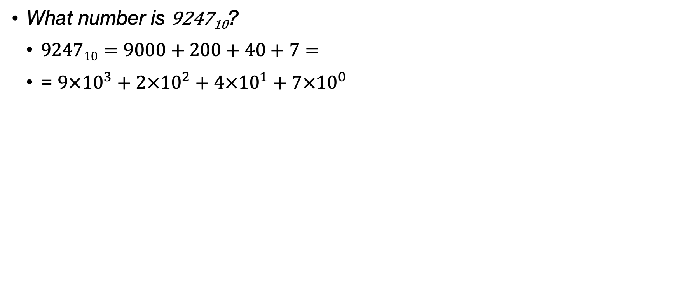
Think
What number is 9247₁₀?
  $\text{9247}\text{10}=9000+200+40+7=$
  = $9×{10}^{3}+2×{10}^{2}+4×{10}^{1}+7×{10}^{0}$
Notes:
In school, you learned that you can break it down as $9000+200+40+7$ which if we think in terms of base 10 can be written as $9×{10}^{3}+2×{10}^{2}+4×{10}^{1}+7×{10}^{0}$

Slide 16
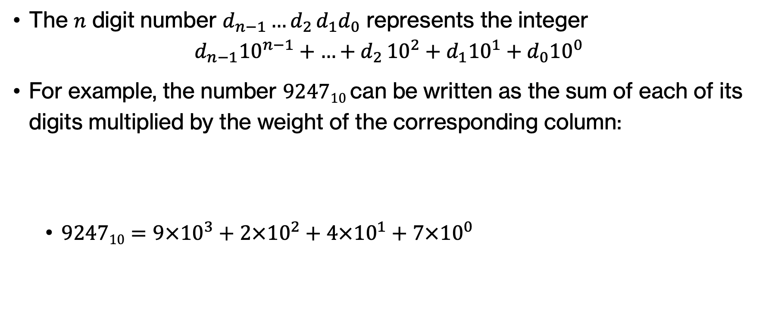
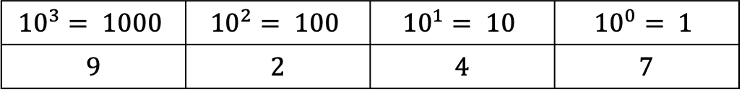
Decimal numbers
The $n$ digit number $d_{n−1}{…d}_{2}d_{1}d_{0}$ represents the integer
$d_{n−1}{10}^{n−1}+{…+d}_{2}{10}^{2}+d_{1}{10}^{1}+d_{0}{10}^{0}$
For example, the number 9247₁₀ can be written as the sum of each of its digits multiplied by the weight of the corresponding column:
    $\text{9247}\text{10}=9×{10}^{3}+2×{10}^{2}+4×{10}^{1}+7×{10}^{0}$
$${10}^{3}= 1000$$ | $${10}^{2}= 100$$ | $${10}^{1}= 10$$ | $${10}^{0}= 1$$
9 | 2 | 4 | 7
Notes:
More formally, if we take a decimal number with n digits we can break it down as the sum of individual digits that are multiplied with increasingly larger powers of 10. Starting with the right-most digit, that would be multiplied with 1 or 10^0. The second to last would be multiplied with 10 or 10^1. Third from the right, would be multiplied with 100 or 10^2 and so on. Notice that each column is 10 times larger than the one on the right.

Slide 17
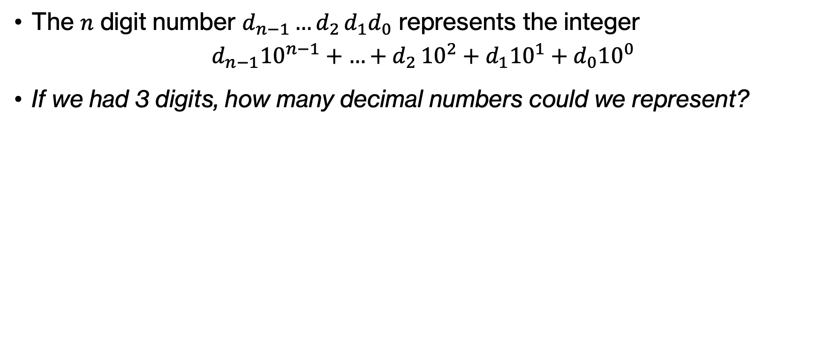
Think
The $n$ digit number $d_{n−1}{…d}_{2}d_{1}d_{0}$ represents the integer
$d_{n−1}{10}^{n−1}+{…+d}_{2}{10}^{2}+d_{1}{10}^{1}+d_{0}{10}^{0}$
If we had 3 digits, how many decimal numbers could we represent?
Notes:
If we know that with n digits, $d_{n−1}{…d}_{2}d_{1}d_{0}$ represents the integer $d_{n−1}{10}^{n−1}+{…+d}_{2}{10}^{2}+d_{1}{10}^{1}+d_{0}{10}^{0}$and we have 3 digits, how many decimal numbers can we represent?

Slide 18
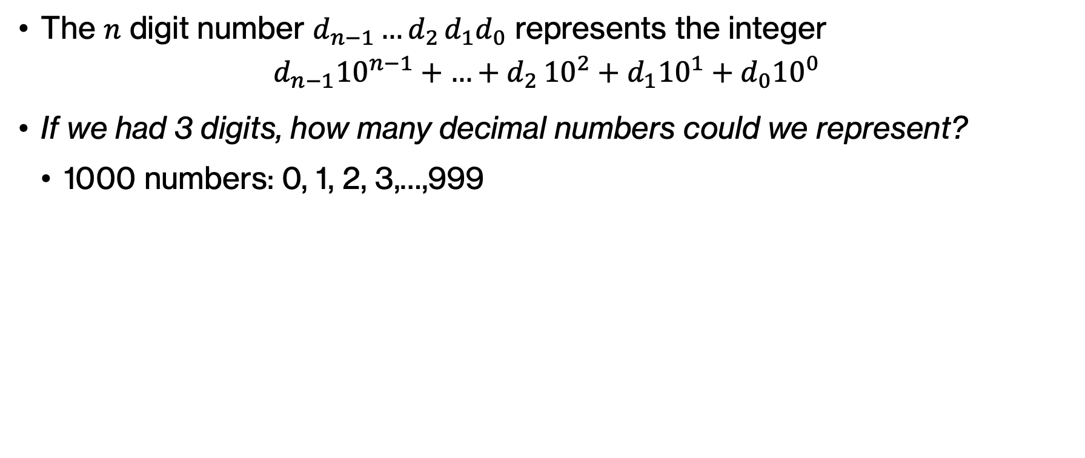
Think
The $n$ digit number $d_{n−1}{…d}_{2}d_{1}d_{0}$ represents the integer
$d_{n−1}{10}^{n−1}+{…+d}_{2}{10}^{2}+d_{1}{10}^{1}+d_{0}{10}^{0}$
If we had 3 digits, how many decimal numbers could we represent?
  1000 numbers: 0, 1, 2, 3,…,999
Notes:
We could represent 1000 numbers: 0, 1, 2, 3, all the way to 999

Slide 19
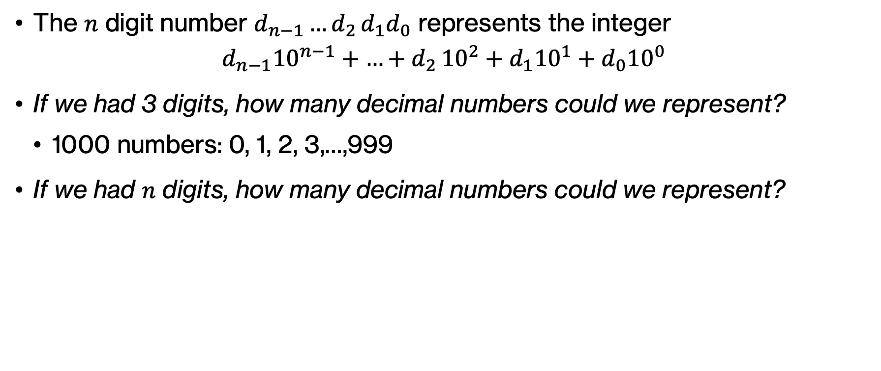
Think
The $n$ digit number $d_{n−1}{…d}_{2}d_{1}d_{0}$ represents the integer
$d_{n−1}{10}^{n−1}+{…+d}_{2}{10}^{2}+d_{1}{10}^{1}+d_{0}{10}^{0}$
If we had 3 digits, how many decimal numbers could we represent?
  1000 numbers: 0, 1, 2, 3,…,999
If we had $n$ digits, how many decimal numbers could we represent?
Notes:
What if we had n digits?

Slide 20
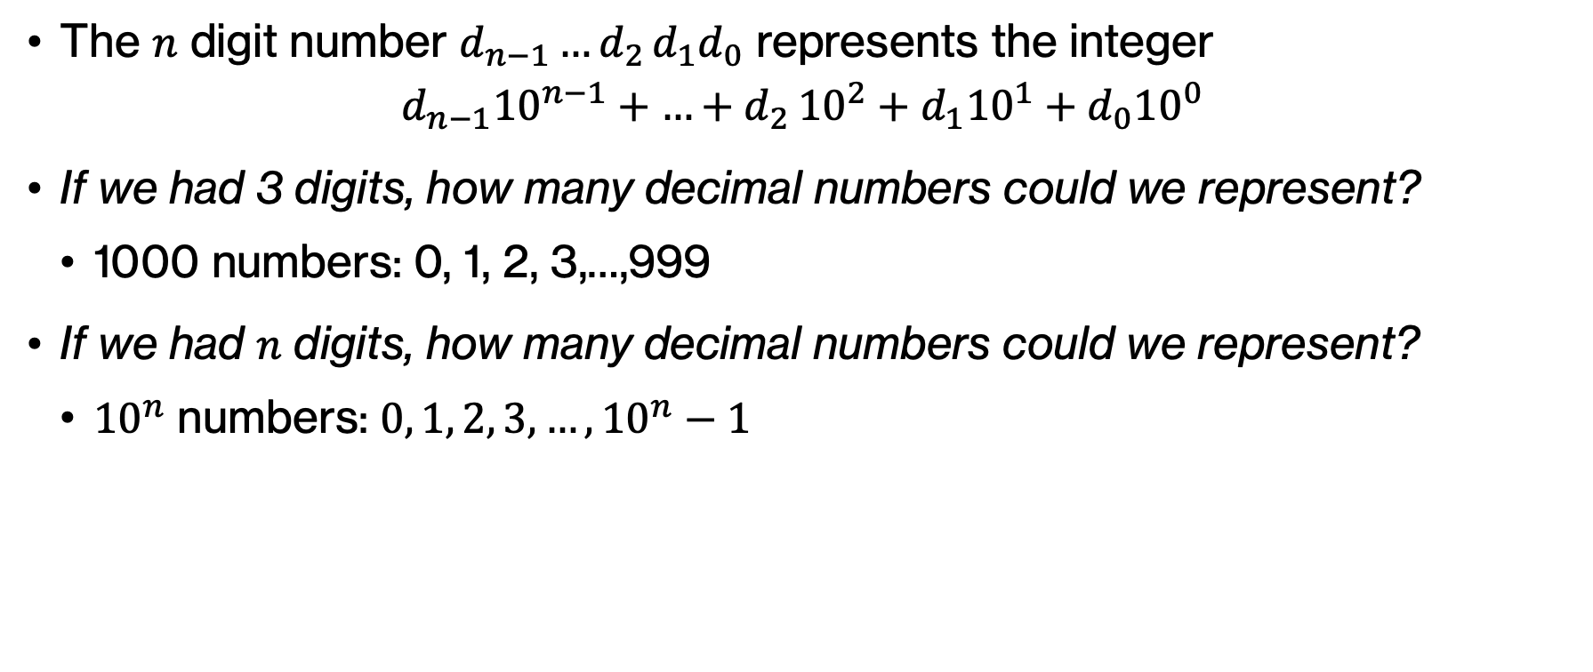
Think
The $n$ digit number $d_{n−1}{…d}_{2}d_{1}d_{0}$ represents the integer
$d_{n−1}{10}^{n−1}+{…+d}_{2}{10}^{2}+d_{1}{10}^{1}+d_{0}{10}^{0}$
If we had 3 digits, how many decimal numbers could we represent?
  1000 numbers: 0, 1, 2, 3,…,999
If we had $n$ digits, how many decimal numbers could we represent?
  ${10}^{n}$ numbers: $0, 1, 2, 3,…,{10}^{n}−1$
Notes:
It would be 10^n, in the range of 0, 1, 2, …, 10^n -1, if we assume only positive numbers

Slide 21
Think
What digits can we use if we are working on base 5?
Notes:
Let's try to extrapolate a bit from the decimal system. In the decimal system, we worked with 10 digits: 0, 1, 2, …, 9. If we were to apply the same thinking, which are the digits we would work with in base 5?

Slide 22
Think
What digits can we use if we are working on base 5?
  0, 1, 2, 3, 4
Notes:
We would have five digits, 0, 1, 2, 3, 4.

Slide 23
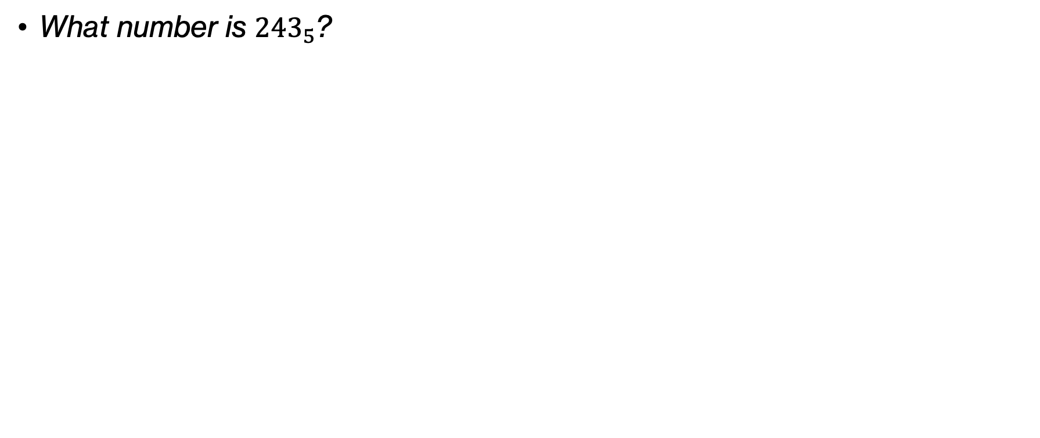
Think
What number is ${243}_{5}$?
Notes:
I will now show you a base-5 number. Thinking similarly to what we did with base 10, what number is 243_5?

Slide 24
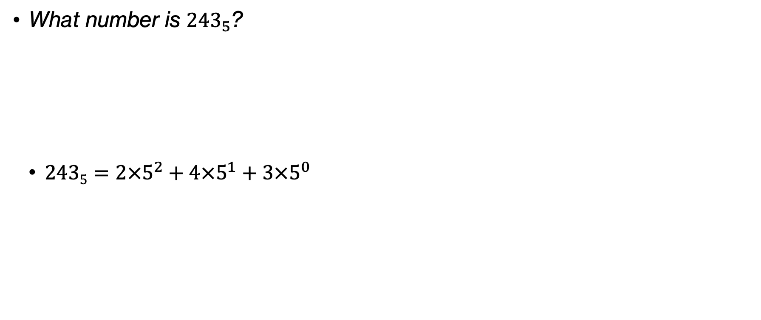
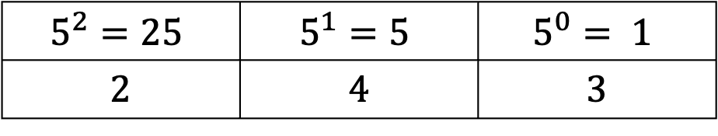
Think
What number is ${243}_{5}$?
  $\text{243}5=2×5^{2}+4×5^{1}+3×5^{0}$
$$5^{2}=25$$ | $$5^{1}=5$$ | $$5^{0}= 1$$
2 | 4 | 3
Notes:
You can start by creating a table for powers of 5. Since we have three digits, we would go from 5^2 down to 5^0. And we can break now 243_5 as $2×5^{2}+4×5^{1}+3×5^{0}$

Slide 25
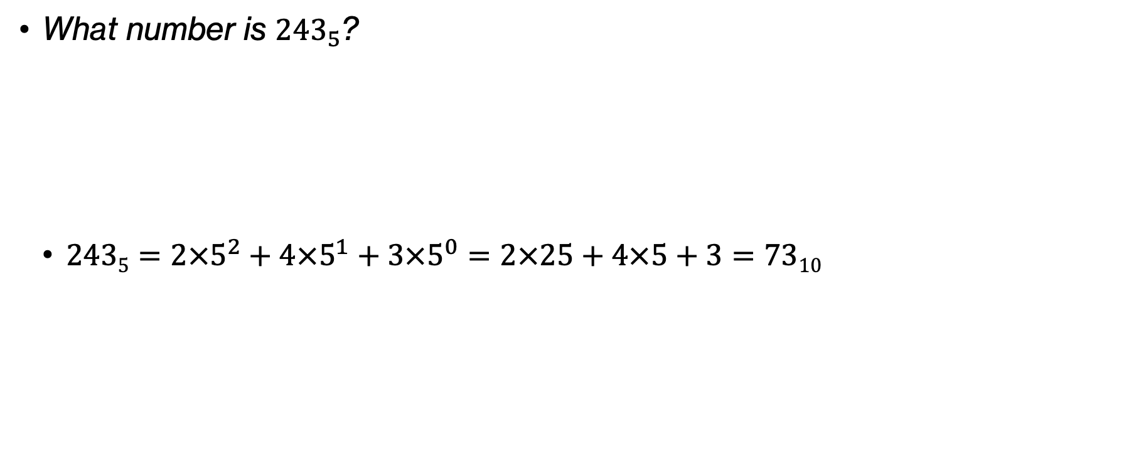
Think
What number is ${243}_{5}$?
  $\text{243}5=2×5^{2}+4×5^{1}+3×5^{0}=2×25+4×5+3=7310$
$$5^{2}=25$$ | $$5^{1}=5$$ | $$5^{0}= 1$$
2 | 4 | 3
Notes:
But this is equal to $2×25+4×5+3=7310$

Slide 26
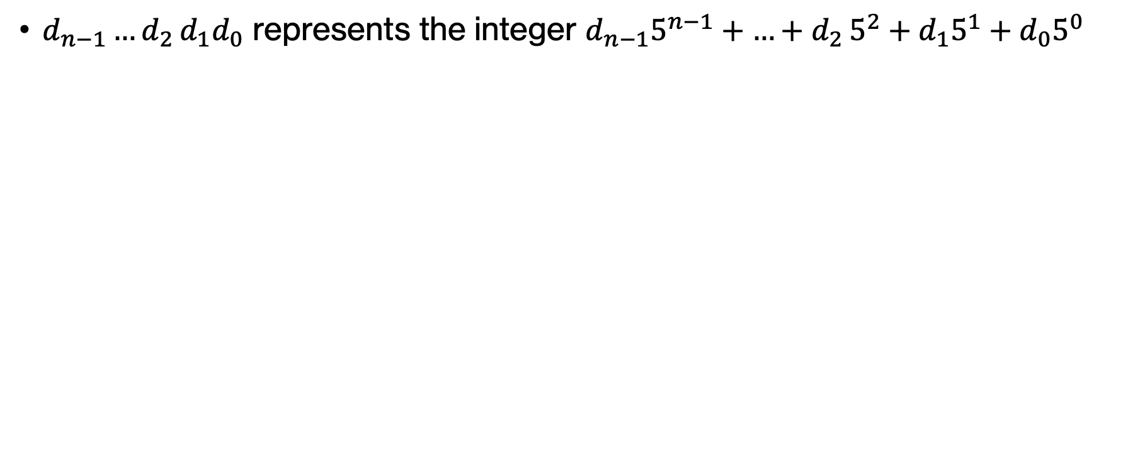
Base 5 numbers
$d_{n−1}{…d}_{2}d_{1}d_{0}$ represents the integer $d_{n−1}5^{n−1}+{…+d}_{2}5^{2}+d_{1}5^{1}+d_{0}5^{0}$
Notes:
Similarly to how we worked with base 10 numbers, we can represent a base 5 number of n digits.

Slide 27
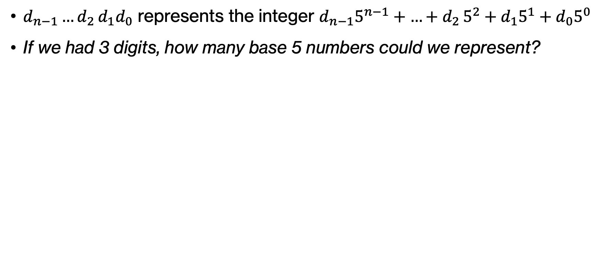
Think
$d_{n−1}{…d}_{2}d_{1}d_{0}$ represents the integer $d_{n−1}5^{n−1}+{…+d}_{2}5^{2}+d_{1}5^{1}+d_{0}5^{0}$
If we had 3 digits, how many base 5 numbers could we represent?
Notes:
Had we had 3 digits, how many base 5 numbers could we represent

Slide 28
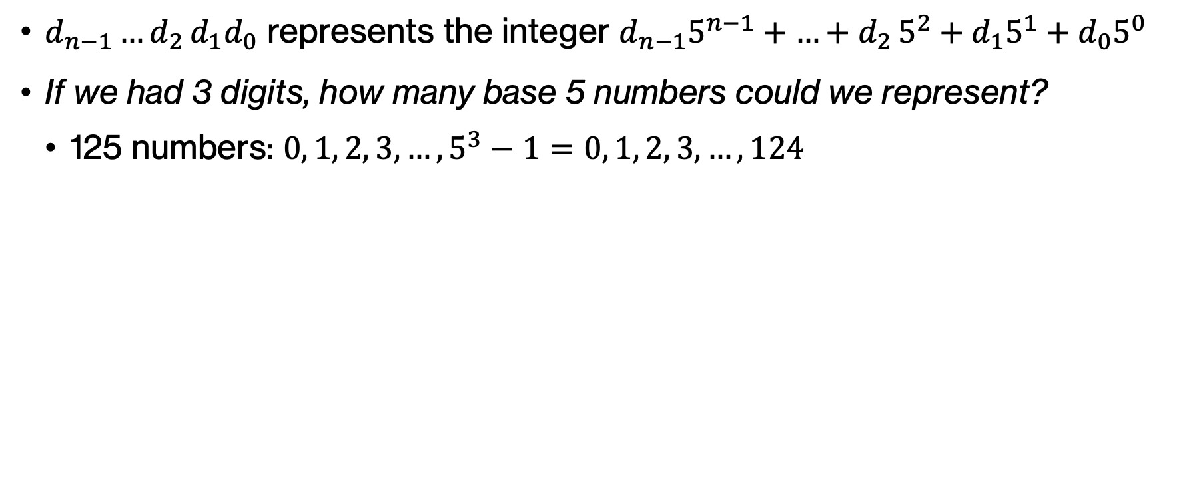
Think
$d_{n−1}{…d}_{2}d_{1}d_{0}$ represents the integer $d_{n−1}5^{n−1}+{…+d}_{2}5^{2}+d_{1}5^{1}+d_{0}5^{0}$
If we had 3 digits, how many base 5 numbers could we represent?
  125 numbers: $0, 1, 2, 3, …, 5^{3}−1=0, 1, 2, 3, …,124$
Notes:
Assuming positive numbers only, the range would be 0, 12, 3, 5^3-1, that is 125 numbers

Slide 29
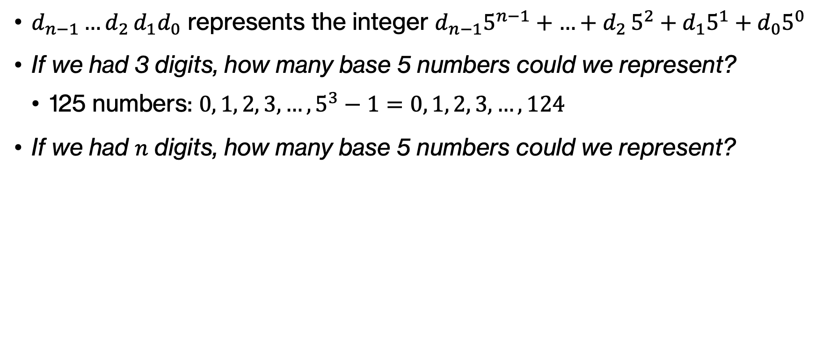
Think
$d_{n−1}{…d}_{2}d_{1}d_{0}$ represents the integer $d_{n−1}5^{n−1}+{…+d}_{2}5^{2}+d_{1}5^{1}+d_{0}5^{0}$
If we had 3 digits, how many base 5 numbers could we represent?
  125 numbers: $0, 1, 2, 3, …, 5^{3}−1=0, 1, 2, 3, …,124$
If we had $n$ digits, how many base 5 numbers could we represent?
Notes:
What if we had n digits?

Slide 30
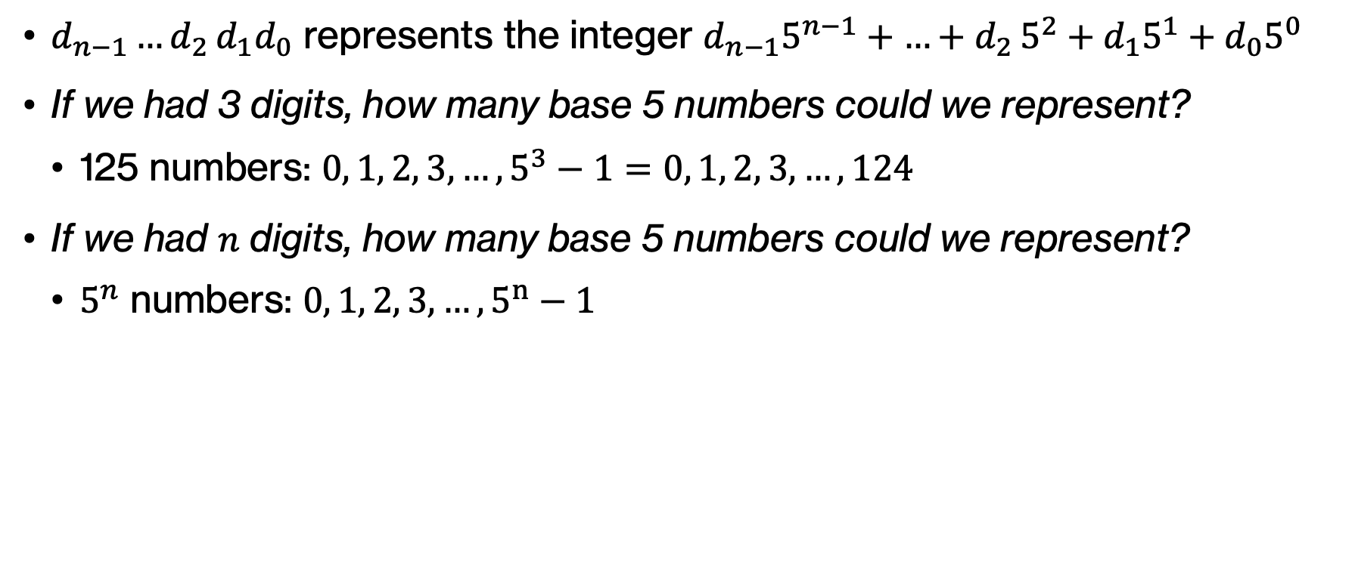
Think
$d_{n−1}{…d}_{2}d_{1}d_{0}$ represents the integer $d_{n−1}5^{n−1}+{…+d}_{2}5^{2}+d_{1}5^{1}+d_{0}5^{0}$
If we had 3 digits, how many base 5 numbers could we represent?
  125 numbers: $0, 1, 2, 3, …, 5^{3}−1=0, 1, 2, 3, …,124$
If we had $n$ digits, how many base 5 numbers could we represent?
  $5^{n}$ numbers: $0, 1, 2, 3, …, 5^{n}−1$
Notes:
5^n numbers

Slide 31
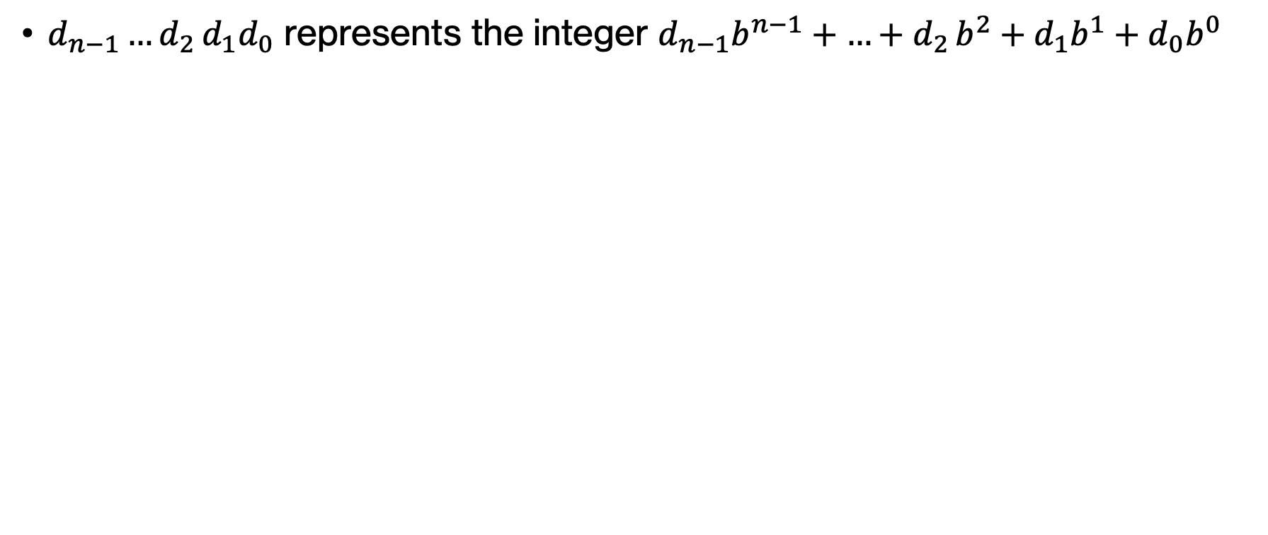
Numbers in other bases
$d_{n−1}{…d}_{2}d_{1}d_{0}$ represents the integer $d_{n−1}b^{n−1}+{…+d}_{2}b^{2}+d_{1}b^{1}+d_{0}b^{0}$
Notes:
Again, we can extrapolate this to any arbitrary base b

Slide 32
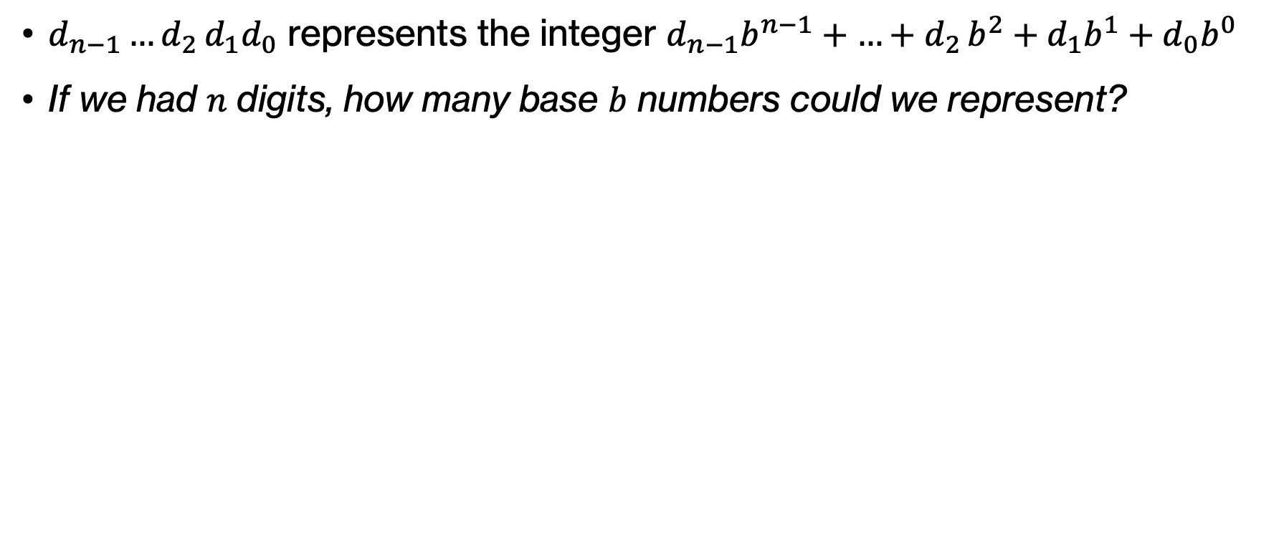
Think
$d_{n−1}{…d}_{2}d_{1}d_{0}$ represents the integer $d_{n−1}b^{n−1}+{…+d}_{2}b^{2}+d_{1}b^{1}+d_{0}b^{0}$
If we had $n$ digits, how many base $b$ numbers could we represent?
Notes:
So how many base b numbers could we represent with n digits?

Slide 33
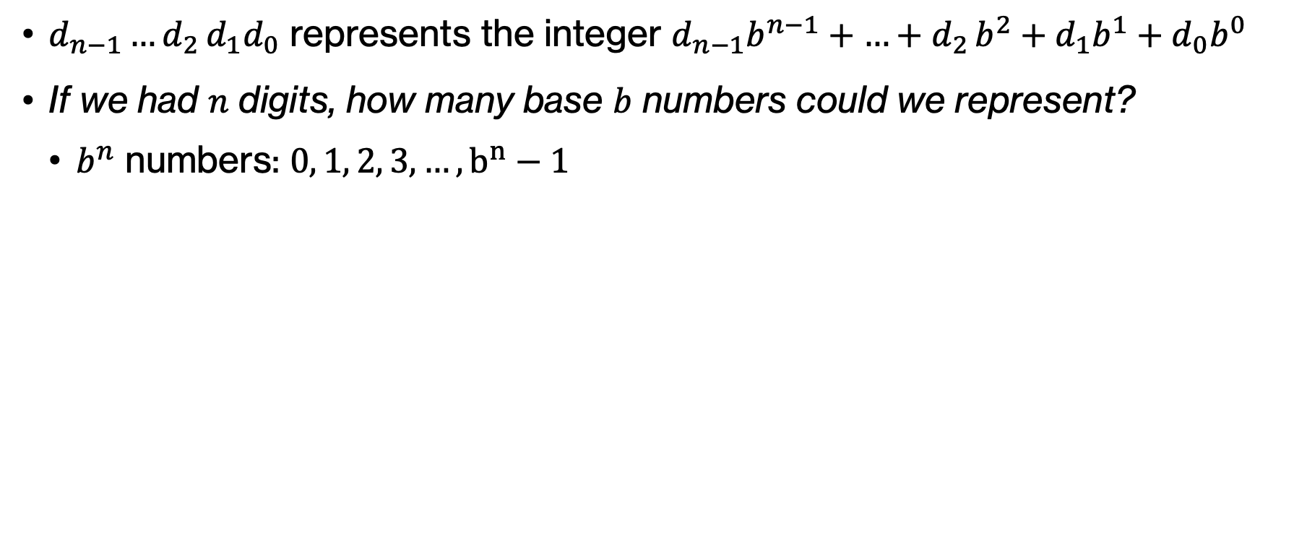
Think
$d_{n−1}{…d}_{2}d_{1}d_{0}$ represents the integer $d_{n−1}b^{n−1}+{…+d}_{2}b^{2}+d_{1}b^{1}+d_{0}b^{0}$
If we had $n$ digits, how many base $b$ numbers could we represent?
  $b^{n}$ numbers: $0, 1, 2, 3, …, b^{n}−1$
Notes:
b^n

Slide 34
Think
What are the valid digits for base 2 numbers?
Notes:
Ok let's get more concrete again. If we work with base 2 numbers, what are the valid digits we have at our disposal?

Slide 35
Think
What are the valid digits for base 2 numbers?
  0, 1
Notes:
Did you get 0 and 1?

Slide 36
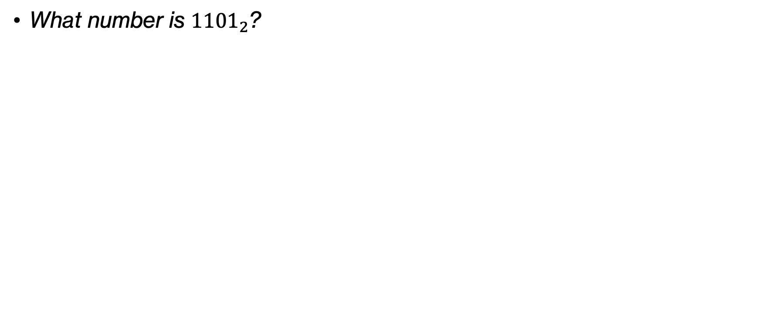
Think
What number is ${1101}_{2}$?
Notes:
I will now show you a base-2 number. Thinking similarly to what we did with base 10 and 5, what number is 1101_2?

Slide 37
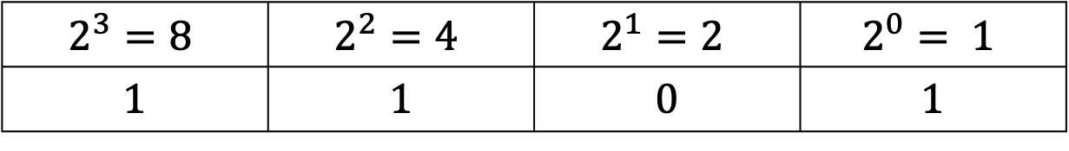
Think
What number is ${1101}_{2}$?
$$2^{3}=8$$ | $$2^{2}=4$$ | $$2^{1}=2$$ | $$2^{0}= 1$$
1 | 1 | 0 | 1
Notes:
Let's start by populating the table with powers of 2.

Slide 38
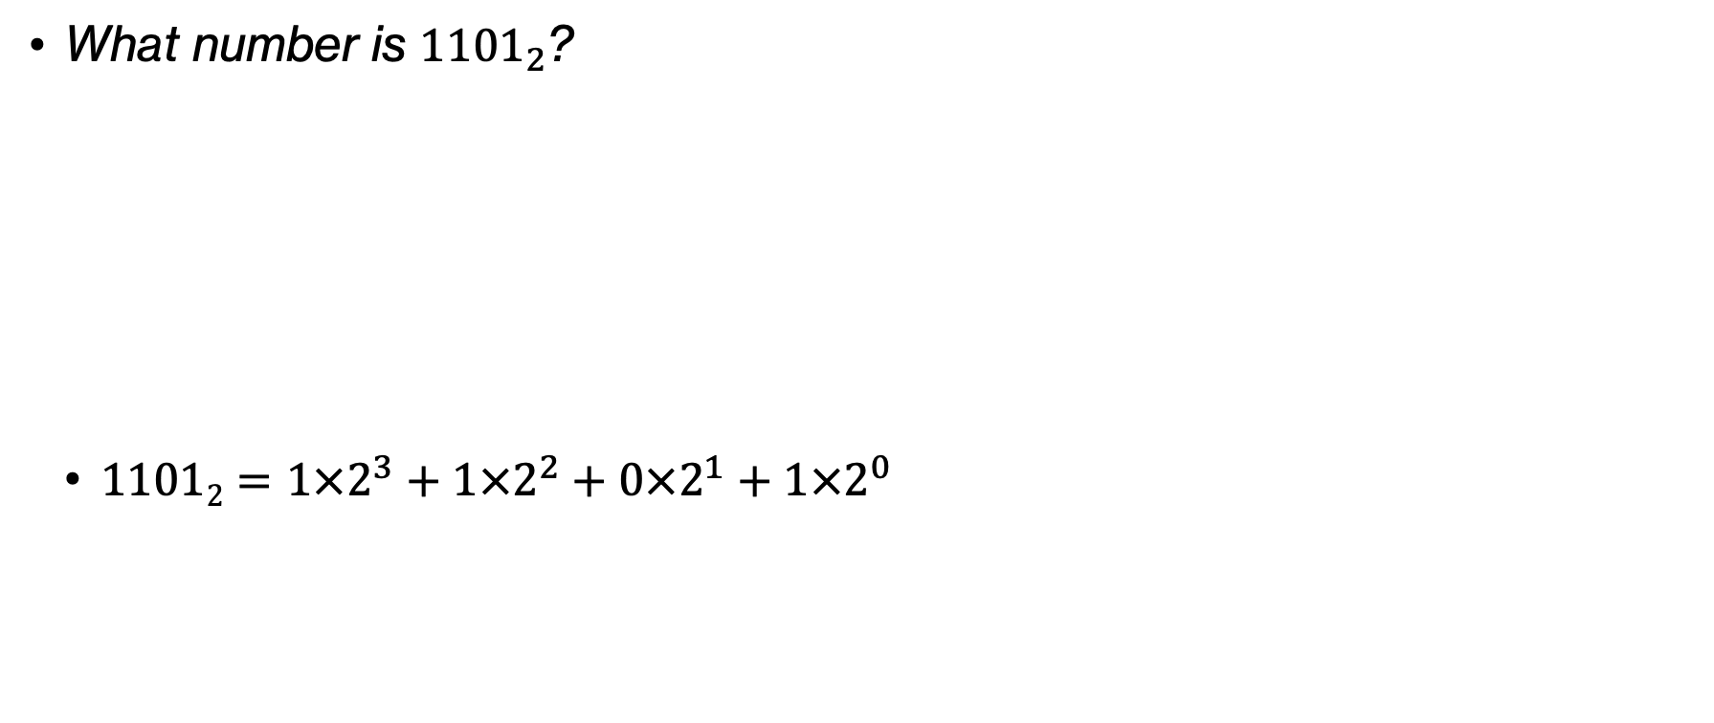
Think
What number is ${1101}_{2}$?
  $\text{11}012=1×2^{3}+1×2^{2}+0×2^{1}+1×2^{0}$
$$2^{3}=8$$ | $$2^{2}=4$$ | $$2^{1}=2$$ | $$2^{0}= 1$$
1 | 1 | 0 | 1

Slide 39
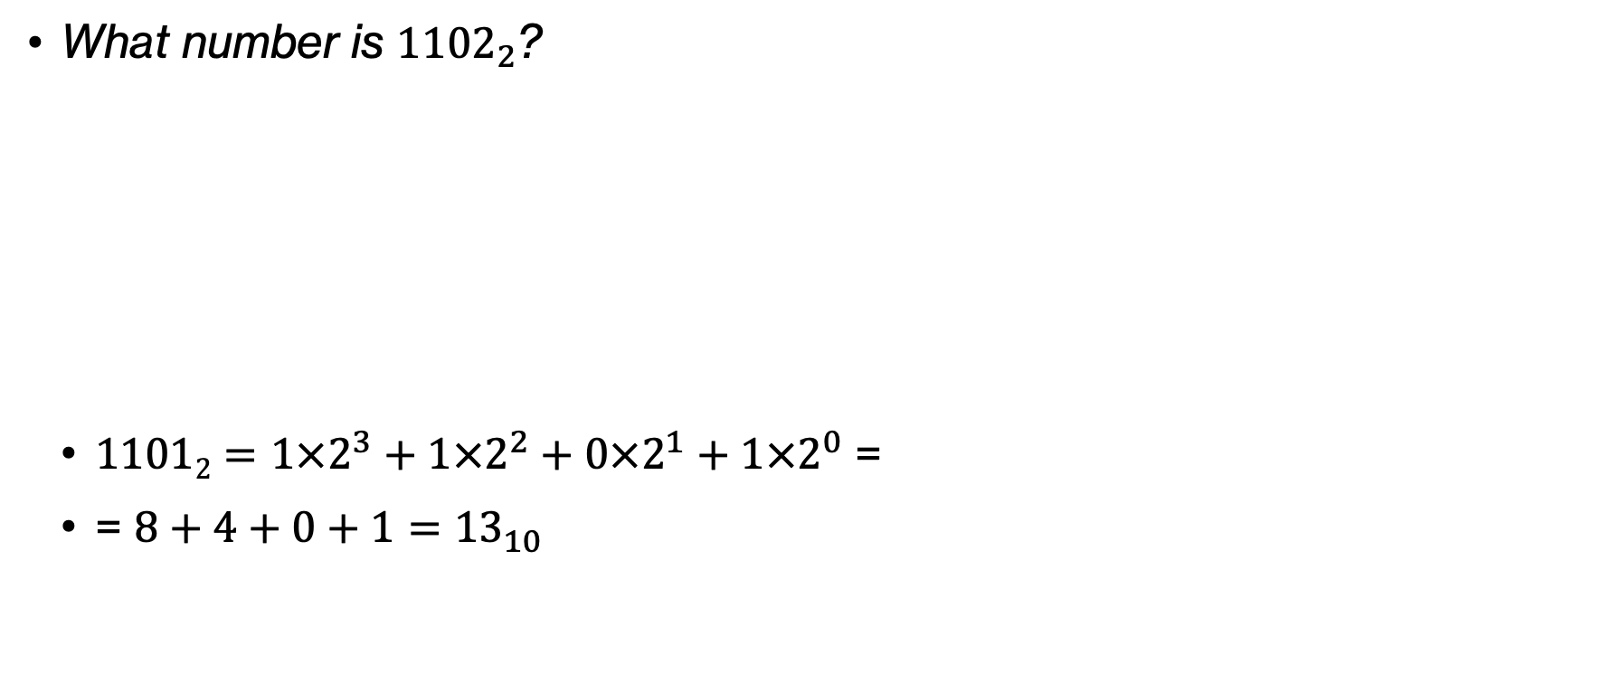
Think
What number is ${1102}_{2}$?
  $\text{11}012=1×2^{3}+1×2^{2}+0×2^{1}+1×2^{0}$ =
  = $8+4+0+1={13}_{10}$
$$2^{3}=8$$ | $$2^{2}=4$$ | $$2^{1}=2$$ | $$2^{0}= 1$$
1 | 1 | 0 | 1
Notes:
which translates to 13 in decimal.

Slide 40
Least and most significant bits
The left-most bit is the most significant bit (MSB).
The right-most is the least significant bit (LSB).
Notes:
You will occasionally hear me talk about least and most significant bits. The leftmost bit is the most significant (think about it, it's the one that contributes the biggest weight). The right most is the least significant.

Slide 41
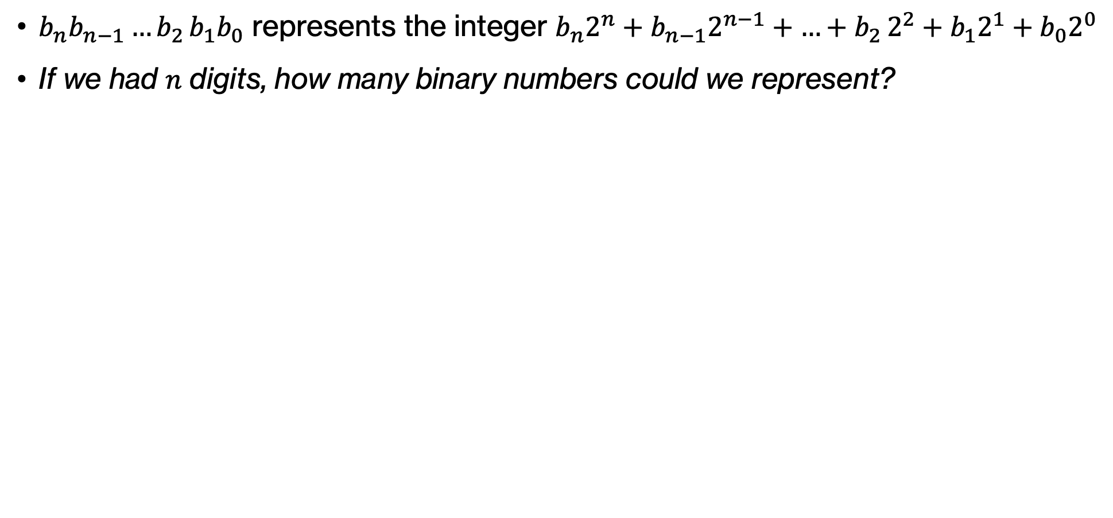
Think
$b_{n}b_{n−1}{…b}_{2}b_{1}b_{0}$ represents the integer $b_{n}2^{n}+b_{n−1}2^{n−1}+{…+b}_{2}2^{2}+b_{1}2^{1}+b_{0}2^{0}$
If we had $n$ digits, how many binary numbers could we represent?
Notes:
Going back to the activity we have repeated before, how many binary numbers can we represent with n digits>

Slide 42
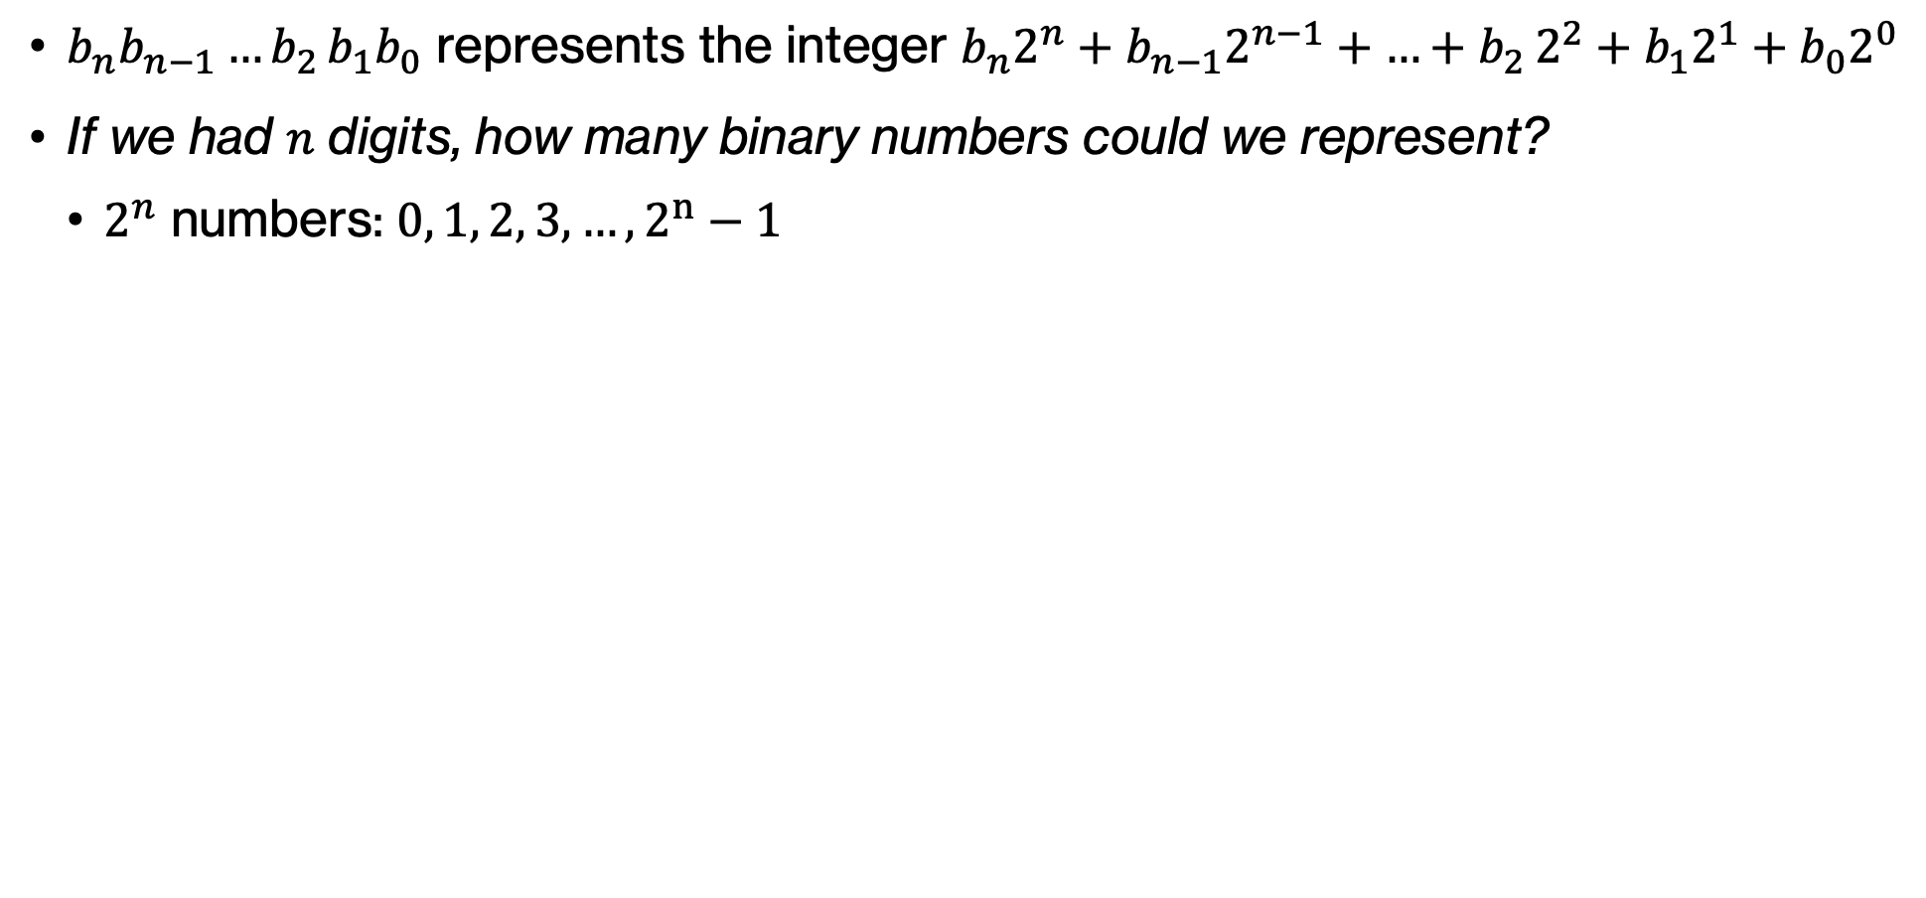
Think
$b_{n}b_{n−1}{…b}_{2}b_{1}b_{0}$ represents the integer $b_{n}2^{n}+b_{n−1}2^{n−1}+{…+b}_{2}2^{2}+b_{1}2^{1}+b_{0}2^{0}$
If we had $n$ digits, how many binary numbers could we represent?
  $2^{n}$ numbers: $0, 1, 2, 3, …, 2^{n}−1$
Notes:
2^n

Slide 43
Binary numbers and their decimal equivalents
1-bit binary | 2-bit binary | 3-bit binary | 4-bit binary | Decimal equivalent
0 | 00 | 000 | 0000 | 0
1 | 01 | 001 | 0001 | 1
 | 10 | 010 | 0010 | 2
 | 11 | 011 | 0011 | 3
 |  | 100 | 0100 | 4
 |  | 101 | 0101 | 5
 |  | 110 | 0110 | 6
 |  | 111 | 0111 | 7
 |  |  | 1000 | 8
 |  |  | 1001 | 9
 |  |  | 1010 | 10
 |  |  | 1011 | 11
 |  |  | 1100 | 12
 |  |  | 1101 | 13
 |  |  | 1110 | 14
 |  |  | 1111 | 15
Notes:
Here is what that would look like if we take binary numbers with 1, 2, 3, or 4 bits. You can also see the decimal equivalent. With 1 bit, we can represent 2 values, with 2 bits 4, with 3 bits 8 and 4 bits 16, and so on.

Slide 44
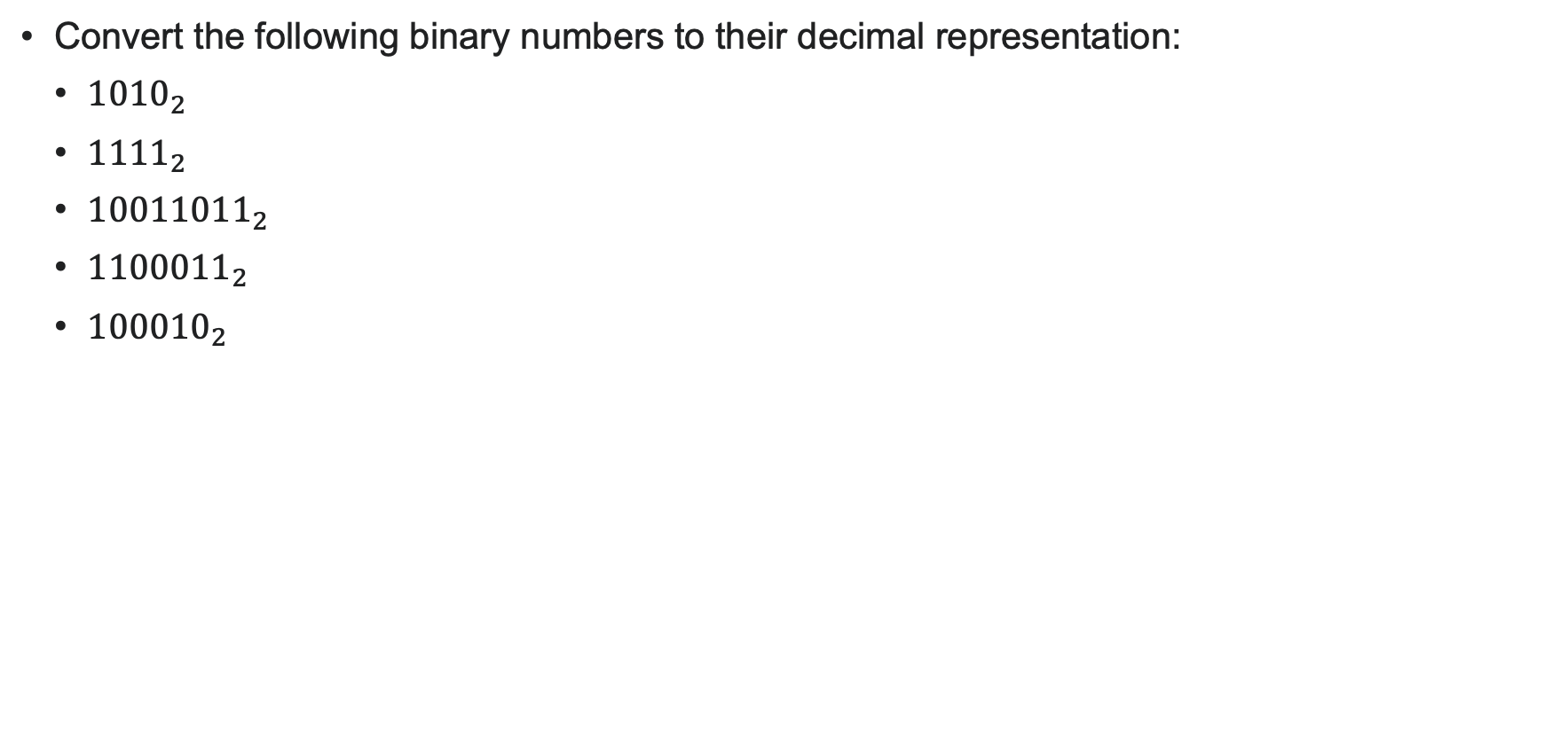
PRACTICE TIME
Convert the following binary numbers to their decimal representation:
  ${1010}_{2}$
  ${1111}_{2}$
  ${10011011}_{2}$
  ${1100011}_{2}$
  ${100010}_{2}$
Notes:
Let's practice, by converting the following binary numbers to their decimal representation.

Slide 45
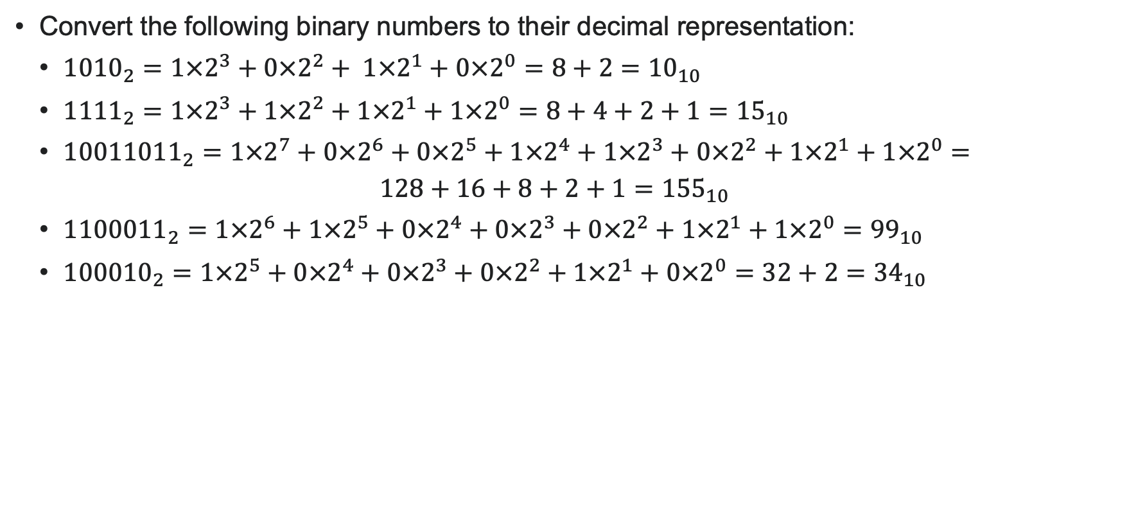
PRACTICE TIME - ANSWER
Convert the following binary numbers to their decimal representation:
  ${1010}_{2}=1×2^{3}+0×2^{2}+ 1×2^{1}+0×2^{0}={8+2=10}_{10}$
  ${1111}_{2}=1×2^{3}+1×2^{2}+1×2^{1}+1×2^{0}={8+4+2+1=15}_{10}$
  ${10011011}_{2}=1×2^{7}+0×2^{6}+0×2^{5}+1×2^{4}+1×2^{3}+0×2^{2}+1×2^{1}+1×2^{0}=$
  $128+16+8+2+1={155}_{10}$
  ${1100011}_{2}=1×2^{6}+1×2^{5}+0×2^{4}+0×2^{3}+0×2^{2}+1×2^{1}+1×2^{0}={99}_{10}$
  ${100010}_{2}=1×2^{5}+0×2^{4}+0×2^{3}+0×2^{2}+1×2^{1}+0×2^{0}=32+2={34}_{10}$
Notes:
Did you get this?

Slide 46
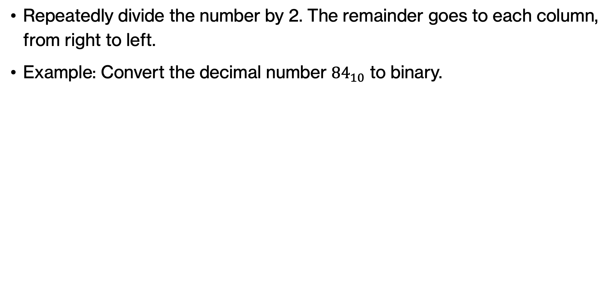
Decimal to binary conversion
Repeatedly divide the number by 2. The remainder goes to each column, from right to left.
Example: Convert the decimal number ${84}_{10}$ to binary.
Divide by 2 | Remainder
84 |  | LSB
 |  | MSB
MSB |  |  |  |  |  | LSB
Notes:
How do we go from decimal numbers to binary? We repeatedly divide the number by 2 and the remainder goes to each column from right to left. Let' see how we can convert the decimal number 84 to binary. We start by writing 84 and we divide it by 2.

Slide 47
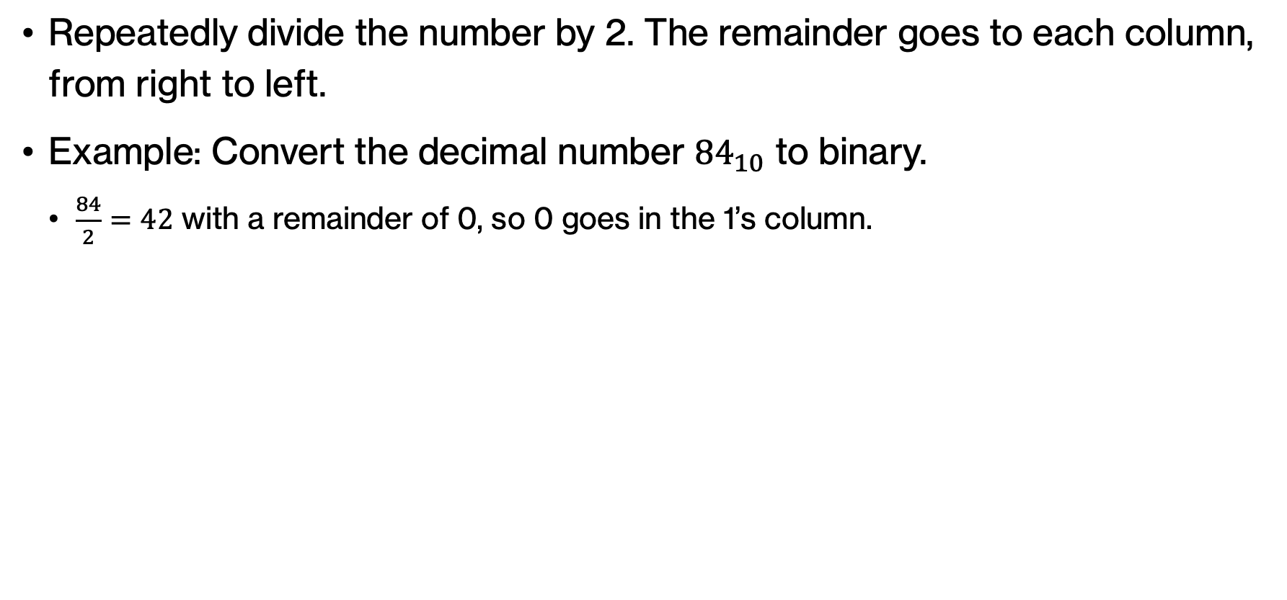
Decimal to binary conversion
Repeatedly divide the number by 2. The remainder goes to each column, from right to left.
Example: Convert the decimal number ${84}_{10}$ to binary.
  $\frac{84}{2}=42$ with a remainder of 0, so 0 goes in the 1’s column.
Divide by 2 | Remainder
84 | 0 | LSB
42
 |  | MSB
 |  |  |  |  |  | 1
 |  |  |  |  |  | 0
MSB |  |  |  |  |  | LSB
Notes:
84/2 = 42 with a remainder of 0. So 0 goes in the 1s column. We next divide 42 by 2.

Slide 48
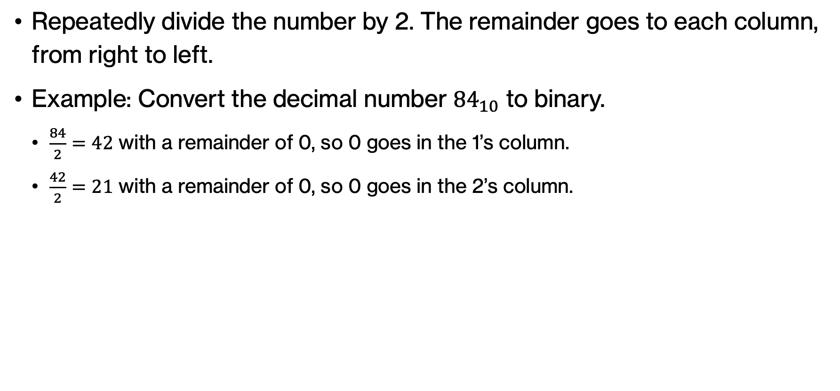
Decimal to binary conversion
Repeatedly divide the number by 2. The remainder goes to each column, from right to left.
Example: Convert the decimal number ${84}_{10}$ to binary.
  $\frac{84}{2}=42$ with a remainder of 0, so 0 goes in the 1’s column.
  $\frac{42}{2}=21$ with a remainder of 0, so 0 goes in the 2’s column.
Divide by 2 | Remainder
84 | 0 | LSB
42 | 0
21
 |  | MSB
 |  |  |  |  | 2 | 1
 |  |  |  |  | 0 | 0
MSB |  |  |  |  |  | LSB
Notes:
42/2 – 21 with a remainder of 0. So 0 goes to the 2s column. We next divide 21 by 2.

Slide 49
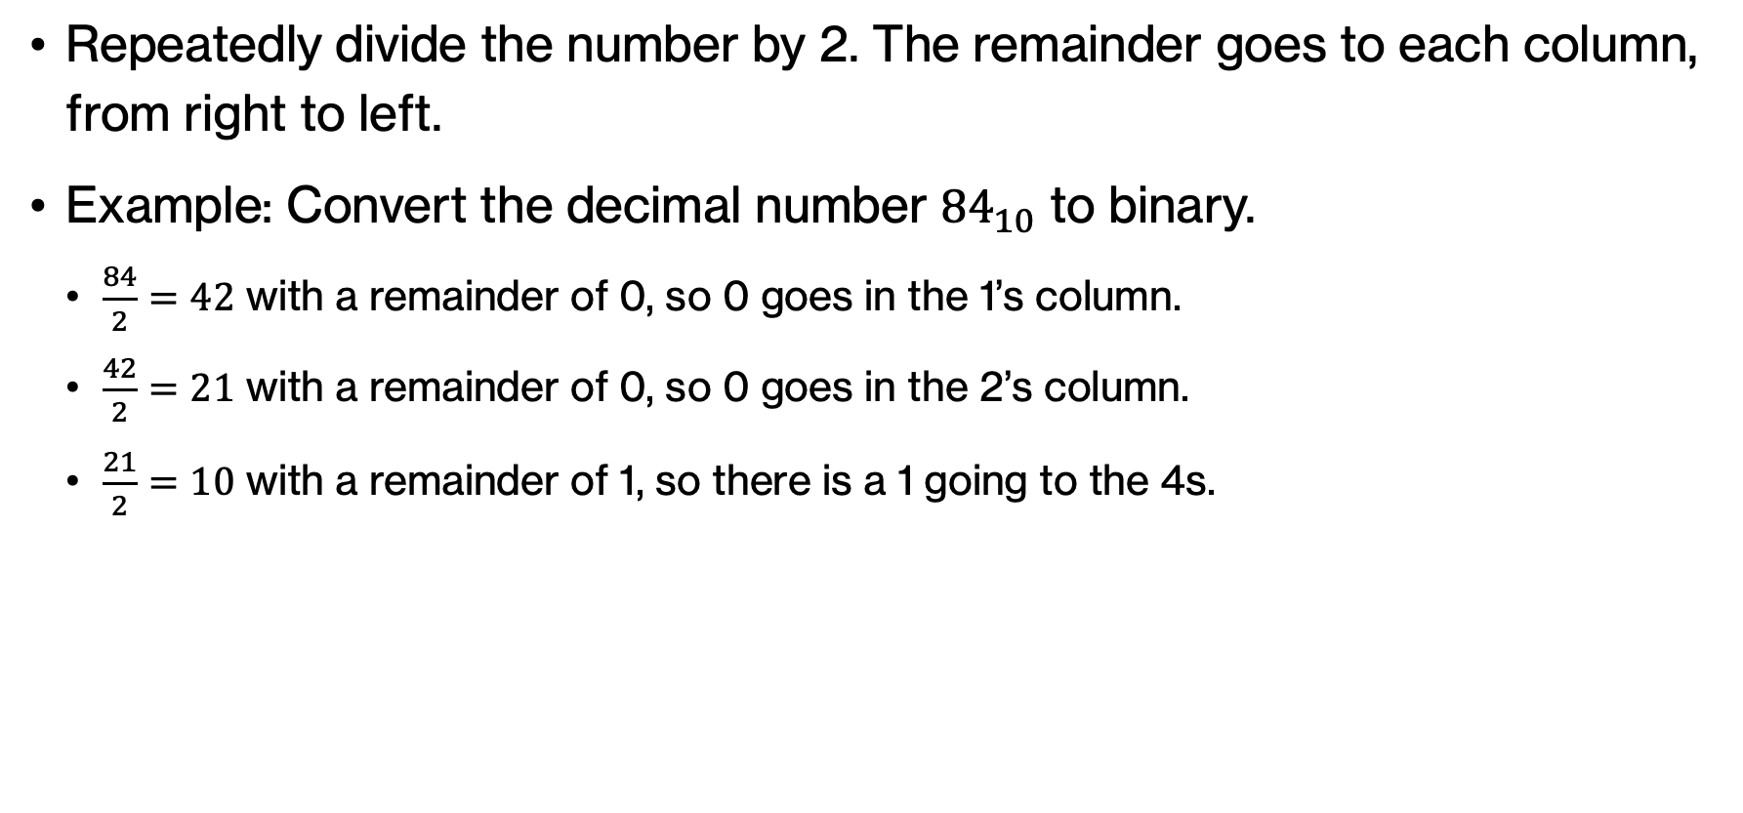
Decimal to binary conversion
Repeatedly divide the number by 2. The remainder goes to each column, from right to left.
Example: Convert the decimal number ${84}_{10}$ to binary.
  $\frac{84}{2}=42$ with a remainder of 0, so 0 goes in the 1’s column.
  $\frac{42}{2}=21$ with a remainder of 0, so 0 goes in the 2’s column.
  $\frac{21}{2}=10$ with a remainder of 1, so there is a 1 going to the 4s.
Divide by 2 | Remainder
84 | 0 | LSB
42 | 0
21 | 1
 |  | MSB
 |  |  |  | 4 | 2 | 1
 |  |  |  | 1 | 0 | 0
MSB |  |  |  |  |  | LSB
Notes:
21/2 = 10 with a remainder of 1. So 1 goes to the 4s column. We next divide 10 by 2.

Slide 50
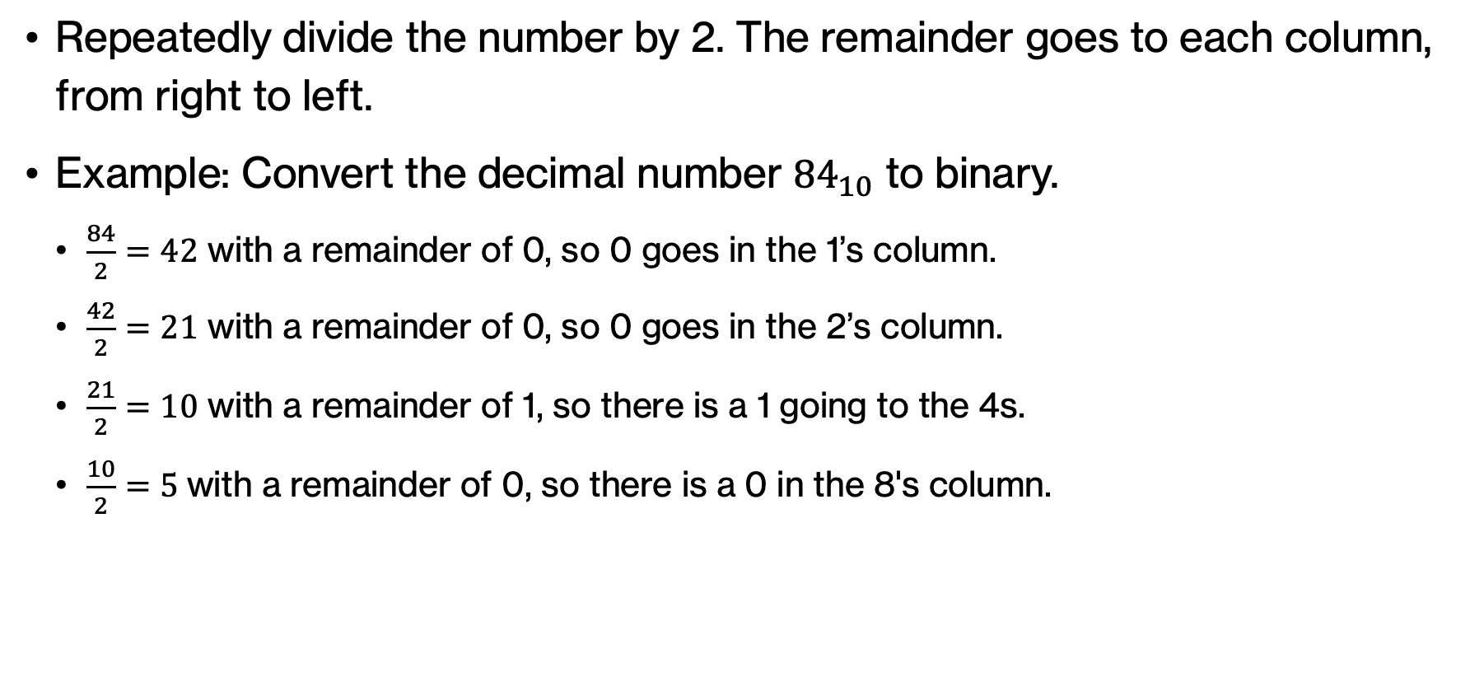
Decimal to binary conversion
Repeatedly divide the number by 2. The remainder goes to each column, from right to left.
Example: Convert the decimal number ${84}_{10}$ to binary.
  $\frac{84}{2}=42$ with a remainder of 0, so 0 goes in the 1’s column.
  $\frac{42}{2}=21$ with a remainder of 0, so 0 goes in the 2’s column.
  $\frac{21}{2}=10$ with a remainder of 1, so there is a 1 going to the 4s.
  $\frac{10}{2}=5 \text{with a remainder of 0}$, so there is a 0 in the 8's column.
Divide by 2 | Remainder
84 | 0 | LSB
42 | 0
21 | 1
10 | 0
5
 |  | MSB
 |  |  | 8 | 4 | 2 | 1
 |  |  | 0 | 1 | 0 | 0
MSB |  |  |  |  |  | LSB
Notes:
10/2 = 5 with a remainder of 0 so 0 goes to the 8s column and we next divide 5 by 2.

Slide 51
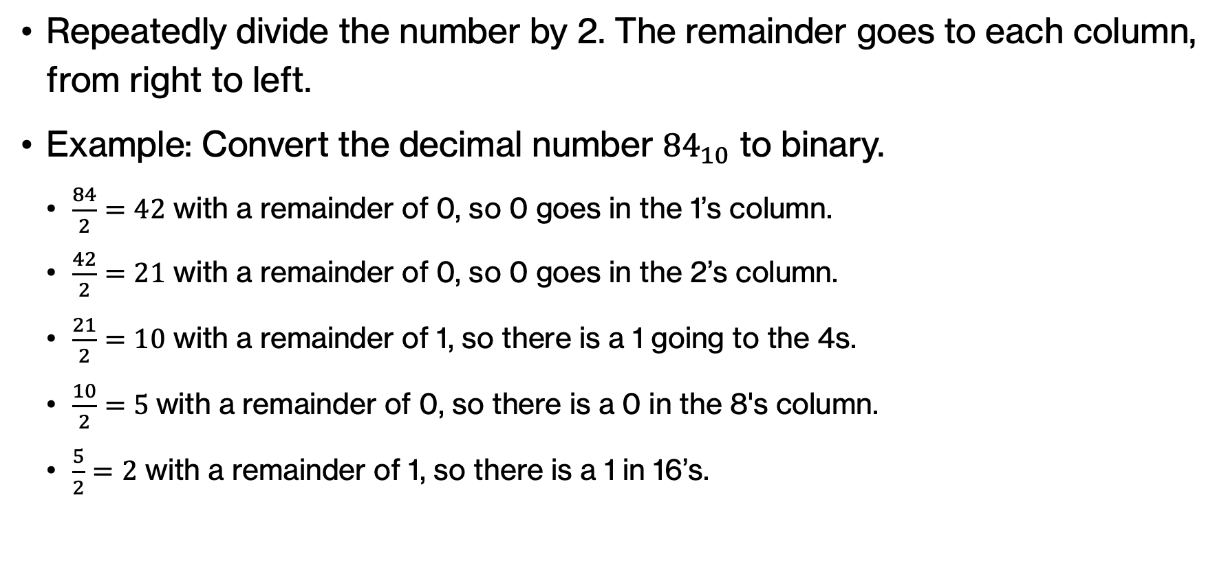
Decimal to binary conversion
Repeatedly divide the number by 2. The remainder goes to each column, from right to left.
Example: Convert the decimal number ${84}_{10}$ to binary.
  $\frac{84}{2}=42$ with a remainder of 0, so 0 goes in the 1’s column.
  $\frac{42}{2}=21$ with a remainder of 0, so 0 goes in the 2’s column.
  $\frac{21}{2}=10$ with a remainder of 1, so there is a 1 going to the 4s.
  $\frac{10}{2}=5 \text{with a remainder of 0}$, so there is a 0 in the 8's column.
  $\frac{5}{2}=2$ with a remainder of 1, so there is a 1 in 16’s.
Divide by 2 | Remainder
84 | 0 | LSB
42 | 0
21 | 1
10 | 0
5 | 1
2
 |  | MSB
 |  | 16 | 8 | 4 | 2 | 1
 |  | 1 | 0 | 1 | 0 | 0
MSB |  |  |  |  |  | LSB
Notes:
5/2=2 with a remainder of 1. So 1 goes to the 16s column. We next divide 2 by 2.

Slide 52
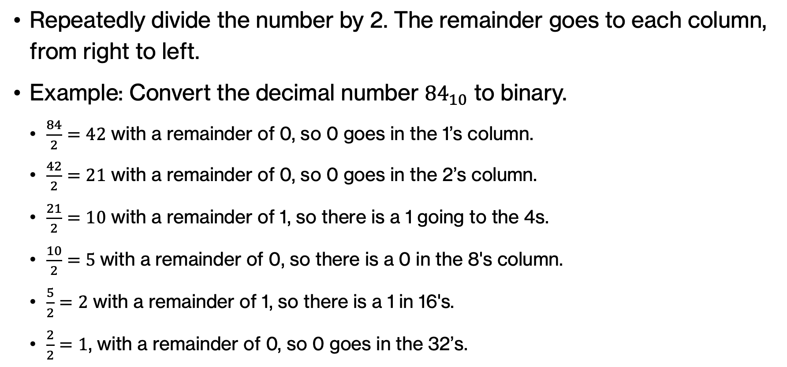
Decimal to binary conversion
Repeatedly divide the number by 2. The remainder goes to each column, from right to left.
Example: Convert the decimal number ${84}_{10}$ to binary.
  $\frac{84}{2}=42$ with a remainder of 0, so 0 goes in the 1’s column.
  $\frac{42}{2}=21$ with a remainder of 0, so 0 goes in the 2’s column.
  $\frac{21}{2}=10$ with a remainder of 1, so there is a 1 going to the 4s.
  $\frac{10}{2}=5 \text{with a remainder of 0}$, so there is a 0 in the 8's column.
  $\frac{5}{2}=2$ with a remainder of 1, so there is a 1 in 16's.
  $\frac{2}{2}=1$, with a remainder of 0, so 0 goes in the 32’s.
Divide by 2 | Remainder
84 | 0 | LSB
42 | 0
21 | 1
10 | 0
5 | 1
2 | 0
1 |  | MSB
 | 32 | 16 | 8 | 4 | 2 | 1
 | 0 | 1 | 0 | 1 | 0 | 0
MSB |  |  |  |  |  | LSB
Notes:
2/2 = 1, with a remainder of 0. So 0 goes in the 32s column. We next divide 1 by 2.

Slide 53
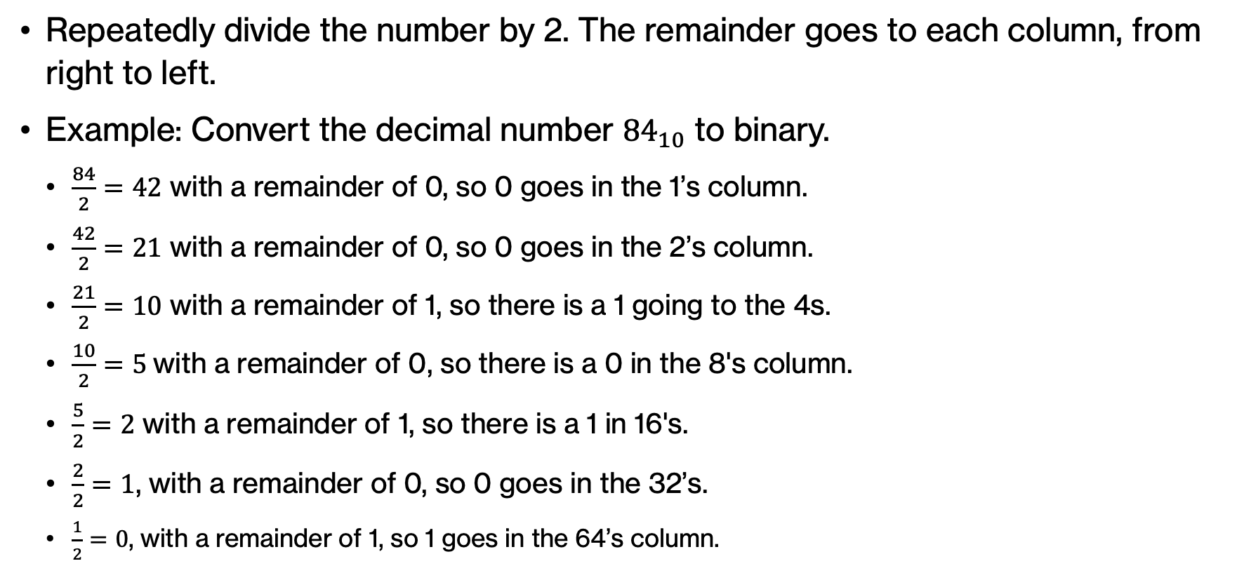
Decimal to binary conversion
Repeatedly divide the number by 2. The remainder goes to each column, from right to left.
Example: Convert the decimal number ${84}_{10}$ to binary.
  $\frac{84}{2}=42$ with a remainder of 0, so 0 goes in the 1’s column.
  $\frac{42}{2}=21$ with a remainder of 0, so 0 goes in the 2’s column.
  $\frac{21}{2}=10$ with a remainder of 1, so there is a 1 going to the 4s.
  $\frac{10}{2}=5 \text{with a remainder of 0}$, so there is a 0 in the 8's column.
  $\frac{5}{2}=2$ with a remainder of 1, so there is a 1 in 16's.
  $\frac{2}{2}=1$, with a remainder of 0, so 0 goes in the 32’s.
  $\frac{1}{2}=0$, with a remainder of 1, so 1 goes in the 64’s column.
Divide by 2 | Remainder
84 | 0 | LSB
42 | 0
21 | 1
10 | 0
5 | 1
2 | 0
1 | 1 | MSB
64 | 32 | 16 | 8 | 4 | 2 | 1
1 | 0 | 1 | 0 | 1 | 0 | 0
MSB |  |  |  |  |  | LSB
Notes:
½=0 with a remainder of 1, so 1 goes in the 64s column.

Slide 54
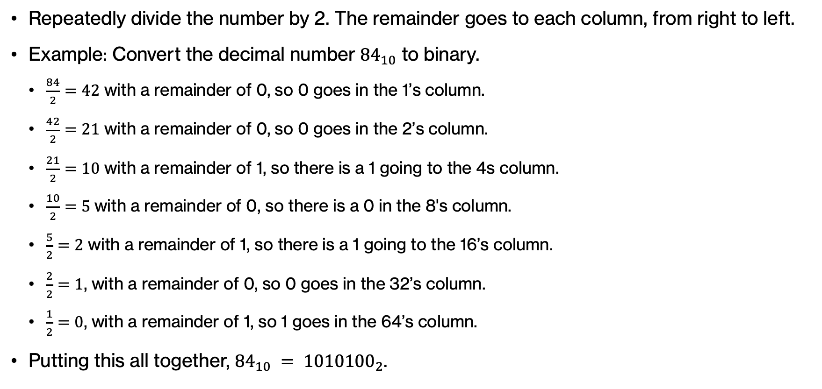
Decimal to binary conversion
Repeatedly divide the number by 2. The remainder goes to each column, from right to left.
Example: Convert the decimal number ${84}_{10}$ to binary.
  $\frac{84}{2}=42$ with a remainder of 0, so 0 goes in the 1’s column.
  $\frac{42}{2}=21$ with a remainder of 0, so 0 goes in the 2’s column.
  $\frac{21}{2}=10$ with a remainder of 1, so there is a 1 going to the 4s column.
  $\frac{10}{2}=5 \text{with a remainder of 0}$, so there is a 0 in the 8's column.
  $\frac{5}{2}=2$ with a remainder of 1, so there is a 1 going to the 16’s column.
  $\frac{2}{2}=1$, with a remainder of 0, so 0 goes in the 32’s column.
  $\frac{1}{2}=0$, with a remainder of 1, so 1 goes in the 64’s column.
Putting this all together, ${84}_{10} = {1010100}_{2}$.
Divide by 2 | Remainder
84 | 0 | LSB
42 | 0
21 | 1
10 | 0
5 | 1
2 | 0
1 | 1 | MSB
64 | 32 | 16 | 8 | 4 | 2 | 1
1 | 0 | 1 | 0 | 1 | 0 | 0
MSB |  |  |  |  |  | LSB
Notes:
Putting this all together, ${84}_{10} = {1010100}_{2}$.

Slide 55
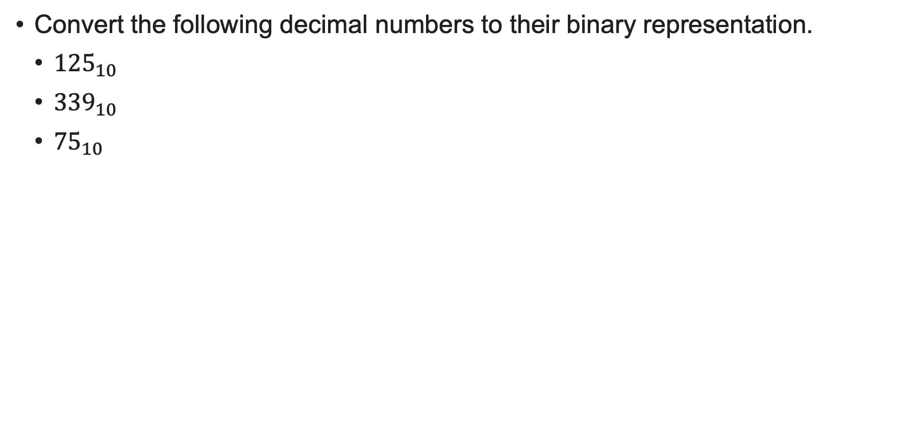
PRACTICE TIME
Convert the following decimal numbers to their binary representation.
  ${125}_{10}$
  ${339}_{10}$
  ${75}_{10}$
Notes:
Practice converting the following decimal numbers to binary.

Slide 56
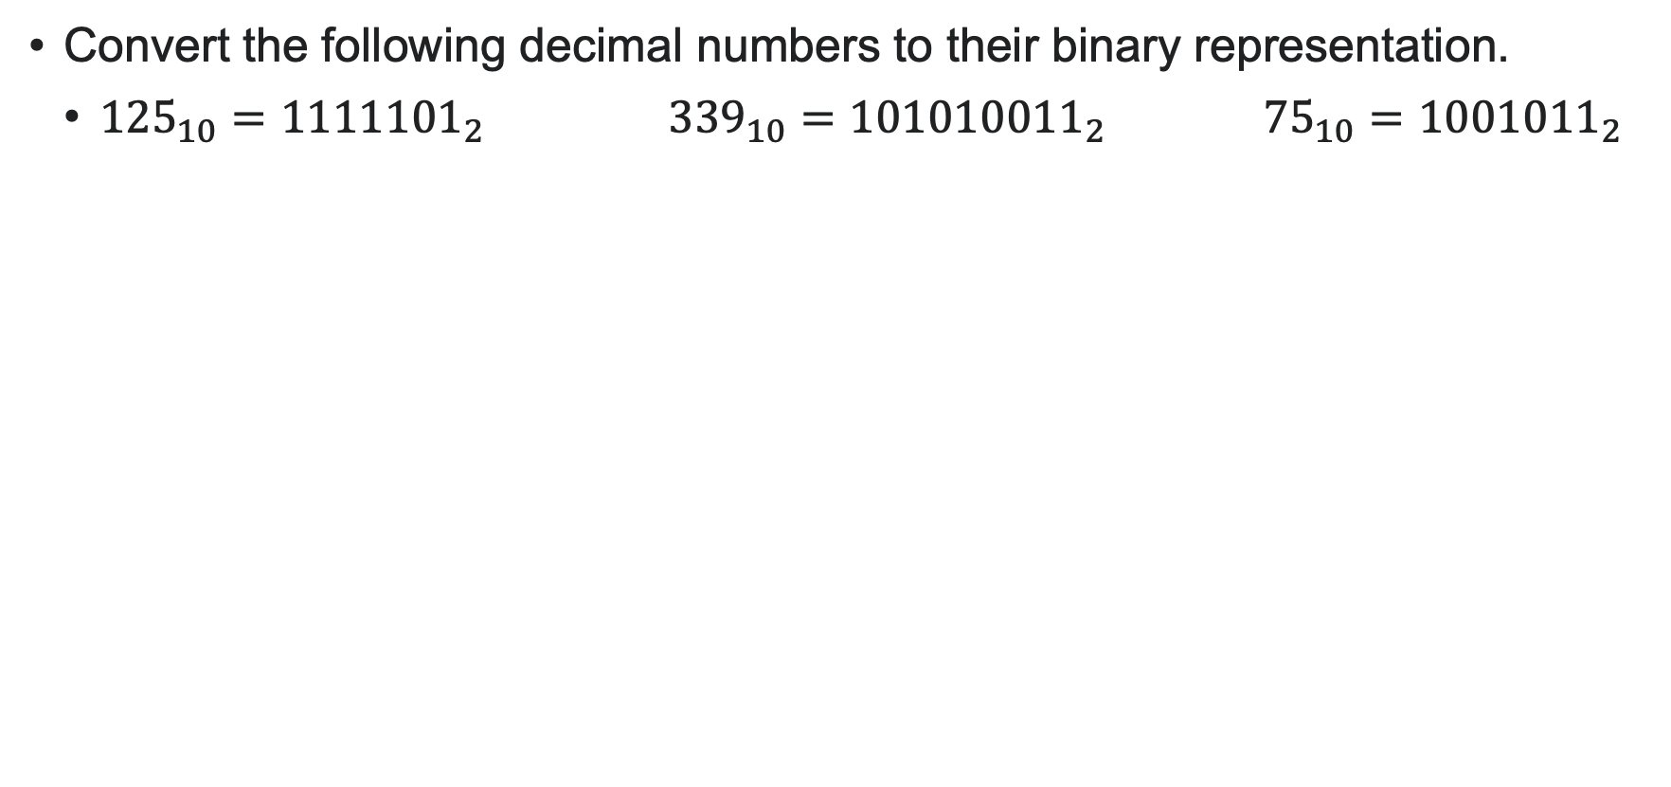
PRACTICE TIME - ANSWER
Convert the following decimal numbers to their binary representation.
  ${{125}_{10}=1111101}_{2}$ ${{339}_{10}=101010011}_{2}$ ${{75}_{10}=1001011}_{2}$
Divide by 2 | Remainder
125 | 1 | LSB
62 | 0
31 | 1
15 | 1
7 | 1
3 | 1
1 | 1 | MSB
Divide by 2 | Remainder
339 | 1 | LSB
169 | 1
84 | 0
42 | 0
21 | 1
10 | 0
5 | 1
2 | 0
1 | 1 | MSB
Divide by 2 | Remainder
75 | 1 | LSB
37 | 1
18 | 0
9 | 1
4 | 0
2 | 0
1 | 1 | MSB
Notes:
This is what you should have gotten.

Slide 57
Hexadecimal numbers
We also use a hexadecimal (or hex) notation where the arithmetic is base 16.
What are the valid digits for hexadecimal numbers?
Notes:
Lastly, we will see one more numeral system called hexadecimal or hex for short which is base 16.

Slide 58
Think
We also use a hexadecimal (or hex) notation where the arithmetic is base 16.
What are the valid digits for hexadecimal numbers?
Notes:
What are the valid digits for hex numbers?

Slide 59
Think
We also use a hexadecimal (or hex) notation where the arithmetic is base 16.
What are the valid digits for hexadecimal numbers?
  One idea: 0, 1, 2, 3, …, 15
  What's the problem here?
Notes:
Maybe you thought 0, …, 15. But what's the problem here? That's right, how would we distinguish between say 14 and 1 and 4 next to each other?

Slide 60
Hexadecimal numbers
We also use a hexadecimal (or hex) notation where the arithmetic is base 16.
What are the valid digits for hexadecimal numbers?
  0, 1, 2, …, 9, A, B, C, D, E, F
  Instead of 10, 11, 12, 13, 14, 15
Notes:
Instead, we will do something different. We will use the 10 unique digits 0, …, 9, and then we will also use the first six letters of the English alphabet. We could have really used any other six unique characters but working with letters is convenient.

Slide 61
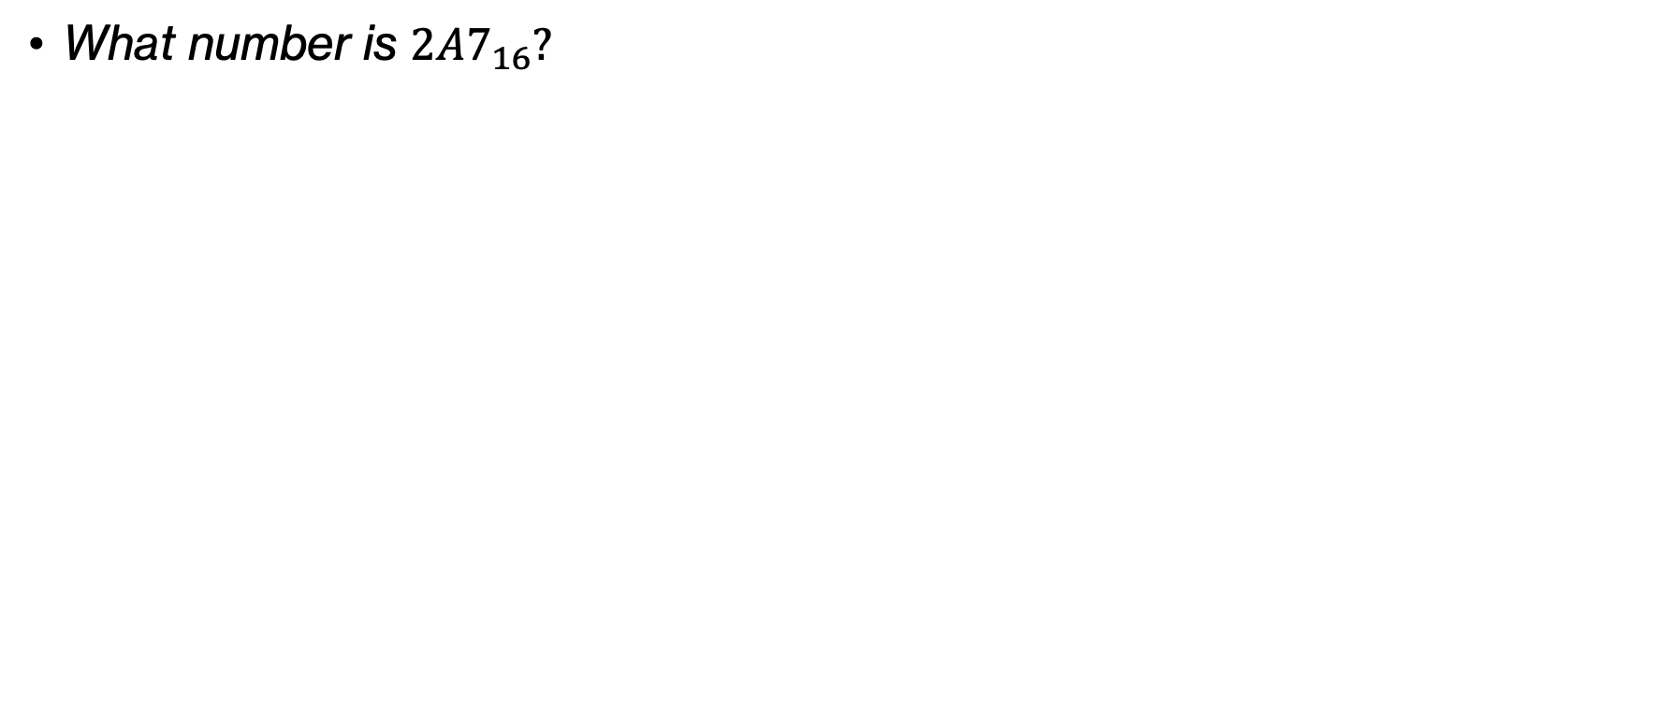
Think
A, B, C, D, E, F
10, 11, 12, 13, 14, 15
What number is $2A7_{16}?$
Notes:
OK, let's think, what's the hex number 2A7?

Slide 62
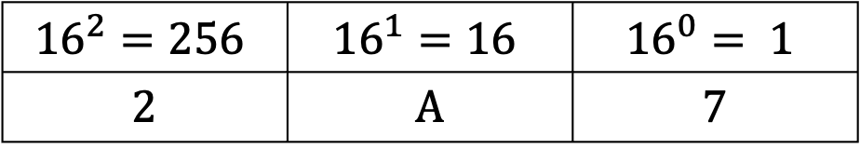
Think
A, B, C, D, E, F
10, 11, 12, 13, 14, 15
What number is $2A7_{16}?$
$${16}^{2}=256$$ | $${16}^{1}=16$$ | $${16}^{0}= 1$$
2 | A | 7
Notes:
We will fill out our table with base 16 now

Slide 63
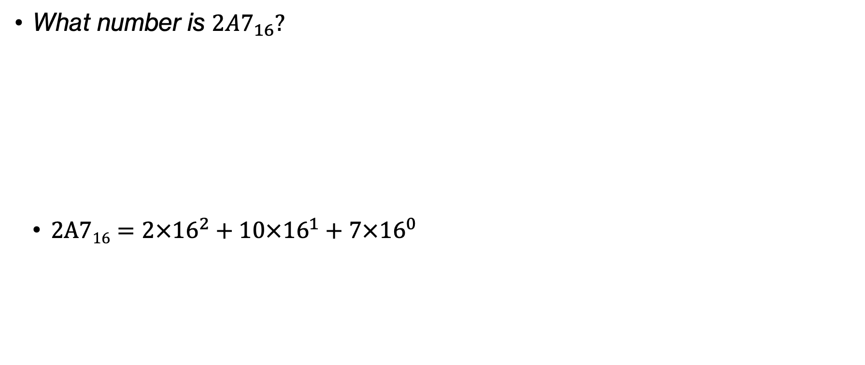
Think
A, B, C, D, E, F
10, 11, 12, 13, 14, 15
What number is $2A7_{16}?$
  $\text{2A}716=2×{16}^{2}+10×{16}^{1}+7×{16}^{0}$
$${16}^{2}=256$$ | $${16}^{1}=16$$ | $${16}^{0}= 1$$
2 | A | 7
Notes:
So $\text{2A}716=2×{16}^{2}+10×{16}^{1}+7×{16}^{0}$

Slide 64
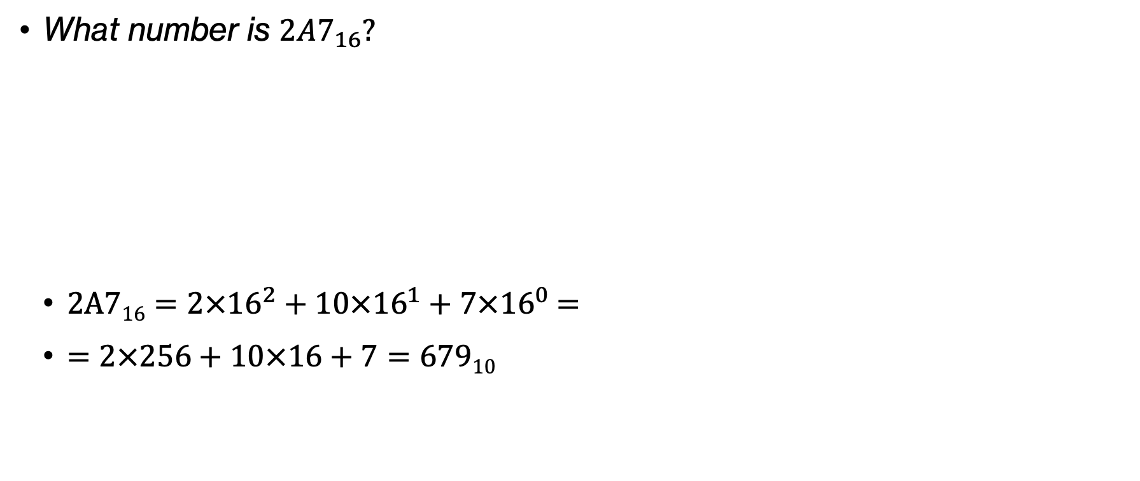
Think
A, B, C, D, E, F
10, 11, 12, 13, 14, 15
What number is $2A7_{16}?$
  $\text{2A}716=2×{16}^{2}+10×{16}^{1}+7×{16}^{0}$ =
  = $2×256+10×16+7=67910$
$${16}^{2}=256$$ | $${16}^{1}=16$$ | $${16}^{0}= 1$$
2 | A | 7
Notes:
which is equal to $2×256+10×16+7=67910$

Slide 65
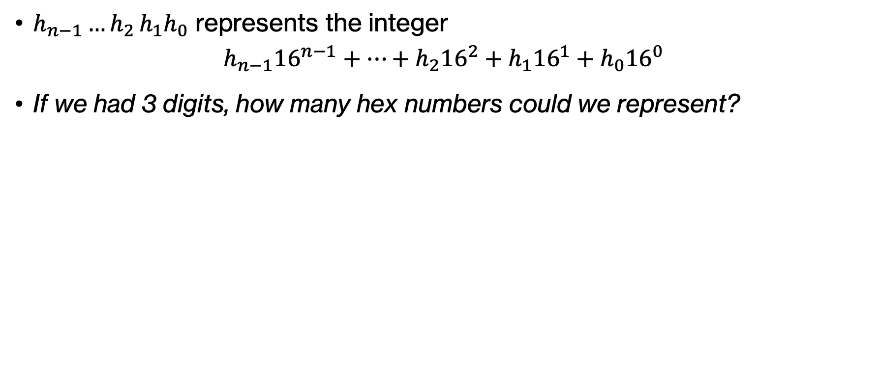
Think
$h_{n−1}{…h}_{2}h_{1}h_{0}$ represents the integer
$h_{n−1}{16}^{n−1}+…+h_{2}{16}^{2}+h_{1}{16}^{1}+h_{0}{16}^{0}$
If we had 3 digits, how many hex numbers could we represent?
Notes:
Had we had 3 digits, how many hex numbers could we represent

Slide 66
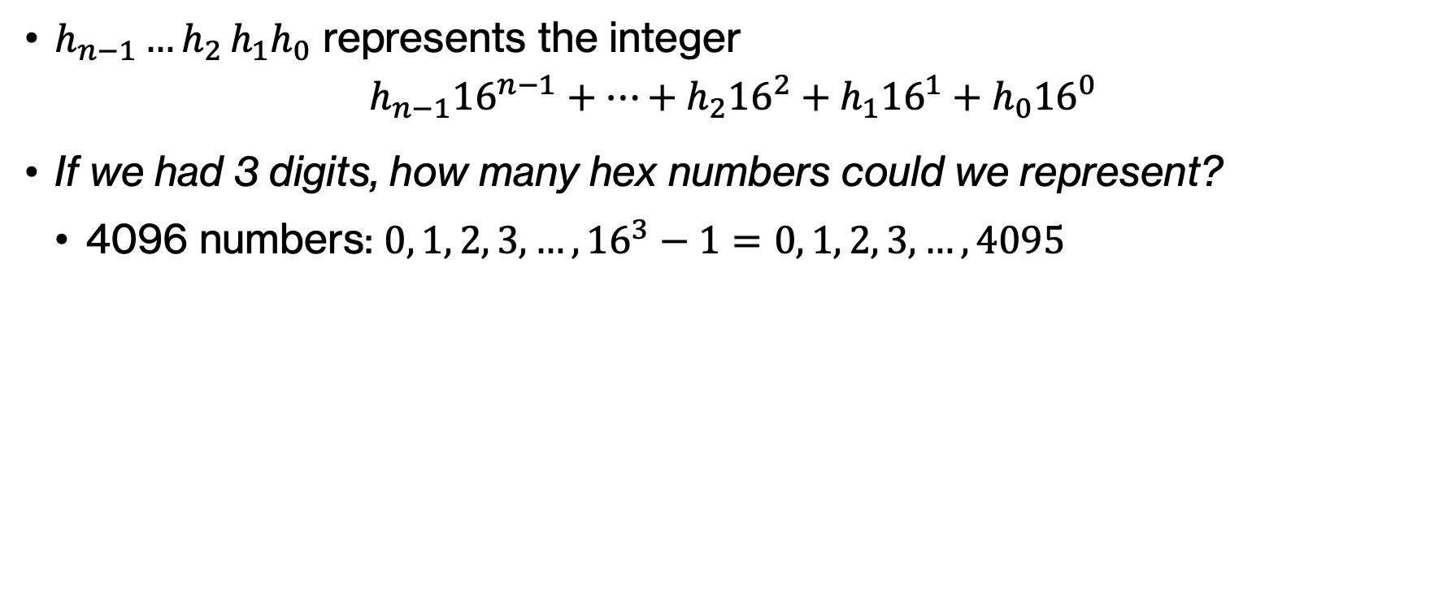
Think
$h_{n−1}{…h}_{2}h_{1}h_{0}$ represents the integer
$h_{n−1}{16}^{n−1}+…+h_{2}{16}^{2}+h_{1}{16}^{1}+h_{0}{16}^{0}$
If we had 3 digits, how many hex numbers could we represent?
  4096 numbers: $0, 1, 2, 3, …, {16}^{3}−1=0, 1, 2, 3, …,4095$
Notes:
Assuming positive numbers only, the range would be 0, 12, 3, 16^3-1, that is 4096 numbers

Slide 67
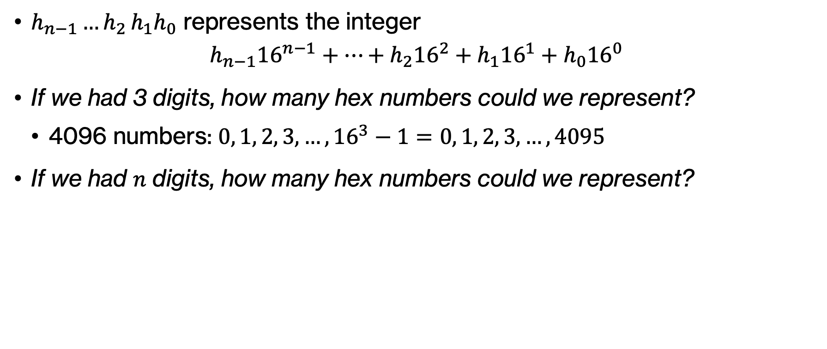
Think
$h_{n−1}{…h}_{2}h_{1}h_{0}$ represents the integer
$h_{n−1}{16}^{n−1}+…+h_{2}{16}^{2}+h_{1}{16}^{1}+h_{0}{16}^{0}$
If we had 3 digits, how many hex numbers could we represent?
  4096 numbers: $0, 1, 2, 3, …, {16}^{3}−1=0, 1, 2, 3, …,4095$
If we had $n$ digits, how many hex numbers could we represent?
Notes:
What if we had n digits?

Slide 68
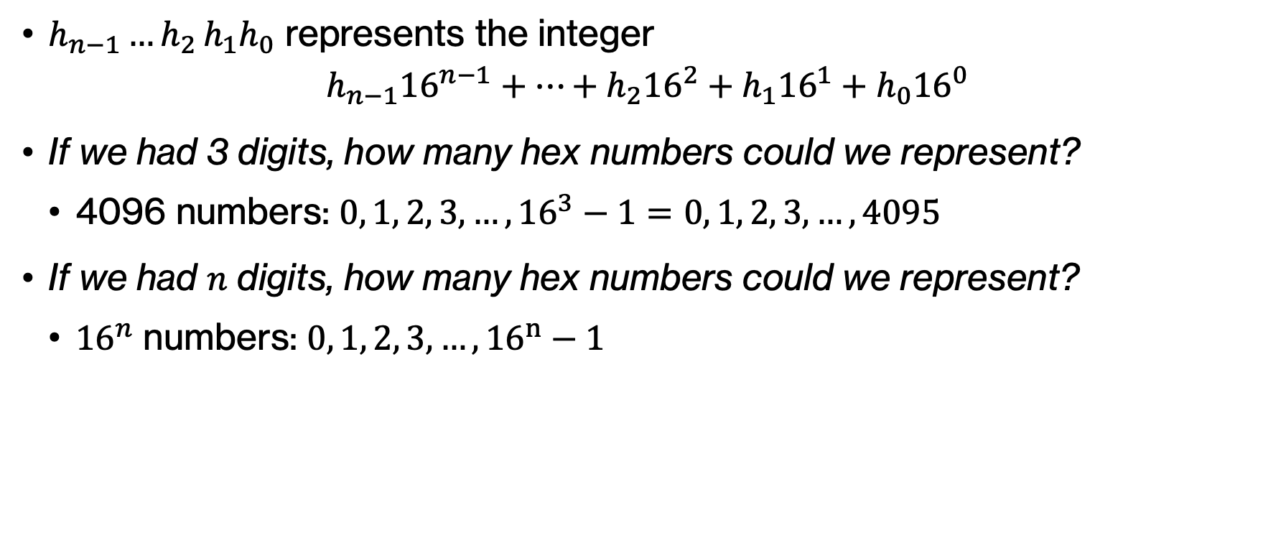
Think
$h_{n−1}{…h}_{2}h_{1}h_{0}$ represents the integer
$h_{n−1}{16}^{n−1}+…+h_{2}{16}^{2}+h_{1}{16}^{1}+h_{0}{16}^{0}$
If we had 3 digits, how many hex numbers could we represent?
  4096 numbers: $0, 1, 2, 3, …, {16}^{3}−1=0, 1, 2, 3, …,4095$
If we had $n$ digits, how many hex numbers could we represent?
  ${16}^{n}$ numbers: $0, 1, 2, 3, …, {16}^{n}−1$
Notes:
I hope it's obvious we would have 16^n numbers.

Slide 69
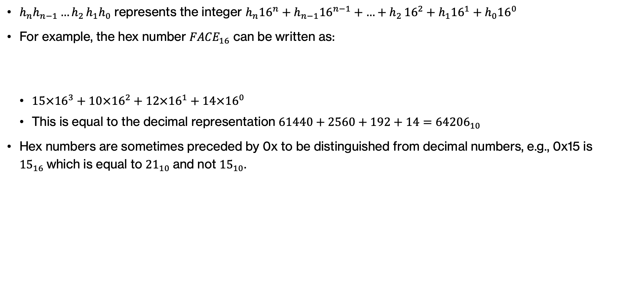
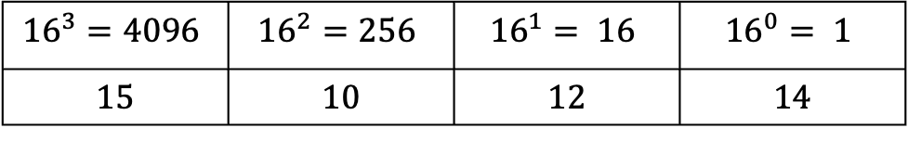
A, B, C, D, E, F
10, 11, 12, 13, 14, 15
Hexadecimal numbers
$h_{n}h_{n−1}{…h}_{2}h_{1}h_{0}$ represents the integer $h_{n}{16}^{n}+h_{n−1}{16}^{n−1}+{…+h}_{2}{16}^{2}+h_{1}{16}^{1}+h_{0}{16}^{0}$
For example, the hex number ${FACE}_{16}$ can be written as:
  $15×{16}^{3}+10×{16}^{2}+12×{16}^{1}+14×{16}^{0}$
  This is equal to the decimal representation $61440+2560+192+14={64206}_{10}$
Hex numbers are sometimes preceded by 0x to be distinguished from decimal numbers, e.g., 0x15 is ${15}_{16}$which is equal to ${21}_{10}$and not ${15}_{10}$.
$${16}^{3}=4096$$ | $${16}^{2}=256$$ | $${16}^{1}= 16$$ | $${16}^{0}= 1$$
15 | 10 | 12 | 14
Notes:
Writing long binary numbers can be both tedious and prone to errors. For this reason, computer scientists also like working in base 16 or with hexadecimal/hex notation (we saw that a group of 4 bits can represent 2^4=16 possibilities). Hexadecimal numbers use the digits 0 to 9 along with the letters A to F which are used for 10 to 15, respectively.

Slide 70
Equivalence across number systems
Hexadecimal digit | Binary equivalent | Decimal equivalent
0 | 0000 | 0
1 | 0001 | 1
2 | 0010 | 2
3 | 0011 | 3
4 | 0100 | 4
5 | 0101 | 5
6 | 0110 | 6
7 | 0111 | 7
8 | 1000 | 8
9 | 1001 | 9
A | 1010 | 10
B | 1011 | 11
C | 1100 | 12
D | 1101 | 13
E | 1110 | 14
F | 1111 | 15
Notes:
This table shows the first 16 numbers as represented in the three systems we have seen so far.

Slide 71
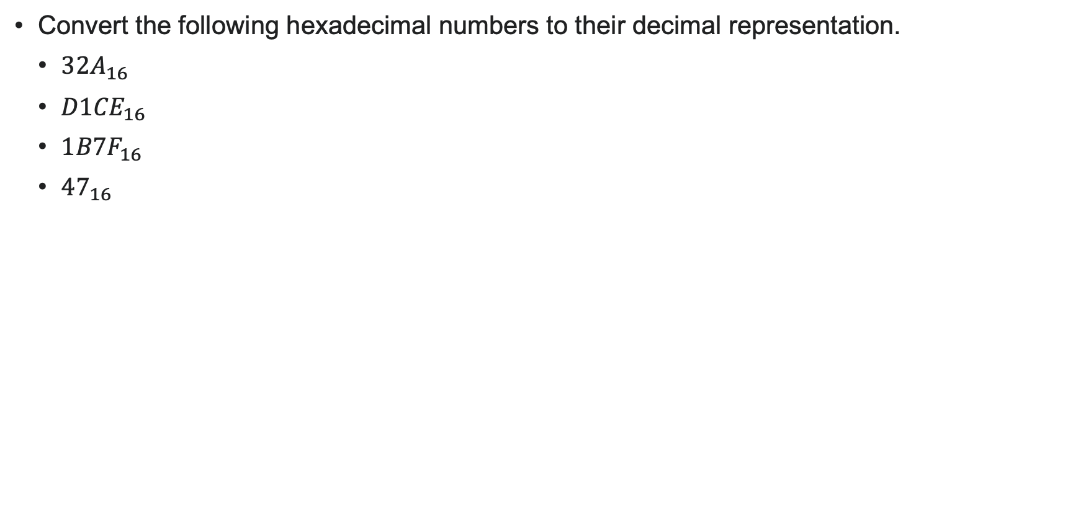
A, B, C, D, E, F
10, 11, 12, 13, 14, 15
PRACTICE TIME
Convert the following hexadecimal numbers to their decimal representation.
  ${32A}_{16}$
  ${D1CE}_{16}$
  ${1B7F}_{16}$
  ${47}_{16}$
Notes:
Let's practice by converting the hexadecimal numbers to decimal.

Slide 72

A, B, C, D, E, F
10, 11, 12, 13, 14, 15
ANSWER
Convert the following hexadecimal numbers to their decimal representation.
  ${32A}_{16}=3×{16}^{2}+2×{16}^{1}+10×{16}^{0}={810}_{10}$
  ${D1CE}_{16}=13×{16}^{3}+1×{16}^{2}+12×{16}^{1}+14×{16}^{0}={53710}_{10}$
  ${1B7F}_{16}=1×{16}^{3}+11×{16}^{2}+7×{16}^{1}+15×{16}^{0}={7039}_{10}$
  ${47}_{16}=4×{16}^{1}+7×{16}^{0}={71}_{10}$
Notes:
Is this what you got?

Slide 73

Decimal to hexadecimal conversion
Similarly to converting from decimal to binary, we will now repeatedly divide by 16 and the remainder is converted to hexadecimal and goes to the corresponding column from right to left.
Example: Convert the decimal number ${333}_{10}$ to hexadecimal.
Divide by 16 | Remainder
333 |  | LSB
 |  | MSB
Notes:
Similarly to converting from decimal to binary, we will now repeatedly divide by 16 and the remainder is converted to hexadecimal and goes to the corresponding column from right to left.
Let's see an example of converting the decimal number 333 to hex. We start by dividing it by 16.

Slide 74


Decimal to hexadecimal conversion
Similarly to converting from decimal to binary, we will now repeatedly divide by 16 and the remainder is converted to hexadecimal and goes to the corresponding column from right to left.
Example: Convert the decimal number ${333}_{10}$ to hexadecimal.
  $\frac{333}{16}=20$ with a remainder of ${13}_{10}=D_{16}$ which goes in the 1’s column.
Divide by 16 | Remainder
333 | $${13}_{10}=D_{16}$$ | LSB
20
 |  | MSB
 |  | 1
 |  | D
Notes:
333/16=20 with a remainder of 13 (in decimal) or D in hex. So we put D in the 1s column. We next divide 20 by 16.

Slide 75


Decimal to hexadecimal conversion
Similarly to converting from decimal to binary, we will now repeatedly divide by 16 and the remainder is converted to hexadecimal and goes to the corresponding column from right to left.
Example: Convert the decimal number ${333}_{10}$ to hexadecimal.
  $\frac{333}{16}=20$ with a remainder of ${13}_{10}=D_{16}$ which goes in the 1’s column.
  $\frac{20}{16}=1$ with a remainder of 4, so 4 goes in the 16’s column.
Divide by 16 | Remainder
333 | $${13}_{10}=D_{16}$$ | LSB
20 | $$4_{10}=4_{16}$$
1 |  | MSB
 | 16 | 1
 | 4 | D
Notes:
20/16$=1$ with a remainder of 4 (same in decimal and hex), so 4 goes in the 16’s column. We next divide 1 by 16.

Slide 76


Decimal to hexadecimal conversion
Similarly to converting from decimal to binary, we will now repeatedly divide by 16 and the remainder is converted to hexadecimal and goes to the corresponding column from right to left.
Example: Convert the decimal number ${333}_{10}$ to hexadecimal.
  $\frac{333}{16}=20$ with a remainder of ${13}_{10}=D_{16}$ which goes in the 1’s column.
  $\frac{20}{16}=1$ with a remainder of 4, so 4 goes in the 16’s column.
  $\frac{1}{16}=0$ with a remainder of 1, so there is a 1 going to the 256s column.
Divide by 16 | Remainder
333 | $${13}_{10}=D_{16}$$ | LSB
20 | $$4_{10}=4_{16}$$
1 | $$1_{10}=1_{16}$$ | MSB
256 | 16 | 1
1 | 4 | D
Notes:
$\frac{1}{16}=0$ with a remainder of 1 (same in decimal and hex), so there is a 1 going to the 256s column.

Slide 77

Decimal to hexadecimal conversion
Similarly to converting from decimal to binary, we will now repeatedly divide by 16 and the remainder is converted to hexadecimal and goes to the corresponding column from right to left.
Example: Convert the decimal number ${333}_{10}$ to hexadecimal.
  $\frac{333}{16}=20$ with a remainder of ${13}_{10}=D_{16}$ which goes in the 1’s column.
  $\frac{20}{16}=1$ with a remainder of 4, so 4 goes in the 16’s column.
  $\frac{1}{16}=0$ with a remainder of 1, so there is a 1 going to the 256s column.
  Putting this all together, ${333}_{10} = {14D}_{16}$.
Divide by 16 | Remainder
333 | $${13}_{10}=D_{16}$$ | LSB
20 | $$4_{10}=4_{16}$$
1 | $$1_{10}=1_{16}$$ | MSB
256 | 16 | 1
1 | 4 | D
Notes:
Putting this all together, ${333}_{10} = {14D}_{16}$.

Slide 78

A, B, C, D, E, F
10, 11, 12, 13, 14, 15
PRACTICE TIME
Convert the following decimal numbers to their hexadecimal representation.
  ${2546}_{10}$
  ${1457}_{10}$
  ${269}_{10}$
  ${47}_{10}$
Notes:
Let's practice by converting the following decimal numbers to their hex representation.

Slide 79





A, B, C, D, E, F
10, 11, 12, 13, 14, 15
ANSWER
Convert the following decimal numbers to their hexadecimal representation.
  ${2546}_{10}=9F2$ ${1457}_{10}=5B1$ ${ 269}_{10}=10D$ ${47}_{10}=2F$
Divide by 16 | Remainder
2546 | $$2_{10}=2_{16}$$
159 | $${15}_{10}=F_{16}$$
9 | $$9_{10}=9_{16}$$
Divide by 16 | Remainder
1457 | $$1_{10}=1_{16}$$
91 | $${11}_{10}=B_{16}$$
5 | $$5_{10}=5_{16}$$
Divide by 16 | Remainder
269 | $${13}_{10}=D_{16}$$
16 | $$0_{10}=0_{16}$$
1 | $$1_{10}=1_{16}$$
Divide by 16 | Remainder
47 | $${15}_{10}=F_{16}$$
2 | $$2_{10}=2_{16}$$
LSB
MSB
Notes:
Is this what you got?

Slide 80

Binary to hexadecimal conversion
Hexadecimal digit | Binary equivalent
0 | 0000
1 | 0001
2 | 0010
3 | 0011
4 | 0100
5 | 0101
6 | 0110
7 | 0111
8 | 1000
9 | 1001
A | 1010
B | 1011
C | 1100
D | 1101
E | 1110
F | 1111
$${ 110011100010000}_{2}$$
break into 4 bit groups
  ${0110 0111 0001 0000}_{2}$
Notes:
To convert from binary to hex, we read the binary digits in groups of four

Slide 81
Binary to hexadecimal conversion
Hexadecimal digit | Binary equivalent
0 | 0000
1 | 0001
2 | 0010
3 | 0011
4 | 0100
5 | 0101
6 | 0110
7 | 0111
8 | 1000
9 | 1001
A | 1010
B | 1011
C | 1100
D | 1101
E | 1110
F | 1111
$${ 110011100010000}_{2}$$
break into 4 bit groups
  ${0110 0111 0001 0000}_{2}$
convert each 4 bit group into a digit
Notes:
and convert each group

Slide 82

Binary to hexadecimal conversion
Hexadecimal digit | Binary equivalent
0 | 0000
1 | 0001
2 | 0010
3 | 0011
4 | 0100
5 | 0101
6 | 0110
7 | 0111
8 | 1000
9 | 1001
A | 1010
B | 1011
C | 1100
D | 1101
E | 1110
F | 1111
$${ 110011100010000}_{2}$$
break into 4 bit groups
  ${0110 0111 0001 0000}_{2}$
convert each 4 bit group into a digit
  ${6 7 1 0}_{16}$
Notes:
group to its corresponding hexadecimal number. If needed, prepend leading 0s to make the number of bits a multiple of 4.

Slide 83

PRACTICE TIME
Hexadecimal digit | Binary equivalent
0 | 0000
1 | 0001
2 | 0010
3 | 0011
4 | 0100
5 | 0101
6 | 0110
7 | 0111
8 | 1000
9 | 1001
A | 1010
B | 1011
C | 1100
D | 1101
E | 1110
F | 1111
Convert the following binary numbers to their hexadecimal representation.
  ${10010011}_{2}$
  ${101100110101}_{2}$
  ${11111011101110010}_{2}$
Notes:
Can you give it a try?

Slide 84

ANSWER
Hexadecimal digit | Binary equivalent
0 | 0000
1 | 0001
2 | 0010
3 | 0011
4 | 0100
5 | 0101
6 | 0110
7 | 0111
8 | 1000
9 | 1001
A | 1010
B | 1011
C | 1100
D | 1101
E | 1110
F | 1111
Convert the following binary numbers to their hexadecimal representation.
  ${1001 0011}_{2}={93}_{16}$
  ${1011 0011 0101}_{2}=B{35}_{16}$
  ${11111011101110010}_{2}=0001 1111 0111 0111 0010=1F{772}_{16}$

Slide 85

Hexadecimal to binary conversion
Hexadecimal digit | Binary equivalent
0 | 0000
1 | 0001
2 | 0010
3 | 0011
4 | 0100
5 | 0101
6 | 0110
7 | 0111
8 | 1000
9 | 1001
A | 1010
B | 1011
C | 1100
D | 1101
E | 1110
F | 1111
We replace each hex digit with the four binary bits that correspond to its value.
Example: Convert the hexadecimal number ${CAFE}_{16}$ to its binary representation.
  $C_{16}={1100}_{2}$
  $A_{16}={1010}_{2}$
  $F_{16}={1111}_{2}$
  $E_{16 }={1110}_{2}$
  Putting this all together, ${CAFE}_{16} = {1100101011111110}_{2}$.
Notes:
To go from hex to binary, we replace each hex digit with the four binary bits that correspond to its value.

Slide 86

PRACTICE TIME
Hexadecimal digit | Binary equivalent
0 | 0000
1 | 0001
2 | 0010
3 | 0011
4 | 0100
5 | 0101
6 | 0110
7 | 0111
8 | 1000
9 | 1001
A | 1010
B | 1011
C | 1100
D | 1101
E | 1110
F | 1111
Convert the following hexadecimal numbers to their binary representation.
  ${\text{F00D}}_{16}$
  $2B3BAD_{16}$
  ${\text{DEADC0DE}}_{16}$
Notes:
Let's try it

Slide 87

ANSWER
Hexadecimal digit | Binary equivalent
0 | 0000
1 | 0001
2 | 0010
3 | 0011
4 | 0100
5 | 0101
6 | 0110
7 | 0111
8 | 1000
9 | 1001
A | 1010
B | 1011
C | 1100
D | 1101
E | 1110
F | 1111
Convert the following hexadecimal numbers to their binary representation.
  ${\text{F00D}}_{16}={1111000000001101}_{2}$
  $2B3BAD_{16}={001010110011101110101101}_{2}$
  ${\text{DEADC0DE}}_{16}={11011110101011011100000011011110}_{2}$
Notes:
Fun, huh? And that's it for today folks. Time to practice on your own at home!

Slide 88
Practice Problems

Slide 89
Practice Problems – Problem 1
  Assuming x = 6, y = 2, z = 12. What would the following Python expressions evaluate to?
  x == 10 or x < 5
  x != 7 and x > 3
  not (x >= 5 and y <= 2)
  (x < 0) or (x >= 0)
  not (x != x)
  x > 1 and (z / x) != 2
  x <= 0 or (z / x) == 1
  x == 4 and y == 4

Slide 90
Practice Problems – Problem 2
Rewrite the following code to make it cleaner and avoid the use of nested if statements:
def get_discount(member, purchase_amount):
if member == True:
if purchase_amount > 100:
return "Discount applied"
else:
return "No discount"
else:
if purchase_amount > 200:
return "Discount applied"
else:
return "No discount"
print(get_discount(True, 120)) # Expected: "Discount applied" print(get_discount(True, 80)) # Expected: "No discount" print(get_discount(False, 220)) # Expected: "Discount applied" print(get_discount(False, 50)) # Expected: "No discount"
Notes:
Can you write the following function in a more condensed way? I have provided you the following print statements and what you should expect them to produce

Slide 91

Practice Problems – Problem 3
  For each row, fill in the missing entries by converting the given number from its representation to every other equivalent representation.
Binary | Decimal | Hexadecimal
 | $${39}_{10}$$
$${100111010}_{2}$$
 |  | $$BADE_{16}$$
 | $${47}_{10}$$
$${101100111}_{2}$$
 |  | $$C0FFEE_{16}$$

Slide 92
Practice Problem 1 – ANSWER
  Assuming x = 6, y = 2, z = 12. What would the following Python expressions evaluate to?
  x == 10 or x < 5 → 6 == 10 or 6 < 5 → False or False → False
  x != 7 and x > 3 → 6 != 7 and 6 > 3 → True and True → True
  not (x >= 5 and y <= 2) → not (6 >= 5 and 2 <= 2) → not (True and True) → not True → False
  (x < 0) or (x >= 0) → 6 < 0 or 6 >= 0 → False or True → True (always true, no matter what x is)
  not (x != x) → not False → True
  x > 1 and (z / x) != 2 → 6 > 1 and (12 / 6 != 2) → True and False → False
  x <= 0 or (z / x) == 1 → 6 <= 0 or (12 / 6 == 1) → False or False → False
  x == 4 and y == 4 → 6 == 4 and 2 == 4 → False and False → False

Slide 93
Practice Problem 2 - ANSWER
Rewrite the following code to make it cleaner and avoid the use of nested if statements:
def get_discount(member, purchase_amount):
if (purchase_amount > 200) or (member and purchase_amount > 100):
return "Discount applied"
else:
return "No discount"
print(get_discount(True, 120)) # Expected: "Discount applied" print(get_discount(True, 80)) # Expected: "No discount" print(get_discount(False, 220)) # Expected: "Discount applied" print(get_discount(False, 50)) # Expected: "No discount"
Notes:
Here is a condensed version that accomplishes the same thing

Slide 94

Practice Problem 3 - ANSWER
  For each row, fill in the missing entries by converting the given number from its representation to every other equivalent representation.
Binary | Decimal | Hexadecimal
$${100111}_{2}$$ | $${39}_{10}$$ | $${27}_{16}$$
$${100111010}_{2}$$ | $${314}_{10}$$ | $$13A_{16}$$
$${1011101011011110}_{2}$$ | $${47838}_{10}$$ | $$BADE_{16}$$
$${101111}_{2}$$ | $${47}_{10}$$ | $$2F_{16}$$
$${101100111}_{2}$$ | $${359}_{10}$$ | $${167}_{16}$$
$${110000001111111111101110}_{2}$$ | $${12648430}_{10}$$ | $$C0FFEE_{16}$$

