Slide 1

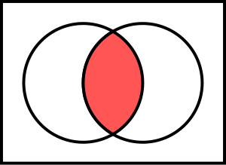
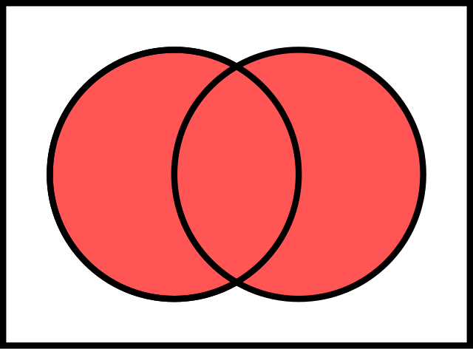
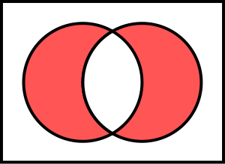
Boolean Algebra
Computer Systems
NOT
AND
CS51 – Spring 2026
OR
XOR

Slide 2
Admin
How is Assignment 1 going?

Slide 3
Booleans
What is a Boolean (e.g., a Boolean variable)?

Slide 4
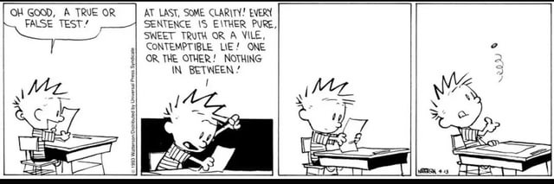
Booleans
What is a Boolean (e.g., Boolean variable)?
A variable/value that only has two possible values True/1 or False/0

Slide 5
Why are they called Booleans?

Slide 6
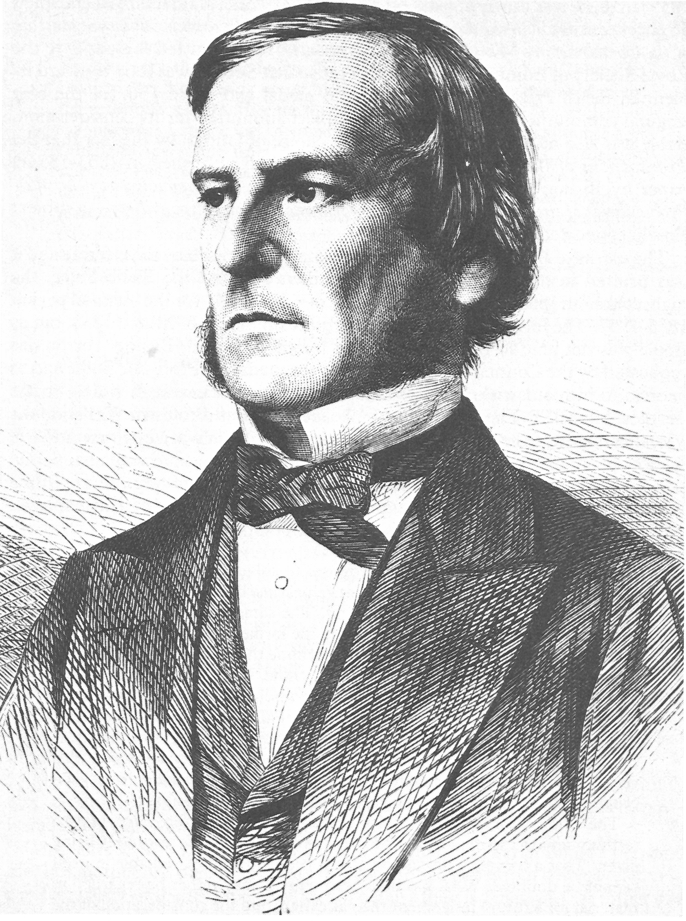
Why are they called Booleans?
George Boole was a self-taught English mathematician (1815-1864)
He introduced binary variables and binary logic
which laid the foundation for Boolean algebra (which looks at how you can combine Boolean variables)
George Boole

Slide 7
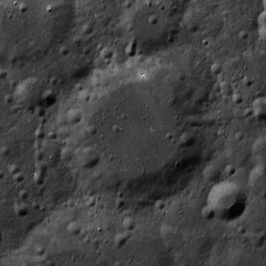
An aside
Anyone know what this is?

Slide 8
An aside
Anyone know what this is?
Boole crater
https://en.wikipedia.org/wiki/Boole_(crater)

Slide 9
Boolean algebra
Boolean algebra is a branch of algebra where variables can only have two values
Algebra:
x + y
(3x – 5)/8
x² – y²
variables (e.g., x or y)
literal (e.g., 8)
operator (e.g., +, -, *, …)

Slide 10
Boolean algebra
Boolean algebra is a branch of algebra where variables can only have two values
Literals: True, False (alternatively: 1, 0)
Operators?

Slide 11
AND operation – Conjunction
X | Y | X AND Y
FALSE | FALSE | FALSE
FALSE | TRUE | FALSE
TRUE | FALSE | FALSE
TRUE | TRUE | TRUE
X | Y | X ∧ Y
0 | 0 | 0
0 | 1 | 0
1 | 0 | 0
1 | 1 | 1
Only TRUE if both (or all) values are TRUE
Example: I’m going to hang out if I finish my homework AND it doesn’t get too late.

Slide 12
OR operation – Disjunction
X | Y | X OR Y
FALSE | FALSE | FALSE
FALSE | TRUE | TRUE
TRUE | FALSE | TRUE
TRUE | TRUE | TRUE
X | Y | X ∨ Y
0 | 0 | 0
0 | 1 | 1
1 | 0 | 1
1 | 1 | 1
TRUE at least one value is TRUE

Slide 13
NOT operation – Negation
X | NOT X
FALSE | TRUE
TRUE | FALSE
X | ¬ X
0 | 1
1 | 0
Negates or flips the value
Example: I’m going to hate CS51. NOT.

Slide 14
XOR operation – Exclusive OR
X | Y | X XOR Y
FALSE | FALSE | FALSE
FALSE | TRUE | TRUE
TRUE | FALSE | TRUE
TRUE | TRUE | FALSE
X | Y | X ⊕ Y
0 | 0 | 0
0 | 1 | 1
1 | 0 | 1
1 | 1 | 0
TRUE if exactly one value is TRUE
Notes:
Beyond these three basic operators that were introduced by Boole, there have been secondary ones that have been subsequently introduced, with XOR being the most popular. XOR, also known as exclusive OR, is a binary operator, that is it is applied on two operands. It is also denoted as ⊕ . XOR produces TRUE (1) if exactly one of the operands it is applied to is TRUE (1). Similarly to NOT, AND, OR, you can encounter two commonly used truth tables for XOR. Note how only the second and third row where only one of X and Y is TRUE/1 produces TRUE/1, all other rows produce FALSE/0. In circuit design, the logic gate that represents XOR is shown above. Note, that similar to AND and OR, it receives two wires that it applies XOR on their electrical input and produces one output. It looks a bit like OR but it has that extra smile :) before the gate.

Slide 15
PRACTICE TIME – Evaluate these expressions
0 ∨ ¬ 0
1 ∧ ¬ 1
¬ (1 ∧ 0)
0 ∧ ¬ 1
¬ (1 ∨ ¬ 1)
1 ⊕ ¬ 1
(1 ∧ (1 ⊕ ¬(0 ∨ ¬ 1)))
AND
X | Y | X ∧ Y
0 | 0 | 0
0 | 1 | 0
1 | 0 | 0
1 | 1 | 1
NOT
X | ¬ X
0 | 1
1 | 0
OR
XOR
X | Y | X ∨ Y
0 | 0 | 0
0 | 1 | 1
1 | 0 | 1
1 | 1 | 1
X | Y | X ⊕ Y
0 | 0 | 0
0 | 1 | 1
1 | 0 | 1
1 | 1 | 0
Notes:
A bit more practice time. Using our understanding of how NOT, AND, OR, and XOR work, write what the results of evaluating the following expressions would be.

Slide 16
ANSWER– Evaluate these expressions
0 ∨ ¬ 0= 0 ∨ 1 = 1
1 ∧ ¬ 1 = 1 ∧ 0 = 0
¬ (1 ∧ 0) = ¬ 0 = 1
0 ∧ ¬ 1 = 0 ∧ 0 = 0
¬ (1 ∨ ¬ 1) = ¬ (1 ∨ 0) = ¬ 1 = 0
1 ⊕ ¬ 1 = 1 ⊕ 0 = 1
(1 ∧ (1 ⊕ ¬(0 ∨ ¬ 1))) =
(1 ∧ (1 ⊕ ¬(0 ∨ 0))) =
(1 ∧ (1 ⊕ ¬1))=
(1 ∧ (1 ⊕0))= 1 ∧ 1 = 1

Slide 17
Boolean functions of three+ variables
We can have Boolean functions with any number of variables:
For example, AND and OR generalize as expected:
X | Y | Z | AND(X,Y,Z) | OR(X,Y,Z)
0 | 0 | 0 | 0 | 0
0 | 0 | 1 | 0 | 1
0 | 1 | 0 | 0 | 1
0 | 1 | 1 | 0 | 1
1 | 0 | 0 | 0 | 1
1 | 0 | 1 | 0 | 1
1 | 1 | 0 | 0 | 1
1 | 1 | 1 | 1 | 1

Slide 18
Operator precedence
2 + 3 * 5 =
(2 + 3) * 5 =

Slide 19
Operator precedence
2 + 3 * 5 = 17
(2 + 3) * 5 = 25

Slide 20
Boolean operator precedence
1 ∨ 1 ∧ 0 =
¬0 ∧ 0 =

Slide 21
Boolean operator precedence
Most common convention:
1 ∨ 1 ∧ 0 = 1
¬0 ∧ 0 = 0
highest precedence (happens first)
¬
∧
∨
lowest precedence (happens later)

Slide 22
Boolean operator precedence: use parens
Most common convention:
(1 ∨ 1) ∧ 0 = 0
¬(0 ∧ 0) = 1
highest precedence (happens first)
()
¬
∧
∨
lowest precedence (happens later)
Programming lang

Slide 23

Distributive law
$$x \left(y+z\right)=$$

Slide 24

Distributive law
$$x \left(y+z\right)=xy+zy$$

Slide 25

Distributive law in Boolean algebra
$$x \text{∧} \left(y \text{∨} z\right)=$$

Slide 26

Distributive law in Boolean algebra
$$x \text{∧} \left(y \text{∨} z\right)=\left(x \text{∧} y\right) \text{∨} \left(\text{x} \text{∧} z\right)$$
How would you check this?

Slide 27
Distributive law in Boolean algebra
$$x \text{∧} \left(y \text{∨} z\right)=\left(x \text{∧} y\right) \text{∨} \left(\text{x} \text{∧} z\right)$$
X | Y | Z | Y ∨ Z | X ∧ (Y∨ Z) | (X ∧ Y) | (X ∧ Z) | (X ∧ Y) ∨ (X ∧ Z)
0 | 0 | 0 | 0 | 0 | 0 | 0 | 0
0 | 0 | 1 | 1 | 0 | 0 | 0 | 0
0 | 1 | 0 | 1 | 0 | 0 | 0 | 0
0 | 1 | 1 | 1 | 0 | 0 | 0 | 0
1 | 0 | 0 | 0 | 0 | 0 | 0 | 0
1 | 0 | 1 | 1 | 1 | 0 | 1 | 1
1 | 1 | 0 | 1 | 1 | 1 | 0 | 1
1 | 1 | 1 | 1 | 1 | 1 | 1 | 1

Slide 28
PRACTICE TIME – De Morgan’s laws
¬ (X ∧ Y) =
¬ (X ∨ Y) =
X | Y | X ∧ Y | ¬ (X ∧ Y) | X ∨ Y | ¬ (X ∨ Y) | ¬ X | ¬ Y | ¬ X ∧ ¬ Y | ¬ X ∨ ¬ Y
0 | 0
0 | 1
1 | 0
1 | 1

Slide 29
ANSWER – De Morgan’s laws
¬ (X ∧ Y) = ¬ X ∨ ¬ Y
¬ (X ∨ Y) = ¬ X ∧ ¬ Y
X | Y | X ∧ Y | ¬ (X ∧ Y) | X ∨ Y | ¬ (X ∨ Y) | ¬ X | ¬ Y | ¬ X ∧ ¬ Y | ¬ X ∨ ¬ Y
0 | 0 | 0 | 1 | 0 | 1 | 1 | 1 | 1 | 1
0 | 1 | 0 | 1 | 1 | 0 | 1 | 0 | 0 | 1
1 | 0 | 0 | 1 | 1 | 0 | 0 | 1 | 0 | 1
1 | 1 | 1 | 0 | 1 | 0 | 0 | 0 | 0 | 0

Slide 30
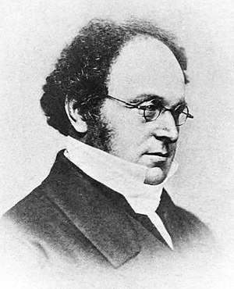
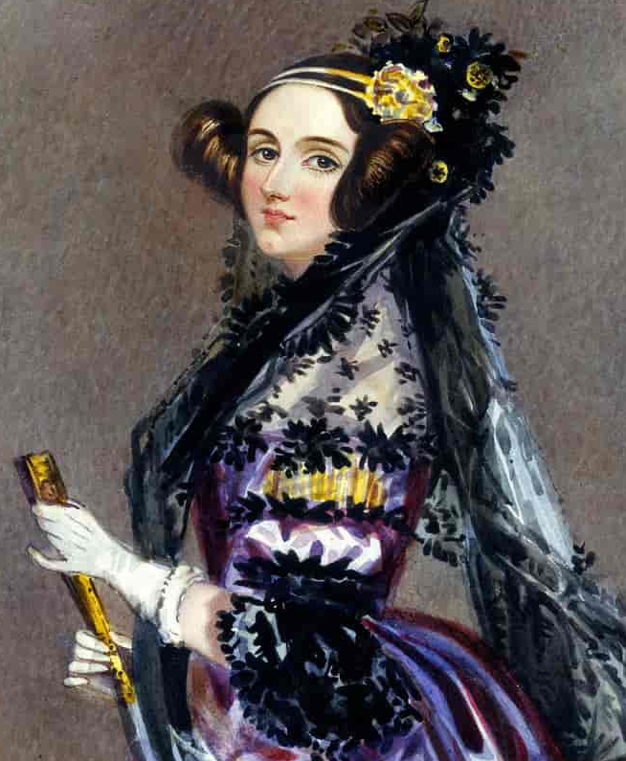
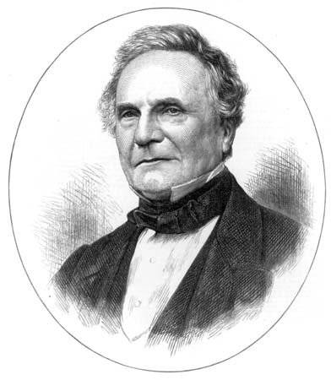
A mathematical lineage to the first computer
Augustus De Morgan
Ada Lovelace
Charles Babbage
Notes:
Interesting tidbit of history. De Morgan’s Laws are named after Augustus De Morgan (1806–1871), a British mathematician and logician who was also the math tutor of Ada Lovelace (1815–1852). As we saw last week, Ada Lovelace was an English mathematician and the only legitimate child of poet Lord Byron! She is known as the first computer programmer and she maintained correspondence and translated the work of English mathematician and inventor Charles Babbage (1791-1871) who worked on the idea of what is considered the first digital computer, the Analytical Engine, which would be a general-purpose, fully program-controlled computer.

Slide 31
Disjunctive normal form (DNF)
Theorem (Boole, 1847):
Any Boolean function can be represented as a disjunction (i.e., OR) of conjunctions (i.e., ANDs) of its arguments and their negation (NOT). This is also known as disjunctive normal form (DNF) or a sum of products/minterms.
conjunction: ANDed variables
(A ∧ ¬ B ∧ C) ∨ (¬ A ∧ ¬ B ∧ C) ∨ (A ∧ B ∧ C) ∨ …
disjunctive: ORed together

Slide 32
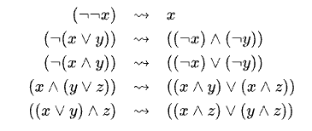
Disjunctive normal form (DNF)
One way this can happen is by using “laws”, specifically:
double negation
De Morgan’s laws
distributive law

Slide 33
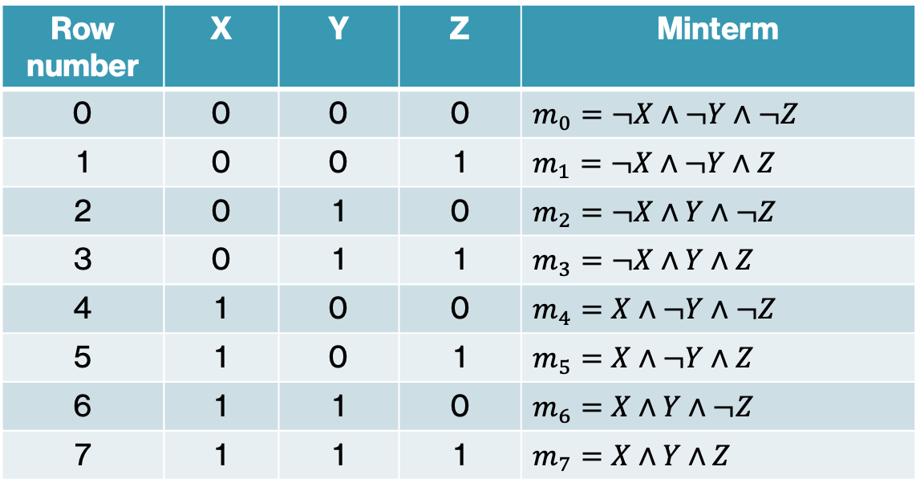
Minterms
Another way this can happen is directly from the truth table
Row number | X | Y | Z | Minterm
0 | 0 | 0 | 0 | $$m_{0}=¬X∧¬Y∧¬Z$$
1 | 0 | 0 | 1 | $$m_{1}=¬X∧¬Y∧Z$$
2 | 0 | 1 | 0 | $$m_{2}=¬X∧Y∧¬Z$$
3 | 0 | 1 | 1 | $$m_{3}=¬X∧Y∧Z$$
4 | 1 | 0 | 0 | $$m_{4}=X∧¬Y∧¬Z$$
5 | 1 | 0 | 1 | $$m_{5}=X∧¬Y∧Z$$
6 | 1 | 1 | 0 | $$m_{6}=X∧Y∧¬Z$$
7 | 1 | 1 | 1 | $$m_{7}=X∧Y∧Z$$
Minterm: a Boolean expression consisting of the conjunction (AND) of all variables of a Boolean function

Slide 34
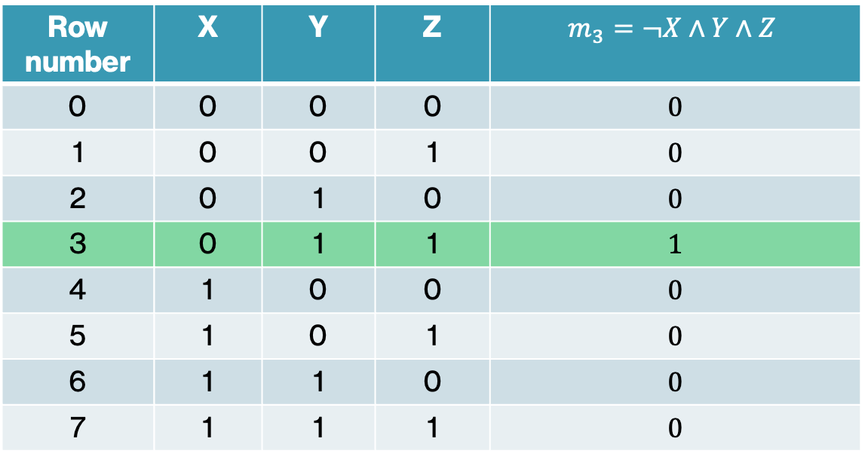
Minterms
Note that a minterm will be TRUE/1 for exactly one entry in the truth table
Row number | X | Y | Z | $$m_{3}=¬X∧Y∧Z$$
0 | 0 | 0 | 0 | 0
1 | 0 | 0 | 1 | 0
2 | 0 | 1 | 0 | 0
3 | 0 | 1 | 1 | 1
4 | 1 | 0 | 0 | 0
5 | 1 | 0 | 1 | 0
6 | 1 | 1 | 0 | 0
7 | 1 | 1 | 1 | 0
Minterm: a Boolean expression consisting of the conjunction (AND) of all variables of a Boolean function

Slide 35
An example: majority function
MAJ: A majority of the variables are TRUE (1)
X | Y | Z | MAJ(X,Y,Z)
0 | 0 | 0 | 0
0 | 0 | 1 | 0
0 | 1 | 0 | 0
0 | 1 | 1 | 1
1 | 0 | 0 | 0
1 | 0 | 1 | 1
1 | 1 | 0 | 1
1 | 1 | 1 | 1

Slide 36
Minterms -> DNF
Key idea: identify and combine entries that are 1
X | Y | Z | MAJ(X,Y,Z)
0 | 0 | 0 | 0
0 | 0 | 1 | 0
0 | 1 | 0 | 0
0 | 1 | 1 | 1
1 | 0 | 0 | 0
1 | 0 | 1 | 1
1 | 1 | 0 | 1
1 | 1 | 1 | 1

Slide 37
Minterms -> DNF
Key idea: identify and combine entries that are 1
X | Y | Z | MAJ(X,Y,Z)
0 | 0 | 0 | 0
0 | 0 | 1 | 0
0 | 1 | 0 | 0
0 | 1 | 1 | 1
1 | 0 | 0 | 0
1 | 0 | 1 | 1
1 | 1 | 0 | 1
1 | 1 | 1 | 1
OR these together
If any one of these is the entry, then we are 1

Slide 38
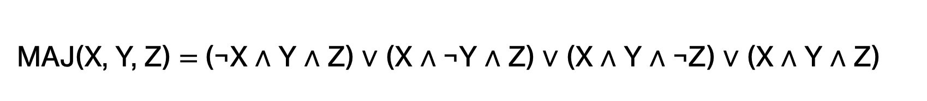
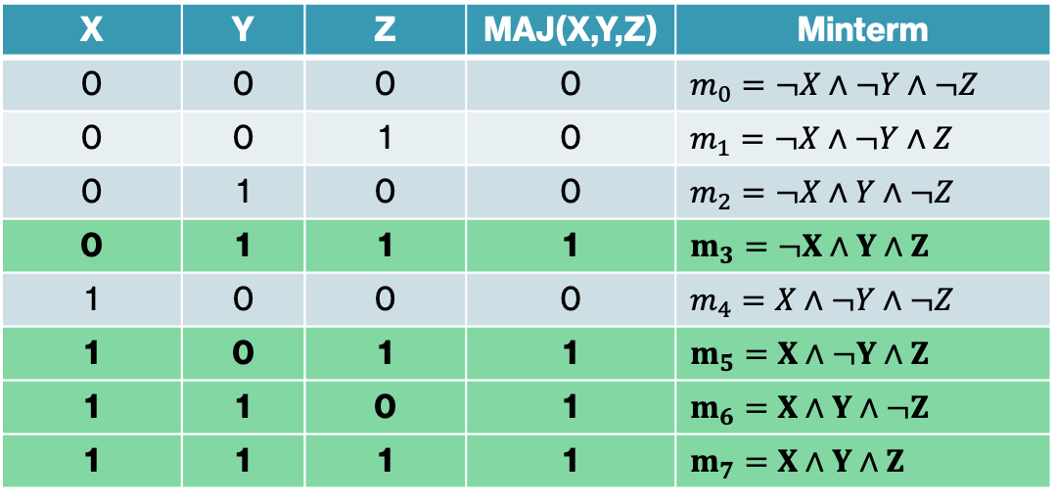
DNF of MAJ function
X | Y | Z | MAJ(X,Y,Z) | Minterm
0 | 0 | 0 | 0 | $$m_{0}=¬X∧¬Y∧¬Z$$
0 | 0 | 1 | 0 | $$m_{1}=¬X∧¬Y∧Z$$
0 | 1 | 0 | 0 | $$m_{2}=¬X∧Y∧¬Z$$
0 | 1 | 1 | 1 | $$m_{3}=¬X∧Y∧Z$$
1 | 0 | 0 | 0 | $$m_{4}=X∧¬Y∧¬Z$$
1 | 0 | 1 | 1 | $$m_{5}=X∧¬Y∧Z$$
1 | 1 | 0 | 1 | $$m_{6}=X∧Y∧¬Z$$
1 | 1 | 1 | 1 | $$m_{7}=X∧Y∧Z$$
MAJ(X, Y, Z) $\text{= }$(¬X ∧ Y ∧ Z) ∨ (X ∧ ¬Y ∧ Z) ∨ (X ∧ Y ∧ ¬Z) ∨ (X ∧ Y ∧ Z)

Slide 39



PRACTICE TIME - ODD function using DNF
ODD($X_{1}, X_{2}, …,X_{n}$) = 1 if an odd number of arguments is 1, 0 otherwise
X | Y | Z | ODD(X,Y,Z) | Minterm
0 | 0 | 0 | 0 | $$m_{0}=$$
0 | 0 | 1 | 1 | $$m_{1}=$$
0 | 1 | 0 | 1 | $$m_{2}=$$
0 | 1 | 1 | 0 | $$m_{3}=$$
1 | 0 | 0 | 1 | $m_{4}$ =
1 | 0 | 1 | 0 | $$m_{5}=$$
1 | 1 | 0 | 0 | $$m_{6}=$$
1 | 1 | 1 | 1 | $$m_{7}=$$
ODD(X, Y, Z) $=$

Slide 40

PRACTICE TIME - ODD function using DNF
ODD($X_{1}, X_{2}, …,X_{n}$) = 1 if an odd number of arguments is 1, 0 otherwise
X | Y | Z | ODD(X,Y,Z) | Minterm
0 | 0 | 0 | 0 | $$m_{0}=$$
0 | 0 | 1 | 1 | $m_{1}=$ $¬X∧¬Y∧Z$
0 | 1 | 0 | 1 | $$m_{2}=¬X∧Y∧¬Z$$
0 | 1 | 1 | 0 | $$m_{3}=$$
1 | 0 | 0 | 1 | $m_{4}$ = $X∧¬Y∧¬Z$
1 | 0 | 1 | 0 | $$m_{5}=$$
1 | 1 | 0 | 0 | $$m_{6}=$$
1 | 1 | 1 | 1 | $$m_{7}=X∧Y∧Z$$
ODD(X, Y, Z) $=$(¬X ∧ ¬Y ∧ Z) ∨ (¬X ∧ Y ∧ ¬Z) ∨ (X ∧ ¬Y ∧ ¬Z) ∨ (X ∧ Y ∧ Z)

Slide 41
Conjunctive normal form (CNF)
Any Boolean function can be represented as a conjunction (i.e., AND) of disjunctions (i.e., ORs) of its arguments and their negation (NOT). This is also known as conjunctive normal form (CNF) or a product of sums/maxterms.
disjunction: ORed variables
(A ∨ ¬ B ∨ C) ∧ (¬ A ∨ ¬ B ∨ C) ∧ (A ∨ B ∨ C) ∧ …
conjunctive: ANDed together

Slide 42
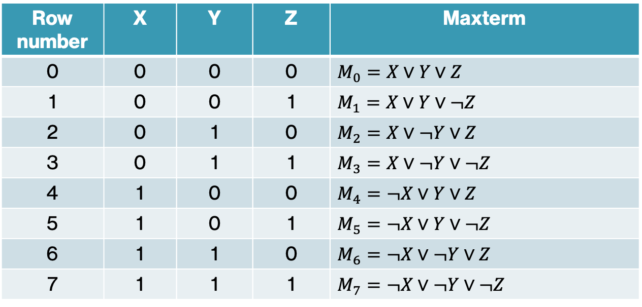
Maxterms
Maxterm: a disjunction (OR) of all variables of a Boolean function
Row number | X | Y | Z | Maxterm
0 | 0 | 0 | 0 | $$M_{0}=X∨Y∨Z$$
1 | 0 | 0 | 1 | $$M_{1}=X∨Y∨¬Z$$
2 | 0 | 1 | 0 | $$M_{2}=X∨¬Y∨Z$$
3 | 0 | 1 | 1 | $$M_{3}=X∨¬Y∨¬Z$$
4 | 1 | 0 | 0 | $$M_{4}=¬X∨Y∨Z$$
5 | 1 | 0 | 1 | $$M_{5}=¬X∨Y∨¬Z$$
6 | 1 | 1 | 0 | $$M_{6}=¬X∨¬Y∨Z$$
7 | 1 | 1 | 1 | $$M_{7}=¬X∨¬Y∨¬Z$$
The maxterm is formed by ORing together the “opposite” of the value in the truth table

Slide 43
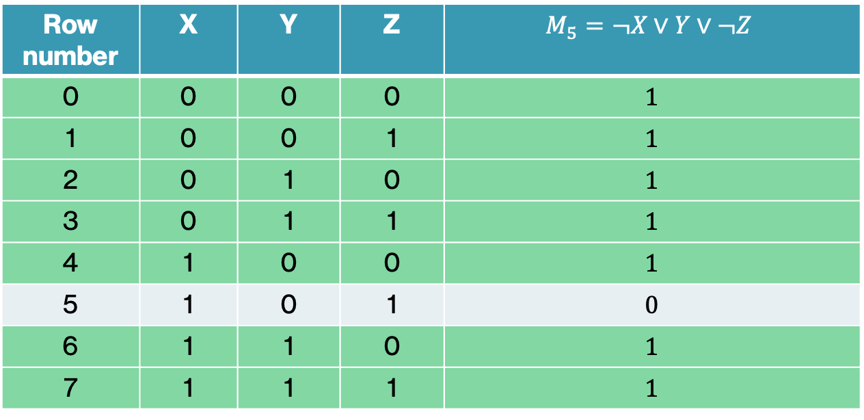
Maxterms
Note that a maxterm will be TRUE/1 for all entries except one in the truth table
Row number | X | Y | Z | $$M_{5}=¬X∨Y∨¬Z$$
0 | 0 | 0 | 0 | 1
1 | 0 | 0 | 1 | 1
2 | 0 | 1 | 0 | 1
3 | 0 | 1 | 1 | 1
4 | 1 | 0 | 0 | 1
5 | 1 | 0 | 1 | 0
6 | 1 | 1 | 0 | 1
7 | 1 | 1 | 1 | 1

Slide 44
Maxterms -> CNF
Key idea: identify and combine entries that are 0, i.e.,
as long as it’s not one of these entries, it’s 1
X | Y | Z | MAJ(X,Y,Z)
0 | 0 | 0 | 0
0 | 0 | 1 | 0
0 | 1 | 0 | 0
0 | 1 | 1 | 1
1 | 0 | 0 | 0
1 | 0 | 1 | 1
1 | 1 | 0 | 1
1 | 1 | 1 | 1

Slide 45
Maxterms -> CNF
Key idea: identify and combine entries that are 0, i.e.,
as long as it’s not one of these entries, it’s 1
X | Y | Z | MAJ(X,Y,Z)
0 | 0 | 0 | 0
0 | 0 | 1 | 0
0 | 1 | 0 | 0
0 | 1 | 1 | 1
1 | 0 | 0 | 0
1 | 0 | 1 | 1
1 | 1 | 0 | 1
1 | 1 | 1 | 1
AND these together

Slide 46
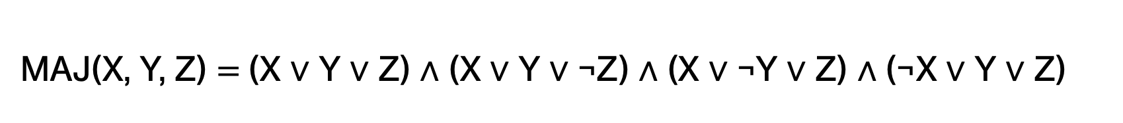
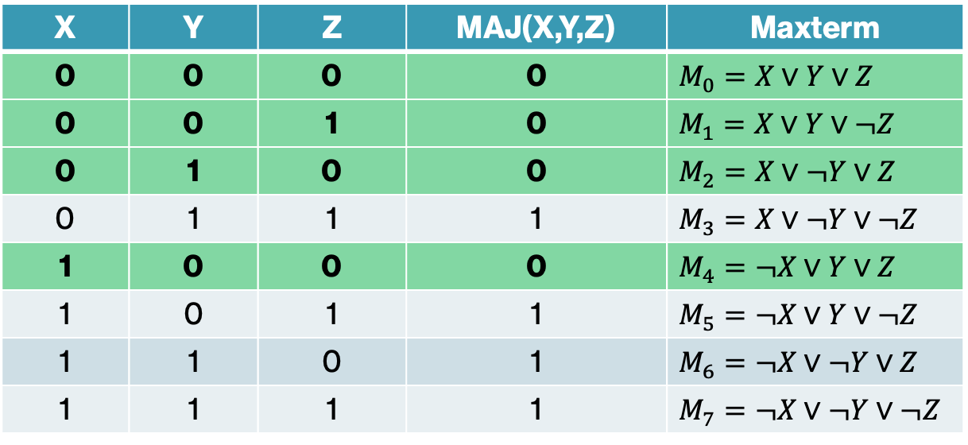
CNF of MAJ function
X | Y | Z | MAJ(X,Y,Z) | Maxterm
0 | 0 | 0 | 0 | $$M_{0}=X∨Y∨Z$$
0 | 0 | 1 | 0 | $$M_{1}=X∨Y∨¬Z$$
0 | 1 | 0 | 0 | $$M_{2}=X∨¬Y∨Z$$
0 | 1 | 1 | 1 | $$M_{3}=X∨¬Y∨¬Z$$
1 | 0 | 0 | 0 | $$M_{4}=¬X∨Y∨Z$$
1 | 0 | 1 | 1 | $$M_{5}=¬X∨Y∨¬Z$$
1 | 1 | 0 | 1 | $$M_{6}=¬X∨¬Y∨Z$$
1 | 1 | 1 | 1 | $$M_{7}=¬X∨¬Y∨¬Z$$
MAJ(X, Y, Z) $\text{= }$(X ∨ Y ∨ Z) ∧ (X ∨ Y ∨ ¬Z) ∧ (X ∨ ¬Y ∨ Z) ∧ (¬X ∨ Y ∨ Z)

Slide 47
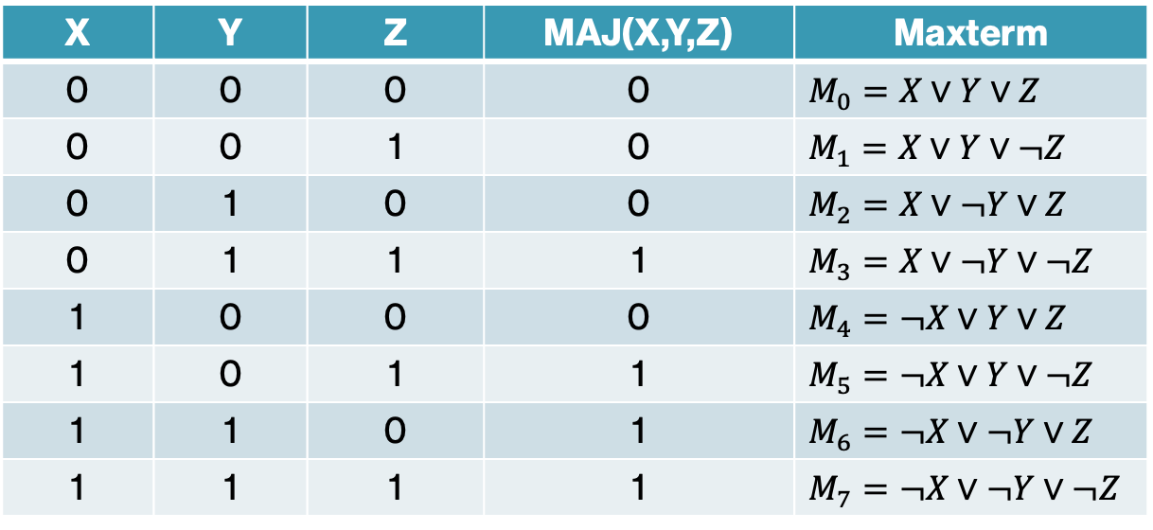
MAJ(0, 1, 1) = ?
X | Y | Z | MAJ(X,Y,Z) | Maxterm
0 | 0 | 0 | 0 | $$M_{0}=X∨Y∨Z$$
0 | 0 | 1 | 0 | $$M_{1}=X∨Y∨¬Z$$
0 | 1 | 0 | 0 | $$M_{2}=X∨¬Y∨Z$$
0 | 1 | 1 | 1 | $$M_{3}=X∨¬Y∨¬Z$$
1 | 0 | 0 | 0 | $$M_{4}=¬X∨Y∨Z$$
1 | 0 | 1 | 1 | $$M_{5}=¬X∨Y∨¬Z$$
1 | 1 | 0 | 1 | $$M_{6}=¬X∨¬Y∨Z$$
1 | 1 | 1 | 1 | $$M_{7}=¬X∨¬Y∨¬Z$$
MAJ(X, Y, Z) $\text{= }$(X ∨ Y ∨ Z) ∧ (X ∨ Y ∨ ¬Z) ∧ (X ∨ ¬Y ∨ Z) ∧ (¬X ∨ Y ∨ Z)

Slide 48
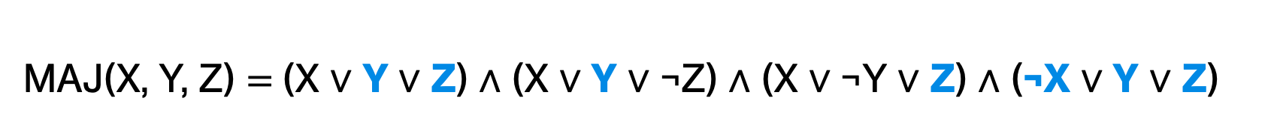
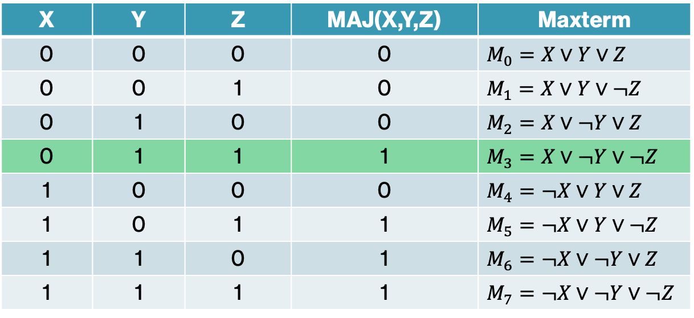
MAJ(0, 1, 1) = ?
X | Y | Z | MAJ(X,Y,Z) | Maxterm
0 | 0 | 0 | 0 | $$M_{0}=X∨Y∨Z$$
0 | 0 | 1 | 0 | $$M_{1}=X∨Y∨¬Z$$
0 | 1 | 0 | 0 | $$M_{2}=X∨¬Y∨Z$$
0 | 1 | 1 | 1 | $$M_{3}=X∨¬Y∨¬Z$$
1 | 0 | 0 | 0 | $$M_{4}=¬X∨Y∨Z$$
1 | 0 | 1 | 1 | $$M_{5}=¬X∨Y∨¬Z$$
1 | 1 | 0 | 1 | $$M_{6}=¬X∨¬Y∨Z$$
1 | 1 | 1 | 1 | $$M_{7}=¬X∨¬Y∨¬Z$$
1
1
1
1
MAJ(X, Y, Z) $\text{= }$(X ∨ Y ∨ Z) ∧ (X ∨ Y ∨ ¬Z) ∧ (X ∨ ¬Y ∨ Z) ∧ (¬X ∨ Y ∨ Z)

Slide 49
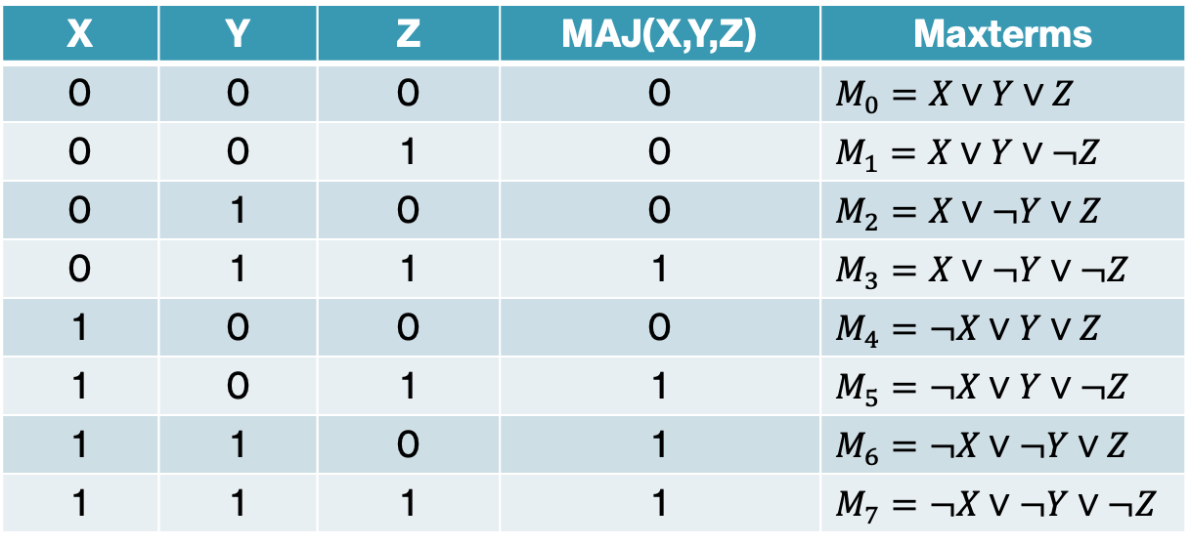
MAJ(1, 0, 0) = ?
X | Y | Z | MAJ(X,Y,Z) | Maxterms
0 | 0 | 0 | 0 | $$M_{0}=X∨Y∨Z$$
0 | 0 | 1 | 0 | $$M_{1}=X∨Y∨¬Z$$
0 | 1 | 0 | 0 | $$M_{2}=X∨¬Y∨Z$$
0 | 1 | 1 | 1 | $$M_{3}=X∨¬Y∨¬Z$$
1 | 0 | 0 | 0 | $$M_{4}=¬X∨Y∨Z$$
1 | 0 | 1 | 1 | $$M_{5}=¬X∨Y∨¬Z$$
1 | 1 | 0 | 1 | $$M_{6}=¬X∨¬Y∨Z$$
1 | 1 | 1 | 1 | $$M_{7}=¬X∨¬Y∨¬Z$$
MAJ(X, Y, Z) $\text{= }$(X ∨ Y ∨ Z) ∧ (X ∨ Y ∨ ¬Z) ∧ (X ∨ ¬Y ∨ Z) ∧ (¬X ∨ Y ∨ Z)

Slide 50
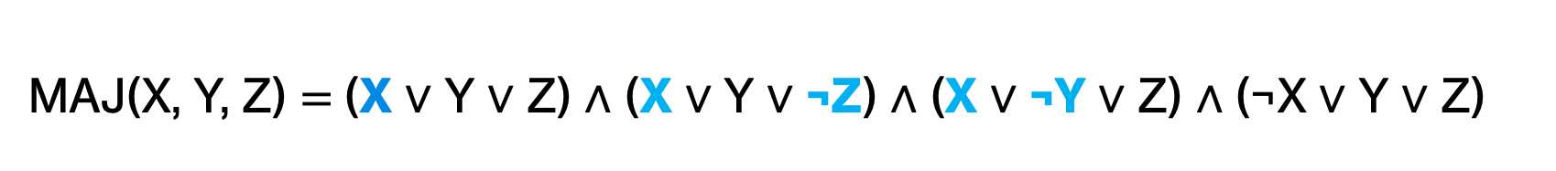
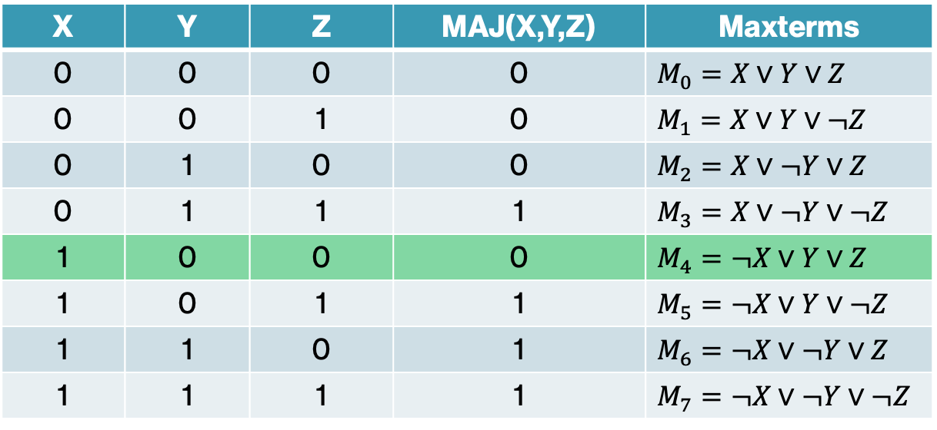
MAJ(1, 0, 0) = ?
X | Y | Z | MAJ(X,Y,Z) | Maxterms
0 | 0 | 0 | 0 | $$M_{0}=X∨Y∨Z$$
0 | 0 | 1 | 0 | $$M_{1}=X∨Y∨¬Z$$
0 | 1 | 0 | 0 | $$M_{2}=X∨¬Y∨Z$$
0 | 1 | 1 | 1 | $$M_{3}=X∨¬Y∨¬Z$$
1 | 0 | 0 | 0 | $$M_{4}=¬X∨Y∨Z$$
1 | 0 | 1 | 1 | $$M_{5}=¬X∨Y∨¬Z$$
1 | 1 | 0 | 1 | $$M_{6}=¬X∨¬Y∨Z$$
1 | 1 | 1 | 1 | $$M_{7}=¬X∨¬Y∨¬Z$$
1
1
1
0
MAJ(X, Y, Z) $\text{= }$(X ∨ Y ∨ Z) ∧ (X ∨ Y ∨ ¬Z) ∧ (X ∨ ¬Y ∨ Z) ∧ (¬X ∨ Y ∨ Z)

Slide 51

PRACTICE TIME - ODD function using CNF
ODD($X_{1}, X_{2}, …,X_{n}$) = 1 if an odd number of arguments is 1, 0 otherwise
X | Y | Z | ODD(X,Y,Z) | Maxterms
0 | 0 | 0 | 0 | $$M_{0}=$$
0 | 0 | 1 | 1 | $$M_{1}=$$
0 | 1 | 0 | 1 | $$M_{2}=$$
0 | 1 | 1 | 0 | $$M_{3}=$$
1 | 0 | 0 | 1 | $M_{4}$ =
1 | 0 | 1 | 0 | $$M_{5}=$$
1 | 1 | 0 | 0 | $$M_{6}=$$
1 | 1 | 1 | 1 | $$M_{7}=$$
ODD(X, Y, Z) $=$

Slide 52

PRACTICE TIME - ODD function using CNF
ODD($X_{1}, X_{2}, …,X_{n}$) = 1 if an odd number of arguments is 1, 0 otherwise
X | Y | Z | ODD(X,Y,Z) | Maxterms
0 | 0 | 0 | 0 | $$M_{0}=X∨Y∨Z$$
0 | 0 | 1 | 1 | $$M_{1}=$$
0 | 1 | 0 | 1 | $$M_{2}=$$
0 | 1 | 1 | 0 | $$M_{3}=X∨¬Y∨¬Z$$
1 | 0 | 0 | 1 | $M_{4}$ =
1 | 0 | 1 | 0 | $$M_{5}=¬X∨Y∨¬Z$$
1 | 1 | 0 | 0 | $$M_{6}=¬X∨¬Y∨Z$$
1 | 1 | 1 | 1 | $$M_{7}=$$
ODD(X, Y, Z) $=\text{(}\text{X}\text{ ∨ }\text{Y}\text{ ∨ }\text{Z}\text{) ∧ (}\text{X}\text{ ∨ }\text{Y}\text{ ∨ ¬}\text{Z}\text{) ∧ (}\text{X}\text{ ∨ ¬}\text{Y}\text{ ∨ }\text{Z}\text{) ∧ (¬}\text{X}\text{ ∨ }\text{Y}\text{ ∨ }\text{Z}\text{)}$

Slide 53
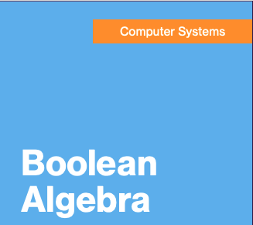
Circling back…
This was the first lecture for our “Computer Systems” section
How does Boolean Algebra fit in?

Slide 54
CPU

Slide 55

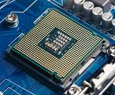
CPU: central processing unit
CPU

Slide 56




Inside a CPU
Gates

Slide 57
Inside a CPU
Gates
NOT
AND
OR
XOR

Slide 58

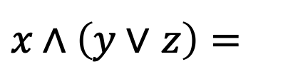


Gates
$$x \text{∧} \left(y \text{∨} z\right)=$$
$$x$$
$$y$$
$$z$$

Slide 59
Abstraction
High level of abstraction
Applications
Algorithms and data structures
Programming languages
Software
Operating system
Architecture
Integrated circuits
Hardware
Low level of abstraction
Physical components, e.g., transistors

Slide 60
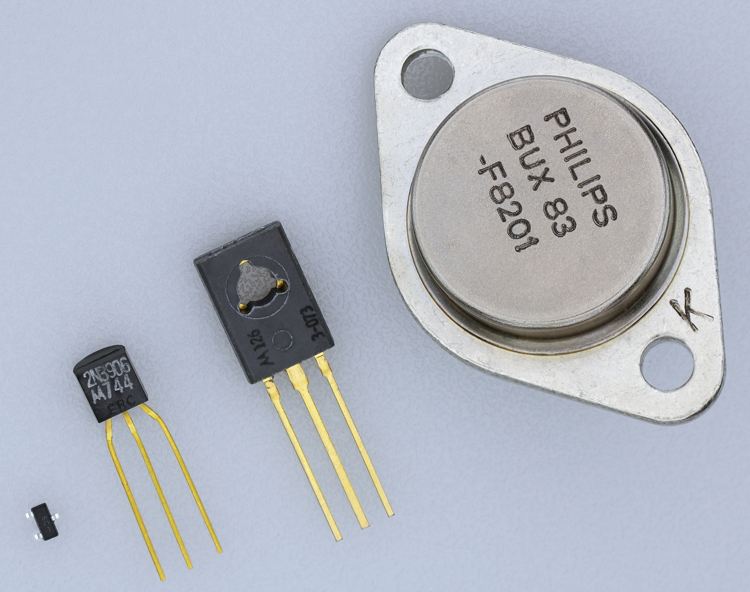
Transistors
https://commons.wikimedia.org/wiki/File:Transistorer_(cropped).jpg

Slide 61
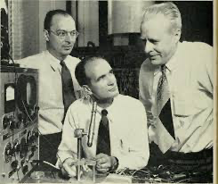
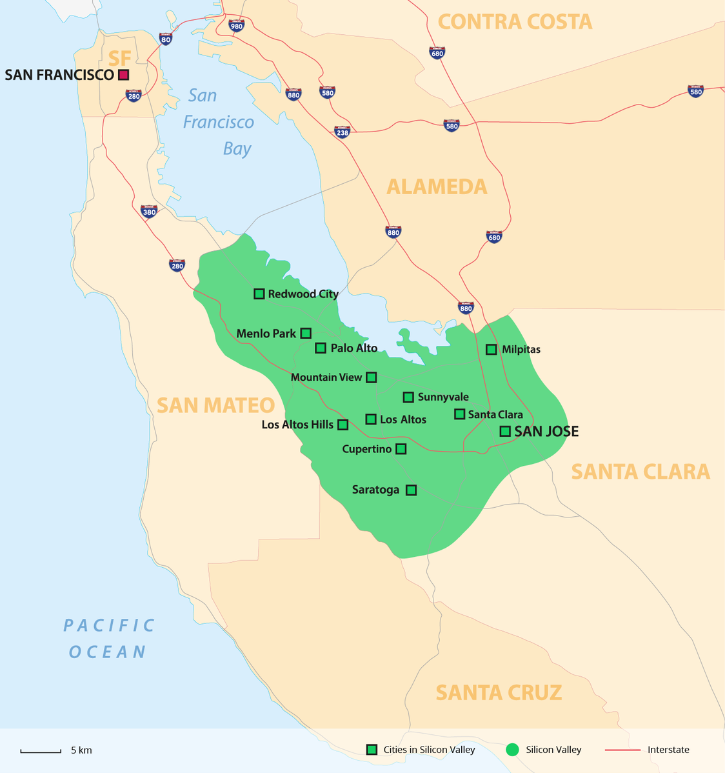
Transistors
Transistors are semiconductor devices made out of silicon.
They act as switches that can be open or closed by applying electricity.
Integrated circuits in modern computers are built off billions of transistors.
  They are small – you can fit a few thousand of them across the width of a human hair!
  They are fast – they can switch states millions of times per second.
  They are reliable – they can run without any issue for decades.
Invented in 1947 by Bardeen, Brattain, and Shockley at Bell Lab.
  They shared the 1956 Nobel Prize in Physics for their achievement.
A lot of development of transistors and circuits took place in Santa Clara Valley, which by the 1980s started being referred to as the Silicon Valley.
https://commons.wikimedia.org/wiki/File:Transistorer_(cropped).jpg

Slide 62
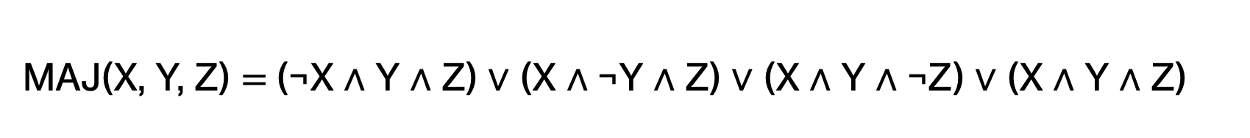
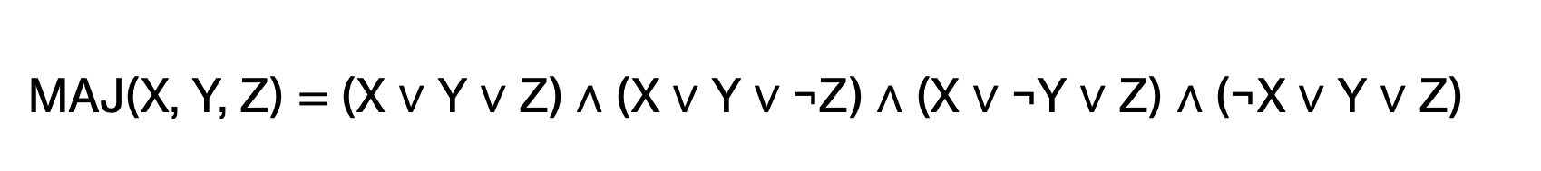
Simplifying Boolean formulas
DNF
MAJ(X, Y, Z) $\text{= }$(¬X ∧ Y ∧ Z) ∨ (X ∧ ¬Y ∧ Z) ∨ (X ∧ Y ∧ ¬Z) ∨ (X ∧ Y ∧ Z)
CNF
MAJ(X, Y, Z) $\text{= }$(X ∨ Y ∨ Z) ∧ (X ∨ Y ∨ ¬Z) ∧ (X ∨ ¬Y ∨ Z) ∧ (¬X ∨ Y ∨ Z)
Both of these are pretty long. Can we come up with a simpler (shorter) representation?

Slide 63

Simplifying Boolean formulas
DNF
MAJ(X, Y, Z) $\text{= }$(¬X ∧ Y ∧ Z) ∨ (X ∧ ¬Y ∧ Z) ∨ (X ∧ Y ∧ ¬Z) ∨ (X ∧ Y ∧ Z)
CNF
MAJ(X, Y, Z) $\text{= }$(X ∨ Y ∨ Z) ∧ (X ∨ Y ∨ ¬Z) ∧ (X ∨ ¬Y ∨ Z) ∧ (¬X ∨ Y ∨ Z)
For example:
MAJ(X, Y, Z) $\text{= }$(X ∧ Y) ∨ (Y ∧ Z) ∨ (Z ∧ X)

Slide 64
Karnaugh Maps (aka, K-maps)
Another approach for creating a Boolean function from a truth table
X | Y | F
0 | 0 | 1
0 | 1 | 0
1 | 0 | 1
1 | 1 | 0

Slide 65
Karnaugh Maps (aka, K-maps)
Another approach for creating a Boolean function from a truth table
X
X | Y | F
0 | 0 | 1
0 | 1 | 0
1 | 0 | 1
1 | 1 | 0
0
1
0
1 | 1
0 | 0
Y
1
Gray Code

Slide 66
Karnaugh Maps (aka, K-maps)
Create groups of 1s:
Only contain 1s
Must be a square or rectangle
Area must be a power of 2
Groups should be as large as possible
Groups can overlap
Groups can wrap around
All 1s must be covered
X
0
1
0
1 | 1
0 | 0
Y
1

Slide 67
Karnaugh Maps (aka, K-maps)
Create groups of 1s:
Only contain 1s
Must be a square or rectangle
Area must be a power of 2
Groups should be as large as possible
Groups can overlap
Groups can wrap around
All 1s must be covered
X
0
1
0
1 | 1
0 | 0
Y
1

Slide 68
Karnaugh Maps (aka, K-maps)
Create groups of 1s:
Only contain 1s
Must be a square or rectangle
Area must be a power of 2
Groups should be as large as possible
Groups can overlap
Groups can wrap around
All 1s must be covered
X
0
1
0
1 | 0
0 | 1
Y
1

Slide 69
Karnaugh Maps (aka, K-maps)
Create groups of 1s:
Only contain 1s
Must be a square or rectangle
Area must be a power of 2
Groups should be as large as possible
Groups can overlap
Groups can wrap around
All 1s must be covered
X
0
1
0
1 | 0
0 | 1
Y
1

Slide 70
Karnaugh Maps (aka, K-maps)
Create groups of 1s:
Only contain 1s
Must be a square or rectangle
Area must be a power of 2
Groups should be as large as possible
Groups can overlap
Groups can wrap around
All 1s must be covered
X
0
1
0
1 | 0
1 | 1
Y
1

Slide 71
Karnaugh Maps (aka, K-maps)
Create groups of 1s:
Only contain 1s
Must be a square or rectangle
Area must be a power of 2
Groups should be as large as possible
Groups can overlap
Groups can wrap around
All 1s must be covered
X
0
1
0
1 | 0
1 | 1
Y
1

Slide 72
Karnaugh Maps (aka, K-maps)
Each group becomes a conjunction:
Look for the variable(s) that don’t change:
  If it stays a 1, you add the variable as is
  If it stays a 0, you add the negation of the variable
OR the conjunctions together
X
0
1
0
1 | 1
0 | 0
Y
1
What does this become?

Slide 73
Karnaugh Maps (aka, K-maps)
Each group becomes a conjunction:
Look for the variable(s) that don’t change:
  If it stays a 1, you add the variable as is
  If it stays a 0, you add the negation of the variable
OR the conjunctions together
X
0
1
0
1 | 1
0 | 0
Y
1
¬Y

Slide 74
Karnaugh Maps (aka, K-maps)
X
X | Y | F
0 | 0 | 1
0 | 1 | 0
1 | 0 | 1
1 | 1 | 0
0
1
0
1 | 1
0 | 0
Y
1
¬Y

Slide 75
Karnaugh Maps (aka, K-maps)
Each group becomes a conjunction:
Look for the variable(s) that don’t change:
  If it stays a 1, you add the variable as is
  If it stays a 0, you add the negation of the variable
OR the conjunctions together
X
0
1
0
1 | 0
1 | 1
Y
1
What does this become?

Slide 76
Karnaugh Maps (aka, K-maps)
Each group becomes a conjunction:
Look for the variable(s) that don’t change:
  If it stays a 1, you add the variable as is
  If it stays a 0, you add the negation of the variable
OR the conjunctions together
X
0
1
0
1 | 0
1 | 1
Y
1
Y
¬X
∨

Slide 77
Karnaugh Maps (aka, K-maps)
Each group becomes a conjunction:
Look for the variable(s) that don’t change:
  If it stays a 1, you add the variable as is
  If it stays a 0, you add the negation of the variable
OR the conjunctions together
X
0
1
0
1 | 0
1 | 1
Y
1
Y
∨
¬X

Slide 78
Practice Problems – Problem 1
  You are given the following truth table for a Boolean function with three variables, A, B, and C, and an output column F.
  What are the disjunctive and conjunctive normal forms based on this truth table?
A | B | C | F
0 | 0 | 0 | 1
0 | 0 | 1 | 0
0 | 1 | 0 | 1
0 | 1 | 1 | 0
1 | 0 | 0 | 0
1 | 0 | 1 | 1
1 | 1 | 0 | 1
1 | 1 | 1 | 0

Slide 79
Practice Problems – Problem 2
  Assuming x = 6, y = 2, z = 12. What would the following Python expressions evaluate to?
  x == 10 or x < 5
  x != 7 and x > 3
  not (x >= 5 and y <= 2)
  (x < 0) or (x >= 0)
  not (x != x)
  x > 1 and (z / x) != 2
  x <= 0 or (z / x) == 1
  x == 4 and y == 4

Slide 80
Practice Problems – Answer 1
  Disjunctive normal form:
  F = (¬A ∧ ¬B ∧ ¬C) ∨ (¬A ∧ B ∧ ¬C) ∨ (A ∧ ¬B ∧ C) ∨ (A ∧ B ∧ ¬C)
  Conjunctive normal form:
  F = (A ∨ B ∨ ¬C) ∧ (A ∨ ¬B ∨ ¬C) ∧ (¬A ∨ B ∨ C) ∧ (¬A ∨ ¬B ∨ ¬C)
A | B | C | F
0 | 0 | 0 | 1
0 | 0 | 1 | 0
0 | 1 | 0 | 1
0 | 1 | 1 | 0
1 | 0 | 0 | 0
1 | 0 | 1 | 1
1 | 1 | 0 | 1
1 | 1 | 1 | 0

Slide 81
Practice Problems – Answer 2
  Assuming x = 6, y = 2, z = 12. What would the following Python expressions evaluate to?
  x == 10 or x < 5 → 6 == 10 or 6 < 5 → False or False → False
  x != 7 and x > 3 → 6 != 7 and 6 > 3 → True and True → True
  not (x >= 5 and y <= 2) → not (6 >= 5 and 2 <= 2) → not (True and True) → not True → False
  (x < 0) or (x >= 0) → 6 < 0 or 6 >= 0 → False or True → True (always true, no matter what x is)
  not (x != x) → not False → True
  x > 1 and (z / x) != 2 → 6 > 1 and (12 / 6 != 2) → True and False → False
  x <= 0 or (z / x) == 1 → 6 <= 0 or (12 / 6 == 1) → False or False → False
  x == 4 and y == 4 → 6 == 4 and 2 == 4 → False and False → False

