Slide 1

Introduction and Ethics of Computer Science
History & Ethics
CS51 – Fall 2026
Notes:
Before we start, here is a link to the course website where you can find the schedule, syllabus, and the lecture slides posted if you want to follow along.

Slide 2
Welcome!
Notes:
Welcome to CSCI051 or CS51 for short.

Slide 3
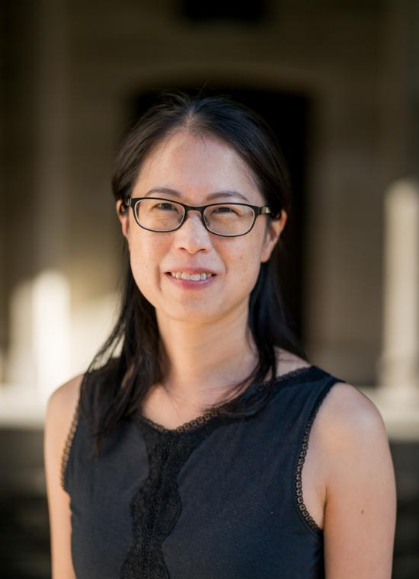
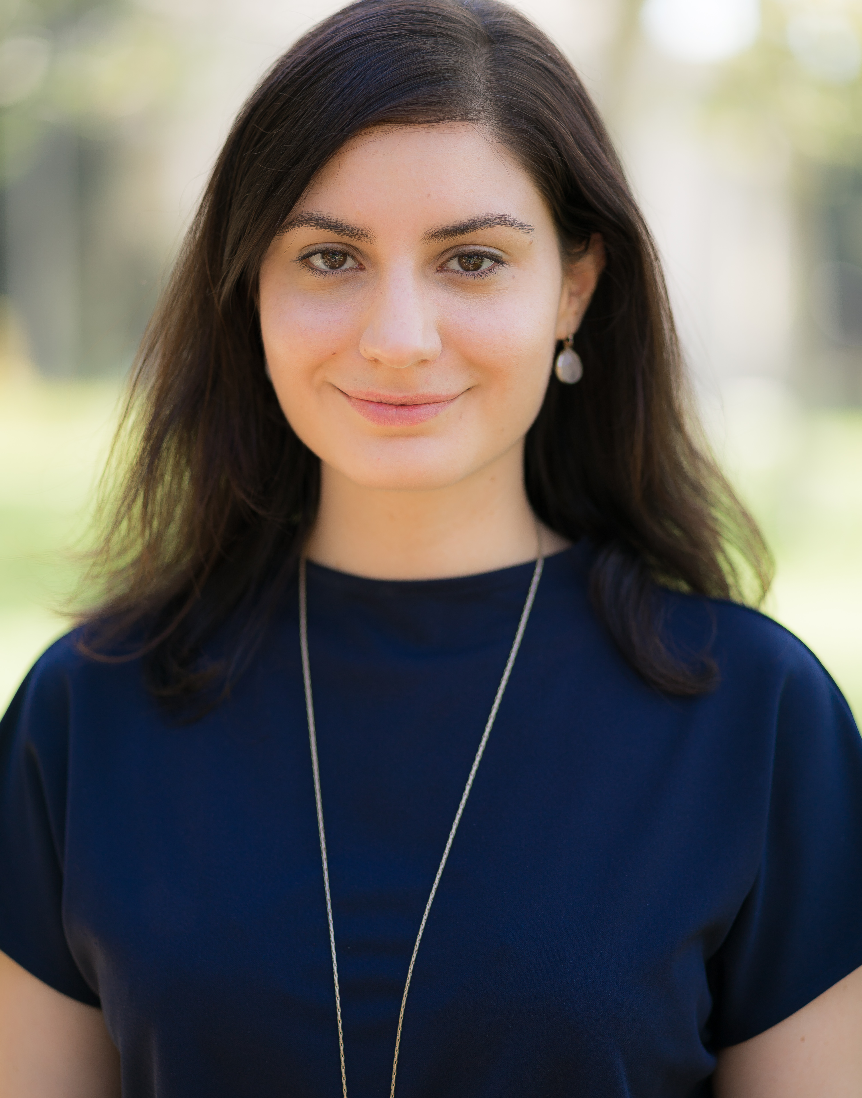
Instructors
Tzu-Yi Chen
she/her/hers
Edmunds 115
OH: M 2:30-3:30pm, F 9-10:30am
and by appointment
Alexandra Papoutsaki
she/her/hers
Edmunds 222
OH: M 10:30-noon TR 10-noon
and by appointment
Notes:
The two instructors for the class are Prof Chen and Professor Papoutsaki (Pa-poo-TSA-kee). Together, we will be covering the Tuesday/Thursday lectures. Prof. Papoutsaki will be covering the Wednesday labs. If you have been registered for the class, you need to also register for one of the two Wednesday lab for which attendance is mandatory. We will be soon announcing our office huors. We want you to come to our office hours with questions about the course material, assignments, College, post-graduate advice, and anything else that is going on.

Slide 4
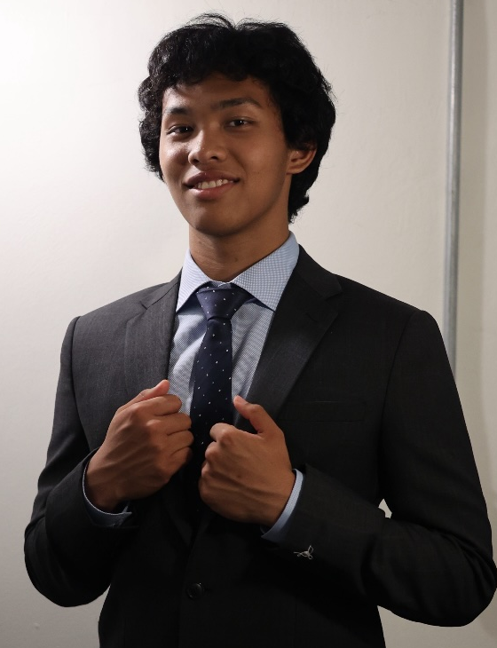


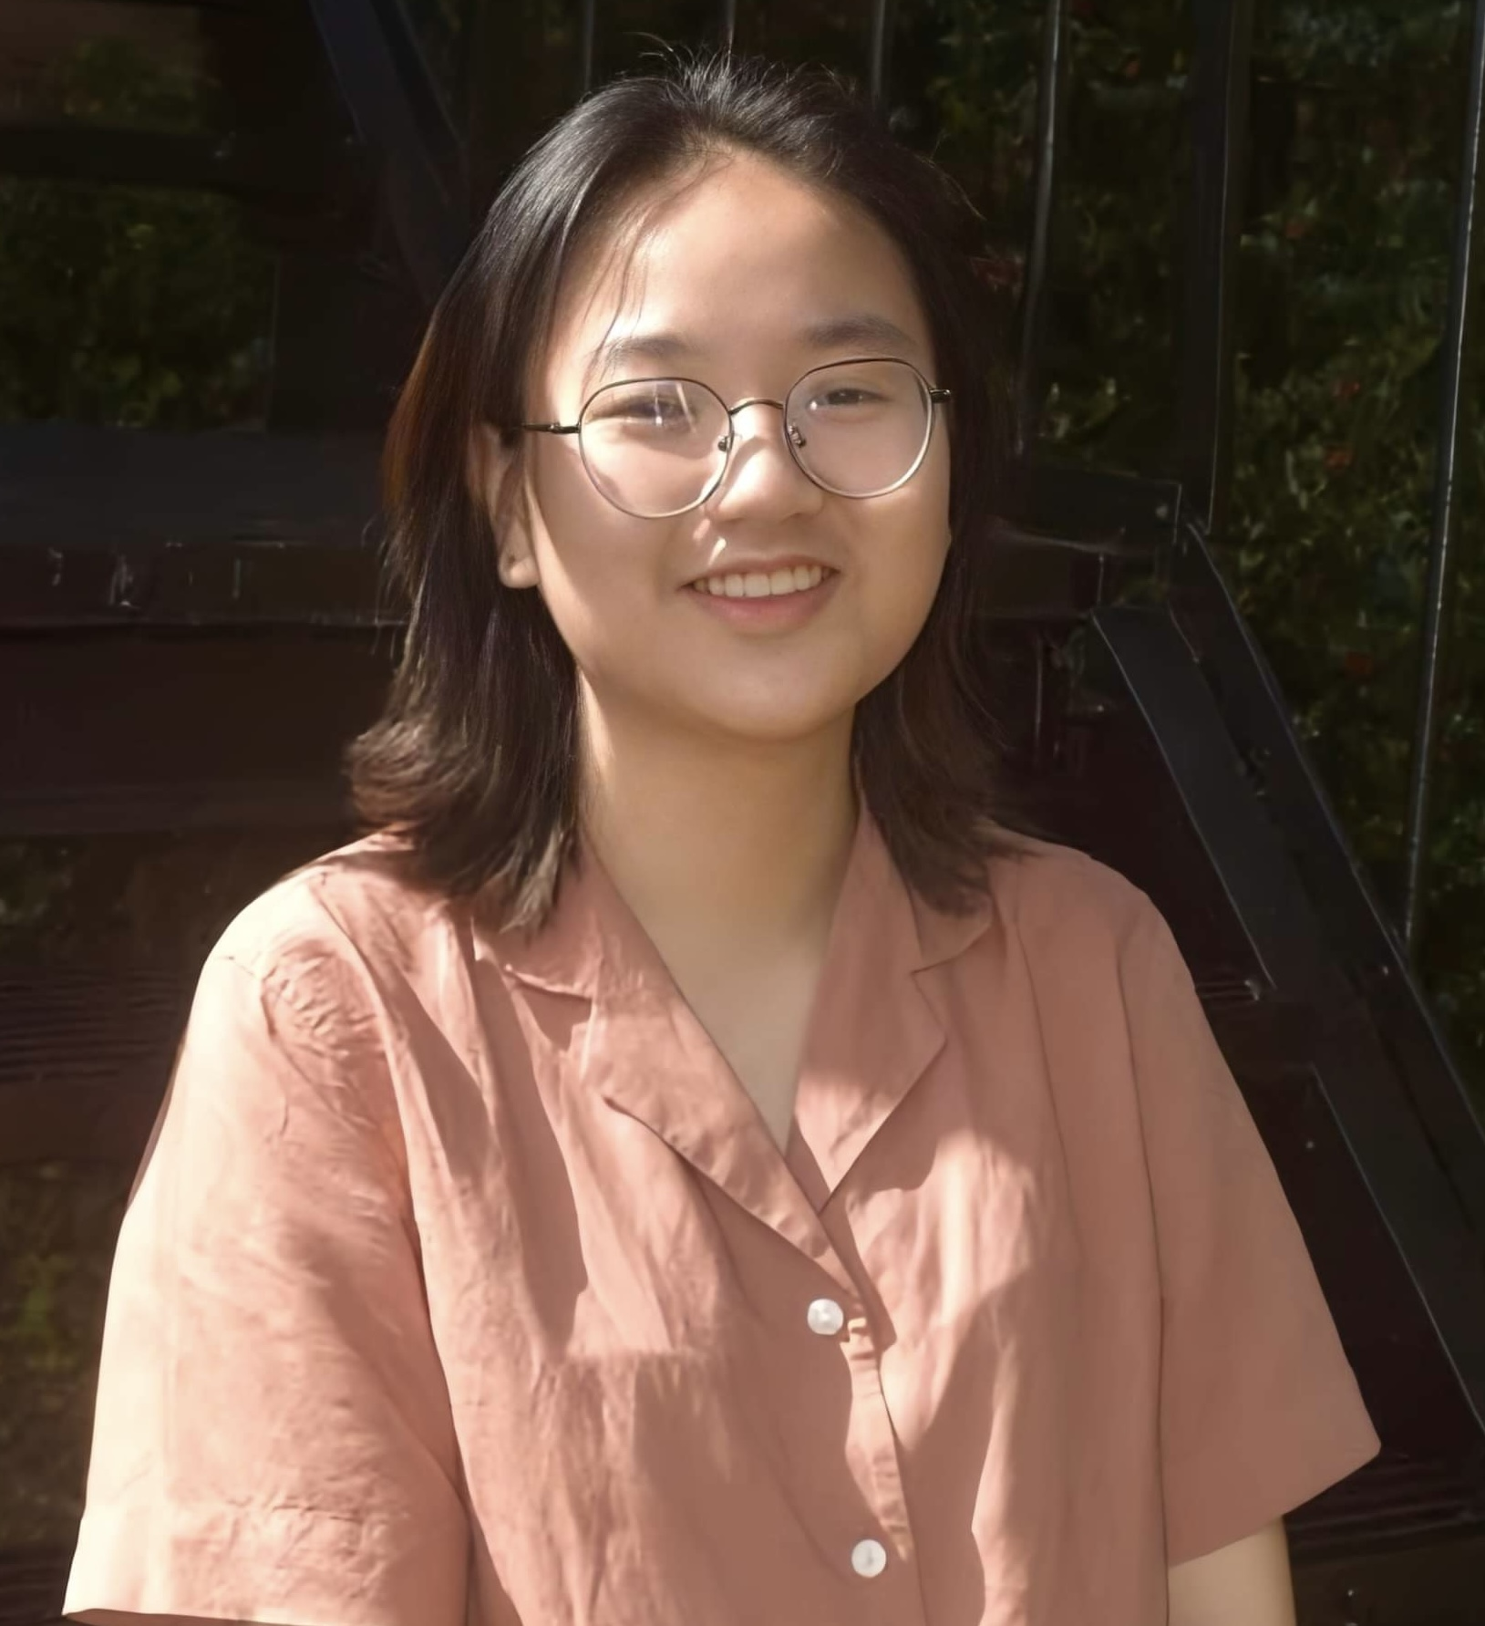
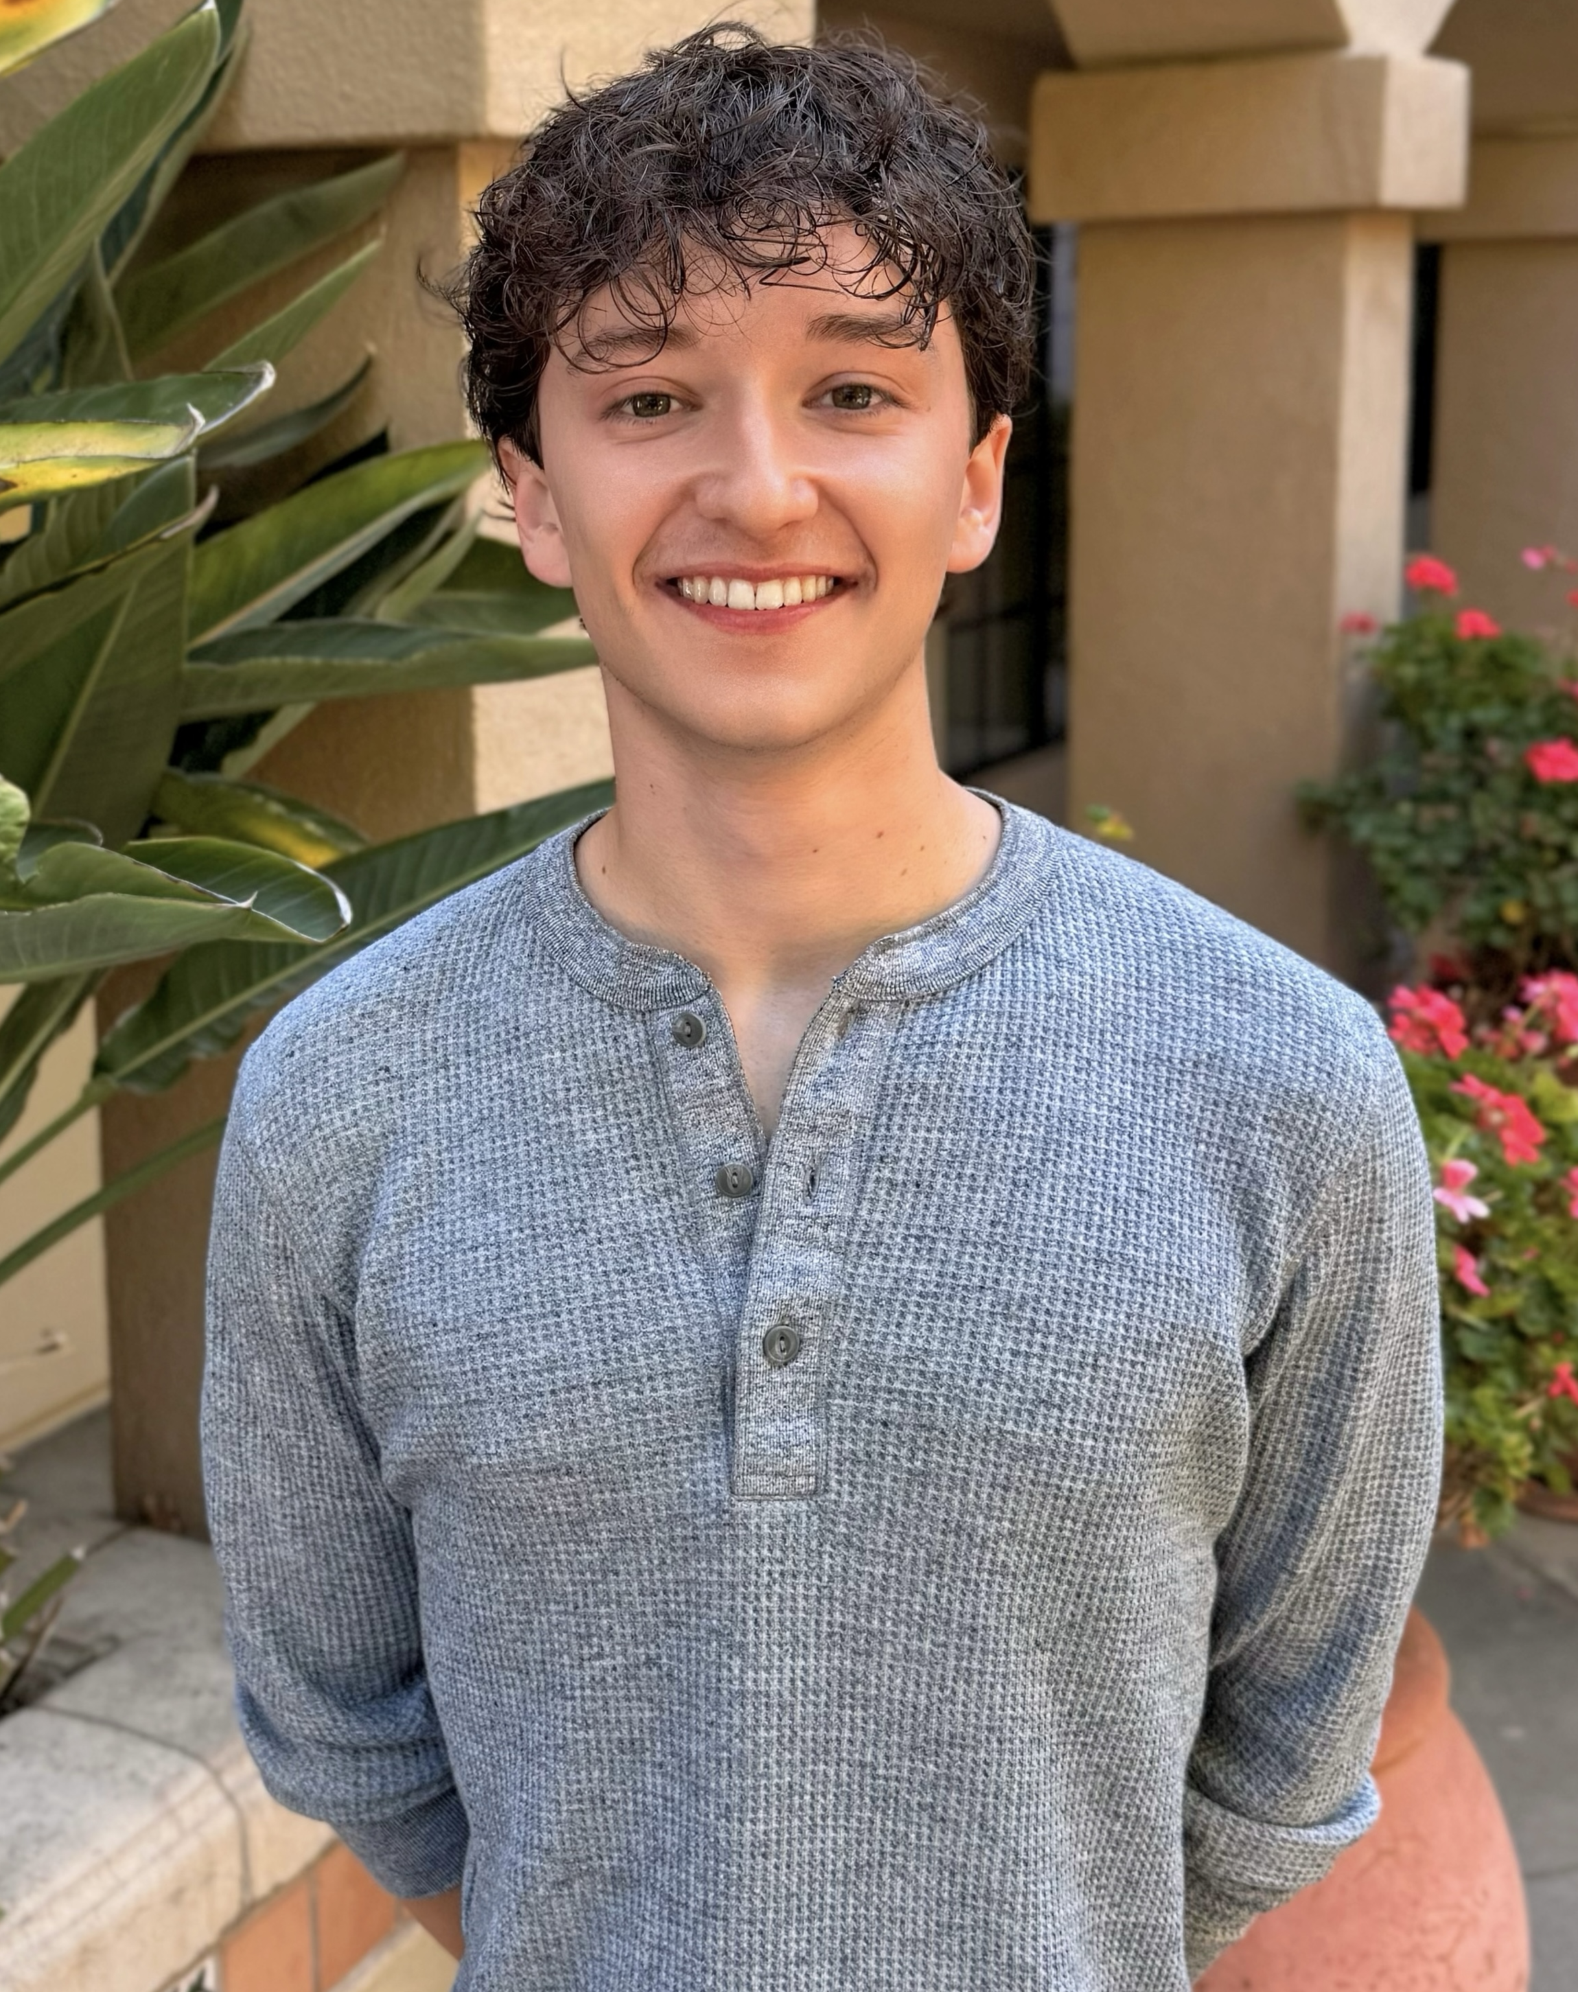
Teaching Assistants
Jinyao DeSandies
he/him/his
Marina Eissenstat
she/her/hers
Cyrus Hnasko
he/him/his
Stefanie Nguyen
she/her/hers
Sebastian Pollack
he/him/his
Notes:
We also have an incredible team of TAs that will be assisting with the grading of the assignments, the Wednesday labs, and mentor sessions. TAs are one of the most valuable resources to the learning environment our department offers. Mentor sessions are a place that you can go not only for help with assignments but also to meet other classmates and hear advice from more experienced peers. Half of our TAs have Taed CS51 before and half took it last year so we have a good mix of people that know how to help you and can really empathize with you. The schedule for mentor sessions will be announced at the end of this week.

Slide 5
Who are you?
Preferred name and pronouns
Year
College
Programming experience
  Concurrently enrolled in CSCI050, or
  Placed out of CSCI050 after talking with Prof. Chen or Prof. Papoutsaki
Notes:
Now I would like us all to get a better sense of who’s in the room. Can you please state your name and pronouns, if you prefer, what year and College you are in, and whether you are currently enrolled in CSCI050 or if you have placed out of it and if yes what is your programming experience?

Slide 6
Nice to meet you!
Notes:
Nice to meet you all! We are very excited to partner with you through this learning journey

Slide 7
What is CS51?
An introduction to computer science through a survey of fundamental topics and a glimpse into our curriculum.
  Week 1 and 14: Ethics and History of Computer Science
  Weeks 1-5: Computer Systems (CSCI105)
  Weeks 5-8: Mathematical Foundations of Computer Science (CSCI054)
  Weeks 9-11: Data Structures and Algorithms (CSCI062 and CSCI140)
  Weeks 11-1: Theory of Computation & Programming Languages (CS101)
  Weeks 14: Machine Learning (electives)
Notes:
CS51 has been designed as an introduction to the field of computer science at large, where programming is just one component and not the whole focus. Together, we will survey some of the biggest areas of computer science. This will also help you get a glimpse of what to expect in our intro sequence and upper division courses, if you choose to continue taking classes in our department. Today, we will start with an introduction to the ethics of cs. Here is what to expect for the rest of the semester.

Slide 8
Some examples of what you will learn
How computers process and store information and the main components of modern computers
Not only to write programs but prove their correctness and analyze their running time
Fundamental data structures to organize data
Simple computational models
Origins of computation, influential historical figures that shaped computer science and ethical implications.
Notes:
Here are some examples of what we will learn this semester.
You will understand that everything we do as computer scientists has the potential to impact society and become more comfortable with thinking of the ethics of technology
You will become familiar with how computers process and store information, what the main components of your computer are and how they work together
You will see how computer scientists not only write programs but can prove their correctness
You will learn fundamental data structures to organize data
You will be exposed to the idea that the algorithms we design should not only be correct but efficient and that depending on the situation we might choose different algorithms
You will see that the idea of computation can be reduced to seemingly simple machines that have the same capabilities with today’s computers
You will exposed to the origins of computation and learn about important historical figures that have shaped the field of computer science and what technology looks like today

Slide 9
How can I succeed in CS51?
Sleep well the night before, eat, attend class, be on time for class and lab
Take notes, participate, ask questions, don’t stay confused
Review slides and do practice problems after each lecture
Start the assignments early
Come to office hours/mentor sessions
Budget at least 8 hours outside class time
Read email/Slack for announcements and bookmark course website:
  https://cs.pomona.edu/classes/cs51/
Notes:
How can you do well in this course (and in College in general)? I always tell students to not underestimate the importance of a good night’s sleep and eating well. We expect you to be here and in lab on time to avoid disruptions and make the most of the time we have together. The slides are available online along with notes, but feel free to add your own notes on them. We want you to participate, ask questions, and not stay confused. It’s always a good idea to review what we covered in class right after since it will be fresh in your mind. The class will have 10 weekly assignments. I can’t stretch enough how important it is to start early. The entire course staff is here with office hours and mentor sessions to help you. But we are asking you to try the problem first before you come to us. This is a full-credit course; please budget at least 8 hours outside class time. And don’t forget to keep an eye on email and Slack for announcements as well as regularly check the website for the slides and assignments.

Slide 10
How can I be a good citizen in CS51?
Use laptops/tablets/phones/other fancy electronics only for note taking/live coding.
Be mindful when in office hours/mentor sessions of other students waiting for help.
TAs are students, too. Respect their time outside mentor sessions.
We encourage collaboration but we want you to submit your own assignments.
Notes:
If you choose to use electronics, please do so only for note taking and live coding. When coming to office hours and mentor sessions, please come with specific questions and respect that TAs are students, too, that are working a job with specific hours. Although I am happy to see students talking about assignments, I expect that the work you submit is your own.

Slide 11
AI Course Policy Tier System
CS51 is Tier 1 within the Computer Science AI Policy Tier System
You cannot use AI tools like coPilot, chatGPT, Claude to complete assignments
You are always encouraged to seek help in office hours/mentor sessions before you turn to AI to help you understand course material or create study guides.
We monitor assignments for plagiarism.
  Per Department policy, Academic honesty violations are reported to the Dean of Students. Assignments/grades will receive a zero and half a letter grade is reduced. Second infraction in the course is referred to the Academic Disciplinary Board of the student's college with a recommendation for a failing grade.
If unsure about what’s allowed, talk to us!
Notes:
The CS Department just launched a new AI policy tier system for our courses. CS51 is tier 1. What that means is that you cannot use AI tools, either those embedded in editors, like coPilot, or external ones like ChatGPT and Claude (this is not exhaustive) for completing assignments. Although we will always advocate for you to come to our office hours and mentor sessions (you have access to humans!!! and your peers can become your mentors and friends), we allow their use for studying. Please take this seriously. Academic honesty violations are a serious matter and they get reported to the Dean of Students with consequences both for this class and future employment. If you are unsure, please come and talk to us.

Slide 12
Grading summary
Weekly Assignments: 35%
  Four free days - can stack on one assignment or use across different assignments.
  If group assignment, both partners have to use a free day.
  Let us know before the deadline if you will take a late day pass.
Checkpoint I: 15% (October 7th)
Checkpoint II: 15% (November 11th)
Final Exam: 30% (Section I: Thursday, December 17th 2-5pm. Section II: Monday December 14th, at 2-5pm)
  If traveling, please book your tickets accordingly to avoid conflicts.
Lab Attendance: 5%
  You have to attend lab in person to receive credit. Can skip one lab, no questions asked.
  Assignments will start with deliverables due at the beginning of each lab.
Notes:
Here is a breakdown of what to expect for grading. There are ten weekly assignments: 35%. You get four free days which you can use on one assignment or across different assignments. Let me know before the deadline if you will take a late day pass. If it is a group assignment, both partners have to use a free day
Two checkpoints, each 15% and a Final Exam: 30%
Labs Attendance: 5%. You have to attend lab in person to receive credit. You can skip *one* lab, no questions asked. Don't use this free pass immediately as you might get sick or have other reasons to skip later on.

Slide 13
Communication
If registered, you have been invited to cs51-fall2026 channel in http://slack.pomona.edu
You can use Slack for questions that everyone in class would benefit knowing the answer to. If it's a personal question, please directly email us.
Notes:
For the class, we will use the cs51-fall2026 slack channel to answer questions off-class and to send announcements, e.g. when assignments have been graded, reminders for mentor sessions, impromptu changes to office hours or mentor sessions. If you are registered in CS51, I have already invited you to this channel. Please let me know if you are facing any issues with it after class. Please make sure that the notifications are on. If there is a private question, just use email.

Slide 14
Ethics of Computer Science
Notes:
With that, we are ready to move onto today's topic, ethics of computer science.

Slide 15
Scenario Activity
Summary of Culpability by Bruce Holsinger:
A family is driving their semi-autonomous minivan to a lacrosse tournament. Charlie who's 17 y.o. is sitting in the driver's seat, but the car's self-driving system is engaged and doing the actual driving. His father, Noah, is sitting next to Charlie and is working on his laptop. His mother, Lorelei, who is a researcher who studies the ethics of AI systems and whose work is behind the self-driving system of their car, is working on her notebook in the back. Their two other younger teenagers are seated in the back row. The youngest, Izzy, is texting with Charlie in the front. The middle child, Alice, is aware that Charlie is texting. The van drifts into oncoming traffic and collides with another car, killing its two elderly occupants.
Front
Charlie
17 y.o.
+
AI system
Noah
father
Lorelei
mother
Izzy
youngest
Alice
middle
Notes:
There are a lot of ways to engage with ethics in CS. As a first conversation, I want us to read together the summary of a book I recently read: Culpability by Bruce Holsinger. As you familiarize yourself with the case, you will notice that it's hard to untangle who's responsible when humans and technology interact.
- Charlie was in the driver's seat and could have taken control, but didn't because he was on his phone. It is disputed whether the car gave him enough warning to do so.
- Noah and Lorelei weren't driving, but as the adults, they'd left a minor "in charge" of an AI-supervised vehicle while distracted with their own work.
The car's AI system made the actual moment-to-moment driving decisions, based on how it was trained and designed off Lorelei's work.
Izzy knew that her older brother was driving but distracted him by texting him.
Alice knew that her brother was not focused on driving but didn't speak up.
The company that built the car set the rules for when the AI hands control back to the human, how loudly it warns them, and what counts as "safe enough" to ship.

Slide 16
Scenario Activity
Individually (5 min): On your own, rank these six parties from most to least responsible for the crash: Charlie, Noah, Lorelei, Izzy, Alice, the AI system, the company that built it. Then think of the following prompt and pick a side: "When an autonomous system causes harm, legal liability should rest primarily with the human nearest to the controls." Argue for or against, using specifics from the scenario.
Small groups (10 min): Compare rankings within your group. Where did you disagree? Try to find the single point of disagreement that matters most: was it about who had control, who had knowledge, or who could have prevented the crash?
What were your thoughts on the prompt?
Whole class(10 min): Each group reports on number 1 pick and what their side is on the prompt above.
Notes:
We will next work in an activity in three stages. First, I want you to take a couple of minutes to rank each of the humans and AI and company parties in terms of how responsible you think they are for the accident. Try to write down 1-2 sentences explaining your reasoning. Also, pick a side: "When an autonomous system causes harm, legal liability should rest primarily with the human nearest to the controls." Argue for or against, using specifics from the scenario.
We will then break into small groups. Compare your rankings within your group. How close were they? Where did you disagree and what's the point of biggest disagreement? Is it who had control, knowledge, or could have prevented the accident.
Once we complete group-work, we will report back in class. Some things we will consider are:
- Does being physically present in the car matter more than being the one who wrote the code?
- Does Lorelei's expertise in AI ethics and that her work influenced the AI system make her more or less culpable for being distracted?
- If the AI "made the decision" in the final second, does that let the humans off the hook — or does someone still have to answer for how the AI was built?

Slide 17
Article Activity
There are four recent news articles to choose from:
  https://www.npr.org/2026/08/26/nx-s1-5944781/meta-settlement-child-safety-lawsui https://www.npr.org/2026/08/18/nx-s1-5929575/ai-suicide-risks-mental-health
  https://www.nytimes.com/2026/08/19/technology/data-centers-backlash-loudoun-virginia.html
  https://www.nytimes.com/2026/08/17/us/student-writing-essays-ai.html
Individually (5 min): On your own, read the article. What did you think?
Small groups (10 min): With your partners, discuss what you thought about the article. What was one surprising thing? What questions do you still have?
Whole class(10 min): Each group provides a summary to the rest of the class about the article they wrote and what they discussed.
Notes:
Our next exercise will be based on four news articles that tackle topics related to technology and ethics. We will start at an individual level with familiarizing ourselves with the article you chose. We will then move to small group discussion and who class summary that is open-ended

