Slide 1

Strong induction
Mathematical Foundations
CS51 – Spring 2026
Photo by Ethan Johnson on Unsplash
Notes:
Last time, we talked about the proof technique of mathematical induction and how it allows us to prove properties for all non-negative integers.

Slide 2
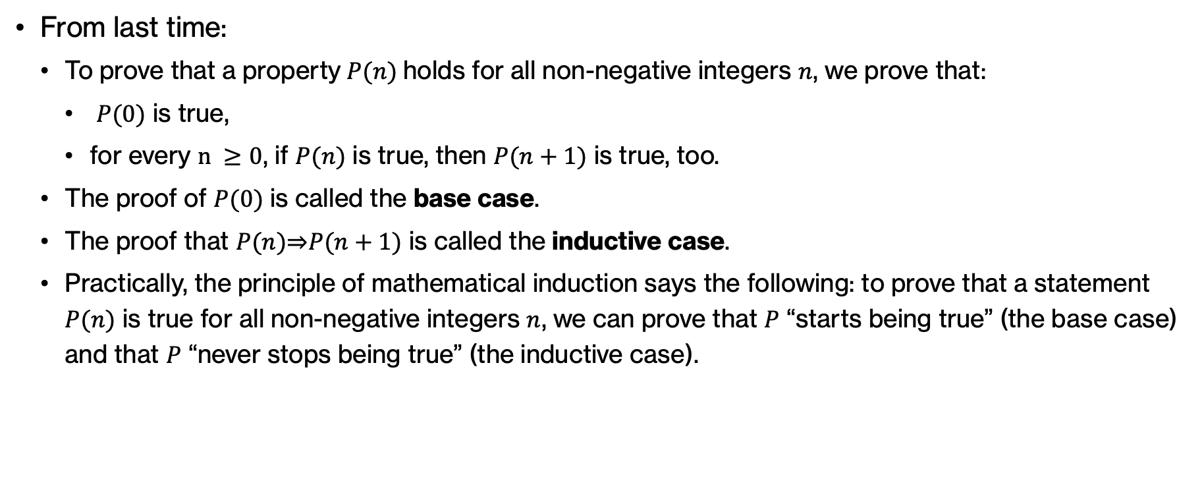
Proof by induction
From last time:
  To prove that a property$P(n)$holds for all non-negative integers $n$, we prove that:
    $P(0)$ is true,
    for every $n ≥0$, if $P(n)$ is true, then $P(n+1)$ is true, too.
  The proof of $P(0)$ is called the base case.
  The proof that $P(n)\text{⇒}P(n+1)$ is called the inductive case.
  Practically, the principle of mathematical induction says the following: to prove that a statement $P(n)$ is true for all non-negative integers $n$, we can prove that $P$ “starts being true” (the base case) and that $P$ “never stops being true” (the inductive case).
Notes:
As a reminder, the structure of a proof by induction assumes that we have a property P(n) that holds true for all non-negative integers n. We start by proving that P(0) is true, what is known as the base case. And then we assume that for every n>=0, if the property is true for n then we show that it is true for P(n+1). This s known as the inductive case. The intuition behind mathematical induction is that P start being true and never stops being true, which corresponds to the base and inductive case, respectively.

Slide 3
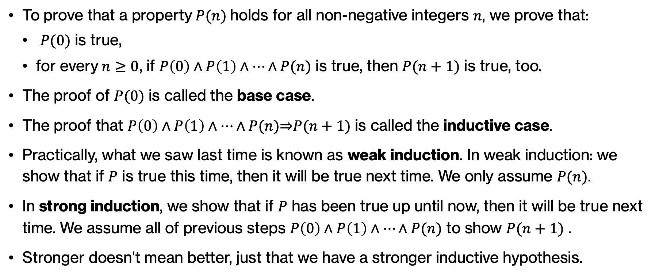
Proof by strong induction
To prove that a property$P(n)$holds for all non-negative integers $n$, we prove that:
  $P(0)$ is true,
  for every$n≥0$, if $P\left(0\right)∧P\left(1\right)∧…∧P(n)$ is true, then $P(n+1)$ is true, too.
The proof of $P(0)$ is called the base case.
The proof that $P\left(0\right)∧P\left(1\right)∧…∧P(n)\text{⇒}P(n+1)$ is called the inductive case.
Practically, what we saw last time is known as weak induction. In weak induction: we show that if $P$ is true this time, then it will be true next time. We only assume $P(n)$.
In strong induction, we show that if $P$ has been true up until now, then it will be true next time. We assume all of previous steps $P\left(0\right)∧P\left(1\right)∧…∧P(n)$ to show $P(n+1)$ .
Stronger doesn't mean better, just that we have a stronger inductive hypothesis.
Notes:
Today, we will see a variation of this proof technique known as strong induction. Strong induction again allows us to prove that a property P(n) holds for all non-negative integers n. The base case is the same, we just prove that P(0) is true. What changes is the inductive case: we don't just assume that P(n) is true for every n>=0 and prove that P(n+1) is also true. Instead, we assume that P is true for all numbers UP to n, that is P(0) AND P(1) AND P(2) AND… AND P(n) are all true and then we show that P(n+1) is also true. Our approach last time is known as weak induction and only assumes P(n). In strong induction, we show that If P has been true for all integers up until now, then it's still true this time.

Slide 4

An aside: floor and ceiling
The floor of a number $x$, written as $\left\lfloor x\right\rfloor$ is the largest integer that is less than or equal to $x$.
  For example, $\left\lfloor 4.7\right\rfloor =4.$
The ceiling of a number $x$, written as $\left\lceil x\right\rceil$ is the smallest integer that is greater than or equal to $x$.
  For example,$\left\lceil 4.7\right\rceil =5.$
Notes:
Before we work on our first strong induction proof, let's go over some notation that will be useful (similar to how sums were handly last time).
The floor of a number x is the largest integer that is less than or equal to x. The ceiling is the opposite idea, the smallest integer that is greater or equal to x.
For any integers k and n (n has to strictly be greater than 0), the integer n mod k is the remainder when we divide n by k, that is n-k* floor of (n/k).

Slide 5
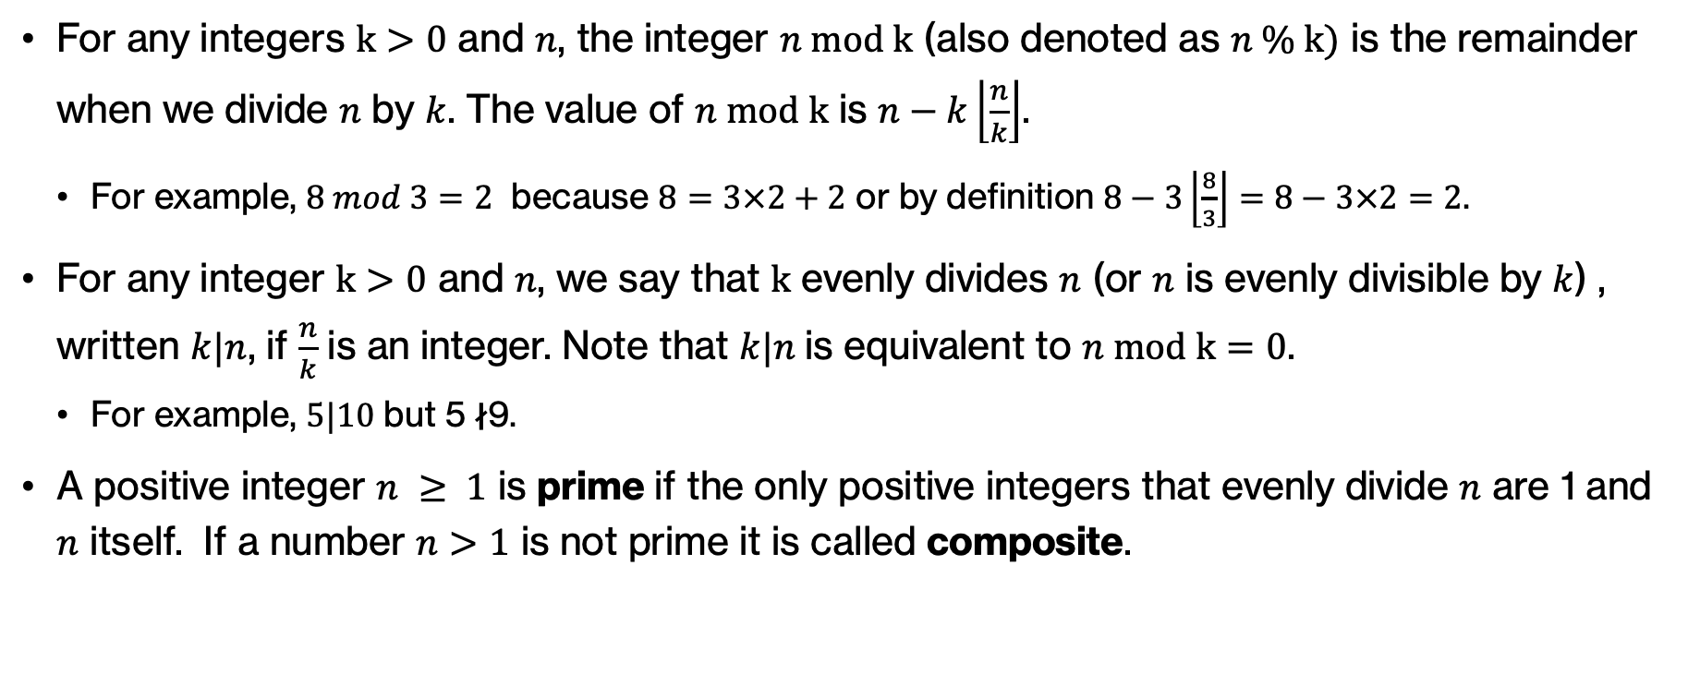
A reminder: moduli and division
For any integers $k>0$ and $n$, the integer $n mod k$ (also denoted as $n \% k)$ is the remainder when we divide $n$ by $k$. The value of $n mod k$ is $n−k\left\lfloor \frac{n}{k}\right\rfloor$.
  For example, $8 mod 3=2$ because $8=3×2+2$ or by definition $8−3\left\lfloor \frac{8}{3}\right\rfloor =8−3×2=2$.
For any integer $k>0$ and $n$, we say that $k$ evenly divides $n$ (or $n$ is evenly divisible by $k$) , written $k|n$, if $\frac{n}{k}$ is an integer. Note that $k|n$is equivalent to $n mod k=0$.
  For example, $5|10$ but 5 ∤9.
A positive integer $n ≥ 1$ is prime if the only positive integers that evenly divide $n$ are 1 and $n$ itself. If a number $n>1$ is not prime it is called composite.
Notes:
For any integers k and n (n has to strictly be greater than 0), the integer n mod k is the remainder when we divide n by k, that is n-k* floor of (n/k). We say that k evenly divides n or n is divisible by k and denote it as k|n if n/k is an integer, that is n mod k = 0. evenly
This helps explain why a number is prime if the only positive integers that evenly divide n are 1 and n itself. Otherwise a number is called a composite.

Slide 6

Example: divisibility by a prime
Using strong induction, we will prove the claim that any integer $n≥2$ is evenly divisible by a prime number.
Notes:
Now that we established this vocabulary, we will use strong induction to prove the claim that any integer greater or equal to 2 is evenly divisible by a prime number.

Slide 7

Example: divisibility by a prime
Using strong induction, we will prove the claim that any integer $n≥2$ is evenly divisible by a prime number.
1. Let $P(n)$ denote the property that $n$ is evenly divisible by a prime number. We will use strong induction on $n$ to show that $P(n)$holds for all $n≥2$ .
Notes:
Now that we established this vocabulary, we will use strong induction to prove the claim that any integer greater or equal to 2 is evenly divisible by a prime number.
As a first step, we need to denote by P(n) the property that evenly divisible by a prime number. We have to state that we will use strong induction on n to show that P(n) holds for all n greater or equal to 2.

Slide 8
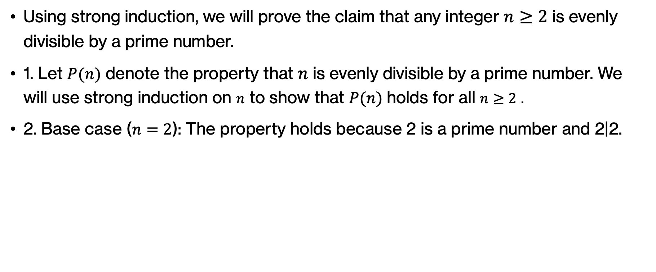
Example: divisibility by a prime
Using strong induction, we will prove the claim that any integer $n≥2$ is evenly divisible by a prime number.
1. Let $P(n)$ denote the property that $n$ is evenly divisible by a prime number. We will use strong induction on $n$ to show that $P(n)$holds for all $n≥2$ .
2. Base case ($n=2$): The property holds because 2 is a prime number and 2|2.
Notes:
Our base case starts with n=2 (not equal to 0, since our property starts at n=2!). P(2) holds because 2 is a prime number and 2 evenly divides 2.

Slide 9
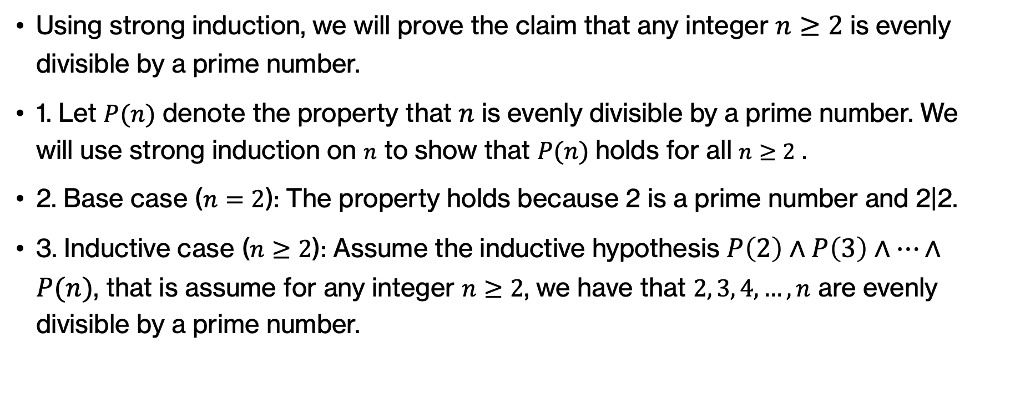
Example: divisibility by a prime
Using strong induction, we will prove the claim that any integer $n≥2$ is evenly divisible by a prime number.
1. Let $P(n)$ denote the property that $n$ is evenly divisible by a prime number. We will use strong induction on $n$ to show that $P(n)$holds for all $n≥2$ .
2. Base case ($n=2$): The property holds because 2 is a prime number and 2|2.
3. Inductive case ($n≥2$): Assume the inductive hypothesis $P\left(2\right)∧P\left(3\right)∧…∧P(n)$, that is assume for any integer $n≥2$, we have that $2, 3, 4, …, n$ are evenly divisible by a prime number.
Notes:
The inductive case assumes that for any integer n that is all P(2) AND P(3) AND…AND P(n) are true, that is we assume that 2, 3, 4, …, n are evenly divisible by a prime number. Given this inductive hypothesis, we must prove that P(n+1) is also evenly divisible by a prime number.

Slide 10
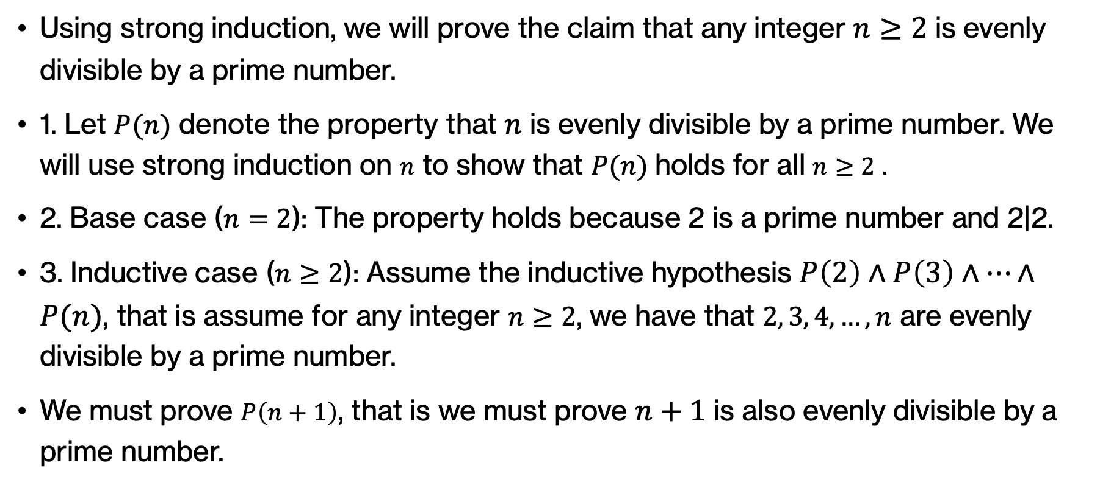
Example: divisibility by a prime
Using strong induction, we will prove the claim that any integer $n≥2$ is evenly divisible by a prime number.
1. Let $P(n)$ denote the property that $n$ is evenly divisible by a prime number. We will use strong induction on $n$ to show that $P(n)$holds for all $n≥2$ .
2. Base case ($n=2$): The property holds because 2 is a prime number and 2|2.
3. Inductive case ($n≥2$): Assume the inductive hypothesis $P\left(2\right)∧P\left(3\right)∧…∧P(n)$, that is assume for any integer $n≥2$, we have that $2, 3, 4, …, n$ are evenly divisible by a prime number.
We must prove $P\left(n+1\right)$, that is we must prove $n+1$ is also evenly divisible by a prime number.
Notes:
Given this inductive hypothesis, we must prove that P(n+1) is also evenly divisible by a prime number.

Slide 11

Example: divisibility by a prime
$n+1$ is either prime or composite.
Notes:
What do we know about n+1? It can either be prime or composite.

Slide 12

Example: divisibility by a prime
$n+1$ is either prime or composite.
If $n+1$ is prime, then $n+1$ is evenly divisible by a prime number, namely itself.
Notes:
What do we know about n+1? It can either be prime or composite. If it is prime, then it is evenly divisible by a prime number, namely itself.

Slide 13

Example: divisibility by a prime
$n+1$ is either prime or composite.
If $n+1$ is prime, then $n+1$ is evenly divisible by a prime number, namely itself.
If $n+1$ is not prime, then there exists an integer $a, 2≤a≤n$ so that $a|(n+1)$.
Notes:
What do we know about n+1? It can either be prime or composite. If it is prime, then it is evenly divisible by a prime number, namely itself. The alternative is that it is not a prime number, that is, there is a number a between 2 and n that divides n+1.

Slide 14
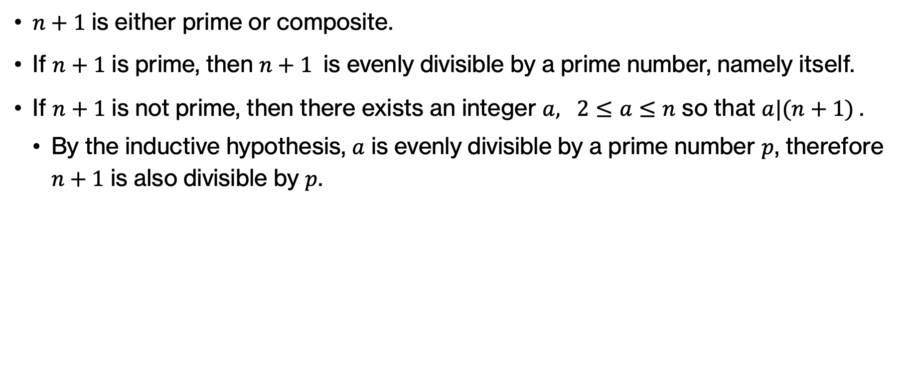
Example: divisibility by a prime
$n+1$ is either prime or composite.
If $n+1$ is prime, then $n+1$ is evenly divisible by a prime number, namely itself.
If $n+1$ is not prime, then there exists an integer $a, 2≤a≤n$ so that $a|(n+1)$.
  By the inductive hypothesis, $a$ is evenly divisible by a prime number $p$, therefore $n+1$ is also divisible by $p$.
Notes:
What do we know about n+1? It can either be prime or composite. If it is prime, then it is evenly divisible by a prime number, namely itself. The alternative is that it is not a prime number, that is, there is a number a between 2 and n that divides n+1. But so far, we have assumed that all numbers up to n are evenly divisible by a prime number. That means that a is evenly divisible by a prime number, let's call it p. That means that n+1 is also divisible by p!

Slide 15
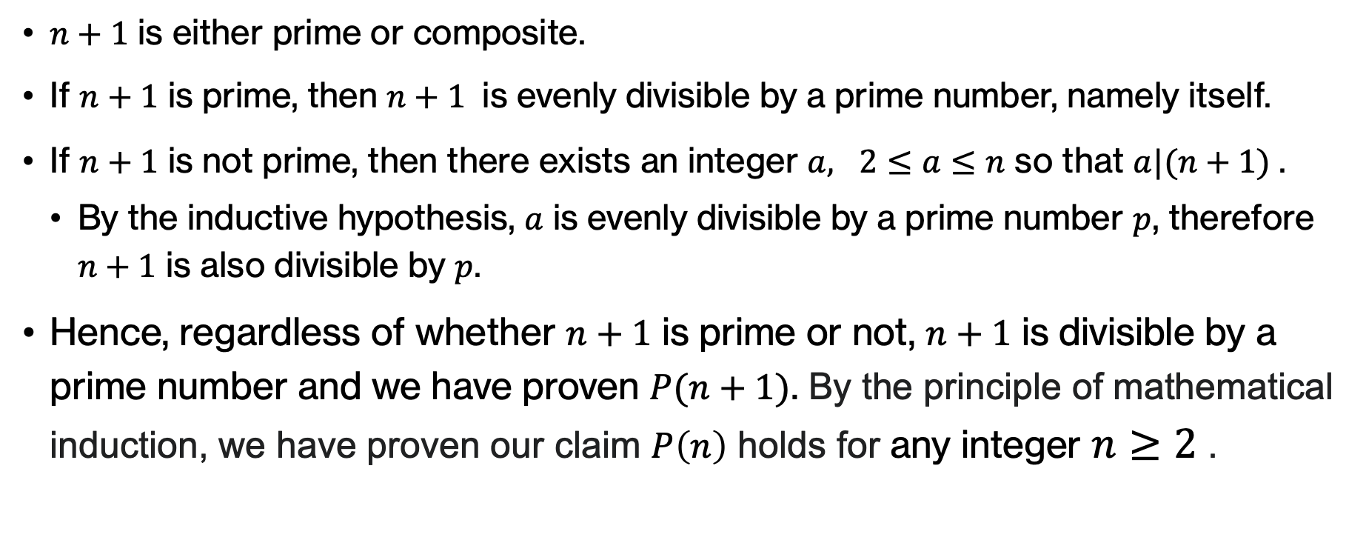
Example: divisibility by a prime
$n+1$ is either prime or composite.
If $n+1$ is prime, then $n+1$ is evenly divisible by a prime number, namely itself.
If $n+1$ is not prime, then there exists an integer $a, 2≤a≤n$ so that $a|(n+1)$.
  By the inductive hypothesis, $a$ is evenly divisible by a prime number $p$, therefore $n+1$ is also divisible by $p$.
Hence, regardless of whether $n+1$ is prime or not, $n+1$ is divisible by a prime number and we have proven $P(n+1)$. By the principle of mathematical induction, we have proven our claim $P\left(n\right)$ holds for any integer $n≥2$ .
Notes:
Thus, P(n+1) holds since n+1 is divisible by a prime number regardless of whether itself is a prime number or a composite. By the principle of mathematical induction, we have proven our claim.

Slide 16
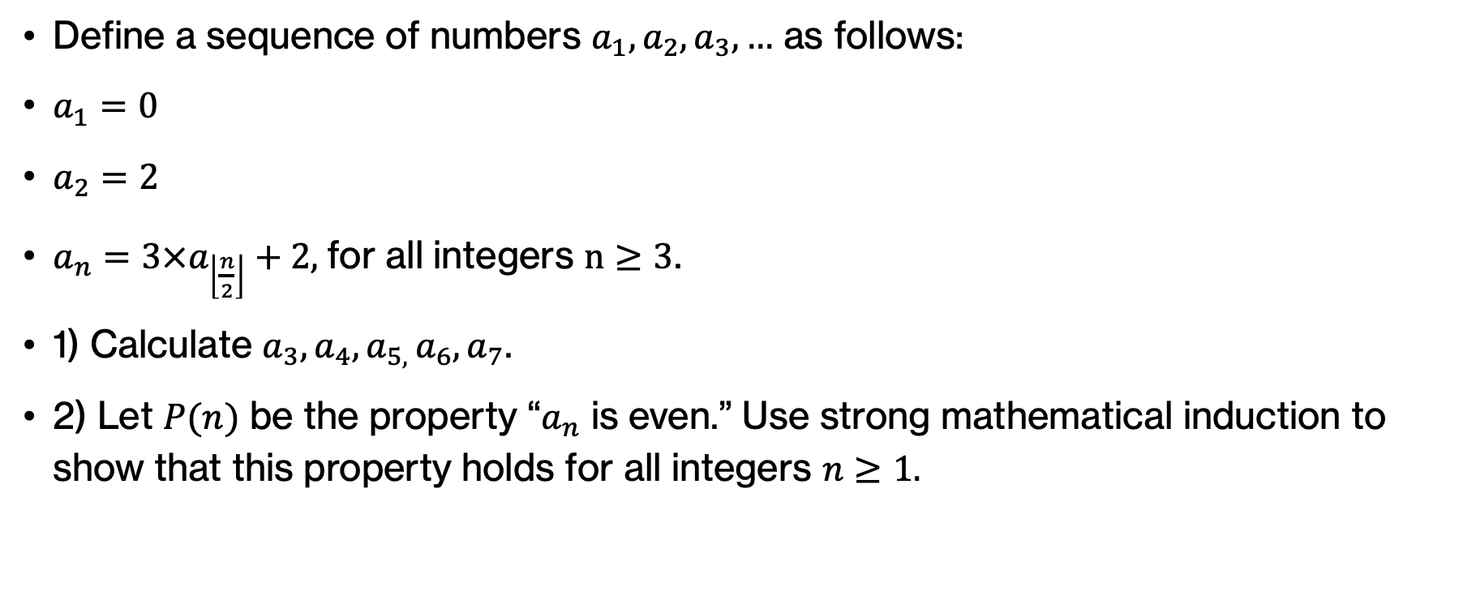
Practice time
Define a sequence of numbers $a_{1},a_{2},a_{3},…$ as follows:
$a_{1}=0$
$a_{2}=2$
$a_{n}=3×a_{\left\lfloor \frac{n}{2}\right\rfloor }+2,$for all integers $n≥3$.
1) Calculate $a_{3},a_{4},a_{5, }a_{6},a_{7}$.
2) Let $P(n)$ be the property “$a_{n}$ is even.” Use strong mathematical induction to show that this property holds for all integers $n≥1.$
Notes:
Your turn now.

Slide 17

Answer – Part 1
$a_{1}=0$
$a_{2}=2$
$a_{3}=3×a_{\left\lfloor \frac{3}{2}\right\rfloor }+2=3×a_{1}+2=3×0+2=2$
$a_{4}=3×a_{\left\lfloor \frac{4}{2}\right\rfloor }+2=3×a_{2}+2=3×2+2=8$
$a_{5}=3×a_{\left\lfloor \frac{5}{2}\right\rfloor }+2=3×a_{2}+2=3×2+2=8$
$a_{6}=3×a_{\left\lfloor \frac{6}{2}\right\rfloor }+2=3×a_{3}+2=3×2+2=8$
$a_{7}=3×a_{\left\lfloor \frac{7}{2}\right\rfloor }+2=3×a_{3}+2=3×2+2=8$

Slide 18

Answer – Part 2
1. Using strong induction, we will prove the property $P(n)$ that $a_{n}$ is even for all integers $n≥1.$
2. Base cases ($n=1, n=2$): The property holds because $a_{1}=0$ and $a_{2}=2$.

Slide 19
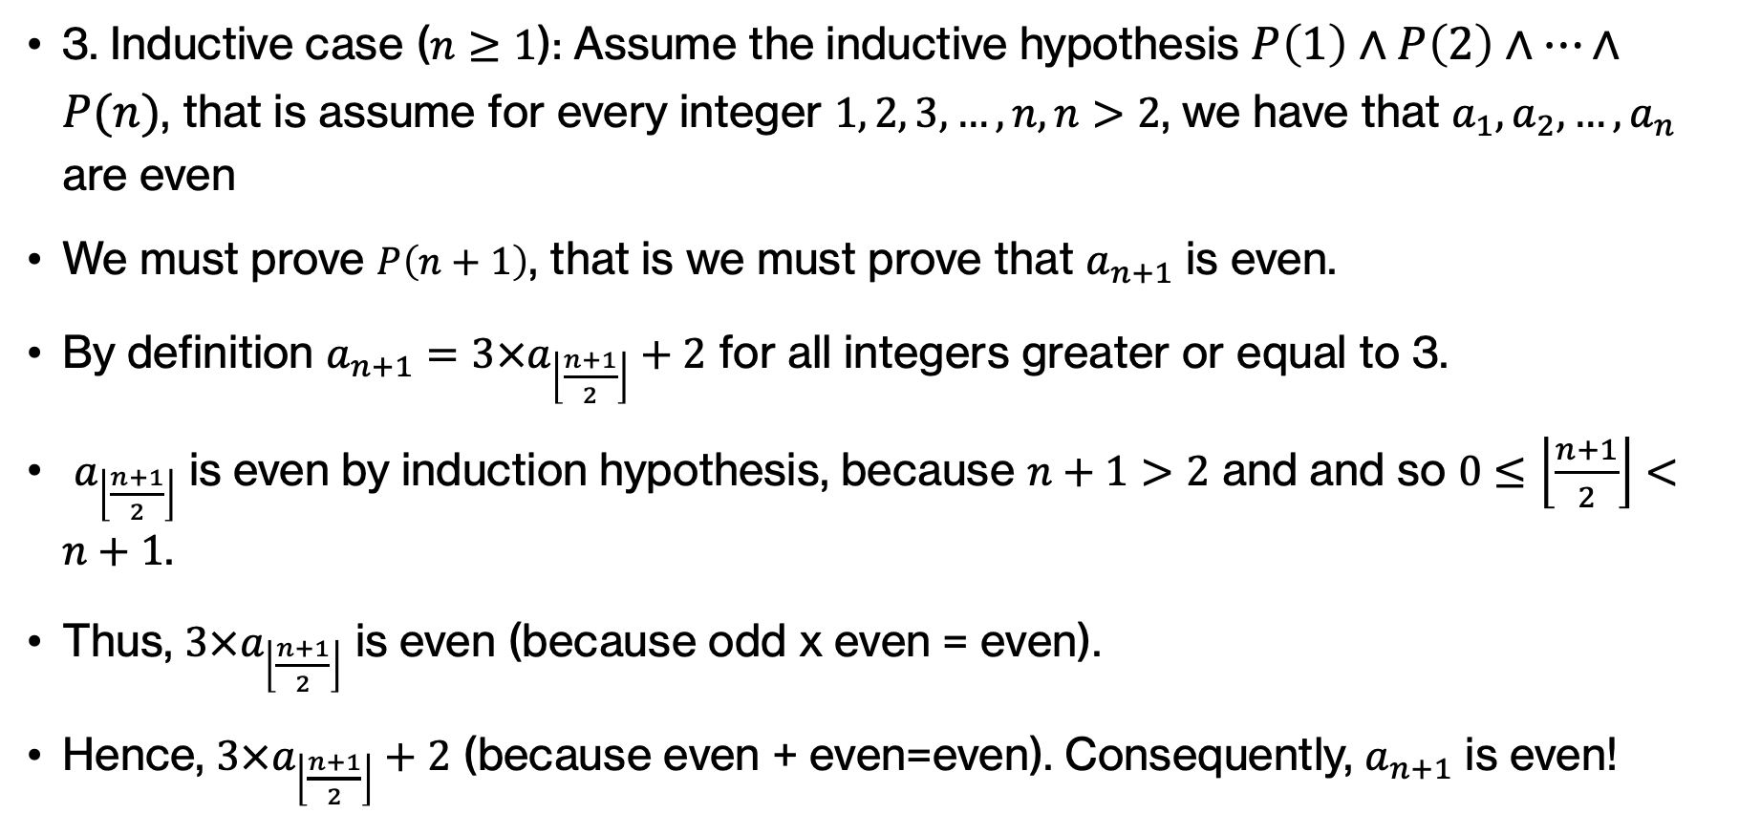
Answer – Part 2
3. Inductive case ($n≥1$): Assume the inductive hypothesis $P\left(1\right)∧P\left(2\right)∧…∧P(n)$, that is assume for every integer $1, 2, 3, …, n,n>2$, we have that $a_{1},a_{2},…, a_{n}$ are even
We must prove $P\left(n+1\right)$, that is we must prove that $a_{n+1}$ is even.
By definition $a_{n+1}=3×a_{\left\lfloor \frac{n+1}{2}\right\rfloor }+2$ for all integers greater or equal to 3.
$a_{\left\lfloor \frac{n+1}{2}\right\rfloor }$ is even by induction hypothesis, because $n+1>2$ and and so $0≤\left\lfloor \frac{n+1}{2}\right\rfloor <n+1$.
Thus, $3×a_{\left\lfloor \frac{n+1}{2}\right\rfloor }$ is even (because odd x even = even).
Hence, $3×a_{\left\lfloor \frac{n+1}{2}\right\rfloor }+2$ (because even + even=even). Consequently, $a_{n+1}$ is even!

Slide 20
Weak vs strong induction
Anything that can be proven using weak induction can also be shown using strong induction.
However, if you can prove something using weak induction, you should.

