Slide 1

Proof by induction
Mathematical Foundations
CS51 – Spring 2026
Photo by Tom Wilson on Unsplash
Notes:
Today, we will see a new technique for proving that a propositional statement is true called mathematical induction. To prove a claim, we will rely on proving a smaller instance of the same claim.

Slide 2
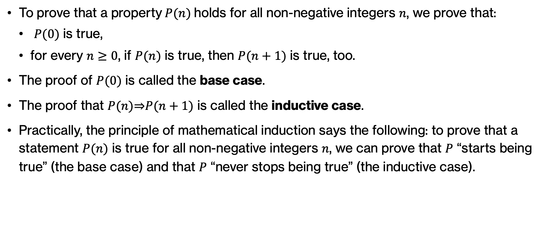
Proof by induction
To prove that a property$P(n)$holds for all non-negative integers $n$, we prove that:
  $P(0)$ is true,
  for every $n≥0$, if $P(n)$ is true, then $P(n+1)$ is true, too.
The proof of $P(0)$ is called the base case.
The proof that $P(n)\text{⇒}P(n+1)$ is called the inductive case.
Practically, the principle of mathematical induction says the following: to prove that a statement $P(n)$ is true for all non-negative integers $n$, we can prove that $P$ “starts being true” (the base case) and that $P$ “never stops being true” (the inductive case).
Notes:
The structure of a proof by induction assumes that we have a property P(n) that holds true for all non-negative integers n. We start by proving that P(0) is true, what is known as the base case. And then we assume that for every n that is greater or equal to 0, if the property is true for n then we show that it is true for P(n+1). This s known as the inductive case. The intuition behind mathematical induction is that P start being true and never stops being true, which corresponds to the base and inductive case, respectively.

Slide 3
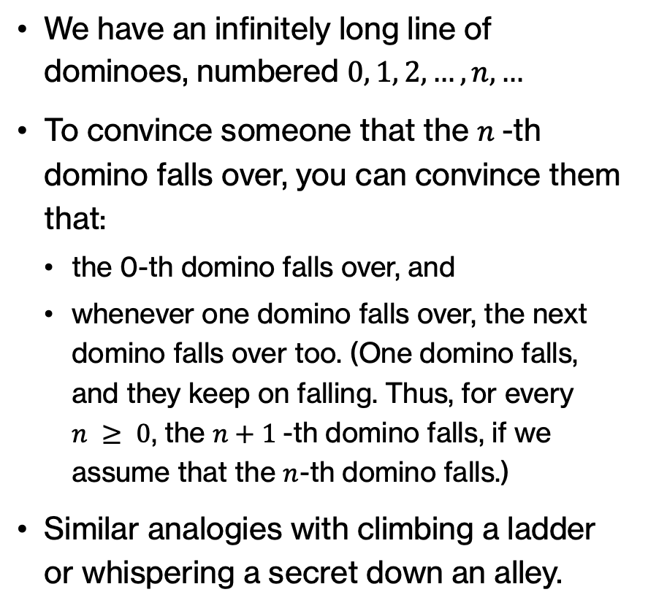
Proof by induction analogies
We have an infinitely long line of dominoes, numbered $0, 1, 2, …, n, …$
To convince someone that the $n$-th domino falls over, you can convince them that:
  the 0-th domino falls over, and
  whenever one domino falls over, the next domino falls over too. (One domino falls, and they keep on falling. Thus, for every $n ≥ 0$, the $n+1$-th domino falls, if we assume that the $n$-th domino falls.)
Similar analogies with climbing a ladder or whispering a secret down an alley.
Notes:
Here are some analogies to make induction more intuitive:
- Dominoes falling: We have an infinitely long line of dominoes, numbered 0, 1, 2, . . . , n, . . .. To convince someone that the nth domino falls over, you can convince them that • the 0th domino falls over, and • whenever one domino falls over, the next domino falls over too. (One domino falls, and they keep on falling. Thus, for every n ≥ 0, the n+1-th domino falls, if the n-th domino falls.)
- Climbing a ladder: We have a ladder with rungs numbered 0, 1, 2, . . . , n, . . .. To convince someone that a climber climbing the ladder reaches the nth rung, you can convince them that • the climber steps onto rung #0. • if the climber steps onto one rung, then she also steps onto the next rung. (The climber starts to climb, and the climber never stops climbing. Thus, for every n ≥ 0, the climber reaches the nth rung.)
- Whispering down the alley: We have an infinitely long line of people, with the people numbered 0, 1, 2, . . . , n, . . .. To argue that everyone in the line learns a secret, we can argue that • person #0 learns the secret. • if person #n learns the secret, then she tells person #(n + 1) the secret. (The person at the front of the line learns the secret, and everyone who learns it tells the secret to the next person in line. Thus, for every n ≥ 0, the nth person learns the secret.)

Slide 4
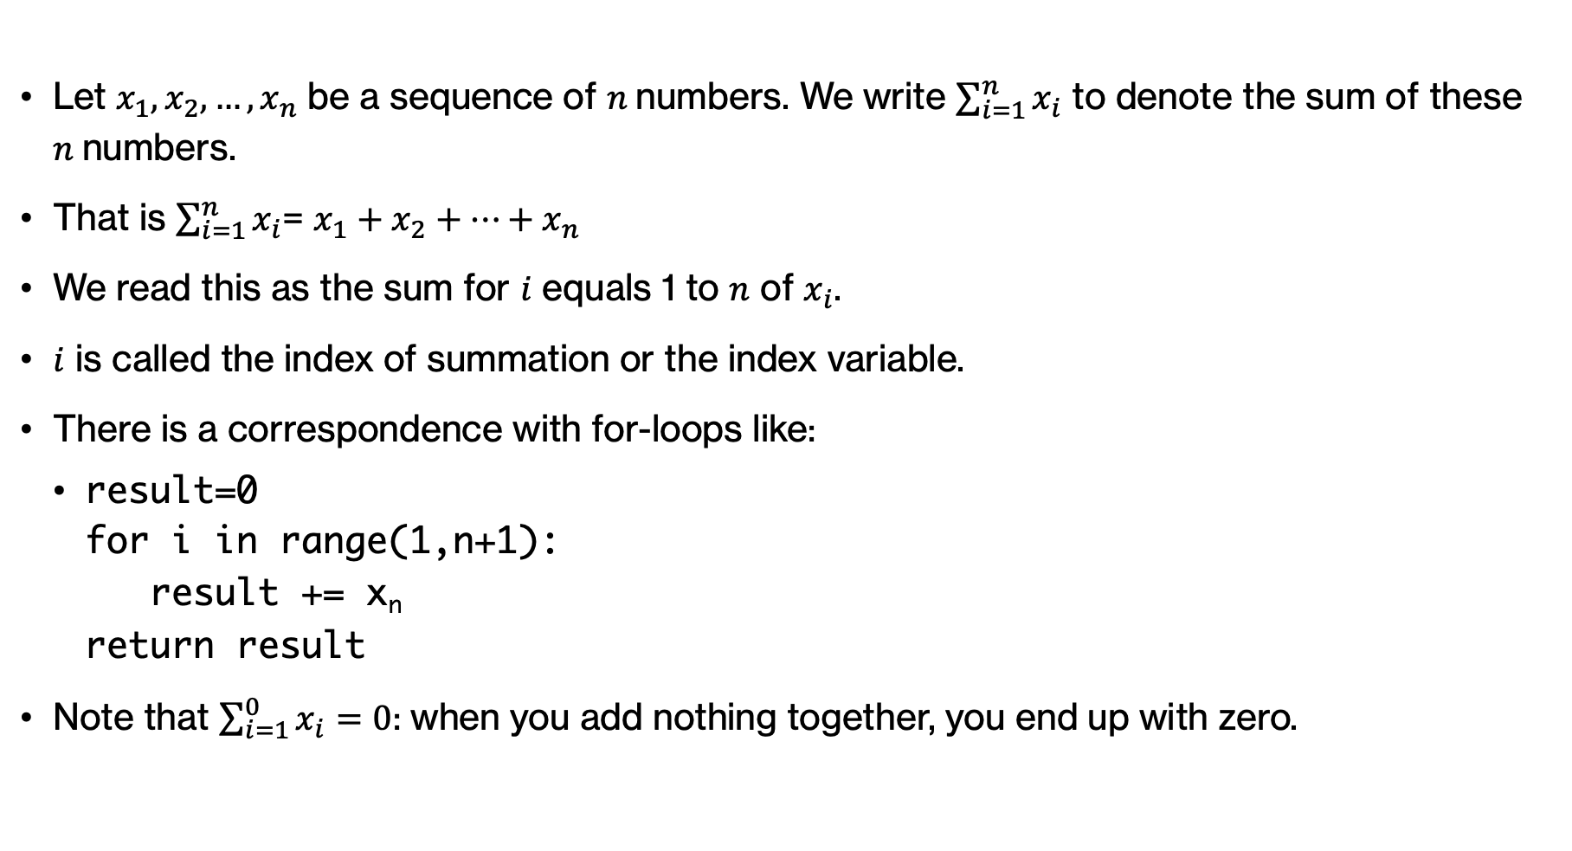
An aside: summation notation
Let $x_{1}, x_{2},…, x_{n}$ be a sequence of $n$numbers. We write $\sum_{i=1}^{n}{x_{i}}$ to denote the sum of these $n$numbers.
That is $\sum_{i=1}^{n}{x_{i}}$= $x_{1}+x_{2}+…+x_{n}$
We read this as the sum for $i$ equals 1 to $n$ of $x_{i}$.
$i$ is called the index of summation or the index variable.
There is a correspondence with for-loops like:
  result=0
  for i in range(1,n+1):
  result += x_{n}
  return result
Note that $\sum_{i=1}^{0}{x_{i}=0}$: when you add nothing together, you end up with zero.
Notes:
Before trying together our first proof, I want to talk about the summation notation. Let's assume that we have n numbers, x1, x2, …, xn. We write \sum_{i=1}^{n} x_i to denote the sum of these n numbers, that is x1+x2+…+xn. We read this as the sum for i equals 1 to n of xi. I is called the index of summation or the index variable and you can easily think that the summation notation corresponds to a simple for loop. Note that the sum for I equals 1 to 0 of xi is equal to 0. Since we added nothing together, we ended up with zero.

Slide 5

Examples: summation notation
Let $a_{1}=2, a_{2}=4, a_{3}=8, a_{4}=16$. Then:
  $\sum_{i=2}^{4}{a_{i}}$
    $\sum_{i=2}^{4}{a_{i}} =4+8+16=28$
  $\sum_{i=1}^{3}{{(a}_{i}+1)}$
    $\sum_{i=1}^{3}{{(a}_{i}+1)}=(2+1)+(4+1)+(8+1)=17$
  $\sum_{i=1}^{4}{i}$
    $\sum_{i=1}^{4}{i}=1+2+3+4=10$
Notes:
Here are a few examples that we will work through together

Slide 6

Practice time: summation notation
Let $a_{1}=2, a_{2}=4, a_{3}=8, a_{4}=16$. Evaluate the following expressions:
  $\sum_{i=1}^{4}{i^{2}}$
  $\sum_{i=2}^{4}{i^{2}}$
  $\sum_{i=1}^{4}{{{(a}_{i}+i}^{2})}$
  $\sum_{i=1}^{4}{5}$
Notes:
Your turn now to evaluate these sums.

Slide 7

Answer: summation notation
Let $a_{1}=2, a_{2}=4, a_{3}=8, a_{4}=16$. Evaluate the following expressions:
  $\sum_{i=1}^{4}{i^{2}}=1^{2}+2^{2}+3^{2}+4^{2}=30$
  $\sum_{i=2}^{4}{i^{2}}=2^{2}+3^{2}+4^{2}=29$
  $\sum_{i=1}^{4}{{{(a}_{i}+i}^{2})}=(2+1^{2})+(4+2^{2})+\left(8+3^{2}\right)+(16+4^{2})=60$
  $\sum_{i=1}^{4}{5}=5+5+5+5=20$
Notes:
Did you get these?

Slide 8
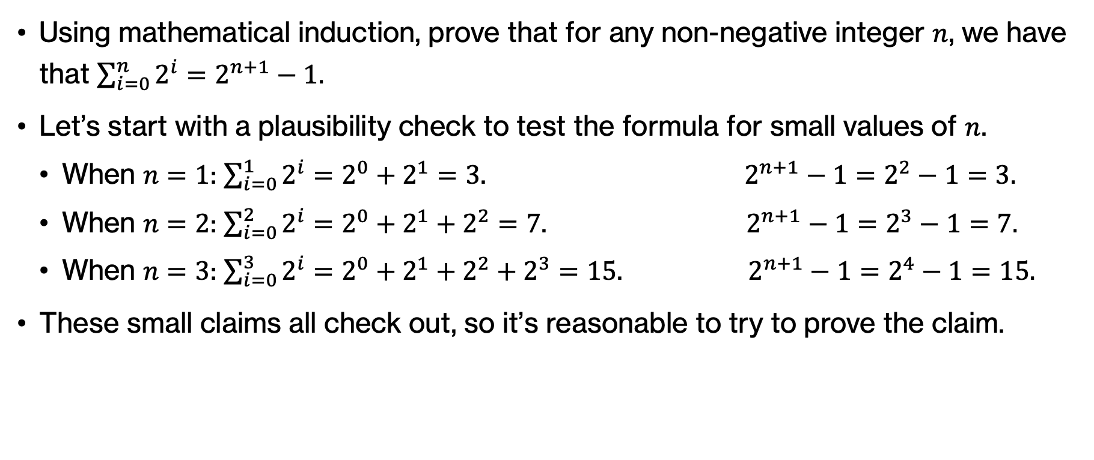
Example: sum of powers of two
Using mathematical induction, prove that for any non-negative integer $n$, we have that $\sum_{i=0}^{n}{2^{i}}=2^{n+1}−1.$
Let’s start with a plausibility check to test the formula for small values of $n$.
  When $n=1$: $\sum_{i=0}^{1}{2^{i}=2^{0}+2^{1}=3}$. $2^{n+1}−1=2^{2}−1=3.$
  When $n=2$: $\sum_{i=0}^{2}{2^{i}=2^{0}+2^{1}+2^{2}=7}$. $2^{n+1}−1=2^{3}−1=7.$
  When $n=3$: $\sum_{i=0}^{3}{2^{i}=2^{0}+2^{1}+2^{2}+2^{3}=15}$. $2^{n+1}−1=2^{4}−1=15.$
These small claims all check out, so it’s reasonable to try to prove the claim.
Notes:
Now that we established the notation for summation, let's go about proving using mathematical induction that for any non-negative integer n, the sum of i equals 0 to n of 2^I is equal to 2^{n+1}-1. Before you jump into the proof by induction, it's always a good idea to test the statement by plugging in a few small values for n. For example, we see that it holds for n=1, 2, 3. Since they all check out, it's reasonable to try to prove the claim for any non-negative integer n.

Slide 9
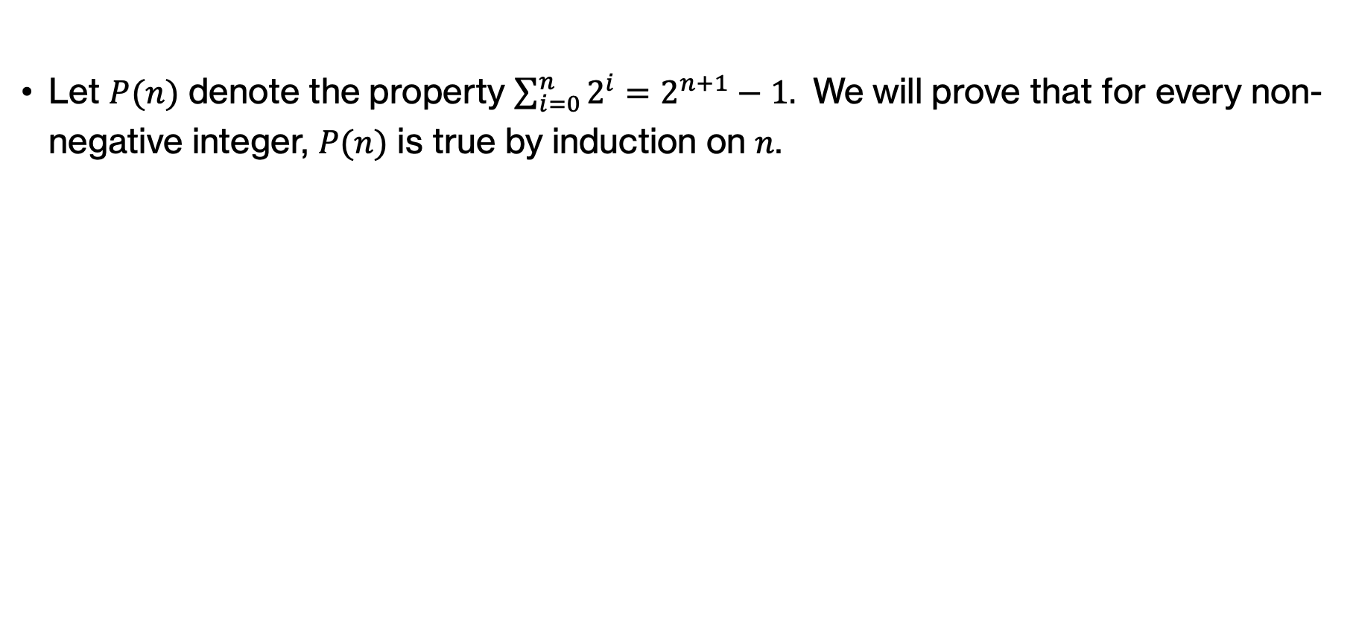
Example: Induction to prove sum of powers of two
Let $P(n)$ denote the property $\sum_{i=0}^{n}{2^{i}}=2^{n+1}−1.$ We will prove that for every non-negative integer, $P(n)$ is true by induction on $n$.
Notes:
We will start by denoting the property by P(n). We have to say that we will do the proof using mathematical induction on n.

Slide 10
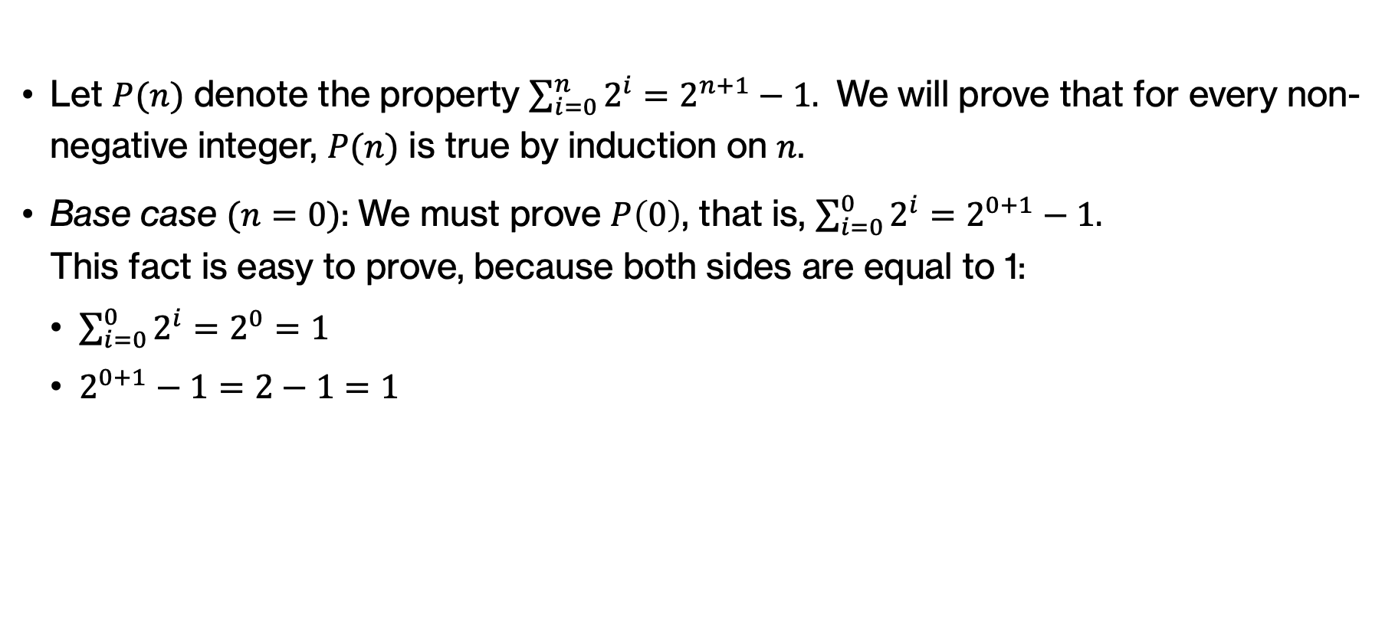
Example: Induction to prove sum of powers of two
Let $P(n)$ denote the property $\sum_{i=0}^{n}{2^{i}}=2^{n+1}−1.$ We will prove that for every non-negative integer, $P(n)$ is true by induction on $n$.
Base case $(n=0)$: We must prove $P\left(0\right)$, that is, $\sum_{i=0}^{0}{2^{i}}=2^{0+1}−1.$
This fact is easy to prove, because both sides are equal to 1:
  $\sum_{i=0}^{0}{2^{i}=2^{0}}=1$
  $2^{0+1}−1=2−1=1$
Notes:
For the base case, we must prove P(0) which is easy to prove since both sides are equal to 1. So we proved P(0).

Slide 11

Example: Induction to prove sum of powers of two
Inductive case$(n≥0)$: We must prove that if $P\left(n\right)⟹P(n+1)$, for an arbitrary $n≥0$.
We prove this by assuming the antecedent/hypothesis (we assume $P\left(n\right)$ and prove $P(n+1)$).
The assumption $P\left(n\right)$ is $\sum_{i=0}^{n}{2^{i}}=2^{n+1}−1$. (*)
Notes:
Next, we will prove the inductive case for every n>=0. We will start by assuming that the P(n) holds and prove that it holds for P(n+1). Once we do so, by the principle of mathematical induction, we have shown that P(n) holds for all non-negative integers.

Slide 12

Example: Induction to prove sum of powers of two
Inductive case$(n≥0)$: We must prove that if $P\left(n\right)⟹P(n+1)$, for an arbitrary $n≥0$.
We prove this by assuming the antecedent/hypothesis (we assume $P\left(n\right)$ and prove $P(n+1)$).
The assumption $P\left(n\right)$ is $\sum_{i=0}^{n}{2^{i}}=2^{n+1}−1$. (*)
We can now prove $P\left(n+1\right)$ (under the assumption (*)) by showing that the left- and right-hand sides of $P\left(n+1\right)$ are equal, that is, we want to prove that $\sum_{i=0}^{n+1}{2^{i}} =$ $2^{\left(n+1\right)+1} −1$:
Notes:
We next say that we want to prove P(n+1) and state what that would mean

Slide 13
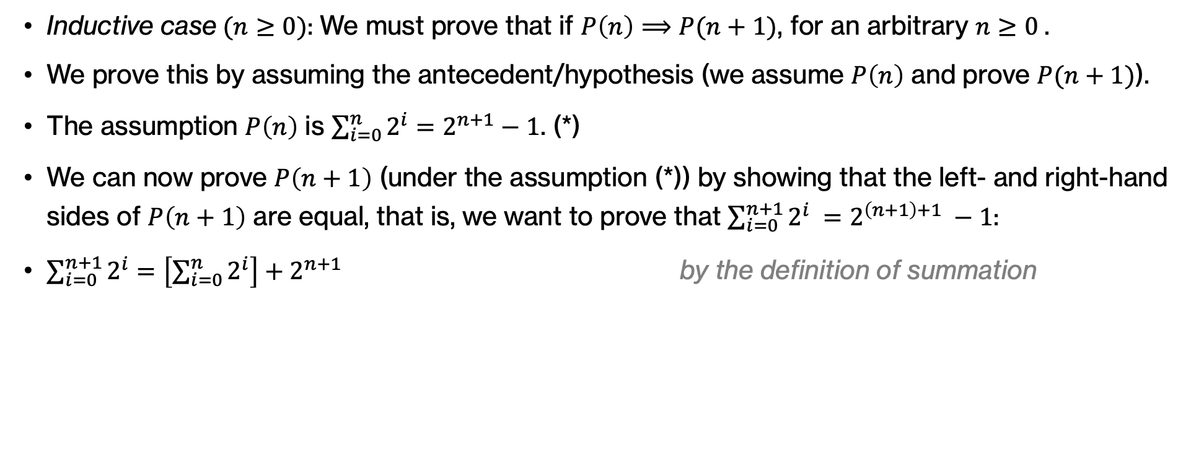
Example: Induction to prove sum of powers of two
Inductive case$(n≥0)$: We must prove that if $P\left(n\right)⟹P(n+1)$, for an arbitrary $n≥0$.
We prove this by assuming the antecedent/hypothesis (we assume $P\left(n\right)$ and prove $P(n+1)$).
The assumption $P\left(n\right)$ is $\sum_{i=0}^{n}{2^{i}}=2^{n+1}−1$. (*)
We can now prove $P\left(n+1\right)$ (under the assumption (*)) by showing that the left- and right-hand sides of $P\left(n+1\right)$ are equal, that is, we want to prove that $\sum_{i=0}^{n+1}{2^{i}} =$ $2^{\left(n+1\right)+1} −1$:
$\sum_{i=0}^{n+1}{2^{i}}=\left[\sum_{i=0}^{n}{2^{i}}\right]+2^{n+1}$ by the definition of summation
Notes:
We start on the left hand side of P(n+1). We know that the sum up to n+1 will include the sum up to n PLUS some extra things (2^n+1)

Slide 14
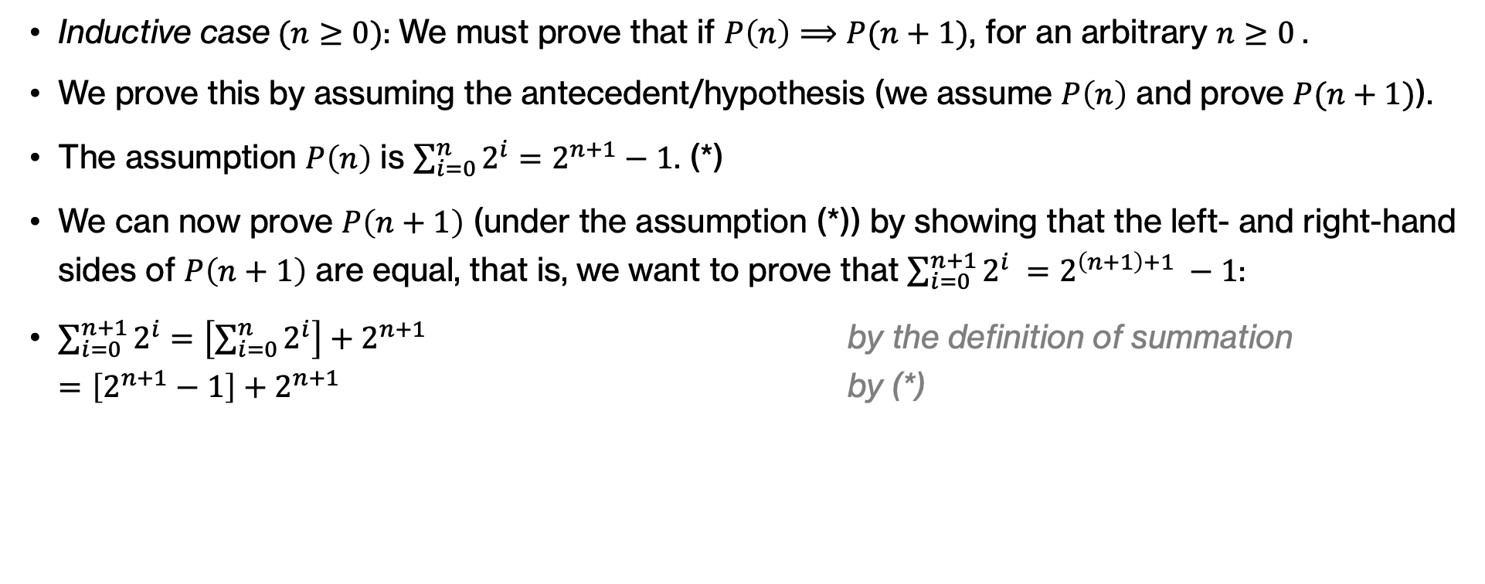
Example: Induction to prove sum of powers of two
Inductive case$(n≥0)$: We must prove that if $P\left(n\right)⟹P(n+1)$, for an arbitrary $n≥0$.
We prove this by assuming the antecedent/hypothesis (we assume $P\left(n\right)$ and prove $P(n+1)$).
The assumption $P\left(n\right)$ is $\sum_{i=0}^{n}{2^{i}}=2^{n+1}−1$. (*)
We can now prove $P\left(n+1\right)$ (under the assumption (*)) by showing that the left- and right-hand sides of $P\left(n+1\right)$ are equal, that is, we want to prove that $\sum_{i=0}^{n+1}{2^{i}} =$ $2^{\left(n+1\right)+1} −1$:
$\sum_{i=0}^{n+1}{2^{i}}=\left[\sum_{i=0}^{n}{2^{i}}\right]+2^{n+1}$ by the definition of summation
$=\left[2^{n+1}−1\right]+2^{n+1}$ by (*)
Notes:
But we now what the sum up to n is through our inductive hypothesis (shown in asterisk). So we can just sub that sum with simpler expression of 2^(n+1)-1.

Slide 15
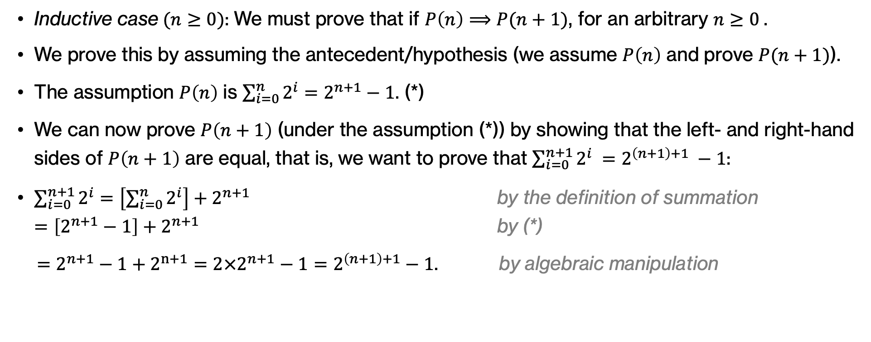
Example: Induction to prove sum of powers of two
Inductive case$(n≥0)$: We must prove that if $P\left(n\right)⟹P(n+1)$, for an arbitrary $n≥0$.
We prove this by assuming the antecedent/hypothesis (we assume $P\left(n\right)$ and prove $P(n+1)$).
The assumption $P\left(n\right)$ is $\sum_{i=0}^{n}{2^{i}}=2^{n+1}−1$. (*)
We can now prove $P\left(n+1\right)$ (under the assumption (*)) by showing that the left- and right-hand sides of $P\left(n+1\right)$ are equal, that is, we want to prove that $\sum_{i=0}^{n+1}{2^{i}} =$ $2^{\left(n+1\right)+1} −1$:
$\sum_{i=0}^{n+1}{2^{i}}=\left[\sum_{i=0}^{n}{2^{i}}\right]+2^{n+1}$ by the definition of summation
$=\left[2^{n+1}−1\right]+2^{n+1}$ by (*)
$=2^{n+1}−1+2^{n+1}=2×2^{n+1}−1=2^{\left(n+1\right)+1}−1$. by algebraic manipulation
Notes:
Then it's just a matter of manipulating with algebra our exponents to derive the righ hand side of P(n+1)

Slide 16
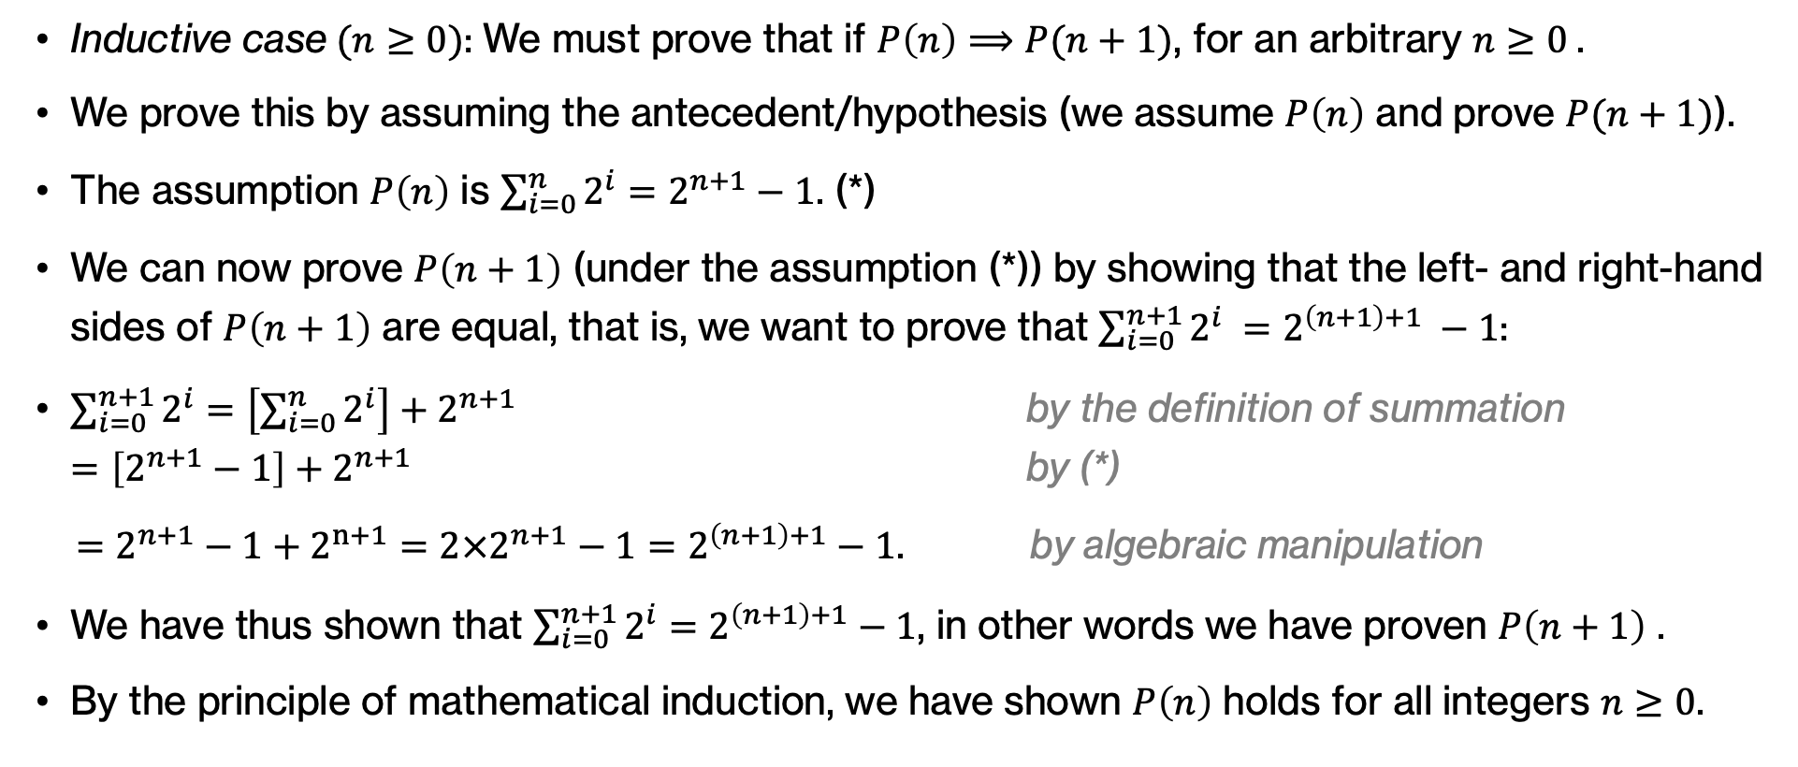
Example: Induction to prove sum of powers of two
Inductive case$(n≥0)$: We must prove that if $P\left(n\right)⟹P(n+1)$, for an arbitrary $n≥0$.
We prove this by assuming the antecedent/hypothesis (we assume $P\left(n\right)$ and prove $P(n+1)$).
The assumption $P\left(n\right)$ is $\sum_{i=0}^{n}{2^{i}}=2^{n+1}−1$. (*)
We can now prove $P\left(n+1\right)$ (under the assumption (*)) by showing that the left- and right-hand sides of $P\left(n+1\right)$ are equal, that is, we want to prove that $\sum_{i=0}^{n+1}{2^{i}} =$ $2^{\left(n+1\right)+1} −1$:
$\sum_{i=0}^{n+1}{2^{i}}=\left[\sum_{i=0}^{n}{2^{i}}\right]+2^{n+1}$ by the definition of summation
$=\left[2^{n+1}−1\right]+2^{n+1}$ by (*)
$=2^{n+1}−1+2^{n+1}=2×2^{n+1}−1=2^{\left(n+1\right)+1}−1$. by algebraic manipulation
We have thus shown that $\sum_{i=0}^{n+1}{2^{i}}=$ $2^{\left(n+1\right)+1}−1$, in other words we have proven $P\left(n+1\right)$ .
By the principle of mathematical induction, we have shown $P\left(n\right)$ holds for all integers $n≥0$.
Notes:
So since we proved P(n+1), then by the principle of mathematical induction, we have shown P(n) holds for all positive integers.

Slide 17
Template for proofs by induction
Clearly state the claim to be proven. Clearly state that the proof will be by induction, and clearly state the variable upon which induction will be performed.
State and prove the base case.
State and prove the inductive case. Within the statement and proof of inductive case:
  state the inductive hypothesis
  state what we need to prove
  Prove it, making use of the inductive hypothesis and stating where it was used.
Notes:
In general, whenever you want to prove a claim using mathematical induction, there is a template that you should follow:
Clearly state the claim to be proven. Clearly state that the proof will be by induction, and clearly state the variable upon which induction will be performed.
State and prove the base case.
State and prove the inductive case. Within the statement and proof of inductive case:
state the inductive hypothesis
state what we need to prove
Prove it, making use of the inductive hypothesis and stating where it was used.

Slide 18
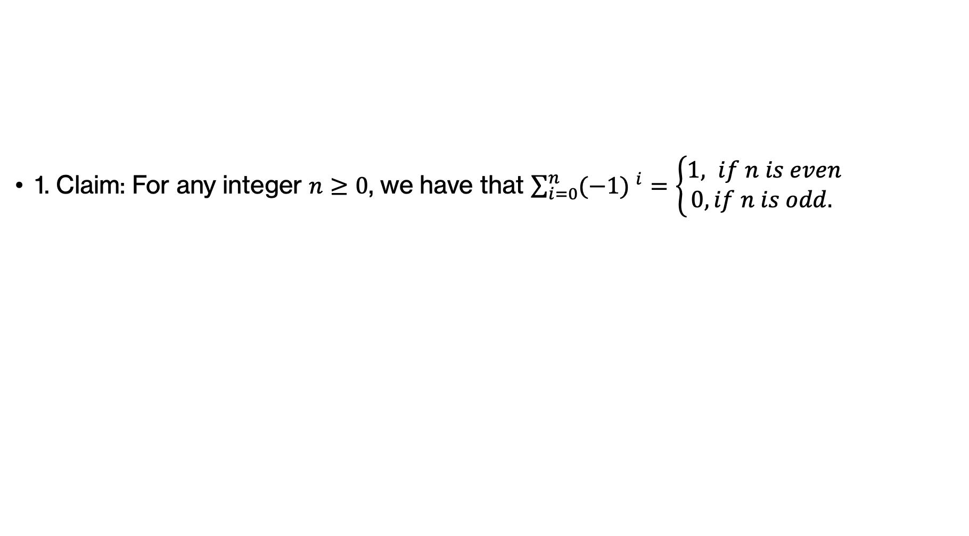
Example: Induction to prove sum of powers of -1
1. Claim: For any integer $n≥0$, we have that $\sum_{i=0}^{n}{{(−1) }^{i}}=\left\{\begin{aligned}1, if n is even \\ 0, if n is odd. \end{aligned}\right.$
Notes:
Let's go over one more example together where we will prove the claim that the sum of I equals 0 to n of -1^I is either equal to 1, if n is even, or 0 if n is odd.

Slide 19
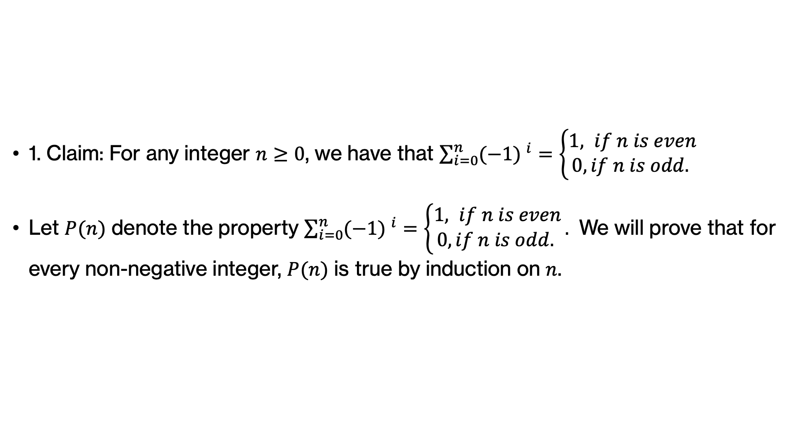
Example: Induction to prove sum of powers of -1
1. Claim: For any integer $n≥0$, we have that $\sum_{i=0}^{n}{{(−1) }^{i}}=\left\{\begin{aligned}1, if n is even \\ 0, if n is odd. \end{aligned}\right.$
Let $P(n)$ denote the property $\sum_{i=0}^{n}{{(−1) }^{i}}=\left\{\begin{aligned}1, if n is even \\ 0, if n is odd. \end{aligned}\right..$ We will prove that for every non-negative integer, $P(n)$ is true by induction on $n$.
Notes:
This will be the property P(n) we want to prove by induction.

Slide 20
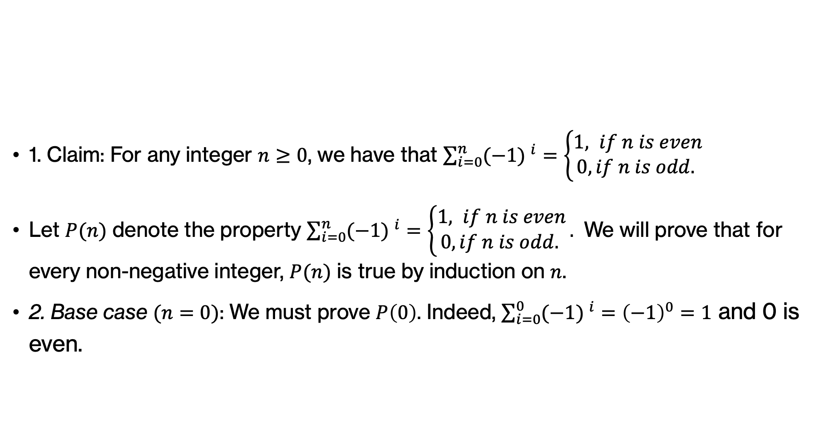
Example: Induction to prove sum of powers of -1
1. Claim: For any integer $n≥0$, we have that $\sum_{i=0}^{n}{{(−1) }^{i}}=\left\{\begin{aligned}1, if n is even \\ 0, if n is odd. \end{aligned}\right.$
Let $P(n)$ denote the property $\sum_{i=0}^{n}{{(−1) }^{i}}=\left\{\begin{aligned}1, if n is even \\ 0, if n is odd. \end{aligned}\right..$ We will prove that for every non-negative integer, $P(n)$ is true by induction on $n$.
2. Base case $(n=0)$: We must prove $P\left(0\right)$. Indeed, $\sum_{i=0}^{0}{{(−1) }^{i}}={\left(−1\right)}^{0}=1$ and 0 is even.
Notes:
Our base case is P(0). The sum of I equals 0 to 0 of -1^0 is equal to -1^0 equals to 1. Since 0 counts as an even number, indeed the sum is equal to 1 and we proved P(0).

Slide 21
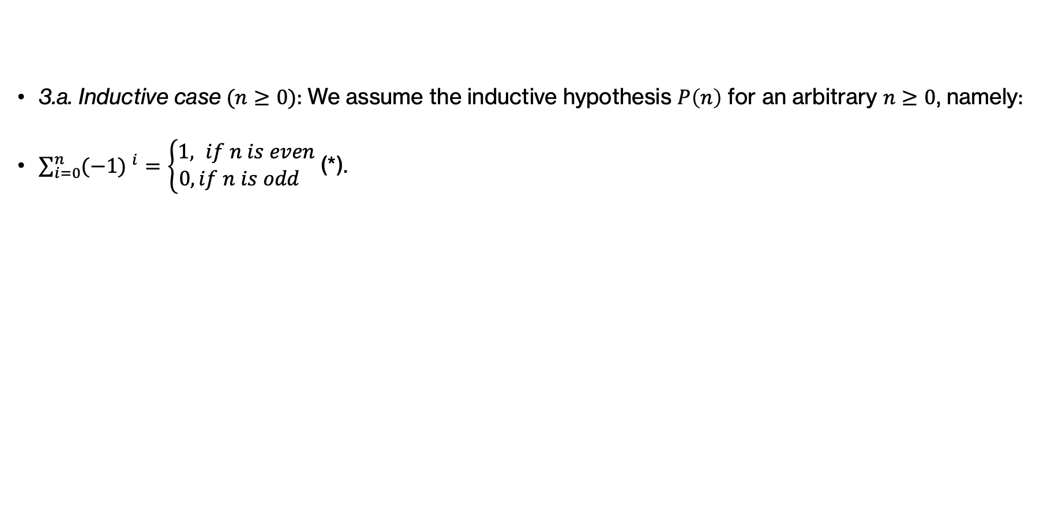
Example: Induction to prove sum of powers of -1
3.a. Inductive case$(n≥0)$: We assume the inductive hypothesis $P\left(n\right)$ for an arbitrary $n≥0$, namely:
$\sum_{i=0}^{n}{{(−1) }^{i}}=\left\{\begin{aligned}1, if n is even \\ 0, if n is odd \end{aligned}\right.$(*).
Notes:
We proceed with proving the inductive case. We start by assuming the inductive hypothesis P(n) for every n>=0

Slide 22
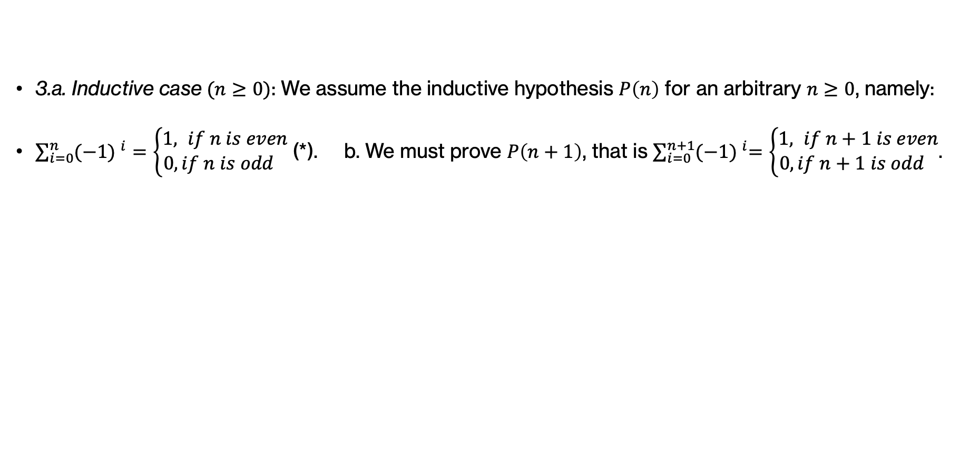
Example: Induction to prove sum of powers of -1
3.a. Inductive case$(n≥0)$: We assume the inductive hypothesis $P\left(n\right)$ for an arbitrary $n≥0$, namely:
$\sum_{i=0}^{n}{{(−1) }^{i}}=\left\{\begin{aligned}1, if n is even \\ 0, if n is odd \end{aligned}\right.$(*). b. We must prove $P\left(n+1\right)$, that is $\sum_{i=0}^{n+1}{{(−1) }^{i}=\left\{\begin{aligned}1, if n+1 is even \\ 0, if n+1 is odd \end{aligned}\right.}$.
Notes:
We then state that we must prove that P(n+1) is also true. It is always a good idea to expand on what that means so that you know what you are trying to prove.

Slide 23
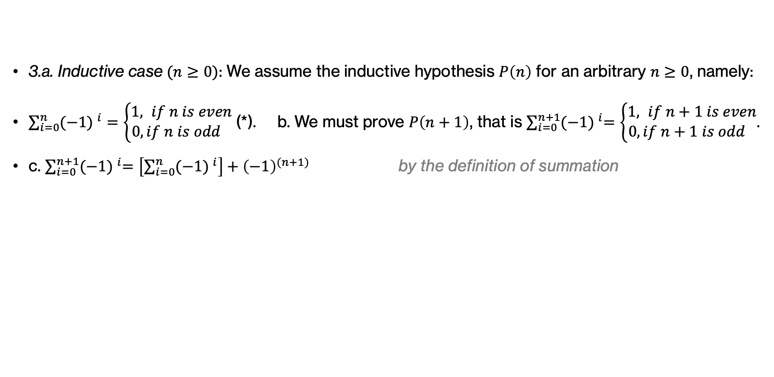
Example: Induction to prove sum of powers of -1
3.a. Inductive case$(n≥0)$: We assume the inductive hypothesis $P\left(n\right)$ for an arbitrary $n≥0$, namely:
$\sum_{i=0}^{n}{{(−1) }^{i}}=\left\{\begin{aligned}1, if n is even \\ 0, if n is odd \end{aligned}\right.$(*). b. We must prove $P\left(n+1\right)$, that is $\sum_{i=0}^{n+1}{{(−1) }^{i}=\left\{\begin{aligned}1, if n+1 is even \\ 0, if n+1 is odd \end{aligned}\right.}$.
c. $\sum_{i=0}^{n+1}{{(−1) }^{i}=\left[\sum_{i=0}^{n}{{(−1) }^{i}}\right]}+{\left(−1\right)}^{(n+1)}$ by the definition of summation
Notes:
We start by taking the left side of what we are trying to prove. By the definition of summation, we know that the sum from 0 up to n+1 of (-1)^i includes the sum from 0 up to n PLUS (-1)^(n+1).

Slide 24
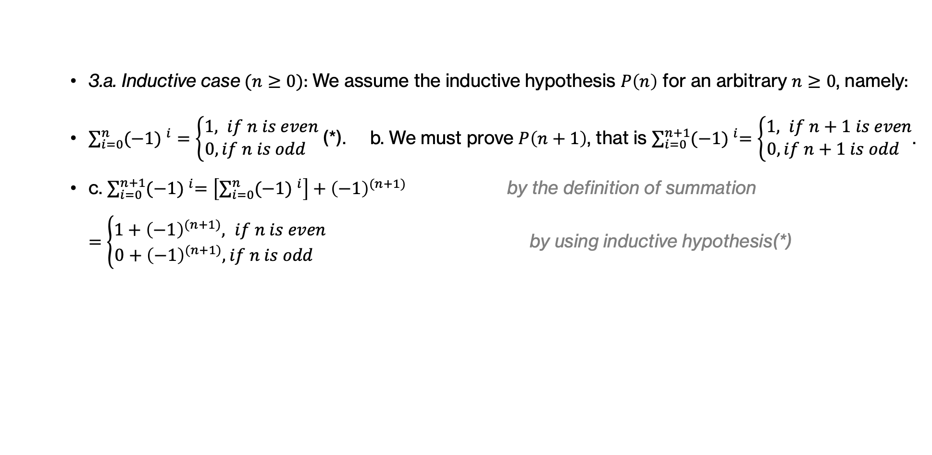
Example: Induction to prove sum of powers of -1
3.a. Inductive case$(n≥0)$: We assume the inductive hypothesis $P\left(n\right)$ for an arbitrary $n≥0$, namely:
$\sum_{i=0}^{n}{{(−1) }^{i}}=\left\{\begin{aligned}1, if n is even \\ 0, if n is odd \end{aligned}\right.$(*). b. We must prove $P\left(n+1\right)$, that is $\sum_{i=0}^{n+1}{{(−1) }^{i}=\left\{\begin{aligned}1, if n+1 is even \\ 0, if n+1 is odd \end{aligned}\right.}$.
c. $\sum_{i=0}^{n+1}{{(−1) }^{i}=\left[\sum_{i=0}^{n}{{(−1) }^{i}}\right]}+{\left(−1\right)}^{(n+1)}$ by the definition of summation
$=\left\{\begin{aligned}1+{\left(−1\right)}^{(n+1)}, if n is even \\ 0+{\left(−1\right)}^{(n+1)}, if n is odd \end{aligned}\right.$ by using inductive hypothesis(*)
Notes:
But we know what the the sum from 0 up to n of (-1)^i through our inductive hypothesis so we substitute it. Don't forget that we need to carry that PLUS (-1)^(n+1)

Slide 25
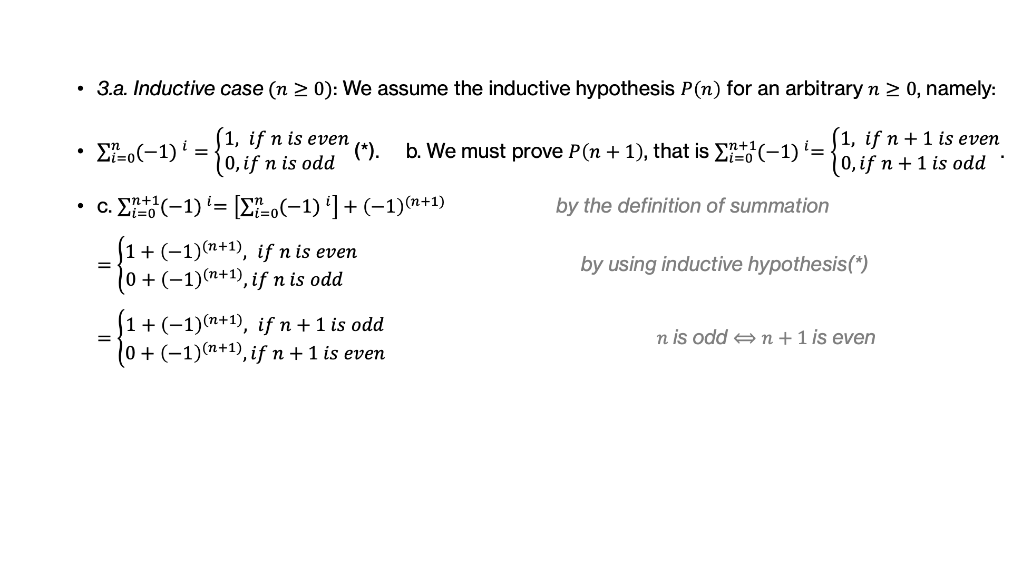
Example: Induction to prove sum of powers of -1
3.a. Inductive case$(n≥0)$: We assume the inductive hypothesis $P\left(n\right)$ for an arbitrary $n≥0$, namely:
$\sum_{i=0}^{n}{{(−1) }^{i}}=\left\{\begin{aligned}1, if n is even \\ 0, if n is odd \end{aligned}\right.$(*). b. We must prove $P\left(n+1\right)$, that is $\sum_{i=0}^{n+1}{{(−1) }^{i}=\left\{\begin{aligned}1, if n+1 is even \\ 0, if n+1 is odd \end{aligned}\right.}$.
c. $\sum_{i=0}^{n+1}{{(−1) }^{i}=\left[\sum_{i=0}^{n}{{(−1) }^{i}}\right]}+{\left(−1\right)}^{(n+1)}$ by the definition of summation
$=\left\{\begin{aligned}1+{\left(−1\right)}^{(n+1)}, if n is even \\ 0+{\left(−1\right)}^{(n+1)}, if n is odd \end{aligned}\right.$ by using inductive hypothesis(*)
$=\left\{\begin{aligned}1+{\left(−1\right)}^{(n+1)}, if n+1 is odd \\ 0+{\left(−1\right)}^{(n+1)}, if n+1 is even \end{aligned}\right. n$is odd $⟺n+1$is even
Notes:
We will next make use of a smart trick. n is odd if and only if n+1 is even. And n is even if and only if n+1 is odd. This allows us to rewrite our equation to bring n+1 in the picture since this is what we ultimately want to prove.

Slide 26
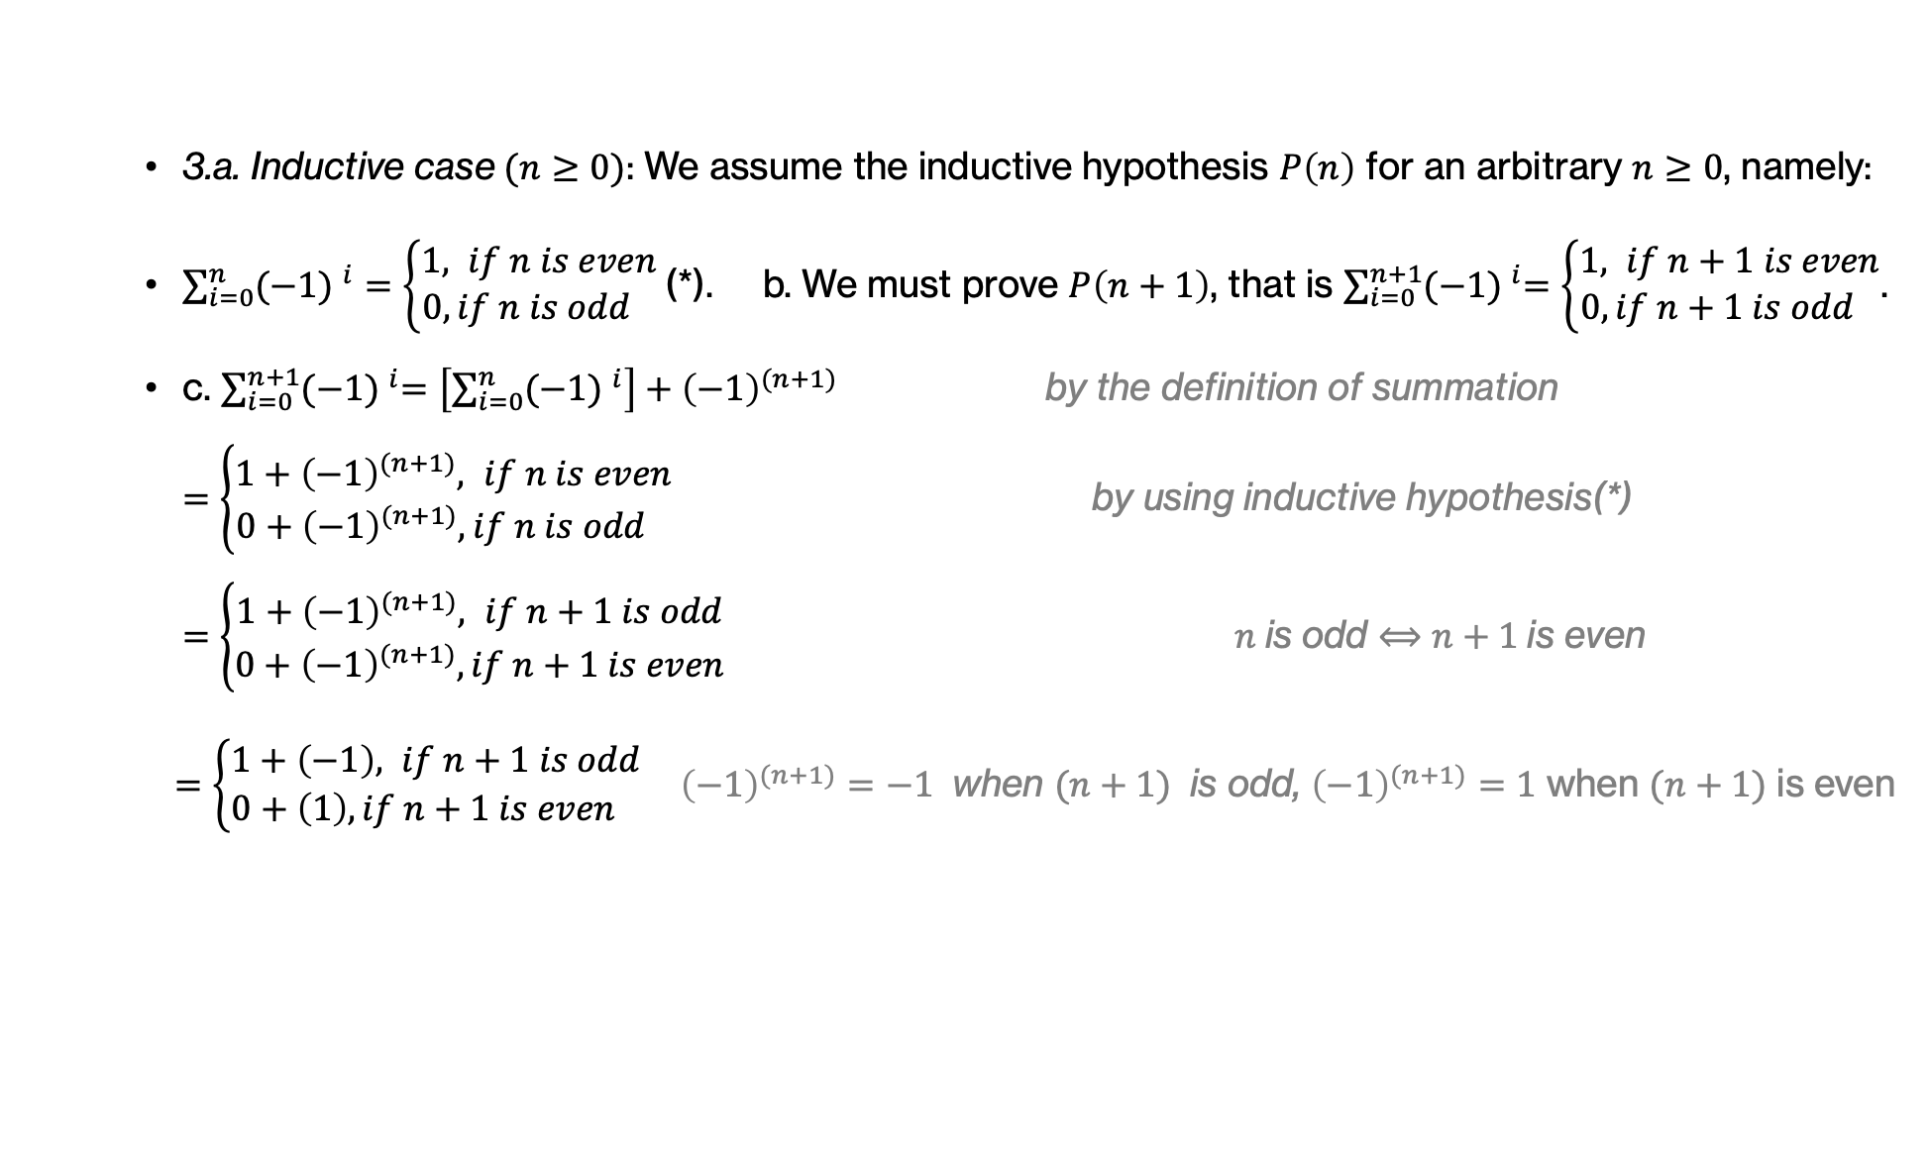
Example: Induction to prove sum of powers of -1
3.a. Inductive case$(n≥0)$: We assume the inductive hypothesis $P\left(n\right)$ for an arbitrary $n≥0$, namely:
$\sum_{i=0}^{n}{{(−1) }^{i}}=\left\{\begin{aligned}1, if n is even \\ 0, if n is odd \end{aligned}\right.$(*). b. We must prove $P\left(n+1\right)$, that is $\sum_{i=0}^{n+1}{{(−1) }^{i}=\left\{\begin{aligned}1, if n+1 is even \\ 0, if n+1 is odd \end{aligned}\right.}$.
c. $\sum_{i=0}^{n+1}{{(−1) }^{i}=\left[\sum_{i=0}^{n}{{(−1) }^{i}}\right]}+{\left(−1\right)}^{(n+1)}$ by the definition of summation
$=\left\{\begin{aligned}1+{\left(−1\right)}^{(n+1)}, if n is even \\ 0+{\left(−1\right)}^{(n+1)}, if n is odd \end{aligned}\right.$ by using inductive hypothesis(*)
$=\left\{\begin{aligned}1+{\left(−1\right)}^{(n+1)}, if n+1 is odd \\ 0+{\left(−1\right)}^{(n+1)}, if n+1 is even \end{aligned}\right. n$is odd $⟺n+1$is even
$=\left\{\begin{aligned}1+\left(−1\right), if n+1 is odd \\ 0+\left(1\right), if n+1 is even \end{aligned}\right.{\left(−1\right)}^{(n+1)}=−1$ when $(n+1)$ is odd, ${\left(−1\right)}^{(n+1)}=1$ when $(n+1)$ is even
Notes:
We also know that if (n+1) is odd and is the exponent of the base (-1), then that will result in -1 (think about it, -1^1=-1, -1^3 =-1, etc). We also know that if n+1 is even then the exponent will result in 1 (-1^2=1, -1^4=1, etc). Thus we can simplify these exponents to -1 and 1 respectively.

Slide 27
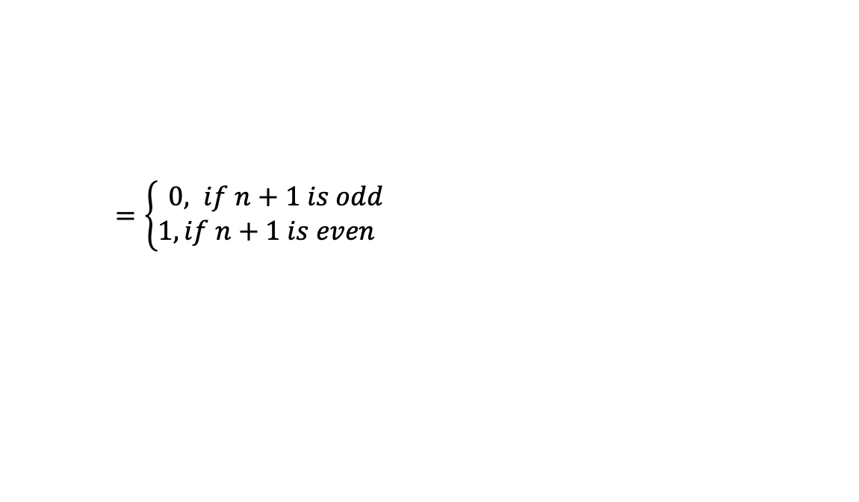
Example: Induction to prove sum of powers of -1
3.a. Inductive case$(n≥0)$: We assume the inductive hypothesis $P\left(n\right)$ for an arbitrary $n≥0$, namely:
$\sum_{i=0}^{n}{{(−1) }^{i}}=\left\{\begin{aligned}1, if n is even \\ 0, if n is odd \end{aligned}\right.$(*). b. We must prove $P\left(n+1\right)$, that is $\sum_{i=0}^{n+1}{{(−1) }^{i}=\left\{\begin{aligned}1, if n+1 is even \\ 0, if n+1 is odd \end{aligned}\right.}$.
c. $\sum_{i=0}^{n+1}{{(−1) }^{i}=\left[\sum_{i=0}^{n}{{(−1) }^{i}}\right]}+{\left(−1\right)}^{(n+1)}$ by the definition of summation
$=\left\{\begin{aligned}1+{\left(−1\right)}^{(n+1)}, if n is even \\ 0+{\left(−1\right)}^{(n+1)}, if n is odd \end{aligned}\right.$ by using inductive hypothesis(*)
$=\left\{\begin{aligned}1+{\left(−1\right)}^{(n+1)}, if n+1 is odd \\ 0+{\left(−1\right)}^{(n+1)}, if n+1 is even \end{aligned}\right. n$is odd $⟺n+1$is even
$=\left\{\begin{aligned}1+\left(−1\right), if n+1 is odd \\ 0+\left(1\right), if n+1 is even \end{aligned}\right.{\left(−1\right)}^{(n+1)}=−1$ when $(n+1)$ is odd, ${\left(−1\right)}^{(n+1)}=1$ when $(n+1)$ is even
$=\left\{\begin{aligned}0, if n+1 is odd \\ 1, if n+1 is even \end{aligned}\right.$
Thus, we have shown $P\left(n\right)$ holds for all integers $n≥0$.
Notes:
Which adding them up, results to exactly what we wanted to prove and P(n+1) holds. Thus, by the principle of mathematical induction, we have shown that P(n) holds for all positive integers!

Slide 28
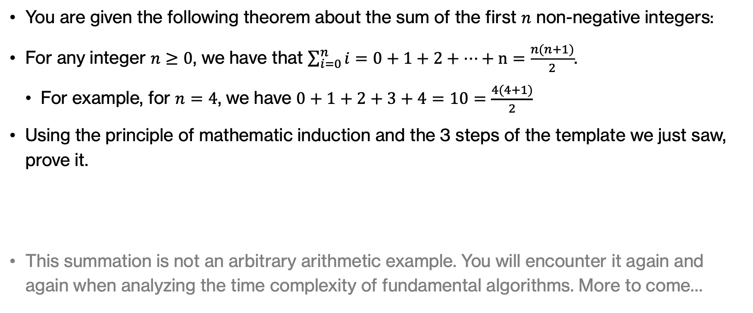
Practice time
You are given the following theorem about the sum of the first $n$ non-negative integers:
For any integer $n≥0$, we have that $\sum_{i=0}^{n}{i}=0+1+2+…+n=\frac{n(n+1)}{2}$.
  For example, for $n=4$, we have $0+1+2+3+4=10=\frac{4(4+1)}{2}$
Using the principle of mathematic induction and the 3 steps of the template we just saw, prove it.
This summation is not an arbitrary arithmetic example. You will encounter it again and again when analyzing the time complexity of fundamental algorithms. More to come…
Notes:
Your turn to prove a remarkably useful summation that you will face a lot when analyzing the time complexity of fundamental algorithms.

Slide 29
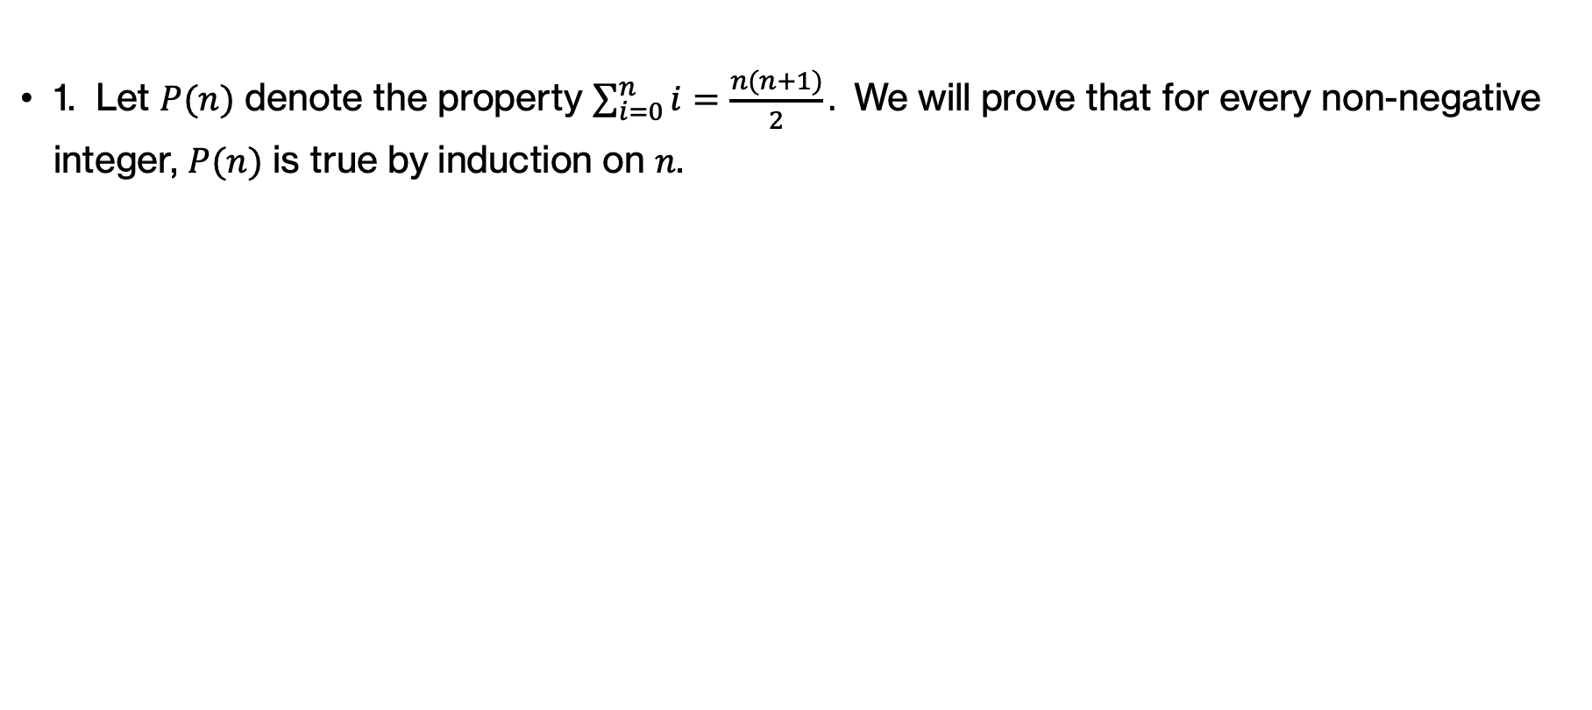
Answer
1. Let $P(n)$ denote the property $\sum_{i=0}^{n}{i}=\frac{n(n+1)}{2}.$ We will prove that for every non-negative integer, $P(n)$ is true by induction on $n$.

Slide 30
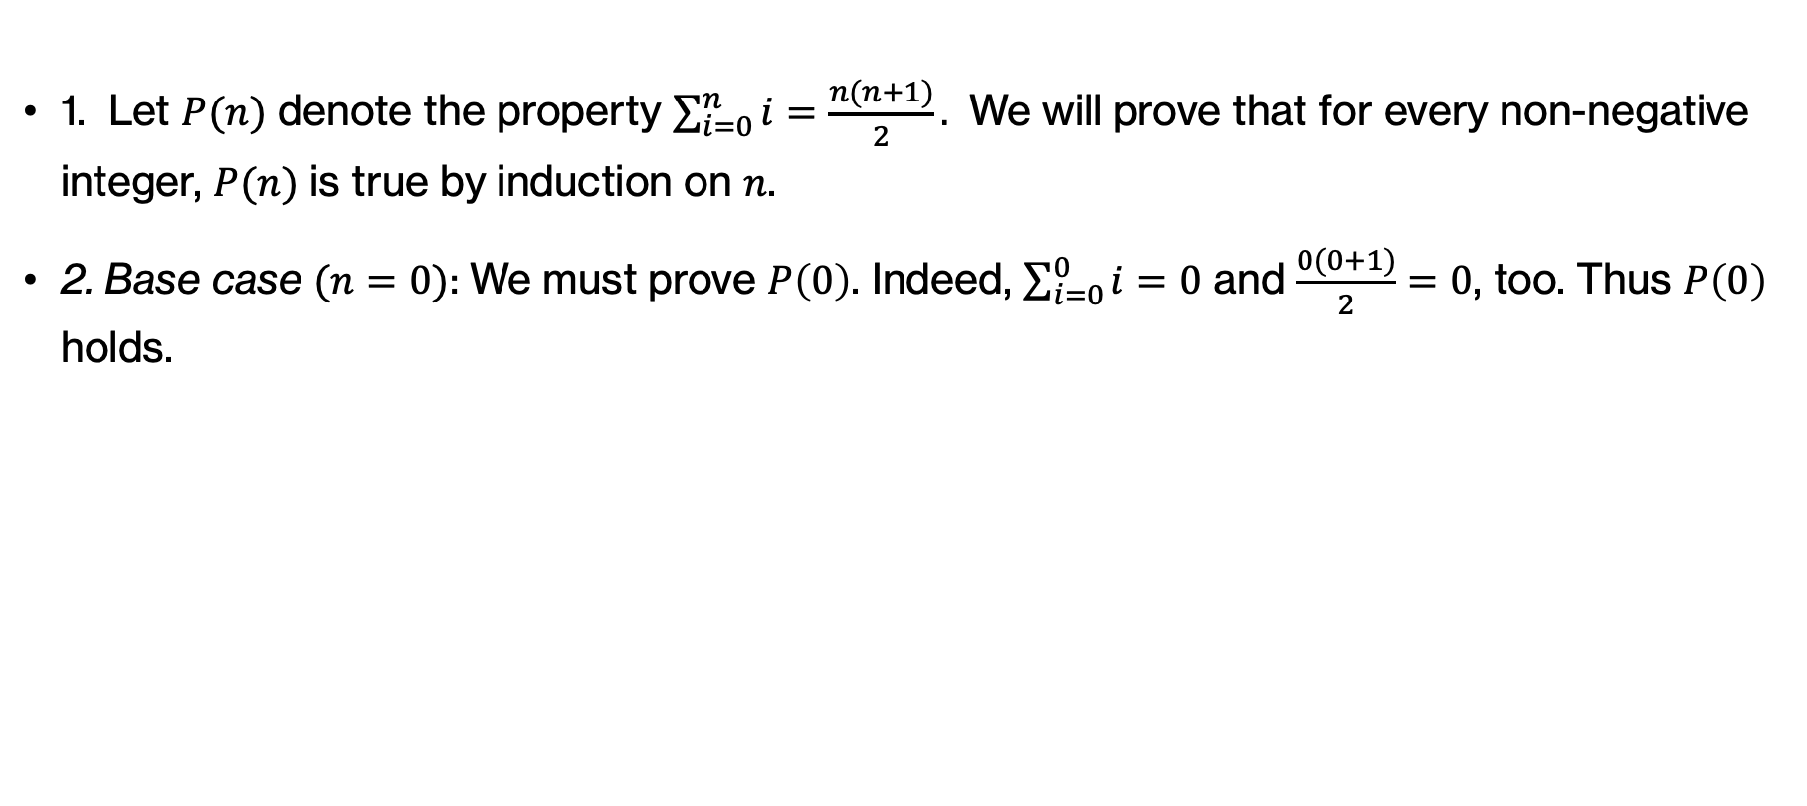
Answer
1. Let $P(n)$ denote the property $\sum_{i=0}^{n}{i}=\frac{n(n+1)}{2}.$ We will prove that for every non-negative integer, $P(n)$ is true by induction on $n$.
2. Base case $(n=0)$: We must prove $P\left(0\right)$. Indeed, $\sum_{i=0}^{0}{i}=0$ and $\frac{0(0+1)}{2}=0$, too. Thus $P\left(0\right)$ holds.

Slide 31

Answer
3.a. Inductive case$(n≥0)$: We assume the inductive hypothesis $P\left(n\right)$ for an arbitrary $n≥0$, namely:
$\sum_{i=0}^{n}{i}=\frac{n(n+1)}{2}$ (*).

Slide 32

Answer
3.a. Inductive case$(n≥0)$: We assume the inductive hypothesis $P\left(n\right)$ for an arbitrary $n≥0$, namely:
$\sum_{i=0}^{n}{i}=\frac{n(n+1)}{2}$ (*). b. We must prove $P\left(n+1\right)$, that is $\sum_{i=0}^{n+1}{i}=\frac{(n+1)(\left(n+1\right)+1)}{2}$.

Slide 33

Answer
3.a. Inductive case$(n≥0)$: We assume the inductive hypothesis $P\left(n\right)$ for an arbitrary $n≥0$, namely:
$\sum_{i=0}^{n}{i}=\frac{n(n+1)}{2}$ (*). b. We must prove $P\left(n+1\right)$, that is $\sum_{i=0}^{n+1}{i}=\frac{(n+1)(\left(n+1\right)+1)}{2}$.
c. $\sum_{i=0}^{n+1}{i=\left[\sum_{i=0}^{n}{i}\right]}+(n+1)$ by the definition of summation

Slide 34
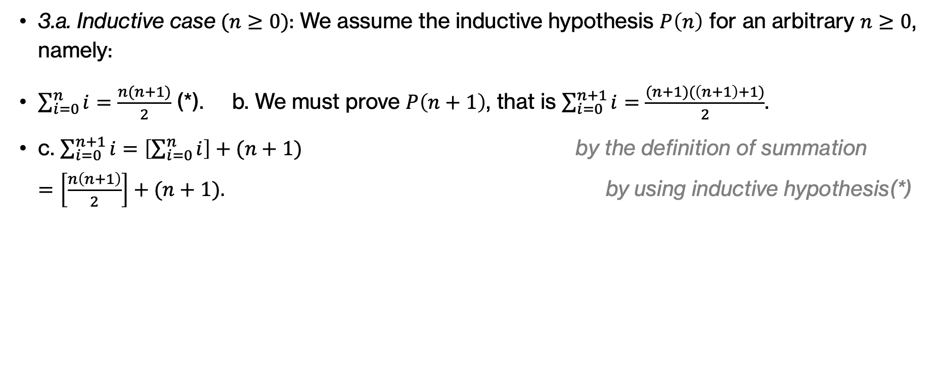
Answer
3.a. Inductive case$(n≥0)$: We assume the inductive hypothesis $P\left(n\right)$ for an arbitrary $n≥0$, namely:
$\sum_{i=0}^{n}{i}=\frac{n(n+1)}{2}$ (*). b. We must prove $P\left(n+1\right)$, that is $\sum_{i=0}^{n+1}{i}=\frac{(n+1)(\left(n+1\right)+1)}{2}$.
c. $\sum_{i=0}^{n+1}{i=\left[\sum_{i=0}^{n}{i}\right]}+(n+1)$ by the definition of summation
$=\left[\frac{n\left(n+1\right)}{2}\right]+(n+1).$ by using inductive hypothesis(*)

Slide 35
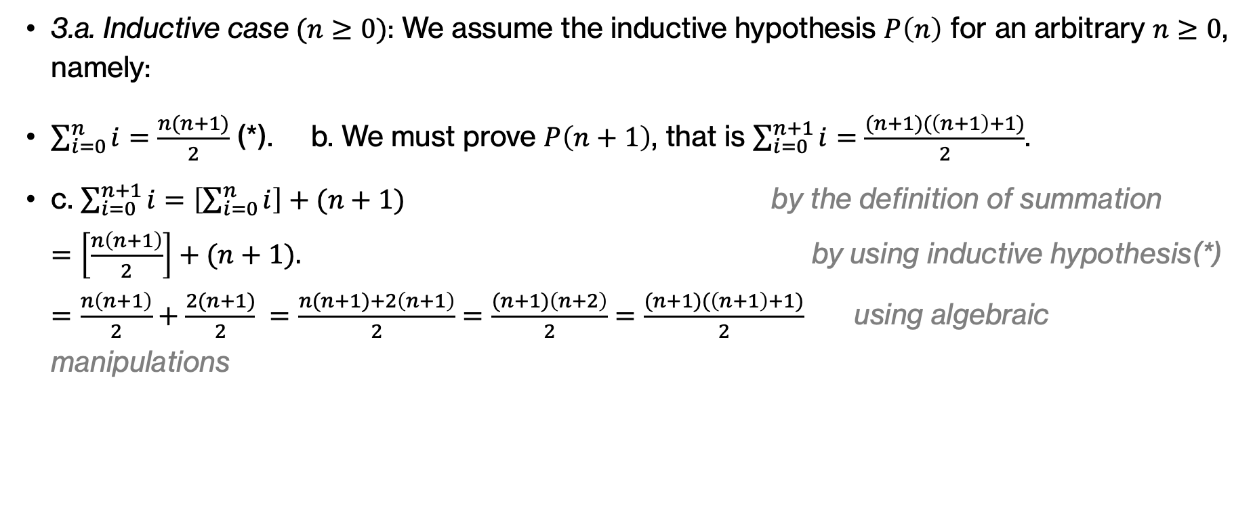
Answer
3.a. Inductive case$(n≥0)$: We assume the inductive hypothesis $P\left(n\right)$ for an arbitrary $n≥0$, namely:
$\sum_{i=0}^{n}{i}=\frac{n(n+1)}{2}$ (*). b. We must prove $P\left(n+1\right)$, that is $\sum_{i=0}^{n+1}{i}=\frac{(n+1)(\left(n+1\right)+1)}{2}$.
c. $\sum_{i=0}^{n+1}{i=\left[\sum_{i=0}^{n}{i}\right]}+(n+1)$ by the definition of summation
$=\left[\frac{n\left(n+1\right)}{2}\right]+(n+1).$ by using inductive hypothesis(*)
$=\frac{n\left(n+1\right)}{2}+\frac{2(n+1)}{2} =\frac{n(n+1)+2\left(n+1\right)}{2}=\frac{(n+1)\left(n+2\right)}{2}=\frac{(n+1)(\left(n+1\right)+1)}{2}$ using algebraic manipulations

Slide 36
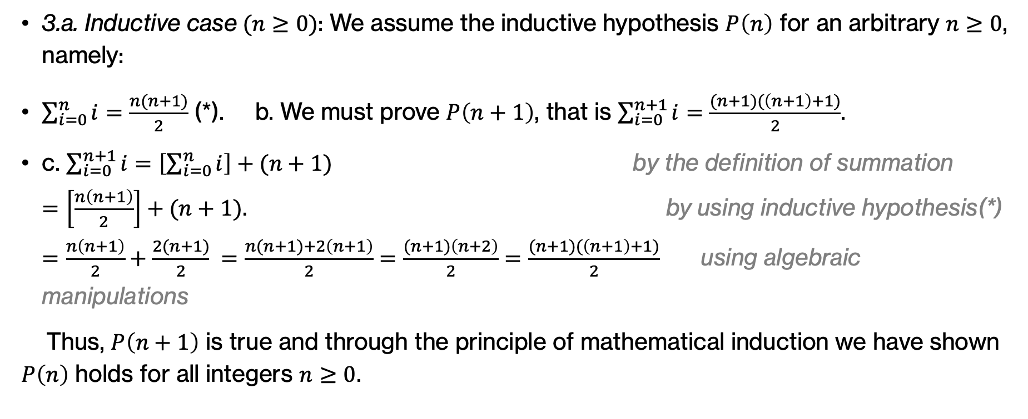
Answer
3.a. Inductive case$(n≥0)$: We assume the inductive hypothesis $P\left(n\right)$ for an arbitrary $n≥0$, namely:
$\sum_{i=0}^{n}{i}=\frac{n(n+1)}{2}$ (*). b. We must prove $P\left(n+1\right)$, that is $\sum_{i=0}^{n+1}{i}=\frac{(n+1)(\left(n+1\right)+1)}{2}$.
c. $\sum_{i=0}^{n+1}{i=\left[\sum_{i=0}^{n}{i}\right]}+(n+1)$ by the definition of summation
$=\left[\frac{n\left(n+1\right)}{2}\right]+(n+1).$ by using inductive hypothesis(*)
$=\frac{n\left(n+1\right)}{2}+\frac{2(n+1)}{2} =\frac{n(n+1)+2\left(n+1\right)}{2}=\frac{(n+1)\left(n+2\right)}{2}=\frac{(n+1)(\left(n+1\right)+1)}{2}$ using algebraic manipulations
Thus, $P\left(n+1\right)$ is true and through the principle of mathematical induction we have shown $P\left(n\right)$ holds for all integers $n≥0$.

Slide 37
Loop invariants and induction
The parallels between loop invariants and induction are pretty direct. A loop invariant is a property that remains true at the beginning and end of each iteration of a loop. The first corresponds to the base case and the second to the inductive case.
Notes:
If you think about it, the parallels between loop invariants and induction are pretty direct. A loop invariant is a property that remains true at the beginning and end of each iteration of a loop. The first corresponds to the base case and the second to the inductive case.

