Slide 1
Checkpoint 2 review
CS51 – Spring 2026
Notes:
Today's lecture will wrap up our work with lists. We will also talk about how to handle working with files.

Slide 2
Basic info

Slide 3
Checkpoint 2
  In class, on Tuesday April 14th
  Can bring a double-sided handwritten (ok if with a stylus) sheet of paper with notes
  Will cover everything in Mathematical Foundations and Data Structures and Algorithms units

Slide 4
Topics
  Propositional Logic (logical connectives and their truth tables), tautology, satisfiable
  Loop invariants (pre-, post-conditions, all four steps to show full correctness of iterative programs)
  Proof by induction (both weak and strong)
  Recursion (comfortable with writing a recursive program and reading recursive code in Python)
  Turtle module (basic commands to control)
  Sequences (lists, strings, tuples, ranges) and dictionaries. Comfortable with indexing, slicing, membership, iterating
  Dictionaries
  Nested lists, list comprehension, files
  Sorting algorithms (bubble, selection, insertion sort) basic idea and complexities

Slide 5
Practice Problem 1
Consider the following pseudocode, which operates on a string counts the number of vowels:
  i = 0
  count = 0
  while i < len(my_string):
    if my_string[i] is a vowel:
      count +=1
    i += 1
Prove that it's correct using loop invariants

Slide 6
Answer 1
Basic idea is to show loop invariant: at the beginning of the i-th iteration, count is equal to the number of vowels in my_string[0:i]
In maintenance, you want to consider two cases:
  Case 1: my_string[i] is a vowel, then count correctly increases and given assumption now reflects the number of vowels in my_string[0:i+1]
  Case 2: my_string[i] is not a vowel, then count does not change and given the assumption now reflects the number of vowels in my_string[0:i+1]

Slide 7

Practice Problem 2
Using weak induction, prove that for all non-negative integers $n$, $3| (n^{3}−n)$ that is that $n^{3}−n$is evenly divisible by 3.

Slide 8
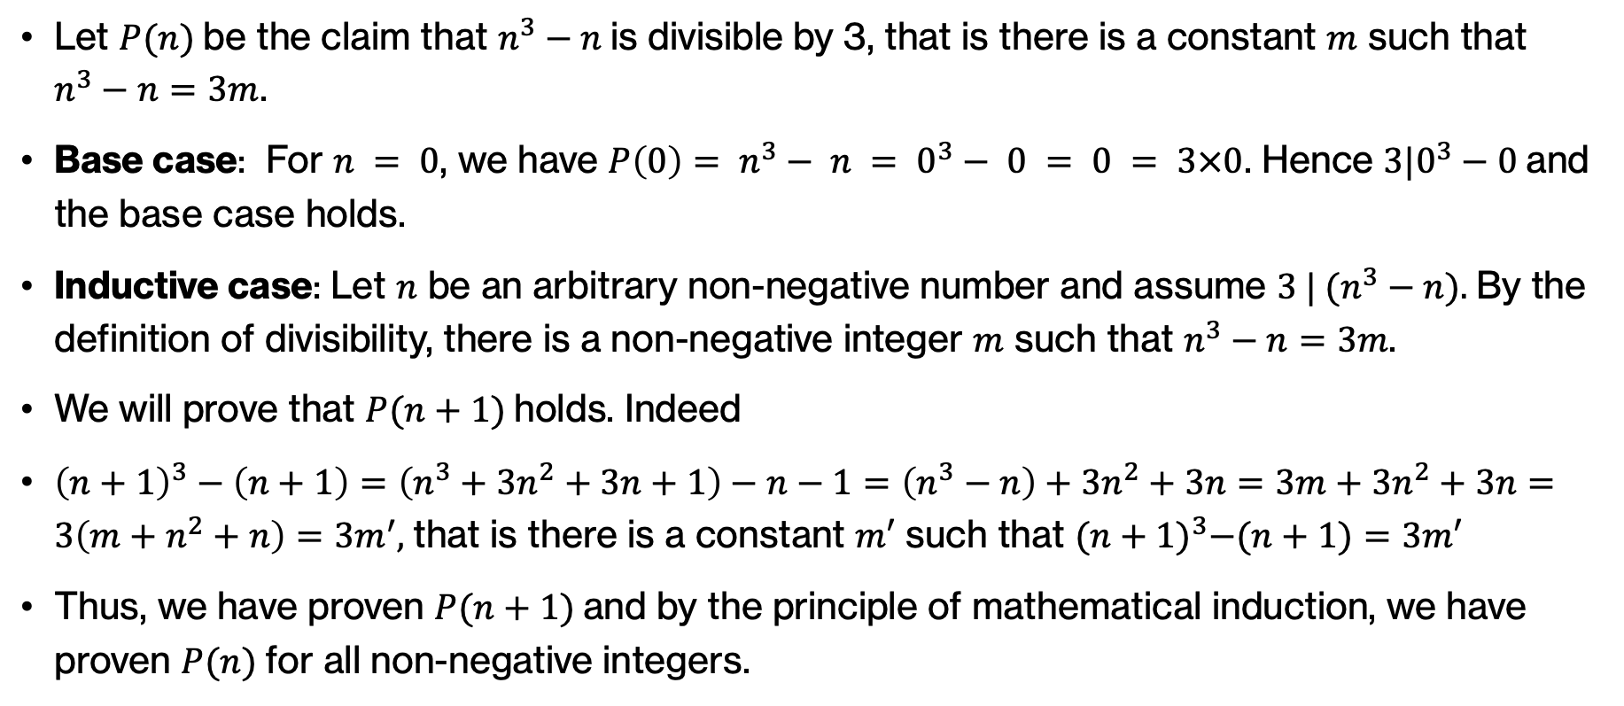
Answer 2
Let $P(n)$be the claim that $n^{3}−n$is divisible by 3, that is there is a constant $m$ such that $n^{3}−n=3m$.
Base case: For $n = 0$, we have $P\left(0\right)= n^{3}− n = 0^{3}− 0 = 0 = 3×0$. Hence $3|0^{3}−0$and the base case holds.
Inductive case: Let $n$ be an arbitrary non-negative number and assume $3 | (n^{3}−n).$By the definition of divisibility, there is a non-negative integer $m$ such that $n^{3}−n=3m$.
We will prove that $P(n+1)$holds. Indeed
${\left(n+1\right)}^{3}−\left(n+1\right)=\left(n^{3}+3n^{2}+3n+1\right)−n−1=\left(n^{3}−n\right)+3n^{2}+3n=3m+3n^{2}+3n=3\left(m+n^{2}+n\right)=3m^{′},$that is there is a constant $m′$ such that ${(n+1)}^{3}−(n+1)=3m′$
Thus, we have proven $P(n+1)$and by the principle of mathematical induction, we have proven $P(n)$for all non-negative integers.

Slide 9
Practice Problem 3
What does the following function do (in one sentence) assuming x is a list:
def mystery(x):
if len(x) <= 1:
return True
else:
if x[0] > x[1]:
return False
else:
return mystery(x[1:])

Slide 10
Answer 3
Checks if the list is sorted in ascending order.

Slide 11
Practice Problem 4
Write a function called swap that takes as input a dictionary and returns a new dictionary where key is the old value and the value is the old key, i.e swaps the key/values. You may assume that the value are unique.
>>> d = {"a":1, "b":2, "c":3}
>>> swap(d)
{1: 'a', 2: 'b', 3: 'c'}

Slide 12
Answer 4
Write a function called swap that takes as input a dictionary and returns a new dictionary where key is the old value and the value is the old key, i.e swaps the key/values. You may assume that the value are unique.
def swap(d):
new_d = {}
for key in d:
value = d[key]
new_d[value] = key
return new_d

Slide 13
Practice Problem 5
Write a function called capitalized_lines that takes as input a file and counts the number of lines that start with a capital letter.

Slide 14
Answer 5
Write a function called capitalized_lines that takes as input a file and counts the number of lines that start with a capital letter.
def capitalized_lies(filename):
file = open(filename, 'r')
count = 0
for line in file:
if line[0].isupper():
count += 1
return count

