Slide 1
CS51 machine
David Kauchak
CS 51 – Spring 2026

Slide 2
Admin
Checkpoint 1
    Covers material up through this week (lighter coverage of this week’s material)
    1 double-side page of notes, hand-written
    will post a few practice problems
Assignment 4
Assignment 5

Slide 3
Examples from this lecture
http://www.cs.pomona.edu/classes/cs51/cs51machine/

Slide 4
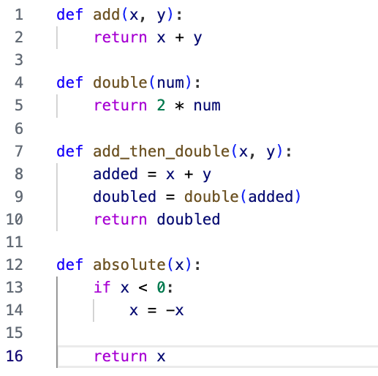
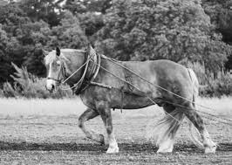
How does a program run on the CPU?
processor
…
registers
How do programs run/execute on a computer?

Slide 5
Assembly code
Python is a “high-level” programming language
high-level programming languages allow you to write code:
  without worrying about hardware-specific details of the computer (memory, registers, CPU specifics…)
  higher-level abstraction, e.g., 2**6 or print()
What actually runs on the processor is assembly code

Slide 6
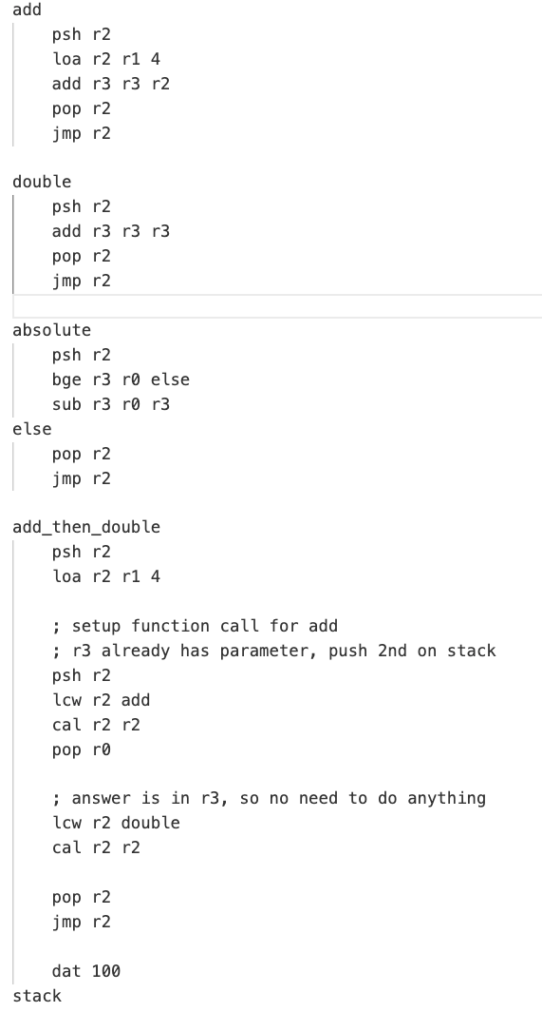
Assembly code

Slide 7
This week
Introduce the CS51 machine
This is a simplified version of an assembly language
It is a “simulator” that assumes a very simple CPU and memory setup

Slide 8
Inside the CPU
CPU
processor
processor: does the work
registers: local, fast memory slots
…
registers

Slide 9
CS51 machine (processor)
CPU
instruction counter
(location in memory of the next
instruction in memory)
processor
ic
r0
holds the value 0 (read only)
r1
general purpose
read/write
r2
registers
r3

Slide 10
Memory
address
32-bit words
0
4
8
...
10101011 10001010 00010010 01011010
11001011 00001110 01010010 01010110
10111011 10010010 00000000 01110100
…
RAM
Most modern computers use 32-bit (4 byte) or 64-bit (8 byte) words

Slide 11
Memory in the CS51 Machine
address
16-bit words
0
2
4
...
10101011 10001010
00010010 01011010
11001011 00001110
…
RAM
We’ll use 16-bit words for our model (the CS51 machine)

Slide 12
When executing a program, the CS51 machine loops over the follow:
Fetch the value from mem[ic] for use as an instruction
Increment ic by 2
Decode the instruction and then execute it
instruction counter
(location in memory of the next
instruction in memory)
ic
r0
holds the value 0 (read only)
r1
general purpose
read/write
r2
r3

Slide 13
CS51 machine instructions
CPU
processor
What types of operations might we want to do (think really basic)?
registers

Slide 14
CS51 machine code
Four main types of instructions
math/logical
branch (conditionals, loops)
memory
control the machine (e.g., stop it)

Slide 15
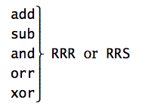
Math/logical operations
instruction name
arguments

Slide 16
Math/logical operations
instruction name
arguments
instruction/operation name
(always three characters)

Slide 17
Math/logical operations
instruction name
arguments
operation arguments
R = register (e.g. r0)
S = signed number (byte)

Slide 18
Math/logical operations
instruction name
arguments
1st R: register where the answer will go
2nd R: register of first operand
3rd S/R: register/value of second operand
operand = input to operator (think, parameters for functions)

Slide 19
add r1 r2 r3
What does this do?
1st R: register where the answer will go
2nd R: register of first operand
3rd S/R: register/value of second operand

Slide 20
add r1 r2 r3
r1 = r2 + r3
Add contents of registers r2 and r3 and store the result in r1
1st R: register where the answer will go
2nd R: register of first operand
3rd S/R: register/value of second operand

Slide 21
add r2 r1 10
What does this do?
1st R: register where the answer will go
2nd R: register of first operand
3rd S/R: register/value of second operand

Slide 22
add r2 r1 10
r2 = r1 + 10
Add 10 to the contents of register r1 and store in r2
1st R: register where the answer will go
2nd R: register of first operand
3rd S/R: register/value of second operand

Slide 23
add r1 r0 8
sub r2 r0 r1
sub r2 r1 r2
Hint: r0 is always 0
What number is in r2?
1st R: register where the answer will go
2nd R: register of first operand
3rd S/R: register/value of second operand

Slide 24
add r1 r0 8
sub r2 r0 r1
sub r2 r1 r2
r1 = 8
r2 = -8, r1 = 8
r2 = 16
1st R: register where the answer will go
2nd R: register of first operand
3rd S/R: register/value of second operand

Slide 25
add r1 r0 6
and r2 r1 10
add r3 r1 r2
Hint: r0 is always 0
What number is in r3?
1st R: register where the answer will go
2nd R: register of first operand
3rd S/R: register/value of second operand

Slide 26
add r1 r0 6 (00110)
and r2 r1 10 (01010)
add r3 r1 r2
r1 = 6 (0110)
r2 = 2, r1 = 6
r3 = 8
1st R: register where the answer will go
2nd R: register of first operand
3rd S/R: register/value of second operand

Slide 27

Accessing memory
sto = save data in register TO memory
loa = put data FROM memory into a register
sto r1 r2 ; store the contents of r1 to mem[r2]
loa r1 r2 ; get data from mem[r2] and put into r1

Slide 28
Accessing memory
sto = save data in register TO memory
loa = put data FROM memory into a register
Special cases:
saving TO (sto) address 0 (r0) prints
reading from (loa) address 0 (r0) gets input from user

Slide 29
Basic structure of CS51 program
; great comments at the top!
;
instruction1 ; comment
instruction2 ; comment
...
hlt
whitespace before operations/instructions

Slide 30
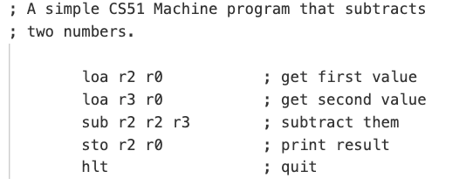
subtract.a51

Slide 31
Running the CS51 machine
Look at subtract.a51
load two numbers from the user
subtract
print the result

Slide 32
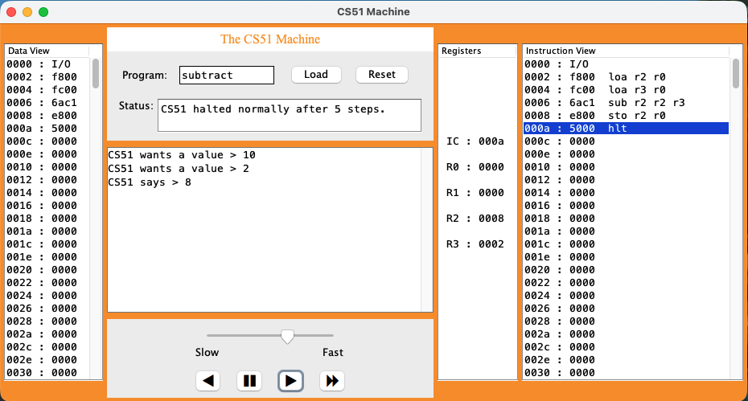
CS51 simulator
memory
instruction execution
registers
I/O and running program

Slide 33
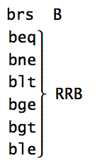
Branch instructions
branch (always)
branch if ==
branch if !=
branch if <
branch if >=
branch if >
branch if <=
1st R: first register for comparison
2nd R: second register in comparison
3rd B: label

Slide 34
Branch instructions
beq r3 r0 done
What does this do?
1st R: first register for comparison
2nd R: second register in comparison
3rd B: label

Slide 35
Branch instructions
beq r3 r0 done
If r3 = 0, branch to the label “done”
if not (else) ic is incremented as normal to the next instruction
1st R: first register for comparison
2nd R: second register in comparison
3rd B: label

Slide 36
Branch instructions
ble r2 r3 done
What does this do?
1st R: first register for comparison
2nd R: second register in comparison
3rd B: label

Slide 37
Branch instructions
ble r2 r3 done
If r2 <= r3, branch to the label done
1st R: first register for comparison
2nd R: second register in comparison
3rd B: label

Slide 38
Branch instructions
branch (always)
branch if ==
branch if !=
branch if <
branch if >=
branch if >
branch if <=
Conditionals
Loops
Change the order that instructions are executed

Slide 39
CS51 machine execution
A program is a sequence of instructions stored in a memory. To execute a program, the CS51 machine follows a simple loop:
Fetch the value from mem[ic] for use as an instruction
Increment ic by 2
Decode the instruction and then execute it

Slide 40
Basic structure of CS51 program
; great comments at the top!
;
instruction1 ; comment
instruction2 ; comment
...
label1
instruction ; comment
instruction ; comment
label2
...
hlt
- whitespace before operations/instructions
- labels go here

Slide 41
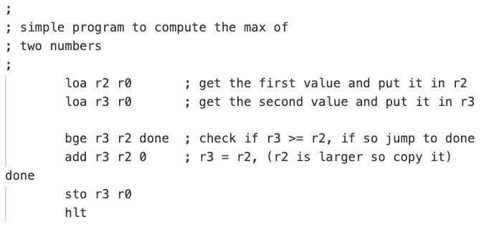
simple_max.a51

Slide 42
More CS51 examples
Look at max_simple.a51
Get two values from the user
Compare them
Use a branch to distinguish between the two cases
  Goal is to get largest value in r3
print largest value

Slide 43
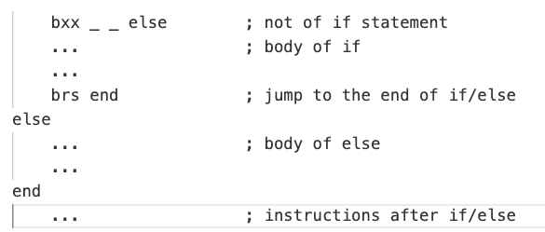
if/else
if block
else block
check the opposite of the if statement
  if it is true, we’ll jump down to else
  if it is not true, we’ll continue into the body of the if part
At the end of the if block, need to jump to the end, otherwise, we’d continue onto else

Slide 44
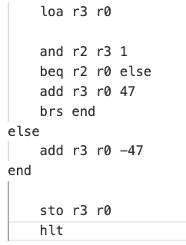
if/else
What does this code do?

Slide 45
if/else
if block
else block

Slide 46
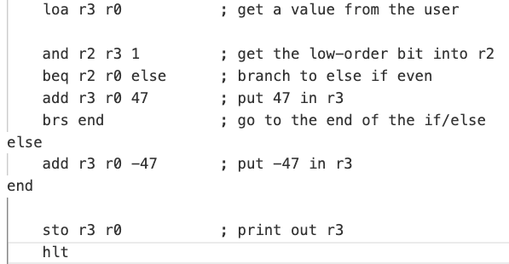
if/else (even_commented.a51)

Slide 47
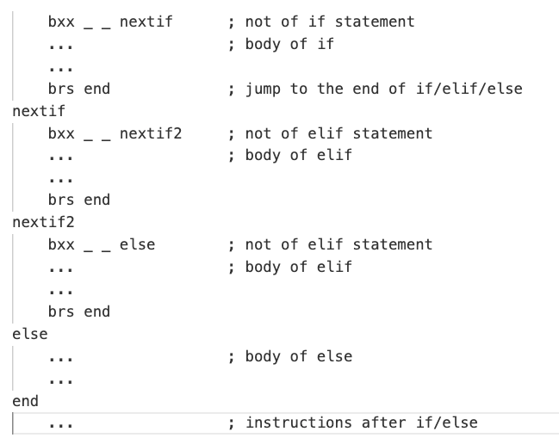
If/elif/else
if block
elif block
elif block
else block

Slide 48
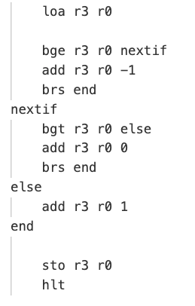
if/elif/else
What does this code do?

Slide 49
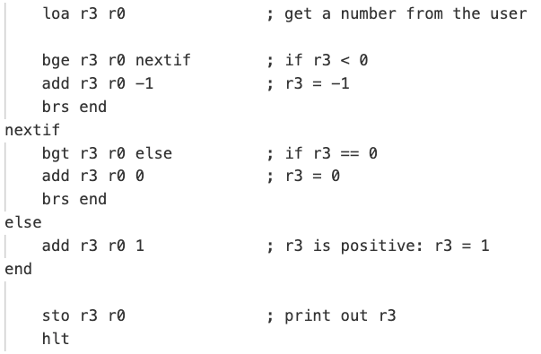
if/elif/else (sign_commented.a51)

Slide 50
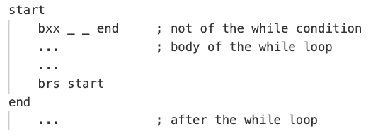
while loop
while block

Slide 51
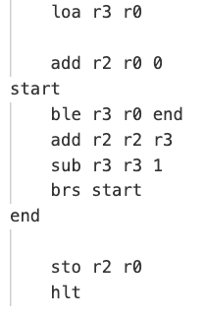
while loop
What does this code do?

Slide 52
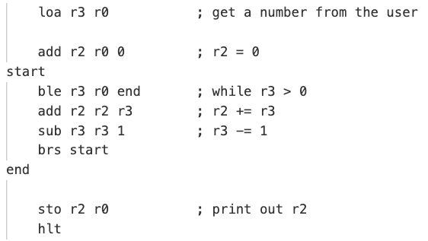
while loop (sum_commented.a51)

Slide 53
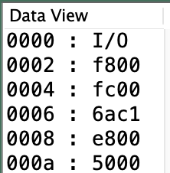
Instructions to binary
CS51 Machine uses 16-bit words
This is my assembly program
16-bit value
(displayed as hexadecimal number)
memory address

Slide 54
Instructions to binary
CS51 Machine uses 16-bit words
What binary number is this?
16-bit value
(displayed as hexadecimal number)
memory address

Slide 55
Instructions to binary
CS51 Machine uses 16-bit words
What binary number is this?
15 8 0 0
1111 1000 0000 0000
16 bits
16-bit value
(displayed as hexadecimal number)
memory address

Slide 56
Instructions to binary
CS51 Machine uses 16-bit words
What binary number is this?
16-bit value
(displayed as hexadecimal number)
memory address

Slide 57
Instructions to binary
CS51 Machine uses 16-bit words
What binary number is this?
6 10 12 1
0110 1010 1100 0001
16-bit value
(displayed as hexadecimal number)
memory address

Slide 58
Encoding instructions
Two formats for instructions
4
2
2
2
6
opcode: specifies what operation (or category of operation)
r_: specifies a register
auxcode: specifies additional operations
argument: a number
rZ
auxcode
opcode
rX
rY
16 bits
4
2
2
8
opcode
rX
rY
argument

Slide 59
opcode
opcode | instruction
0x0 | beq
0x1 | bne
0x2 | blt
0x3 | bge
0x4 | cal
0x5 | hlt
0x6 | arithmetic instruction
…
0xe | sto
0xf | loa

Slide 60
Instructions to binary
What is this instruction?
15 8 0 0
1111 1000 0000 0000
4
2
2
8
opcode
rX
rY
argument

Slide 61
Instructions to binary
What is this instruction?
15 8 0 0
1111 1000 0000 0000
4
2
2
8
opcode
rX
rY
argument
loa r2 r0

Slide 62
Instructions to binary
What is this instruction?
6 10 12 1
0110 1010 1100 0001
4
2
2
2
6
opcode
rX
rY
rZ
auxcode

Slide 63
Instructions to binary
What is this instruction?
6 10 12 1
0110 1010 1100 0001
4
2
2
2
6
opcode
rX
rY
rZ
auxcode
arithmetic r2 r2 r3 0x1

Slide 64
arithmetic auxcode
opcode | instruction
0x0 | add
0x1 | sub
0x2
0x3
0x4 | and
0x5 | orr
0x6
0x7
0x8 | logical shift left
0x9 | logical shift right
…

Slide 65
Instructions to binary
What is this instruction?
6 10 12 1
0110 1010 1100 0001
4
2
2
2
6
opcode
rX
rY
rZ
auxcode
sub r2 r2 r3

Slide 66
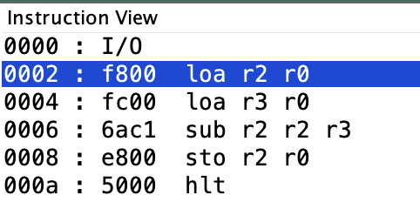
instructions to binary

