Slide 1
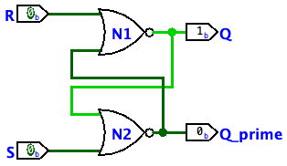
Memory
Computer Systems
CS51 – Spring 2026
Notes:
Today we will continue seeing circuits, but this time sequential circuits.

Slide 2
Administrative
Assignment 3
Assignment 4
  Released
  Don’t forget to do pre-lab
Lab tomorrow

Slide 3
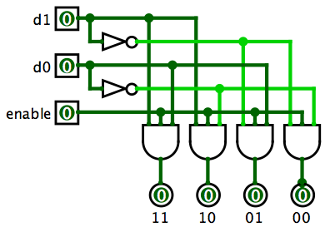
2-bit decoder recap
What does a 2-bit decoder do?

Slide 4
2-bit decoder recap
d₁ | d₀ | out₀ | out₁ | out₃ | out₃
0 | 0 | 1 | 0 | 0 | 0
0 | 1 | 0 | 1 | 0 | 0
1 | 0 | 0 | 0 | 1 | 0
1 | 1 | 0 | 0 | 0 | 1
Sends ‘1’ along one input line according to d₁ d₀
enable=0 turns off all lines

Slide 5
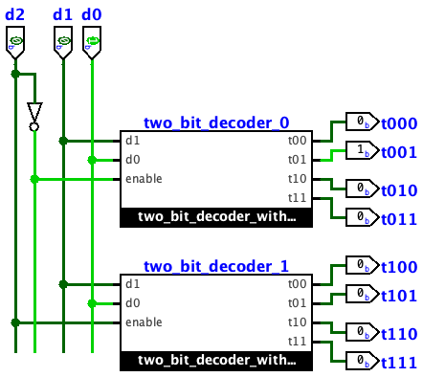

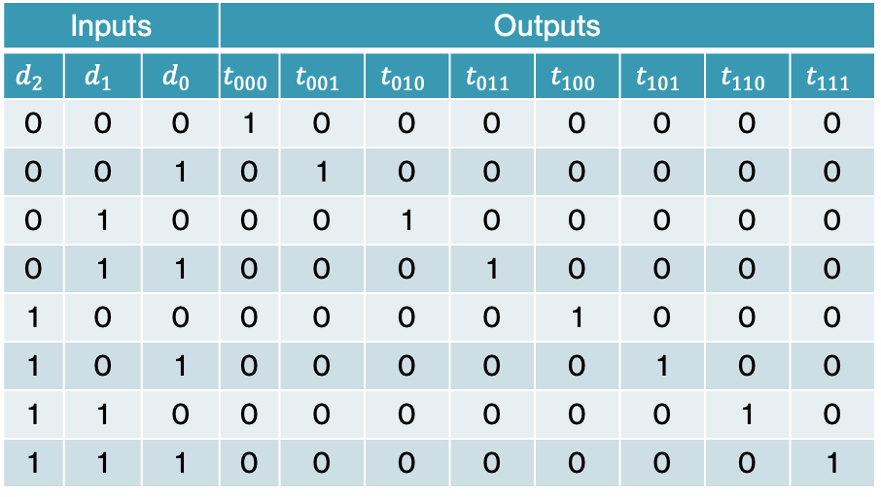
3-bit decoder
Inputs |  |  | Outputs
$$d_{2}$$ | $$d_{1}$$ | $$d_{0}$$ | $$t_{000}$$ | $$t_{001}$$ | $$t_{010}$$ | $$t_{011}$$ | $$t_{100}$$ | $$t_{101}$$ | $$t_{110}$$ | $$t_{111}$$
0 | 0 | 0 | 1 | 0 | 0 | 0 | 0 | 0 | 0 | 0
0 | 0 | 1 | 0 | 1 | 0 | 0 | 0 | 0 | 0 | 0
0 | 1 | 0 | 0 | 0 | 1 | 0 | 0 | 0 | 0 | 0
0 | 1 | 1 | 0 | 0 | 0 | 1 | 0 | 0 | 0 | 0
1 | 0 | 0 | 0 | 0 | 0 | 0 | 1 | 0 | 0 | 0
1 | 0 | 1 | 0 | 0 | 0 | 0 | 0 | 1 | 0 | 0
1 | 1 | 0 | 0 | 0 | 0 | 0 | 0 | 0 | 1 | 0
1 | 1 | 1 | 0 | 0 | 0 | 0 | 0 | 0 | 0 | 1
$d_{2}$ acts as the enable bit to two decoders.
When $d_{2}$ is 0, the top decoder is activated, sending output to one of t0xx.
When $d_{2}$ is 1, the bottom decoder is activated, sending output to one of t1xx.

Slide 6
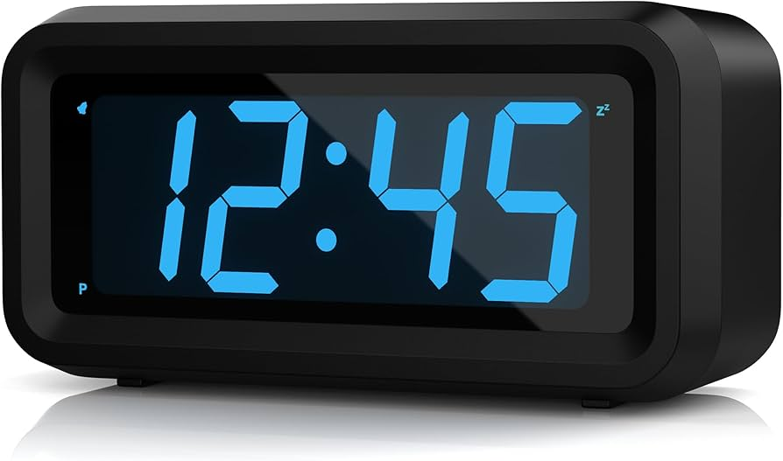
Decoder application example
How do clocks like this work?

Slide 7
Decoding 7-segment displays
c
b
a
d
e
g
f
c
c
c
c
c
c
c
c
c
c
b
a
d
b
a
d
b
a
d
b
a
d
b
a
d
b
a
d
b
a
d
b
a
d
b
a
d
b
a
d
e
g
e
g
e
g
e
g
e
g
e
g
e
g
e
g
e
g
e
g
f
f
f
f
f
f
f
f
f
f
7 segments, labeled a to g
Different combinations of these segments, generate the digits 0-9

Slide 8
7-segment display
hardware component with 7 inputs
c
a b c d
b
a
d
Number to display
circuit
e
g
f
e f g

Slide 9
7-segment display
hardware component with 7 inputs
c
a b c d
b
a
d
Number to display
circuit
e
g
f
e f g
c
a = 0
b = 0
c = 1
d = 1
e = 0
f = 0
g = 1
7
b
a
d
e
g
f

Slide 10
7-segment displays in clocks
c
c
c
c
c
c
c
c
c
c
b
a
d
b
a
d
b
a
d
b
a
d
b
a
d
b
a
d
b
a
d
b
a
d
b
a
d
b
a
d
e
g
e
g
e
g
e
g
e
g
e
g
e
g
e
g
e
g
e
g
f
f
f
f
f
f
f
f
f
f
Digit | Illuminated segments
 | a | b | c | d | e | f | g
0 |  | x | x | x | x | x | x
1 |  |  |  | x |  |  | x
2 | x |  | x | x | x | x
3 | x |  | x | x |  | x | x
4 | x | x |  | x |  |  | x
5 | x | x | x |  |  | x | x
6 | x | x | x |  | x | x | x
7 |  |  | x | x |  |  | x
8 | x | x | x | x | x | x | x
9 | x | x | x | x |  |  | x

Slide 11
7-segment display
hardware component with 7 inputs
c
a b c d
b
a
d
Number to display
circuit
e
g
f
e f g
How many binary inputs do we need for the numbers 0-9?

Slide 12
Decoding 7-segment displays in clocks
c
c
c
c
c
c
c
c
c
c
b
a
d
b
a
d
b
a
d
b
a
d
b
a
d
b
a
d
b
a
d
b
a
d
b
a
d
b
a
d
e
g
e
g
e
g
e
g
e
g
e
g
e
g
e
g
e
g
e
g
f
f
f
f
f
f
f
f
f
f
Input | Digit | Illuminated segments
 |  | a | b | c | d | e | f | g
0000 | 0 |  | x | x | x | x | x | x
0001 | 1 |  |  |  | x |  |  | x
0010 | 2 | x |  | x | x | x | x
0011 | 3 | x |  | x | x |  | x | x
0100 | 4 | x | x |  | x |  |  | x
0101 | 5 | x | x | x |  |  | x | x
0110 | 6 | x | x | x |  | x | x | x
0111 | 7 |  |  | x | x |  |  | x
1000 | 8 | x | x | x | x | x | x | x
1001 | 9 | x | x | x | x |  |  | x

Slide 13
Our friend the decoder
2-bit decoder: 4 output lines
3-bit decoder: 8 output lines
4-input bits
decoder
How many output lines?

Slide 14
Our friend the decoder
2-bit decoder: 4 output lines
3-bit decoder: 8 output lines
16 output lines: exactly 1 will be activated depending on the input
4-input bits
decoder

Slide 15
Our friend the decoder
Input | Digit | Illuminated segments
 |  | a | b | c | d | e | f | g
0000 | 0 |  | x | x | x | x | x | x
0000 line will be 1
a b c d
c
b
a
d
0000
decoder
all others will be 0
e
g
e f g
f

Slide 16
Our friend the decoder
Input | Digit | Illuminated segments
 |  | a | b | c | d | e | f | g
0000 | 0 |  | x | x | x | x | x | x
0000 line will be 1
a b c d
c
c
b
a
d
b
a
d
0000
decoder
all others will be 0
e
g
e
g
e f g
f
f
How do we get it to display a 0?

Slide 17
Our friend the decoder
Input | Digit | Illuminated segments
 |  | a | b | c | d | e | f | g
0000 | 0 |  | x | x | x | x | x | x
0000 line will be 1
a b c d
c
c
b
a
d
b
a
d
0000
decoder
all others will be 0
e
g
e
g
e f g
f
f
Connect the 0000 line to: b c d e f g
When the line is active those segments will illuminate
When it’s not active, no display

Slide 18
Our friend the decoder
Input | Digit | Illuminated segments
 |  | a | b | c | d | e | f | g
0001 | 1 |  |  |  | x |  |  | x
0001 line will be 1
a b c d
c
c
b
a
d
b
a
d
0001
decoder
all others will be 0
e
g
e
g
e f g
f
f
How do we get it to display a 1?

Slide 19
Our friend the decoder
Input | Digit | Illuminated segments
 |  | a | b | c | d | e | f | g
0001 | 1 |  |  |  | x |  |  | x
0001 line will be 1
a b c d
c
c
b
a
d
b
a
d
0001
decoder
all others will be 0
e
g
e
g
e f g
f
f
Connect the 0001 line to: d g
When the line is active those segments will illuminate
When it’s not active, no display

Slide 20
Our friend the decoder
Input | Digit | Illuminated segments
 |  | a | b | c | d | e | f | g
0000 | 0 |  | x | x | x | x | x | x
0001 | 1 |  |  |  | x |  |  | x
0000 line
Both of these lines want to connect to d
a b c d
c
0001 line
b
a
d
4-input bits
decoder
e
g
e f g
f
How do we do this? Hint: gate??

Slide 21

Our friend the decoder
Input | Digit | Illuminated segments
 |  | a | b | c | d | e | f | g
0000 | 0 |  | x | x | x | x | x | x
0001 | 1 |  |  |  | x |  |  | x
0000 line
a b c d
c
0001 line
b
a
d
4-input bits
decoder
e
g
e f g
f
Since only one line will be active at a time, use OR gate

Slide 22
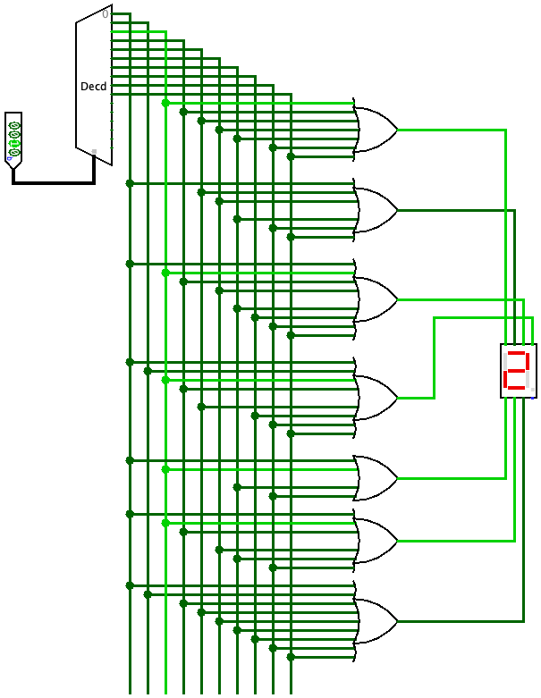
A 7-segment display in Logisim
c
c
c
c
c
b
a
d
b
a
d
b
a
d
b
d
b
d
a
a
a
e
g
e
g
e
g
e
g
e
g
f
f
f
f
f
b
c
c
c
c
c
b
a
d
b
a
d
b
a
d
b
a
d
b
a
d
c
e
g
e
g
e
g
e
g
e
g
f
f
f
f
f
Input | Digit | Illuminated segments
 |  | a | b | c | d | e | f | g
0000 | 0 |  | x | x | x | x | x | x
0001 | 1 |  |  |  | x |  |  | x
0010 | 2 | x |  | x | x | x | x
0011 | 3 | x |  | x | x |  | x | x
0100 | 4 | x | x |  | x |  |  | x
0101 | 5 | x | x | x |  |  | x | x
0110 | 6 | x | x | x |  | x | x | x
0111 | 7 |  |  | x | x |  |  | x
1000 | 8 | x | x | x | x | x | x | x
1001 | 9 | x | x | x | x |  |  | x
d
e
f
g
Notes:
Cool stuff?

Slide 23
A 7-segment display in Logisim
Check it out!

Slide 24
PRACTICE TIME – Expanding to 16 characters
c
c
c
c
c
c
c
c
c
c
b
a
d
b
a
d
b
a
d
b
a
d
b
a
d
b
a
d
b
a
d
b
a
d
b
a
d
b
a
d
e
g
e
g
e
g
e
g
e
g
e
g
e
g
e
g
e
g
e
g
f
f
f
f
f
f
f
f
f
f
Imagine that the 7-segment display we have built so far is expanded to include 16 characters, the existing 10 digits, and A-F, as depicted here to differentiate among them.
How will the design of the circuit change on Logisim-Evolution?
c
c
Input | Character | Illuminated segments
 |  | a | b | c | d | e | f | g
0000 | 0 |  | x | x | x | x | x | x
0001 | 1 |  |  |  | x |  |  | x
0010 | 2 | x |  | x | x | x | x
0011 | 3 | x |  | x | x |  | x | x
0100 | 4 | x | x |  | x |  |  | x
0101 | 5 | x | x | x |  |  | x | x
0110 | 6 | x | x | x |  | x | x | x
0111 | 7 |  |  | x | x |  |  | x
1000 | 8 | x | x | x | x | x | x | x
1001 | 9 | x | x | x | x |  |  | x
b
a
d
b
a
d
e
g
e
g
f
f
c
c
b
a
d
b
a
d
e
g
e
g
f
f
c
c
b
a
d
b
a
d
e
g
e
g
f
f

Slide 25
ANSWER– Expanding to 16 characters
Expanded table:
Circuit in Logisim-Evolution is expanded to include all outputs of decoders connected to 6 additional or gates
Input | Character | Illuminated segments
 |  | a | b | c | d | e | f | g
0000 | 0 |  | x | x | x | x | x | x
0001 | 1 |  |  |  | x |  |  | x
0010 | 2 | x |  | x | x | x | x
0011 | 3 | x |  | x | x |  | x | x
0100 | 4 | x | x |  | x |  |  | x
0101 | 5 | x | x | x |  |  | x | x
0110 | 6 | x | x | x |  | x | x | x
0111 | 7 |  |  | x | x |  |  | x
1000 | 8 | x | x | x | x | x | x | x
1001 | 9 | x | x | x | x |  |  | x
1010 | A | x | x | x | x | x |  | x
1011 | B | x | x |  |  | x | x | x
1100 | C | x |  |  |  | x | x
1101 | D | x |  |  | x | x | x | x
1110 | E | x | x | x |  | x | x
1111 | F | x | x | x |  | x
c
c
b
a
d
b
a
d
e
g
e
g
f
f
c
c
b
a
d
b
a
d
e
g
e
g
f
f
c
c
b
a
d
b
a
d
e
g
e
g
f
f

Slide 26
Combinational circuits
All circuits we have seen have been combinational: their output depends on the present inputs and there is no notion of memory of past inputs.
combinational circuits perform arithmetic and logical operations, transmit data, or convert code. So far, we have seen for
  Arithmetic and logical operations: logic circuits and half/full/and ripple-carry adders
  Transmit data: decoders (and we will see multiplexers in the next assignment)
  Convert code: 7-segment display decoders

Slide 27





Computer simplified
“the computer”
hard drive
CPU
RAM
network
media drive
input devices
display

Slide 28
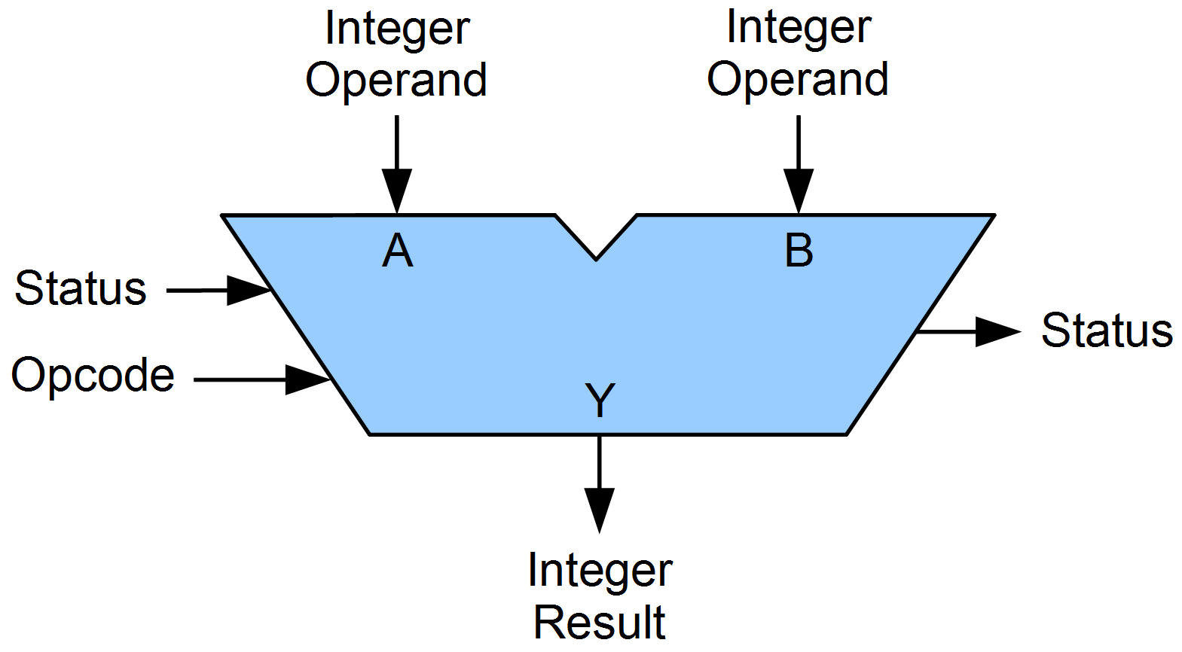
Inside the CPU: Arithmetic Logic Unit (ALU)
Performs arithmetic and logical operations
Arithmetic: add, subtract, multiply, …
Logical: AND, OR, shift

Slide 29
Inside the CPU: Arithmetic Logic Unit (ALU)
Performs arithmetic and logical operations
Arithmetic: add, subtract, multiply, …
Logical: AND, OR, shift
Opcode specifies what operation
(encoded in binary)

Slide 30
Inside the CPU: Arithmetic Logic Unit (ALU)
Where do the numbers come from?
Performs arithmetic and logical operations
Arithmetic: add, subtract, multiply, …
Logical: AND, OR, shift
Opcode specifies what operation
(encoded in binary)

Slide 31
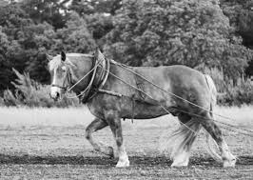
Inside the CPU
CPU
processor
Floating-point unit (FPU)
…
…
registers
registers: local, fast memory slots

Slide 32
Memory hierarchy
processor
hard drive
RAM
…
registers
Why do we have these different types of memory?

Slide 33
Memory speed
operation | access time | times slower than register access | for comparison…
register | 0.3 ns | 1 | 1 s
RAM | 120 ns | 400 | 6 min
Hard disk (SSD) | 1ms | ~million | 1 month
Hard disk (HDD) | 10ms | ~million | 10 months
google.com | 0.4s | ~billion | 30 years

Slide 34
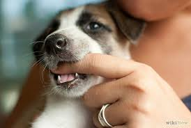
Memory
RAM
010101111000101000010010 …
What is a byte?
?

Slide 35
Memory
RAM
01010111 10001010 00010010 …
byte = 8 bits
byte is abbreviated as B
My laptop has 64GB (gigabytes) of memory. How many bits is that?

Slide 36
Units of memory
Bit:
Nibble:
Byte: 8 bits
Kilobyte (KB):
Megabyte (MB)
Gigabyte (GB):
Terabyte (TB):

Slide 37
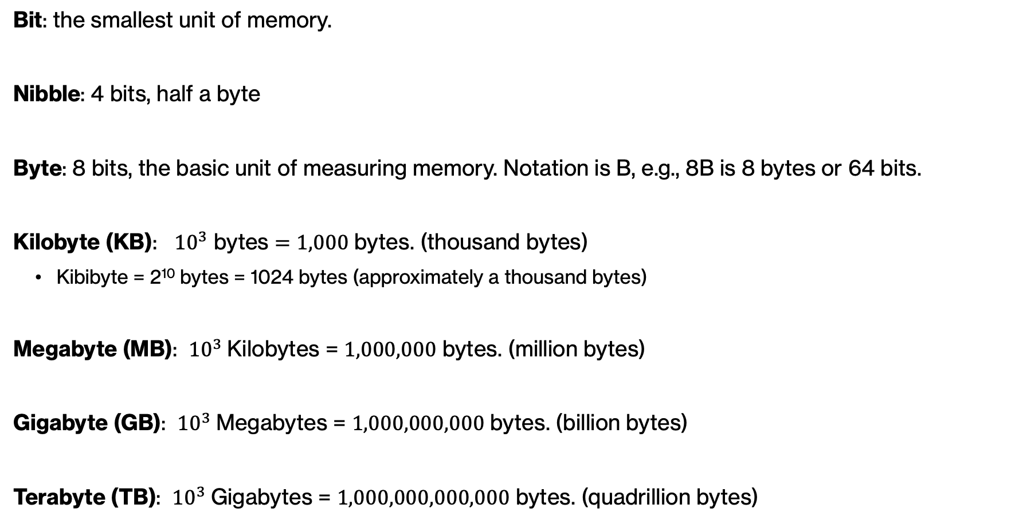
Units of memory
Bit: the smallest unit of memory.
Nibble: 4 bits, half a byte
Byte: 8 bits, the basic unit of measuring memory. Notation is B, e.g., 8B is 8 bytes or 64 bits.
Kilobyte (KB): ${10}^{3}$ bytes $=1,000$ bytes. (thousand bytes)
  Kibibyte = 2¹⁰ bytes = 1024 bytes (approximately a thousand bytes)
Megabyte (MB): ${10}^{3}$Kilobytes = $1,000,000$ bytes. (million bytes)
Gigabyte (GB): ${10}^{3}$Megabytes = $1,000,000,000$ bytes. (billion bytes)
Terabyte (TB): ${10}^{3}$Gigabytes = $1,000,000,000,000$ bytes. (quadrillion bytes)

Slide 38
Memory
RAM
01010111 10001010 00010010 …
byte = 8 bits
byte is abbreviated as B
My laptop has 64GB (gigabytes) of memory. How many bits is that?

Slide 39
Memory
RAM
01010111 10001010 00010010 …
byte = 8 bits
byte is abbreviated as B
64GB = 64,000,000,000 = 64 billion bytes = 512 billion bits

Slide 40
Memory hierarchy
processor
hard drive
RAM
…
registers
Capacity:
hundreds of registers
Gigabytes
Terabytes

Slide 41
Memory
address
0
1
2
3
…
01010111
10001010
0001001
01011010
…
RAM
Memory is byte addressable

Slide 42
Memory
address
0
1
2
3
…
01010111
10001010
0001001
01011010
…
RAM
Memory is organized into “words”, which is the most common functional unit

Slide 43
Memory
address
32-bit words
0
4
8
...
10101011 10001010 00010010 01011010
11001011 00001110 01010010 01010110
10111011 10010010 00000000 01110100
…
RAM
Most modern computers use 32-bit (4 byte) or 64-bit (8 byte) words

Slide 44
Memory capacity
Memory is commonly byte addressable (i.e., we can ask for a specific byte)
32-bit processors access memory locations using a 32-bit number
What is the largest a 32-bit, byte-addressable memory can be? Hint: how many unique addresses are possible?

Slide 45
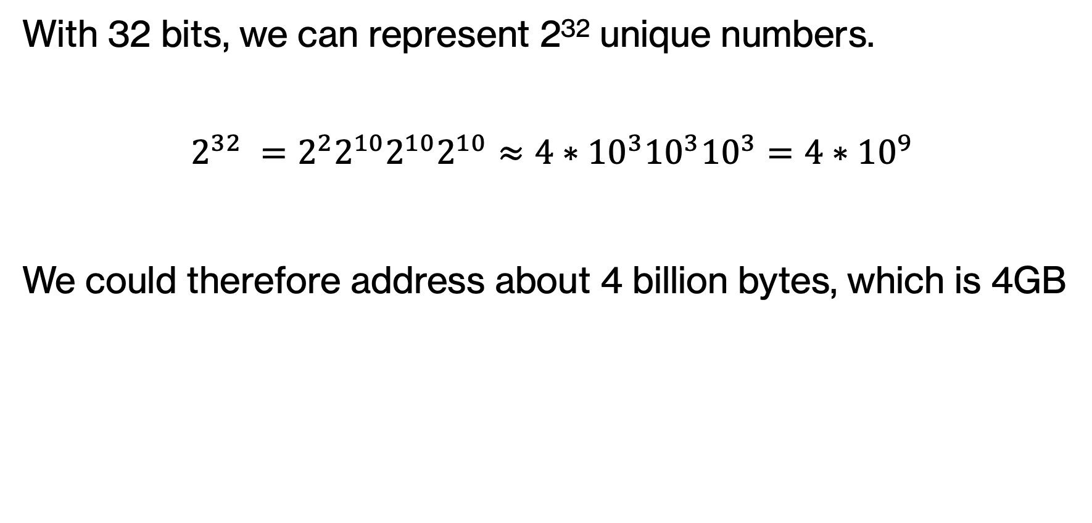
Memory capacity
With 32 bits, we can represent 2³² unique numbers.
$$2^{32} =2^{2}2^{10}2^{10}2^{10}≈4∗{10}^{3}{10}^{3}{10}^{3}=4{∗10}^{9}$$
We could therefore address about 4 billion bytes, which is 4GB

Slide 46
Memory capacity
64-bit processors access memory locations using a 64-bit number
What is the largest a 64-bit, byte-addressable memory can be? Hint: how many unique addresses are possible?

Slide 47
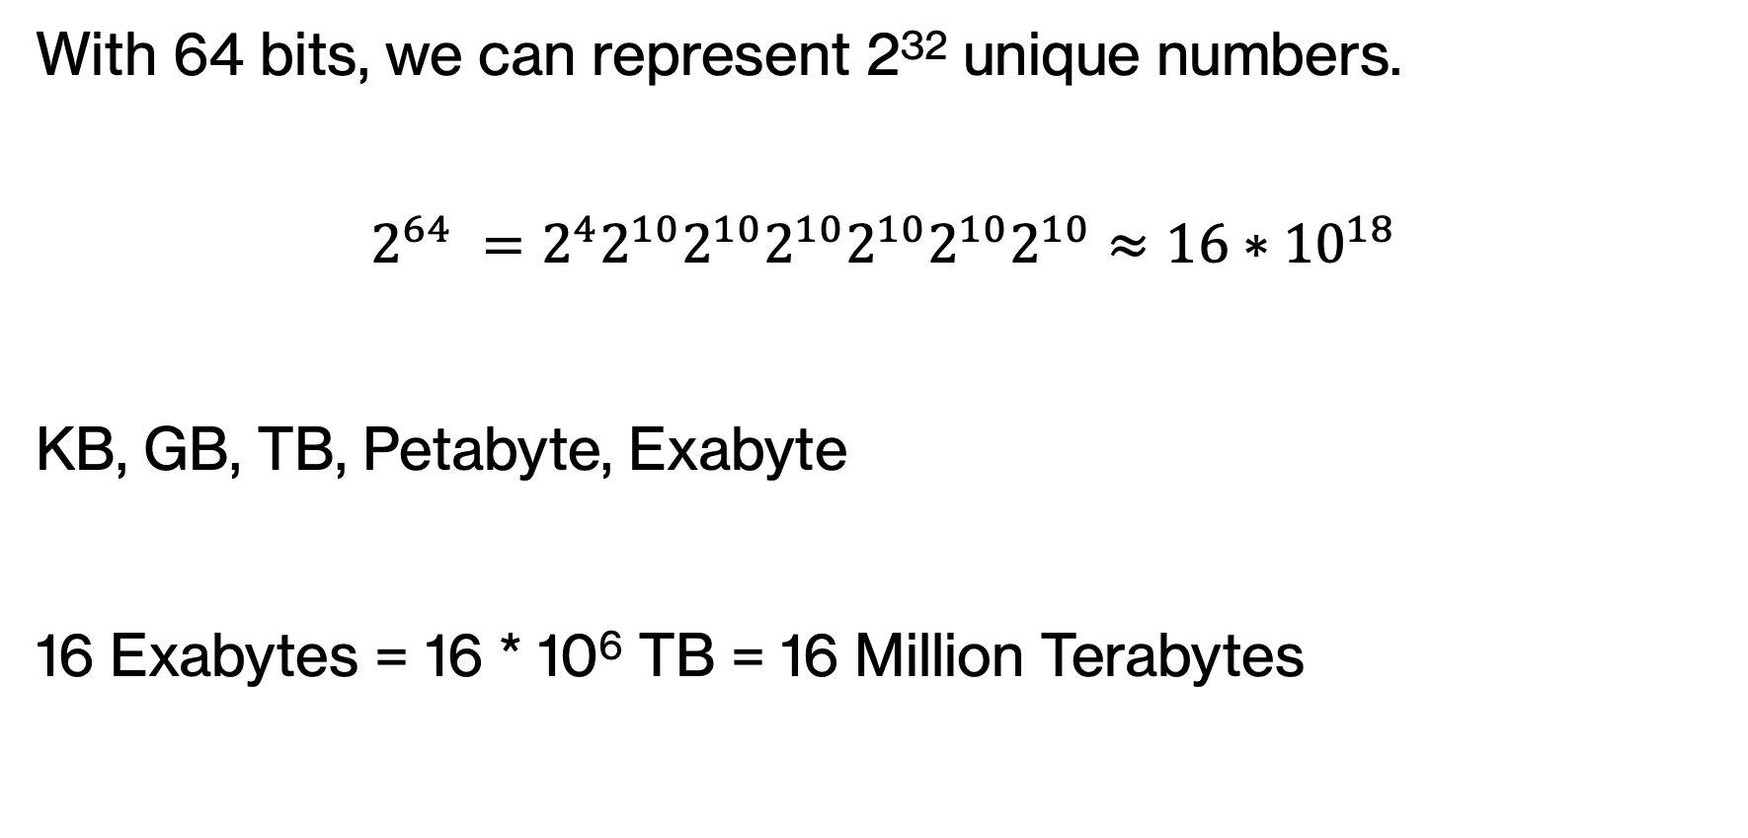
Memory capacity
With 64 bits, we can represent 2³² unique numbers.
$$2^{64} =2^{4}2^{10}2^{10}2^{10}2^{10}2^{10}2^{10}≈16{∗10}^{18}$$
KB, GB, TB, Petabyte, Exabyte
16 Exabytes = 16 * 10⁶ TB = 16 Million Terabytes

Slide 48
Memory implemented
16 columns
 | c0 | c1 | c2 | c3 | c4 | c5 | c6 | c7 | c8 | c9 | c10 | c11 | c12 | c13 | c14 | c15
r0
r1
r2
r3
r4
r5
r6
r7
r8
r9
r10
r11
r12
r13
r14
r15
Memory is generally implemented as a grid/matrix of bytes
16 rows

Slide 49
Memory implemented
16 columns
 | c0 | c1 | c2 | c3 | c4 | c5 | c6 | c7 | c8 | c9 | c10 | c11 | c12 | c13 | c14 | c15
r0
r1
r2
r3
r4
r5
r6
r7
r8
r9
r10
r11
r12
r13
r14
r15
Memory is generally implemented as a grid/matrix of bytes
16 rows
How much memory is this?

Slide 50
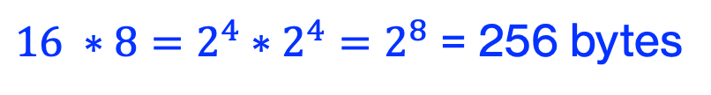
Memory implemented
16 columns
 | c0 | c1 | c2 | c3 | c4 | c5 | c6 | c7 | c8 | c9 | c10 | c11 | c12 | c13 | c14 | c15
r0
r1
r2
r3
r4
r5
r6
r7
r8
r9
r10
r11
r12
r13
r14
r15
Memory is generally implemented as a grid/matrix of bytes
16 rows
$16 ∗8=2^{4}∗2^{4}=2^{8}$ = 256 bytes

Slide 51
Memory implemented
16 columns
 | c0 | c1 | c2 | c3 | c4 | c5 | c6 | c7 | c8 | c9 | c10 | c11 | c12 | c13 | c14 | c15
r0
r1
r2
r3
r4
r5
r6
r7
r8
r9
r10
r11
r12
r13
r14
r15
We can access a given by via a row index and a column index
16 rows
What row/column would this entry be? (Assuming indices start at 0)

Slide 52
Memory implemented
16 columns
 | c0 | c1 | c2 | c3 | c4 | c5 | c6 | c7 | c8 | c9 | c10 | c11 | c12 | c13 | c14 | c15
r0
r1
r2
r3
r4
r5
r6
r7
r8
r9
r10
r11
r12
r13
r14
r15
We can access a given by via a row index and a column index
16 rows
row = 4, column = 3

Slide 53
Memory implemented
16 columns
 | c0 | c1 | c2 | c3 | c4 | c5 | c6 | c7 | c8 | c9 | c10 | c11 | c12 | c13 | c14 | c15
r0
r1
r2
r3
r4
r5
r6
r7
r8
r9
r10
r11
r12
r13
r14
r15
We can access a given by via a row index and a column index
16 rows
Everything is binary: how many bits do we need to specify the row and column?

Slide 54
Memory implemented
16 columns
 | c0 | c1 | c2 | c3 | c4 | c5 | c6 | c7 | c8 | c9 | c10 | c11 | c12 | c13 | c14 | c15
r0
r1
r2
r3
r4
r5
r6
r7
r8
r9
r10
r11
r12
r13
r14
r15
We can access a given by via a row index and a column index
16 rows
4 bits each for a total of 8 bits
<8-bit memory address>
4 bits for row
4 bits for column

Slide 55
Memory implemented
16 columns
 | c0 | c1 | c2 | c3 | c4 | c5 | c6 | c7 | c8 | c9 | c10 | c11 | c12 | c13 | c14 | c15
r0
r1
r2
r3
r4
r5
r6
r7
r8
r9
r10
r11
r12
r13
r14
r15
We can access a given by via a row index and a column index
What would be this memory address in binary?
16 rows
<8-bit memory address>
4 bits for row
4 bits for column

Slide 56
Memory implemented
16 columns
 | c0 | c1 | c2 | c3 | c4 | c5 | c6 | c7 | c8 | c9 | c10 | c11 | c12 | c13 | c14 | c15
r0
r1
r2
r3
r4
r5
r6
r7
r8
r9
r10
r11
r12
r13
r14
r15
We can access a given by via a row index and a column index
16 rows
0100 0011
row
column

Slide 57
Memory implemented
16 columns
 | c0 | c1 | c2 | c3 | c4 | c5 | c6 | c7 | c8 | c9 | c10 | c11 | c12 | c13 | c14 | c15
r0
r1
r2
r3
r4
r5
r6
r7
r8
r9
r10
r11
r12
r13
r14
r15
We can access a given by via a row index and a column index
What would be this memory address in binary?
16 rows
<8-bit memory address>
4 bits for row
4 bits for column

Slide 58
Memory implemented
16 columns
 | c0 | c1 | c2 | c3 | c4 | c5 | c6 | c7 | c8 | c9 | c10 | c11 | c12 | c13 | c14 | c15
r0
r1
r2
r3
r4
r5
r6
r7
r8
r9
r10
r11
r12
r13
r14
r15
We can access a given by via a row index and a column index
Note we use unsigned numbers
16 rows
1101 0100
row
column

Slide 59
Quick aside
4-bit decoder
4 bits
How many lines out?
decoder

Slide 60
Quick aside
4-bit decoder
16 lines out, exactly one line will be 1
4 bits
decoder

Slide 61
Quick aside: multiplexer
16:1 multiplexer
4 bits
How many lines out?
decoder

Slide 62
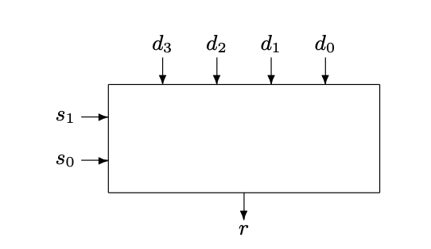
Quick aside: multiplexer
4:1 multiplexer
4 inputs
2 inputs to “select” which line

Slide 63
Quick aside: multiplexer
4:1 multiplexer
4 inputs
0 0

Slide 64
Quick aside: multiplexer
4:1 multiplexer
4 inputs
1 0

Slide 65
Quick aside: multiplexer
16:1 multiplexer
16 inputs
4 inputs to “select” which line

Slide 66
From addresses to actual memory cells
4-bit column
address
Column address multiplexer
 | c0 | c1 | c2 | c3 | c4 | c5 | c6 | c7 | c8 | c9 | c10 | c11 | c12 | c13 | c14 | c15
r0
r1
r2
r3
r4
r5
r6
r7
r8
r9
r10
r11
r12
r13
r14
r15
The decoder will be responsible for taking the 4-bits of the row address and mapping it to one of the 16 rows.
The multiplexer will be responsible for taking the 4-bits of the column address as selection lines and to map to a single column.
Row address decoder
4-bit row
address
Notes:
To convert from an address to the actual memory cell that contains the desired bit, we will utilize one multiplexer and one decoder.
The decoder will be responsible for taking the 4-bits of the row address and mapping it to one of the 16 rows.
The multiplexer will be responsible for taking the 4-bits of the column address as selection lines and to map to a single column.

Slide 67
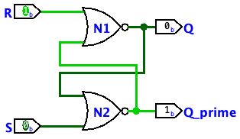
How do we store bits?
Anything unusual about this circuit?

Slide 68
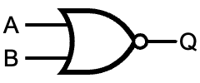

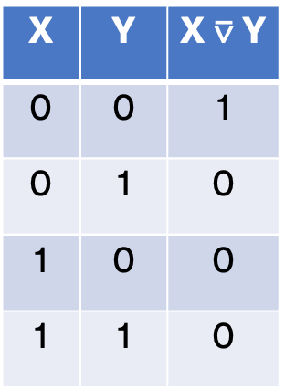
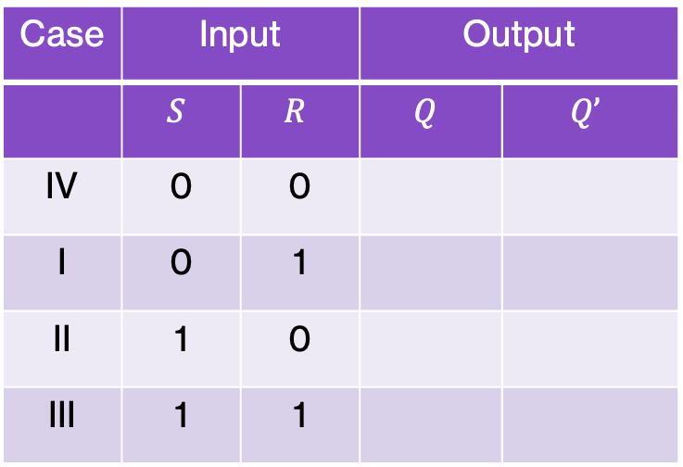
Case I: $R=1$, $S=0$
Case | Input |  | Output
 | $$S$$ | $$R$$ | $$Q$$ | $$Q’$$
IV | 0 | 0
I | 0 | 1
II | 1 | 0
III | 1 | 1
What will be the output?
1
X | Y | X $\text{⊽}$ Y
0 | 0 | 1
0 | 1 | 0
1 | 0 | 0
1 | 1 | 0
0

Slide 69
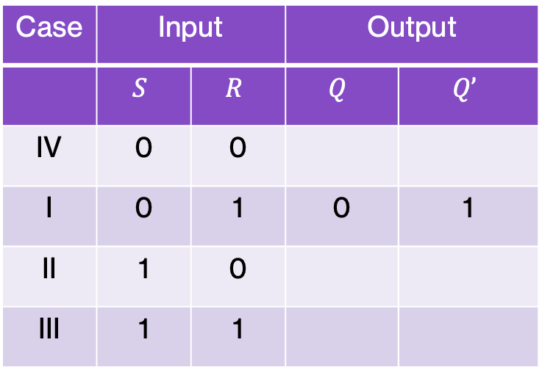
Case I: $R=1$, $S=0$
Case | Input |  | Output
 | $$S$$ | $$R$$ | $$Q$$ | $$Q’$$
IV | 0 | 0
I | 0 | 1 | 0 | 1
II | 1 | 0
III | 1 | 1
What will be the output?
1
0
0
X | Y | X $\text{⊽}$ Y
0 | 0 | 1
0 | 1 | 0
1 | 0 | 0
1 | 1 | 0
1
0
1

Slide 70
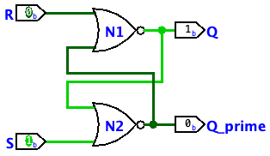

Case II: $R=0$, $S=1$
Case | Input |  | Output
 | $$S$$ | $$R$$ | $$Q$$ | $$Q’$$
IV | 0 | 0
I | 0 | 1 | 0 | 1
II | 1 | 0
III | 1 | 1
What will be the output?
0
X | Y | X $\text{⊽}$ Y
0 | 0 | 1
0 | 1 | 0
1 | 0 | 0
1 | 1 | 0
1

Slide 71
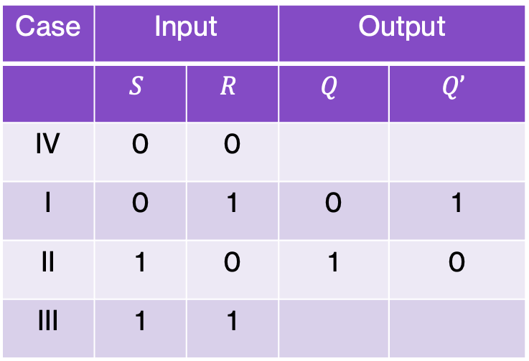
Case II: $R=0$, $S=1$
Case | Input |  | Output
 | $$S$$ | $$R$$ | $$Q$$ | $$Q’$$
IV | 0 | 0
I | 0 | 1 | 0 | 1
II | 1 | 0 | 1 | 0
III | 1 | 1
What will be the output?
0
1
1
X | Y | X $\text{⊽}$ Y
0 | 0 | 1
0 | 1 | 0
1 | 0 | 0
1 | 1 | 0
0
1
0

Slide 72
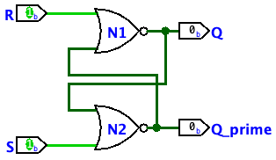

Case IV: $R=0$, $S=0$
Case | Input |  | Output
 | $$S$$ | $$R$$ | $$Q$$ | $$Q’$$
IV | 0 | 0
I | 0 | 1 | 0 | 1
II | 1 | 0 | 1 | 0
III | 1 | 1
What will be the output?
0
1
X | Y | X $\text{⊽}$ Y
0 | 0 | 1
0 | 1 | 0
1 | 0 | 0
1 | 1 | 0
0
0

Slide 73
Case IV: $R=0$, $S=0$
Case | Input |  | Output
 | $$S$$ | $$R$$ | $$Q$$ | $$Q’$$
IV | 0 | 0
I | 0 | 1 | 0 | 1
II | 1 | 0 | 1 | 0
III | 1 | 1
What will be the output?
0
1
1
X | Y | X $\text{⊽}$ Y
0 | 0 | 1
0 | 1 | 0
1 | 0 | 0
1 | 1 | 0
nothing changes
0
0
0

Slide 74
Case IV: $R=0$, $S=0$
Case | Input |  | Output
 | $$S$$ | $$R$$ | $$Q$$ | $$Q’$$
IV | 0 | 0
I | 0 | 1 | 0 | 1
II | 1 | 0 | 1 | 0
III | 1 | 1
What will be the output?
0
0
X | Y | X $\text{⊽}$ Y
0 | 0 | 1
0 | 1 | 0
1 | 0 | 0
1 | 1 | 0
0
1

Slide 75
Case IV: $R=0$, $S=0$
Case | Input |  | Output
 | $$S$$ | $$R$$ | $$Q$$ | $$Q’$$
IV | 0 | 0
I | 0 | 1 | 0 | 1
II | 1 | 0 | 1 | 0
III | 1 | 1
What will be the output?
0
0
0
X | Y | X $\text{⊽}$ Y
0 | 0 | 1
0 | 1 | 0
1 | 0 | 0
1 | 1 | 0
nothing changes
1
0
1

Slide 76
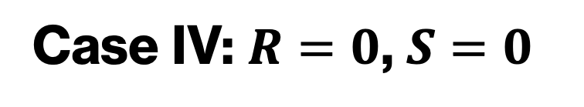
Case IV: $R=0$, $S=0$
0
1
0
1
1
0
0
0
0
0
0
0
0
0
0
1
0
1
0
1

Slide 77
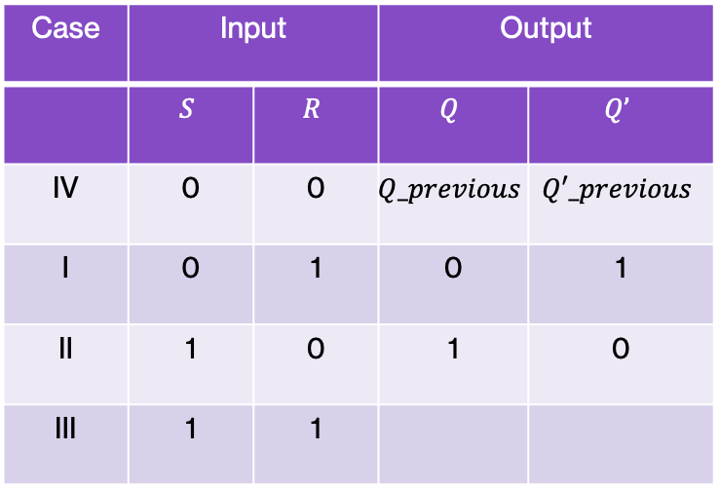
SR-latch
Case | Input |  | Output
 | $$S$$ | $$R$$ | $$Q$$ | $$Q’$$
IV | 0 | 0 | $$Q_previous$$ | $$Q′_previous$$
I | 0 | 1 | 0 | 1
II | 1 | 0 | 1 | 0
III | 1 | 1
Hold current state
Reset: Q = 0
Set: Q = 1
messy… not allowed

Slide 78

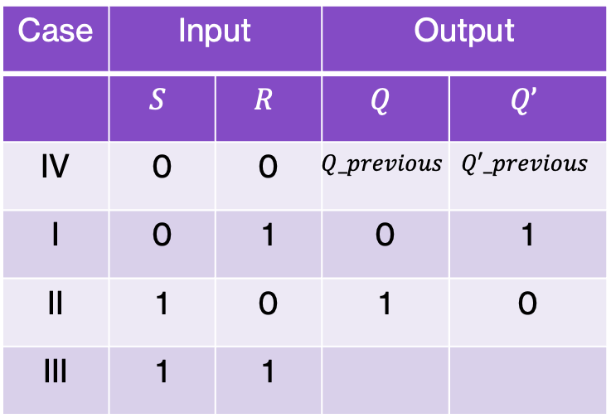
Case III: $R=1$, $S=1$
Case | Input |  | Output
 | $$S$$ | $$R$$ | $$Q$$ | $$Q’$$
IV | 0 | 0 | $$Q_previous$$ | $$Q′_previous$$
I | 0 | 1 | 0 | 1
II | 1 | 0 | 1 | 0
III | 1 | 1
What will be the output?
X | Y | X $\text{⊽}$ Y
0 | 0 | 1
0 | 1 | 0
1 | 0 | 0
1 | 1 | 0

Slide 79
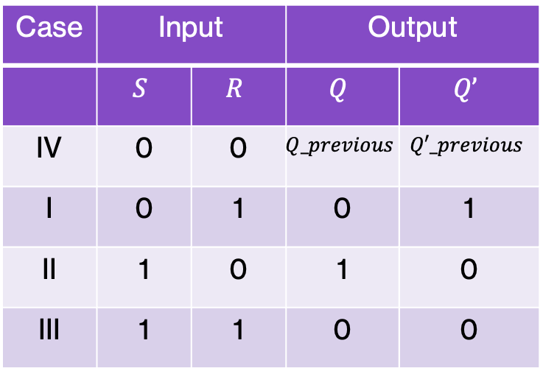
Case III: $R=1$, $S=1$
Case | Input |  | Output
 | $$S$$ | $$R$$ | $$Q$$ | $$Q’$$
IV | 0 | 0 | $$Q_previous$$ | $$Q′_previous$$
I | 0 | 1 | 0 | 1
II | 1 | 0 | 1 | 0
III | 1 | 1 | 0 | 0
What will be the output?
1
0
0
X | Y | X $\text{⊽}$ Y
0 | 0 | 1
0 | 1 | 0
1 | 0 | 0
1 | 1 | 0
1
0
0

Slide 80
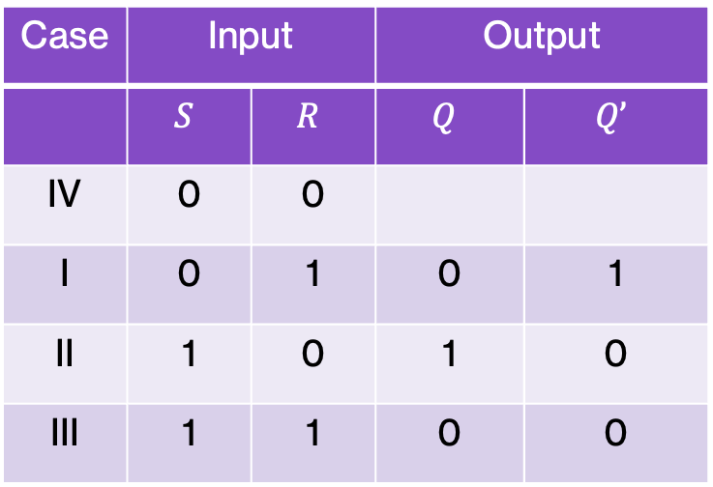

Case I: $R=0$, $S=0$
Case | Input |  | Output
 | $$S$$ | $$R$$ | $$Q$$ | $$Q’$$
IV | 0 | 0
I | 0 | 1 | 0 | 1
II | 1 | 0 | 1 | 0
III | 1 | 1 | 0 | 0
What will be the output?
0
X | Y | X $\text{⊽}$ Y
0 | 0 | 1
0 | 1 | 0
1 | 0 | 0
1 | 1 | 0
0

Slide 81




SR-latch - Abstraction
As an application of abstraction, instead of seeing the full circuit on the right, you might encounter the following symbol for SR-latches:
$$R$$
$$Q$$
$$S$$
$Q$’
Notes:
As an application of abstraction, instead of seeing the full circuit on the right, you might encounter the following symbol for SR-latches.

Slide 82
Latches for memory
Latches can store 1 bit
Other latches exists (e.g., D latch)
Other circuits that store 1 bit (e.g., flip-flops)
Can combine these to make memory (registers, RAM)

Slide 83
Latches for memory
Latches can store 1 bit
Other latches exists (e.g., D latch)
Other circuits that store 1 bit (e.g., flip-flops)
Can combine these to make memory (registers, RAM)
Why do we have hard drives?

Slide 84
Latches for memory
When power goes off, we lose what we stored!

