Slide 1
Circuits
David Kauchak
CS 51 – Spring 2026

Slide 2
Admin
Assignment 3
Check autograder results after submitting assignment

Slide 3
Examples
The Logisim circuit examples can be found at:
http://www.cs.pomona.edu/classes/cs51/circuits/

Slide 4





Inside a CPU
Gates

Slide 5
Quick recap
01010
01111
+

Slide 6
Quick recap
1
1
1
0
01010
01111
+
11001

Slide 7
A component
1
1
1
0
01010
01111
+
11001
in1
in2
carry-in
carry-out
out

Slide 8
Adding with components
01010
01111
+
1
1
0
1
1
1
0
1
in1
in2
carry-in
in1
in2
carry-in
in1
in2
carry-in
in1
in2
carry-out
carry-out
carry-out
carry-out
out
out
out
out

Slide 9
Adding with components
01010
01111
+
1
1
0
1
1
1
0
1
in1
in2
carry-in
in1
in2
carry-in
in1
in2
carry-in
in1
in2
?
carry-out
carry-out
carry-out
carry-out
out
out
out
out
?

Slide 10
Adding with components
0
01010
01111
+
1
1
1
0
1
1
1
0
0
1
in1
in2
carry-in
in1
in2
carry-in
in1
in2
carry-in
in1
in2
?
carry-out
carry-out
carry-out
carry-out
out
out
out
out
?
1

Slide 11
Adding with components
1
0
01010
01111
+
0
1
1
1
0
1
1
1
1
0
0
1
in1
in2
carry-in
in1
in2
carry-in
in1
in2
carry-in
in1
in2
?
carry-out
carry-out
carry-out
carry-out
out
out
out
out
0
1
?

Slide 12
Adding with components
1
1
0
01010
01111
+
0
0
1
1
1
1
0
1
1
1
1
0
0
1
?
in1
in2
carry-in
in1
in2
carry-in
in1
in2
carry-in
in1
in2
carry-out
carry-out
carry-out
carry-out
out
out
out
out
?
0
0
1

Slide 13
Adding with components
1
1
1
0
01010
01111
+
1
1
0
0
1
1
1
1
0
1
1
1
1
0
0
1
1
in1
in2
carry-in
in1
in2
carry-in
in1
in2
carry-in
in1
in2
carry-out
carry-out
carry-out
carry-out
out
out
out
out
1
0
0
1

Slide 14
Implementing the component
in1
in2
carry-in
carry-out
out
What goes on inside the component?

Slide 15
Implementing the component
in1 | in2 | carry-in | out | carry-out
0 | 0 | 0
0 | 0 | 1
0 | 1 | 0
0 | 1 | 1
1 | 0 | 0
1 | 0 | 1
1 | 1 | 0
1 | 1 | 1
in1
in2
carry-in
carry-out
out
What are the outputs?

Slide 16
Implementing the component
in1 | in2 | carry-in | out | carry-out
0 | 0 | 0 | 0 | 0
0 | 0 | 1 | 1 | 0
0 | 1 | 0 | 1 | 0
0 | 1 | 1 | 0 | 1
1 | 0 | 0 | 1 | 0
1 | 0 | 1 | 0 | 1
1 | 1 | 0 | 0 | 1
1 | 1 | 1 | 1 | 1
in1
in2
carry-in
carry-out
out

Slide 17
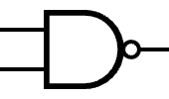
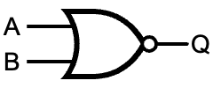
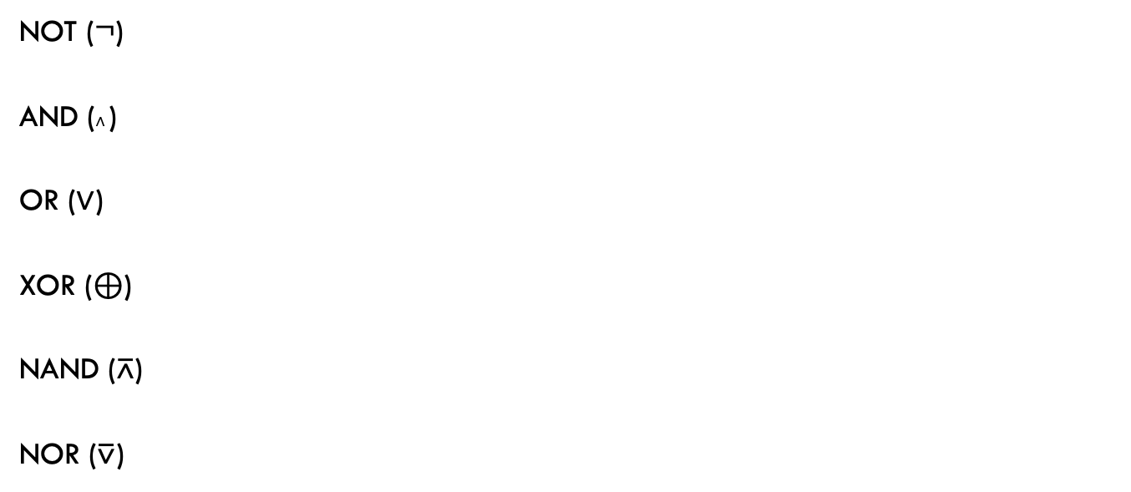
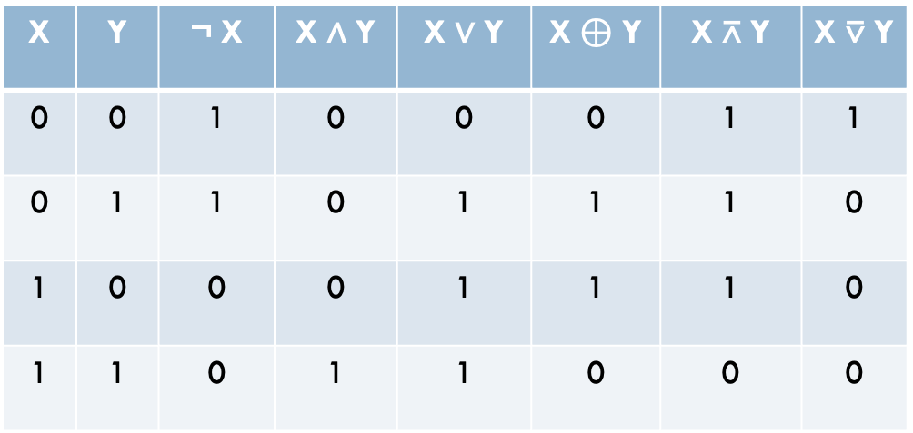
Gates and Boolean logic
X | Y | ¬ X | X ∧ Y | X ∨ Y | X $⊕$ Y | X $\text{⊼}$ Y | X $\text{⊽}$ Y
0 | 0 | 1 | 0 | 0 | 0 | 1 | 1
0 | 1 | 1 | 0 | 1 | 1 | 1 | 0
1 | 0 | 0 | 0 | 1 | 1 | 1 | 0
1 | 1 | 0 | 1 | 1 | 0 | 0 | 0
NOT (¬)
AND (∧ )
OR (∨)
XOR ($⊕$)
NAND ($\text{⊼}$)
NOR ($\text{⊽}$)
Gates have inputs and outputs
  values are 0 or 1
They are hardware components!

Slide 18
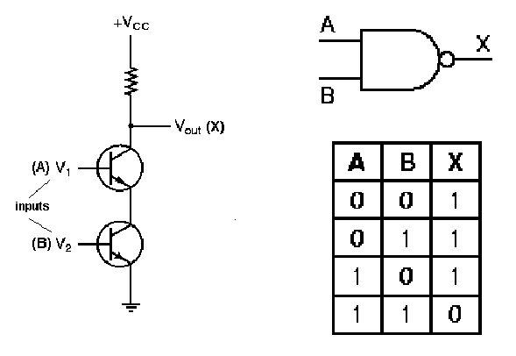
Gates as hardware

Slide 19
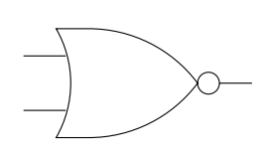
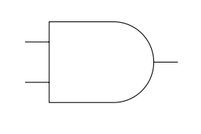
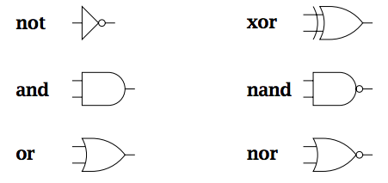


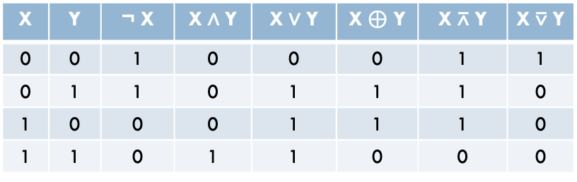

Utilizing gates
X | Y | ¬ X | X ∧ Y | X ∨ Y | X $⊕$ Y | X $\text{⊼}$ Y | X $\text{⊽}$ Y
0 | 0 | 1 | 0 | 0 | 0 | 1 | 1
0 | 1 | 1 | 0 | 1 | 1 | 1 | 0
1 | 0 | 0 | 0 | 1 | 1 | 1 | 0
1 | 1 | 0 | 1 | 1 | 0 | 0 | 0
1
0
?
0
¬
$$⊕$$
∧
$$\text{⊼}$$
∨
$$\text{⊽}$$

Slide 20
Utilizing gates
X | Y | ¬ X | X ∧ Y | X ∨ Y | X $⊕$ Y | X $\text{⊼}$ Y | X $\text{⊽}$ Y
0 | 0 | 1 | 0 | 0 | 0 | 1 | 1
0 | 1 | 1 | 0 | 1 | 1 | 1 | 0
1 | 0 | 0 | 0 | 1 | 1 | 1 | 0
1 | 1 | 0 | 1 | 1 | 0 | 0 | 0
0
1
0
0
0
¬
$$⊕$$
∧
$$\text{⊼}$$
∨
$$\text{⊽}$$

Slide 21
Utilizing gates
X | Y | ¬ X | X ∧ Y | X ∨ Y | X $⊕$ Y | X $\text{⊼}$ Y | X $\text{⊽}$ Y
0 | 0 | 1 | 0 | 0 | 0 | 1 | 1
0 | 1 | 1 | 0 | 1 | 1 | 1 | 0
1 | 0 | 0 | 0 | 1 | 1 | 1 | 0
1 | 1 | 0 | 1 | 1 | 0 | 0 | 0
1
1
?
1
¬
$$⊕$$
∧
$$\text{⊼}$$
∨
$$\text{⊽}$$

Slide 22
Utilizing gates
X | Y | ¬ X | X ∧ Y | X ∨ Y | X $⊕$ Y | X $\text{⊼}$ Y | X $\text{⊽}$ Y
0 | 0 | 1 | 0 | 0 | 0 | 1 | 1
0 | 1 | 1 | 0 | 1 | 1 | 1 | 0
1 | 0 | 0 | 0 | 1 | 1 | 1 | 0
1 | 1 | 0 | 1 | 1 | 0 | 0 | 0
0
1
1
0
1
¬
$$⊕$$
When is this circuit 1?
∧
$$\text{⊼}$$
∨
$$\text{⊽}$$

Slide 23
Utilizing gates
X | Y | Z | OUT
0 | 0 | 0 | 0
0 | 0 | 1 | 1
0 | 1 | 0 | 0
0 | 1 | 1 | 0
1 | 0 | 0 | 0
1 | 0 | 1 | 0
1 | 1 | 0 | 0
1 | 1 | 1 | 0
1
1
1
Notes:
nor is only true with inputs 0, 0
and gate will therefore only be true when in1 and in2 are both 0 and in3 is 1

Slide 24
Designing more interesting circuits
X | Y | ¬ X | X ∧ Y | X ∨ Y | X $⊕$ Y | X $\text{⊼}$ Y | X $\text{⊽}$ Y
0 | 0 | 1 | 0 | 0 | 0 | 1 | 1
0 | 1 | 1 | 0 | 1 | 1 | 1 | 0
1 | 0 | 0 | 0 | 1 | 1 | 1 | 0
1 | 1 | 0 | 1 | 1 | 0 | 0 | 0
X | Y | Z | OUT
0 | 0 | 0 | 0
0 | 0 | 1 | 1
0 | 1 | 0 | 1
0 | 1 | 1 | 1
1 | 0 | 0 | 1
1 | 0 | 1 | 1
1 | 1 | 0 | 1
1 | 1 | 1 | 1
¬
$$⊕$$
∧
$$\text{⊼}$$
Design a circuit for this
∨
$$\text{⊽}$$

Slide 25
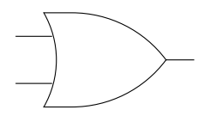
Designing more interesting circuits
X | Y | Z | OUT
0 | 0 | 0 | 0
0 | 0 | 1 | 1
0 | 1 | 0 | 1
0 | 1 | 1 | 1
1 | 0 | 0 | 1
1 | 0 | 1 | 1
1 | 1 | 0 | 1
1 | 1 | 1 | 1

Slide 26
Designing more interesting circuits
X | Y | ¬ X | X ∧ Y | X ∨ Y | X $⊕$ Y | X $\text{⊼}$ Y | X $\text{⊽}$ Y
0 | 0 | 1 | 0 | 0 | 0 | 1 | 1
0 | 1 | 1 | 0 | 1 | 1 | 1 | 0
1 | 0 | 0 | 0 | 1 | 1 | 1 | 0
1 | 1 | 0 | 1 | 1 | 0 | 0 | 0
X | Y | Z | OUT
0 | 0 | 0 | 1
0 | 0 | 1 | 0
0 | 1 | 0 | 0
0 | 1 | 1 | 0
1 | 0 | 0 | 1
1 | 0 | 1 | 0
1 | 1 | 0 | 1
1 | 1 | 1 | 0
¬
$$⊕$$
∧
$$\text{⊼}$$
Design a circuit for this
∨
$$\text{⊽}$$

Slide 27
Truth table to Boolean expression
What approaches have we seen for developing a Boolean expression from a truth table?
X | Y | Z | OUT
0 | 0 | 0 | 1
0 | 0 | 1 | 0
0 | 1 | 0 | 0
0 | 1 | 1 | 0
1 | 0 | 0 | 1
1 | 0 | 1 | 0
1 | 1 | 0 | 1
1 | 1 | 1 | 0

Slide 28
Truth table to Boolean expression
What approaches have we seen for developing a Boolean expression from a truth table?
X | Y | Z | OUT
0 | 0 | 0 | 1
0 | 0 | 1 | 0
0 | 1 | 0 | 0
0 | 1 | 1 | 0
1 | 0 | 0 | 1
1 | 0 | 1 | 0
1 | 1 | 0 | 1
1 | 1 | 1 | 0
minterm expansion (DNF – OR of ANDs)
maxterm expansion (CNF – AND or ORs)
K-Maps (OR of ANDs)

Slide 29
Minterm expansion
All these should be 1 and everything else 0
X | Y | Z | OUT | Minterm
0 | 0 | 0 | 1 | ⌐X ∧ ⌐Y ∧ ⌐Z
0 | 0 | 1 | 0
0 | 1 | 0 | 0
0 | 1 | 1 | 0
1 | 0 | 0 | 1 | X ∧ ⌐Y ∧ ⌐Z
1 | 0 | 1 | 0
1 | 1 | 0 | 1 | X ∧ Y ∧ ⌐Z
1 | 1 | 1 | 0

Slide 30
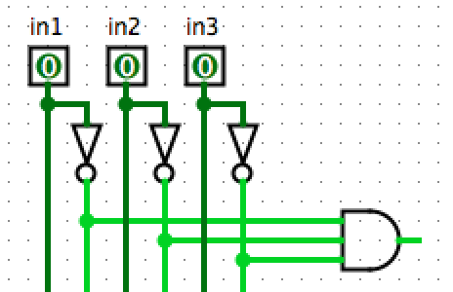
Minterm expansion
X
Y
Z
inputs
gates
connection

Slide 31
Minterm expansion
X
Y
Z
When will this AND-gate be 1?

Slide 32
Minterm expansion
X
Y
Z
Only when X=0, Y=0, Z=0
X | Y | Z | OUT | Minterm
0 | 0 | 0 | 1 | ⌐X ∧ ⌐Y ∧ ⌐Z

Slide 33
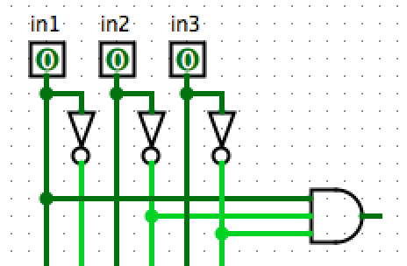
Minterm expansion
X
Y
Z
When will this AND-gate be 1?

Slide 34
Minterm expansion
X
Y
Z
Only when in1=1, in2=0, in3=0
X | Y | Z | OUT | Minterm
1 | 0 | 0 | 1 | X ∧ ⌐Y ∧ ⌐Z

Slide 35
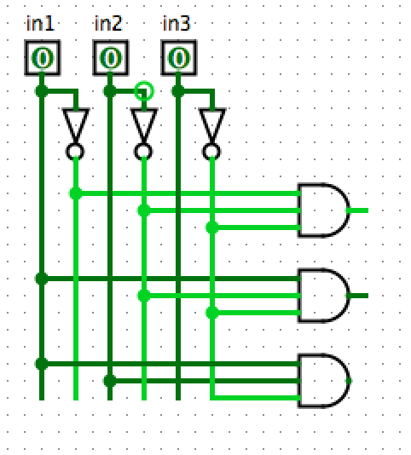
Minterm expansion
X
Y
Z
X | Y | Z | OUT | Minterm
0 | 0 | 0 | 1 | ⌐X ∧ ⌐Y ∧ ⌐Z
0 | 0 | 1 | 0
0 | 1 | 0 | 0
0 | 1 | 1 | 0
1 | 0 | 0 | 1 | X ∧ ⌐Y ∧ ⌐Z
1 | 0 | 1 | 0
1 | 1 | 0 | 1 | X ∧ Y ∧ ⌐Z
1 | 1 | 1 | 0
Make a conjunction for each minterm

Slide 36
Minterm expansion
X
Y
Z
X | Y | Z | OUT | Minterm
0 | 0 | 0 | 1 | ⌐X ∧ ⌐Y ∧ ⌐Z
0 | 0 | 1 | 0
0 | 1 | 0 | 0
0 | 1 | 1 | 0
1 | 0 | 0 | 1 | X ∧ ⌐Y ∧ ⌐Z
1 | 0 | 1 | 0
1 | 1 | 0 | 1 | X ∧ Y ∧ ⌐Z
1 | 1 | 1 | 0
How do we combine these?

Slide 37
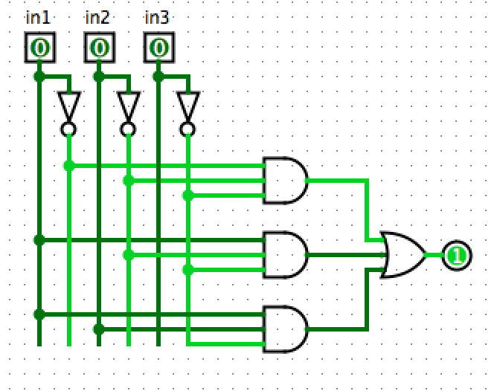
Minterm expansion
X
Y
Z
X | Y | Z | OUT | Minterm
0 | 0 | 0 | 1 | ⌐X ∧ ⌐Y ∧ ⌐Z
0 | 0 | 1 | 0
0 | 1 | 0 | 0
0 | 1 | 1 | 0
1 | 0 | 0 | 1 | X ∧ ⌐Y ∧ ⌐Z
1 | 0 | 1 | 0
1 | 1 | 0 | 1 | X ∧ Y ∧ ⌐Z
1 | 1 | 1 | 0
OR-gate: (⌐X ∧ ⌐Y ∧ ⌐Z) ∨ (X ∧ ⌐Y ∧ ⌐Z) ∨ (X ∧ Y ∧ ⌐Z)

Slide 38
K-maps
Can you use a K-map to come up with a Boolean expression for this table?
X | Y | Z | OUT
0 | 0 | 0 | 1
0 | 0 | 1 | 0
0 | 1 | 0 | 0
0 | 1 | 1 | 0
1 | 0 | 0 | 1
1 | 0 | 1 | 0
1 | 1 | 0 | 1
1 | 1 | 1 | 0

Slide 39
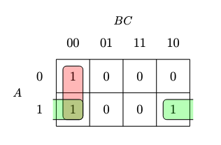
K-maps
Can you use a K-map to come up with a Boolean expression for this table?
X | Y | Z | OUT
0 | 0 | 0 | 1
0 | 0 | 1 | 0
0 | 1 | 0 | 0
0 | 1 | 1 | 0
1 | 0 | 0 | 1
1 | 0 | 1 | 0
1 | 1 | 0 | 1
1 | 1 | 1 | 0
YZ
X
What is the Boolean expression?

Slide 40
K-maps
Can you use a K-map to come up with a Boolean expression for this table?
X | Y | Z | OUT
0 | 0 | 0 | 1
0 | 0 | 1 | 0
0 | 1 | 0 | 0
0 | 1 | 1 | 0
1 | 0 | 0 | 1
1 | 0 | 1 | 0
1 | 1 | 0 | 1
1 | 1 | 1 | 0
YZ
X
(⌐Y ∧ ⌐Z) ∨ (X ∧ ⌐Z)

Slide 41
K-maps
Can you design a circuit?
X | Y | Z | OUT
0 | 0 | 0 | 1
0 | 0 | 1 | 0
0 | 1 | 0 | 0
0 | 1 | 1 | 0
1 | 0 | 0 | 1
1 | 0 | 1 | 0
1 | 1 | 0 | 1
1 | 1 | 1 | 0
YZ
X
(⌐Y ∧ ⌐Z) ∨ (X ∧ ⌐Z)

Slide 42
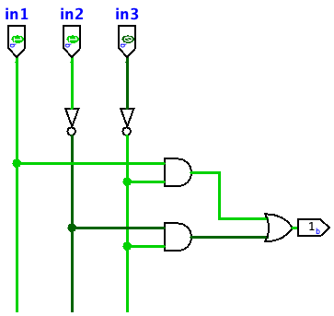
K-maps
X
Y
Z
Can you design a circuit?
X | Y | Z | OUT
0 | 0 | 0 | 1
0 | 0 | 1 | 0
0 | 1 | 0 | 0
0 | 1 | 1 | 0
1 | 0 | 0 | 1
1 | 0 | 1 | 0
1 | 1 | 0 | 1
1 | 1 | 1 | 0
(⌐Y ∧ ⌐Z) ∨ (X ∧ ⌐Z)

Slide 43
Back to addition…
in1 | in2 | carry-in | carry-out | sum
0 | 0 | 0 | 0 | 0
0 | 0 | 1 | 0 | 1
0 | 1 | 0 | 0 | 1
0 | 1 | 1 | 1 | 0
1 | 0 | 0 | 0 | 1
1 | 0 | 1 | 1 | 0
1 | 1 | 0 | 1 | 0
1 | 1 | 1 | 1 | 1
in1
in2
carry-in
carry-out
out

Slide 44
A half-adder: no carry-in
A | B | carry | sum
0 | 0 | 0 | 0
0 | 1 | 0 | 1
1 | 0 | 0 | 1
1 | 1 | 1 | 0

Slide 45
A half-adder: no carry-in
X | Y | ¬ X | X ∧ Y | X ∨ Y | X $⊕$ Y | X $\text{⊼}$ Y | X $\text{⊽}$ Y
0 | 0 | 1 | 0 | 0 | 0 | 1 | 1
0 | 1 | 1 | 0 | 1 | 1 | 1 | 0
1 | 0 | 0 | 0 | 1 | 1 | 1 | 0
1 | 1 | 0 | 1 | 1 | 0 | 0 | 0
A | B | carry | sum
0 | 0 | 0 | 0
0 | 1 | 0 | 1
1 | 0 | 0 | 1
1 | 1 | 1 | 0
Hint: solve each output bit independently
¬
$$⊕$$
∧
$$\text{⊼}$$
Design a circuit for this
∨
$$\text{⊽}$$

Slide 46
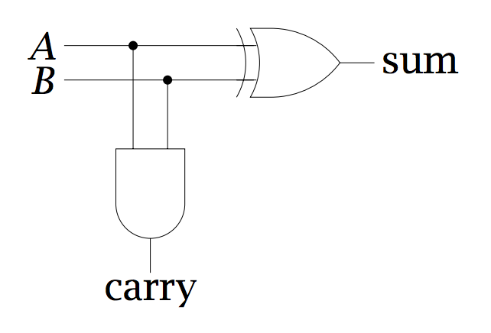
A half-adder: no carry-in
low order bit of A+B
A | B | carry | sum
0 | 0 | 0 | 0
0 | 1 | 0 | 1
1 | 0 | 0 | 1
1 | 1 | 1 | 0
higher order bit of A+B

Slide 47
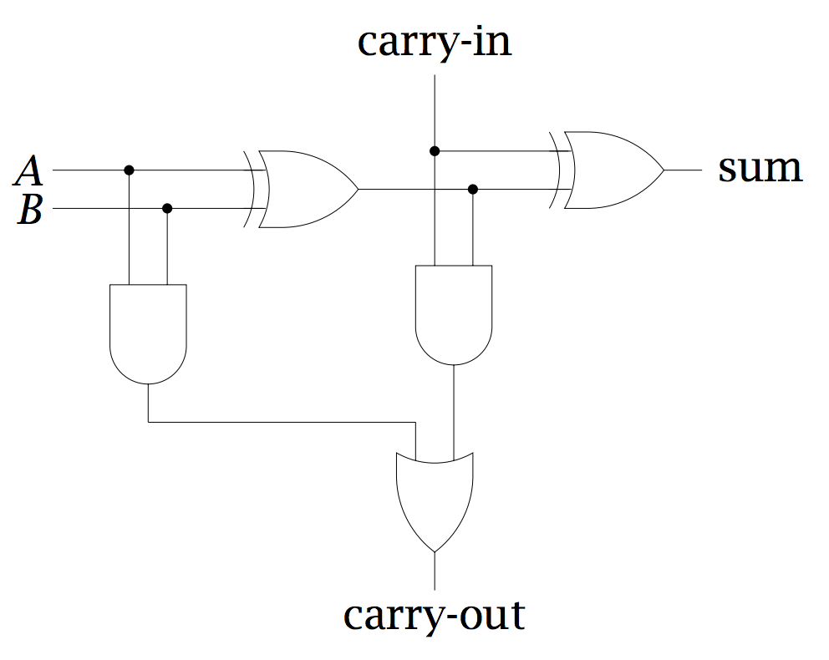
Implementing a full adder
half-adder
half-adder
A+B

Slide 48
Implementing a full adder
low order bit of A+B
low order bit of A+B+C
high order bit of A+B
Can we ever get a carry from both half adders?
A | B | carry | sum
0 | 0 | 0 | 0
0 | 1 | 0 | 1
1 | 0 | 0 | 1
1 | 1 | 1 | 0
high order bit of A+B+C

Slide 49
Implementing a full adder
low order bit of A+B
low order bit of A+B+C
No. If there is a carry from A+B, then the low order bit (sum) must be 0
high order bit of A+B
A | B | carry | sum
0 | 0 | 0 | 0
0 | 1 | 0 | 1
1 | 0 | 0 | 1
1 | 1 | 1 | 0
high order bit of A+B+C

Slide 50
Implementing the component
in1
in2
carry-in
carry-out
out
What goes on inside the component?

Slide 51
Implementing the component
A
B
carry-in
carry-out
sum

Slide 52
Ripple carry adder
To implement an n-bit adder, we chain together n full- adders, each adder handles one bit position
A = A₃ A₂ A₁ A₀
Adder for adding 4-bit numbers
B = B₃ B₂ B₁ B₀
?
A₃
B₃
carry-in
A₂
B₂
carry-in
A₁
B₁
carry-in
A₀
B₀
carry-in
carry-out
carry-out
carry-out
carry-out
out
out
out
out

Slide 53
Ripple carry adder
To implement an n-bit adder, we chain together n full- adders, each adder handles one bit position
A = A₃ A₂ A₁ A₀
Adder for adding 4-bit numbers
B = B₃ B₂ B₁ B₀
0
A₃
B₃
carry-in
A₂
B₂
carry-in
A₁
B₁
carry-in
A₀
B₀
carry-in
carry-out
carry-out
carry-out
carry-out
out
out
out
out

Slide 54
Ripple carry adder
To implement an n-bit adder, we chain together n full- adders, each adder handles one bit position
A = A₃ A₂ A₁ A₀
Adder for adding 4-bit numbers
B = B₃ B₂ B₁ B₀
0
A₃
B₃
carry-in
A₂
B₂
carry-in
A₁
B₁
carry-in
A₀
B₀
carry-in
carry-out
carry-out
carry-out
carry-out
out
out
out
out
Any downsides (computationally) to ripple carry adder?

Slide 55
Look at ripple carry adder example
Many circuits
  half-adder
  full-adder (using half-adders)
  ripple-carry adder (using full-adders)

Slide 56
Simulator basics

Slide 57
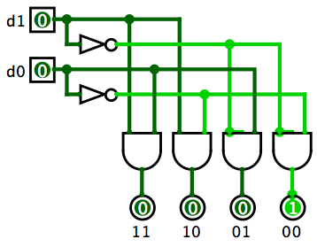
Mystery circuit
d₁ | d₀ | out₀ | out₁ | out₃ | out₃
0 | 0
0 | 1
1 | 0
1 | 1
out₃
out₂
out₁
out₀
What does this circuit do?

Slide 58
2-bit decoder
d₁ | d₀ | out₀ | out₁ | out₃ | out₃
0 | 0 | 1 | 0 | 0 | 0
0 | 1 | 0 | 1 | 0 | 0
1 | 0 | 0 | 0 | 1 | 0
1 | 1 | 0 | 0 | 0 | 1
Sends ‘1’ along one of the output lines

Slide 59
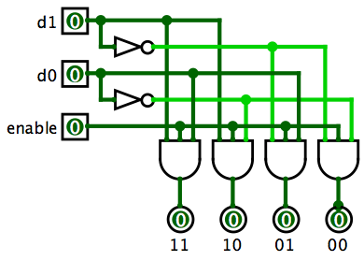
2-bit decoder*
What does the extra input do?

Slide 60
2-bit decoder*
When 0, doesn’t select any lines, when 1, functions normally

Slide 61
3-bit decoder
3 inputs
How many output lines?

Slide 62
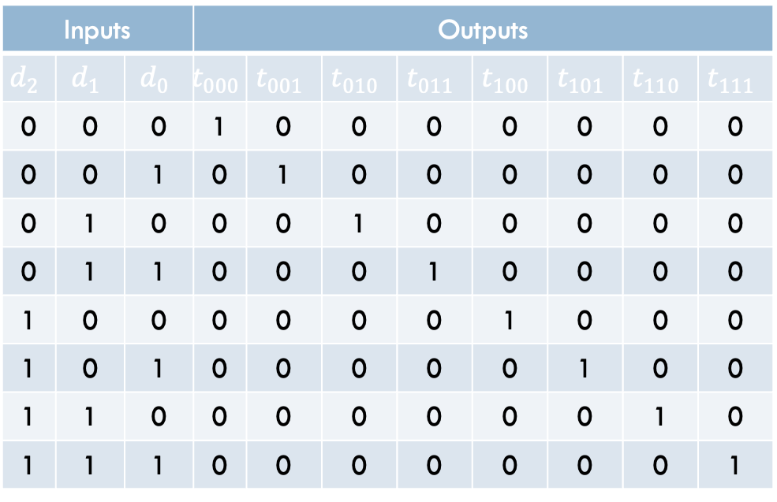
3-bit decoder
3 inputs
8 output lines
Inputs |  |  | Outputs
$$d_{2}$$ | $$d_{1}$$ | $$d_{0}$$ | $$t_{000}$$ | $$t_{001}$$ | $$t_{010}$$ | $$t_{011}$$ | $$t_{100}$$ | $$t_{101}$$ | $$t_{110}$$ | $$t_{111}$$
0 | 0 | 0 | 1 | 0 | 0 | 0 | 0 | 0 | 0 | 0
0 | 0 | 1 | 0 | 1 | 0 | 0 | 0 | 0 | 0 | 0
0 | 1 | 0 | 0 | 0 | 1 | 0 | 0 | 0 | 0 | 0
0 | 1 | 1 | 0 | 0 | 0 | 1 | 0 | 0 | 0 | 0
1 | 0 | 0 | 0 | 0 | 0 | 0 | 1 | 0 | 0 | 0
1 | 0 | 1 | 0 | 0 | 0 | 0 | 0 | 1 | 0 | 0
1 | 1 | 0 | 0 | 0 | 0 | 0 | 0 | 0 | 1 | 0
1 | 1 | 1 | 0 | 0 | 0 | 0 | 0 | 0 | 0 | 1

Slide 63
3-bit decoder
3 inputs
8 output lines
Inputs |  |  | Outputs
$$d_{2}$$ | $$d_{1}$$ | $$d_{0}$$ | $$t_{000}$$ | $$t_{001}$$ | $$t_{010}$$ | $$t_{011}$$ | $$t_{100}$$ | $$t_{101}$$ | $$t_{110}$$ | $$t_{111}$$
0 | 0 | 0 | 1 | 0 | 0 | 0 | 0 | 0 | 0 | 0
0 | 0 | 1 | 0 | 1 | 0 | 0 | 0 | 0 | 0 | 0
0 | 1 | 0 | 0 | 0 | 1 | 0 | 0 | 0 | 0 | 0
0 | 1 | 1 | 0 | 0 | 0 | 1 | 0 | 0 | 0 | 0
1 | 0 | 0 | 0 | 0 | 0 | 0 | 1 | 0 | 0 | 0
1 | 0 | 1 | 0 | 0 | 0 | 0 | 0 | 1 | 0 | 0
1 | 1 | 0 | 0 | 0 | 0 | 0 | 0 | 0 | 1 | 0
1 | 1 | 1 | 0 | 0 | 0 | 0 | 0 | 0 | 0 | 1
Could make from scratch
Better idea: reuse 2-bit decoders

Slide 64

3-bit decoder
Could we use two 2-bit decoders?

Slide 65
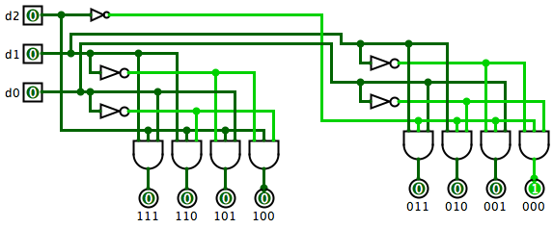
3-bit decoder
d2 gets sent to the enable of the two 2-bit decoders. One as normal and one negated.

Slide 66
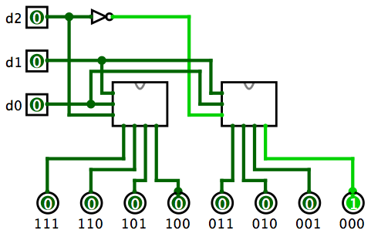
3-bit decoder using 2-bit decoders
2-bit decoder
2-bit decoder

Slide 67
Look at decoders in simulator

Slide 68
Barrel shifters

Slide 69
Examples
The Logisim circuit examples can be found at:
http://www.cs.pomona.edu/classes/cs51/circuits/
You can download Logism Evolution at:
https://github.com/logisim-evolution/logisim-evolution

