Slide 1
binary Arithmetic
David Kauchak
CS 51 – Spring 2026

Slide 2
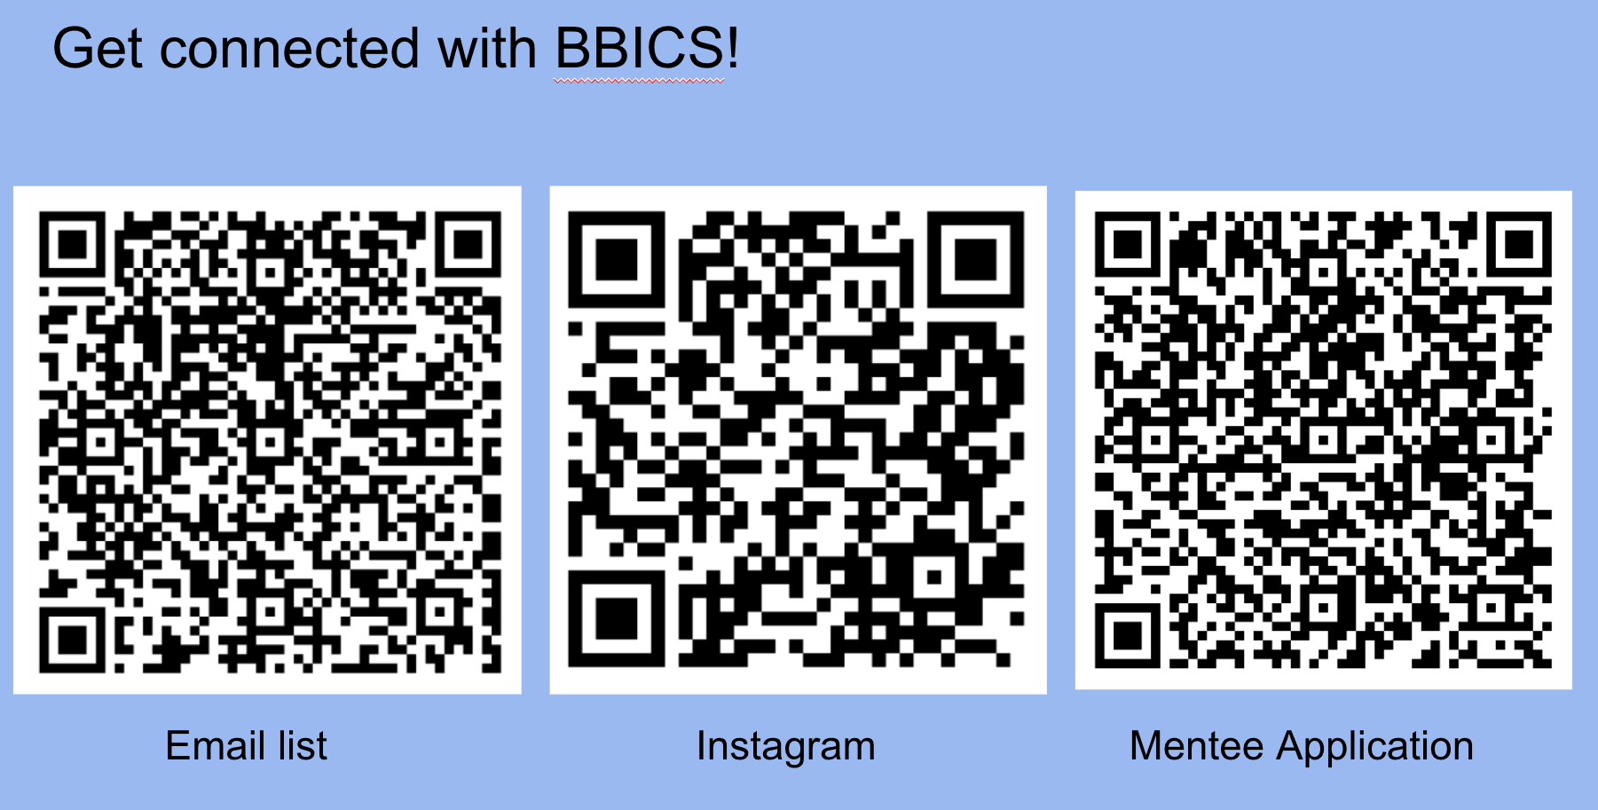
BBICS

Slide 3
Administrative
Assignment 1 graded
Assignment 2
Academic honesty
  Working with other students
  AI tools

Slide 4
Adding numbers base 10
Add: 456 and 735

Slide 5
Adding numbers base 10
456
735
+
?

Slide 6
Adding numbers base 10
1 0 1
456
735
+
1191

Slide 7
Adding numbers base 5
Add: 223₅ and 414₅

Slide 8
Adding numbers base 5
223₅
414₅
+
?

Slide 9
Adding numbers base 5
1 0 1
223₅
414₅
+
1142₅

Slide 10
Adding numbers base 5
1 0 1
223₅
414₅
Is this correct?
What numbers are these?
+
1142₅

Slide 11
Adding numbers base 5
1 0 1
223₅
414₅
2*25 + 2*5 + 3
+
4*25 + 1*5 + 4
1142₅
1*125 + 1*25+4*5+2

Slide 12
Adding numbers base 5
1 0 1
223₅
414₅
63₁₀
+
109₁₀
1142₅
172₁₀

Slide 13
Adding numbers base 2
Add: 0001₂ and 0101₂

Slide 14
Adding numbers base 2
0001₂
0101₂
+
?

Slide 15
Adding numbers base 2
0
0
1
0001₂
0101₂
+
0110₂

Slide 16
Adding numbers base 2
0
0
1
0001₂
0101₂
Is this correct?
What numbers are these?
+
0110₂

Slide 17
Adding numbers base 2
0
0
1
0001₂
0101₂
1₁₀
+
5₁₀
0110₂
6₁₀

Slide 18

PRACTICE TIME - Addition
Compute the following sums
${0111}_{2}+{0101}_{2}$
${9B9}_{16}+{38}_{16}$
Notes:
OK Let's see whether we can do addition in binary and hex.

Slide 19

ANSWER - Addition
Compute the following sums
${0111}_{2}+{0101}_{2}$
${9B9}_{16}+{38}_{16}$
${0111}_{2}+{0101}_{2}$ ${9B3}_{16}+{38}_{16}$
0 1 1 1 $←$ carry $→$ 0 0 1
0 1 1 1 9 B 9
+ 0 1 0 1 + 3 8
1 1 0 0 9 F 1
Notes:
Dod you get these results?

Slide 20
Adding numbers base 2
1001₂
1101₂
+
?

Slide 21
Adding numbers base 2
1 0 0 1
1001₂
1101₂
+
10110₂

Slide 22
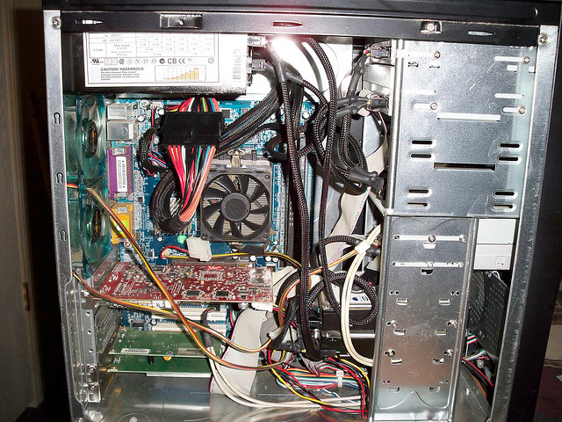
Computer internals

Slide 23
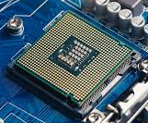
Computer internals simplified
CPU
RAM
What does it stand for?
What does it do?

Slide 24
Computer internals simplified
CPU
RAM
(Random Access Memory,
aka “memory” or “main memory”)
Does all the work!
Temporary storage

Slide 25
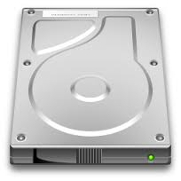
Computer internals simplified
“the computer”
CPU
hard drive
RAM
Why do we need a hard drive?

Slide 26
Computer internals simplified
“the computer”
CPU
hard drive
RAM
Persistent memory
RAM only stores data while it has power

Slide 27

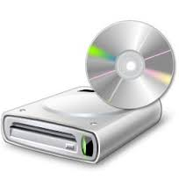


Computer simplified
“the computer”
hard drive
CPU
RAM
network
media drive
input devices
display

Slide 28
Fixed length numbers
0100100100101001000111100010001010
This is more than one number. What are the numbers?

Slide 29
Memory
“the computer”
CPU
hard drive
RAM
Both RAM and the hard drive stores a sequence of bits
To simplify hardware, these bits are grouped into fixed length chunks called “words”

Slide 30
Fixed length numbers
0100 1001 0011 0100 1001 0111 1000 1000 1010
For example, we could have a 4-bit word

Slide 31
Fixed length numbers
0100 1001 0011 0100 1001 0111 1000 1000 1010
For example, we could have a 4-bit word
Most computers these days have 64-bit words

Slide 32
Fixed length words
With 4 bits, how many values/numbers can we represent?

Slide 33
Fixed length words
With 4 bits, how many values/numbers can we represent?
2⁴ = 16 values from 0000 up to 1111

Slide 34
Fixed length words
1 0 0 1
1001₂
1101₂
+
10110₂
What happens here?

Slide 35
Overflow
1 0 0 1
1001₂
1101₂
9₁₀
+
13₁₀
10110₂
22₁₀
Overflow: the result is too large to represent

Slide 36
Overflow
1 0 0 1
1001₂
1101₂
+
10110₂
How do we detect overflow?

Slide 37
Overflow
1 0 0 1
1001₂
1101₂
+
10110₂
Check the carry bit for the most significant bit

Slide 38
Binary numbers revisited
What is -6₁₀ in binary?

Slide 39
One option: sign/magnitude
sign
0 = positive
1 = negative
magnitude
fixed bit length (e.g., 4 bits)

Slide 40
One option: sign/magnitude
What is -6₁₀ in sign/magnitude?
sign
0 = positive
1 = negative
magnitude
fixed bit length (e.g., 4 bits)

Slide 41
One option: sign/magnitude
1
1
1
0
What is -6₁₀ in sign/magnitude?
sign
0 = positive
1 = negative
magnitude
fixed bit length (e.g., 4 bits)

Slide 42
One option: sign/magnitude
1
1
1
0
What are the range of values?
sign
0 = positive
1 = negative
magnitude
fixed bit length (e.g., 4 bits)

Slide 43
One option: sign/magnitude
1
1
1
0
What are the range of values?
sign
0 = positive
1 = negative
magnitude
1111 = -7 to
0111 = 7
fixed bit length (e.g., 4 bits)

Slide 44
One option: sign/magnitude
1
1
1
0
Any problems?
sign
0 = positive
1 = negative
magnitude
fixed bit length (e.g., 4 bits)

Slide 45
One option: sign/magnitude
1
1
1
0
What are the range of values?
sign
0 = positive
1 = negative
magnitude
1000 = 0000
two zeros
hardware-wise, can be more difficult
fixed bit length (e.g., 4 bits)

Slide 46
Another option: twos complement
For a number with n digits the high order bit represents -2^{n-1}
unsigned
2³
2²
2¹
2⁰
signed
(twos complement)
-2³
2²
2¹
2⁰

Slide 47
Twos complement
What number is it?
1
0
0
1
unsigned
9
2³
2²
2¹
2⁰
1
0
0
1
signed
(twos complement)
-7
-2³
2²
2¹
2⁰

Slide 48
Twos complement
What number is it?
1
1
1
1
unsigned
15
2³
2²
2¹
2⁰
1
1
1
1
signed
(twos complement)
-1
-2³
2²
2¹
2⁰

Slide 49
Twos complement
What number is it?
1
1
0
0
unsigned
12
2³
2²
2¹
2⁰
1
1
0
0
signed
(twos complement)
-4
-2³
2²
2¹
2⁰

Slide 50
Twos complement
How many numbers can we represent with each approach using 4 bits?
16 (2⁴) numbers, 0000, 0001, …., 1111
Doesn’t matter the representation!
unsigned
2³
2²
2¹
2⁰
signed
(twos complement)
-2³
2²
2¹
2⁰

Slide 51
Twos complement
How many numbers can we represent with each approach using 32 bits?
2³² ≈ 4 billion numbers
unsigned
2³
2²
2¹
2⁰
signed
(twos complement)
-2³
2²
2¹
2⁰

Slide 52
Twos complement
What is the range of numbers that we can represent for each approach with 4 bits?
unsigned: 0, 1, … 15
signed: -8, -7, …, 7
unsigned
2³
2²
2¹
2⁰
signed
(twos complement)
-2³
2²
2¹
2⁰

Slide 53
binary representation | unsigned
0000 | 0
0001 | 1
0010 | ?
0011
0100
0101
0110
0111
1000
1001
1010
1011
1100
1101
1110
1111

Slide 54
binary representation | unsigned | twos complement
0000 | 0 | ?
0001 | 1
0010 | 2
0011 | 3
0100 | 4
0101 | 5
0110 | 6
0111 | 7
1000 | 8
1001 | 9
1010 | 10
1011 | 11
1100 | 12
1101 | 13
1110 | 14
1111 | 15

Slide 55
binary representation | unsigned | twos complement
0000 | 0 | 0
0001 | 1 | 1
0010 | 2 | 2
0011 | 3 | 3
0100 | 4 | 4
0101 | 5 | 5
0110 | 6 | 6
0111 | 7 | 7
1000 | 8 | ?
1001 | 9
1010 | 10
1011 | 11
1100 | 12
1101 | 13
1110 | 14
1111 | 15

Slide 56
binary representation | unsigned | twos complement
0000 | 0 | 0
0001 | 1 | 1
0010 | 2 | 2
0011 | 3 | 3
0100 | 4 | 4
0101 | 5 | 5
0110 | 6 | 6
0111 | 7 | 7
1000 | 8 | -8
1001 | 9 | ?
1010 | 10
1011 | 11
1100 | 12
1101 | 13
1110 | 14
1111 | 15

Slide 57
binary representation | unsigned | twos complement
0000 | 0 | 0
0001 | 1 | 1
0010 | 2 | 2
0011 | 3 | 3
0100 | 4 | 4
0101 | 5 | 5
0110 | 6 | 6
0111 | 7 | 7
1000 | 8 | -8
1001 | 9 | -7
1010 | 10 | -6
1011 | 11 | -5
1100 | 12 | -4
1101 | 13 | -3
1110 | 14 | -2
1111 | 15 | -1

Slide 58
binary representation | unsigned | twos complement
0000 | 0 | 0
0001 | 1 | 1
0010 | 2 | 2
0011 | 3 | 3
0100 | 4 | 4
0101 | 5 | 5
0110 | 6 | 6
0111 | 7 | 7
1000 | 8 | -8
1001 | 9 | -7
1010 | 10 | -6
1011 | 11 | -5
1100 | 12 | -4
1101 | 13 | -3
1110 | 14 | -2
1111 | 15 | -1
How can you tell if a number is negative?

Slide 59
binary representation | unsigned | twos complement
0000 | 0 | 0
0001 | 1 | 1
0010 | 2 | 2
0011 | 3 | 3
0100 | 4 | 4
0101 | 5 | 5
0110 | 6 | 6
0111 | 7 | 7
1000 | 8 | -8
1001 | 9 | -7
1010 | 10 | -6
1011 | 11 | -5
1100 | 12 | -4
1101 | 13 | -3
1110 | 14 | -2
1111 | 15 | -1
High order bit!

Slide 60
A two’s complement trick
You can also calculate the value of a negative number represented as twos complement as follows:
  Flip all of the bits (0 → 1 and 1→ 0)
  Add 1
  The resulting number is the magnitude of the original negative number
flip the bits
add 1
1101
0010
0011
-3

Slide 61
A two’s complement trick
You can also calculate the value of a negative number represented as twos complement as follows:
  Flip all of the bits (0 → 1 and 1→ 0)
  Add 1
  The resulting number is the magnitude of the original negative number
flip the bits
add 1
1110
0001
0010
-2

Slide 62
Addition with 4-bit twos complement numbers
0001₂
0101₂
+
?

Slide 63
Addition with 4-bit twos complement numbers
0
0
1
0001₂
0101₂
+
0110₂

Slide 64
Addition with 4-bit twos complement numbers
0110
0101
+
?
(Note: I’m going to stop writing the base 2 ☺)

Slide 65
Addition with 4-bit twos complement numbers
1
0110
0101
+
1011?

Slide 66
Addition with 4-bit twos complement numbers
1
0110
0101
6
+
5
1011?
-5? (11 unsigned)
Overflow! We cannot represent this number (it’s too large)

Slide 67
Addition with 4-bit twos complement numbers
0110
1101
+
?

Slide 68
Addition with 4-bit twos complement numbers
1
1
0110
1101
+
0011

Slide 69
Addition with 4-bit twos complement numbers
1
1
0110
1101
6
ignore the last carry
+
-3
0011
3

Slide 70
Overflow in twos complement
How do you know that overflow has occurred with twos complement numbers?

Slide 71
Overflow in twos complement
How do you know that overflow has occurred with twos complement numbers?
Can only happen when adding two numbers of the same sign
Add the numbers and discard the carry
Check the sign of the resulting number: if it differs than the number added = overflow

Slide 72
Subtraction
Ideas?

Slide 73
Subtraction
Negate the 2nd number (flip the bits and add 1)
Add them!

Slide 74

PRACTICE TIME – Subtracting two’s complements
Calculate $3_{10}−5_{10}$ using 4-bit two's complement numbers.
Notes:
Let's practice by calculating 3-5 in two's complement assuming 4 bits,

Slide 75
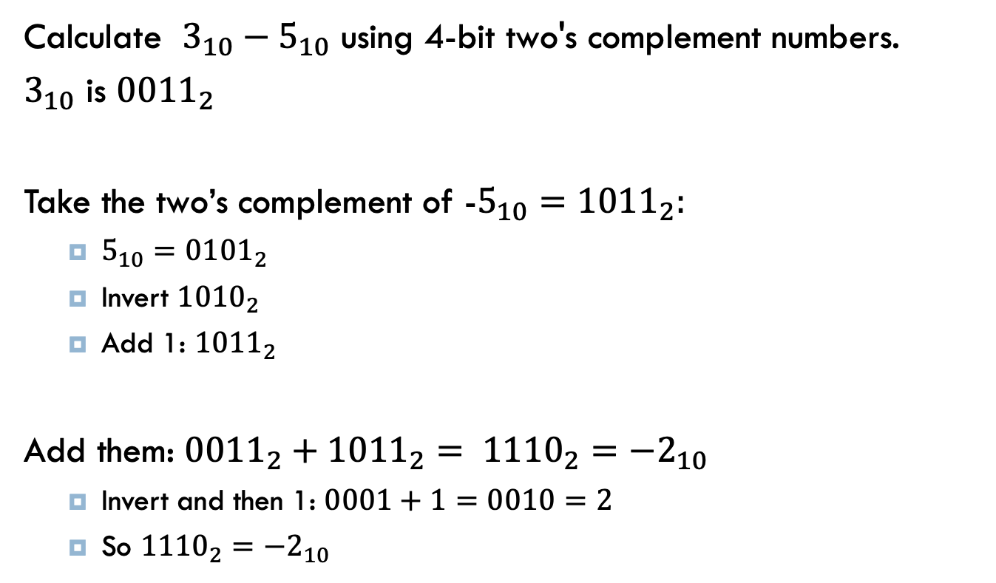
ANSWER – Subtracting two’s complements
Calculate $3_{10}−5_{10}$ using 4-bit two's complement numbers.
$3_{10}$ is ${0011}_{2}$
Take the two’s complement of -$5_{10}={1011}_{2}:$
  ${5_{10}=0101}_{2}$
  Invert ${1010}_{2}$
  Add 1: ${1011}_{2}$
Add them: ${{0011}_{2}+{1011}_{2}= 1110}_{2}={−2}_{10}$
  Invert and then 1: $0001+1=0010=2$
  So ${1110}_{2}=−2_{10}$
Notes:
Did you get this?

Slide 76
Shifting: variable length numbers
Shifting shifts the binary representation of the number right or left

Slide 77
Shifting: variable length numbers
Shifting shifts the binary representation of the number right or left
37 >> 2
?
number to be shifted
number of positions to shift
right shift

Slide 78
Shifting: variable length numbers
Shifting shifts the binary representation of the number right or left
37 >> 2
37
100101
1001
9
shift right two positions
(discard bits shifting off)
number in binary
decimal form

Slide 79
Shifting: variable length numbers
Shifting shifts the binary representation of the number right or left
37 >> 3
?

Slide 80
Shifting: variable length numbers
Shifting shifts the binary representation of the number right or left
37 >> 3
37
100101
100
4
shift right three positions
(discard bits shifting off)
number in binary
decimal form

Slide 81
Shifting 8-bit numbers
Shifting shifts the binary representation of the number right or left
37 >> 2
What is 37 as an 8-bit binary number?
37
00100101
pad with 0s
number in binary

Slide 82
Shifting 8-bit numbers
Shifting shifts the binary representation of the number right or left
37 >> 2
How do we fill in the leftmost bits?
37
00100101
shift right two positions
(discard bits shifting off)
number in binary

Slide 83
Shifting 8-bit numbers
Shifting shifts the binary representation of the number right or left
37 >> 2
How do we fill in the leftmost bits?
37
00100101
00001001
shift right two positions
(discard bits shifting off)
number in binary

Slide 84
Shifting 8-bit numbers
Shifting shifts the binary representation of the number right or left
37 >> 2
37
00100101
00001001
9
shift right two positions
(discard away bits shifting off)
number in binary
decimal form

Slide 85
Shifting 8-bit numbers
Shifting shifts the binary representation of the number right or left
15 << 2
?

Slide 86
Shifting 8-bit numbers
Shifting shifts the binary representation of the number right or left
15 << 2
15
?
number in binary

Slide 87
Shifting 8-bit numbers
Shifting shifts the binary representation of the number right or left
15 << 2
15
00001111
number in binary

Slide 88
Shifting 8-bit numbers
Shifting shifts the binary representation of the number right or left
15 << 2
15
00001111
?
shift left two positions
(discard bits shifting off)
number in binary

Slide 89
Shifting 8-bit numbers
Shifting shifts the binary representation of the number right or left
15 << 2
15
00001111
001111??
shift left two positions
(discard bits shifting off)
number in binary

Slide 90
Shifting 8-bit numbers
Shifting shifts the binary representation of the number right or left
15 << 2
15
00001111
00111100
shift left two positions
(discard bits shifting off)
number in binary

Slide 91
Shifting 8-bit numbers
Shifting shifts the binary representation of the number right or left
15 << 2
15
00001111
00111100
60
shift left two positions
(discard bits shifting off)
number in binary
decimal form

Slide 92
Shifting mathematically: unsigned
What does left shifting by one position do mathematically?
0
A
B
C
2³
2²
2¹
2⁰

Slide 93
Shifting mathematically: unsigned
What does left shifting by one position do mathematically?
0
A
B
C
2³
2²
2¹
2⁰
A
B
C
0
2³
2²
2¹
2⁰

Slide 94
Shifting mathematically: unsigned
What does left shifting by one position do mathematically?
0
A
B
C
2³
2²
2¹
2⁰
A
B
C
0
2³
2²
2¹
2⁰

Slide 95
Shifting mathematically: unsigned
What does left shifting by one position do mathematically?
0
A
B
C
2³
2²
2¹
2⁰
Doubles the number!
A
B
C
0
2³
2²
2¹
2⁰

Slide 96
Shifting mathematically: unsigned
What does left shifting by n positions do mathematically?
Multiply by 2^{n} (double n times)

Slide 97
Shifting mathematically: unsigned
What does right shifting by one position do mathematically?
0
A
B
C
2³
2²
2¹
2⁰

Slide 98
Shifting mathematically: unsigned
What does right shifting by one position do mathematically?
0
A
B
C
2³
2²
2¹
2⁰
0
0
A
B
2³
2²
2¹
2⁰

Slide 99
Shifting mathematically: unsigned
What does right shifting by one position do mathematically?
0
A
B
C
2³
2²
2¹
2⁰
0
0
A
B
2³
2²
2¹
2⁰

Slide 100
Shifting mathematically: unsigned
What does right shifting by one position do mathematically?
0
A
B
C
2³
2²
2¹
2⁰
Integer divide by 2
(// in Python)
0
0
A
B
2³
2²
2¹
2⁰

Slide 101
Shifting mathematically: unsigned
What does right shifting by n positions do mathematically?
Integer division by 2^{n} (halve n times)

Slide 102
Shifting 4-bit numbers
Shifting shifts the binary representation of the number right or left
-4 >> 1
?

Slide 103
Shifting 4-bit numbers
Shifting shifts the binary representation of the number right or left
-4 >> 1
What is -4 as a 4-bit binary number?
-4
1100
number in binary

Slide 104
Shifting 4-bit numbers
Shifting shifts the binary representation of the number right or left
-4 >> 1
How do we fill in the leftmost bit?
-4
1100
?110
shift right one position
(discard bits shifting off)
number in binary

Slide 105
Shifting 4-bit numbers
Two types of right shifts:
logical shift: always shift in 0s
arithmetic shift: shift in the same as the high-order bit
-4
1100
?110
shift right one position
(discard bits shifting off)
number in binary

Slide 106
Shifting 4-bit numbers
Two types of right shifts:
logical shift: always shift in 0s
arithmetic shift: shift in the same as the high-order bit
-4
1100
?110
shift right one position
(discard bits shifting off)
number in binary

Slide 107
Shifting 4-bit numbers
Two types of right shifts:
logical shift: always shift in 0s
arithmetic shift: shift in the same as the high-order bit
-4
1100
1110
shift right one position
(discard bits shifting off)
number in binary

Slide 108
Shifting 4-bit numbers
Two types of right shifts:
logical shift: always shift in 0s
arithmetic shift: shift in the same as the high-order bit
-4 >> 1
-4
1100
1110
?
shift right one position
(discard bits shifting off)
number in binary
decimal form

Slide 109
Shifting 4-bit numbers
Two types of right shifts:
logical shift: always shift in 0s
arithmetic shift: shift in the same as the high-order bit
-4 >> 1
-4
1100
1110
-2
shift right one position
(discard bits shifting off)
number in binary
decimal form

Slide 110
Shifting 4-bit numbers
Shifting shifts the binary representation of the number right or left
-4 >> 2
?

Slide 111
Shifting 4-bit numbers
Two types of right shifts:
logical shift: always shift in 0s
arithmetic shift: shift in the same as the high-order bit
-4 >> 2
-4
1100
1111
-1
shift right two positions
(discard bits shifting off)
number in binary
decimal form

Slide 112
Arithmetic shifting mathematically
What does right arithmetic shifting by n positions do mathematically for signed numbers?
Integer division by 2^{n} (halve n times)
Same thing!!

Slide 113
Shifting 4-bit numbers
Two types of right shifts:
logical shift: always shift in 0s
arithmetic shift: shift in the same as the high-order bit
-4
1100
?110
shift right one position
(discard bits shifting off)
number in binary

Slide 114
Shifting 4-bit numbers
Two types of right shifts:
logical shift: always shift in 0s
arithmetic shift: shift in the same as the high-order bit
-4
1100
0110
shift right one position
(discard bits shifting off)
number in binary

Slide 115
Shifting 4-bit numbers
Two types of right shifts:
logical shift: always shift in 0s
arithmetic shift: shift in the same as the high-order bit
-4 >>> 1
-4
1100
0110
?
shift right one position
(discard bits shifting off)
number in binary
decimal form

Slide 116
Shifting 4-bit numbers
Two types of right shifts:
logical shift: always shift in 0s
arithmetic shift: shift in the same as the high-order bit
-4 >>> 1
-4
1100
0110
6
shift right one position
(discard bits shifting off)
number in binary
decimal form

Slide 117
Left shifts
Two types of left shifts?
logical shift: always shift in 0s
arithmetic shift: ?
arithmetic
-3 << 1
?
logical
-3 <<< 1
?

Slide 118
Left shifts
Two types of left shifts?
logical shift: always shift in 0s
arithmetic shift: ?
arithmetic
-3 << 1
1101
101?
(double the number)
logical
-3 <<< 1
1101
1010

Slide 119
Left shifts
Two types of left shifts?
logical shift: always shift in 0s
arithmetic shift: ?
arithmetic
-3 << 1
1101
1010
(double the number)
logical
-3 <<< 1
1101
1010
Only one type of left shift

Slide 120
Shifting summarized
Arithmetic shift:
  Right shift n
    shift n bits to the right
    discard right n bits
    left n bits match high-order bits of original number
    Effect: Integer division by 2^{n} (halve n times)
  Left shift
    shift n bits to the left
    discard left n bits
    right n bits are 0s
    Effect: multiply by 2^{n} (double n times)
Logical shift right:
  left n bits are 0s (no mathematical guarantees for negative numbers)

