Slide 1
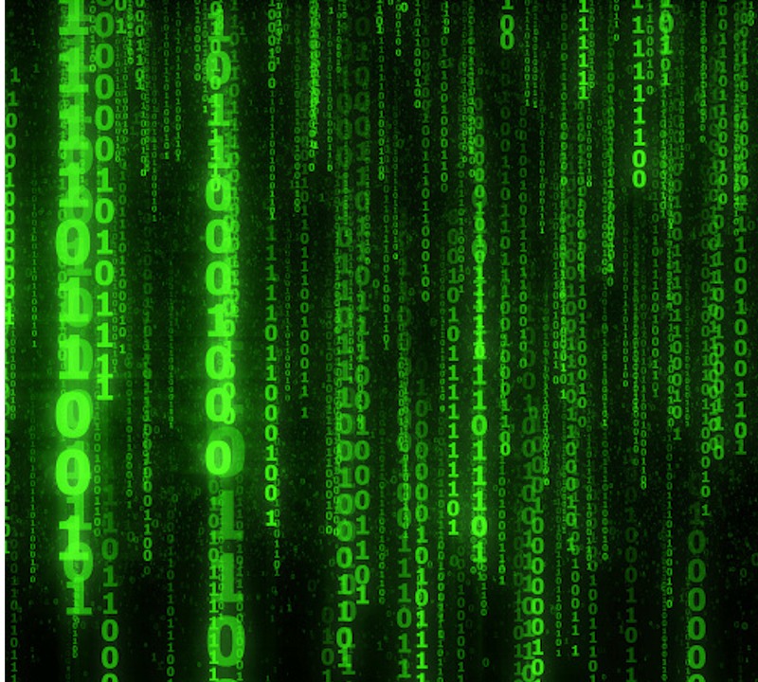
Numeral Systems
Computer Systems
CS51 – Spring 2026
Notes:
Last time we talked about how physical components like transistors allow us to represent data in computers in one of two binary states, 0 or 1, False or True etc. Working with binary data is just one example of a numeral system.

Slide 2
Administrative
Assignment 1
Assignment 2
Lab tomorrow
Practice problems at the end of slides
Slack/canvas

Slide 3
Booleans in Python
bool type in python: True or False
The comparison operators ==, !=, >, <, >=, <= return bools. For example,
  10 < 0 evaluates to False
  11 >= 11 evaluates to True
  11 > 11.0 evaluates to False
  10 == 10.0 evaluates to True
  10 != 10.0 evaluates to False

Slide 4
Boolean Algebra in Python
We can combine bools and logical operators in Boolean expressions, for example, to evaluate them in conditionals (if statements) and loops (for and while).
Python supports three logical operators:
  not for negation (i.e., ¬)
  and for conjunction (i.e., ∧)
  or for disjunction (i.e., ∨)
Notes:
We can combine bool variables and logical operators in Boolean expressions, for example to evaluate them in conditionals (if statements) and loops, such as the for and while loops. Python also supports not, and, and or.

Slide 5
Short-circuit evaluation in Python
Python supports short-circuiting: evaluates a Boolean expression from left to right and stops evaluation once the truth can be determined
When could this happen with a Boolean expression?

Slide 6
Short-circuit evaluation in Python
Python supports short-circuiting: evaluates a Boolean expression from left to right and stops evaluation once the truth can be determined
If any part of an and is False, the expression is False
False and …
If any part of an or is True, the expression is True
True or …

Slide 7
Short-circuit evaluation in Python
Python supports short-circuiting: evaluates a Boolean expression from left to right and stops evaluation once the truth can be determined
What is the benefit of this?

Slide 8
Short-circuit evaluation and optimization
  if x == 0 or (x-1)/x > 0.5: …
  How does short-circuiting help us?

Slide 9
Short-circuit evaluation and optimization
  if x == 0 or (x-1)/x > 0.5: …
  When x is equal to 0, evaluating would cause a divide-by-zero error. But the second disjunct isn’t evaluated when x is equal to 0 because the first operand was True!
Notes:
Short-circuiting allows us to write more condensed if statements or even make our code faster.

Slide 10
Short-circuit evaluation and optimization
It also can be computationally faster:
if (simpleOrOftenFalse() and complexOrOftenTrue()):…
Notes:
Short-circuiting allows us to write more condensed if statements or even make our code faster.

Slide 11
PRACTICE TIME – Boolean expressions
Assume the variable x currently stores the value 47. What will the following expressions evaluate to?
  True and not False
  not True or not False
  True and not 0
  False or not 1
  2 < x and x < 50
  x > 2 and < 20
  (2 > x) or (x == 47)
  not (x == x)
  not (x != 3)
  x < 0 and (y/x) == 3
  x > 0 or (y/x) == 3

Slide 12
ANSWER – Boolean expressions
Assume the variable x currently stores the value 47. What will the following expressions evaluate to?
  True and not False - True
  not True or not False - True
  True and not 0 – True
  False or not 1 - False
  2 < x and x < 50 - True
  x > 2 and < 20 – Invalid syntax
  (2 > x) or (x == 47) - True
  not (x == x) - False
  not (x != 3) – False
  x < 0 and (y/x) == 3 – False
  x > 0 or (y/x) == 3 - True

Slide 13
PRACTICE TIME – Conditionals
Rewrite the following code to make it cleaner and avoid the use of nested if statements:
def get_discount(member, purchase_amount):
if member == True:
if purchase_amount > 100:
return "Discount applied"
else:
return "No discount"
else:
if purchase_amount > 200:
return "Discount applied"
else:
return "No discount"
print(get_discount(True, 120)) # Expected: "Discount applied" print(get_discount(True, 80)) # Expected: "No discount" print(get_discount(False, 220)) # Expected: "Discount applied" print(get_discount(False, 50)) # Expected: "No discount"
Notes:
Can you write the following function in a more condensed way? I have provided you the following print statements and what you should expect them to produce

Slide 14
ANSWER – Conditionals
Rewrite the following code to make it cleaner and avoid the use of nested if statements:
def get_discount(member, purchase_amount):
if (purchase_amount > 200) or (member and purchase_amount > 100):
return "Discount applied"
else:
return "No discount"
print(get_discount(True, 120)) # Expected: "Discount applied" print(get_discount(True, 80)) # Expected: "No discount" print(get_discount(False, 220)) # Expected: "Discount applied" print(get_discount(False, 50)) # Expected: "No discount"
Notes:
Here is a condensed version that accomplishes the same thing

Slide 15
Numbers
What number is 9247?

Slide 16

Numbers
What number is 9247₁₀ =
= 9000 + 200 + 40 + 7
= 9 $×$ 10³ + 2 $×$ 10² + 4 $×$ 10¹ + 7 $×$ 10⁰

Slide 17
Decimal numbers: base 10
For any base, the digits (individual numbers in the number) range from 0 to base - 1
Base 10 digits: 0, 1, 2, 3, 4, 5, 6, 7, 8, 9

Slide 18

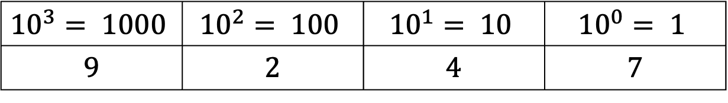
Decimal numbers: base 10
n-digit number
$d_{n−1}{…d}_{2}d_{1}d_{0}$ represents the integer
$$d_{n−1}{10}^{n−1}+{…+d}_{2}{10}^{2}+d_{1}{10}^{1}+d_{0}{10}^{0}$$
$${10}^{3}= 1000$$ | $${10}^{2}= 100$$ | $${10}^{1}= 10$$ | $${10}^{0}= 1$$
9 | 2 | 4 | 7

Slide 19
Decimal numbers: base 10
$d_{n−1}{…d}_{2}d_{1}d_{0}$ represents the integer
$$d_{n−1}{10}^{n−1}+{…+d}_{2}{10}^{2}+d_{1}{10}^{1}+d_{0}{10}^{0}$$
$${10}^{3}= 1000$$ | $${10}^{2}= 100$$ | $${10}^{1}= 10$$ | $${10}^{0}= 1$$
9 | 2 | 4 | 7
    $$\text{9247}\text{10}=9×{10}^{3}+2×{10}^{2}+4×{10}^{1}+7×{10}^{0}$$

Slide 20
Decimal numbers: base 10
$d_{n−1}{…d}_{2}d_{1}d_{0}$ represents the integer
$$d_{n−1}{10}^{n−1}+{…+d}_{2}{10}^{2}+d_{1}{10}^{1}+d_{0}{10}^{0}$$
For a d digit decimal number, what are the range of values? E.g., three digits?

Slide 21
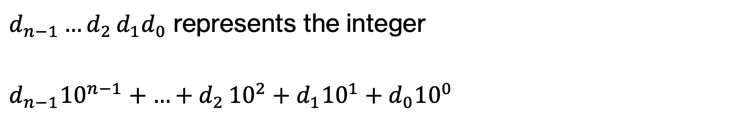
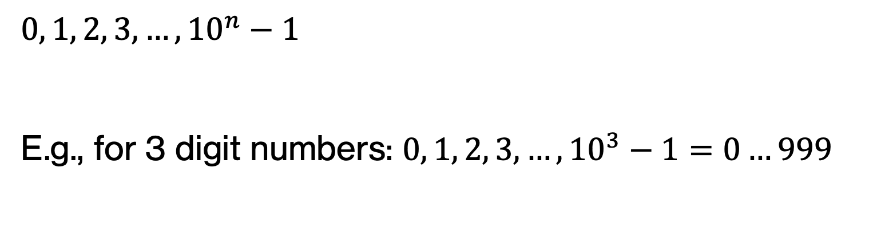
Decimal numbers: base 10
$d_{n−1}{…d}_{2}d_{1}d_{0}$ represents the integer
$$d_{n−1}{10}^{n−1}+{…+d}_{2}{10}^{2}+d_{1}{10}^{1}+d_{0}{10}^{0}$$
$$0, 1, 2, 3, …, {10}^{n}−1$$
E.g., for 3 digit numbers: $0, 1, 2, 3, …, {10}^{3}−1=0…999$

Slide 22
Numbers in other bases
What are valid digits for base 5 numbers?

Slide 23
Number in other bases
For any base, the digits (individual numbers in the number) range from 0 to base - 1
Base 5 digits: 0, 1, 2, 3, 4

Slide 24
Numbers in other bases
What number is 243₅?

Slide 25
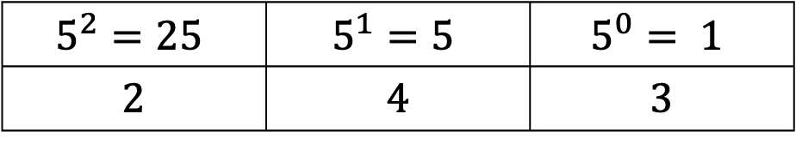
Numbers in other bases
What number is 243₅?
$$5^{2}=25$$ | $$5^{1}=5$$ | $$5^{0}= 1$$
2 | 4 | 3

Slide 26
Numbers in other bases
What number is 243₅?
$$5^{2}=25$$ | $$5^{1}=5$$ | $$5^{0}= 1$$
2 | 4 | 3
    $$\text{2}\text{43}5=2×5^{2}+4×5^{1}+3×5^{0}$$
    $$=2×25+4×5+3=7310$$

Slide 27

Numbers in other bases
$d_{n−1}{…d}_{2}d_{1}d_{0}$ represents the integer
$$d_{n−1}5^{n−1}+{…+d}_{2}5^{2}+d_{1}5^{1}+d_{0}5^{0}$$
For a d digit base 5 number, what are the range of values? E.g., three digits?

Slide 28
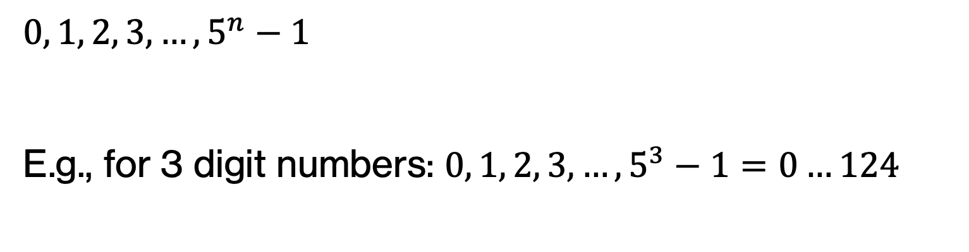
Numbers in other bases
$d_{n−1}{…d}_{2}d_{1}d_{0}$ represents the integer
$$d_{n−1}5^{n−1}+{…+d}_{2}5^{2}+d_{1}5^{1}+d_{0}5^{0}$$
$$0, 1, 2, 3, …, 5^{n}−1$$
E.g., for 3 digit numbers: $0, 1, 2, 3, …, 5^{3}−1=0…124$

Slide 29

Numbers in other bases
$d_{n−1}{…d}_{2}d_{1}d_{0}$ represents the integer
$$d_{n−1}b^{n−1}+{…+d}_{2}b^{2}+d_{1}b^{1}+d_{0}b^{0}$$
For a d digit base b number, what are the range of values? E.g., three digits?

Slide 30
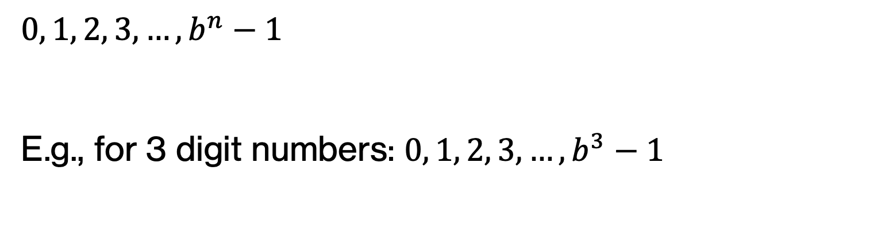
Numbers in other bases
$d_{n−1}{…d}_{2}d_{1}d_{0}$ represents the integer
$$d_{n−1}b^{n−1}+{…+d}_{2}b^{2}+d_{1}b^{1}+d_{0}b^{0}$$
$$0, 1, 2, 3, …, b^{n}−1$$
E.g., for 3 digit numbers: $0, 1, 2, 3, …, b^{3}−1$

Slide 31
Numbers in other bases
What are valid digits for base 2 numbers?

Slide 32
Number in other bases
For any base, the digits (individual numbers in the number) range from 0 to base - 1
Base 2 digits: 0, 1

Slide 33
Numbers in other bases
What number is 1101₂?

Slide 34
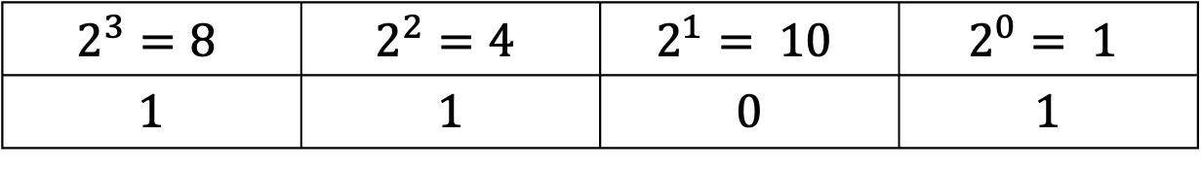
Numbers in other bases
What number is 1101₂?
$$2^{3}=8$$ | $$2^{2}=4$$ | $$2^{1}= 10$$ | $$2^{0}= 1$$
1 | 1 | 0 | 1

Slide 35
Numbers in other bases
What number is 1101₂?
$$2^{3}=8$$ | $$2^{2}=4$$ | $$2^{1}= 10$$ | $$2^{0}= 1$$
1 | 1 | 0 | 1
    $$\text{1}\text{1}012=1×2^{3}+1×2^{2}+0×2^{1}+1×5^{0}$$
    $$=8+4+1=1310$$

Slide 36
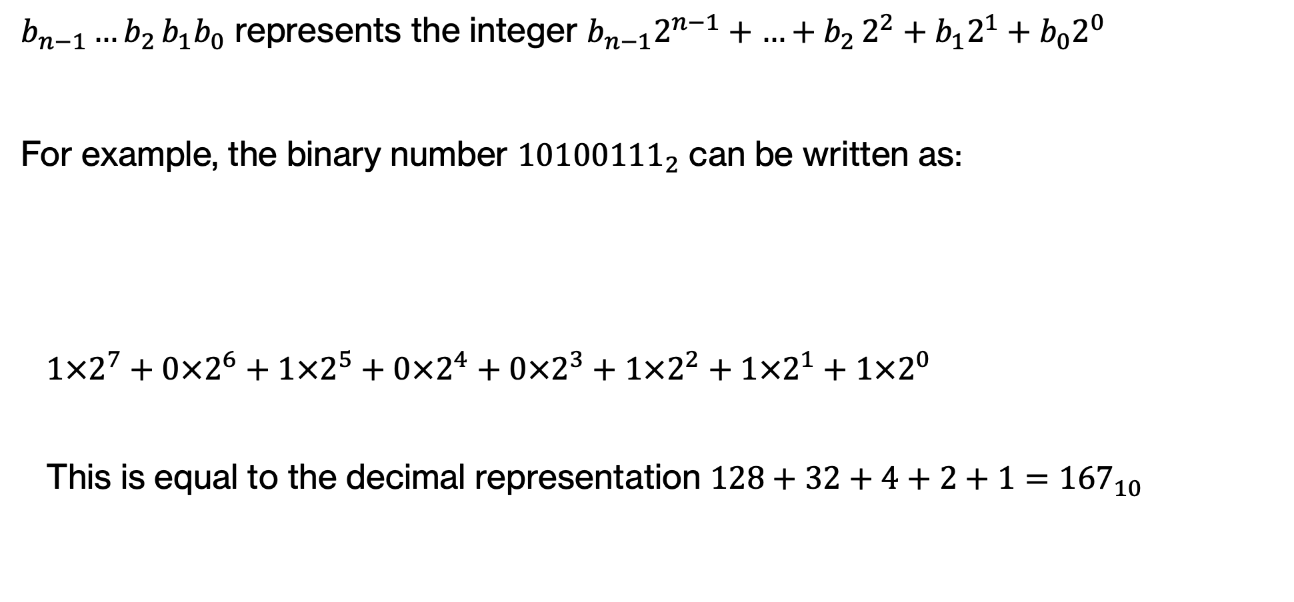
Binary numbers
$b_{n−1}{…b}_{2}b_{1}b_{0}$ represents the integer $b_{n−1}2^{n−1}+{…+b}_{2}2^{2}+b_{1}2^{1}+b_{0}2^{0}$
For example, the binary number ${10100111}_{2}$ can be written as:
  $$1×2^{7}+0×2^{6}+1×2^{5}+0×2^{4}+0×2^{3}+1×2^{2}+1×2^{1}+1×2^{0}$$
  This is equal to the decimal representation $128+32+4+2+1={167}_{10}$
$$2^{7}=128$$ | $$2^{6}=64$$ | $$2^{5}=32$$ | $$2^{4}=16$$ | $$2^{3}=8$$ | $$2^{2}=4$$ | $$2^{1}=2$$ | $$2^{0}= 1$$
1 | 0 | 1 | 0 | 0 | 1 | 1 | 1

Slide 37
binary numbers
For a d digit base b number, what are the range of values? E.g., three digits?

Slide 38
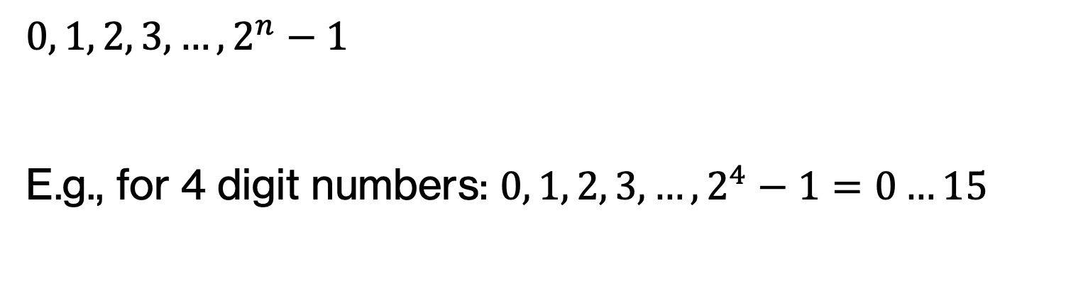
binary numbers
For a d digit binary number, what are the range of values? E.g., four digits?
$$0, 1, 2, 3, …, 2^{n}−1$$
E.g., for 4 digit numbers: $0, 1, 2, 3, …, 2^{4}−1=0…15$

Slide 39
Binary numbers and their decimal equivalents
1-bit binary | 2-bit binary | 3-bit binary | 4-bit binary | Decimal equivalent
0 | 00 | 000 | 0000 | 0
1 | 01 | 001 | 0001 | 1
 | 10 | 010 | 0010 | 2
 | 11 | 011 | 0011 | 3
 |  | 100 | 0100 | 4
 |  | 101 | 0101 | 5
 |  | 110 | 0110 | 6
 |  | 111 | 0111 | 7
 |  |  | 1000 | 8
 |  |  | 1001 | 9
 |  |  | 1010 | 10
 |  |  | 1011 | 11
 |  |  | 1100 | 12
 |  |  | 1101 | 13
 |  |  | 1110 | 14
 |  |  | 1111 | 15

Slide 40

PRACTICE TIME
Convert the following binary numbers to their decimal representation:
  ${1010}_{2}$
  ${1111}_{2}$
  ${10011011}_{2}$
  ${1100011}_{2}$
  ${100010}_{2}$
Notes:
Let's practice, by converting the following binary numbers to their decimal representation.

Slide 41
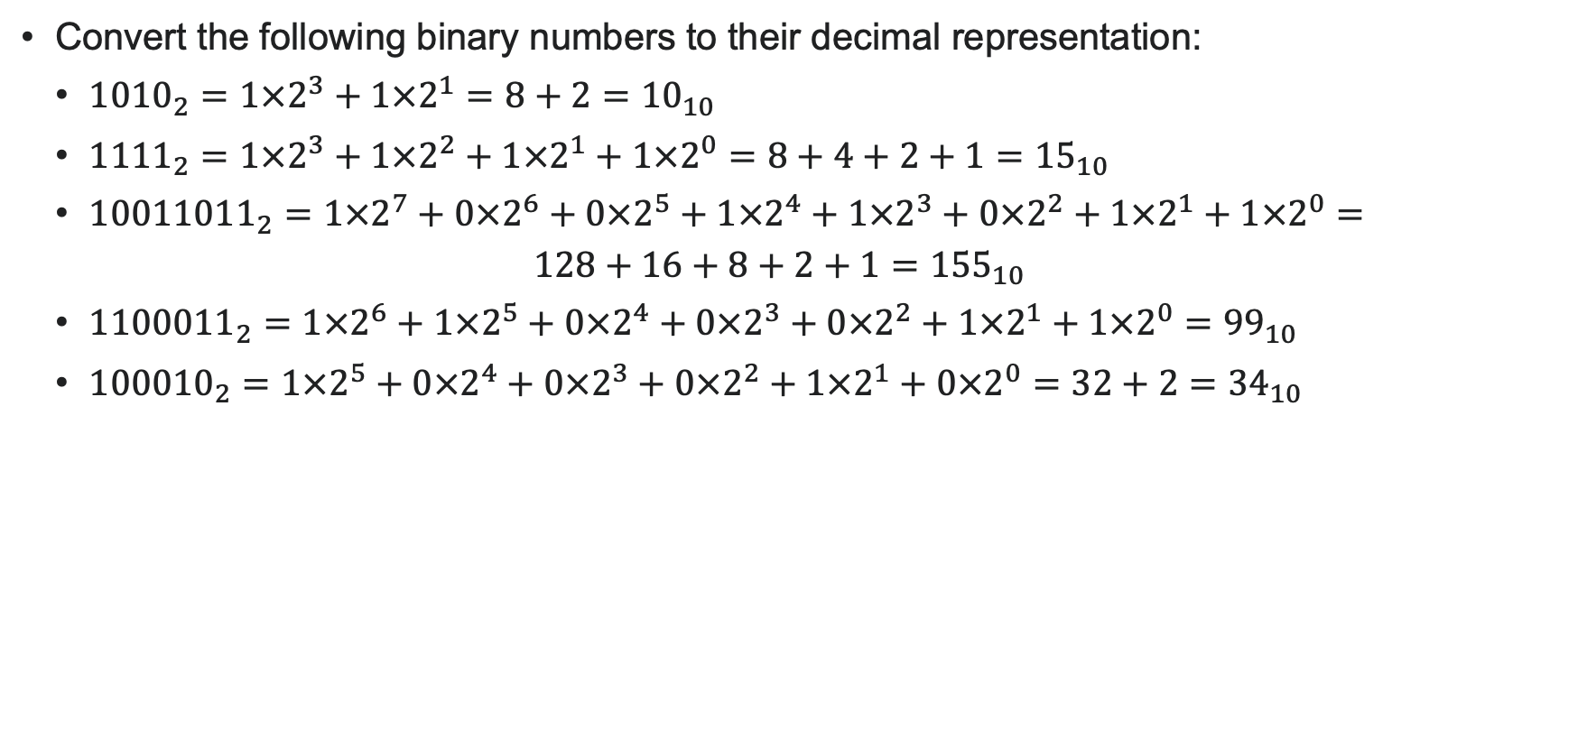
PRACTICE TIME - ANSWER
Convert the following binary numbers to their decimal representation:
  ${1010}_{2}=1×2^{3}+1×2^{1}={8+2=10}_{10}$
  ${1111}_{2}=1×2^{3}+1×2^{2}+1×2^{1}+1×2^{0}={8+4+2+1=15}_{10}$
  ${10011011}_{2}=1×2^{7}+0×2^{6}+0×2^{5}+1×2^{4}+1×2^{3}+0×2^{2}+1×2^{1}+1×2^{0}=$
  $128+16+8+2+1={155}_{10}$
  ${1100011}_{2}=1×2^{6}+1×2^{5}+0×2^{4}+0×2^{3}+0×2^{2}+1×2^{1}+1×2^{0}={99}_{10}$
  ${100010}_{2}=1×2^{5}+0×2^{4}+0×2^{3}+0×2^{2}+1×2^{1}+0×2^{0}=32+2={34}_{10}$
Notes:
Did you get this?

Slide 42
Decimal to binary conversion
$$2^{7}=$$ $$128$$ | $$2^{6}=$$ $$64$$ | $$2^{5}=$$ $$32$$ | $$2^{4}=$$ $$16$$ | $$2^{3}=$$ $$8$$ | $$2^{2}=$$ $$4$$ | $$2^{1}=$$ $$2$$ | $$2^{0}=$$ $$1$$
What is 55₁₀ in binary?

Slide 43
Decimal to binary conversion
$$2^{7}=$$ $$128$$ | $$2^{6}=$$ $$64$$ | $$2^{5}=$$ $$32$$ | $$2^{4}=$$ $$16$$ | $$2^{3}=$$ $$8$$ | $$2^{2}=$$ $$4$$ | $$2^{1}=$$ $$2$$ | $$2^{0}=$$ $$1$$
32 + 16 + 4 + 2 + 1 = 55
What is 55₁₀ in binary?

Slide 44
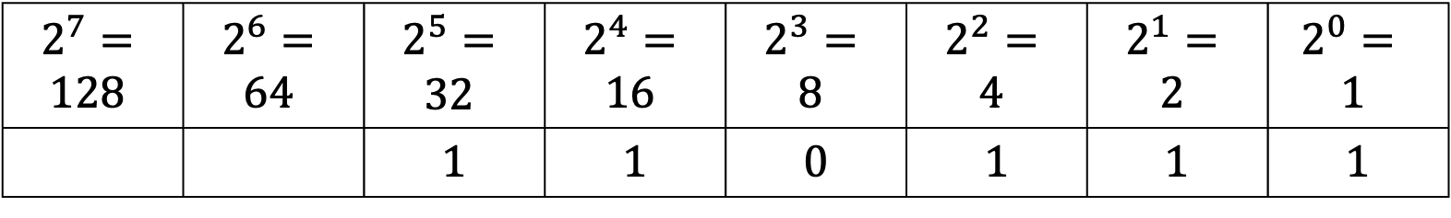
Decimal to binary conversion
$$2^{7}=$$ $$128$$ | $$2^{6}=$$ $$64$$ | $$2^{5}=$$ $$32$$ | $$2^{4}=$$ $$16$$ | $$2^{3}=$$ $$8$$ | $$2^{2}=$$ $$4$$ | $$2^{1}=$$ $$2$$ | $$2^{0}=$$ $$1$$
 |  | 1 | 1 | 0 | 1 | 1 | 1
32 + 16 + 4 + 2 + 1 = 55 = 110111₂
What is 55₁₀ in binary?

Slide 45
Decimal to binary conversion
$$2^{7}=$$ $$128$$ | $$2^{6}=$$ $$64$$ | $$2^{5}=$$ $$32$$ | $$2^{4}=$$ $$16$$ | $$2^{3}=$$ $$8$$ | $$2^{2}=$$ $$4$$ | $$2^{1}=$$ $$2$$ | $$2^{0}=$$ $$1$$
What is 84₁₀ in binary?

Slide 46
Decimal to binary conversion
$$2^{7}=$$ $$128$$ | $$2^{6}=$$ $$64$$ | $$2^{5}=$$ $$32$$ | $$2^{4}=$$ $$16$$ | $$2^{3}=$$ $$8$$ | $$2^{2}=$$ $$4$$ | $$2^{1}=$$ $$2$$ | $$2^{0}=$$ $$1$$
64 + 16 + 4 = 84
What is 84₁₀ in binary?

Slide 47
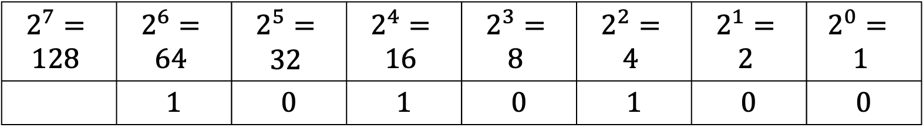
Decimal to binary conversion
$$2^{7}=$$ $$128$$ | $$2^{6}=$$ $$64$$ | $$2^{5}=$$ $$32$$ | $$2^{4}=$$ $$16$$ | $$2^{3}=$$ $$8$$ | $$2^{2}=$$ $$4$$ | $$2^{1}=$$ $$2$$ | $$2^{0}=$$ $$1$$
 | 1 | 0 | 1 | 0 | 1 | 0 | 0
32 + 16 + 4 = 84 = 1010100₂
What is 84₁₀ in binary?

Slide 48
Decimal to binary: another approach
9247₁₀= $9 × 103 + 2 × 102 + 4 × 101 + 7 × 100$
How can we get this digit?

Slide 49
Decimal to binary: another approach
9247₁₀= $9 × 103 + 2 × 102 + 4 × 101 + 7 × 100$
How can we get this digit?
Modulo (remainder) by the base (10)

Slide 50
Decimal to binary: another approach
9247₁₀= $9 × 103 + 2 × 102 + 4 × 101 + 7 × 100$
9247₁₀= (924)*10 + 7
How can we get this digit?

Slide 51
Decimal to binary: another approach
9247₁₀= $9 × 103 + 2 × 102 + 4 × 101 + 7 × 100$
9247₁₀= (924)*10 + 7
Divide by 10 (base) then
Modulo (remainder) by the base (10)
How can we get this digit?

Slide 52
Decimal to binary: another approach
9247₁₀= $9 × 103 + 2 × 102 +4 × 101 + 7 × 100$
9247₁₀= (92)$×102$+$4 ×$10+ 7
How can we get this digit?

Slide 53
Decimal to binary: another approach
9247₁₀= $9 × 103 + 2 × 102 +4 × 101 + 7 × 100$
9247₁₀= (92)$×102$+$4 ×$10+ 7
Divide by 10² then
Modulo (remainder) by the base (10)
How can we get this digit?

Slide 54
Decimal to binary: another approach
9247₁₀= $9 × 103 + 2 × 102 +4 × 101 + 7 × 100$
= $9 × 103 + 2 × 102 +4 × 101 + 7$
= $\left(9 × 102 + 2 × 101 +4\right)×10+ 7$
= $((9 × 10)+ 2)×10+4) ×10+ 7$

Slide 55
Decimal to binary: another approach
9247₁₀= $9 × 103 + 2 × 102 +4 × 101 + 7 × 100$
= $((9 × 10)+ 2)×10+4) ×10+ 7$
Another way to build up a number:
Remainder by base to get next (right-most) digit
Divide by base
Repeat

Slide 56

Decimal to binary: another approach
Repeatedly divide the number by 2. The remainder goes to each column, from right to left.
Example: Convert the decimal number ${84}_{10}$ to binary.
Divide by 2 | Remainder
84 |  | LSB
 |  | MSB
MSB |  |  |  |  |  | LSB

Slide 57

Decimal to binary conversion
Repeatedly divide the number by 2. The remainder goes to each column, from right to left.
Example: Convert the decimal number ${84}_{10}$ to binary.
  $\frac{84}{2}=42$ with a remainder of 0, so 0 goes in the 1’s column.
Divide by 2 | Remainder
84 | 0 | LSB
42
 |  | MSB
 |  |  |  |  |  | 1
 |  |  |  |  |  | 0
MSB |  |  |  |  |  | LSB
Notes:
84/2 = 42 with a remainder of 0. So 0 goes in the 1s column. We next divide 42 by 2.

Slide 58

Decimal to binary conversion
Repeatedly divide the number by 2. The remainder goes to each column, from right to left.
Example: Convert the decimal number ${84}_{10}$ to binary.
  $\frac{84}{2}=42$ with a remainder of 0, so 0 goes in the 1’s column.
  $\frac{42}{2}=21$ with a remainder of 0, so 0 goes in the 2’s column.
Divide by 2 | Remainder
84 | 0 | LSB
42 | 0
21
 |  | MSB
 |  |  |  |  | 2 | 1
 |  |  |  |  | 0 | 0
MSB |  |  |  |  |  | LSB
Notes:
42/2 – 21 with a remainder of 0. So 0 goes to the 2s column. We next divide 21 by 2.

Slide 59
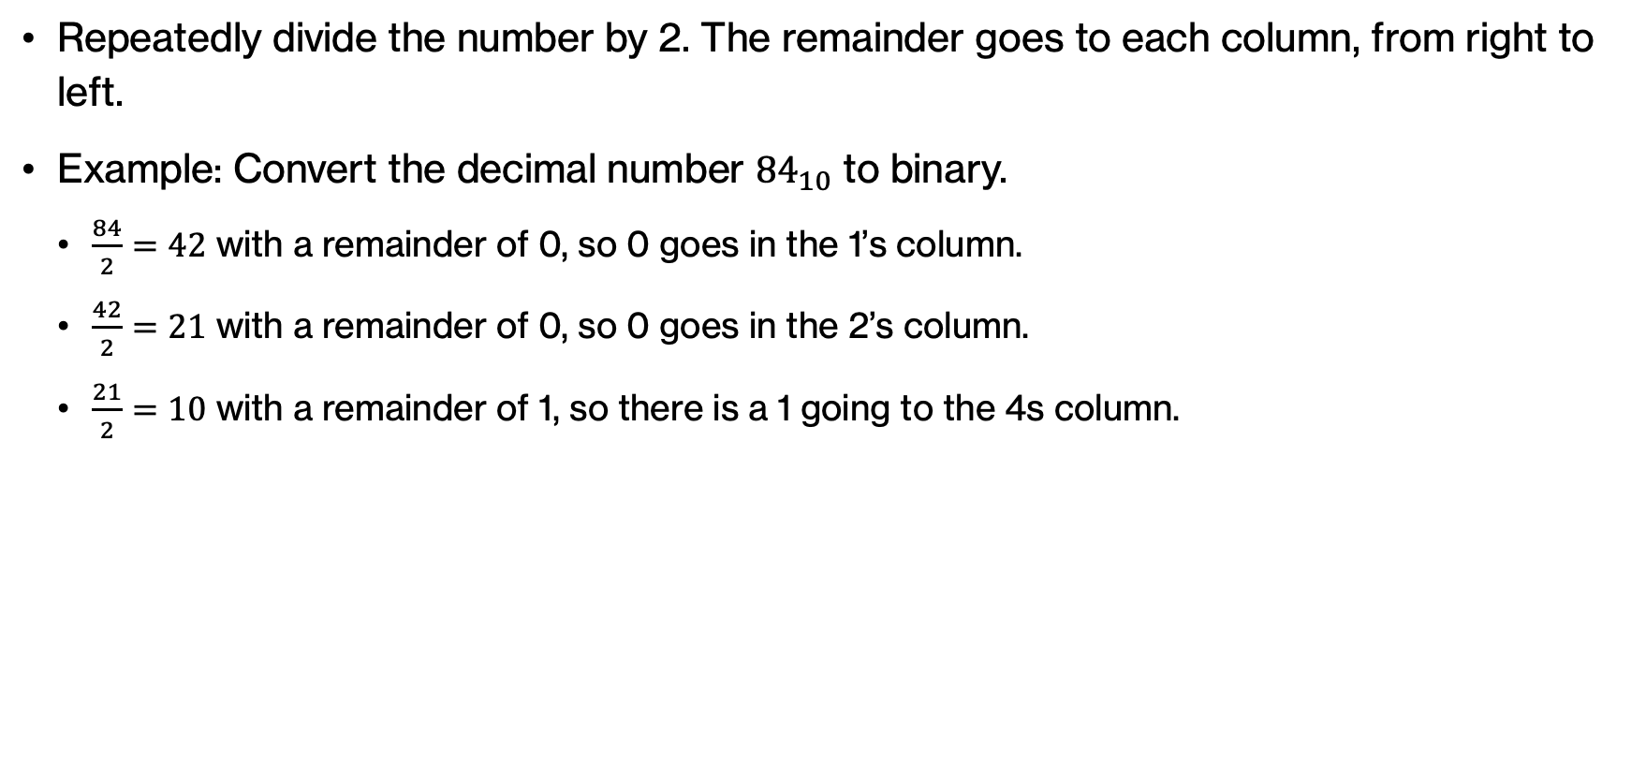
Decimal to binary conversion
Repeatedly divide the number by 2. The remainder goes to each column, from right to left.
Example: Convert the decimal number ${84}_{10}$ to binary.
  $\frac{84}{2}=42$ with a remainder of 0, so 0 goes in the 1’s column.
  $\frac{42}{2}=21$ with a remainder of 0, so 0 goes in the 2’s column.
  $\frac{21}{2}=10$ with a remainder of 1, so there is a 1 going to the 4s column.
Divide by 2 | Remainder
84 | 0 | LSB
42 | 0
21 | 1
 |  | MSB
 |  |  |  | 4 | 2 | 1
 |  |  |  | 1 | 0 | 0
MSB |  |  |  |  |  | LSB
Notes:
21/2 = 10 with a remainder of 1. So 1 goes to the 4s column. We next divide 10 by 2.

Slide 60
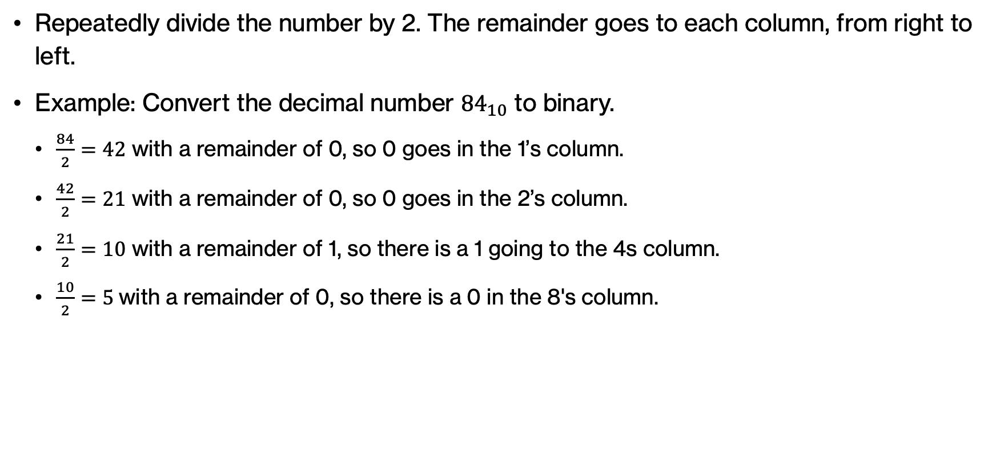
Decimal to binary conversion
Repeatedly divide the number by 2. The remainder goes to each column, from right to left.
Example: Convert the decimal number ${84}_{10}$ to binary.
  $\frac{84}{2}=42$ with a remainder of 0, so 0 goes in the 1’s column.
  $\frac{42}{2}=21$ with a remainder of 0, so 0 goes in the 2’s column.
  $\frac{21}{2}=10$ with a remainder of 1, so there is a 1 going to the 4s column.
  $\frac{10}{2}=5 \text{with} \text{a} \text{remainder} \text{of}\text{ 0}$, so there is a 0 in the 8's column.
Divide by 2 | Remainder
84 | 0 | LSB
42 | 0
21 | 1
10 | 0
5
 |  | MSB
 |  |  | 8 | 4 | 2 | 1
 |  |  | 0 | 1 | 0 | 0
MSB |  |  |  |  |  | LSB
Notes:
10/2 = 5 with a remainder of 0 so 0 goes to the 8s column and we next divide 5 by 2.

Slide 61
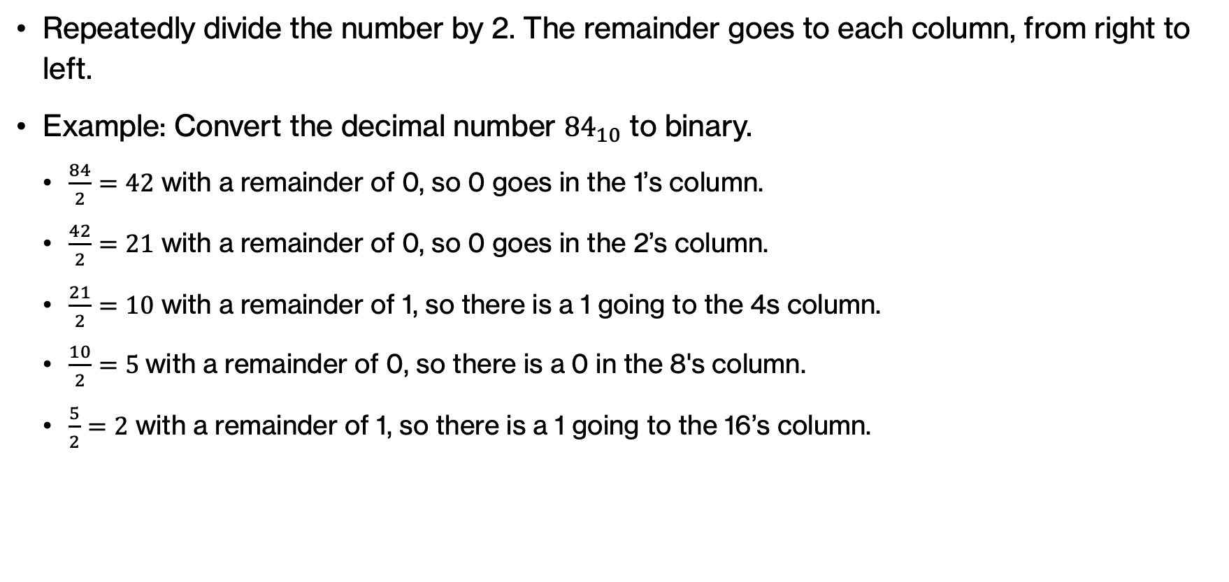
Decimal to binary conversion
Repeatedly divide the number by 2. The remainder goes to each column, from right to left.
Example: Convert the decimal number ${84}_{10}$ to binary.
  $\frac{84}{2}=42$ with a remainder of 0, so 0 goes in the 1’s column.
  $\frac{42}{2}=21$ with a remainder of 0, so 0 goes in the 2’s column.
  $\frac{21}{2}=10$ with a remainder of 1, so there is a 1 going to the 4s column.
  $\frac{10}{2}=5 \text{with} \text{a} \text{remainder} \text{of}\text{ 0}$, so there is a 0 in the 8's column.
  $\frac{5}{2}=2$ with a remainder of 1, so there is a 1 going to the 16’s column.
Divide by 2 | Remainder
84 | 0 | LSB
42 | 0
21 | 1
10 | 0
5 | 1
2
 |  | MSB
 |  | 16 | 8 | 4 | 2 | 1
 |  | 1 | 0 | 1 | 0 | 0
MSB |  |  |  |  |  | LSB
Notes:
5/2=2 with a remainder of 1. So 1 goes to the 16s column. We next divide 2 by 2.

Slide 62
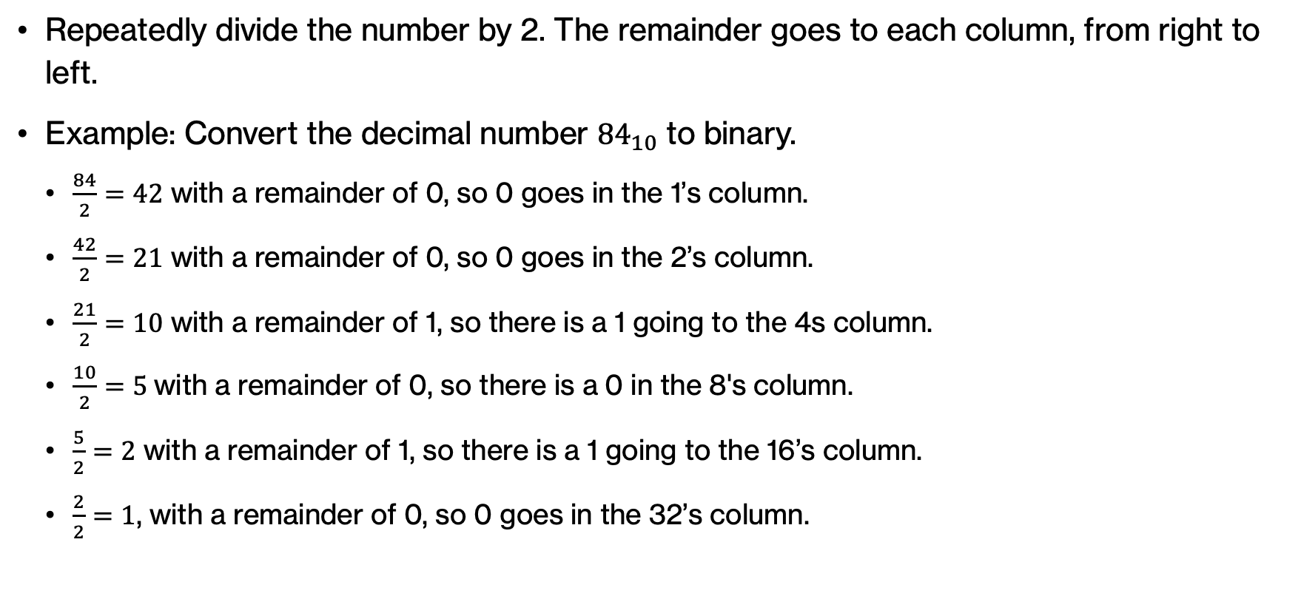
Decimal to binary conversion
Repeatedly divide the number by 2. The remainder goes to each column, from right to left.
Example: Convert the decimal number ${84}_{10}$ to binary.
  $\frac{84}{2}=42$ with a remainder of 0, so 0 goes in the 1’s column.
  $\frac{42}{2}=21$ with a remainder of 0, so 0 goes in the 2’s column.
  $\frac{21}{2}=10$ with a remainder of 1, so there is a 1 going to the 4s column.
  $\frac{10}{2}=5 \text{with} \text{a} \text{remainder} \text{of}\text{ 0}$, so there is a 0 in the 8's column.
  $\frac{5}{2}=2$ with a remainder of 1, so there is a 1 going to the 16’s column.
  $\frac{2}{2}=1$, with a remainder of 0, so 0 goes in the 32’s column.
Divide by 2 | Remainder
84 | 0 | LSB
42 | 0
21 | 1
10 | 0
5 | 1
2 | 0
1 |  | MSB
 | 32 | 16 | 8 | 4 | 2 | 1
 | 0 | 1 | 0 | 1 | 0 | 0
MSB |  |  |  |  |  | LSB
Notes:
2/2 = 1, with a remainder of 0. So 0 goes in the 32s column. We next divide 1 by 2.

Slide 63
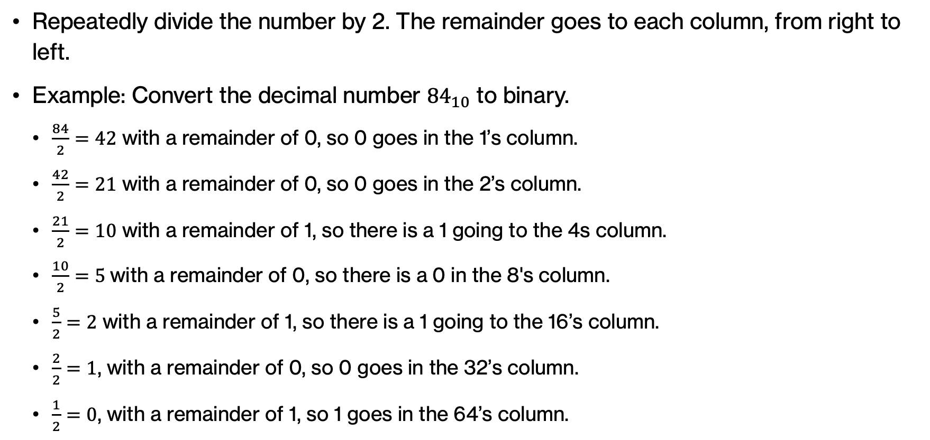
Decimal to binary conversion
Repeatedly divide the number by 2. The remainder goes to each column, from right to left.
Example: Convert the decimal number ${84}_{10}$ to binary.
  $\frac{84}{2}=42$ with a remainder of 0, so 0 goes in the 1’s column.
  $\frac{42}{2}=21$ with a remainder of 0, so 0 goes in the 2’s column.
  $\frac{21}{2}=10$ with a remainder of 1, so there is a 1 going to the 4s column.
  $\frac{10}{2}=5 \text{with} \text{a} \text{remainder} \text{of}\text{ 0}$, so there is a 0 in the 8's column.
  $\frac{5}{2}=2$ with a remainder of 1, so there is a 1 going to the 16’s column.
  $\frac{2}{2}=1$, with a remainder of 0, so 0 goes in the 32’s column.
  $\frac{1}{2}=0$, with a remainder of 1, so 1 goes in the 64’s column.
Divide by 2 | Remainder
84 | 0 | LSB
42 | 0
21 | 1
10 | 0
5 | 1
2 | 0
1 | 1 | MSB
64 | 32 | 16 | 8 | 4 | 2 | 1
1 | 0 | 1 | 0 | 1 | 0 | 0
MSB |  |  |  |  |  | LSB
Notes:
½=0 with a remainder of 1, so 1 goes in the 64s column.

Slide 64
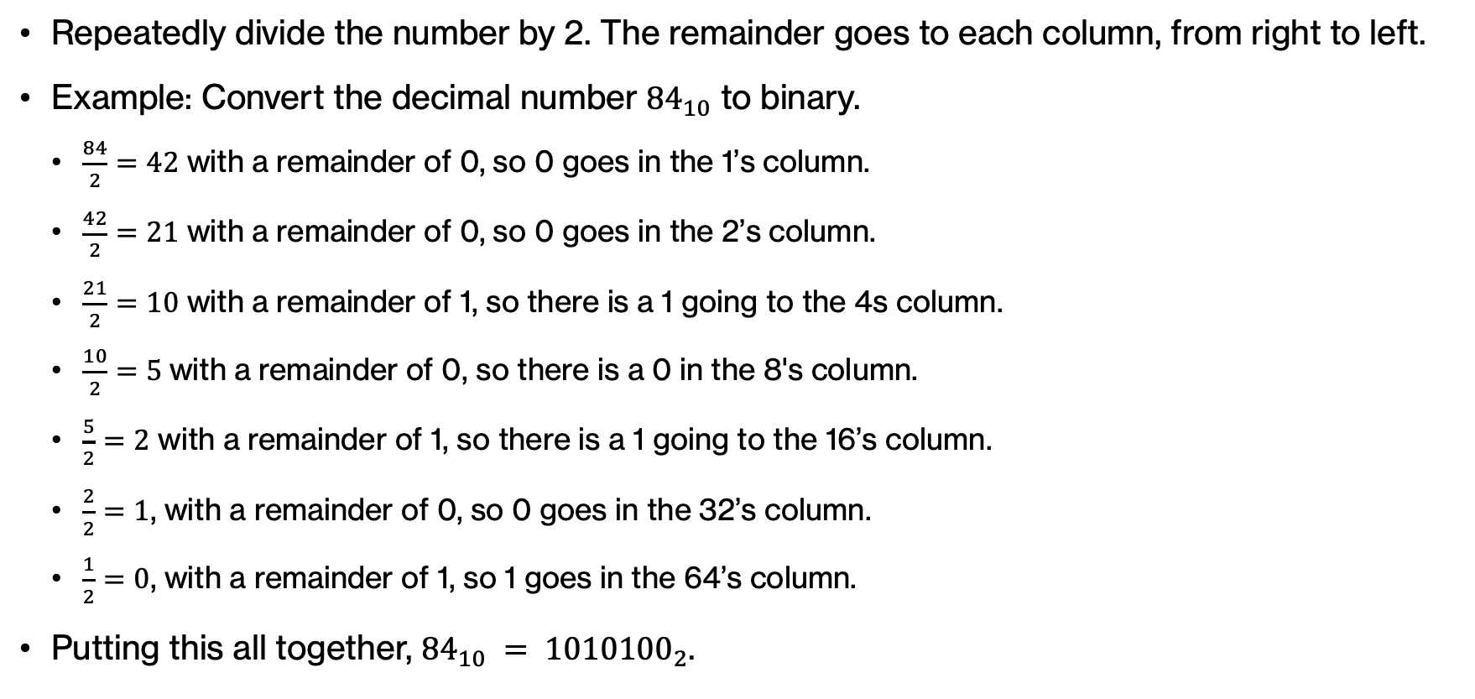
Decimal to binary conversion
Repeatedly divide the number by 2. The remainder goes to each column, from right to left.
Example: Convert the decimal number ${84}_{10}$ to binary.
  $\frac{84}{2}=42$ with a remainder of 0, so 0 goes in the 1’s column.
  $\frac{42}{2}=21$ with a remainder of 0, so 0 goes in the 2’s column.
  $\frac{21}{2}=10$ with a remainder of 1, so there is a 1 going to the 4s column.
  $\frac{10}{2}=5 \text{with} \text{a} \text{remainder} \text{of}\text{ 0}$, so there is a 0 in the 8's column.
  $\frac{5}{2}=2$ with a remainder of 1, so there is a 1 going to the 16’s column.
  $\frac{2}{2}=1$, with a remainder of 0, so 0 goes in the 32’s column.
  $\frac{1}{2}=0$, with a remainder of 1, so 1 goes in the 64’s column.
Putting this all together, ${84}_{10} = {1010100}_{2}$.
Divide by 2 | Remainder
84 | 0 | LSB
42 | 0
21 | 1
10 | 0
5 | 1
2 | 0
1 | 1 | MSB
64 | 32 | 16 | 8 | 4 | 2 | 1
1 | 0 | 1 | 0 | 1 | 0 | 0
MSB |  |  |  |  |  | LSB
Notes:
Putting this all together, ${84}_{10} = {1010100}_{2}$.

Slide 65

PRACTICE TIME
Convert the following decimal numbers to their binary representation.
  ${125}_{10}$
  ${339}_{10}$
  ${75}_{10}$
$$2^{8}=$$ $$256$$ | $$2^{7}=$$ $$128$$ | $$2^{6}=$$ $$64$$ | $$2^{5}=$$ $$32$$ | $$2^{4}=$$ $$16$$ | $$2^{3}=$$ $$8$$ | $$2^{2}=$$ $$4$$ | $$2^{1}=$$ $$2$$ | $$2^{0}=$$ $$1$$
Notes:
Practice converting the following decimal numbers to binary.

Slide 66

PRACTICE TIME
Convert the following decimal numbers to their binary representation.
  ${125}_{10}=64+32+16+8+4+0+1=11111012$
  ${339}_{10}=256+0+64+0+16+0±0+2+1=1010100112$
  ${75}_{10}=64+0+0+8+0+2+1=10010112$
$$2^{8}=$$ $$256$$ | $$2^{7}=$$ $$128$$ | $$2^{6}=$$ $$64$$ | $$2^{5}=$$ $$32$$ | $$2^{4}=$$ $$16$$ | $$2^{3}=$$ $$8$$ | $$2^{2}=$$ $$4$$ | $$2^{1}=$$ $$2$$ | $$2^{0}=$$ $$1$$
Notes:
Practice converting the following decimal numbers to binary.

Slide 67

PRACTICE TIME - ANSWER
Convert the following decimal numbers to their binary representation.
  ${{125}_{10}=1111101}_{2}$ ${{339}_{10}=101010011}_{2}$ ${{75}_{10}=1001011}_{2}$
Divide by 2 | Remainder
125 | 1 | LSB
62 | 0
31 | 1
15 | 1
7 | 1
3 | 1
1 | 1 | MSB
Divide by 2 | Remainder
339 | 1 | LSB
169 | 1
84 | 0
42 | 0
21 | 1
10 | 0
5 | 1
2 | 0
1 | 1 | MSB
Divide by 2 | Remainder
75 | 1 | LSB
37 | 1
18 | 0
9 | 1
4 | 0
2 | 0
1 | 1 | MSB
Notes:
This is what you should have gotten.

Slide 68
Hexadecimal
What are valid digits for base 16 numbers (aka, hexadecimal numbers)?

Slide 69
Hexadecimal numbers
For any base, the digits (individual numbers in the number) range from 0 to base - 1
Base 16 digits: 0, 1, 2, 3, 4, …, 15

Slide 70
Hexadecimal numbers
For any base, the digits (individual numbers in the number) range from 0 to base - 1
Base 16 digits: 0, 1, 2, 3, 4, …, 15
Any problems with this?

Slide 71
Hexadecimal numbers
For any base, the digits (individual numbers in the number) range from 0 to base - 1
Base 16 digits: 0, 1, 2, …, 9, A, B, C, D, E, F
10, 11, 12, 13, 14, 15

Slide 72
Hexadecimal numbers
A, B, C, D, E, F
10, 11, 12, 13, 14, 15
What number is 2A7₁₆?

Slide 73
Hexadecimal numbers
A, B, C, D, E, F
10, 11, 12, 13, 14, 15
What number is 2A7₁₆?

Slide 74
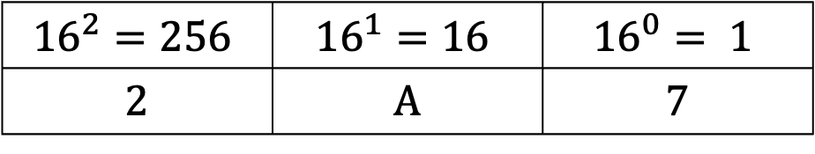
Hexadecimal numbers
A, B, C, D, E, F
10, 11, 12, 13, 14, 15
What number is 2A7₁₆?
$${16}^{2}=256$$ | $${16}^{1}=16$$ | $${16}^{0}= 1$$
2 | A | 7

Slide 75
Hexadecimal numbers
A, B, C, D, E, F
10, 11, 12, 13, 14, 15
What number is 2A7₁₆?
$${16}^{2}=256$$ | $${16}^{1}=16$$ | $${16}^{0}= 1$$
2 | A | 7
    $$\text{2}\text{A}716=2×{16}^{2}+10×{16}^{1}+7×{16}^{0}$$
    $$=2×256+10×16+7=67910$$

Slide 76

Hexadecimal numbers
$d_{n−1}{…d}_{2}d_{1}d_{0}$ represents the integer
$$d_{n−1}{16}^{n−1}+{…+d}_{2}{16}^{2}+d_{1}16+d_{0}{16}^{0}$$
For a d digit hexadecimal number, what are the range of values? E.g., three digits?

Slide 77
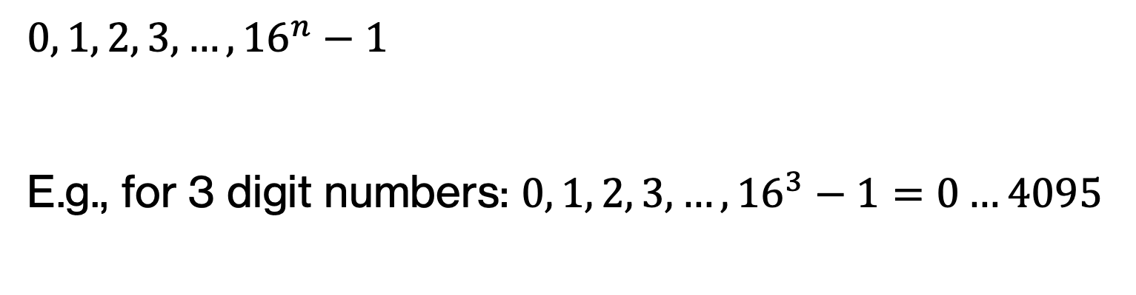
Hexadecimal numbers
$d_{n−1}{…d}_{2}d_{1}d_{0}$ represents the integer
$$d_{n−1}{16}^{n−1}+{…+d}_{2}{16}^{2}+d_{1}16+d_{0}{16}^{0}$$
$$0, 1, 2, 3, …, {16}^{n}−1$$
E.g., for 3 digit numbers: $0, 1, 2, 3, …, {16}^{3}−1=0…4095$

Slide 78
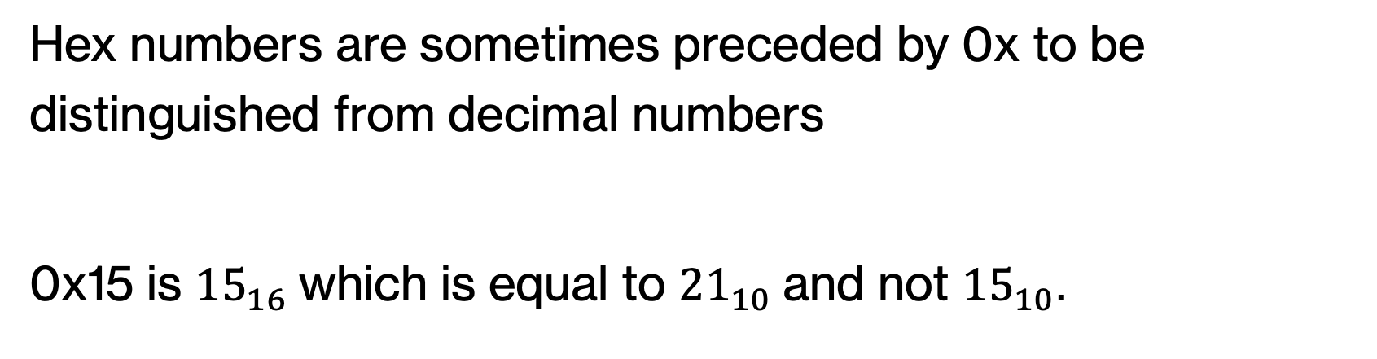
Hexadecimal numbers
Hex numbers are sometimes preceded by 0x to be distinguished from decimal numbers
0x15 is ${15}_{16}$which is equal to ${21}_{10}$and not ${15}_{10}$.

Slide 79
Equivalence across number systems
Hexadecimal digit | Binary equivalent | Decimal equivalent
0 | 0000 | 0
1 | 0001 | 1
2 | 0010 | 2
3 | 0011 | 3
4 | 0100 | 4
5 | 0101 | 5
6 | 0110 | 6
7 | 0111 | 7
8 | 1000 | 8
9 | 1001 | 9
A | 1010 | 10
B | 1011 | 11
C | 1100 | 12
D | 1101 | 13
E | 1110 | 14
F | 1111 | 15

Slide 80

PRACTICE TIME
Convert the following hexadecimal numbers to their decimal representation.
  ${32A}_{16}$
  ${D1CE}_{16}$
  ${1B7F}_{16}$
  ${47}_{16}$
Notes:
Let's practice by converting the hexadecimal numbers to decimal.

Slide 81

ANSWER
Convert the following hexadecimal numbers to their decimal representation.
  ${32A}_{16}=3×{16}^{2}+2×{16}^{1}+10×{16}^{0}={810}_{10}$
  ${D1CE}_{16}=13×{16}^{3}+1×{16}^{2}+12×{16}^{1}+14×{16}^{0}={53710}_{10}$
  ${1B7F}_{16}=1×{16}^{3}+11×{16}^{2}+7×{16}^{1}+15×{16}^{0}={7039}_{10}$
  ${47}_{16}=4×{16}^{1}+7×{16}^{0}={71}_{10}$
Notes:
Is this what you got?

Slide 82

Decimal to hexadecimal conversion
Repeatedly divide by 16 and leave remainder as LSB
Example: Convert the decimal number ${333}_{10}$ to hexadecimal.
Divide by 16 | Remainder
333 |  | LSB
 |  | MSB
Notes:
Similarly to converting from decimal to binary, we will now repeatedly divide by 16 and the remainder is converted to hexadecimal and goes to the corresponding column from right to left.
Let's see an example of converting the decimal number 333 to hex. We start by dividing it by 16.

Slide 83

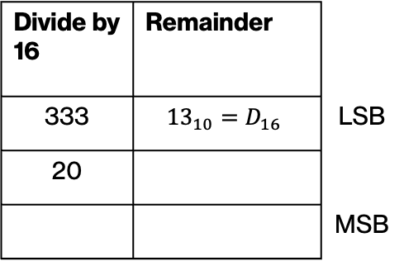
Decimal to hexadecimal conversion
Repeatedly divide by 16 and leave remainder as LSB
Example: Convert the decimal number ${333}_{10}$ to hexadecimal.
  $\frac{333}{16}=20$ with a remainder of ${13}_{10}=D_{16}$ which goes in the 1’s column.
Divide by 16 | Remainder
333 | $${13}_{10}=D_{16}$$ | LSB
20
 |  | MSB
 |  | 1
 |  | D
Notes:
333/16=20 with a remainder of 13 (in decimal) or D in hex. So we put D in the 1s column. We next divide 20 by 16.

Slide 84

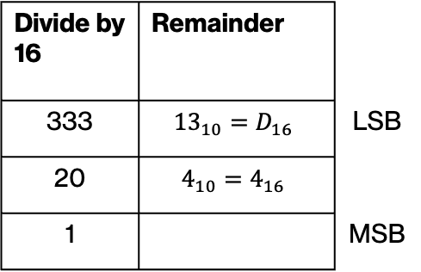
Decimal to hexadecimal conversion
Repeatedly divide by 16 and leave remainder as LSB
Example: Convert the decimal number ${333}_{10}$ to hexadecimal.
  $\frac{333}{16}=20$ with a remainder of ${13}_{10}=D_{16}$ which goes in the 1’s column.
  $\frac{20}{16}=1$ with a remainder of 4, so 4 goes in the 16’s column.
Divide by 16 | Remainder
333 | $${13}_{10}=D_{16}$$ | LSB
20 | $$4_{10}=4_{16}$$
1 |  | MSB
 | 16 | 1
 | 4 | D
Notes:
20/16$=1$ with a remainder of 4 (same in decimal and hex), so 4 goes in the 16’s column. We next divide 1 by 16.

Slide 85
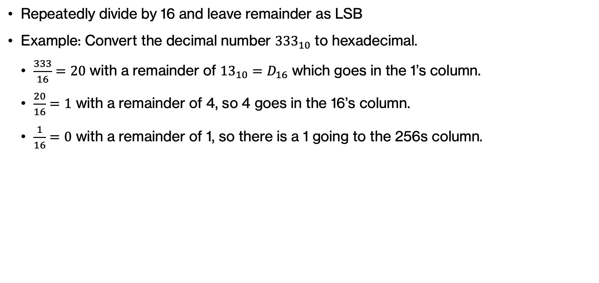
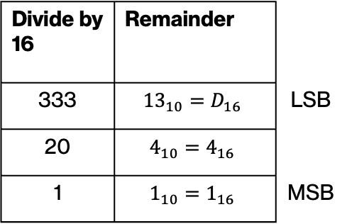
Decimal to hexadecimal conversion
Repeatedly divide by 16 and leave remainder as LSB
Example: Convert the decimal number ${333}_{10}$ to hexadecimal.
  $\frac{333}{16}=20$ with a remainder of ${13}_{10}=D_{16}$ which goes in the 1’s column.
  $\frac{20}{16}=1$ with a remainder of 4, so 4 goes in the 16’s column.
  $\frac{1}{16}=0$ with a remainder of 1, so there is a 1 going to the 256s column.
Divide by 16 | Remainder
333 | $${13}_{10}=D_{16}$$ | LSB
20 | $$4_{10}=4_{16}$$
1 | $$1_{10}=1_{16}$$ | MSB
256 | 16 | 1
1 | 4 | D
Notes:
$\frac{1}{16}=0$ with a remainder of 1 (same in decimal and hex), so there is a 1 going to the 256s column.

Slide 86
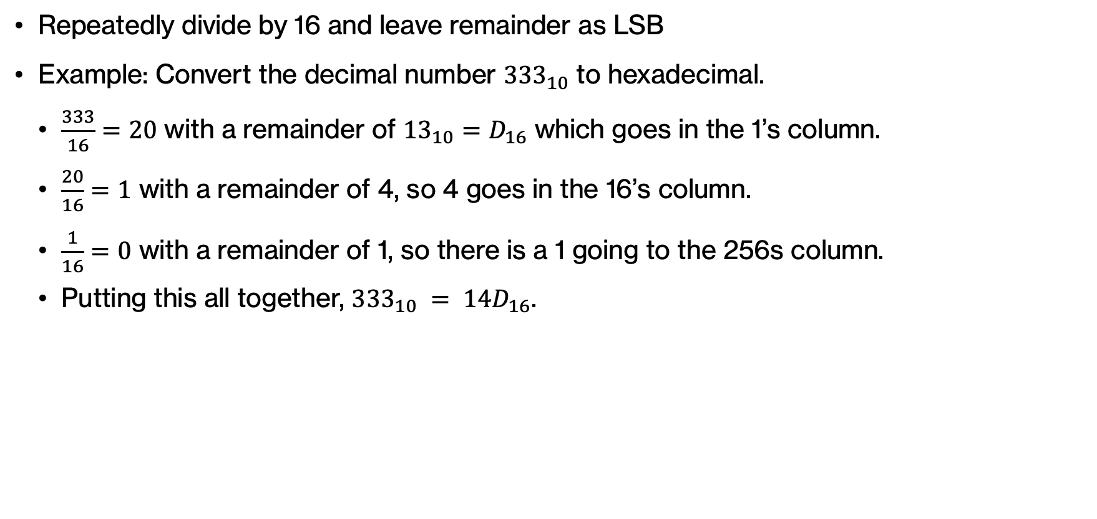
Decimal to hexadecimal conversion
Repeatedly divide by 16 and leave remainder as LSB
Example: Convert the decimal number ${333}_{10}$ to hexadecimal.
  $\frac{333}{16}=20$ with a remainder of ${13}_{10}=D_{16}$ which goes in the 1’s column.
  $\frac{20}{16}=1$ with a remainder of 4, so 4 goes in the 16’s column.
  $\frac{1}{16}=0$ with a remainder of 1, so there is a 1 going to the 256s column.
  Putting this all together, ${333}_{10} = {14D}_{16}$.
Divide by 16 | Remainder
333 | $${13}_{10}=D_{16}$$ | LSB
20 | $$4_{10}=4_{16}$$
1 | $$1_{10}=1_{16}$$ | MSB
256 | 16 | 1
1 | 4 | D
Notes:
Putting this all together, ${333}_{10} = {14D}_{16}$.

Slide 87

PRACTICE TIME
Convert the following decimal numbers to their hexadecimal representation.
  ${2546}_{10}$
  ${1457}_{10}$
  ${269}_{10}$
  ${47}_{10}$
Notes:
Let's practice by converting the following decimal numbers to their hex representation.

Slide 88

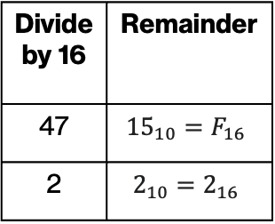
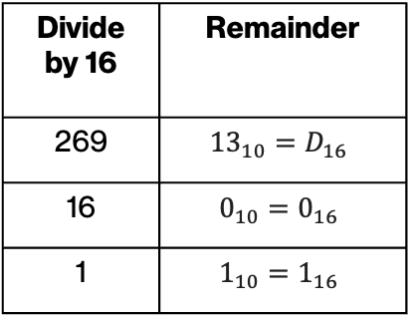
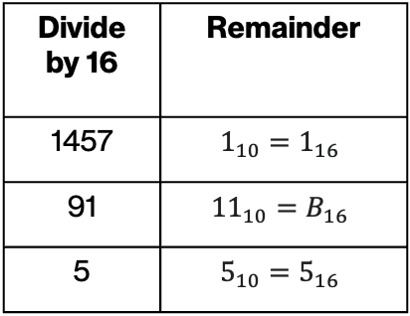
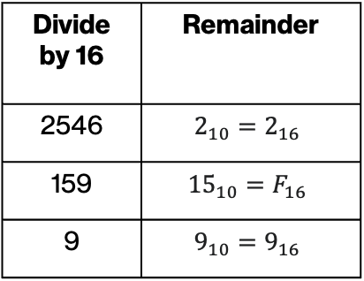
ANSWER
Convert the following decimal numbers to their hexadecimal representation.
  ${2546}_{10}=9F2$ ${1457}_{10}=5B1$ ${ 269}_{10}=10D$ ${47}_{10}=2F$
Divide by 16 | Remainder
2546 | $$2_{10}=2_{16}$$
159 | $${15}_{10}=F_{16}$$
9 | $$9_{10}=9_{16}$$
Divide by 16 | Remainder
1457 | $$1_{10}=1_{16}$$
91 | $${11}_{10}=B_{16}$$
5 | $$5_{10}=5_{16}$$
Divide by 16 | Remainder
269 | $${13}_{10}=D_{16}$$
16 | $$0_{10}=0_{16}$$
1 | $$1_{10}=1_{16}$$
Divide by 16 | Remainder
47 | $${15}_{10}=F_{16}$$
2 | $$2_{10}=2_{16}$$
LSB
MSB
Notes:
Is this what you got?

Slide 89

Binary to Hexadecimal conversion
$${ 110011100010000}_{2}$$
What is the following binary number in hexadecimal?

Slide 90
4 bits is equal to one hex digit
Hexadecimal digit | Binary equivalent | Decimal equivalent
0 | 0000 | 0
1 | 0001 | 1
2 | 0010 | 2
3 | 0011 | 3
4 | 0100 | 4
5 | 0101 | 5
6 | 0110 | 6
7 | 0111 | 7
8 | 1000 | 8
9 | 1001 | 9
A | 1010 | 10
B | 1011 | 11
C | 1100 | 12
D | 1101 | 13
E | 1110 | 14
F | 1111 | 15

Slide 91
Binary to Hexadecimal conversion
Hexadecimal digit | Binary equivalent
0 | 0000
1 | 0001
2 | 0010
3 | 0011
4 | 0100
5 | 0101
6 | 0110
7 | 0111
8 | 1000
9 | 1001
A | 1010
B | 1011
C | 1100
D | 1101
E | 1110
F | 1111
$${ 110011100010000}_{2}$$
break into 4 bit groups
  ${0110 0111 0001 0000}_{2}$

Slide 92
Binary to Hexadecimal conversion
Hexadecimal digit | Binary equivalent
0 | 0000
1 | 0001
2 | 0010
3 | 0011
4 | 0100
5 | 0101
6 | 0110
7 | 0111
8 | 1000
9 | 1001
A | 1010
B | 1011
C | 1100
D | 1101
E | 1110
F | 1111
$${ 110011100010000}_{2}$$
break into 4 bit groups
  ${0110 0111 0001 0000}_{2}$
convert each 4 bit group into a digit

Slide 93

Binary to Hexadecimal conversion
Hexadecimal digit | Binary equivalent
0 | 0000
1 | 0001
2 | 0010
3 | 0011
4 | 0100
5 | 0101
6 | 0110
7 | 0111
8 | 1000
9 | 1001
A | 1010
B | 1011
C | 1100
D | 1101
E | 1110
F | 1111
$${ 110011100010000}_{2}$$
break into 4 bit groups
  ${0110 0111 0001 0000}_{2}$
convert each 4 bit group into a digit
  ${6 7 1 0}_{16}$

Slide 94

PRACTICE TIME
Hexadecimal digit | Binary equivalent
0 | 0000
1 | 0001
2 | 0010
3 | 0011
4 | 0100
5 | 0101
6 | 0110
7 | 0111
8 | 1000
9 | 1001
A | 1010
B | 1011
C | 1100
D | 1101
E | 1110
F | 1111
Convert the following binary numbers to their hexadecimal representation.
  ${10010011}_{2}$
  ${101100110101}_{2}$
  ${11011}_{2}$
  ${11111011101110010}_{2}$
Notes:
Can you give it a try?

Slide 95

ANSWER
Hexadecimal digit | Binary equivalent
0 | 0000
1 | 0001
2 | 0010
3 | 0011
4 | 0100
5 | 0101
6 | 0110
7 | 0111
8 | 1000
9 | 1001
A | 1010
B | 1011
C | 1100
D | 1101
E | 1110
F | 1111
Convert the following binary numbers to their hexadecimal representation.
  ${1001 0011}_{2}={93}_{16}$
  ${1011 0011 0101}_{2}=B{35}_{16}$
  ${11011}_{2}=0001 1011=1B16$
  ${11111011101110010}_{2}=0001 1111 0111 0111 0010=1F{772}_{16}$

Slide 96

Hexadecimal to binary conversion
Hexadecimal digit | Binary equivalent
0 | 0000
1 | 0001
2 | 0010
3 | 0011
4 | 0100
5 | 0101
6 | 0110
7 | 0111
8 | 1000
9 | 1001
A | 1010
B | 1011
C | 1100
D | 1101
E | 1110
F | 1111
We replace each hex digit with the four binary bits that correspond to its value.
Example: Convert the hexadecimal number ${CAFE}_{16}$ to its binary representation.
  $C_{16}={1100}_{2}$
  $A_{16}={1010}_{2}$
  $F_{16}={1111}_{2}$
  $E_{16 }={1110}_{2}$
  Putting this all together, ${CAFE}_{16} = {1100101011111110}_{2}$.
Notes:
To go from hex to binary, we replace each hex digit with the four binary bits that correspond to its value.

Slide 97

PRACTICE TIME
Hexadecimal digit | Binary equivalent
0 | 0000
1 | 0001
2 | 0010
3 | 0011
4 | 0100
5 | 0101
6 | 0110
7 | 0111
8 | 1000
9 | 1001
A | 1010
B | 1011
C | 1100
D | 1101
E | 1110
F | 1111
Convert the following hexadecimal numbers to their binary representation.
  ${\text{F}\text{00}\text{D}}_{16}$
  $2B3BAD_{16}$
  ${\text{DEADC}\text{0}\text{DE}}_{16}$
Notes:
Let's try it

Slide 98

ANSWER
Hexadecimal digit | Binary equivalent
0 | 0000
1 | 0001
2 | 0010
3 | 0011
4 | 0100
5 | 0101
6 | 0110
7 | 0111
8 | 1000
9 | 1001
A | 1010
B | 1011
C | 1100
D | 1101
E | 1110
F | 1111
Convert the following hexadecimal numbers to their binary representation.
  ${\text{F}\text{00}\text{D}}_{16}={1111000000001101}_{2}$
  $2B3BAD_{16}={001010110011101110101101}_{2}$
  ${\text{DEADC}\text{0}\text{DE}}_{16}={11011110101011011100000011011110}_{2}$
Notes:
Fun, huh?

Slide 99

Practice Problem
  For each row, fill in the missing entries by converting the given number from its representation to every other equivalent representation.
Binary | Decimal | Hexadecimal
 | $${39}_{10}$$
$${100111010}_{2}$$
 |  | $$BADE_{16}$$
 | $${47}_{10}$$
$${101100111}_{2}$$
 |  | $$C0FFEE_{16}$$

Slide 100

Practice Problem - ANSWER
  For each row, fill in the missing entries by converting the given number from its representation to every other equivalent representation.
Binary | Decimal | Hexadecimal
$${100111}_{2}$$ | $${39}_{10}$$ | $${27}_{16}$$
$${100111010}_{2}$$ | $${314}_{10}$$ | $$13A_{16}$$
$${1011101011011110}_{2}$$ | $${47838}_{10}$$ | $$BADE_{16}$$
$${101111}_{2}$$ | $${47}_{10}$$ | $$2F_{16}$$
$${101100111}_{2}$$ | $${359}_{10}$$ | $${167}_{16}$$
$${110000001111111111101110}_{2}$$ | $${12648430}_{10}$$ | $$C0FFEE_{16}$$

