Slide 1
Intro to Machine Learning and Perceptron
Machine Learning
Input x₁
Weight w₁
Weight w₂
Input x₂
Output y
Input x₃
Weight w₃
CS51 – Spring 2026
Weight w₄
Input x₄
Notes:
Welcome to the last unit of the class where we will learn about machine learning, a subfield of computer science that is extremely active and behind all the AI developments that are in the news.

Slide 2
Machine Learning
past
future
predict
learn
Training
Data
model/
predictor
Testing
Data
model/
predictor
Notes:
Machine learning as a field studies algorithms that learn from past data and experiences in order to predict the future. The data the algorithms learn from are called training data. We build a model or predictor that learns the training data with the goal that in the future, when we are given new data we can use the prior knowledge. The new data are called testing data. They are passed on the model/predictor we have trained on prior data and make predictions.

Slide 3

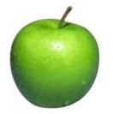
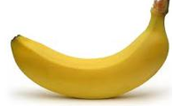
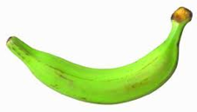
Data
examples
Data
Notes:
For example, we might have a dataset with picture, let's say of fruit, and we build a model that learns to differentiate the pictures of different fruit. If in the future we are given a new picture, we can recognize whether it is a fruit and maybe even predict what kind of fruit it is.

Slide 4

Data
examples
Data
Notes:
Or maybe we have a model that learns from past movies we have liked watching on Netflix and makes recommendations about movies we are likely to enjoy in the future. These are just two examples of machine learning algorithms but there are SO many applications out there.

Slide 5

Supervised learning learns from labeled examples
examples
labels
class
red, round, …
apple
Data
green, round, …
apple
yellow, oblong, …
banana
green, oblong, …
banana
Notes:
The are different flavors of machine learning algorithms. The most common one is supervised learning where the algorithm learns from labeled examples. Let's take our fruit picture dataset. For each picture, we would have different labels that characterize the picture. E.g., the color and shape. For each example, we also have done somehow the hard work of assigning it to a class, let's say the class here represents the type of fruit, apple or banana. We train our model on this dataset which learns a relationship between labels and classes. When in the future we get a picture of a fruit we have never seen before, we ask the model to predict what kind of fruit it is based on its own set of labels, e.g., yellow, round. This example of supervised learning is called classification because we classify examples with a finite number of labels into a finite and already agreed upon number of classes. As you can imagine, it can be quite costly to build datasets that are perfectly labeled and properly classified in order to build good classifiers.

Slide 6
Classification
Predicts a discrete category (e.g., yes/no, or a discrete number of classes)
Face recognition
Character recognition
Spam detection
Medical diagnosis
Biometrics
Notes:
Classification has a lot of applications. Face recognition is an increasingly popular one where individuals are recognized in video frames or pictures. As we have seen during the first week of class, this application is rife with racial biases. To the more innocuous side, character recognition refers to the process of recognizing non-digital text, e.g., a scanned copy of a book, or signs when walking in a new city. Spam detection is an application that we rarely think of when our email filters work well but can have catastrophic financial consequences if not successful. Medical diagnosis is another rising area of applying machine learning. Finally, biometrics where information like fingerprints, iris, etc, are used for security purposes is another example of classification.

Slide 7
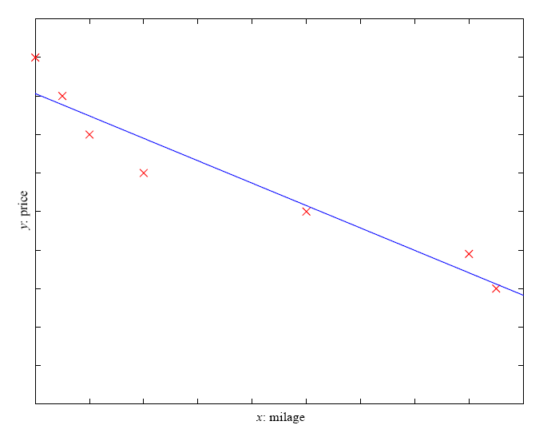
Regression
Predicts a continuous numerical value
Economics/Finance
Epidemiology
Car/plane navigation
Temporal trends
Notes:
Another type of supervised learning is regression where the outcomes are real-valued. For example, the training data could have labels like a car's mileage and the model could learn the price. When trying to buy a car, we can look into a car's mileage and see what price is reasonable. Regression examples can be found in economics and finance, e.g when predicting the value of stocks, in epidemiology, when predict outbreaks, in navigation, e.g., with autonomous cars, in temporal trends such as weather forecast and so on.

Slide 8
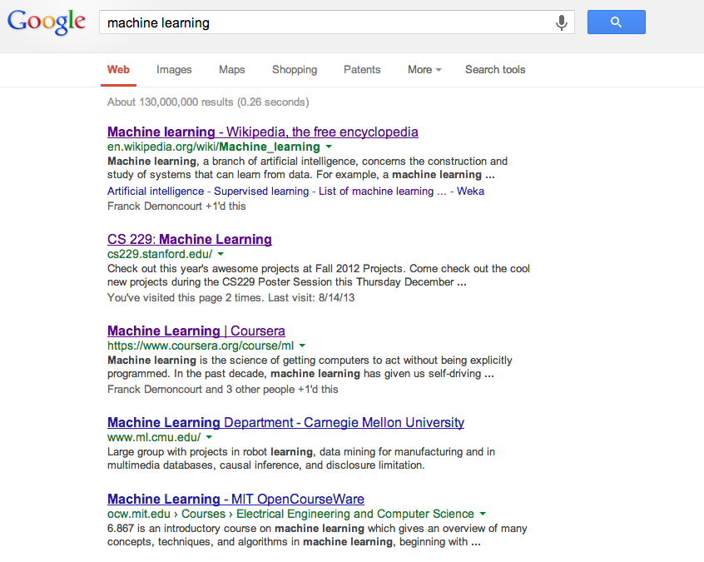
Ranking
Predicts a ranking of items
Web search
Movie/music recommendation
Flight search
Notes:
Finally, ranking algorithms are also part of supervised learning where the predicted outcome is a ranking of items, e.g., of web pages based on their relevance to a query, movie or music recommendations that are most likely to align with a user's taste, or flight search recommendations that rank flight options.

Slide 9
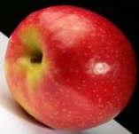
Unsupervised learning
Provided with data but not labels
Notes:
Other than supervised learning, there is unsupervised learning where we have a dataset to learn from but although we are provided with data, we are not given any labels. Think of it as being a given a bunch of pictures of fruit where you don't know which pictures are apples and which bananas. There are a lot of examples of unsupervised learning algorithms, e.g., clustering algorithms which build groups based on similarities of features or ways to segment customers etc

Slide 10
Reinforcement learning
left, right, straight, left, left, left, straight
GOOD
left, straight, straight, left, right, straight, straight
BAD
left, right, straight, left, left, left, straight
18.5
left, straight, straight, left, right, straight, straight
-3
Given a sequence of examples/states and a reward after completing that sequence, learn to predict the action to take in for an individual example/state
Notes:
Finally, with reinforcement learning, we are given a sequence of examples/states and some utility function which represents a reward loss. We learn which examples lead to good outcomes and try to maximize those. Reinforcement learning is behind a lot of robotics research.

Slide 11
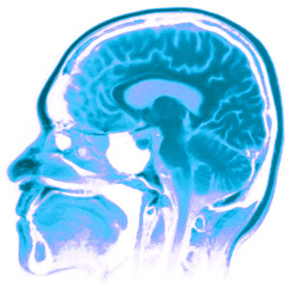
Neural networks
Neural Networks try to mimic the structure and function of our nervous system.
Notes:
11
Lately, much of the research activity in machine learning is driven by neural networks that are behind deep learning. Today, we will explore the foundations of artificial networks which draw the inspiration from biology, something that researchers have loved trying in their search for building artificial intelligence.

Slide 12
Our nervous system according to CS
the human brain is a large collection of interconnected neurons
a neuron is a brain cell
  they collect, process, and disseminate electrical signals
  hey are connected via synapses
  they fire depending on the conditions of the neighboring neurons
Neuron
Notes:
12
I am going to fudge a bit the details but neurons are the basic working unit of the brain, and are designed to transmit transmit information to other nerve cells, muscle, or gland cells. Most neurons have a cell body, an axon, and dendrites. The axon extends from the cell body and often gives rise to many smaller branches before ending at nerve terminals. Dendrites extend from the neuron cell body and receive messages from other neurons. Synapses are the contact points where one neuron communicates with another. The dendrites are covered with synapses formed by the ends of axons from other neurons. Dendrites bring information to the cell body and axons take information away from the cell body.
Computer scientists don't really care about these details. In our view, the human brain is a large collection of interconnected neurons which are connected via synapses and process electrical signals. A neuron may fire depending on the conditions of the neighboring neurons.

Slide 13
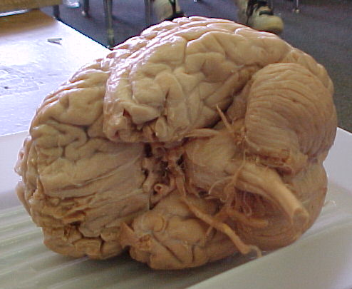
Our brains in numbers
The human brain
contains ~10¹¹ (100 billion) neurons
each neuron is connected to ~10⁴ (10,000) other neurons
Neurons can fire as fast as 10⁻³ seconds
How does this compare to a computer?
Notes:
Here are some cool numbers about our nervous system. The human brain contains 100 billion neurons and each neuron is connected to about 10,000 other neurons. Nuerons can fire as fast as 10^-3 seconds. How does a brain compare to a computer?

Slide 14
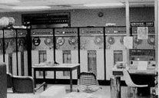
Human Vs. Machine
10¹¹ neurons
10¹¹ neurons
10¹⁴ synapses
10⁻³ “cycle” time
10¹⁰ transistors
10¹¹ bits of RAM
10¹³ bits on disk
10⁻⁹ cycle time
Notes:
You can see that there are parallels between neurons and physical components like transistors and memory. Our brains are slower than computers.

Slide 15

Brains are still pretty fast
Who is this?
Notes:
Still, brains are quite fast. As I flashed this picture, how quickly did you think it's Lebron James? In less than second.

Slide 16
Artificial neural networks
Node (Neuron)
Edge (synapses)
Notes:
16
We use our basic biological understanding of the brain to approximate artificial networks where nodes are neurons and edges are synapses.

Slide 17
Node A
Weight w
Node B
(neuron)
(neuron)
W is the strength of signal sent between A and B.
If A fires and w is positive, then A stimulates B.
If A fires and w is negative, then A inhibits B.
Notes:
17
If we have two neurons, A and B, connected by an edge with a weight w that represent the signal strength from A to B, we say that if A fires and w is positiven then A stimulates or excites B. If A fires and w is negative, then A inhibits B.

Slide 18
…
A given neuron has many, many connecting, input neurons
If a neuron is stimulated enough, then it also fires
How much stimulation is required is determined by its threshold
Notes:
18

Slide 19
A single neuron/perceptron
Input x₁
Each input contributes:
x_{i} * w_{i}
Weight w₁
Weight w₂
Input x₂
Output y
Input x₃
Weight w₃
Weight w₄
Input x₄
threshold function
Notes:
19
In machine learning, the perceptron is a single neuron supervised learning algorithm that works on a number of inputs with certain weights, sums these weighted inputs and if it is above a threshold it fires.

Slide 20
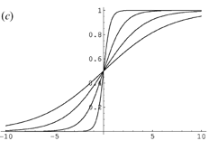
Possible thresholds
hard threshold
sigmoid
Notes:
There are many ways to define thresholds, e.g., we could have a hard threshold where the output is either 1 or 0 based on whether we meet the threshold or we could be following something more complicated like a sigmoid curve. We will assume the former.

Slide 21
A single neuron/perceptron
1
1
1
-1
?
0
1
Threshold of 1
0.5
1
Notes:
21
Let's say we have a neuron with four inputs and their associated weights shown on top of the edges. If the threshold is 1, will this neuron fire?

Slide 22
A single neuron/perceptron
1
1
1
-1
?
0
1
Threshold of 1
0.5
1
1*1 + 1*-1 + 0*1 + 1*0.5 = 0.5
Notes:
22
We would have to see if the weighted sum of the inputs is above or equal to 1.

Slide 23
A single neuron/perceptron
1
1
1
-1
0
Weighted sum is 0.5, which is not larger than the threshold
0
1
Threshold of 1
0.5
1
Notes:
23
Since it's not, the neuron doesn't fire

Slide 24
A single neuron/perceptron
1
1
0
-1
?
0
1
Threshold of 1
0.5
1
Notes:
24
What if we change the second input to 0?

Slide 25
A single neuron/perceptron
1
1
0
-1
?
0
1
Threshold of 1
0.5
1
1*1 + 0*-1 + 0*1 + 1*0.5 = 1.5
Notes:
25
This small change brought the sum to 1.5

Slide 26
A single neuron/perceptron
1
1
0
-1
1
Weighted sum is 1.5, which is larger than the threshold
0
1
Threshold of 1
0.5
1
Notes:
26
which meets the threshold and the neuron fires

Slide 27
AND logical operator
x₁ | x₂ | x₁ and x₂
0 | 0 | 0
0 | 1 | 0
1 | 0 | 0
1 | 1 | 1
Notes:
27
If you don’t remember, here is the truth table for the AND operator.

Slide 28
x₁ | x₂ | x₁ and x₂
0 | 0 | 0
0 | 1 | 0
1 | 0 | 0
1 | 1 | 1
AND logical operator
Input x₁
W₁ = ?
T = ?
Output y
Input x₂
W₂ = ?
Notes:
28
If we assume that all inputs are either 1 or 0 (on or off) and this neuron is activated when it is 1 or on, what weights do we need to assign to these two edges and what theshold do we need to put to this neuro to represent the AND gate?

Slide 29
x₁ | x₂ | x₁ and x₂
0 | 0 | 0
0 | 1 | 0
1 | 0 | 0
1 | 1 | 1
AND logical operator
Input x₁
W₁ = 1
T = 2
Output y
Output is 1 only if
all inputs are 1
Input x₂
W₂ = 1
Inputs are either 0 or 1
Notes:
29
If they both have weights of 1 and the threshold is 2 then we represent the AND gate

Slide 30
AND logical operator
Input x₁
W₁ = ?
W₂ = ?
Input x₂
T = ?
Output y
Input x₃
W₃ = ?
W₄ = ?
Input x₄
Notes:
30
What if we extend this AND gate to four inputs. What weights and threshold would we need?

Slide 31
AND logical operator
Input x₁
W₁ = 1
W₂ = 1
Input x₂
T = 4
Output y
Output is 1 only if
all inputs are 1
Input x₃
W₃ = 1
W₄ = 1
Input x₄
Inputs are either 0 or 1
Notes:
31
If they all have a weight of 1 the threshold would need to be 4.

Slide 32
OR logical operator
x₁ | x₂ | x₁ or x₂
0 | 0 | 0
0 | 1 | 1
1 | 0 | 1
1 | 1 | 1
Notes:
32
Let's try to learn the OR logical operator

Slide 33
x₁ | x₂ | x₁ or x₂
0 | 0 | 0
0 | 1 | 1
1 | 0 | 1
1 | 1 | 1
OR logical operator
Input x₁
W₁ = ?
T = ?
Output y
Input x₂
W₂ = ?
Notes:
33
What about for an OR gate?
What weights and thresholds would serve to create an OR gate?

Slide 34
x₁ | x₂ | x₁ or x₂
0 | 0 | 0
0 | 1 | 1
1 | 0 | 1
1 | 1 | 1
OR logical operator
Input x₁
W₁ = 1
T = 1
Output y
Output is 1 if at
least 1 input is 1
Input x₂
W₂ = 1
Inputs are either 0 or 1
Notes:
34
For weights of 1, the threshold would need to be 1.

Slide 35
OR logical operator
Input x₁
W₁ = ?
W₂ = ?
Input x₂
T = ?
Output y
Input x₃
W₃ = ?
W₄ = ?
Input x₄
Notes:
35
Similarly, we can expand it to take more inputs

Slide 36
OR logical operator
Input x₁
W₁ = 1
W₂ = 1
Input x₂
T = 1
Output y
Output is 1 if at
least 1 input is 1
Input x₃
W₃ = 1
W₄ = 1
Input x₄
Inputs are either 0 or 1
Notes:
36
Note that the weights are 1 but the threshold remains 1

Slide 37
NOT logical operator
x₁ | not x₁
0 | 1
1 | 0
Notes:
37
Time to learn the NOT gate

Slide 38
x₁ | not x₁
0 | 1
1 | 0
NOT logical operator
W₁ = ?
Input x₁
T = ?
Output y
Notes:
38
Now it gets a little bit trickier, what weight and threshold might work to create a NOT gate?

Slide 39
NOT logical operator
W₁ = -1
Input x₁
T = 0
Output y
Input is either 0 or 1
If input is 1, output is 0.
If input is 0, output is 1.
Notes:
39
Did you get this?

Slide 40
How about…
x₁ | x₂ | x₃ | y
0 | 0 | 0 | 1
0 | 1 | 0 | 0
1 | 0 | 0 | 1
1 | 1 | 0 | 0
0 | 0 | 1 | 1
0 | 1 | 1 | 1
1 | 0 | 1 | 1
1 | 1 | 1 | 0
Input x₁
w₁ = ?
w₂ = ?
Input x₂
Output y
T = ?
Input x₃
w₃ = ?
Notes:
What if we are given a more complex truth table of an unknown Boolean function?

Slide 41
Positive or negative?
NEGATIVE
Notes:
Let's put a pause here and play a game

Slide 42
Positive or negative?
NEGATIVE

Slide 43
Positive or negative?
POSITIVE

Slide 44
Positive or negative?
NEGATIVE

Slide 45
Positive or negative?
POSITIVE

Slide 46
Positive or negative?
POSITIVE

Slide 47
Positive or negative?
NEGATIVE

Slide 48
Positive or negative?
POSITIVE

Slide 49
A method to the madness…
blue = positive
yellow triangles = positive
all others negative
Notes:
How did you figure it out?

Slide 50
Training neural networks
x₁ | x₂ | x₃ | y
0 | 0 | 0 | 1
0 | 1 | 0 | 0
1 | 0 | 0 | 1
1 | 1 | 0 | 0
0 | 0 | 1 | 1
0 | 1 | 1 | 1
1 | 0 | 1 | 1
1 | 1 | 1 | 0
Input x₁
w₁ = ?
w₂ = ?
Input x₂
Output y
T = ?
Input x₃
w₃ = ?
start with some initial weights and thresholds
show examples repeatedly to NN
update weights/thresholds by comparing NN output to actual output
Notes:
Next time we will see how to train neural networks. The basic idea is that we start with some initial weights and thresholds. We repeatedly show examples to the neural network and update the weights and threshold by comparing the neural network output to what we should have gotten it

Slide 51
Perceptron learning algorithm
repeat until you get all examples right:
for each “training” example:
  calculate current prediction on example
  if wrong:
    update weights and threshold towards getting this example correct
Notes:
We repeat the following process until we get all examples right. For each training example, we calculated the current prediction from the perceptron. If it was off, we update the weights and threshold towards getting this example correct and repeat.

Slide 52
Perceptron learning algorithm
1
1
predicted
1
-1
?
0
actual
1
Threshold of 1
1
0.5
1
Notes:
52
Let's say we have the following randomly selected weights (1, -1, 1, 0.5) and threshold (1). We know that for those inputs (1, 1, 0, 1), we should get 1. What do we get instead?

Slide 53
Perceptron learning algorithm
Weighted sum is 0.5, which is not equal or larger than the threshold
1
1
predicted
1
-1
0
0
actual
1
Threshold of 1
1
0.5
1
What could we adjust to make it right?
Notes:
53
Our perceptron predicted 0 instead of 1. What can we do to adjust it to make it right?

Slide 54
Perceptron learning algorithm
1
1
predicted
1
-1
0
0
actual
1
Threshold of 1
1
0.5
1
This weight doesn’t matter, so don’t change
Notes:
54
If we look at the inputs, x3=0 so that weight doesn't really matter so we won't change it

Slide 55
Perceptron learning algorithm
1
1
predicted
1
-1
0
0
actual
1
Threshold of 1
1
0.5
1
Could increase any of these weights
Notes:
55
We could increase any of these weights to meet the threshold

Slide 56
Perceptron learning algorithm
1
1
predicted
1
-1
0
0
actual
1
Threshold of 1
1
0.5
1
Could decrease the threshold
Notes:
56
or we could decrease the threshold

Slide 57
Perceptron update rule
  if wrong:
    update weights and threshold towards getting this example correct
  if wrong:
w_{i} = w_{i} + Δw_{i}
Δw_{i} = λ * (actual - predicted) * x_{i}
Notes:
The rule for updating is that we will add a delta w to each of the weights, where that delta will be a lambda parameter times the difference of actual minus predicted value for each input.

Slide 58
Perceptron learning algorithm
1
1
-1
1
predicted
1
0
0
Threshold of 1
actual
1
0.5
1
w_{i} = w_{i} + Δwi
Δw_{i} = λ * (actual - predicted) * x_{i}
What does this do in this case?
Notes:
58
What does this look in practice?

Slide 59
Perceptron learning algorithm
1
1
-1
1
predicted
1
0
0
Threshold of 1
actual
1
0.5
1
w_{i} = w_{i} + Δwi
Δw_{i} = λ * (actual - predicted) * x_{i}
causes us to increase the weights!
Notes:
59
Since the actual value was 1 but we predicted 0, it will result to 1 and it causes us to increase the weights since delta will be positive.

Slide 60
Perceptron learning algorithm
predicted
1
Threshold of 1
actual
0
w_{i} = w_{i} + Δwi
Δw_{i} = λ * (actual - predicted) * x_{i}
What if predicted = 1 and actual = 0?
Notes:
60
If the predicted and actual values were flipped, we would have the oppositive effect.

Slide 61
Perceptron learning algorithm
predicted
1
Threshold of 1
actual
0
w_{i} = w_{i} + Δwi
Δw_{i} = λ * (actual - predicted) * x_{i}
We’re over the threshold, so want to decrease weights:
actual - predicted = -1
Notes:
61
With the difference being negative, we want to decrease the weights to not exceed the threshold

Slide 62
Perceptron learning algorithm
1
1
-1
1
predicted
1
0
0
Threshold of 1
actual
1
0.5
1
w_{i} = w_{i} + Δwi
Δw_{i} = λ * (actual - predicted) * x_{i}
What does this do?
Notes:
62
If you look at our formula for delta, there is a multiplication with xi. what does it do?

Slide 63
Perceptron learning algorithm
1
1
-1
1
predicted
1
0
0
Threshold of 1
actual
1
0.5
1
w_{i} = w_{i} + Δwi
Δw_{i} = λ * (actual - predicted) * x_{i}
Only adjust those weights that actually contributed!
Notes:
63
If an xi==0, it will not adjust it since delta will be also 0 as a product. That means that our algorithm will only adjust those weights that actually contributed to the weighted sum.

Slide 64
Perceptron learning algorithm
1
1
-1
1
predicted
1
0
0
Threshold of 1
actual
1
0.5
1
w_{i} = w_{i} + Δwi
Δw_{i} = λ * (actual - predicted) * x_{i}
What does this do?
Notes:
64
The final unknown of calculating delta is this lambda value.

Slide 65
Perceptron learning algorithm
1
1
-1
1
predicted
1
0
0
Threshold of 1
actual
1
0.5
1
w_{i} = w_{i} + Δwi
Δw_{i} = λ * (actual - predicted) * x_{i}
“learning rate”: value between 0 and 1 (e.g., 0.1)
adjusts how abrupt the changes are to the model
Notes:
65
This is known as the learning rate and it is a value between 0 and 1 which adjusts how aggressively we make changes to the model.

Slide 66
Perceptron learning algorithm
1
1
-1
1
predicted
1
0
0
Threshold of 1
actual
1
0.5
1
w_{i} = w_{i} + Δwi
Δw_{i} = λ * (actual - predicted) * x_{i}
What about the threshold?
Notes:
66
What if we want to change the threshold?

Slide 67
Input x₁
Weight w₁
Weight w₂
Input x₂
Output y
Input x₃
Weight w₃
Threshold of t
Input x₁
Weight w₁
Weight w₂
Input x₂
Output y
Input x₃
Weight w₃
Threshold of 0
1
Weight w₄
Notes:
67
We will make two small changes to our perceptron. We will ass a new input x4=1 and we will change to threshold to 0.

Slide 68
Input x₁
Weight w₁
Weight w₂
Input x₂
Output y
Input x₃
Weight w₃
Threshold of t
Input x₁
Weight w₁
Weight w₂
Input x₂
Output y
Input x₃
Weight w₃
Threshold of 0
1
Weight w₄
equivalent when w₄ = -t
Notes:
68
This is equivalent to w4 being equal to -t, our threshold.

Slide 69
Perceptron learning algorithm
initialize weights of the model randomly
repeat until you get all examples right:
for each “training” example (in a random order):
calculate current prediction on the example
if wrong:
w_{i} = w_{i} + λ * (actual - predicted) * x_{i}
Notes:
Putting it all together, our perceptron learning algorithm asks us to initialize weights of the model randomly and repeat until we get all the examples right by adjusting the weights.

Slide 70
x₁ | x₂ | x₁ and x₂
0 | 0 | 0
0 | 1 | 0
1 | 0 | 0
1 | 1 | 1
λ = 0.1
initialize with random weights
W₁
Input x₁
W₂
Output y
Input x₂
W₃
1
Notes:
Let's try learning AND. We will assume our learning rate lambda is equal to 0.1 and we will add a third input x3=1.

Slide 71
x₁ | x₂ | x₁ and x₂
0 | 0 | 0
0 | 1 | 0
1 | 0 | 0
1 | 1 | 1
λ = 0.1
W₁ = 0.2
Input x₁
W₂ = 0.5
Output y
Input x₂
1
W₃ = 0.1
Notes:
We will assign random weights to each input, say 0.2, 0.5 and 0.1

Slide 72
x₁ | x₂ | x₁ and x₂
0 | 0 | 0
0 | 1 | 0
1 | 0 | 0
1 | 1 | 1
λ = 0.1
if wrong:
w_{i} = w_{i} + λ * (actual - predicted) * x_{i}
W₁ = 0.2
1
W₂ = 0.5
Output y
0
1
W₃ = 0.1
Right or wrong?
Notes:
For the input 1, 0 we are expecting the output 0. Remember, our threshold is 0. Did we correctly predict 0?

Slide 73
x₁ | x₂ | x₁ and x₂
0 | 0 | 0
0 | 1 | 0
1 | 0 | 0
1 | 1 | 1
λ = 0.1
if wrong:
w_{i} = w_{i} + λ * (actual - predicted) * x_{i}
W₁ = 0.2
1
sum = 0.3: output 1
W₂ = 0.5
Output y
0
1
W₃ = 0.1
Wrong
Notes:
Unfortunately we are wrong. Our weighted sum was equal to 0.3 which is above the 0 threshold and we will predict 1 instead of 0.

Slide 74
x₁ | x₂ | x₁ and x₂
0 | 0 | 0
0 | 1 | 0
1 | 0 | 0
1 | 1 | 1
λ = 0.1
if wrong:
w_{i} = w_{i} + λ * (actual - predicted) * x_{i}
W₁ = 0.2
1
sum = 0.3: output 1
W₂ = 0.5
Output y
0
1
W₃ = 0.1
new weights?
Notes:
How do we adjust our weights?

Slide 75
x₁ | x₂ | x₁ and x₂
0 | 0 | 0
0 | 1 | 0
1 | 0 | 0
1 | 1 | 1
λ = 0.1
if wrong:
w_{i} = w_{i} + λ * (actual - predicted) * x_{i}
decrease (0-1=-1) all non-zero x_{i} by 0.1
W₁ = 0.2
1
W₂ = 0.5
Output y
0
1
W₃ = 0.1
Notes:
Looking at our delta, we will need to decrease all non-zero xi by 0.1

Slide 76
x₁ | x₂ | x₁ and x₂
0 | 0 | 0
0 | 1 | 0
1 | 0 | 0
1 | 1 | 1
λ = 0.1
if wrong:
w_{i} = w_{i} + λ * (actual - predicted) * x_{i}
decrease (0-1=-1) all non-zero x_{i} by 0.1
W₁ = 0.1
1
W₂ = 0.5
Output y
0
1
W₃ = 0.0
Notes:
Which updates the weights for x1 and x3.

Slide 77
x₁ | x₂ | x₁ and x₂
0 | 0 | 0
0 | 1 | 0
1 | 0 | 0
1 | 1 | 1
λ = 0.1
if wrong:
w_{i} = w_{i} + λ * (actual - predicted) * x_{i}
W₁ = 0.1
1
W₂ = 0.5
Output y
1
1
W₃ = 0.0
Right or wrong?
Notes:
Given our new weights, let's test another row, for x1=1 and x2=1. What's our predicted output?

Slide 78
x₁ | x₂ | x₁ and x₂
0 | 0 | 0
0 | 1 | 0
1 | 0 | 0
1 | 1 | 1
λ = 0.1
if wrong:
w_{i} = w_{i} + λ * (actual - predicted) * x_{i}
W₁ = 0.1
1
sum = 0.6: output 1
W₂ = 0.5
Output y
0
1
W₃ = 0.0
Right. No update!
Notes:
We correctly predicted 1.

Slide 79
x₁ | x₂ | x₁ and x₂
0 | 0 | 0
0 | 1 | 0
1 | 0 | 0
1 | 1 | 1
λ = 0.1
if wrong:
w_{i} = w_{i} + λ * (actual - predicted) * x_{i}
W₁ = 0.1
0
W₂ = 0.5
Output y
1
1
W₃ = 0.0
Right or wrong?
Notes:
We are not done, we have to see if every single input is also leading to a correct prediction. What about 0 and 1 as inputs?

Slide 80
x₁ | x₂ | x₁ and x₂
0 | 0 | 0
0 | 1 | 0
1 | 0 | 0
1 | 1 | 1
λ = 0.1
if wrong:
w_{i} = w_{i} + λ * (actual - predicted) * x_{i}
W₁ = 0.1
0
sum = 0.5: output 1
W₂ = 0.5
Output y
1
1
W₃ = 0.0
Wrong
Notes:
We are unfortunately wrong

Slide 81
x₁ | x₂ | x₁ and x₂
0 | 0 | 0
0 | 1 | 0
1 | 0 | 0
1 | 1 | 1
λ = 0.1
if wrong:
w_{i} = w_{i} + λ * (actual - predicted) * x_{i}
W₁ = 0.1
0
sum = 0.5: output 1
W₂ = 0.5
Output y
1
1
W₃ = 0.0
new weights?
Notes:
How do we adjust our weights?

Slide 82
x₁ | x₂ | x₁ and x₂
0 | 0 | 0
0 | 1 | 0
1 | 0 | 0
1 | 1 | 1
λ = 0.1
if wrong:
w_{i} = w_{i} + λ * (actual - predicted) * x_{i}
W₁ = 0.1
0
sum = 0.5: output 1
W₂ = 0.4
Output y
1
1
W₃ = -0.1
decrease (0-1=-1) all non-zero x_{i} by 0.1
Notes:
We are going again to decrease all non-zero inputs by 0.1

Slide 83
x₁ | x₂ | x₁ and x₂
0 | 0 | 0
0 | 1 | 0
1 | 0 | 0
1 | 1 | 1
λ = 0.1
if wrong:
w_{i} = w_{i} + λ * (actual - predicted) * x_{i}
W₁ = 0.1
0
W₂ = 0.4
Output y
0
1
W₃ = -0.1
Right or wrong?
Notes:
How about now with 0, 0 inputs?

Slide 84
x₁ | x₂ | x₁ and x₂
0 | 0 | 0
0 | 1 | 0
1 | 0 | 0
1 | 1 | 1
λ = 0.1
if wrong:
w_{i} = w_{i} + λ * (actual - predicted) * x_{i}
W₁ = 0.1
0
sum = -0.1: output 0
W₂ = 0.4
Output y
0
1
W₃ = -0.1
Right. No update!
Notes:
We are right!

Slide 85
x₁ | x₂ | x₁ and x₂
0 | 0 | 0
0 | 1 | 0
1 | 0 | 0
1 | 1 | 1
λ = 0.1
if wrong:
w_{i} = w_{i} + λ * (actual - predicted) * x_{i}
W₁ = 0.1
0
W₂ = 0.4
Output y
1
1
W₃ = -0.1
Right or wrong?
Notes:
How about 0 and 1?

Slide 86
x₁ | x₂ | x₁ and x₂
0 | 0 | 0
0 | 1 | 0
1 | 0 | 0
1 | 1 | 1
λ = 0.1
if wrong:
w_{i} = w_{i} + λ * (actual - predicted) * x_{i}
W₁ = 0.1
0
sum = 0.3: output 1
W₂ = 0.4
Output y
1
1
W₃ = -0.1
Wrong
Notes:
We unfortunately predicted 1 instead of 0. How do we adjust our weights?

Slide 87
x₁ | x₂ | x₁ and x₂
0 | 0 | 0
0 | 1 | 0
1 | 0 | 0
1 | 1 | 1
λ = 0.1
if wrong:
w_{i} = w_{i} + λ * (actual - predicted) * x_{i}
W₁ = 0.1
0
sum = 0.3: output 1
W₂ = 0.3
Output y
1
1
W₃ = -0.2
decrease (0-1=-1) all non-zero x_{i} by 0.1
Notes:
We are going to decrease all non-zero inputs by 0.1

Slide 88
x₁ | x₂ | x₁ and x₂
0 | 0 | 0
0 | 1 | 0
1 | 0 | 0
1 | 1 | 1
λ = 0.1
if wrong:
w_{i} = w_{i} + λ * (actual - predicted) * x_{i}
W₁ = 0.1
1
sum = 0.2: output 1
W₂ = 0.3
Output y
1
1
W₃ = -0.2
Right. No update!
Notes:
If we test for 1, 1 we see we are right.

Slide 89
x₁ | x₂ | x₁ and x₂
0 | 0 | 0
0 | 1 | 0
1 | 0 | 0
1 | 1 | 1
λ = 0.1
if wrong:
w_{i} = w_{i} + λ * (actual - predicted) * x_{i}
W₁ = 0.1
0
sum = -0.2: output 0
W₂ = 0.3
Output y
0
1
W₃ = -0.2
Right. No update!
Notes:
Same for 0, 0

Slide 90
x₁ | x₂ | x₁ and x₂
0 | 0 | 0
0 | 1 | 0
1 | 0 | 0
1 | 1 | 1
λ = 0.1
if wrong:
w_{i} = w_{i} + λ * (actual - predicted) * x_{i}
W₁ = 0.1
1
sum = -0.1: output 0
W₂ = 0.3
Output y
0
1
W₃ = -0.2
Right. No update!
Notes:
And 1, 0

Slide 91
x₁ | x₂ | x₁ and x₂
0 | 0 | 0
0 | 1 | 0
1 | 0 | 0
1 | 1 | 1
λ = 0.1
if wrong:
w_{i} = w_{i} + λ * (actual - predicted) * x_{i}
W₁ = 0.1
1
W₂ = 0.3
Output y
0
1
W₃ = -0.2
Are they all right?
Notes:
Are they all right?

Slide 92
x₁ | x₂ | x₁ and x₂
0 | 0 | 0
0 | 1 | 0
1 | 0 | 0
1 | 1 | 1
λ = 0.1
if wrong:
w_{i} = w_{i} + λ * (actual - predicted) * x_{i}
W₁ = 0.1
0
sum = 0.1: output 1
W₂ = 0.3
Output y
1
1
W₃ = -0.2
Wrong
Notes:
Oops, we are wrong for 0, 1.

Slide 93
x₁ | x₂ | x₁ and x₂
0 | 0 | 0
0 | 1 | 0
1 | 0 | 0
1 | 1 | 1
λ = 0.1
if wrong:
w_{i} = w_{i} + λ * (actual - predicted) * x_{i}
W₁ = 0.1
0
sum = 0.1: output 1
W₂ = 0.2
Output y
1
1
W₃ = -0.3
decrease (0-1=-1) all non-zero x_{i} by 0.1
Notes:
We will decrease all our non-zero inputs by 0.1

Slide 94
x₁ | x₂ | x₁ and x₂
0 | 0 | 0
0 | 1 | 0
1 | 0 | 0
1 | 1 | 1
λ = 0.1
if wrong:
w_{i} = w_{i} + λ * (actual - predicted) * x_{i}
W₁ = 0.1
0
sum = 0.1: output 1
W₂ = 0.2
Output y
1
1
W₃ = -0.3
Are they all right?
Notes:
How about now, are they all right?

Slide 95
x₁ | x₂ | x₁ and x₂
0 | 0 | 0
0 | 1 | 0
1 | 0 | 0
1 | 1 | 1
λ = 0.1
if wrong:
w_{i} = w_{i} + λ * (actual - predicted) * x_{i}
W₁ = 0.1
1
W₂ = 0.2
Output y
1
1
W₃ = -0.3
We’ve learned AND!
Notes:
Yes, we have learned AND!

Slide 96
Perceptron learning algorithm
A few missing details, but not much more than this
Keeps adjusting weights as long as it makes mistakes
If the training data is linearly separable, the perceptron learning algorithm is guaranteed to converge to the “correct” solution (where it gets all examples right)
Notes:
Overall, there are a few missing details but this is the key idea behind training a simple neuron: we keep adjusting weights as long we make mistakes. If the training data is linearly separable, the perceptron learning algorithm is guaranteed to converge to the correct solution where it gets all examples right. Two sets of points in a two-dimensional space are linearly separable if they can be completely separated by a single line

