Slide 1
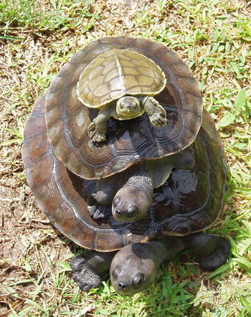
More Recursion
Mathematical Foundations
CS51 – Spring 2026
https://commons.wikimedia.org/w/index.php?curid=2747463
Notes:
Today we will revisit recursion using the cs51 machine. We will also introduce the turtle module which you will use to draw (recursive!) shapes in your next assignment.

Slide 2
Revisiting rec_sum
Write a recursive function called rec_sum that takes a positive number as a parameter and calculates the sum of the numbers from 0 up to and including that provided number.
def rec_sum(n):
if n == 0:
return 0
else:
return n + rec_sum(n-1)
Notes:
If you remember from our last lesson, we wrote together a recursive function that takes a positive integer as a parameter and calculates the sum of the numbers from 0 up to and including that provided number. We walked through the Python code which captures this idea.

Slide 3
rec_sum function in cs51 machine
lcw r1 stack ; set up stack
loa r3 r0 ; get n and store it in r3
lcw r2 rec_sum ; call rec_sum
cal r2 r2
sto r3 r0 ; print result,
hlt ; and halt
…
dat 100
stack
Notes:
Today we will work toward understanding how a recursive function would look like in assembly. For that, we will use our trusted cs51 machine. Here's a bit of code that will help us get things set up. We start by setting up the stack. We will prompt the user for the number n they want to calculate the sum from 0 to n. We will then call a rec_sum function which we’ll see in detail. Eventually this rec_sum function should give us the answer in r3 which we will print and halt our program.

Slide 4
rec_sum function in cs51 machine
rec_sum
psh r2 ; save the return address on the stack
bne r3 r0 recurse ; if n!=0 recurse
add r3 r0 0 ; if n == 0, result is 0
brs done
recurse
psh r3 ; save n on the stack
sub r3 r3 1 ; n = n-1
lcw r2 rec_sum ; make recursive call
cal r2 r2 ; rec_sum (n-1), answer should be in r3
pop r2 ; get n into r2
add r3 r3 r2 ; r3 = n + rec_sum (n-1)
done
pop r2 ; get the return address
jmp r2 ; go back to caller
Function startup
base case
recursive case
Function cleanup and return
Notes:
This is the rec_sum function implemented in assembly. As always, the first thing we do in a function is to push the return address on the stack. Symmetrically, the last thing we will do is to pop and jump to that return address. I have annotated the base case and recursive case. Our base case is satisifed when n==0 where we just return 0. Otherwise, we would need to recurse, which we do in the recurse block of code which we will soon see in detail.

Slide 5
rec_sum function in cs51 machine
rec_sum
psh r2 ; save the return address on the stack
bne r3 r0 recurse ; if n!=0 recurse
add r3 r0 0 ; if n == 0, result is 0
brs done
recurse
psh r3 ; save n on the stack
sub r3 r3 1 ; n = n-1
lcw r2 rec_sum ; make recursive call
cal r2 r2 ; rec_sum (n-1), answer should be in r3
pop r2 ; get n into r2
add r3 r3 r2 ; r3 = n + rec_sum (n-1)
done
pop r2 ; get the return address
jmp r2 ; go back to caller
Notice the symmetry between push and pop
Notes:
Notice how the push and pop are symmetrically. Specifically, I have color-coded the two pairs so you understand which one maps to which.

Slide 6
Calling rec_sum
r2
r3
2 lcw r1 stack
6 loa r3 r0
8 lcw r2 rec_sum
12 cal r2 r2
14 sto r3 r0
16 hlt
rec_sum
18 psh r2
22 bne r3 r0 recurse
24 add r3 r0 0
26 brs done
…
sp (r1)
Stack
Notes:
Let's walk through an example of how rec_sum would work. I have annotated on the left the numbers of the addresses. Remember, the word size is 2 bytes in cs51 and certain instructions like lcw, psh, and pop end up being decoded in two instructions. That's why we jump from 2 to 6 instead of 2 to 4. You see our stack has been set up and r1 is the stack pointer to its top.

Slide 7
Calling rec_sum
r2
r3
2 lcw r1 stack
6 loa r3 r0
8 lcw r2 rec_sum
12 cal r2 r2
14 sto r3 r0
16 hlt
rec_sum
18 psh r2
22 bne r3 r0 recurse
24 add r3 r0 0
26 brs done
…
sp (r1)
Stack
Notes:
next, we will prompt the user for their input n.

Slide 8
Calling rec_sum
r2
r3 | 2
2 lcw r1 stack
6 loa r3 r0
8 lcw r2 rec_sum
12 cal r2 r2
14 sto r3 r0
16 hlt
rec_sum
18 psh r2
22 bne r3 r0 recurse
24 add r3 r0 0
26 brs done
…
sp (r1)
Stack
Notes:
Let's say they type 2 which we will store in r3

Slide 9
Calling rec_sum
r2
r3 | 2
2 lcw r1 stack
6 loa r3 r0
8 lcw r2 rec_sum
12 cal r2 r2
14 sto r3 r0
16 hlt
rec_sum
18 psh r2
22 bne r3 r0 recurse
24 add r3 r0 0
26 brs done
…
sp (r1)
Stack
Notes:
Next, we have lcw r2 rec_sum

Slide 10
Calling rec_sum
r2 | 18
r3 | 2
2 lcw r1 stack
6 loa r3 r0
8 lcw r2 rec_sum
12 cal r2 r2
14 sto r3 r0
16 hlt
rec_sum
18 psh r2
22 bne r3 r0 recurse
24 add r3 r0 0
26 brs done
…
sp (r1)
Stack
Notes:
Remember, this instruction will store in r2 the location of the first line of the rec_sum function. That would be address 18

Slide 11
Calling rec_sum
r2 | 18
r3 | 2
2 lcw r1 stack
6 loa r3 r0
8 lcw r2 rec_sum
12 cal r2 r2
14 sto r3 r0
16 hlt
rec_sum
18 psh r2
22 bne r3 r0 recurse
24 add r3 r0 0
26 brs done
…
sp (r1)
Stack
Notes:
cal r2 r2 will do two things. First, it will jump to the address that r2 has stored (i.e. address 18 which is the location of the first line of the rec_sum function) and second it will update r2 to the address of the next instruction after cal, that is 14.

Slide 12
r2 | 14
r3 | 2
rec_sum
18 psh r2
22 bne r3 r0 recurse
24 add r3 r0 0
26 brs done
recurse
28 psh r3
32 sub r3 r3 1
34 lcw r2 rec_sum
38 cal r2 r2
40 pop r2
44 add r3 r3 r2
done
46 pop r2
50 jmp r2
sp (r1)
Stack
Notes:
This results in moving the execution to line 18 and updating r2 with the address 14.

Slide 13
r2 | 14
r3 | 2
rec_sum
18 psh r2
22 bne r3 r0 recurse
24 add r3 r0 0
26 brs done
recurse
28 psh r3
32 sub r3 r3 1
34 lcw r2 rec_sum
38 cal r2 r2
40 pop r2
44 add r3 r3 r2
done
46 pop r2
50 jmp r2
sp (r1)
14
Stack
Notes:
OK, we are now in the first line of rec_sum and we see need to push the contents of the r2 register into the stack. Remember, when you push something to the stack, the stack pointer (i.e., register r1) has to go up (i.e. in a lower memory address).

Slide 14
r2 | 14
r3 | 2
rec_sum
18 psh r2
22 bne r3 r0 recurse
24 add r3 r0 0
26 brs done
recurse
28 psh r3
32 sub r3 r3 1
34 lcw r2 rec_sum
38 cal r2 r2
40 pop r2
44 add r3 r3 r2
done
46 pop r2
50 jmp r2
sp (r1)
14
Stack
Notes:
Next, we check the base case by asking whether r3!=0. Since it is, we have to branch to the label recurse.

Slide 15
r2 | 14
r3 | 2
rec_sum
18 psh r2
22 bne r3 r0 recurse
24 add r3 r0 0
26 brs done
recurse
28 psh r3
32 sub r3 r3 1
34 lcw r2 rec_sum
38 cal r2 r2
40 pop r2
44 add r3 r3 r2
done
46 pop r2
50 jmp r2
sp (r1)
14
Stack
Notes:
We see that we will need to push the contents of the register r3 into the stack.

Slide 16
r2 | 14
r3 | 2
rec_sum
18 psh r2
22 bne r3 r0 recurse
24 add r3 r0 0
26 brs done
recurse
28 psh r3
32 sub r3 r3 1
34 lcw r2 rec_sum
38 cal r2 r2
40 pop r2
44 add r3 r3 r2
done
46 pop r2
50 jmp r2
Why psh r3?
sp (r1)
2
14
Stack
Notes:
This will result in 2 being pushed into the stack and the stack pointer r1 moving one word up. Why do you think we do this?

Slide 17
r2 | 14
r3 | 2
rec_sum
18 psh r2
22 bne r3 r0 recurse
24 add r3 r0 0
26 brs done
recurse
28 psh r3
32 sub r3 r3 1
34 lcw r2 rec_sum
38 cal r2 r2
40 pop r2
44 add r3 r3 r2
done
46 pop r2
50 jmp r2
We’re about to make a function call
The result of that call will go into r3 so that would erase its contents if not saved
n + rec_sum (n-1)
sp (r1)
2
14
Stack
Notes:
Remember, we are about to recurse, that is make a function call. The result of that call will go into r3 so that would erase the contents if we don’t save them. So by pushing 2 in the stack, we can reuse it down the line. That ensures that when we have the expression n + rec_sum(n-1), our n has been stored safely in the stack.

Slide 18
r2 | 14
r3 | 2
rec_sum
18 psh r2
22 bne r3 r0 recurse
24 add r3 r0 0
26 brs done
recurse
28 psh r3
32 sub r3 r3 1
34 lcw r2 rec_sum
38 cal r2 r2
40 pop r2
44 add r3 r3 r2
done
46 pop r2
50 jmp r2
sp (r1)
2
14
Stack
Notes:
Now that we settled that, we move to the next instruction, sub r3 r3 1.

Slide 19
r2 | 14
r3 | 1
rec_sum
18 psh r2
22 bne r3 r0 recurse
24 add r3 r0 0
26 brs done
recurse
28 psh r3
32 sub r3 r3 1
34 lcw r2 rec_sum
38 cal r2 r2
40 pop r2
44 add r3 r3 r2
done
46 pop r2
50 jmp r2
sp (r1)
2
14
Stack
Notes:
This will decrement r3 by 1, which will update r3 to 1. (see our stack is still safely storing 2!).

Slide 20
r2 | 14
r3 | 1
rec_sum
18 psh r2
22 bne r3 r0 recurse
24 add r3 r0 0
26 brs done
recurse
28 psh r3
32 sub r3 r3 1
34 lcw r2 rec_sum
38 cal r2 r2
40 pop r2
44 add r3 r3 r2
done
46 pop r2
50 jmp r2
sp (r1)
2
14
Stack
Notes:
Next we have the recursive call to rec_sum.

Slide 21
r2 | 18
r3 | 1
rec_sum
18 psh r2
22 bne r3 r0 recurse
24 add r3 r0 0
26 brs done
recurse
28 psh r3
32 sub r3 r3 1
34 lcw r2 rec_sum
38 cal r2 r2
40 pop r2
44 add r3 r3 r2
done
46 pop r2
50 jmp r2
sp (r1)
2
14
Stack
Notes:
lcw r2 rec_sum will result in r2 storing the address of the first address of rec_sum function, i.e. 18

Slide 22
r2 | 18
r3 | 1
rec_sum
18 psh r2
22 bne r3 r0 recurse
24 add r3 r0 0
26 brs done
recurse
28 psh r3
32 sub r3 r3 1
34 lcw r2 rec_sum
38 cal r2 r2
40 pop r2
44 add r3 r3 r2
done
46 pop r2
50 jmp r2
sp (r1)
2
14
Stack
Notes:
Next, we have cal r2 r2.

Slide 23
r2 | 18
r3 | 1
rec_sum
18 psh r2
22 bne r3 r0 recurse
24 add r3 r0 0
26 brs done
recurse
28 psh r3
32 sub r3 r3 1
34 lcw r2 rec_sum
38 cal r2 r2
40 pop r2
44 add r3 r3 r2
done
46 pop r2
50 jmp r2
Make a recursive call:
rec_sum(1)
sp (r1)
2
14
Stack
Notes:
Remember that cal does two things. We will jump to the address stored by r2, that is to the first line of rec_sum which is psh r2 in address 18 and update r2 to the address of the next instruction after cal which is pop r2 at address 40.

Slide 24
r2 | 40
r3 | 1
rec_sum
18 psh r2
22 bne r3 r0 recurse
24 add r3 r0 0
26 brs done
recurse
28 psh r3
32 sub r3 r3 1
34 lcw r2 rec_sum
38 cal r2 r2
40 pop r2
44 add r3 r3 r2
done
46 pop r2
50 jmp r2
sp (r1)
2
14
Stack
Notes:
we will also update r2 to hold the address of the next line of where we came, that is the next line after cal r2 r2. Since this is our second time doing this, I will note that as loc:cal 1.

Slide 25
r2 | 40
r3 | 1
rec_sum
18 psh r2
22 bne r3 r0 recurse
24 add r3 r0 0
26 brs done
recurse
28 psh r3
32 sub r3 r3 1
34 lcw r2 rec_sum
38 cal r2 r2
40 pop r2
44 add r3 r3 r2
done
46 pop r2
50 jmp r2
sp (r1)
40
2
14
Stack
Notes:
We are again in rec_sum and the first line asks us to push the contents of r2 in the stack, that is push 40 and move our stack pointer in a lower memory address (up).

Slide 26
r2 | 40
r3 | 1
rec_sum
18 psh r2
22 bne r3 r0 recurse
24 add r3 r0 0
26 brs done
recurse
28 psh r3
32 sub r3 r3 1
34 lcw r2 rec_sum
38 cal r2 r2
40 pop r2
44 add r3 r3 r2
done
46 pop r2
50 jmp r2
sp (r1)
40
2
14
Stack
Notes:
Next instruction checks the base case and since r3!=0 we will branch to the label recurse.

Slide 27
r2 | 40
r3 | 1
rec_sum
18 psh r2
22 bne r3 r0 recurse
24 add r3 r0 0
26 brs done
recurse
28 psh r3
32 sub r3 r3 1
34 lcw r2 rec_sum
38 cal r2 r2
40 pop r2
44 add r3 r3 r2
done
46 pop r2
50 jmp r2
sp (r1)
40
2
14
Stack
Notes:
First thing we do in recurse is to push the contents of r3 to 1. Remember, we do that so we don't lose the n from n+rec_sum(n-1).

Slide 28
r2 | 40
r3 | 1
rec_sum
18 psh r2
22 bne r3 r0 recurse
24 add r3 r0 0
26 brs done
recurse
28 psh r3
32 sub r3 r3 1
34 lcw r2 rec_sum
38 cal r2 r2
40 pop r2
44 add r3 r3 r2
done
46 pop r2
50 jmp r2
sp (r1)
1
40
2
14
Stack
Notes:
That means that 1 is safely in our stack for later use and we move the stack pointer in a lower memory address.

Slide 29
r2 | 40
r3 | 1
rec_sum
18 psh r2
22 bne r3 r0 recurse
24 add r3 r0 0
26 brs done
recurse
28 psh r3
32 sub r3 r3 1
34 lcw r2 rec_sum
38 cal r2 r2
40 pop r2
44 add r3 r3 r2
done
46 pop r2
50 jmp r2
sp (r1)
1
40
2
14
Stack
Notes:
Next, we decrement r3 by 1.

Slide 30
r2 | 40
r3 | 0
rec_sum
18 psh r2
22 bne r3 r0 recurse
24 add r3 r0 0
26 brs done
recurse
28 psh r3
32 sub r3 r3 1
34 lcw r2 rec_sum
38 cal r2 r2
40 pop r2
44 add r3 r3 r2
done
46 pop r2
50 jmp r2
sp (r1)
1
40
2
14
Stack
Notes:
Which results in r3 being equal to 0.

Slide 31
r2 | 18
r3 | 0
rec_sum
18 psh r2
22 bne r3 r0 recurse
24 add r3 r0 0
26 brs done
recurse
28 psh r3
32 sub r3 r3 1
34 lcw r2 rec_sum
38 cal r2 r2
40 pop r2
44 add r3 r3 r2
done
46 pop r2
50 jmp r2
sp (r1)
1
40
2
14
Stack
Notes:
Again, we update r2 to hold the address of the first line of rec_sum, i.e. 18

Slide 32
r2 | 18
r3 | 0
rec_sum
18 psh r2
22 bne r3 r0 recurse
24 add r3 r0 0
26 brs done
recurse
28 psh r3
32 sub r3 r3 1
34 lcw r2 rec_sum
38 cal r2 r2
40 pop r2
44 add r3 r3 r2
done
46 pop r2
50 jmp r2
Make a recursive call:
rec_sum(0)
sp (r1)
1
40
2
14
Stack
Notes:
cal r2 r2 will do two things, it will jump the execution to the location stated by r2 (i.e. address 18) and update r2 to the address of the next instruction after cal, that is the address of pop r2 which is 40.

Slide 33
r2 | 40
r3 | 0
rec_sum
18 psh r2
22 bne r3 r0 recurse
24 add r3 r0 0
26 brs done
recurse
28 psh r3
32 sub r3 r3 1
34 lcw r2 rec_sum
38 cal r2 r2
40 pop r2
44 add r3 r3 r2
done
46 pop r2
50 jmp r2
sp (r1)
1
40
2
14
Stack
Notes:
You see that now the execution is at address 18 and r2 has been updated to 40

Slide 34
r2 | 40
r3 | 0
rec_sum
18 psh r2
22 bne r3 r0 recurse
24 add r3 r0 0
26 brs done
recurse
28 psh r3
32 sub r3 r3 1
34 lcw r2 rec_sum
38 cal r2 r2
40 pop r2
44 add r3 r3 r2
done
46 pop r2
50 jmp r2
sp (r1)
40
1
40
2
14
Stack
Notes:
We will next push that address to the stack and move the stack pointer.

Slide 35
r2 | 40
r3 | 0
rec_sum
18 psh r2
22 bne r3 r0 recurse
24 add r3 r0 0
26 brs done
recurse
28 psh r3
32 sub r3 r3 1
34 lcw r2 rec_sum
38 cal r2 r2
40 pop r2
44 add r3 r3 r2
done
46 pop r2
50 jmp r2
sp (r1)
40
1
40
2
14
Stack
Notes:
We check our base case and for the first time, r3 is equal to 0. So instead of branching to the recurse label, we need to continue sequentially to our next instruction.

Slide 36
r2 | 40
r3 | 0
rec_sum
18 psh r2
22 bne r3 r0 recurse
24 add r3 r0 0
26 brs done
recurse
28 psh r3
32 sub r3 r3 1
34 lcw r2 rec_sum
38 cal r2 r2
40 pop r2
44 add r3 r3 r2
done
46 pop r2
50 jmp r2
sp (r1)
40
1
40
2
14
Stack
Notes:
This will set r3 to 0 which is equivalent to returning 0.

Slide 37
r2 | 40
r3 | 0
rec_sum
18 psh r2
22 bne r3 r0 recurse
24 add r3 r0 0
26 brs done
recurse
28 psh r3
32 sub r3 r3 1
34 lcw r2 rec_sum
38 cal r2 r2
40 pop r2
44 add r3 r3 r2
done
46 pop r2
50 jmp r2
sp (r1)
40
1
40
2
14
Stack
Notes:
We are ready now to branch to the label done.

Slide 38
r2 | 40
r3 | 0
rec_sum
18 psh r2
22 bne r3 r0 recurse
24 add r3 r0 0
26 brs done
recurse
28 psh r3
32 sub r3 r3 1
34 lcw r2 rec_sum
38 cal r2 r2
40 pop r2
44 add r3 r3 r2
done
46 pop r2
50 jmp r2
sp (r1)
40
1
40
2
14
Stack
Notes:
This brings us to the instruction pop r2

Slide 39
r2 | 40
r3 | 0
rec_sum
18 psh r2
22 bne r3 r0 recurse
24 add r3 r0 0
26 brs done
recurse
28 psh r3
32 sub r3 r3 1
34 lcw r2 rec_sum
38 cal r2 r2
40 pop r2
44 add r3 r3 r2
done
46 pop r2
50 jmp r2
sp (r1)
rec_sum(0)
n=1
return address = 40
40
1
rec_sum(1)
n=1
return address = 40
40
2
rec_sum(2)
n=2
return address = 14
14
Stack
Notes:
If you think about it, what we have been doing is directly linked with stack frames!

Slide 40
r2 | 40
r3 | 0
rec_sum
18 psh r2
22 bne r3 r0 recurse
24 add r3 r0 0
26 brs done
recurse
28 psh r3
32 sub r3 r3 1
34 lcw r2 rec_sum
38 cal r2 r2
40 pop r2
44 add r3 r3 r2
done
46 pop r2
50 jmp r2
sp (r1)
40
1
40
2
14
Stack
Notes:
OK let’s go back to seeing how our code execution will unfold. We were about to pop the top of the stack and update r2.

Slide 41
r2 | 40
r3 | 0
rec_sum
18 psh r2
22 bne r3 r0 recurse
24 add r3 r0 0
26 brs done
recurse
28 psh r3
32 sub r3 r3 1
34 lcw r2 rec_sum
38 cal r2 r2
40 pop r2
44 add r3 r3 r2
done
46 pop r2
50 jmp r2
sp (r1)
1
40
2
14
Stack
Notes:
This will result in 40 being popped and stored in r2 and the stack pointer moving to higher memory addresses.

Slide 42
r2 | 40
r3 | 0
rec_sum
18 psh r2
22 bne r3 r0 recurse
24 add r3 r0 0
26 brs done
recurse
28 psh r3
32 sub r3 r3 1
34 lcw r2 rec_sum
38 cal r2 r2
40 pop r2
44 add r3 r3 r2
done
46 pop r2
50 jmp r2
sp (r1)
1
40
2
14
Returning with answer in r3
Stack
Notes:
Next, we execute jmp r2 which moves the execution of code to the address stored in r2, that is address 40. This will also coincide with returning with the answer (0) stored in r3.

Slide 43
r2 | 40
r3 | 0
rec_sum
18 psh r2
22 bne r3 r0 recurse
24 add r3 r0 0
26 brs done
recurse
28 psh r3
32 sub r3 r3 1
34 lcw r2 rec_sum
38 cal r2 r2
40 pop r2
44 add r3 r3 r2
done
46 pop r2
50 jmp r2
Why are we doing this?
sp (r1)
1
40
2
14
Stack
Notes:
Why do we have to pop next?

Slide 44
r2 | 40
r3 | 0
rec_sum
18 psh r2
22 bne r3 r0 recurse
24 add r3 r0 0
26 brs done
recurse
28 psh r3
32 sub r3 r3 1
34 lcw r2 rec_sum
38 cal r2 r2
40 pop r2
44 add r3 r3 r2
done
46 pop r2
50 jmp r2
- Need to calculate n + rec_sum (n-1)
- Saved n on the stack
sp (r1)
1
40
2
14
Stack
Notes:
Remember, we had stashed away our n (i.e. 1) into the stack. Now it's time to use it by popping it.

Slide 45
r2 | 1
r3 | 0
rec_sum
18 psh r2
22 bne r3 r0 recurse
24 add r3 r0 0
26 brs done
recurse
28 psh r3
32 sub r3 r3 1
34 lcw r2 rec_sum
38 cal r2 r2
40 pop r2
44 add r3 r3 r2
done
46 pop r2
50 jmp r2
sp (r1)
40
2
14
Stack
Notes:
Ok we pop 1 from the top of the stack, move the stack pointer in higher memory address, and store 1 in r2.

Slide 46
r2 | 1
r3 | 0
rec_sum
18 psh r2
22 bne r3 r0 recurse
24 add r3 r0 0
26 brs done
recurse
28 psh r3
32 sub r3 r3 1
34 lcw r2 rec_sum
38 cal r2 r2
40 pop r2
44 add r3 r3 r2
done
46 pop r2
50 jmp r2
sp (r1)
40
2
14
Stack
Notes:
Next, we will update r3 by adding to it r2 (this is where we do the n+rec_sum(n-1), where n=1).

Slide 47
r2 | 1
r3 | 1
rec_sum
18 psh r2
22 bne r3 r0 recurse
24 add r3 r0 0
26 brs done
recurse
28 psh r3
32 sub r3 r3 1
34 lcw r2 rec_sum
38 cal r2 r2
40 pop r2
44 add r3 r3 r2
done
46 pop r2
50 jmp r2
sp (r1)
40
2
14
Stack
Notes:
This will result in r3 being updated to 1.

Slide 48
r2 | 1
r3 | 1
rec_sum
18 psh r2
22 bne r3 r0 recurse
24 add r3 r0 0
26 brs done
recurse
28 psh r3
32 sub r3 r3 1
34 lcw r2 rec_sum
38 cal r2 r2
40 pop r2
44 add r3 r3 r2
done
46 pop r2
50 jmp r2
sp (r1)
40
2
14
Stack
Notes:
We continue sequentially the execution of our code which will take us to pop r2.

Slide 49
r2 | 40
r3 | 1
rec_sum
18 psh r2
22 bne r3 r0 recurse
24 add r3 r0 0
26 brs done
recurse
28 psh r3
32 sub r3 r3 1
34 lcw r2 rec_sum
38 cal r2 r2
40 pop r2
44 add r3 r3 r2
done
46 pop r2
50 jmp r2
sp (r1)
2
14
Stack
Notes:
This will result in the top of the stack (40) being popped and stored in r2 and the stack pointer r1 moving.

Slide 50
r2 | 40
r3 | 1
rec_sum
18 psh r2
22 bne r3 r0 recurse
24 add r3 r0 0
26 brs done
recurse
28 psh r3
32 sub r3 r3 1
34 lcw r2 rec_sum
38 cal r2 r2
40 pop r2
44 add r3 r3 r2
done
46 pop r2
50 jmp r2
sp (r1)
2
14
Stack
Notes:
Next, we are in address 50 which says we should jump to the address stored in r2, that is address 40.

Slide 51
r2 | 40
r3 | 1
rec_sum
18 psh r2
22 bne r3 r0 recurse
24 add r3 r0 0
26 brs done
recurse
28 psh r3
32 sub r3 r3 1
34 lcw r2 rec_sum
38 cal r2 r2
40 pop r2
44 add r3 r3 r2
done
46 pop r2
50 jmp r2
sp (r1)
2
14
Returning with answer in r3
Stack
Notes:
Again, our answer from the call rec_sum(1) is stored in r3 and is equal to 1.

Slide 52
r2 | 40
r3 | 1
rec_sum
18 psh r2
22 bne r3 r0 recurse
24 add r3 r0 0
26 brs done
recurse
28 psh r3
32 sub r3 r3 1
34 lcw r2 rec_sum
38 cal r2 r2
40 pop r2
44 add r3 r3 r2
done
46 pop r2
50 jmp r2
sp (r1)
2
14
Stack
Notes:
We are next asked to pop the top of the stack and store it in r2.

Slide 53
r2 | 2
r3 | 1
rec_sum
18 psh r2
22 bne r3 r0 recurse
24 add r3 r0 0
26 brs done
recurse
28 psh r3
32 sub r3 r3 1
34 lcw r2 rec_sum
38 cal r2 r2
40 pop r2
44 add r3 r3 r2
done
46 pop r2
50 jmp r2
sp (r1)
14
Stack
Notes:
This will result in address 2 stored in r2 and the stack pointer moving.

Slide 54
r2 | 2
r3 | 1
rec_sum
18 psh r2
22 bne r3 r0 recurse
24 add r3 r0 0
26 brs done
recurse
28 psh r3
32 sub r3 r3 1
34 lcw r2 rec_sum
38 cal r2 r2
40 pop r2
44 add r3 r3 r2
done
46 pop r2
50 jmp r2
sp (r1)
14
Stack
Notes:
Next, we have to add to r3 r2.

Slide 55
r2 | 2
r3 | 3
rec_sum
18 psh r2
22 bne r3 r0 recurse
24 add r3 r0 0
26 brs done
recurse
28 psh r3
32 sub r3 r3 1
34 lcw r2 rec_sum
38 cal r2 r2
40 pop r2
44 add r3 r3 r2
done
46 pop r2
50 jmp r2
sp (r1)
14
Stack
Notes:
This will result in r3 having the result 3

Slide 56
r2 | 2
r3 | 3
rec_sum
18 psh r2
22 bne r3 r0 recurse
24 add r3 r0 0
26 brs done
recurse
28 psh r3
32 sub r3 r3 1
34 lcw r2 rec_sum
38 cal r2 r2
40 pop r2
44 add r3 r3 r2
done
46 pop r2
50 jmp r2
sp (r1)
14
Stack
Notes:
We continue to the next instruction, i.e. pop r2.

Slide 57
r2 | 14
r3 | 3
rec_sum
18 psh r2
22 bne r3 r0 recurse
24 add r3 r0 0
26 brs done
recurse
28 psh r3
32 sub r3 r3 1
34 lcw r2 rec_sum
38 cal r2 r2
40 pop r2
44 add r3 r3 r2
done
46 pop r2
50 jmp r2
sp (r1)
Stack
Notes:
This will result in 14 being popped and stored in r2 and r1 moving.

Slide 58
r2 | 14
r3 | 3
rec_sum
18 psh r2
22 bne r3 r0 recurse
24 add r3 r0 0
26 brs done
recurse
28 psh r3
32 sub r3 r3 1
34 lcw r2 rec_sum
38 cal r2 r2
40 pop r2
44 add r3 r3 r2
done
46 pop r2
50 jmp r2
sp (r1)
Returning with answer in r3
Stack
Notes:
We then are asked to jump to the address stored in register r2, that is to address 14. Along the way, we have our ultimate answer in r3!

Slide 59
r2 | 14
r3 | 3
2 lcw r1 stack
6 loa r3 r0
8 lcw r2 rec_sum
12 cal r2 r2
14 sto r3 r0
16 hlt
rec_sum
18 psh r2
22 bne r3 r0 recurse
24 add r3 r0 0
26 brs done
…
sp (r1)
Stack
Notes:
We are now ready to print the answer (3) to the output.

Slide 60
r2 | 14
r3 | 3
2 lcw r1 stack
6 loa r3 r0
8 lcw r2 rec_sum
12 cal r2 r2
14 sto r3 r0
16 hlt
rec_sum
18 psh r2
22 bne r3 r0 recurse
24 add r3 r0 0
26 brs done
…
sp (r1)
Stack
Notes:
And proceed with halting our program. TADA!!!

Slide 61
Python modules
Module: a collection of functions and variables allowing us to share code with others.
For example, there is a module called math that has many math functions you might want.
  We can look at the documentation for this module by going to https://docs.python.org/3/ and searching math which will lead you to https://docs.python.org/3/library/math.html#module-math
Some examples of useful functions and variables in the math module:
  Variations of logs with different bases (e.g., log, log2, log10)
  sqrt for calculating the square root
  trigonometric functions (e.g., cos, sin, tan)
  Constants (e.g., pi, e, etc.)
Notes:
In Python, a module is a collection of functions and variables. Modules allows us to use code that other people have written and enable us to share our own code. For example, there is a module called math that has many of the math functions you might want. If you look up the official documentation of Python, you will discover that the math module offers you access to all sorts of functions, such as logarithmic ones, square root, trigonometric functions, and constants such as PI, e, etc.

Slide 62
Importing modules
If we want to use a module, we need to tell the program to "import" it in our program.
Code to import all functions and variables from math module:
  from math import *
This statement has multiple components:
  from is a keyword,
  math is the name of the module,
  import loads the module into our program,
  * means everything, i.e. all functions and variables included in the math module.
Just replace math with the name of the module you want to import.
Notes:
If we want to use a module, we need to tell the program to include it with our program. We would type from math import *.
This statement has multiple components:
from is a keyword,
math is the name of the module,
import loads the module into our program,
means everything, i.e. load everything included in the math module.
Just replace math with the name of the module you want to import.

Slide 63
random module
The random module generates pseudo-random numbers.
If you want truly random numbers, check out http://www.random.org/
Notes:
Another module that will be handy is the the random module. The random module contains functions that generate pseudo-random numbers. Why pseudo (==not genuine)? The numbers are not technically random, they are generated by an algorithm but for most purposes, including ours, they are random enough. If you want truly random numbers check out the website http://www.random.org/

Slide 64
Useful random functions
random() - returns a random float between 0 and 1.
uniform(a, b) - returns a random float between a and b.
randint(a, b) - returns a random integer between a and b.
Notes:
Some functions that you might find useful are random (returns a number between [0,1), uniform (returns a float between [a,b] or [a,b) depending on rounding), and randint (returns an int between [a,b]), as well as samples from well-known distributions.

Slide 65
Importing only one function
Let's say we only want to use the randint function.
Rather than importing everything (*) we will be specific:
  from random import randint
What would the following piece of code do?
for i in range(100):
print(randint(0,10))
Prints 100 random integers between 0 and 10 (inclusive)
Notes:
Let's say we only want to use the randint function.
. Instead of loading all functions, we can be specific: from random import randint.

Slide 66
turtle module
The turtle module controls the movements of a "turtle" (really, an arrow), such as:
  forward(distance): Move the turtle forward by the specified distance.
  backward(distance): Move the turtle backward by distance, opposite to the direction the turtle is headed without changing the turtle’s heading.
  right(angle): Turn the turtle right by angle units.
  left(angle): Turn turtle left by angle units.
  …and many others. Check the documentation and more practice in the upcoming assignment.
As the turtle moves, it draws a line, so by controlling it we can draw on the screen!
Notes:
Time to have fun with a cool module called turtle…The turtle module implements a set of commands similar to the Logo programming language
The basic idea is that you control the movements of a turtle (in our case, it will be an arrow) through basic commands such as:
forward
backward
right
left
…and many others
As the turtle moves, it draws a line behind it, so by giving it different commands, we can draw things on the screen!
Check the documentation for the turtle class online
You'll be getting more comfortable with this documentation in the upcoming assignment.

Slide 67
Open VS Code
Go to the Python shell at the bottom
python3
>>> from turtle import *
Notes:
OK let's give it a try together. If you have your laptop, open VS Code and type python3.
Then from turtle import *
Note that if you try to import the turtle module on macOS and receive the following error "import _tkinter # If this fails your Python may not be configured for Tk", you will need to go https://www.python.org/downloads/release/python-3143/ download again python, install it, and then open a Terminal and write PATH="/Library/Frameworks/Python.framework/Versions/3.14/bin:${PATH}"
export PATH

Slide 68
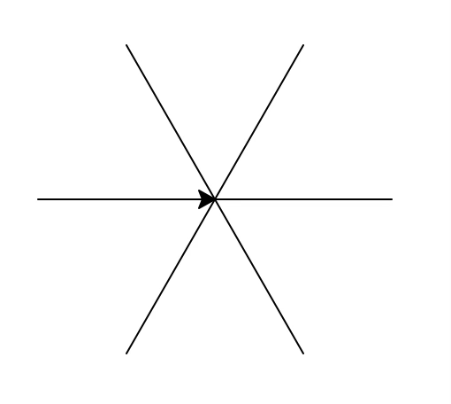
A star with a different number of spokes
def asterisk_star(length, spokes):
angle = 360 / spokes
for i in range(spokes):
forward(length)
backward(length)
right(angle)
Notes:
Here's an example of a function that uses the turtle module. It creates a star/asterisk with a different number of spokes. We first figure out how we have to space the spokes. We do a for loop over the number of spokes. At each iteration we draw a spoke, go backwards for the next spoke, rotate right based on the angle we calculated. Here’s the result of asterisk_star(100, 6)

Slide 69
mystery1 function
def mystery1():
for i in range(50):
forward(i * 5)
right(55)
Notes:
What do you think this mystery function does?

Slide 70
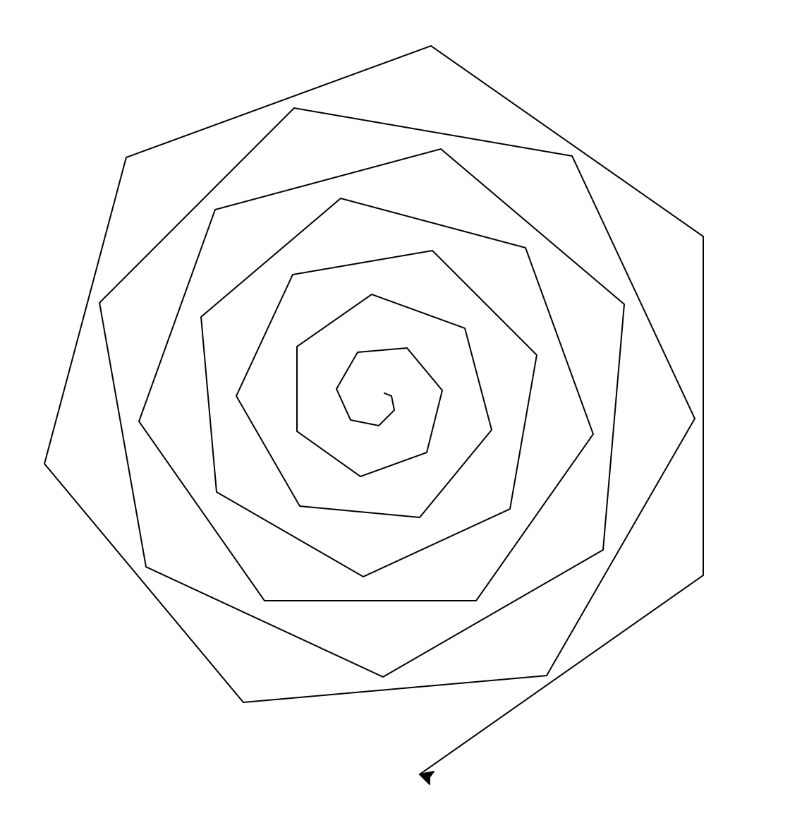
simple_spiral function
def simple_spiral():
for i in range(50):
forward(i * 5)
right(55)
Notes:
It draws a simple spiral! Look at the code: The variable i will keep count of how many times we need to get in the loop. For small loops (i.e. just a handful of statements), it’s common to just name the counter variable as i which stands for index. Each time we get in the loop, the length of the edge drawn will be longer by 5: 0, 5, 10, 15, 20, … and it will be at a 50 degree angle. If it is less than 90 degrees, it will spiral out, and above it, it will spiral in.

Slide 71
mystery2 function
def mystery2(par1, par2):
for i in range(par1):
forward(i * 5)
right(par2)
Notes:
What about this mystery function

Slide 72
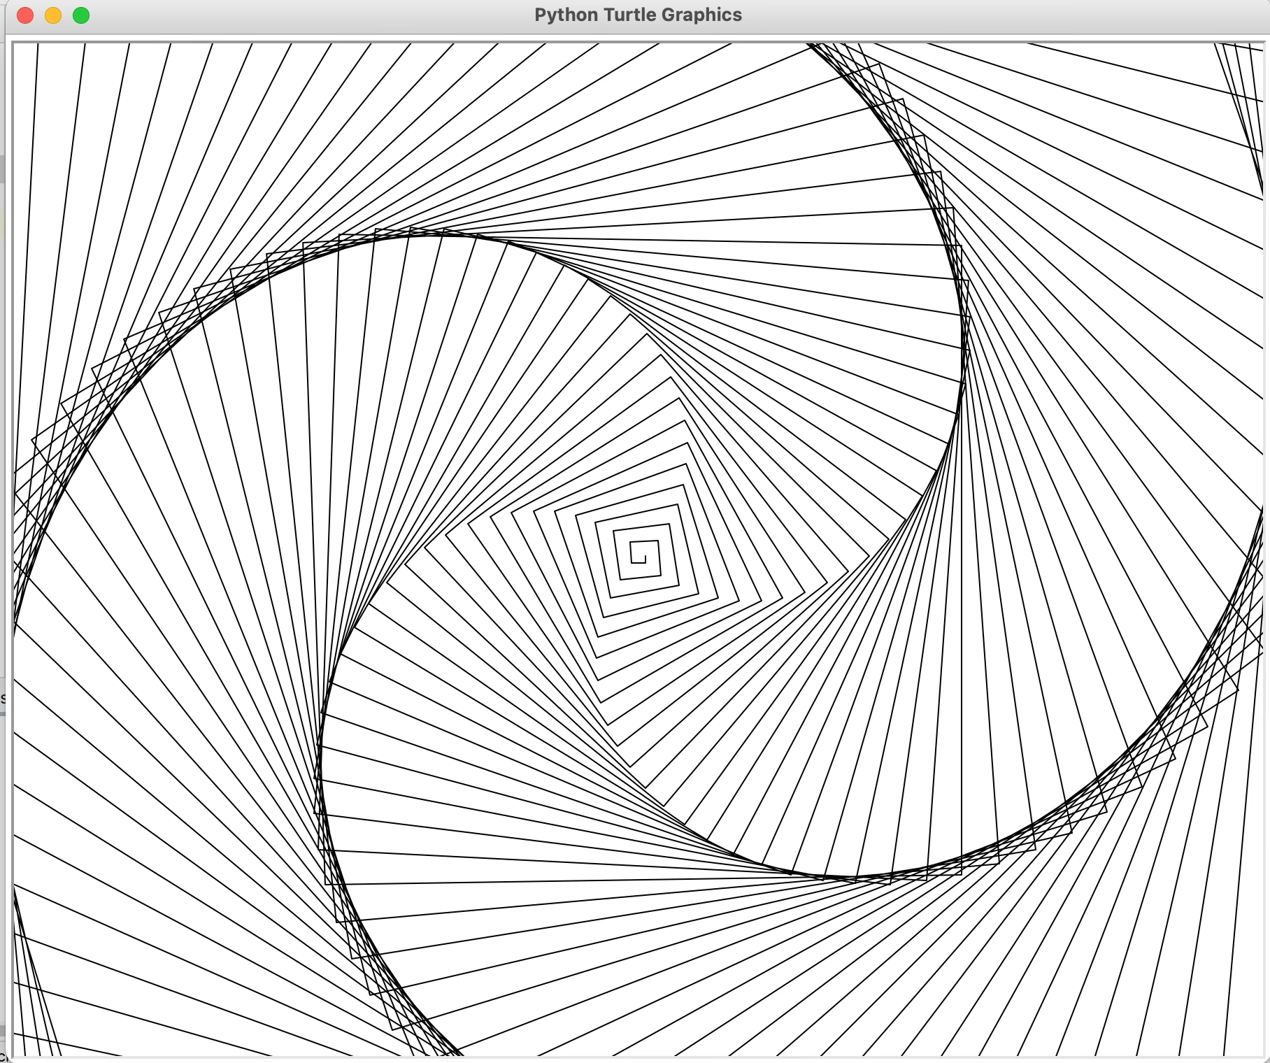
spiral function
def spiral(sides, angle):
for i in range(sides):
forward(i * 5)
right(angle)
Notes:
The spiral function is similar to simple_spiral, however now we've parameterized the length of the sides and the angle. A good example, is side = 200 and angle = 89

Slide 73
mystery3 function
def mystery3(par1, par2):
var = 360 / par2
for i in range(par2):
circle(par1)
right(var)
Notes:
What about this function?

Slide 74
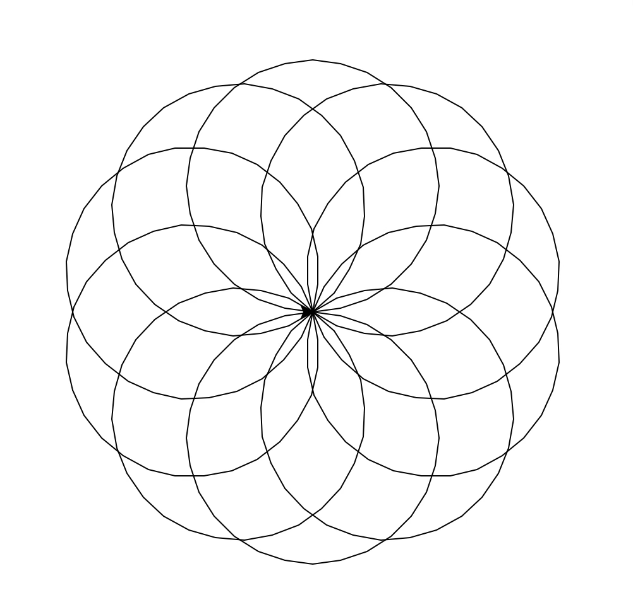
rotating_circles function
def rotating_circles(radius, num):
angle = 360 / num
for i in range(num):
circle(radius)
right(angle)
Notes:
Finally, rotating_circles is another fun function that draws “num” circles, each one rotated "angle" degrees from the previous one. This is the result of the rotating_circles(100, 10) call.

Slide 75
mystery4 function
def mystery4(par1, par2):
for i in range(par1):
var = randint(-90, 90)
right(var)
forward(par2)
Notes:
What about this function?

Slide 76
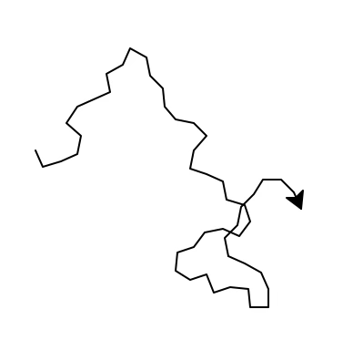
walk function
def walk(num_steps, step_size):
for i in range(num_steps):
angle = randint(-90, 90)
right(angle)
forward(step_size)
Notes:
It draws a random walk: It turns a random angle between -90 and 90 and steps forward some step size for num_steps.

Slide 77
mystery5 function
def mystery5():
for i in range(10):
var1 = randint(5, 30)
var2 = randint(10, 60)
var3 = randint(-90, 90)
var4 = randint(20, 100)
right(var3)
forward(var4)
asterisk_star(var2, var1)
Notes:
What about this mystery function?

Slide 78
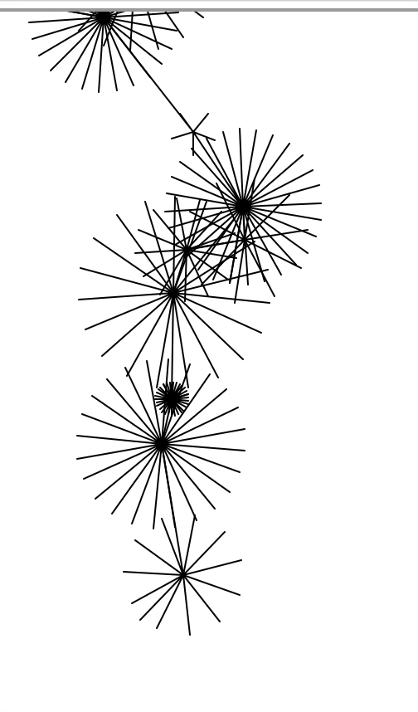
pretty_picture function
def pretty_picture():
for i in range(10):
spokes = randint(5, 30)
length = randint(10, 60)
angle = randint(-90, 90)
move = randint(20, 100)
right(angle)
forward(move)
asterisk_star(length, spokes)
Notes:
It draws a line of length between 10 and 60 at an angle between -90 and 90 then draws a star of length between 10 and 60 and with “spokes” spokes. It does that 10 times. Pretty, right?

Slide 79
setcolor_random function
def setcolor_random():
color = randint(1, 4)
if color == 1:
fillcolor("blue")
elif color == 2:
fillcolor("purple")
elif color == 3:
fillcolor("red")
else: # color == 4
fillcolor("yellow")
Notes:
What about the setcolor_random function? It randomly picks between blue, purple, red and yellow (instead of based on x, y). Any ideas on how could we get this behavior? We will use random.randint to select a number between 1 and 4. We will save this number and use it in an if-elif-else statement. We MUST save this number to a variable and not try and do your if/else statement based on new calls to random.randint!!!

Slide 80
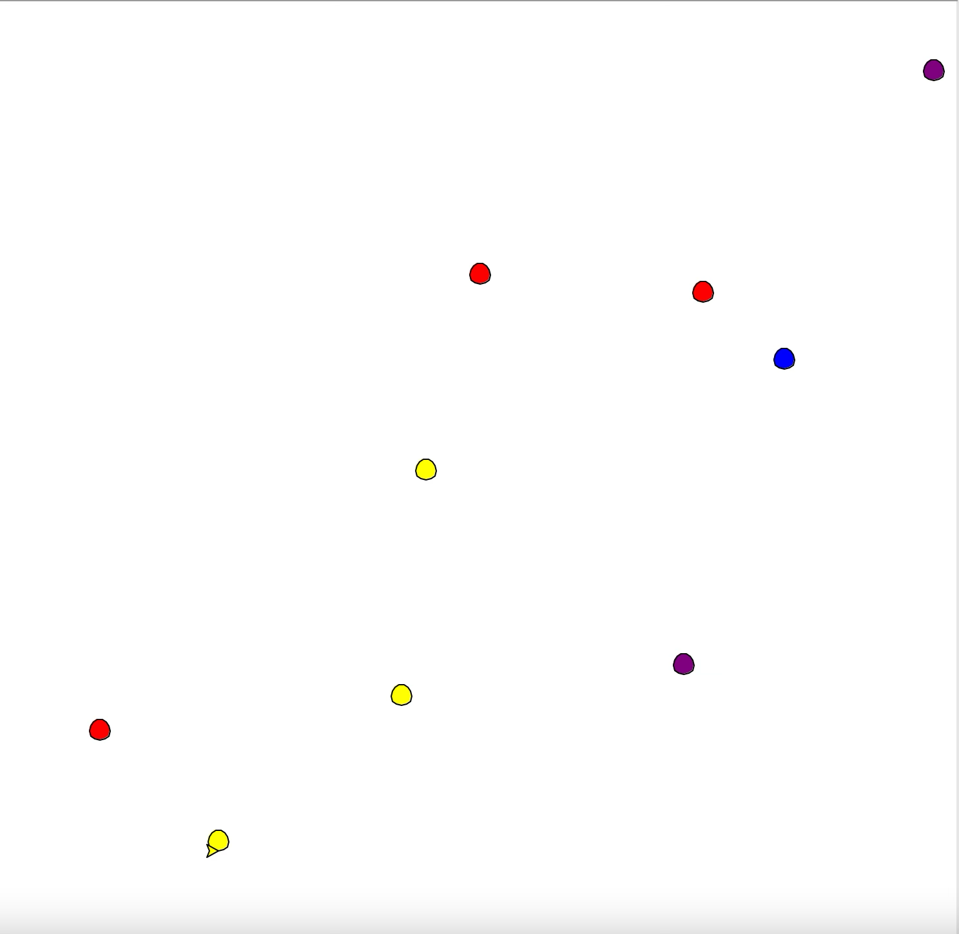
add_circles function
def add_circles(number):
x_range = int(window_width() / 2)
y_range = int(window_height() / 2)
for i in range(number):
x = randint(-x_range, x_range)
y = randint(-y_range, y_range)
setcolor_random()
pu()
goto(x, y)
pd()
begin_fill()
circle(8)
end_fill()
Notes:
It picks random x and y coordinates to draw a circle. It uses the randint function which we have seen before. Now how are the colors chosen? Each quadrant of the xy-axes is a different color. Wait, how can we do this? We will have to ask a question about x and y.

Slide 81
Revisiting creating a spiral
def spiral(length, levels):
if levels == 0:
dot()
else:
forward(length)
left(30)
spiral(0.95 * length, levels – 1)
Notes:
Let’s revisit the spiral function written now in a recursive manner

Slide 82
Revisiting spiral function
Let’s assume I called spiral(80, 50)
When does it stop?
  When levels = 0.
    We put a dot there to make it explicit.
Repeat 50 times:
  forward length
  left 30
  reduce length by 5%
def spiral(length, levels):
if levels == 0:
dot()
else:
forward(length)
left(30)
spiral(0.95 * length, levels – 1)

Slide 83
Revisiting spiral function
What if we wanted to end up back at the starting point, but not pick the pen up?
We could trace our steps backwards.
def spiral(length, levels):
if levels == 0:
dot()
else:
forward(length)
left(30)
spiral(0.95 * length, levels – 1)
right(30)
backward(length)
Notes:
What if we wanted to end up back at the starting point, but not pick the pen up?
We could trace our steps backwards.
Assume that the recursive call returns back to its starting point. What would we need to do to make sure that our call returned back to the starting point?
Add the following after the recursive call:
right(30)
backward(length)
if we run it now, we draw the spiral all the way down, and then we retrace backwards.:
each call to spiral retraces its own part after the recursive call.
the call stack keeps track of each of the recursive calls.

Slide 84
broccoli_demo function
  1. Define what the header function is:
    broccoli(x, y, length, angle)
  2. Define the recursive case:
    broccoli is a line with three other broccolis at the end:
      one directly straight out
      one 20 degrees to the left
      one 20 degrees to the right
    the three other broccolis should be smaller/shorter than the current

Slide 85
broccoli_demo function
  3. Define the base case:
    in each case, the length of the broccoli to be drawn gets shorter.
    We stop at length < 10 and place a yellow dot
  4. put it all together!
    Check the base case first:
      if length < 10
        Draw a yellow dot.
    Otherwise:
      draw three smaller broccolis at different angles.
new_x and new_y are the ending coordinates of the line being drawn. We save them because after the first recursive call to broccoli the turtle won't be in the same place.

Slide 86
Code
rec_sum.a51
turtle-examples.py
turtle-recursion.py

